Slide 1
Legris reductions correction catalogue
Ian Crotty
28 August 2023

Slide 2
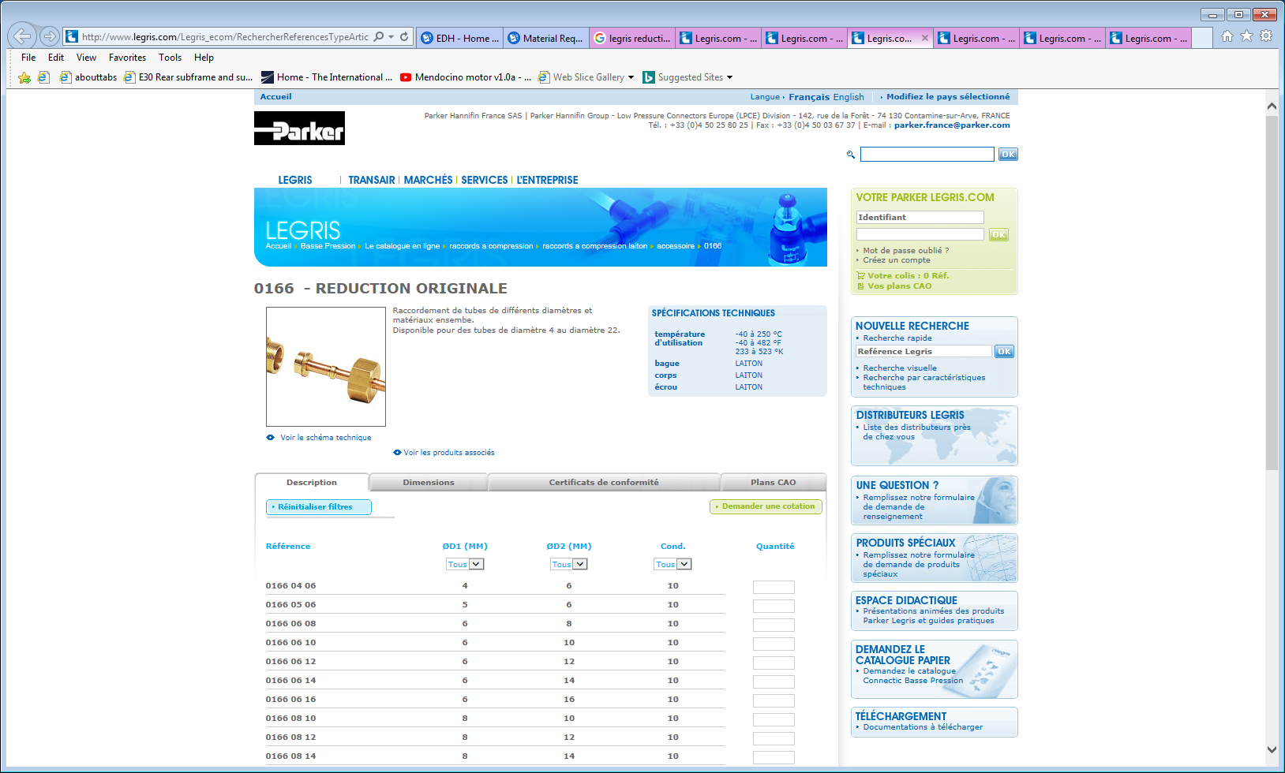
The original design some years ago when a special nut was necessary

Slide 3
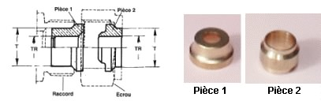
CERN catalogue
“New” version
The photo “Piece 2” do not agree with the drawing “Piece 2”.
The photo is of a standard external ferrule

Slide 4
On previous orders I was not supplied the correct pieces.
As an example the EDH 9523953, line 2, I was only delivered the “Piece 1” so they are of no use.
I have just generated a ticket and with a new order I wish to order the same reduction again BUT complete this time. EDH 9898888.

