Slide 1
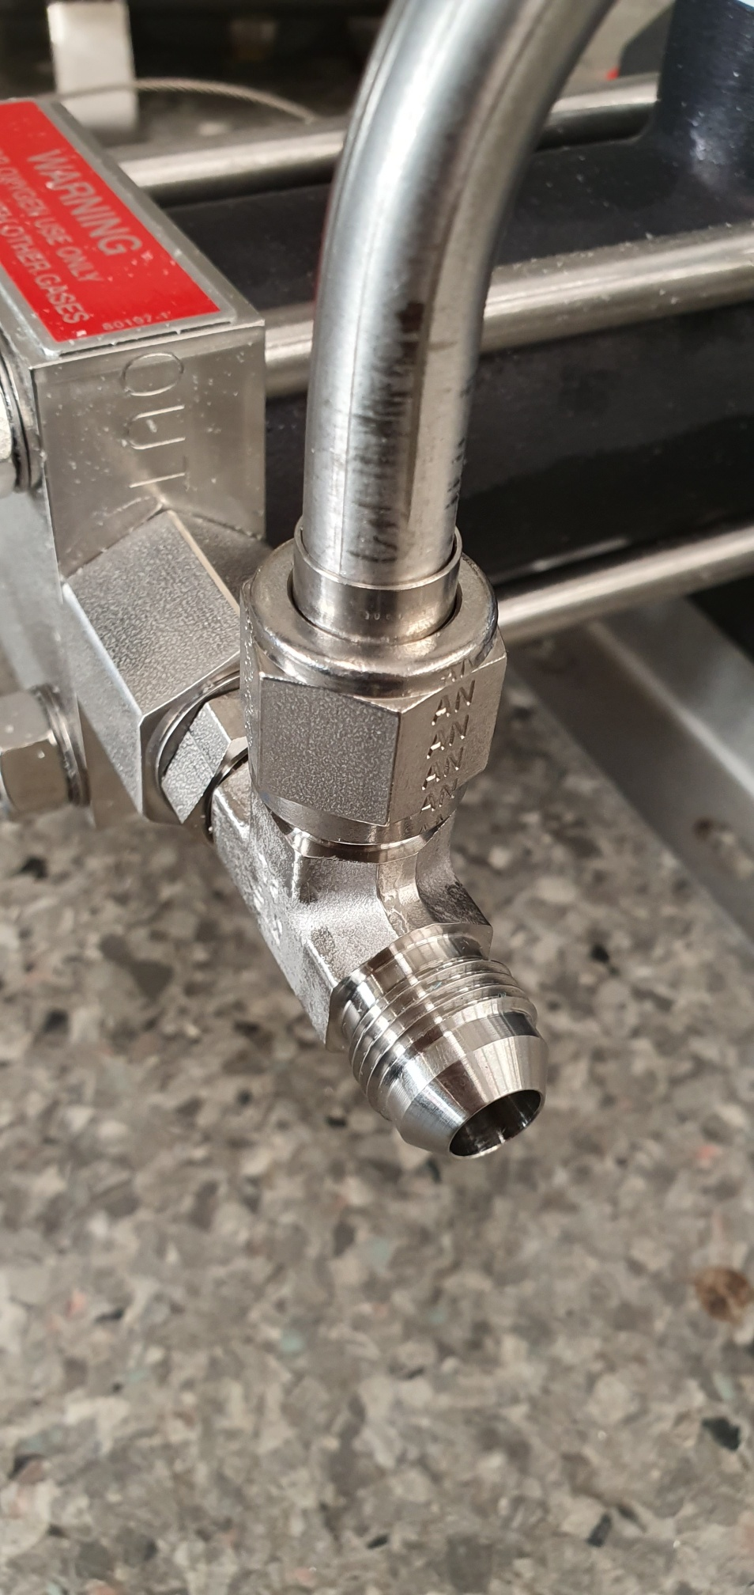
Connection to compressor
Info from supplier company:
«The connection for booster 7G are 8SAE with thread 3/4-16 UNF»

Slide 2
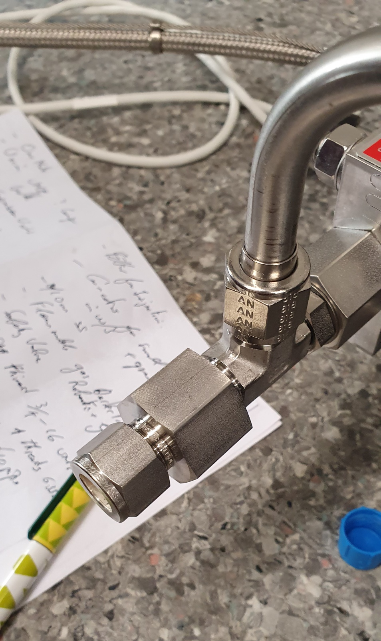
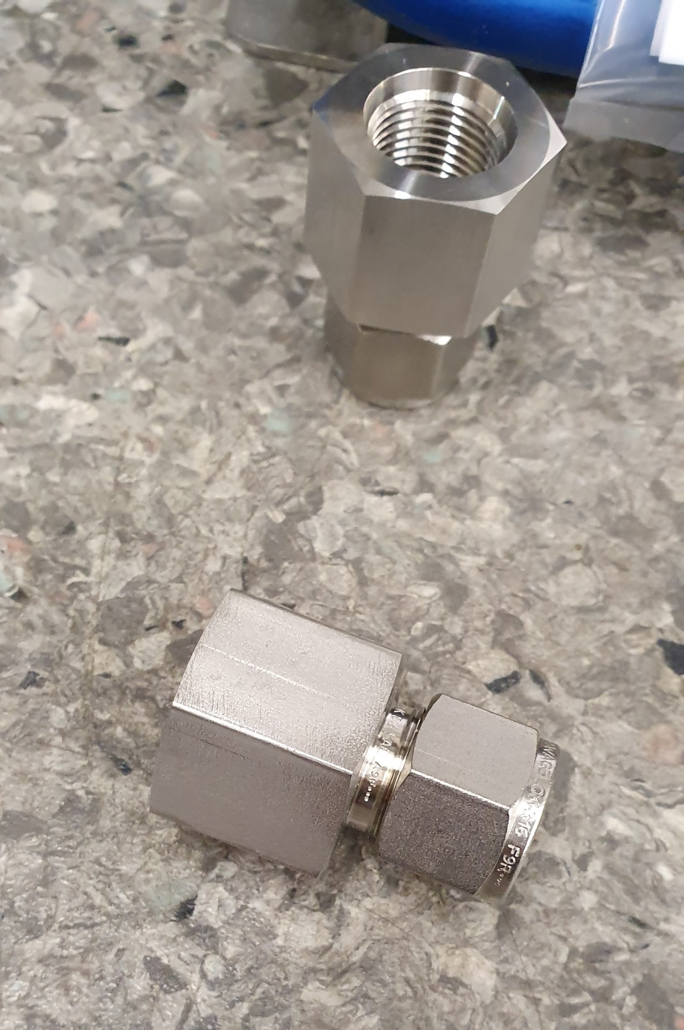
SS-810-7-8ST
https://www.swagelok.com/fr-FR/catalog/Product/Detail?part=SS-810-7-8ST
Thread ok, but connector too long and not ok

Slide 3
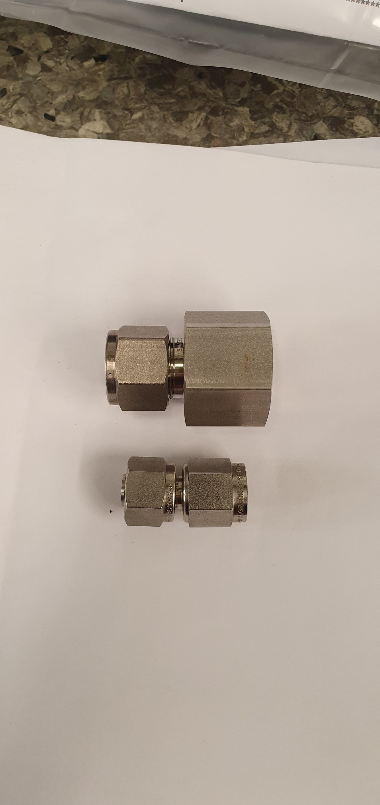
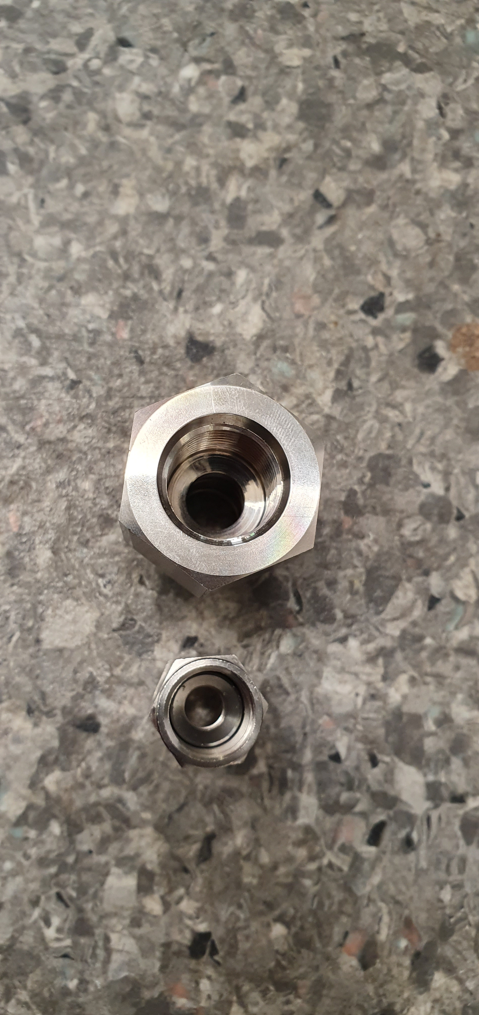
SS-810-7-8ST
SS-600-A-6ANF
https://www.swagelok.com/fr-FR/catalog/Product/Detail?part=SS-600-A-6ANF
SS-600-A-6ANF looks close to right model but it is too small

Slide 4
SS-600-A-6ANF looks close to right model but it is too small
We need bigger on thread side but the same on the pipe side
SS-600-A-6ANF
Pipe side is ok
But if you have a direct connection to 10 mm is even better
Compressor side is NOT ok. Too small.
we measured 19 mm external on the thread and we think is 37° cone
19 mm

