Slide 1
Gas web resources
Ian
4 Dec 2019

Slide 2
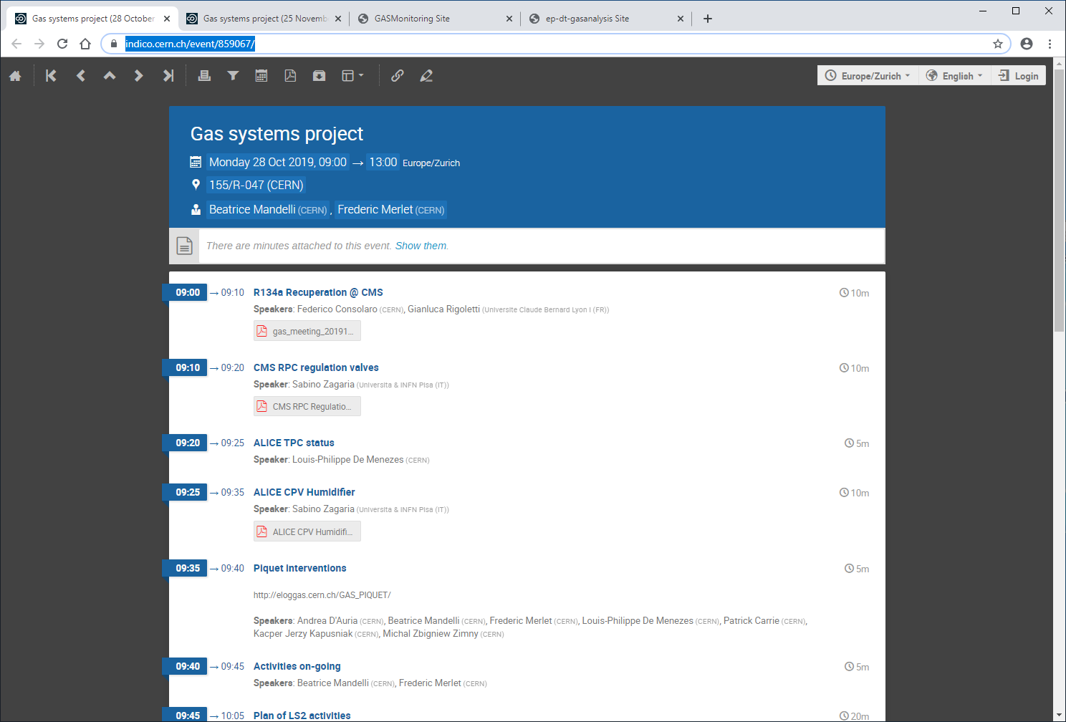
https://indico.cern.ch/event/865957/
https://indico.cern.ch/event/859067/

Slide 3
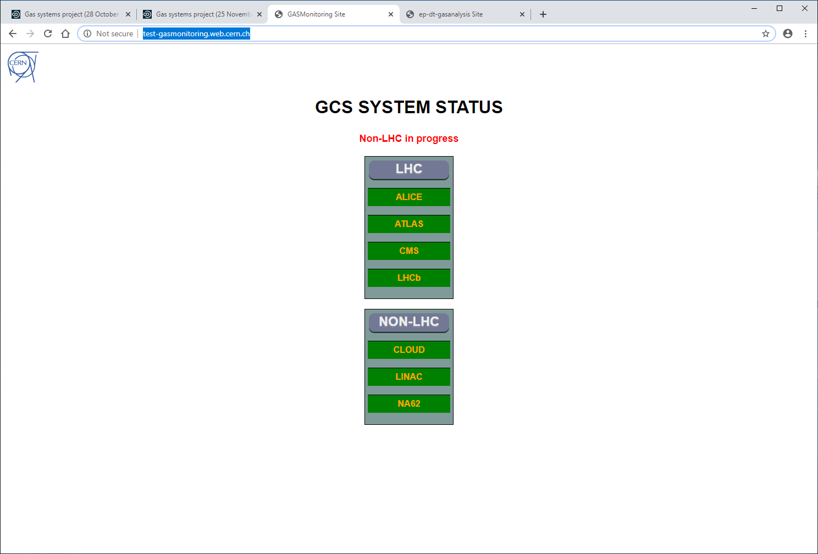
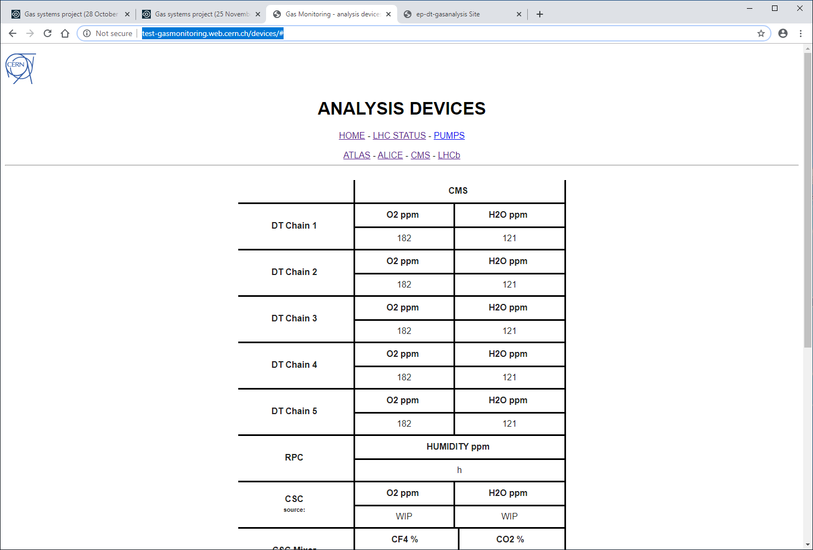
http://test-gasmonitoring.web.cern.ch/
http://test-gasmonitoring.web.cern.ch/devices/#

Slide 4
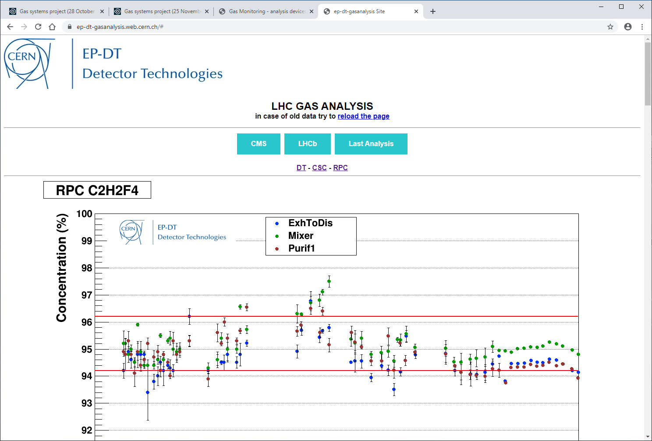
https://ep-dt-gasanalysis.web.cern.ch/#

