Slide 1
Gas mixing calibration by counting bubbles !
Ian
18 July 2023

Slide 2
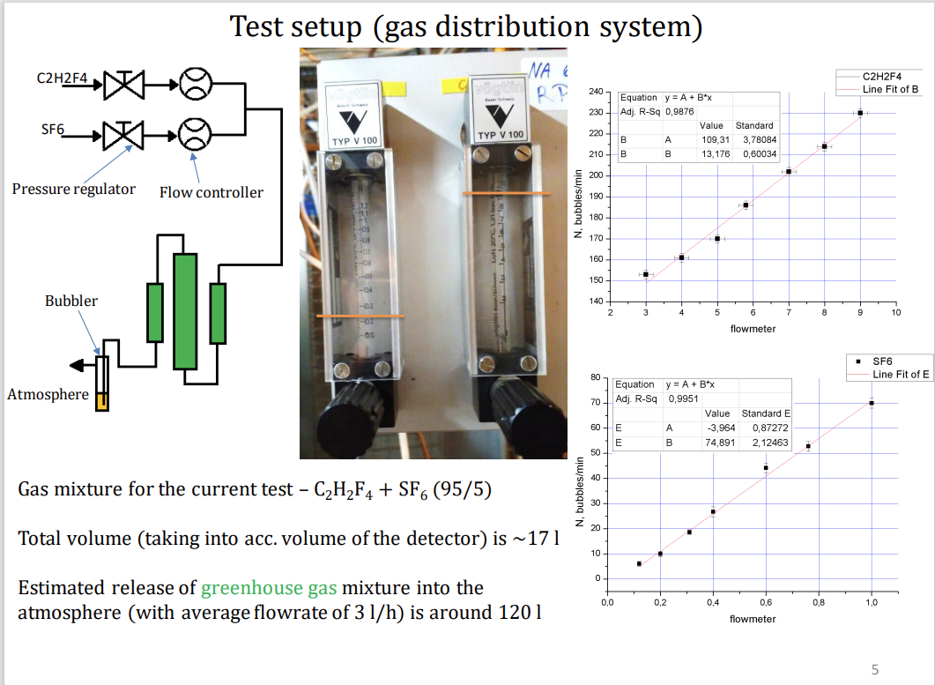

Slide 3
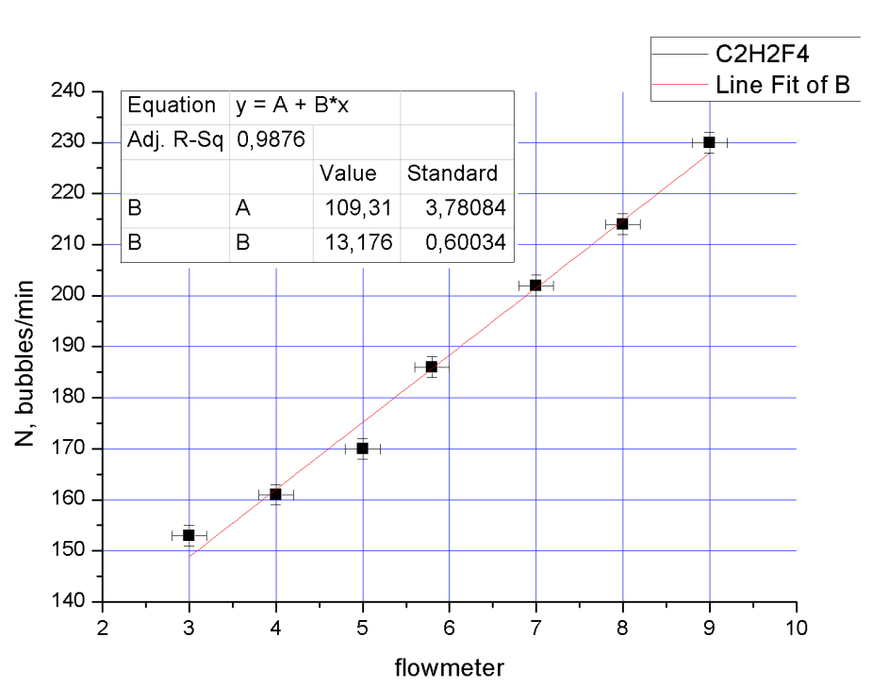

Slide 4
