Slide 1
Gas mixing calibration by counting bubbles !
Ian, taken from NA61 slides on mRPC
By V. Babkin
https://cernbox.cern.ch/s/KGTLVzci0s9fZaG
18 July 2023

Slide 2
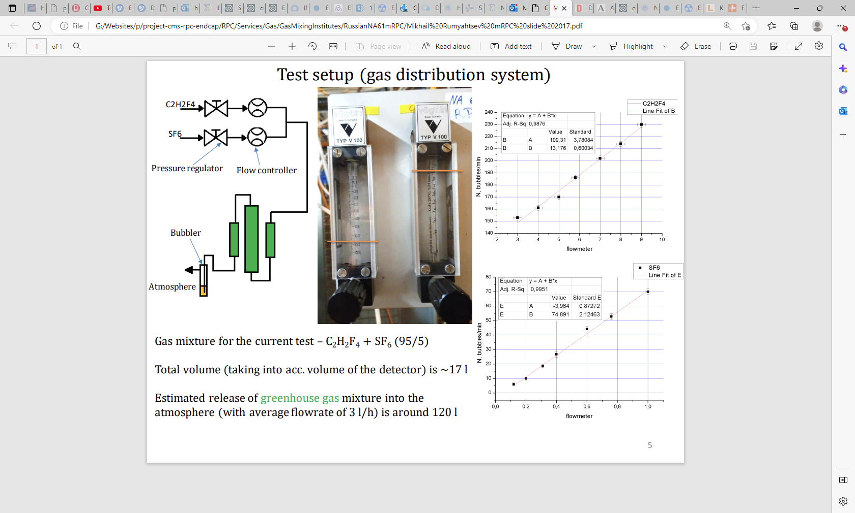

Slide 3
Method
Set up the system as shown ready for chamber operation. Choose the calibrated glass tubes to correspond to the approximate ratio of the desired mixture, in this case 95:5 ~ 20:1. This can be taken for a low value, say 0.2l/h of the SF6 (range 0.1-1.3l/h) and a high value (say 4l/h)of the R134a (range 0.5-5l/h)
Turn on the R134a gas supply.
Adjust the flow controller (Rotameter) to the lowest graduated value and count the bubbles in 1 or 10 minutes. Repeat 10 times.
Adjust the flow controller to the next graduated value and repeat the bubble count.
Continue to the highest value.
Stop the gas.
Repeat for the SF6 and any other gases if required.
Plot the data and obtain the calibration factor for each graduated value of each gas. See below plots made by NA61 collegues Vadim Babkin and communicated by
.
Chambers

Slide 4
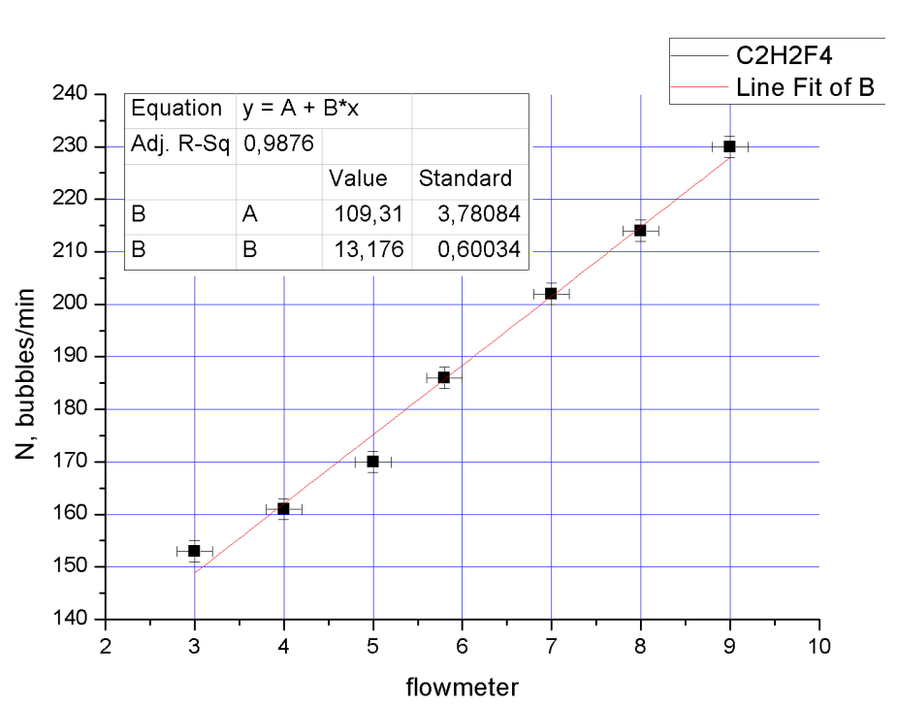

Slide 5
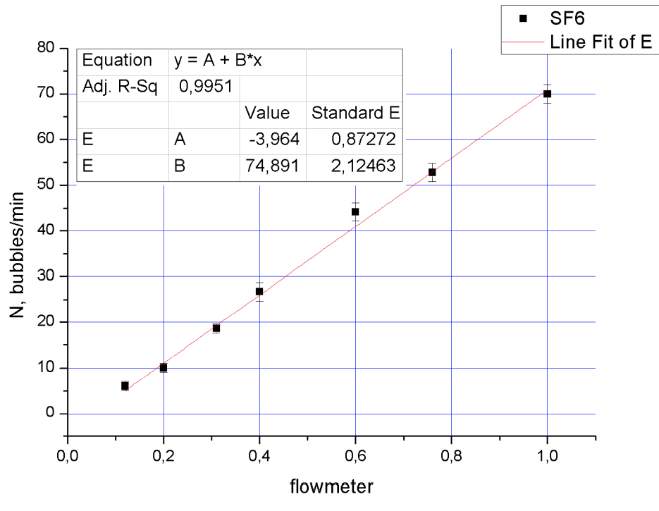

Slide 7
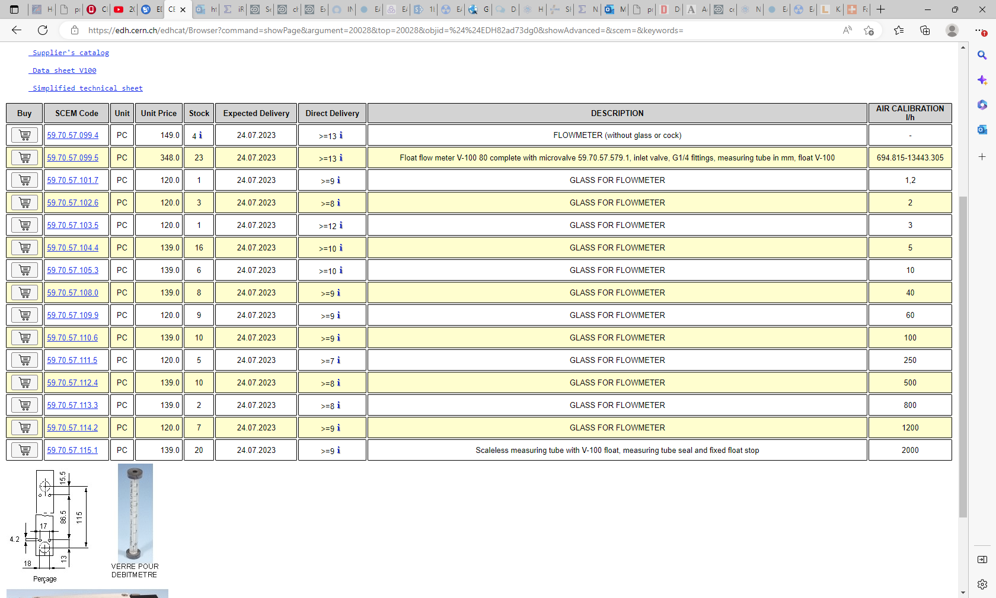

Slide 8
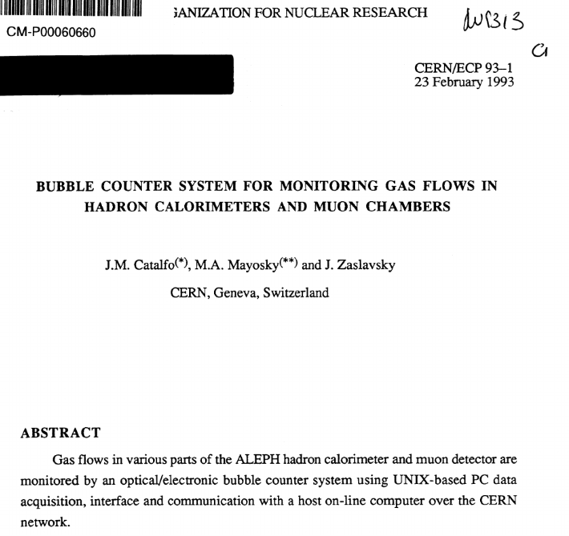
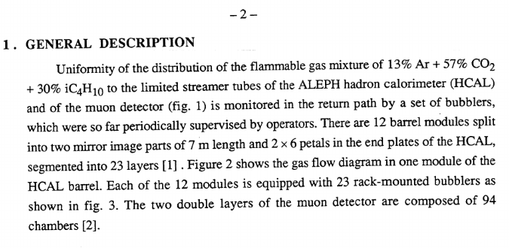
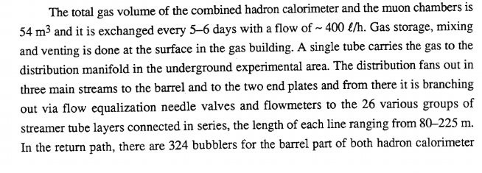
https://www.researchgate.net/publication/41592514_Bubble_counter_system_for_monitoring_gas_flows_in_hadron_calorimeters_and_muon_chambers

Slide 9
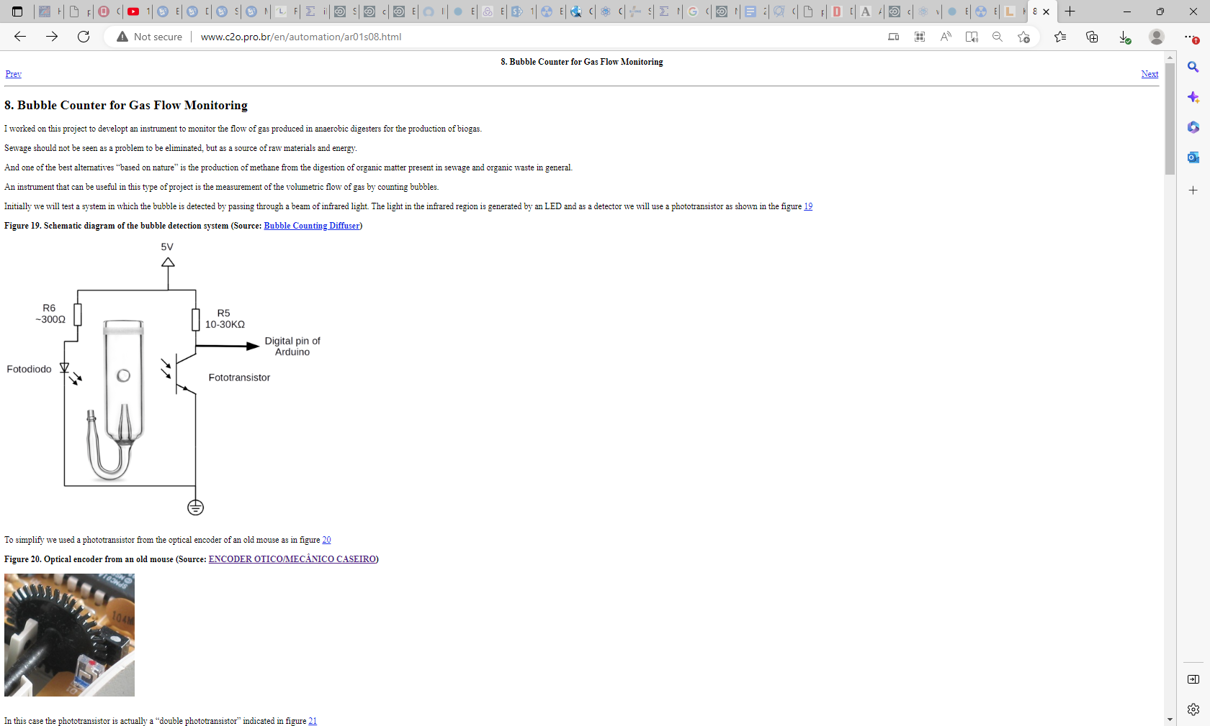
http://www.c2o.pro.br/en/automation/ar01s08.html

Slide 10
https://www.housedillon.com/posts/homebrew-bubble-counter/

Slide 11
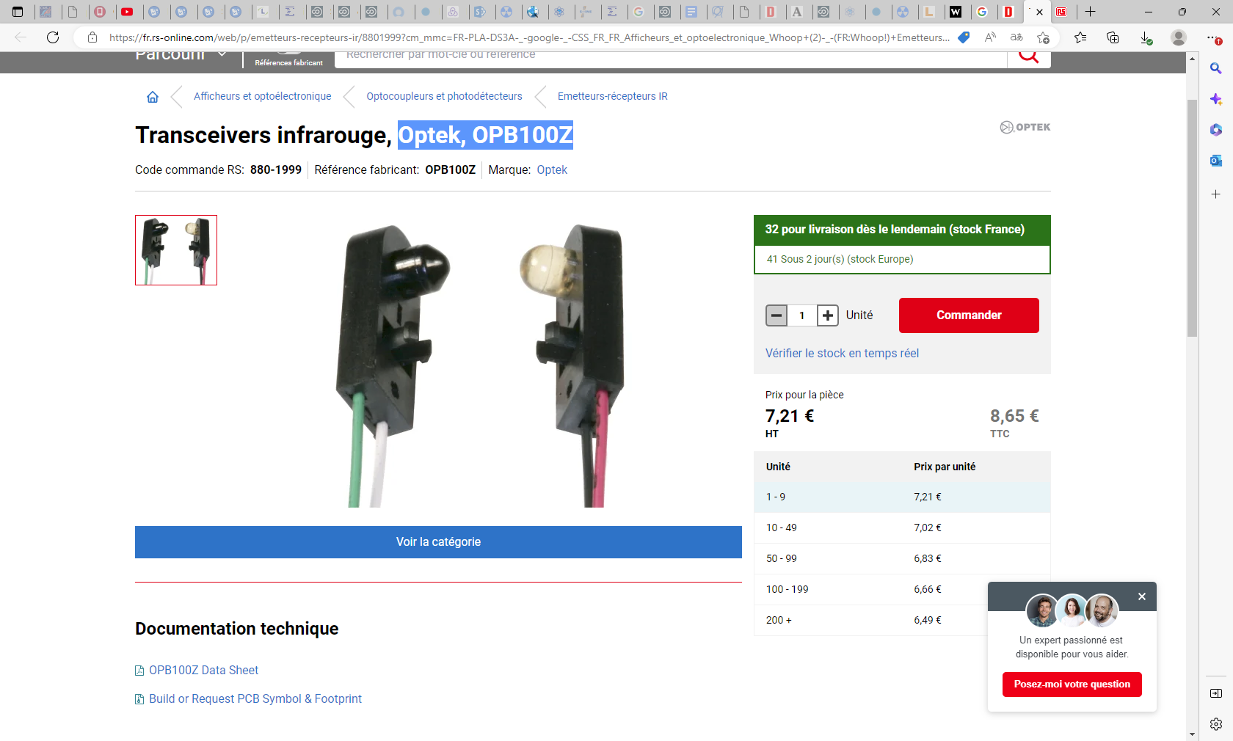

Slide 12
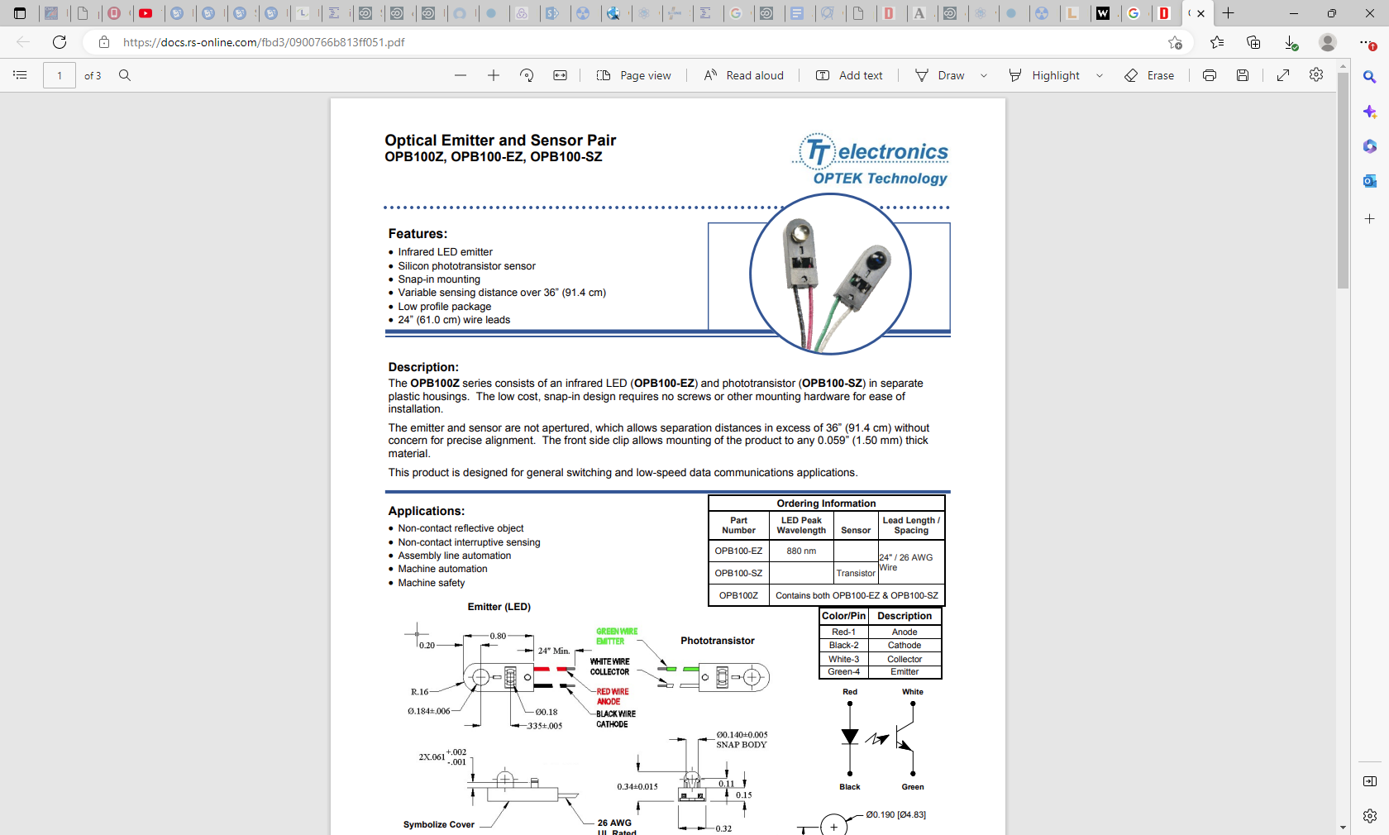

Slide 13

https://www.researchgate.net/publication/230927429_The_Accuracy_of_the_Bubble_Meter_Method_for_Gas_Flow_Measurements

Slide 14
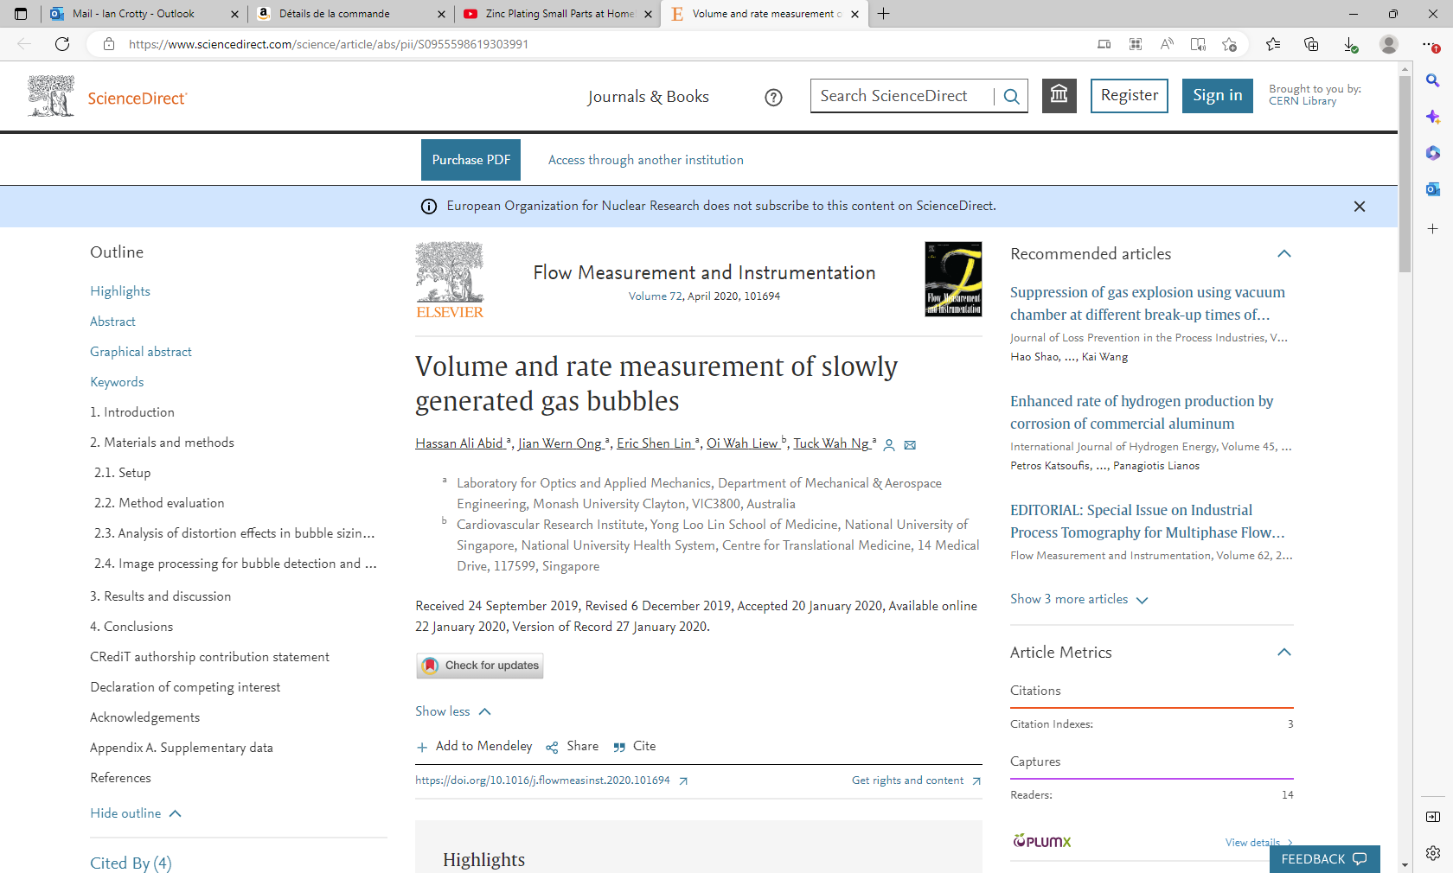
Volume and rate measurement of slowly generated gas bubbles
Author links open overlay panelHassan Ali Abid
https://www.sciencedirect.com/science/article/abs/pii/S0955598619303991

Slide 15
Abstract
The use of an inverted burette arrangement that allowed volume and time-course tracking of bubble movement via camera imaging is shown here to improve on the classical inverted jar (or beaker) method for measuring gases generated in small volumes and at slow rates (below 1 mL/s). In tests involving discrete gas volume measurements delivered at 0.57 mL/s, comparison with pre-set air volume delivered by a syringe pump showed high correspondence, linearity, and repeatability. Tests with continuous gas flows at 0.2, 0.32 and 0.57 mL/s revealed average bubble count versus volume trends that displayed high linearity to indicate that the bubble volumes (at any flowrate) were constant. The average bubble count versus time also showed linear trends and repeatability indicating that the time intervals between the appearance of any two bubbles (at a particular flowrate) were uniform. The analytical and simulated results helped to explain why bubble size determination by high speed camera recording for measuring gas volume and flowrate is fraught with inherent problems. An analysis using light ray tracing showed that flowrate determination using such an approach would necessitate complicated image correction when two cameras are used for simultaneous recording due to distortion effects resulting from refraction. A virtual gate approach involving the binarization of images recorded with a standard camera is shown to be more feasible in establishing the flowrate using bubble counting or finding the time interval between bubbles.

Slide 16
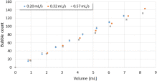
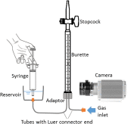
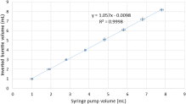
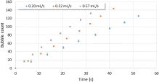

Slide 17

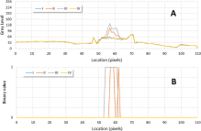
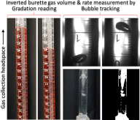
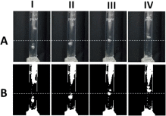
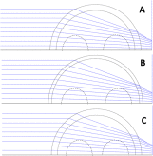

Slide 18
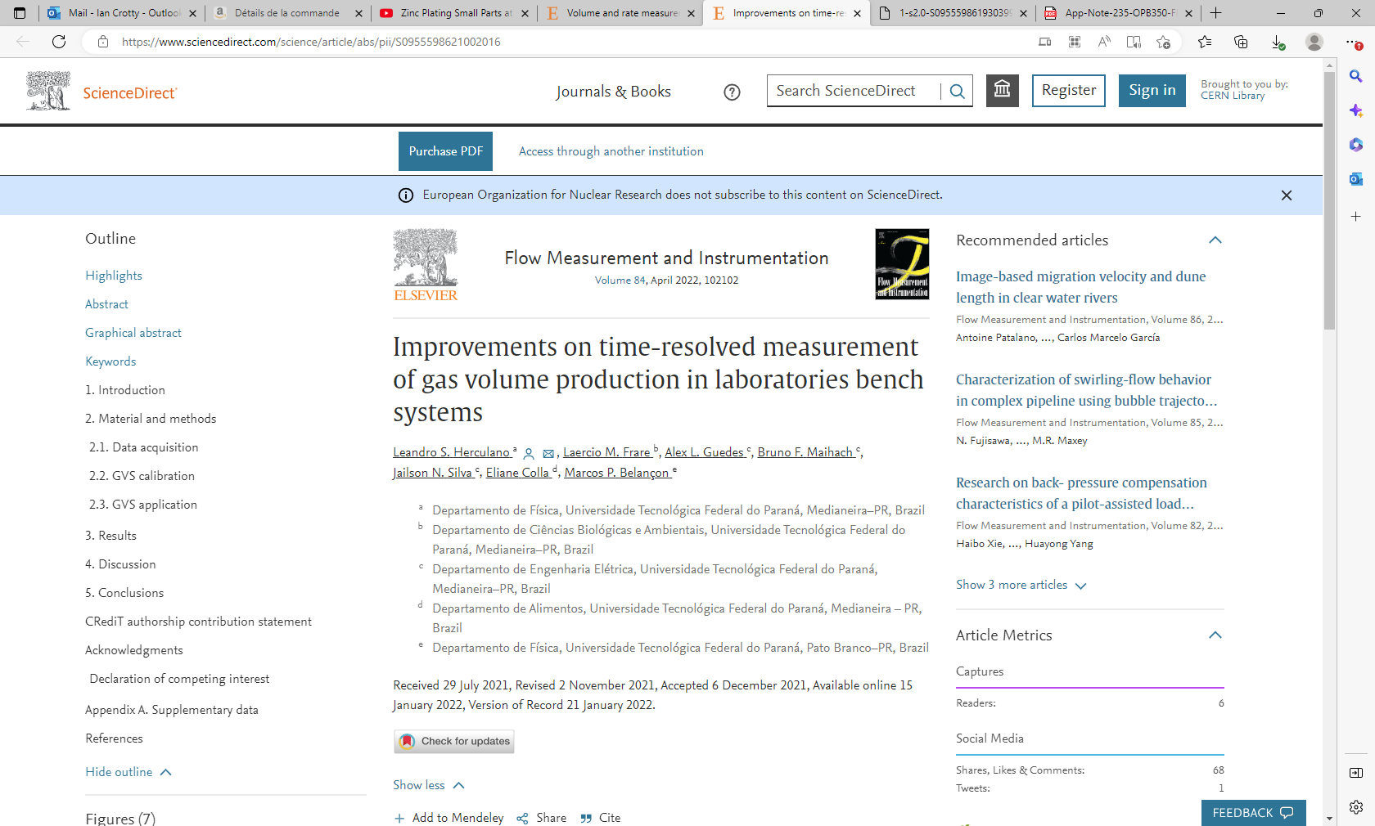
https://www.sciencedirect.com/science/article/abs/pii/S0955598621002016

Slide 19
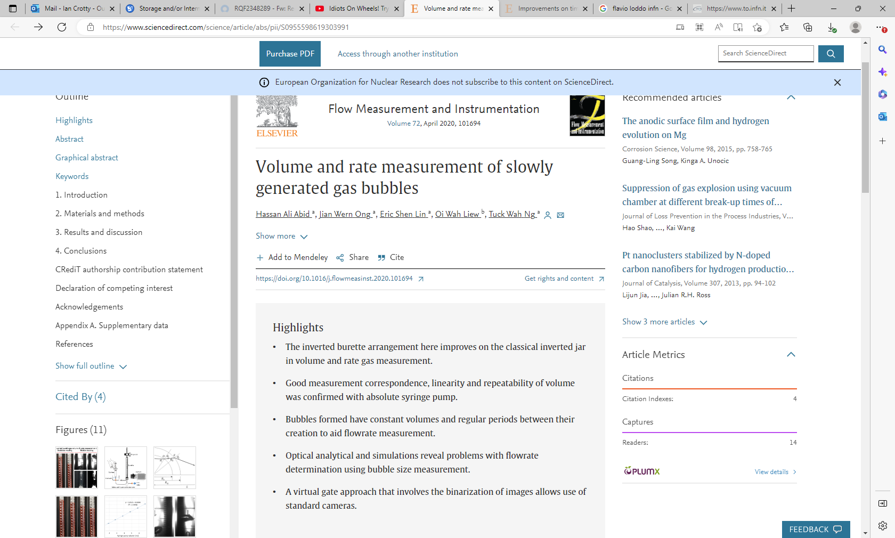
https://www.sciencedirect.com/science/article/abs/pii/S0955598619303991

