Slide 1
Gas mixing calibration by counting bubbles !
Ian, taken from NA61 slides on mRPC
By V. Babkin (?)
18 July 2023

Slide 2
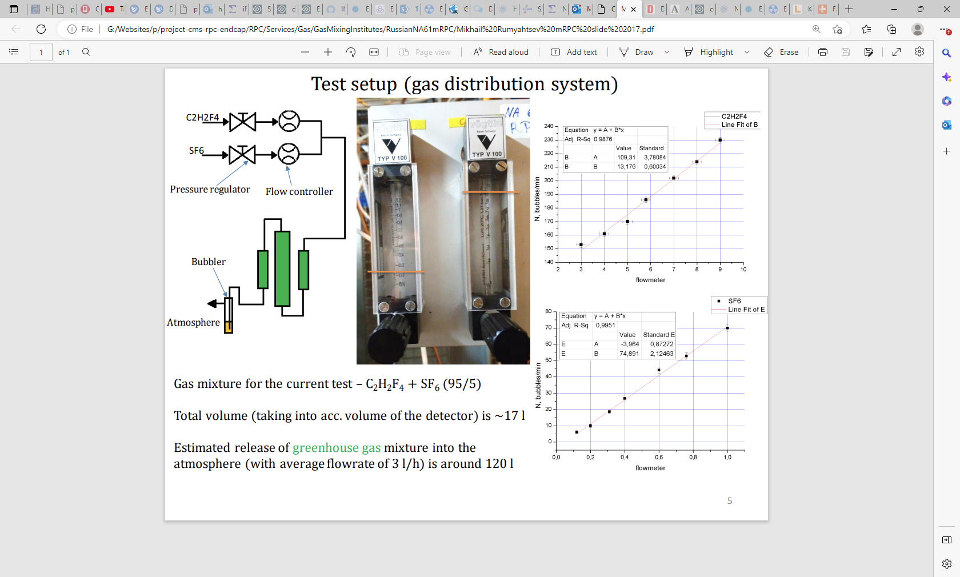

Slide 3
Method
Set up the system as shown ready for chamber operation. Choose the calibrated glass tubes to correspond to the approximate ratio of the desired mixture, in this case 95:5 ~ 20:1. This can be taken for a low value of the SF6 (0.1-1.3l/h) and a high value of the R134a (0.3-3l/h)
Turn on one of the R134a gas supply.
Adjust the Flow controller (Rotameter) to the
Chambers

Slide 4
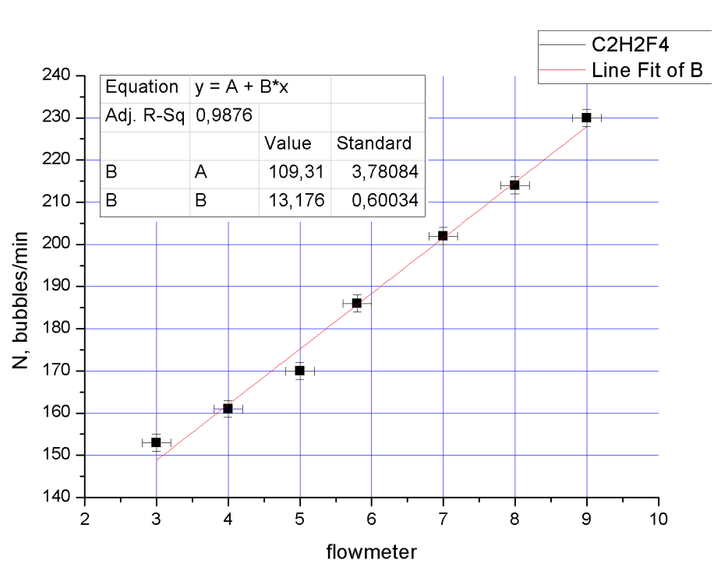

Slide 5
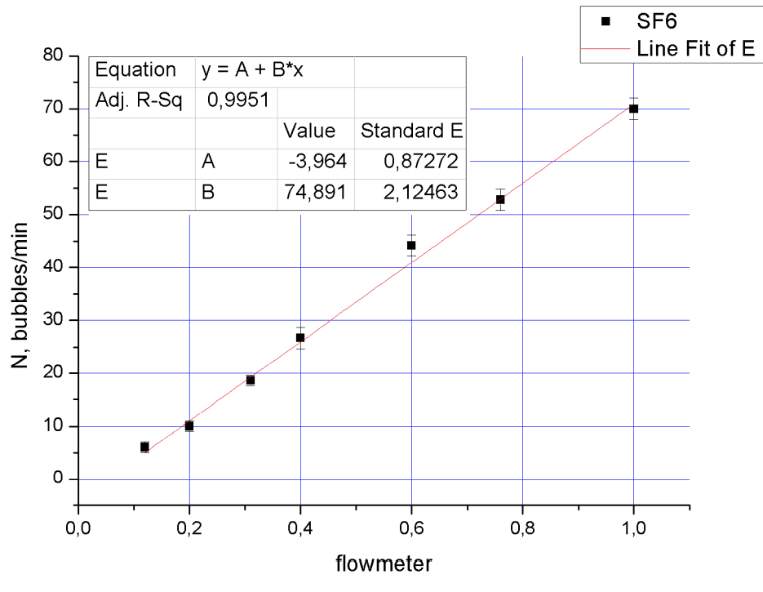

Slide 7
