Slide 1
Position sensitive array for gas flow rota meter
Induction, photo, and magnetic
Ian
28 Sept 2022

Slide 2
Photosensitivediodes
GL5516 LDR Resistor Light-Dependent Photoresistor

Slide 3
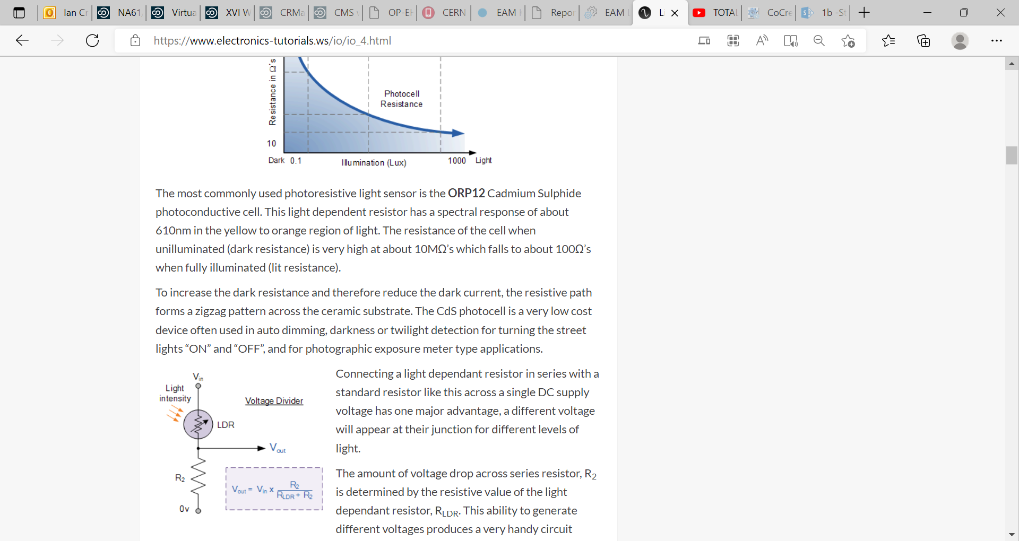
Light Sensor including Photocell and LDR Sensor (electronics-tutorials.ws)

Slide 4
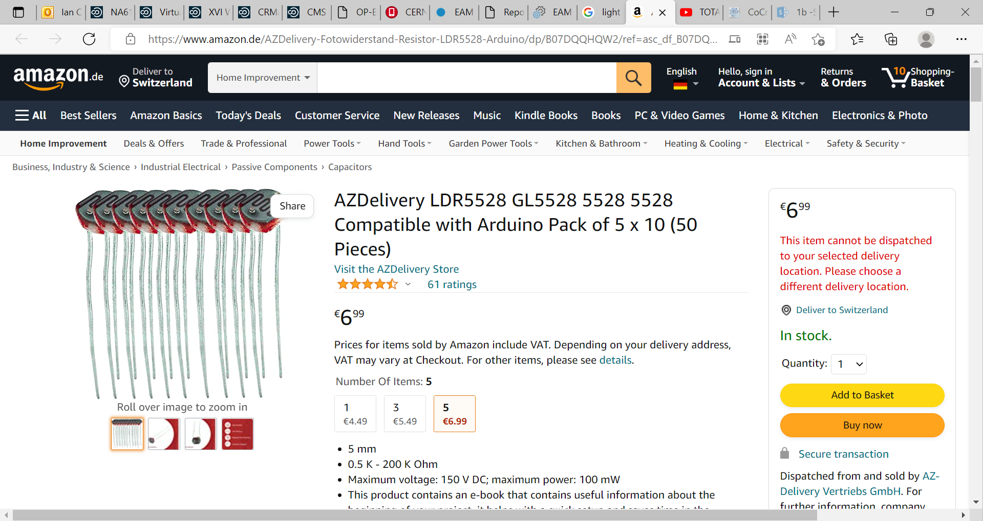
AZDelivery LDR5528 GL5528 5528 5528 Compatible with Arduino Pack of 5 x 10 (50 Pieces) : Amazon.de: Business, Industry & Science

Slide 5
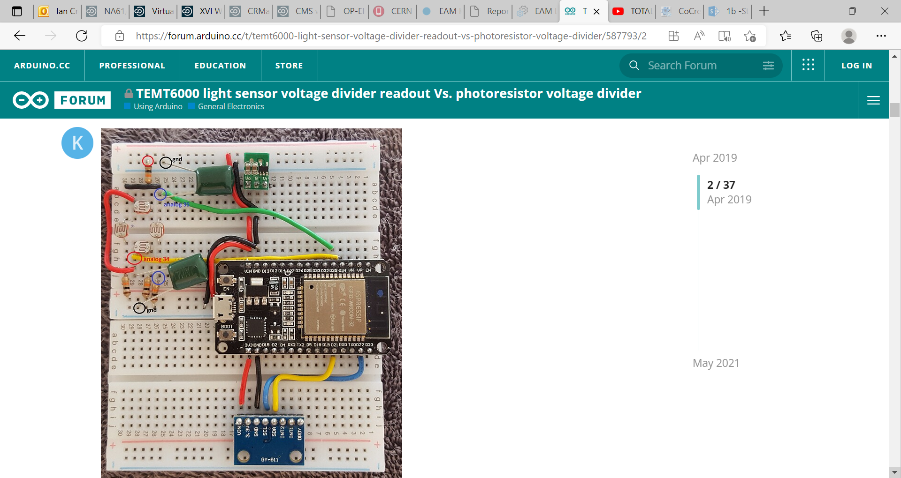
TEMT6000 light sensor voltage divider readout Vs. photoresistor voltage divider - Using Arduino / General Electronics - Arduino Forum

Slide 6
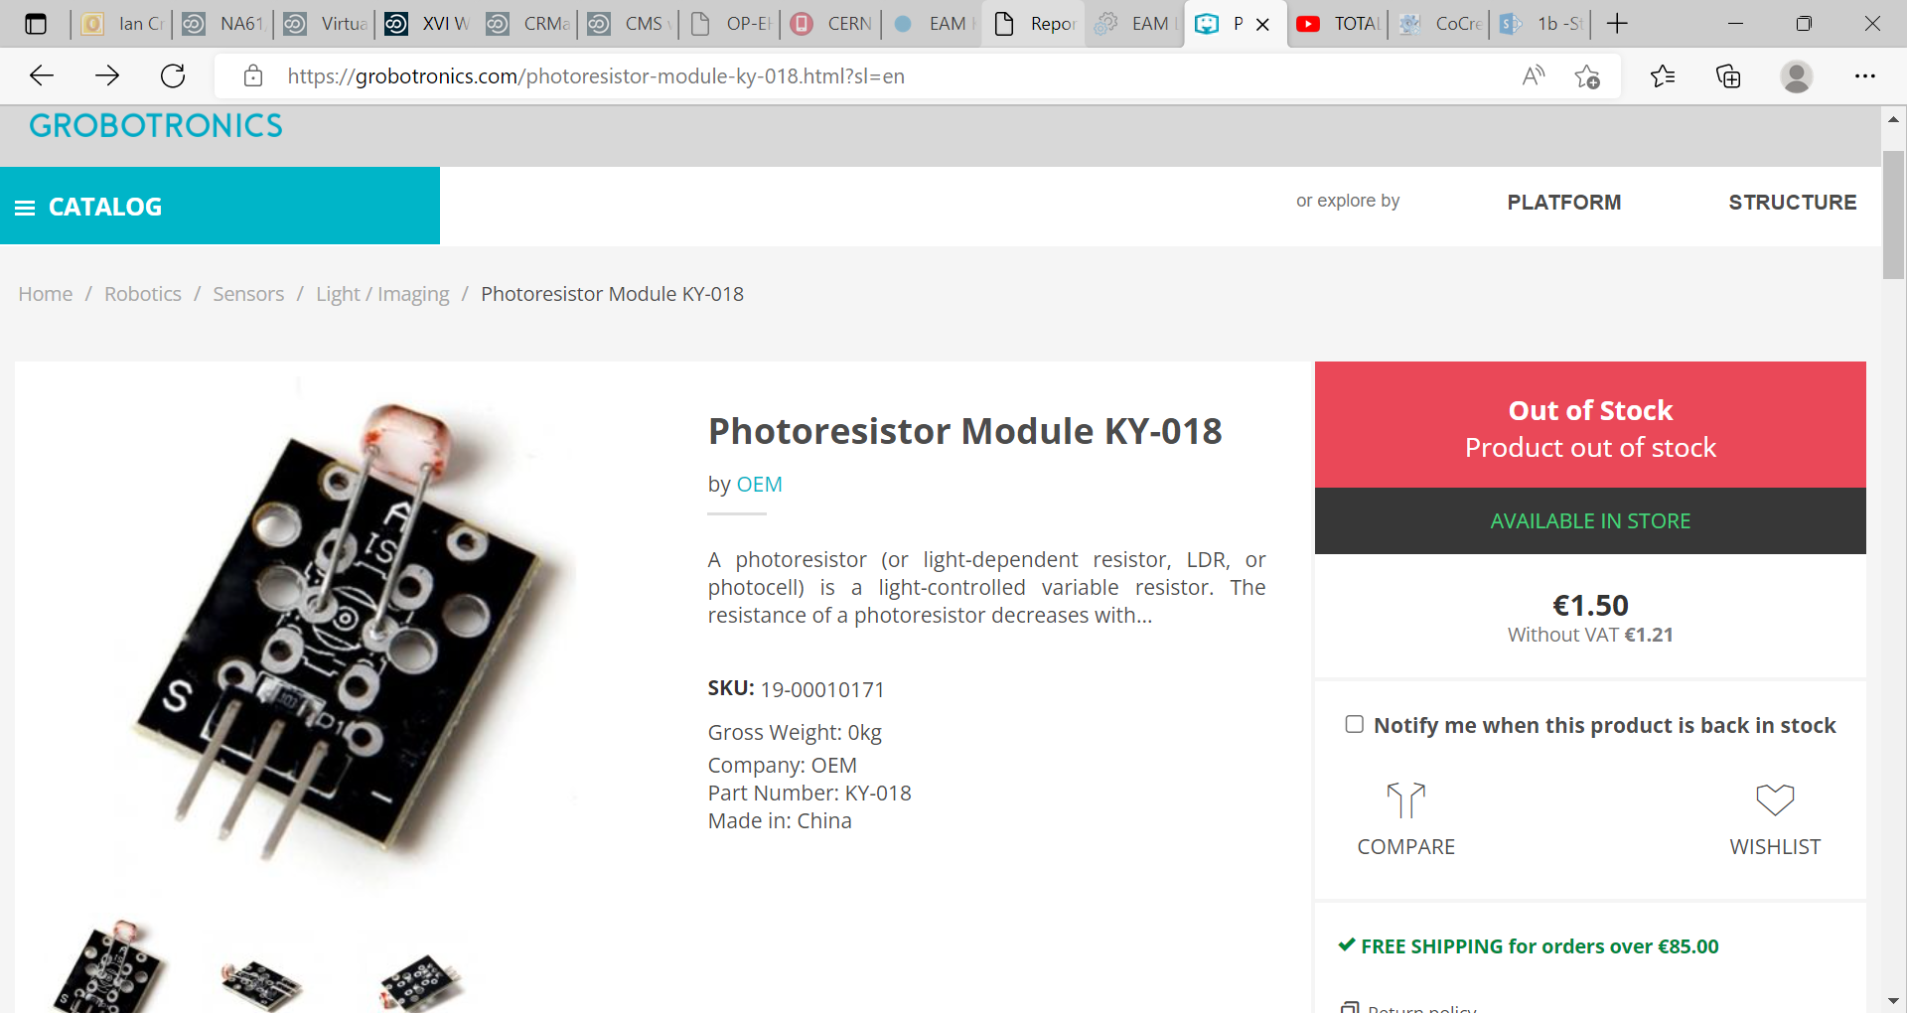
Photoresistor Module KY-018 (grobotronics.com)

Slide 7

Week 6 Arduino.pptx - Arrays, Loops and Photoresistors Review ● At 25C as a median temperature what should the other fixed resistors resistance be to | Course Hero

Slide 13
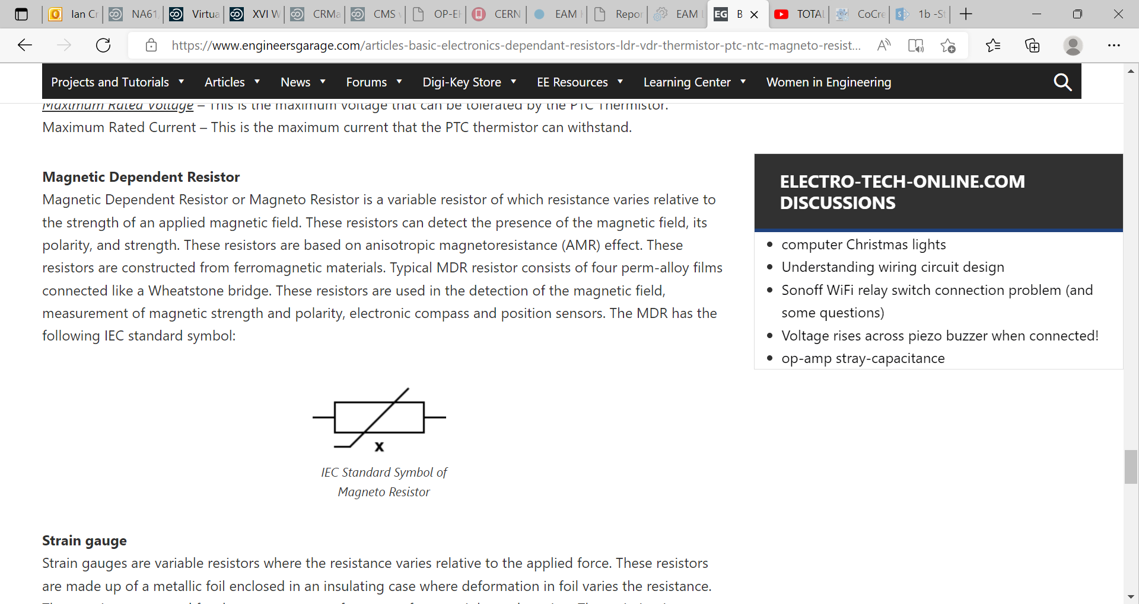
Basic Electronics - Dependant Resistors - LDR, Thermistor, Magneto Resistor, VDR (engineersgarage.com)

Slide 14
Detect the position in the tube my sensing through the open glas pipe end
Perhaps with transparent mirror at 45 degrees to r ead out the position

Slide 15
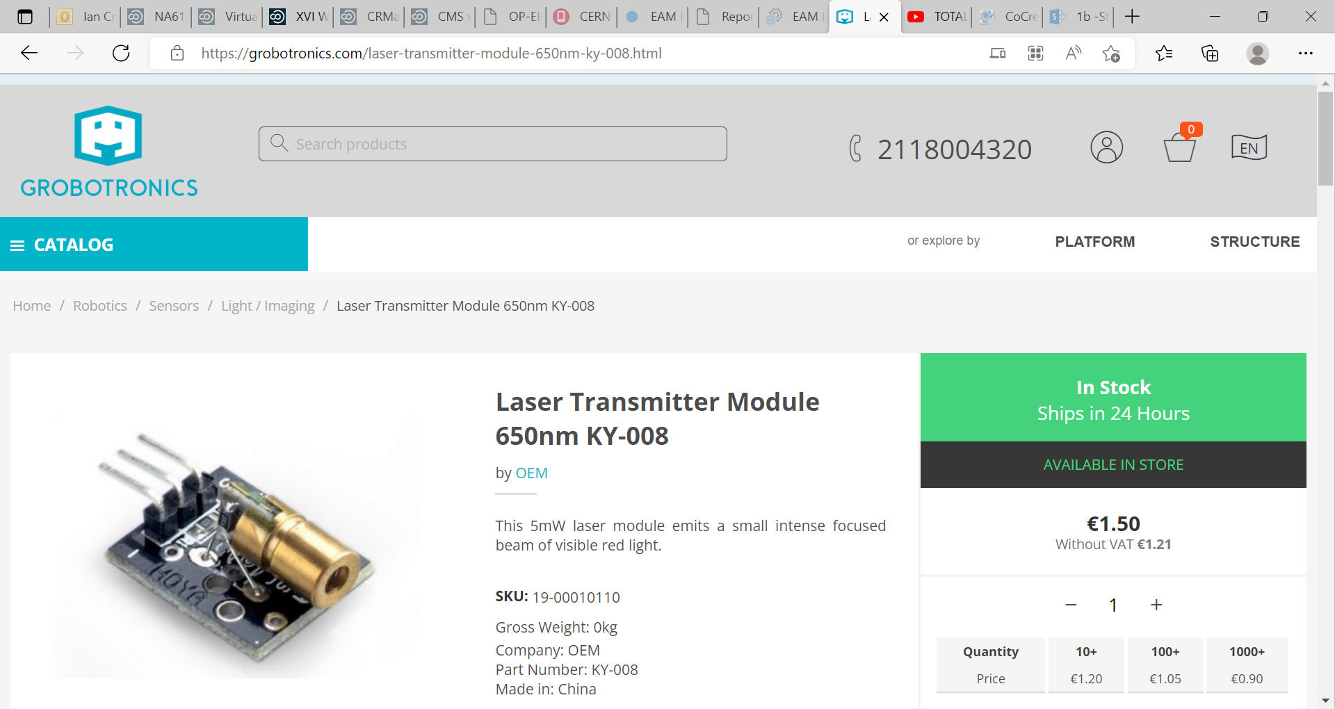
Laser Transmitter Module 650nm KY-008 (grobotronics.com)

Slide 16
Use ultra sonic rthrough the open end

