Slide 1
Gas mixing with Analogue flow meters
Ian Crotty
15 Aug 2017

Slide 2
Desired mixing ratios
R134a 94.7%
isoButane 5%
SF6 0.3%
Assume total flow of 10 [l\h]
Gives R134a 9.47 [l/h]
            Isobutane 0.5 [l/h]
            SF6 0.03 [l/h]

Slide 3
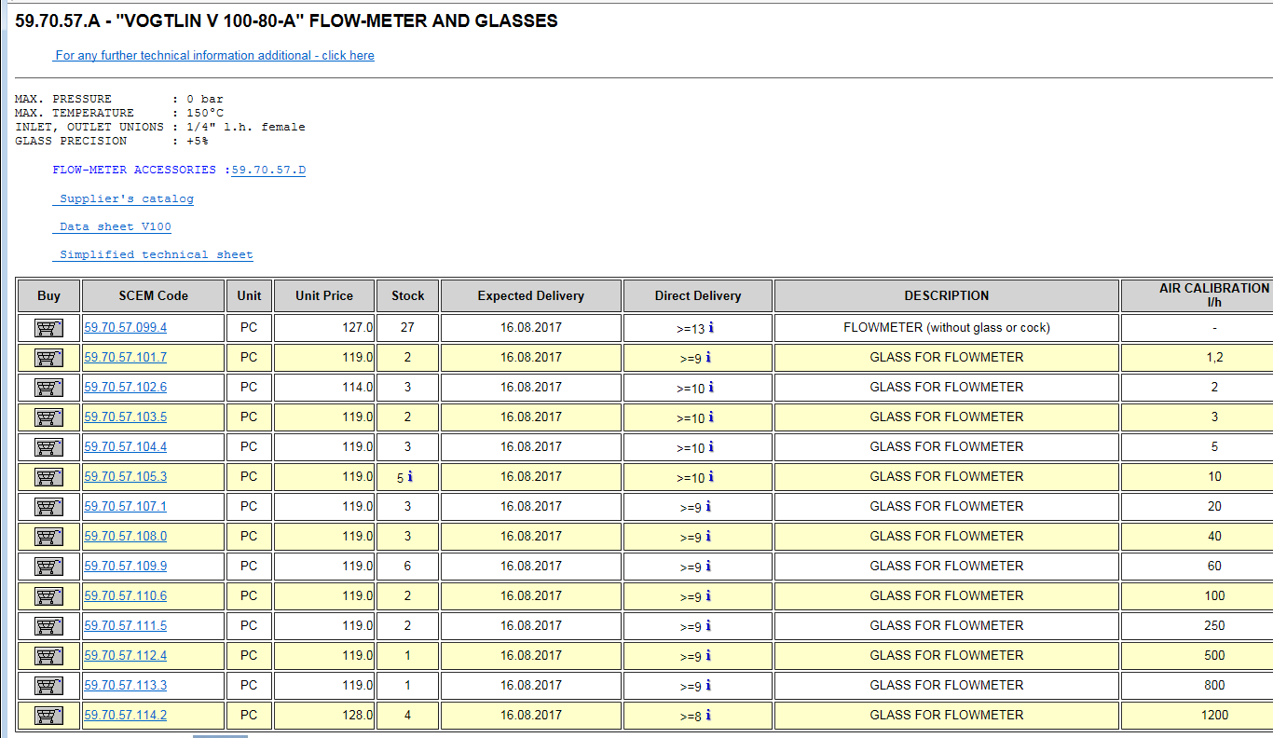
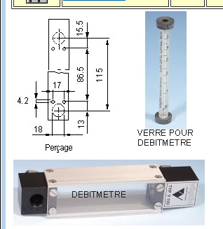

Slide 4
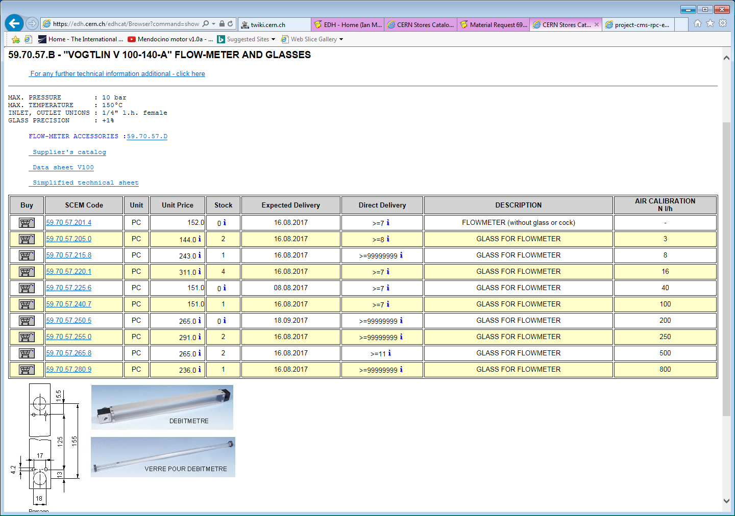

Slide 5
Calibration of vogtlin flow meters for different gases

