Slide 1
Flow sensor gas
MEMS technology
Ian
8 March 2024

Slide 2
omron d6f-p0010a2 specification

Slide 4
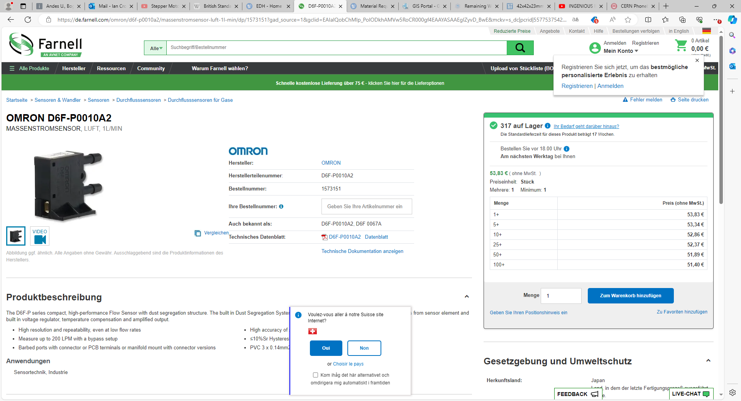
https://de.farnell.com/omron/d6f-p0010a2/massenstromsensor-luft-1l-min/dp/1573151?gad_source=1&gclid=EAIaIQobChMIp_PolODkhAMVw5RoCR000gf4EAAYASAAEgIZyvD_BwE&mckv=s_dc|pcrid|557753754202|kword|d6f%20p0010a2|match|p|plid||slid||product||pgrid|130636464233|ptaid|kwd-382312150773|&CMP=KNC-GDE-GEN-SKU-MDC-Electromechanical-943-Max-Conv-Value

Slide 5
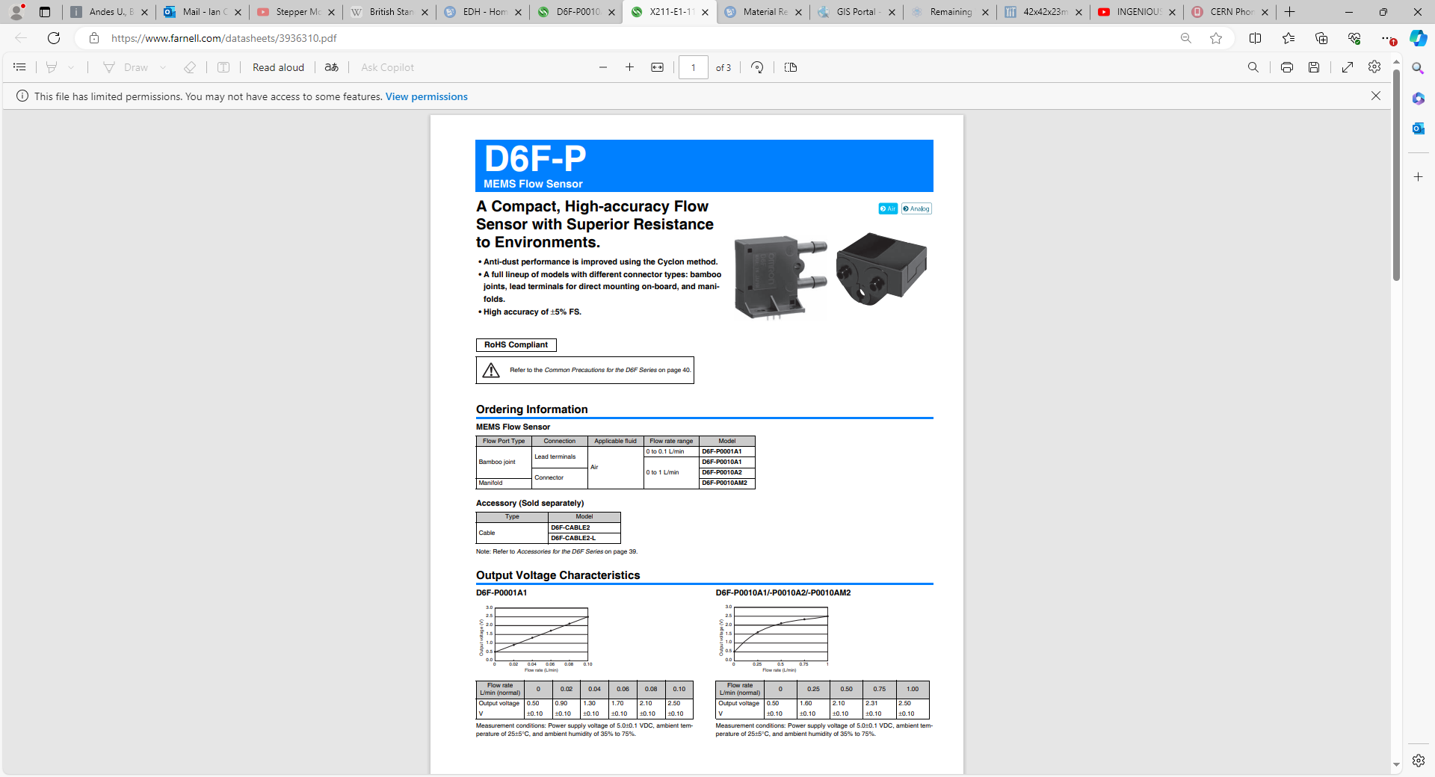
https://www.farnell.com/datasheets/3936310.pdf

Slide 6
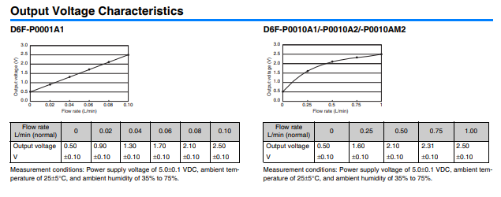

Slide 7
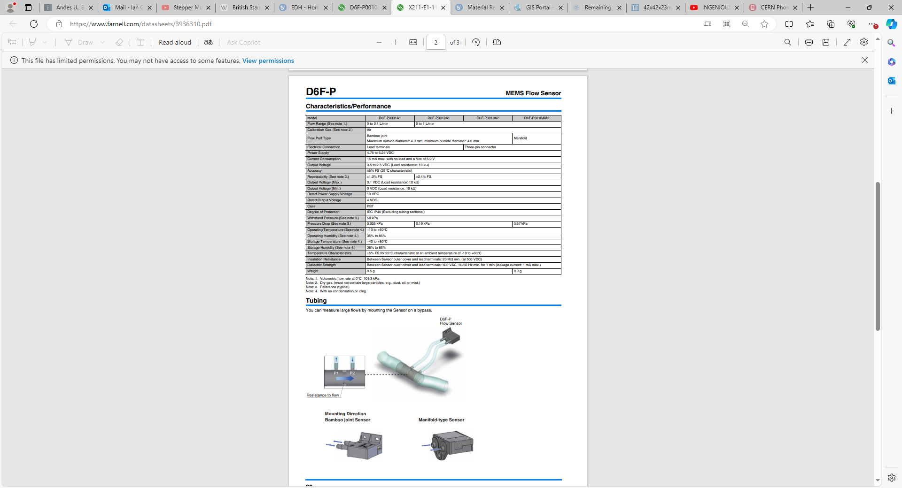

Slide 8


Slide 9
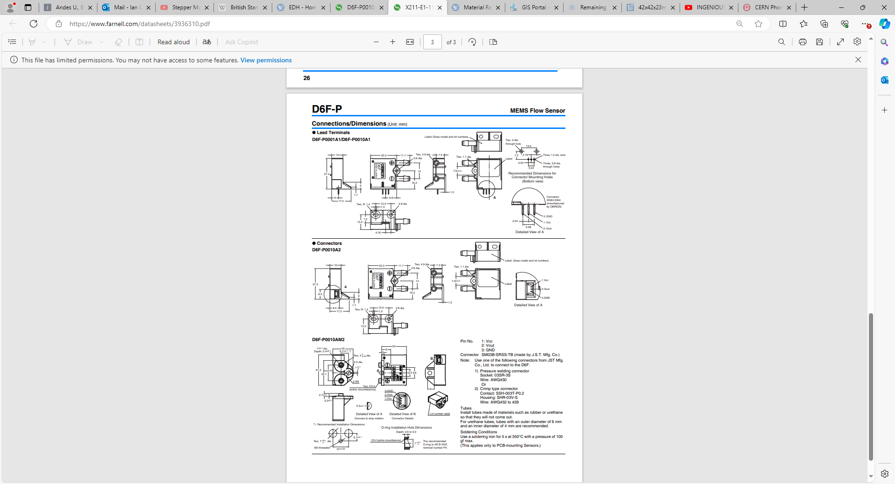

Slide 13
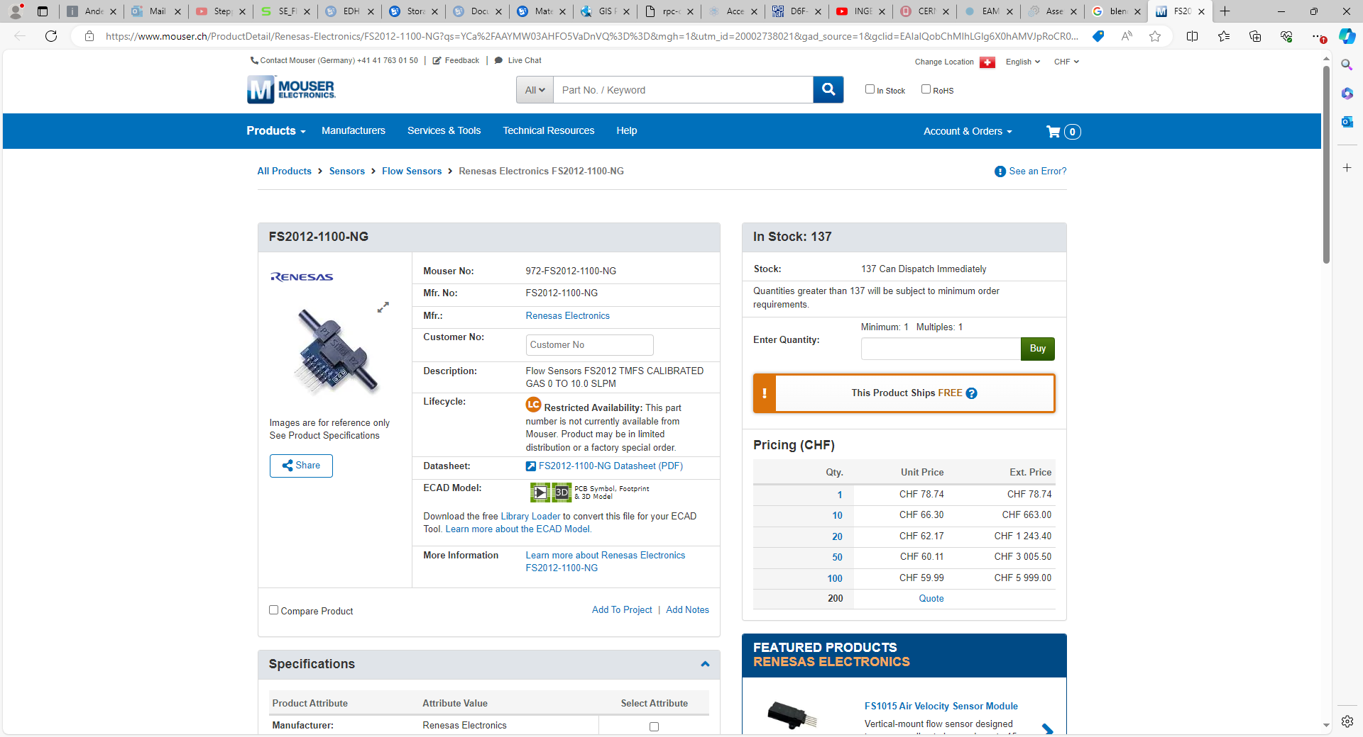
FS2012-1100-NG Renesas Electronics | Mouser Switzerland

Slide 14
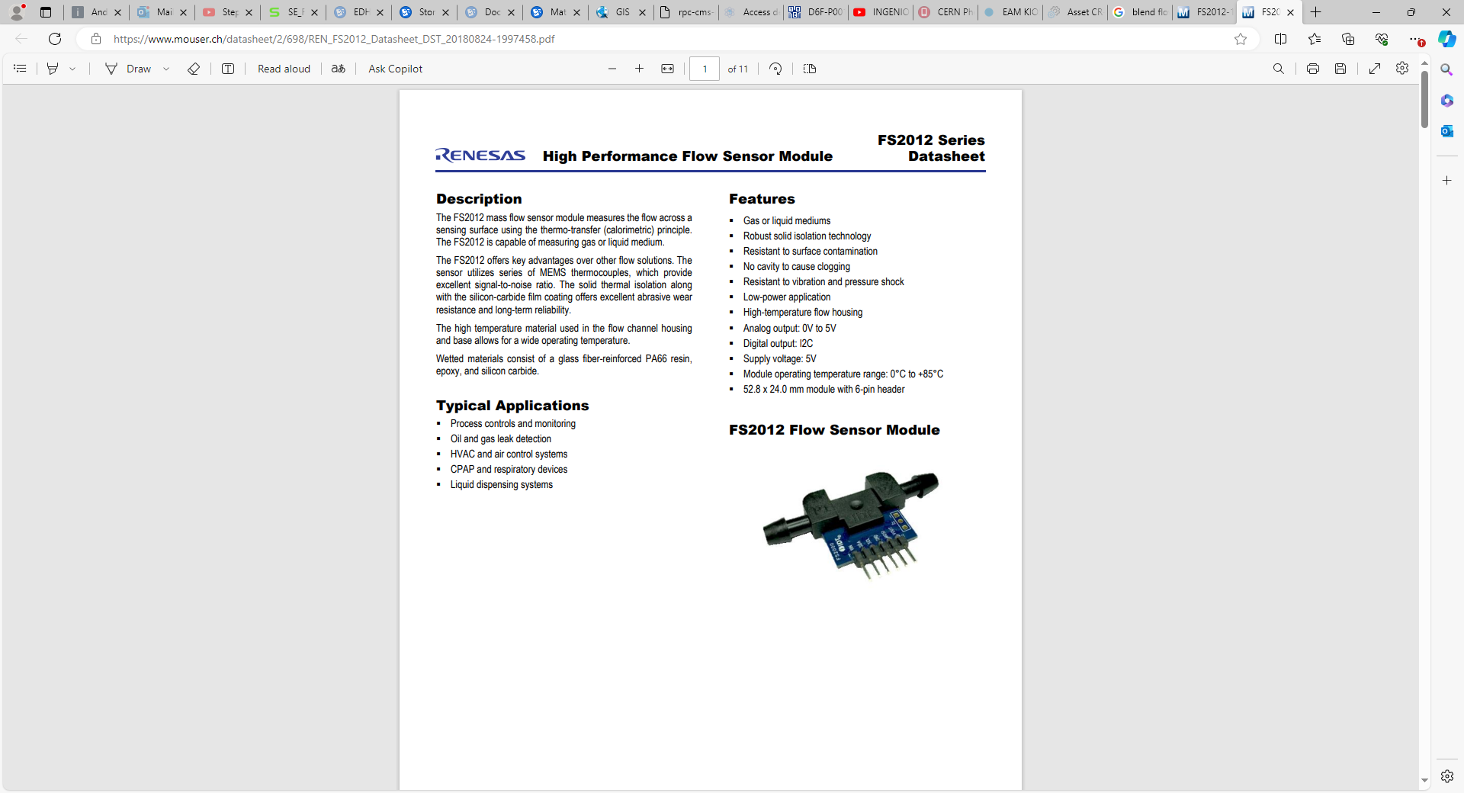
https://www.mouser.ch/datasheet/2/698/REN_FS2012_Datasheet_DST_20180824-1997458.pdf

Slide 15
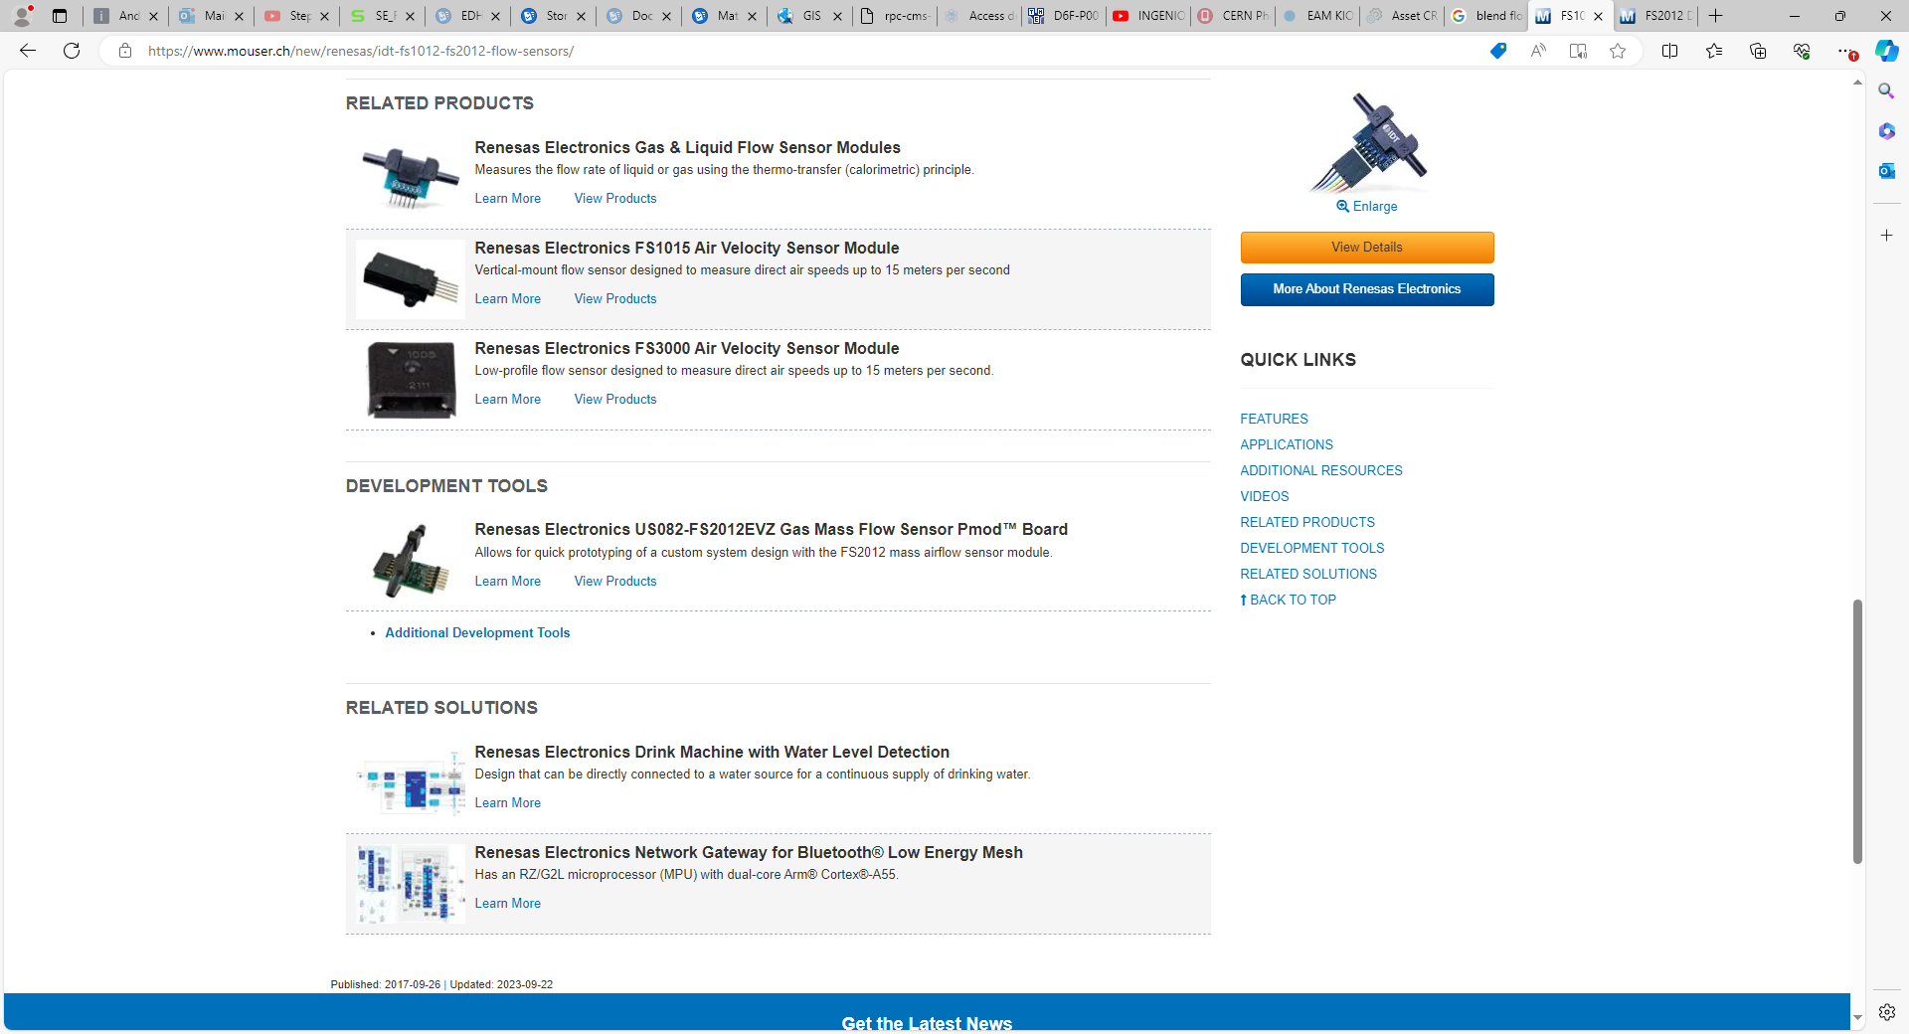
https://www.mouser.ch/new/renesas/idt-fs1012-fs2012-flow-sensors/

Slide 16
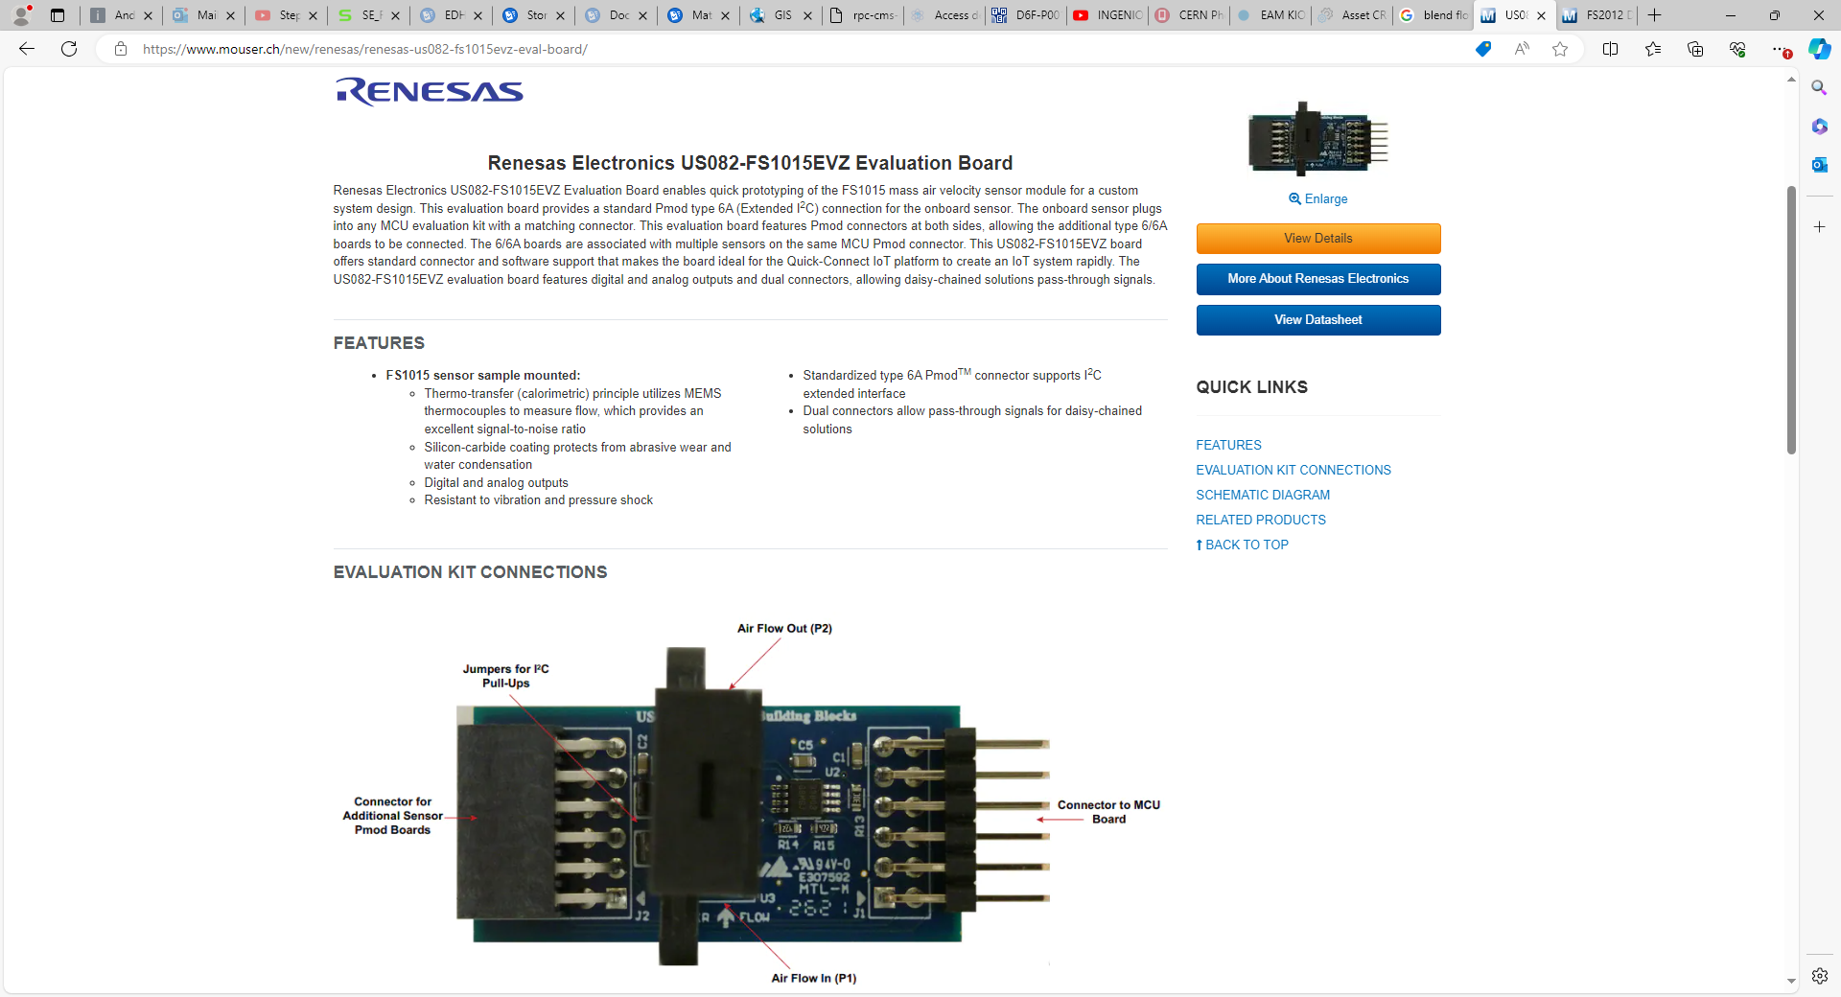
https://www.mouser.ch/new/renesas/renesas-us082-fs1015evz-eval-board/

Slide 17
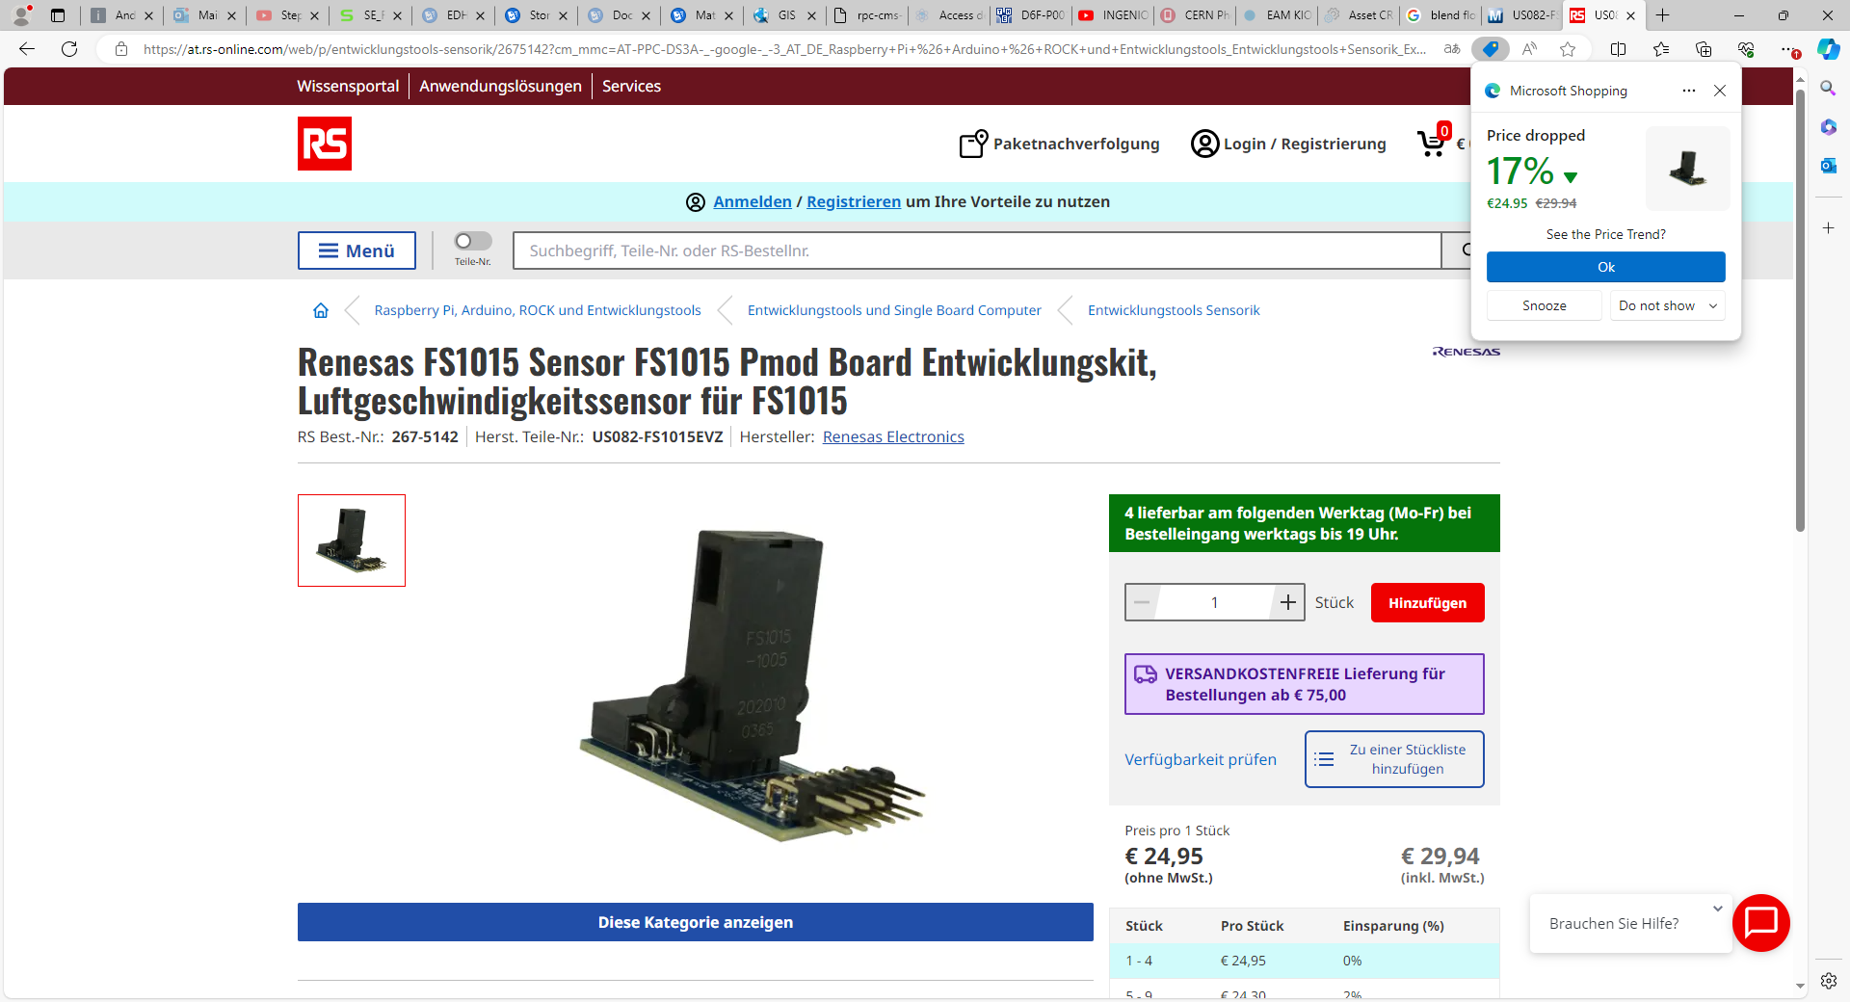

Slide 19
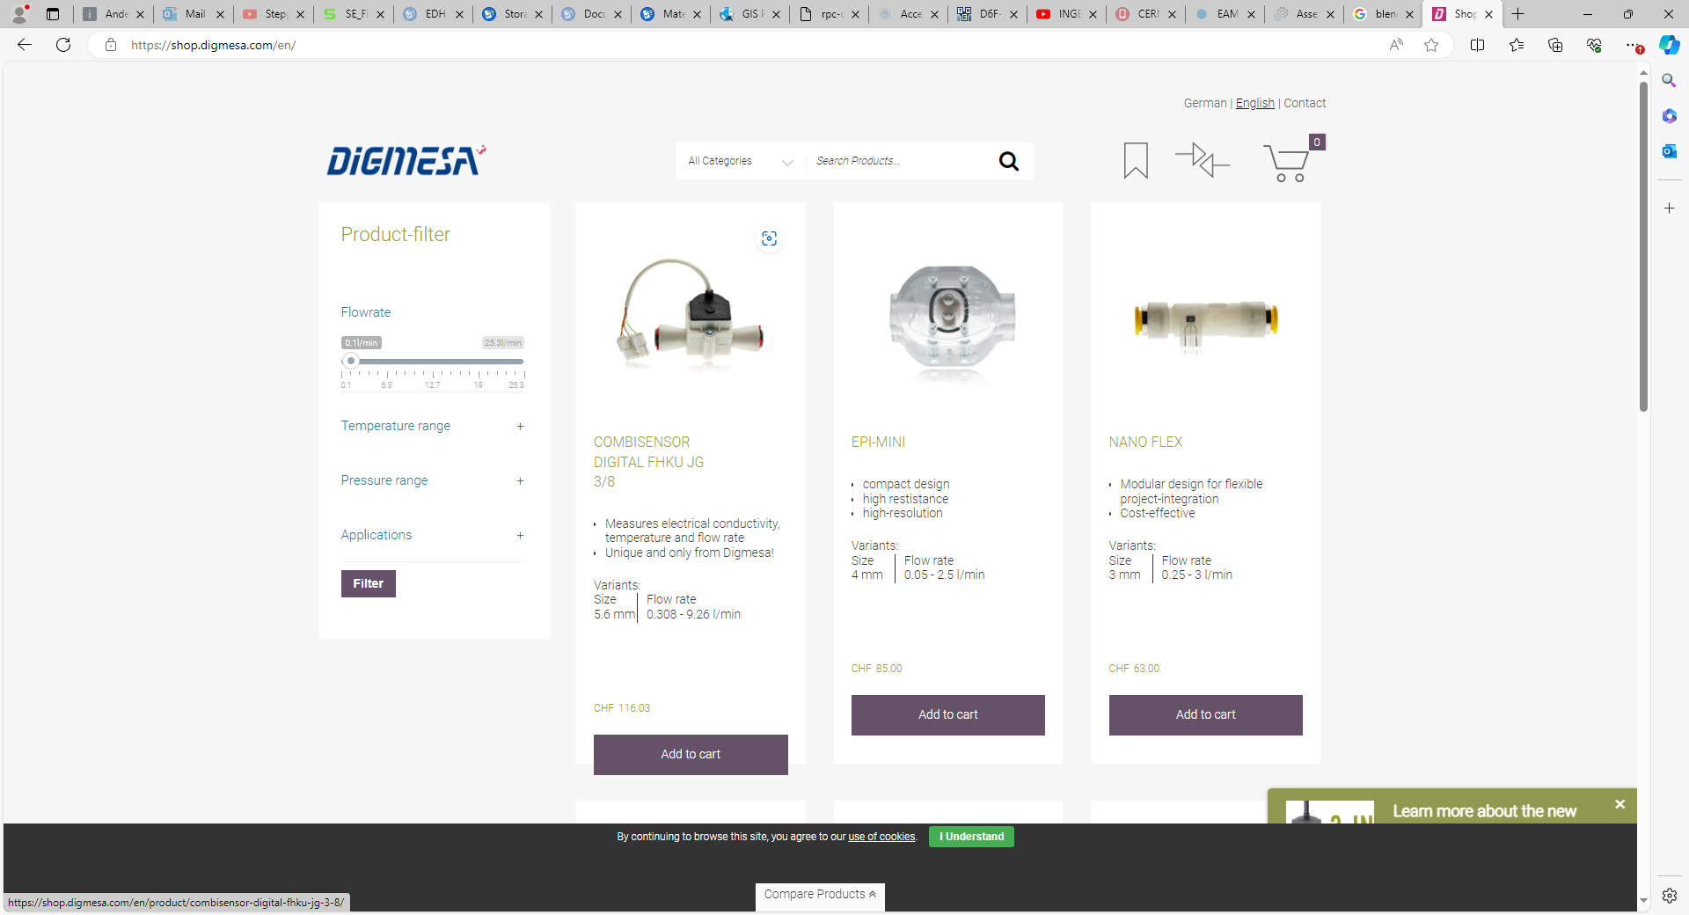

Slide 20
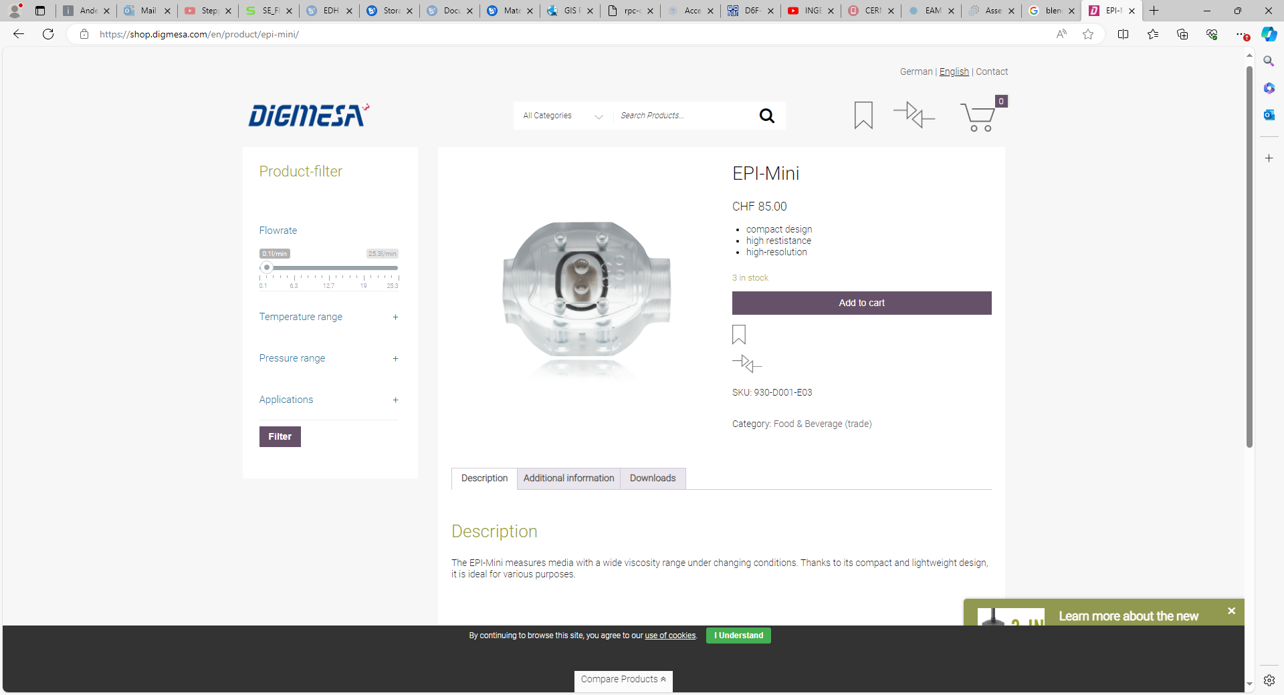
https://shop.digmesa.com/en/product/epi-mini/

Slide 21
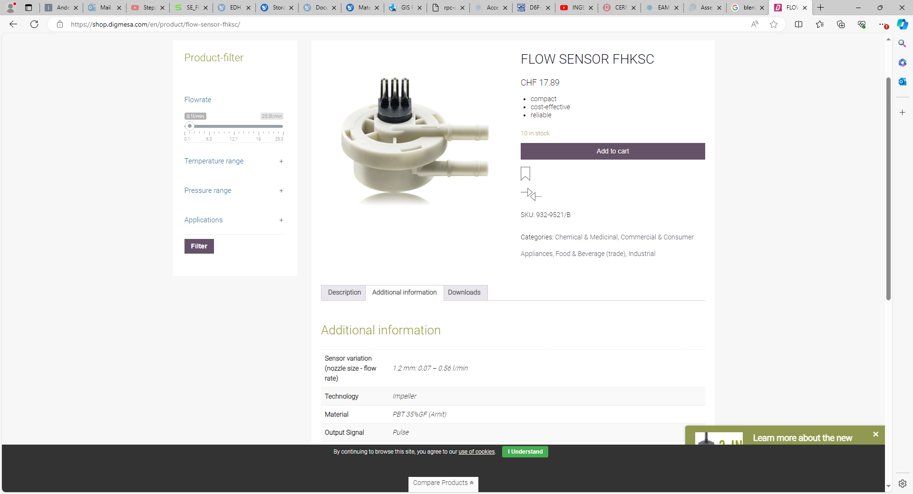
https://shop.digmesa.com/en/product/flow-sensor-fhksc/

