Slide 1
Flow sensor gas
Ian
8 March 2024

Slide 2
omron d6f-p0010a2 specification

Slide 4
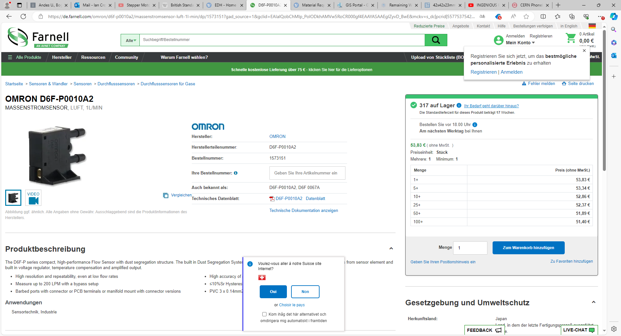
https://de.farnell.com/omron/d6f-p0010a2/massenstromsensor-luft-1l-min/dp/1573151?gad_source=1&gclid=EAIaIQobChMIp_PolODkhAMVw5RoCR000gf4EAAYASAAEgIZyvD_BwE&mckv=s_dc|pcrid|557753754202|kword|d6f%20p0010a2|match|p|plid||slid||product||pgrid|130636464233|ptaid|kwd-382312150773|&CMP=KNC-GDE-GEN-SKU-MDC-Electromechanical-943-Max-Conv-Value

Slide 5
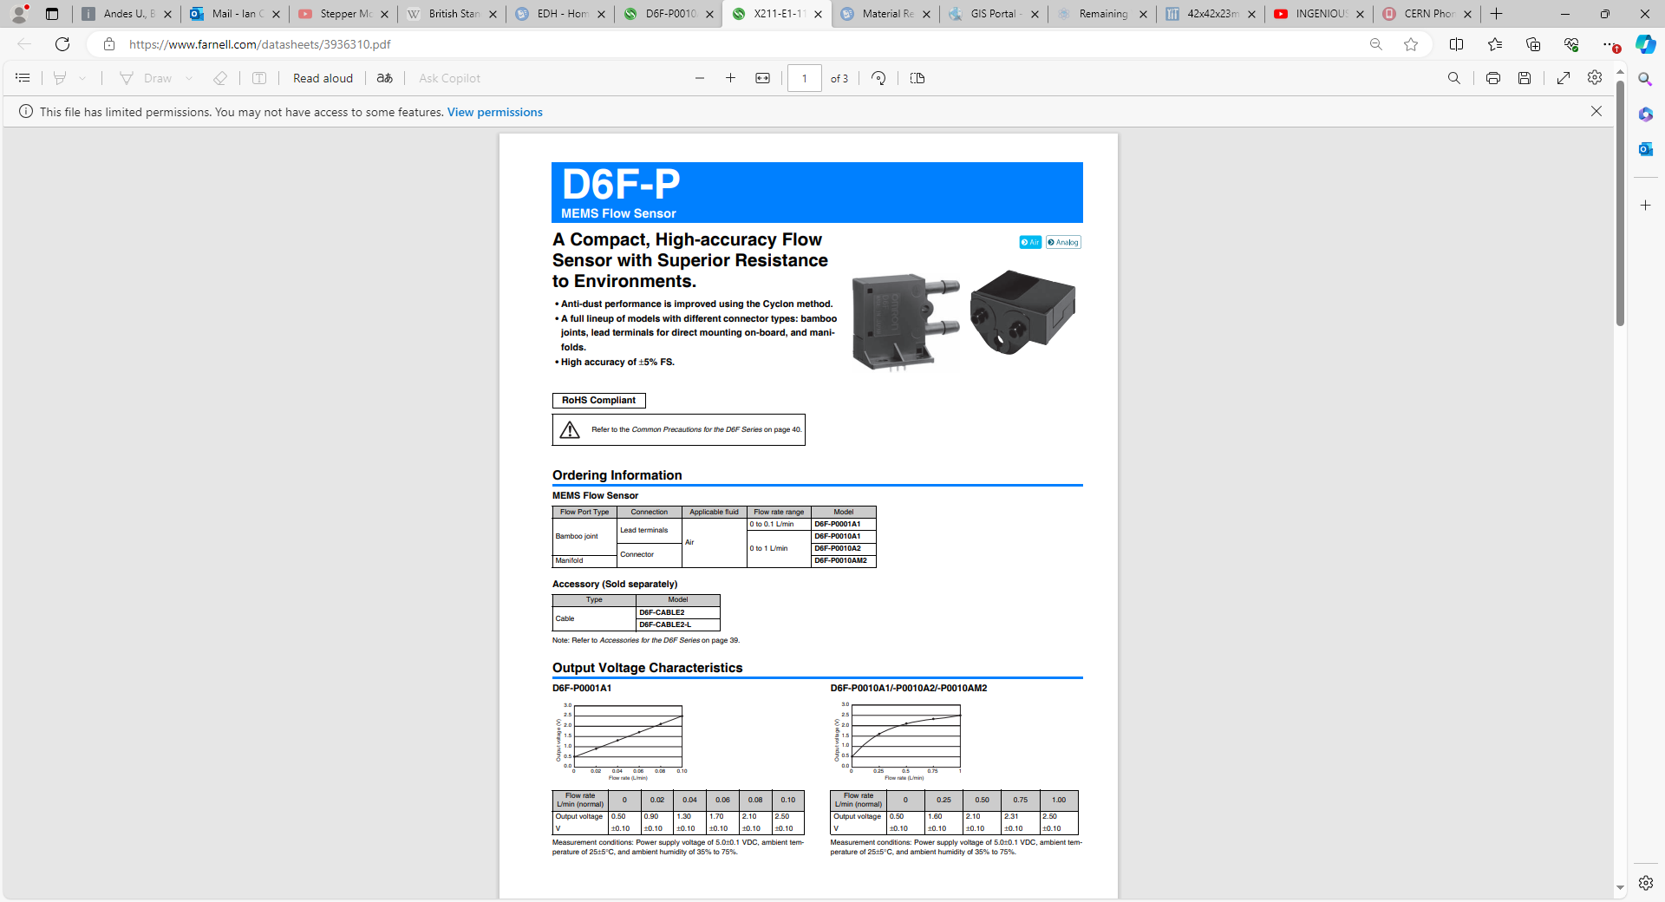
https://www.farnell.com/datasheets/3936310.pdf

Slide 6
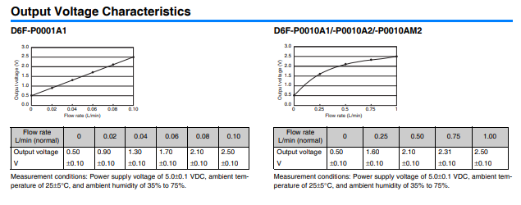

Slide 7
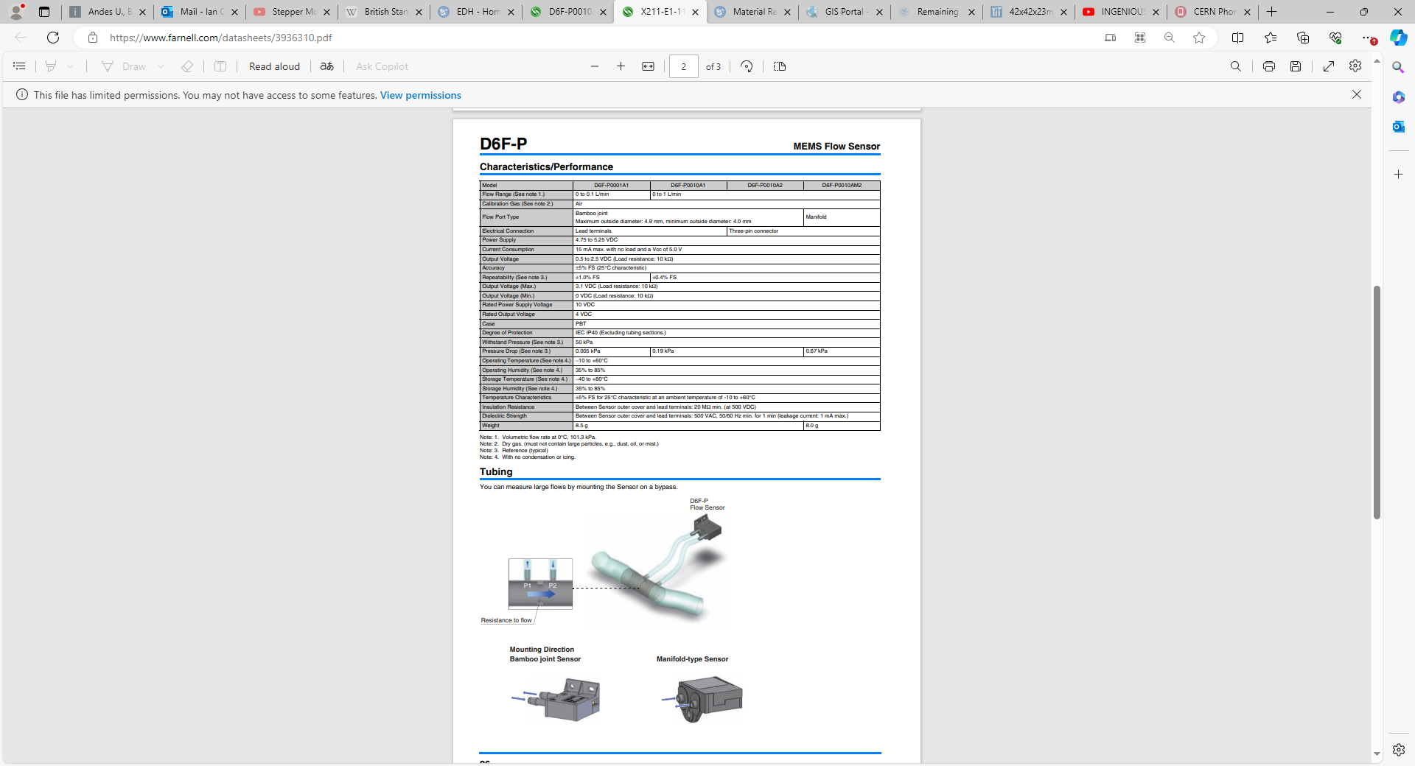

Slide 8


Slide 9
