Slide 1
Gas for World wide RPCs
Ian Crotty 12 Feb 2015

Slide 2
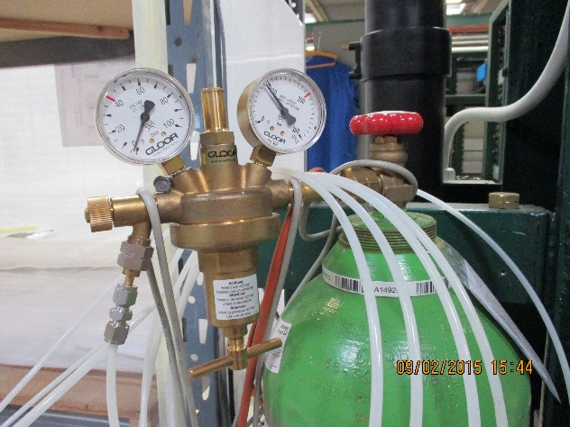
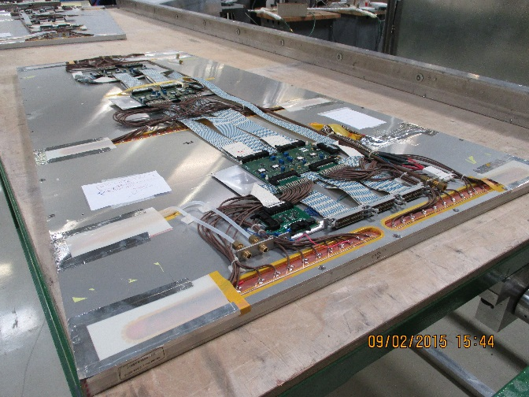
Contents
Gas Bottle
Chamber
The problem
Sourcing the gases
Storing
Mixing
Exhaust
Safety
Is simple

Slide 3
Gas Sources
R134a
    Industrial gas for refrigeration systems, But purity is 99.9% with a max of 100ppm
Iso-butane quality 35, Flammable,
Commercial name, R600a,
Camping Gas cylinders
SF6 quality ? non toxic

Slide 4
Source the Gases in your country
PanGas
Linde
Air Liquid
CarbaGas
Camping Gas

Slide 5
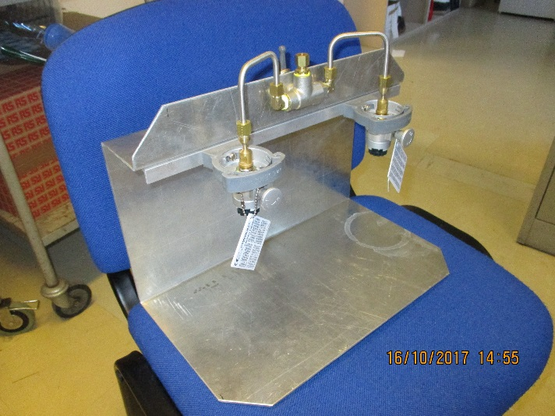
Bottles and regulation
IsoButane
  Use camping gas cylinders. Usually a mixture of propane and Butane. Small volume is a smaller safety hazard. See switching installation made for CV-300 Plus bottles.
  See other photos here
  http://project-cms-rpc-endcap.web.cern.ch/project-cms-rpc-endcap/rpc/Services/Gas/GasMixingInstitutes/GasBottles/IsoButane/CampingGas/DistributionCV300Plus/

Slide 6
Freon and SF6 bottle regulators

Slide 7
Mixing
3 approaches
    1 simple analogic gas panel
    2 MFC with simple rack
    Sophisticated with isobutene control (LEL control), humidity
    3 CERN Rack 20kchf (See appendix for details)
    4 re-cycle, closed loop
    Mixing rate calculator
    http://project-cms-rpc-endcap.web.cern.ch/project-cms-rpc-endcap/rpc/Services/Gas/GasMixingInstitutes/MixingRackCERN/MixingFlowRates.xlsx

Slide 8
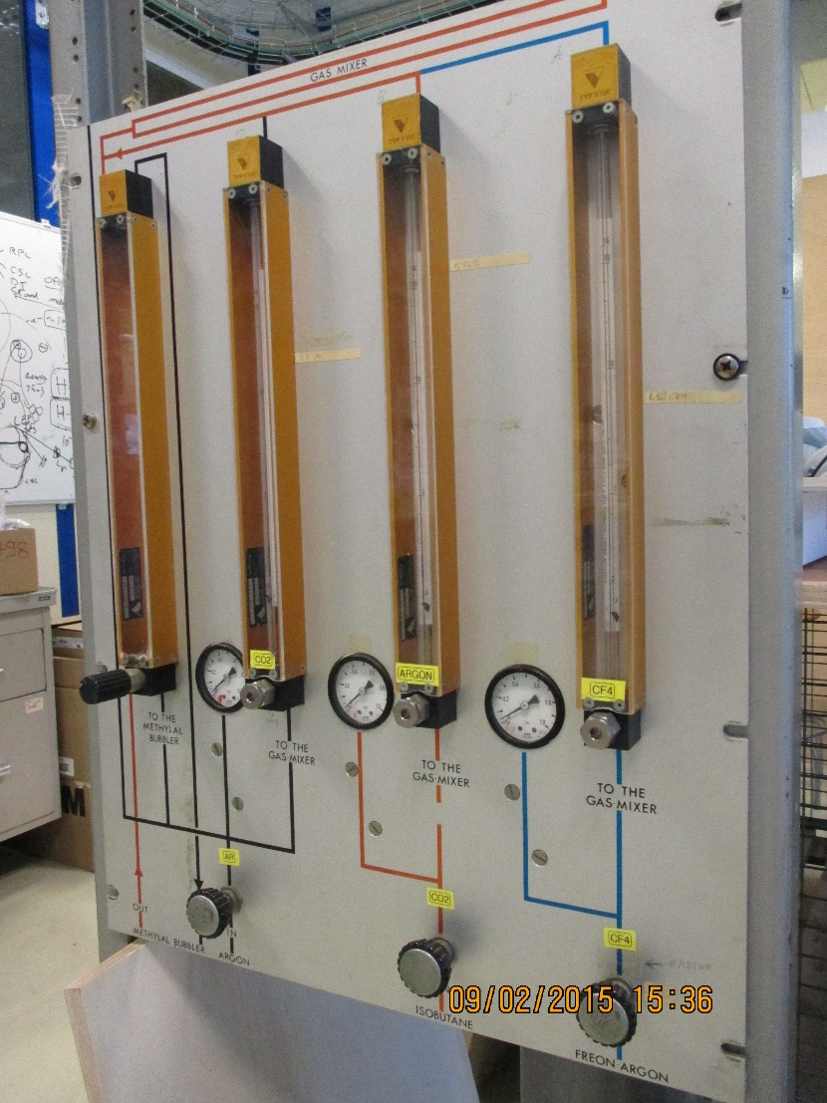
Analogue some times called Rotameter
Available cheaply ( perhaps at CERN)
Vogtlin (Swiss)
Difficult to calibrate
( We have the calibration curves……..)
A first approach, that was used 20 years ago,
to get set-up.

Slide 9
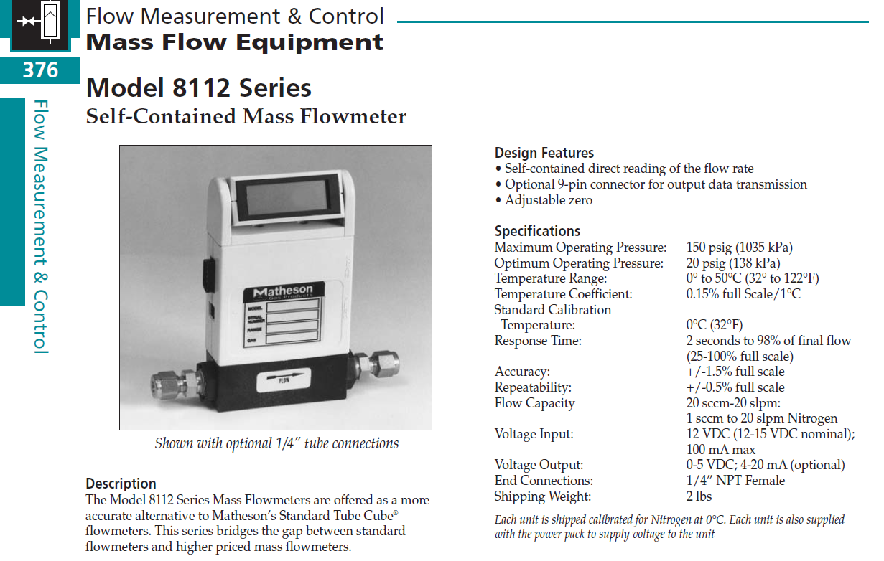
Mass Flow Controllers
Generally expensive equipment

Slide 10
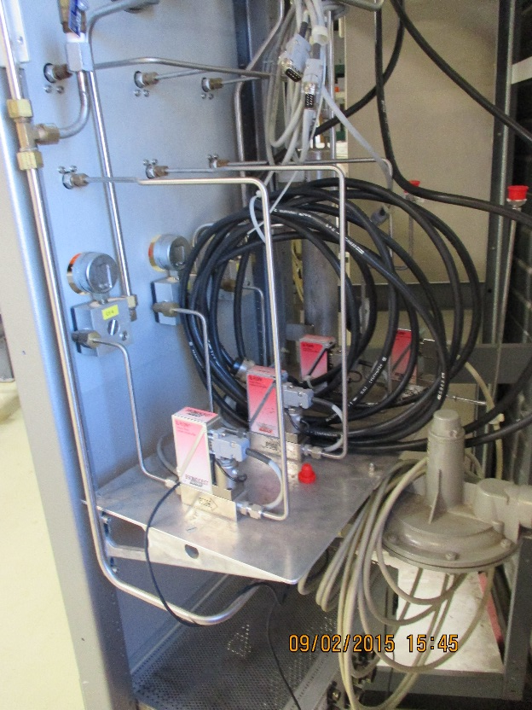
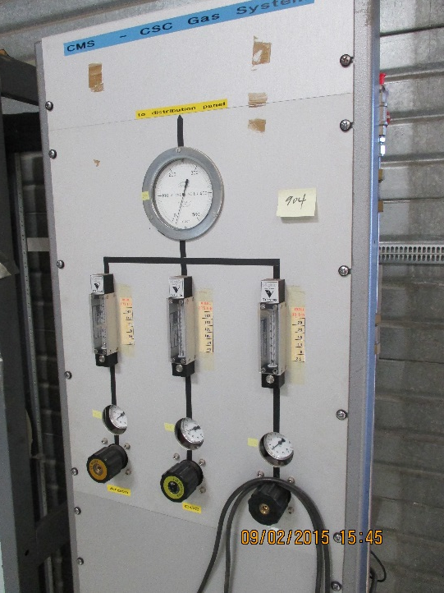
Very simple rack
Rear area with MFCs, mixer and piping
Front panel with Analogue meters
Many types of mass flow meters available; Mathesongas, Aalborg, Sierra, Bronkhorst, Alicat, Brooks Instruments etc

Slide 11
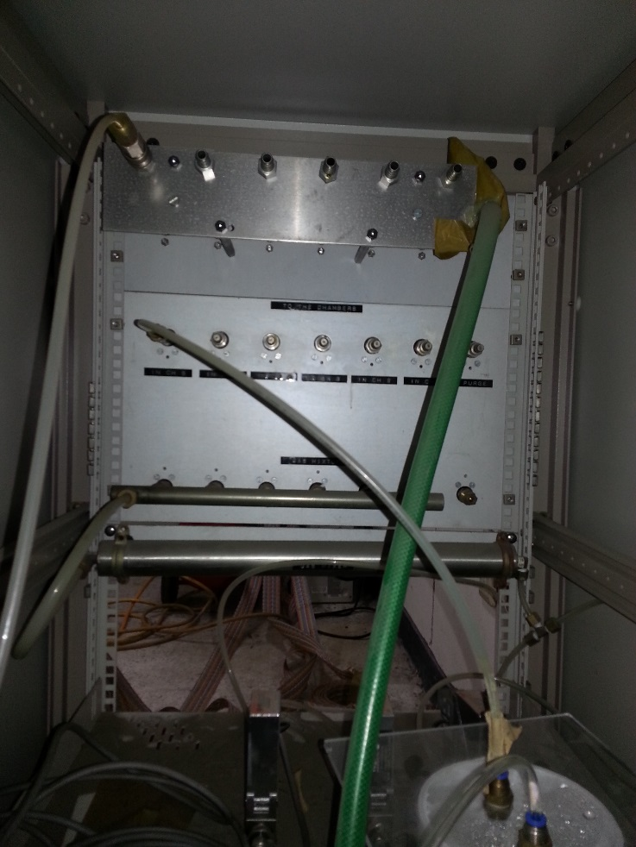
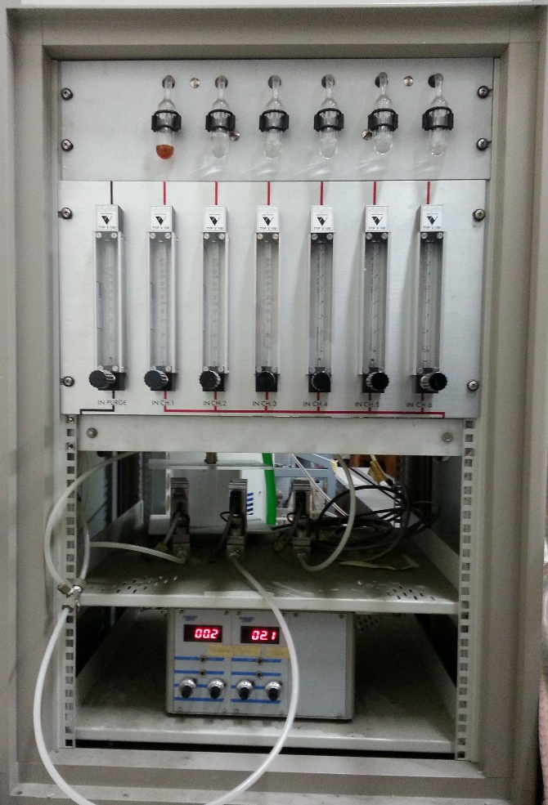

An example of the two CERN gas racks in Korea since 15years
3x MFCs with plastic piping
Bubbler panel
6 channel panel Distribution
4x Channel controller
Rear View showing humidifier and mixing volume
See Appendix for component list

Slide 12
Humidifier the gas to stop HPL drying
There are 2 approaches
          1 separate the gas flows, one for dry proportion and the 2nd for the wet proportion that is bubbled thru water. This can be done with 2 “rotameters”.
          2 pass the entire mixture thru water at the temperature that gives the RH you require, eg a fridge set at 10degC for approx. 50% RH. CERN still has old elements of this type available.

Slide 13
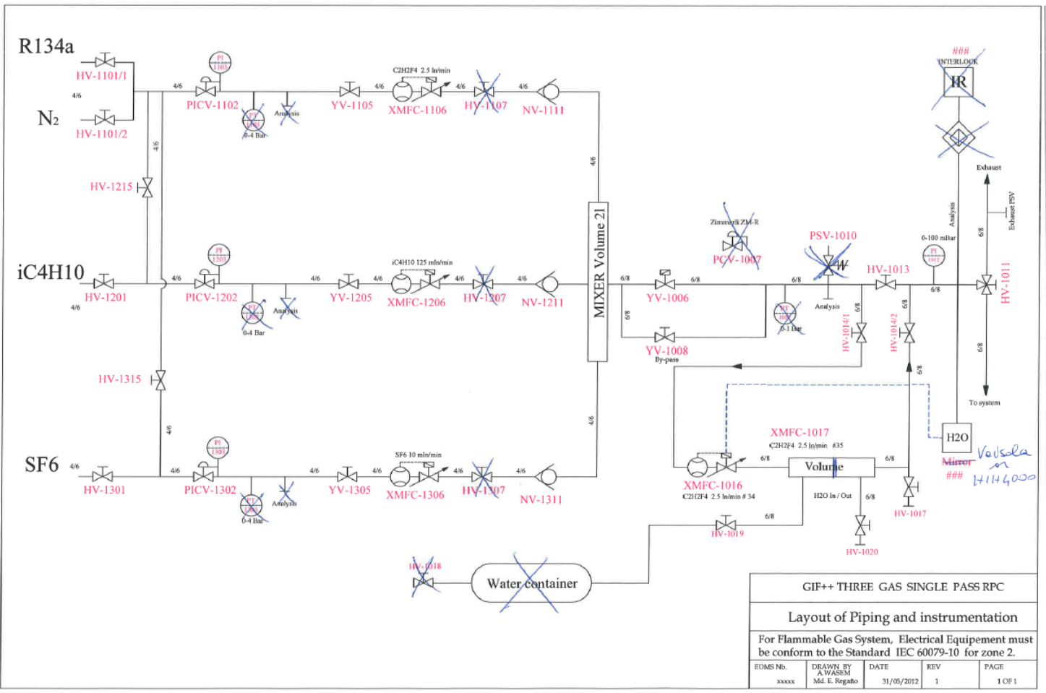
Basic circuit from CERN Gas Group
15kChf for components, 20kChf fully built

Slide 14
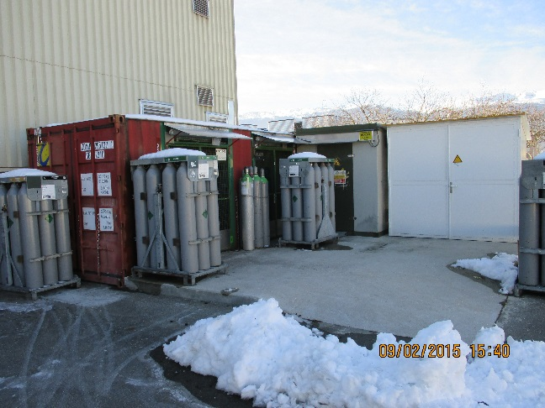
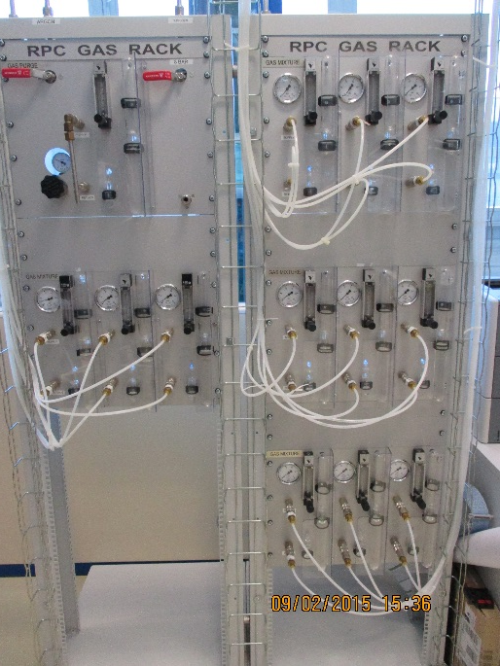
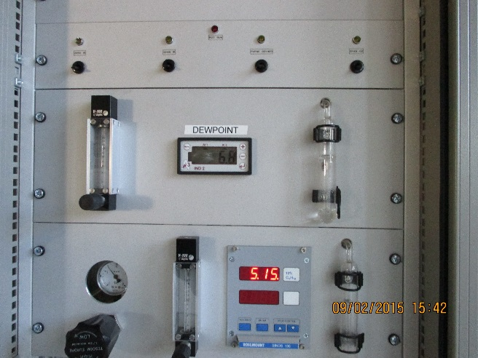
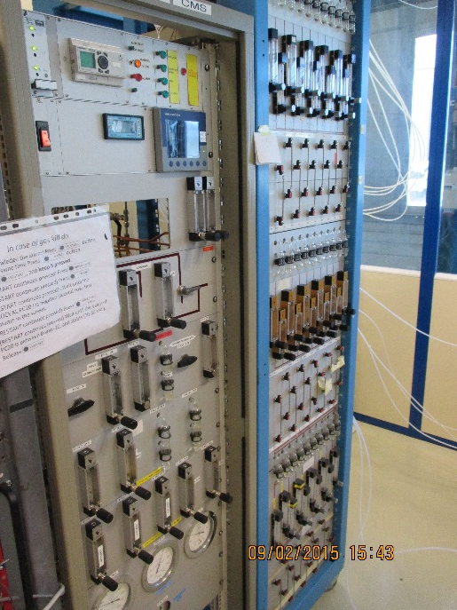
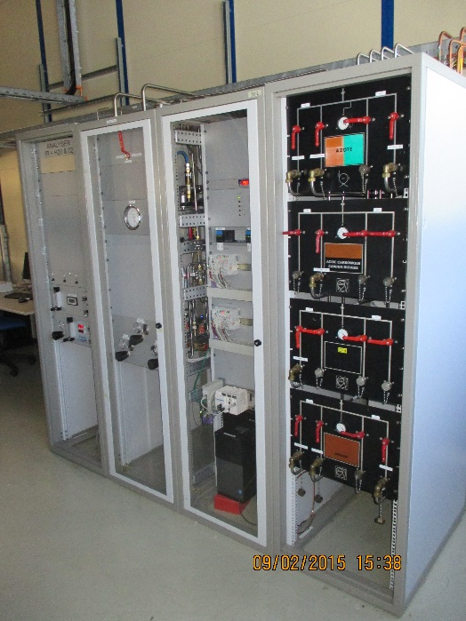
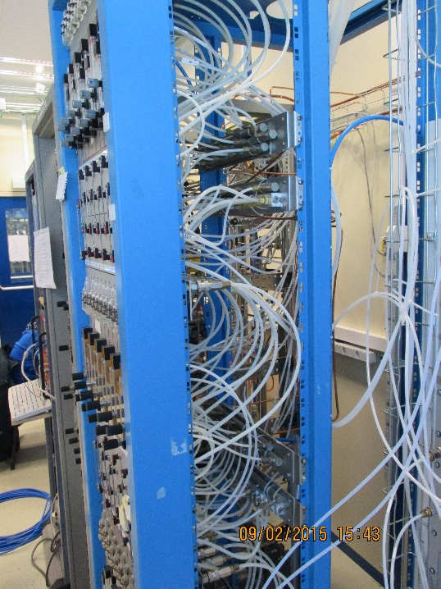
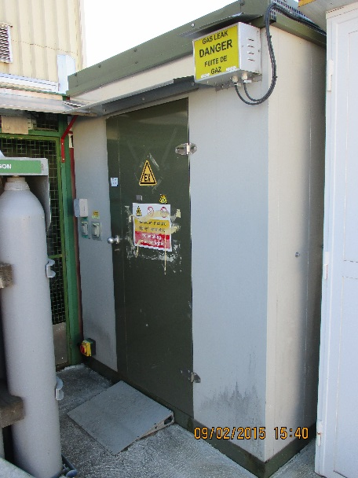
Industrial type approach(possibly with recirculation)

Slide 15
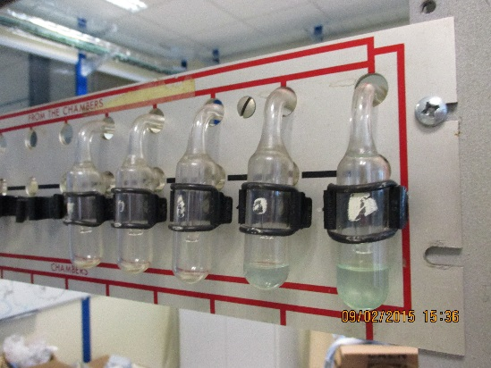
Exhaust
The exhaust should be safe away from the area of use, outside.
The gases are heavier than air and so should not exit far above the chambers to avoid hydrostatic back pressure.
Limit the retro-diffusion of oxygen by very
long lines or bubblers

Slide 16

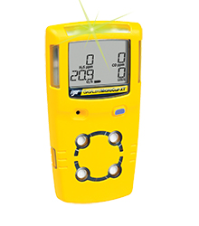
Safety
Normally all the system should have an ATEX classification
Hand held devices at moderate prices available such as Oldham or Draeger
Hand held gas detector
https://www.youtube.com/watch?v=DgWAenS9kzc
https://www.youtube.com/watch?v=Ocw6TZ5XVAo
https://www.youtube.com/watch?v=0QV1zR9kIM0

Slide 17
Appendix
http://project-cms-rpc-endcap.web.cern.ch/project-cms-rpc-endcap/rpc/Services/Gas/GasMixingInstitutes/MixingRackCERN/PriceQuotationMixerRPCv2.docx
http://project-cms-rpc-endcap.web.cern.ch/project-cms-rpc-endcap/rpc/Services/Gas/GasMixingInstitutes/MixingRackCERN/RecirculationRack_ShoppingList_v2_june2014.xlsx
http://www.draeger.com/sites/assets/PublishingImages/Products/gds_regard_3900_3910/Attachments/explosion_protection_br_9046262_en.pdf

Slide 18
Component list for Korean Gas Rack
Rack
3 MFCs & controller
Distribution panel
Mixing Volume
Bubbler
Humidifier
3x Pressure regulators for gas bottles
Piping and some unions

