Slide 1
Gas with Louis-Phillipe
Ian
30 Jan 2019

Slide 2
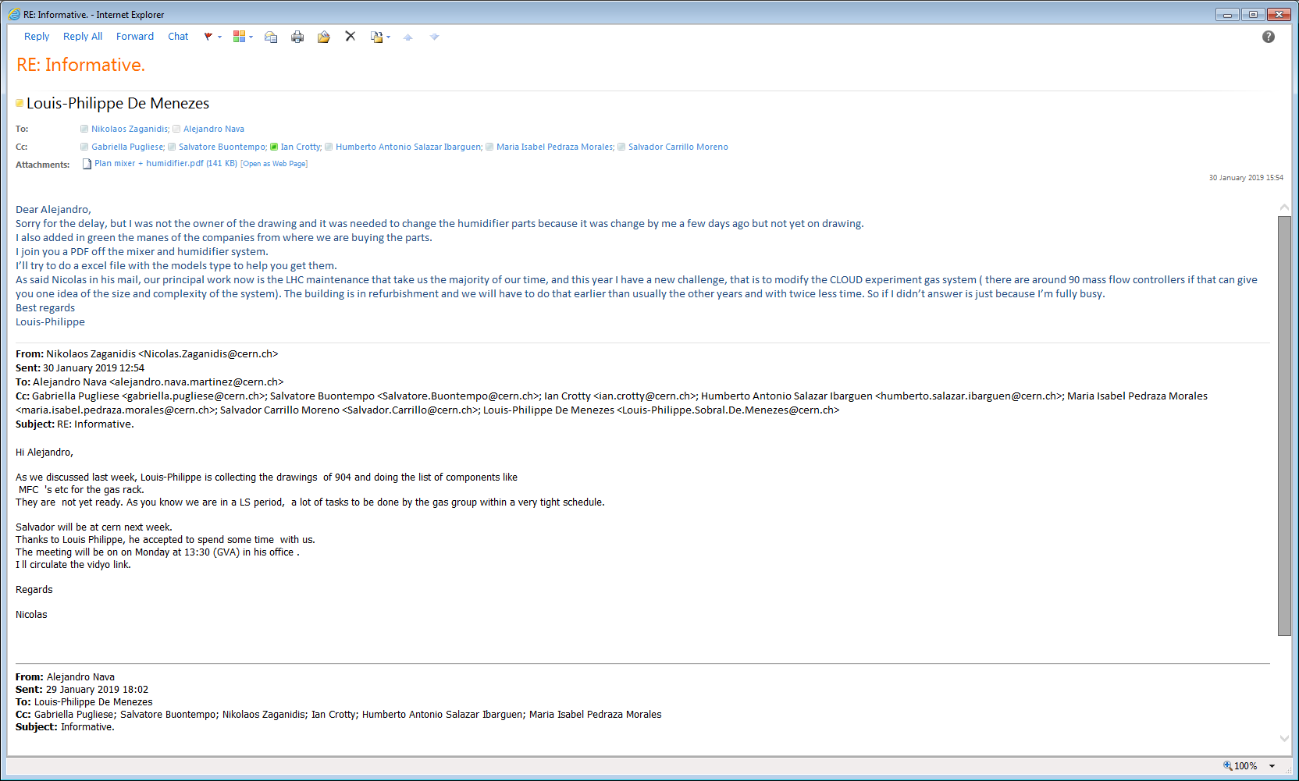

Slide 3
