Slide 1
Counting Bubbles
This is the 2nd document ?
Ian
16 April 2024

Slide 2
What is required for a gas mixer for classic RPC
95% R134a
4.5% iso Butane
0.5% SF6 This is assumed to be adjustable down to 0.1%
Assuming 10 litres/hr.
9.5 [l/h] R134a
0.45 [l/h] isoC4H10
0.05 [l/h] SF6
The minimum available analogue flow meter is 0.13 to 1.3 [l/h]
1 litre is 1000cm3
0.1 L is 100cm3
0.01 L is 10cm3
Bubbles can be assumed to be 14mm3 for a 3mm dia. Bubble.
1cm3 is 1000mm3
Assume 1 bubble per second gives 3600 bubbles/ h
1 bubble x 14mm3 x 3600 = 50400mm3/h = 50.4cm3/h ~ 0.05l/h
This is the nominal flow of SF6
Assume 1 bubble every 5 seconds then = 0.01l/h ( an order of magnitude better than the rotameter) which is 5 times smaller.
The bubble size can be varied.

Slide 3
A quick measurement by Omar in 2023 gave 1 bubble/sec @ 1 litre/hr
This does NOT agree with the previous slide.
What is going on ?

Slide 4
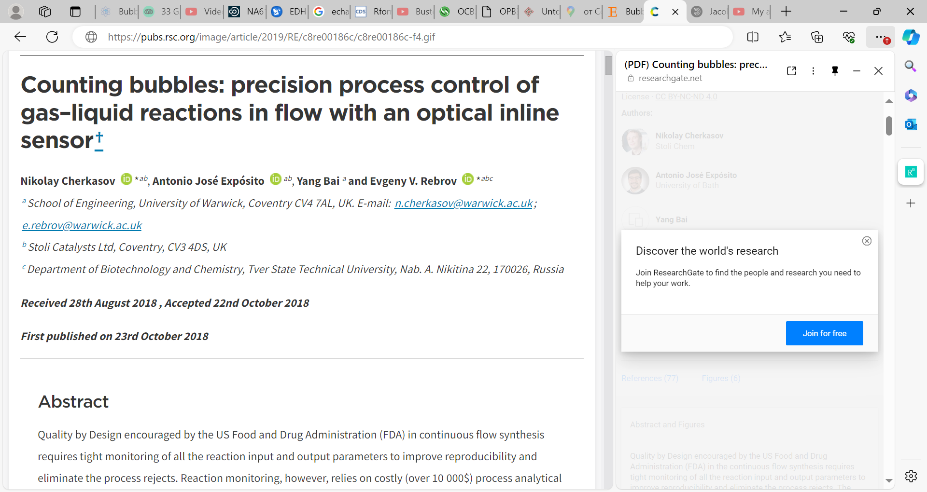
https://pubs.rsc.org/image/article/2019/RE/c8re00186c/c8re00186c-f4.gif

Slide 5
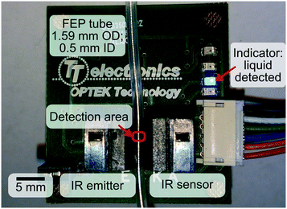
School of Engineering,
University of Warwick,
Coventry CV4 7AL, UK.
E-mail: n.cherkasov@warwick.ac.uk;
e.rebrov@warwick.ac.uk

Slide 6
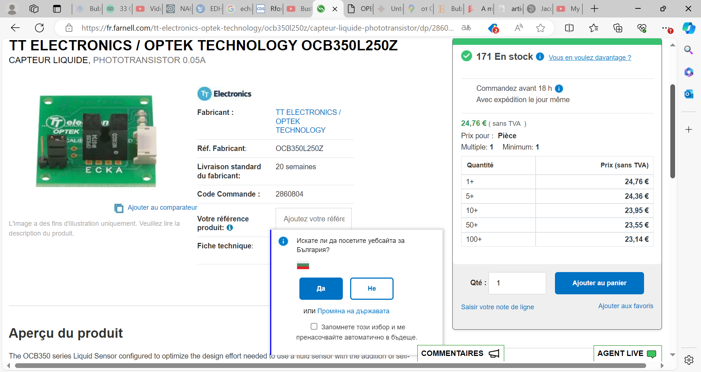
Réf. Fabricant: OCB350L250Z

Slide 7
Adapt the device to the standard bubble formation style used in gas systems @ CERN
Sensor potted in hot melt or epoxy
Need balance connection between top and bottom……

Slide 10
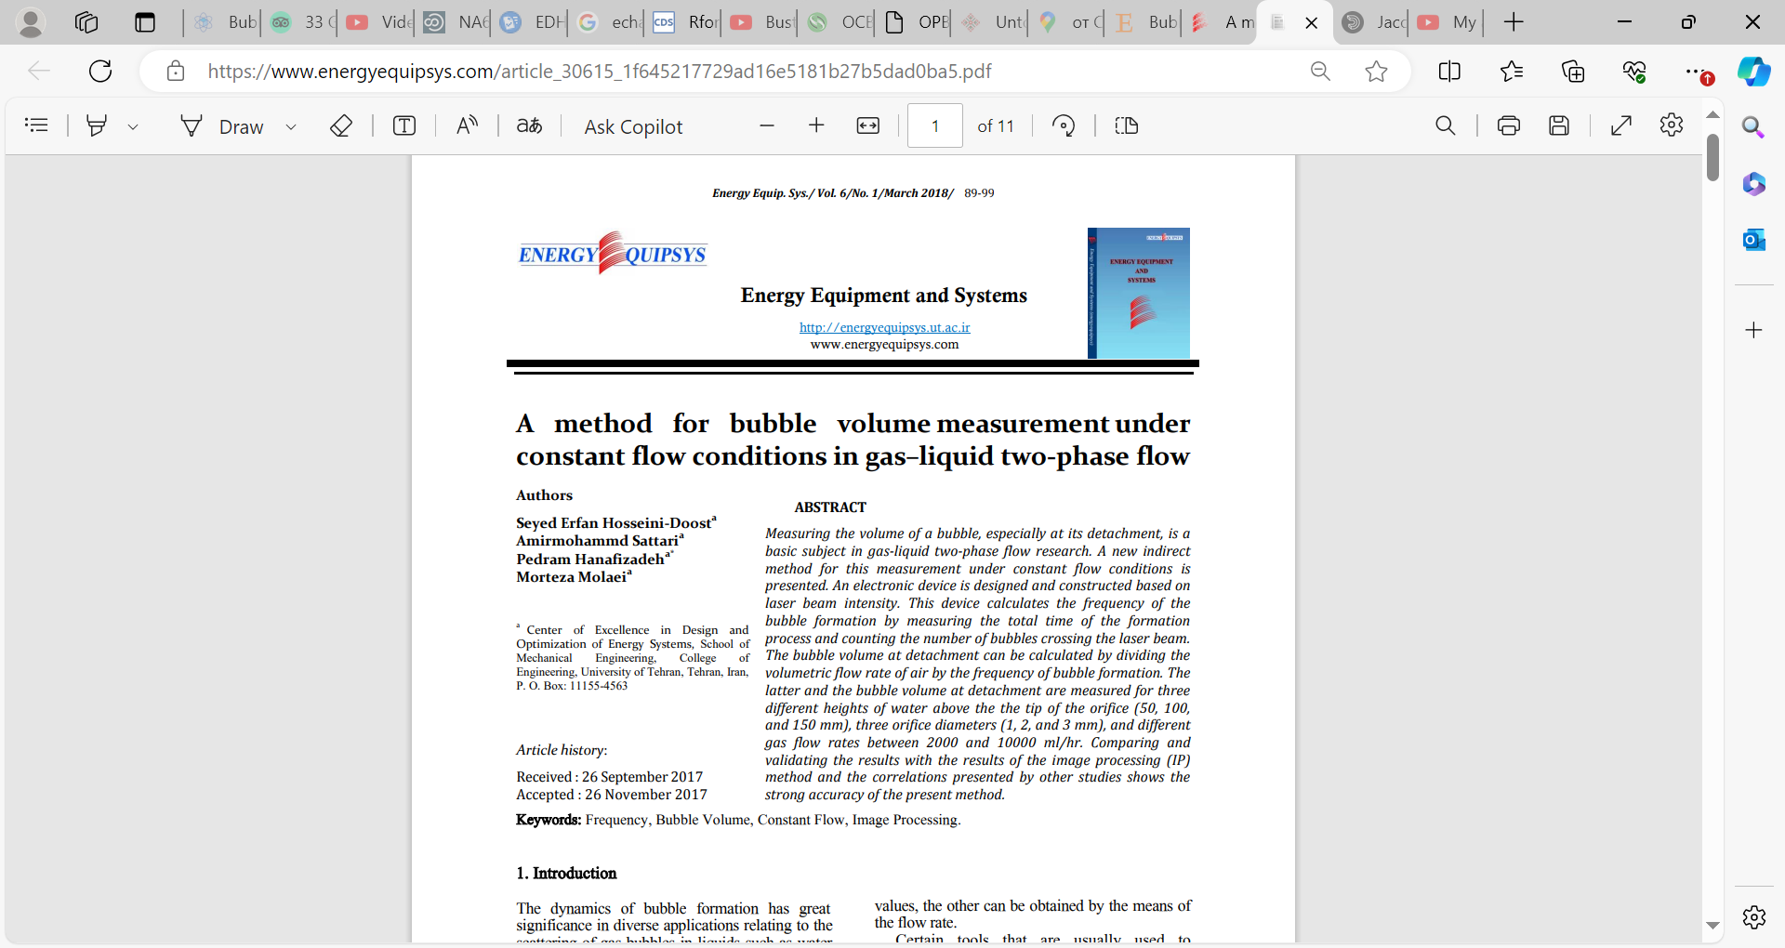
https://www.energyequipsys.com/article_30615_1f645217729ad16e5181b27b5dad0ba5.pdf

Slide 11
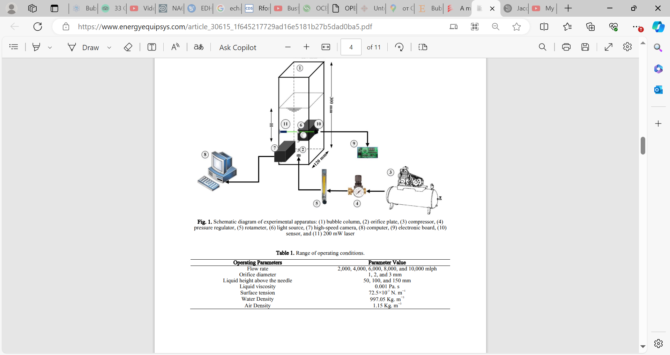

Slide 12
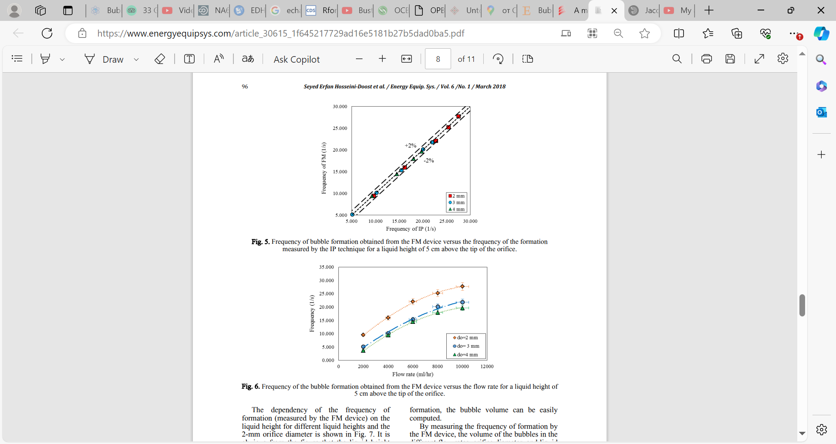

Slide 13
