Slide 1
Status of GHG emission reduction strategy
(from RPC side)
G.M.I. Pugliese
INFN and Politecnico of Bari
on behalf of the Muon group
Muon Workshop, CERN Oct 7th-9th, 2019

Slide 2
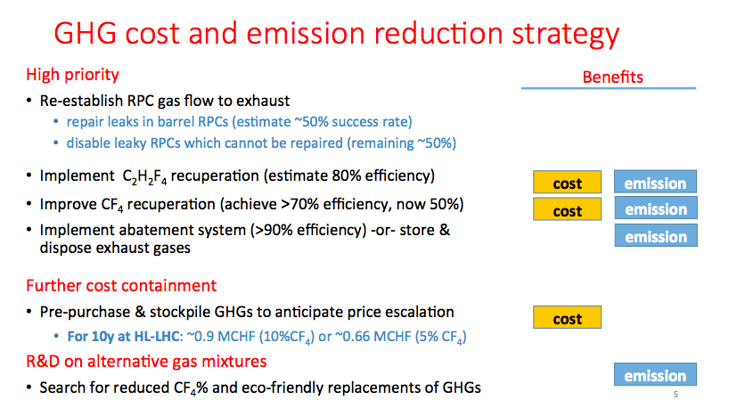
Outline: Update of muon strategy (AR2018)

Slide 3
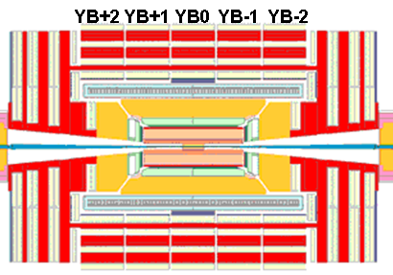
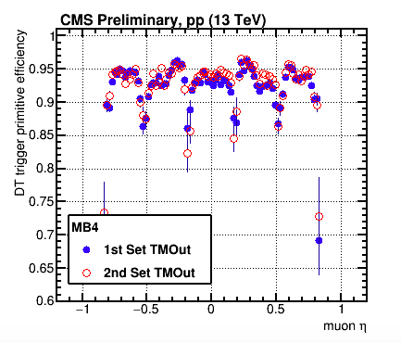
RPC Gas System in 2018
2018
C₂H₂F₄+iC₄H₁₀+SF₆ 95.2+4.5+0.3%
In 2018, RPC gas system was operated with:
Total flow ~9000 l/h
Leak rate: ~900 l/h (constant)
Replenishing rate 10%
Flow gas from the exhaust ~0 l/h
total flow ~9000 l/h
Closed loop Replenishing rate ~10% (900 l/h)
Leak rate ~900 l/h
The leaky chambers were:
43 leaky chambers in the Barrel → 800-850 l/h
20 leaky chambers in the Barrel → disconnected
8 leaky chambers in the Endcap → 50-100 l/h
Exhaust ~0 l/h
63 leaky
    Note
    In Run 2, 20/480 Barrel RPC, not repairable (no access), have been disabled. They are located in the outermost Barrel stations (RB3 and RB4)
      Degradation of L1 Trigger performance at a few percent level
    This has reduced the leak rate from 1200 l/h to 900 l/h and brought the replenishing gas rate from 12% to 10%
RPC leaky OFF
RPC leaky ON

Slide 4
Leak repairs in 2019

Slide 5
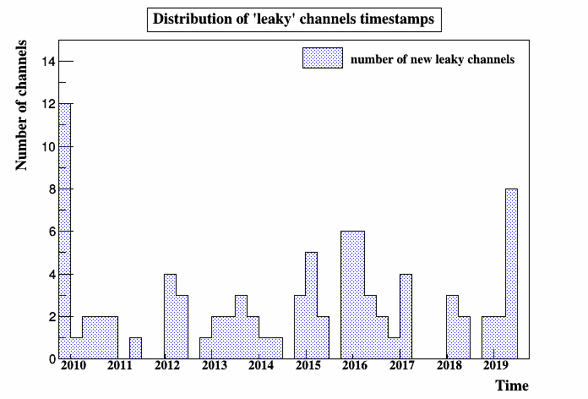
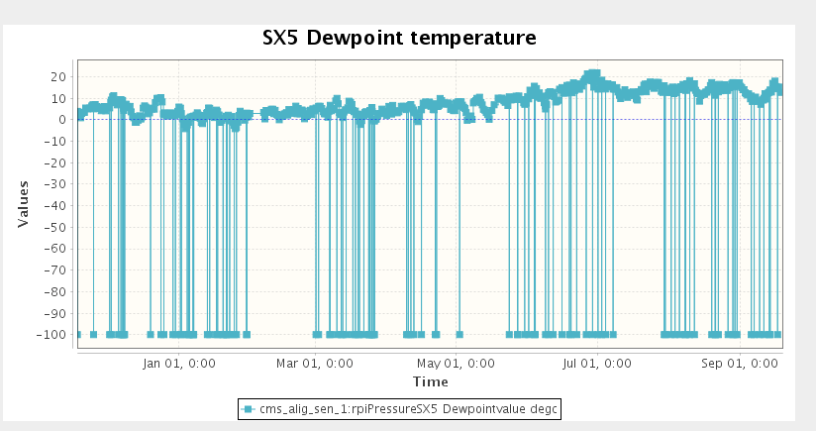
RPC Leak rate measurements in 2019
A significant increase of new leaky chambers detected this year by the leak measurement campaigns: 12 new leaks in the barrel region, bringing the total number from 63 to 75 (15% of barrel chambers).
An increase of the leak rate in 6 chambers with medium leaks (1-10 l/h) also detected.
The main causes for these new leaks are to believe to come from not stable CMS cavern conditions (mainly RH and pressure for several openings and closings) and several actions on the gas system (N2, air and gas mixture, open and close mode, etc) and fragile gas components.
Barrel leaks History
70%
20%
Dec 18
Mar 19
Jul 19

Slide 6
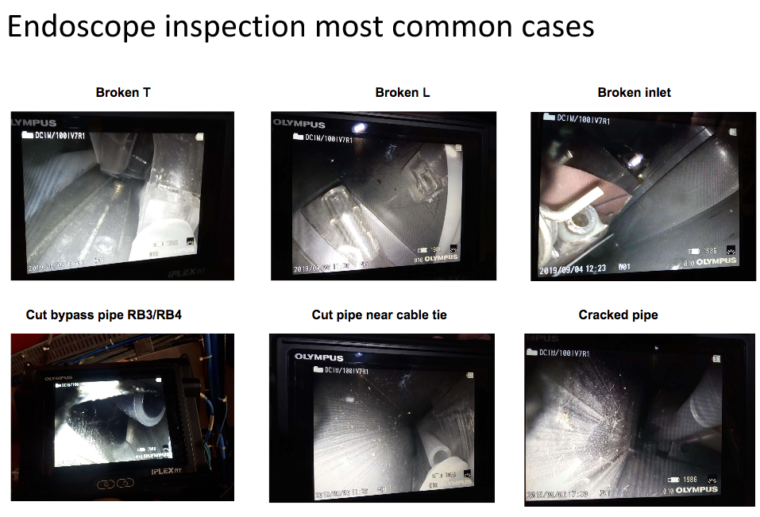
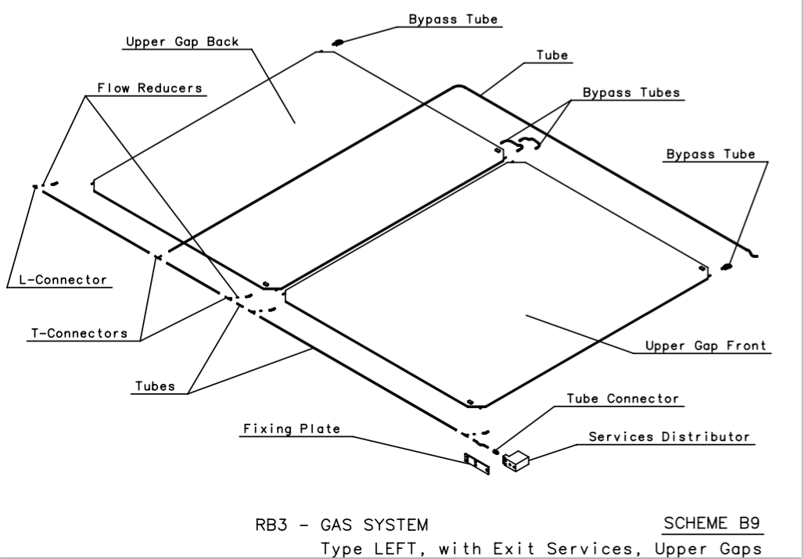
2019 Barrel Leak repair campaign (1)
Extensive leak search campaign performed with a non-invasive technique by using an endoscope. This procedure allows to check most of gas pipes and connections located inside the chambers:
All leaky chambers have been inspected and source of leak has been identified in 63 chambers (84%)
Main sources of leak identified: T-L gas connectors and cut pipes (only in RB3-4 where two chambers are internally connected in parallel) and brittle pipes

Slide 7
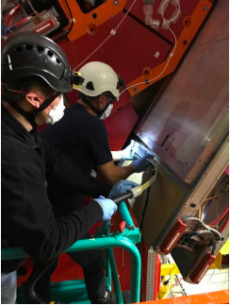
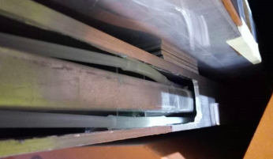
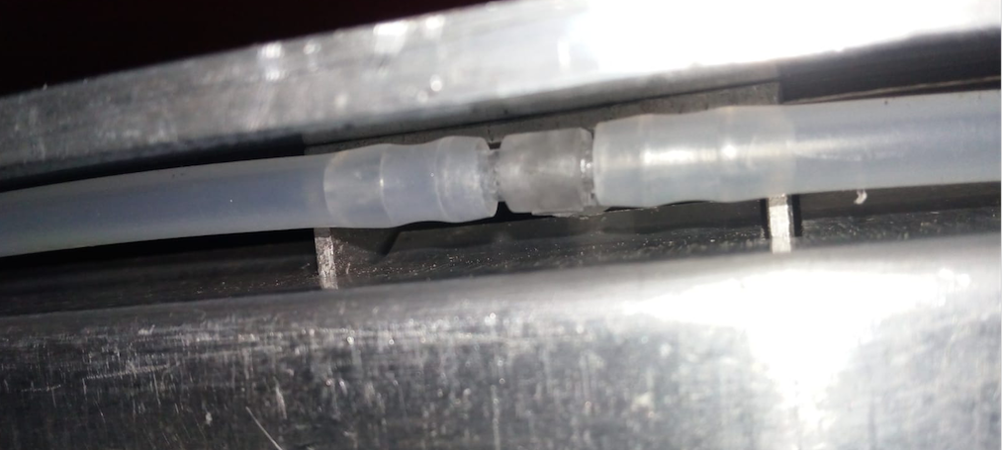
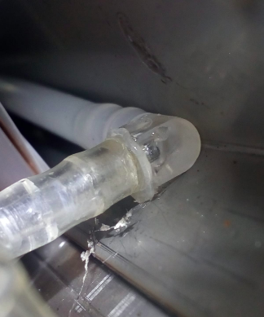
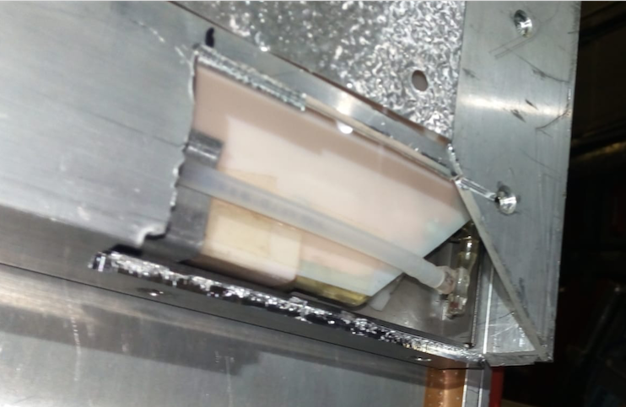
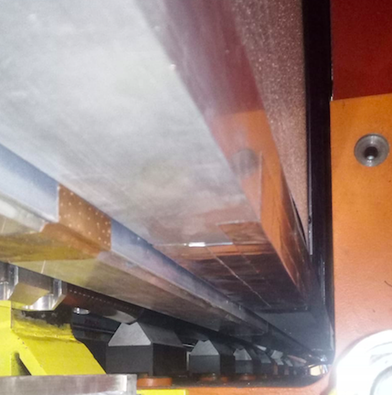
2019 Barrel Leak repair campaign (2)
New repair procedure developed consisting of partial extraction of the muon station (RPC and DT) for 80 cm from back or front side, then cutting the C illumining profile in order to have access to the broken component (gas pipes or T/L connector) and finally repairing/replacing the component.
Back extraction example:
Repairs
Access to broken component
Repair done by removing the broken pipe and by-passing the internal circuit and moving externally the parallel connection of two chambers
Repair done by gluing the L connector
Cut of the C profile
Closing and validation

Slide 8
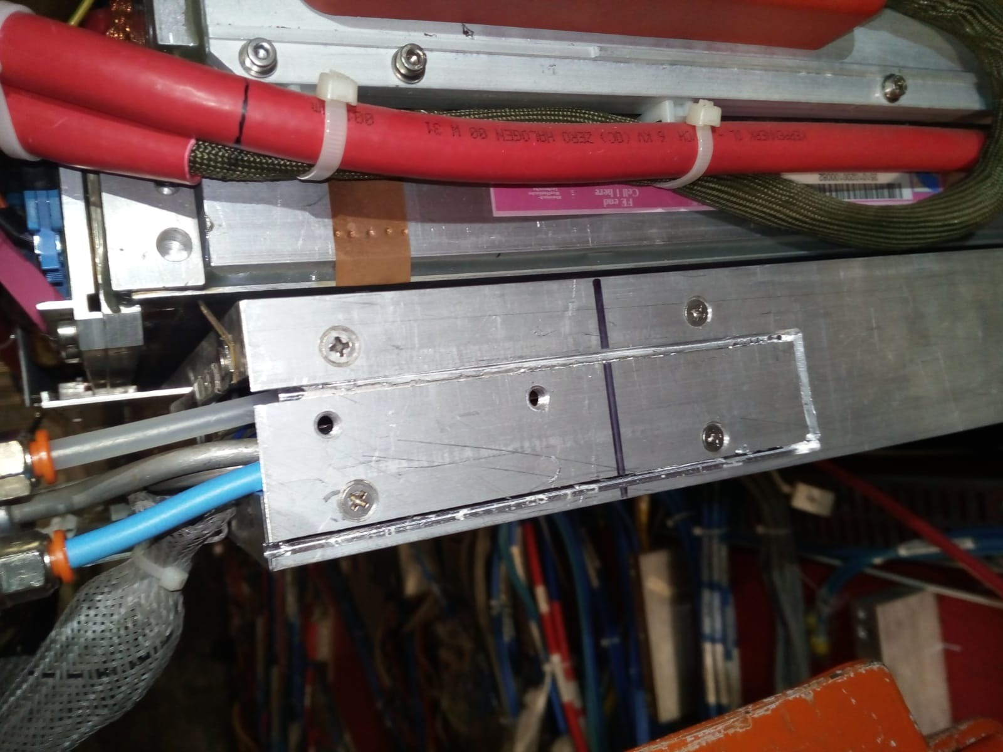
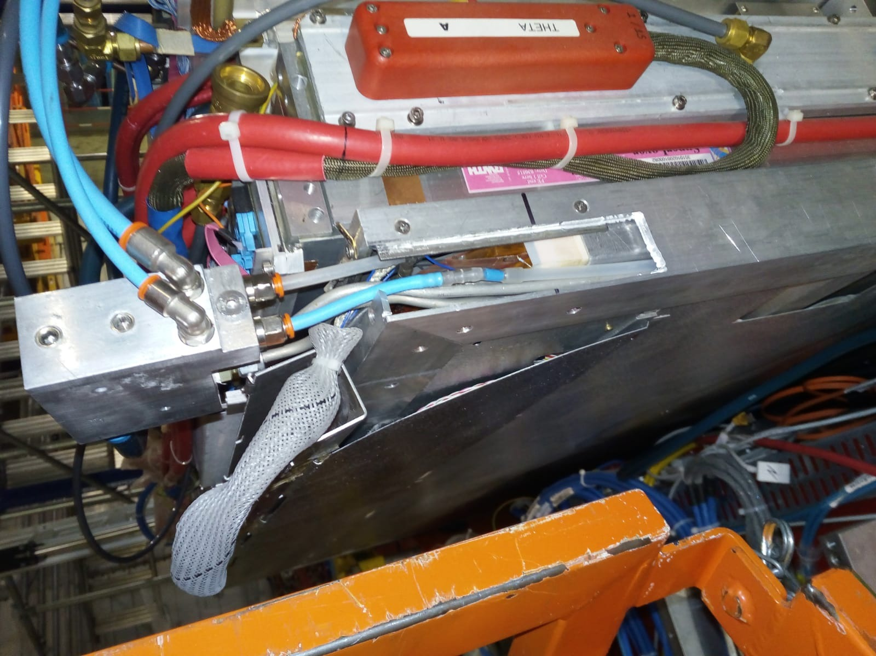
2019 Barrel Leak repair campaign (3)
New repair procedure developed consisting of partial extraction of the muon station (RPC and DT) for 80 cm from back or front side, then cutting the C illumining profile in order to have access to the broken component (gas pipes or T/L connector) and finally repairing/replacing the component.
Front extraction example:
Access and repair of the broken T component
W-1/Sect8/RB1 out leaking since Feb 2015

Slide 9
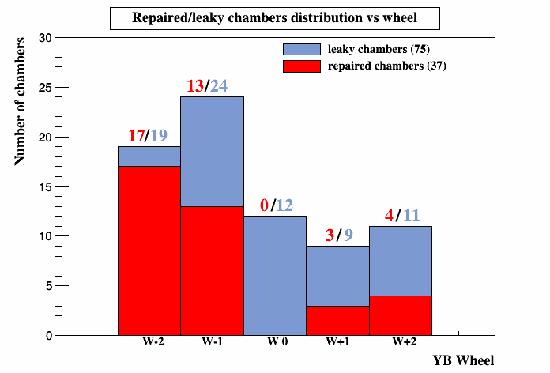
2019 Barrel Leak repair campaign: status and plan
    37 repaired chambers (49.3%)
    6 chambers could be repaired in Oct
    4 shorter chambers could be repaired by modifying the extractor (Chimney sectors)
    16 chambers can not be repaired with partial extraction because of:
          Located in W0 where no extraction from back is possible, 12 chambers
          The broken element is not reachable with partial extraction, 4 chambers
Summary of leak repairs:
REPAIRED | INSPECTED AND potentially REPAIRABLE | Leak not identified | NO reparation possible with partially extraction
49.3% | 13.3% | 16% | 21.3%
Six medium leaks are not included in the agreed list of repairs. These leaks will evolve soon in big leak, we request to include them. Going to be discussed with DT and at next TCO

Slide 10
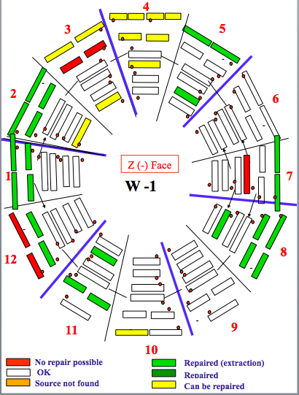
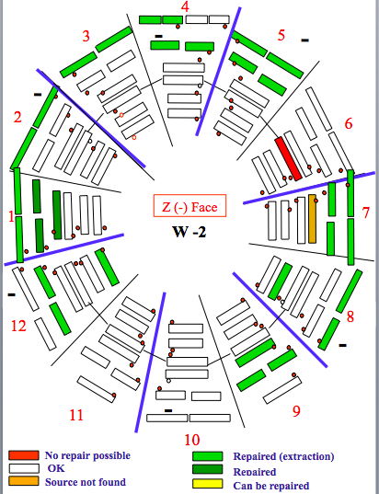
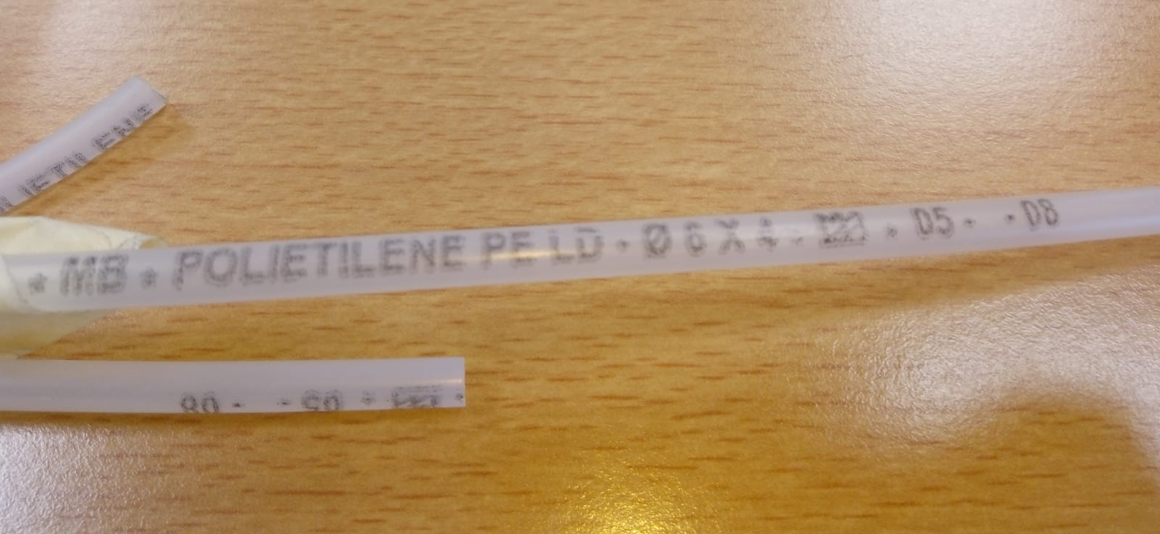

Preventing intervention (NEW)
One main cause of the leak is the deterioration of the Polyethylene LD pipes. In the Barrel chamber construction the gas pipes were purchased in Italy (in Swiss for Endcap).
During the endoscope inspection two batches of pipes identified and brittle pipes are all coming from the same batch.
Proposals for LS2:
Endoscope inspection of all chambers to localize the chambers with bad pipes. Estimated time ≈ 6chambers/day ≈ 66 days
Replace bad pipe in not-leaky RB4&RB3 by partial extraction of the chambers. In worst case:
  15 chambers on negative side ≈ 8 days
  37 chambers on positive side ≈ 19 days
  Intervention on RB1/RB2 could be planned for LS3
RPC IB recommends to implement all possible repairs and prevention interventions on the RPC system to slow down as much as possible the increase of leak rate and the development of new leaks which could put in serious risk the future of the RPC system (Sept 2019, IB meeting)

Slide 11
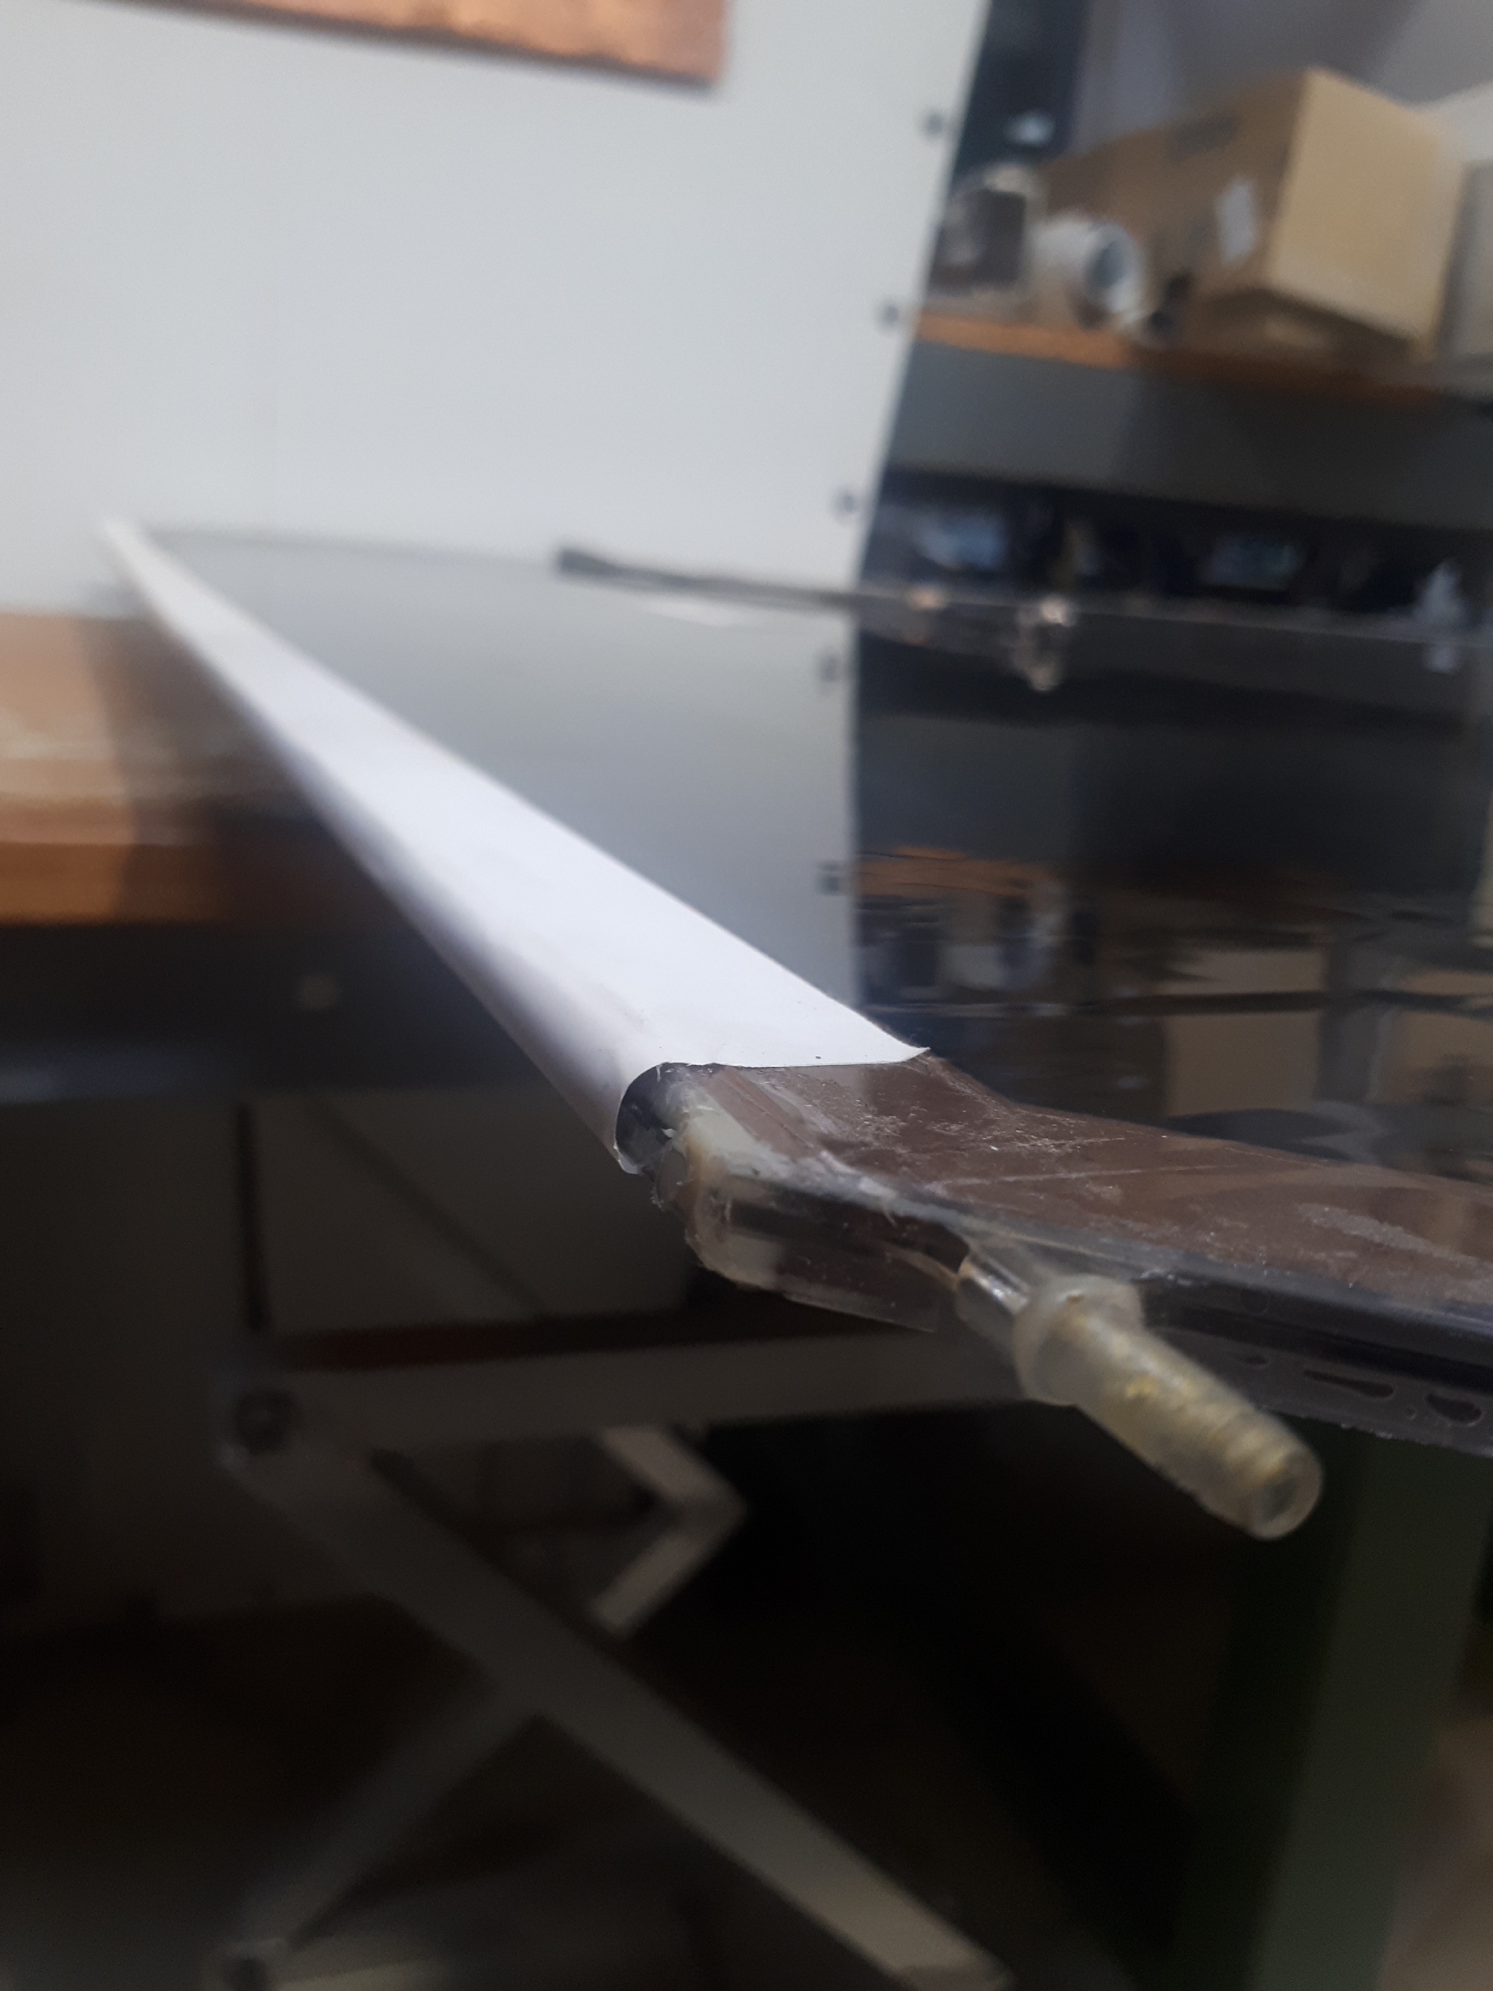
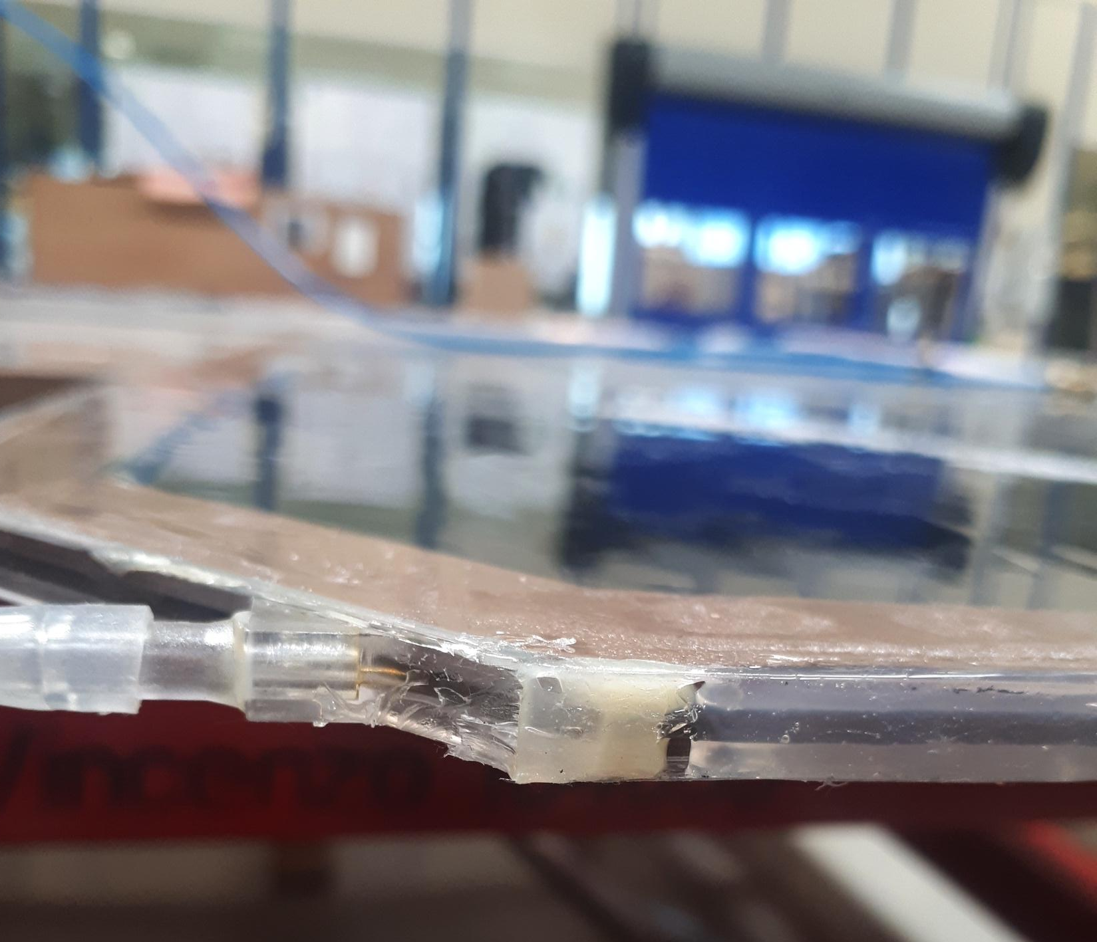
2019 Leak reduction campaign: Endcap
Endcap RPCs are ”easily” accessible when CMS is in opened configuration. It was decided to dismount all leaky chambers in order to reduce leak rate of ≈50-100 l/h.
Status:
5 have been replaced with spare chambers
3 will be extracted in Dec 2019
The extracted chambers have been inspected in the RPC 904 lab and source of leak has been identified in:
  Broken/cracked gas inlet
  Small crack in the gas-gap.
  Preliminary conclusion:
The leak is due to single points of failure with no
evidence of pipes or gas connectors deterioration

Slide 12
RPC Gas System consolidation

Slide 13
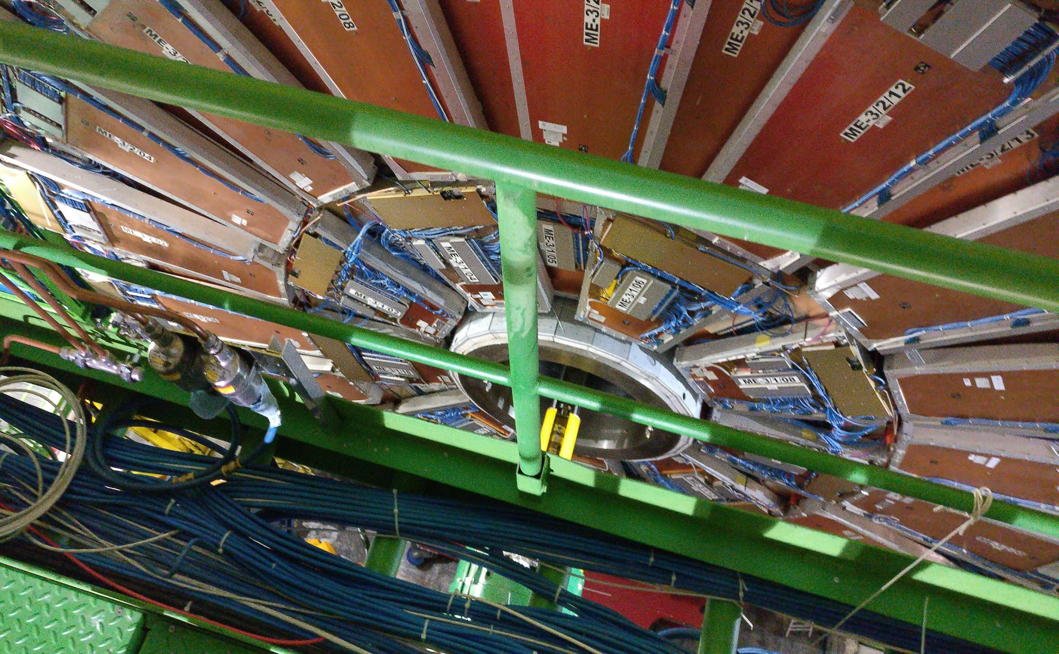
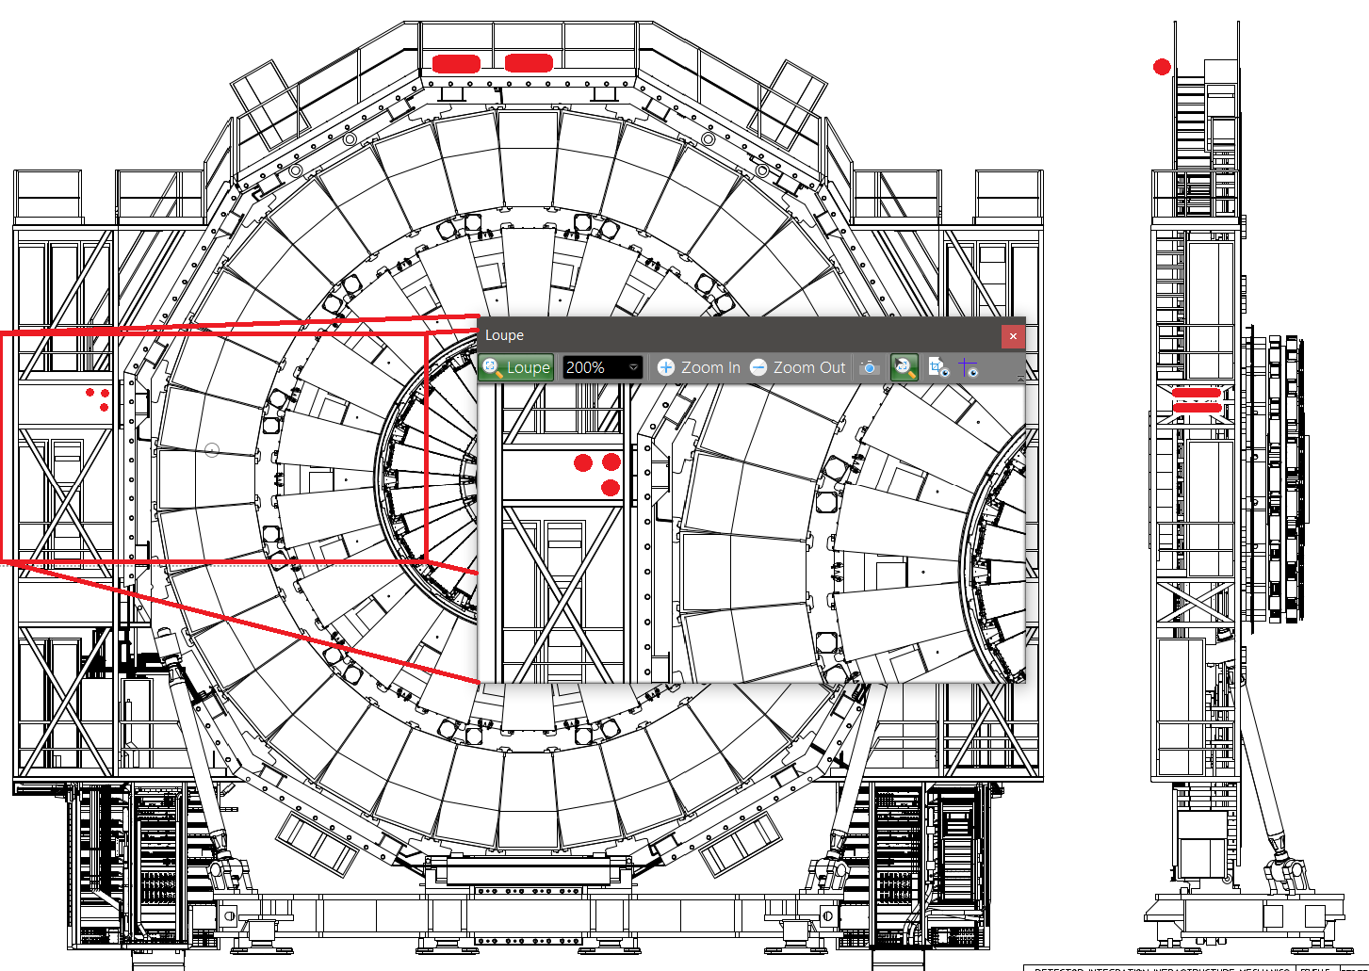
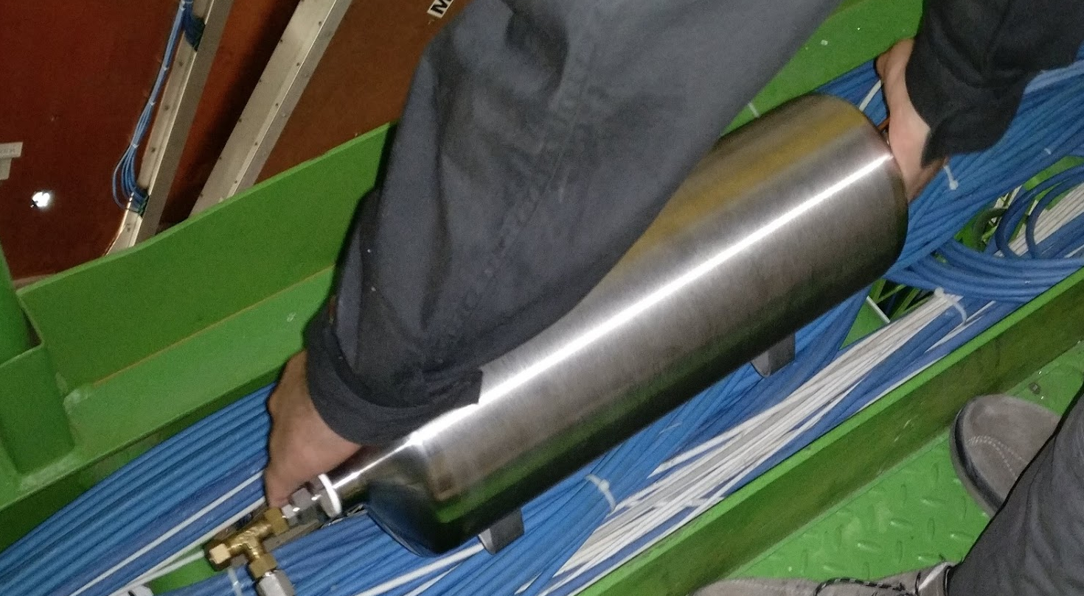
Gas system consolidation: stabilize leak rate
    Two modifications on the gas system planned to minimize pressure variations in the chambers and to stabilize leak rate:
      Pressure regulation valves. The manual return-manifold-rack-pressure-regulation valves will be replaced with automatic valves to reducing chamber pressure stress when gas refill procedure after YETS or LS and enhance protection against unexpected pressure differentials (magnet quench, fire, ..).
        A first prototype will be installed and tested in Nov. EP-DT group does not expect to have the valves ready before middle of 2020. This implies that we will refill the RPC with gas mixture in 2019 without the new valves.
      Dummy chambers. The pressure used to control the new automatic valve will be measured by using new dummy chambers instead of, as it is now, real chambers.
        Installation of cupper pipes, sensors and chambers just started on YE+3
YE+3

Slide 14
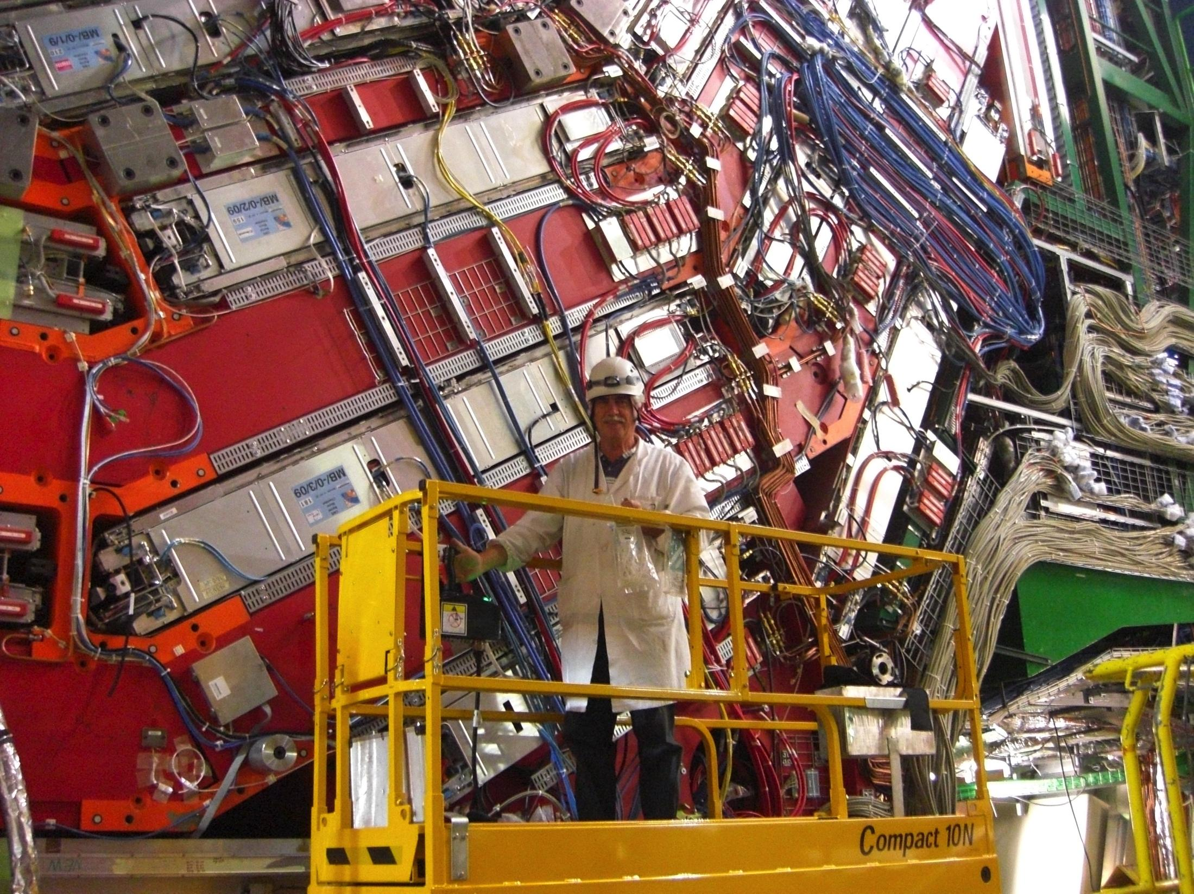
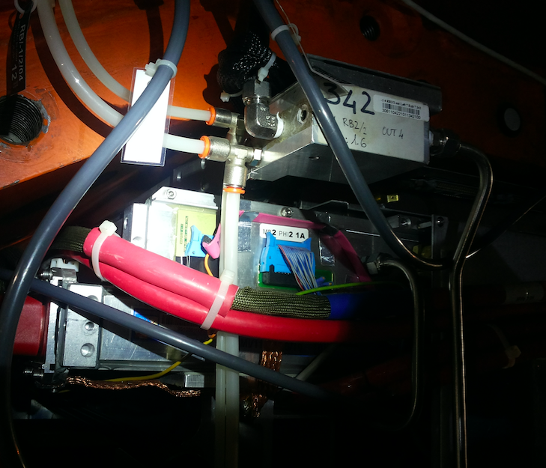
Gas system consolidation: improve chamber accessibility (NEW)
    A new gas layout distribution is proposed in order to reduce the impact on system performance when disconnecting leaky chambers.
    Motivation: two barrel chambers are connected in parallel to one gas channel, near to the service box, accessible only when CMS is opened.
    Proposal: Move the parallel gas connection of the two chambers to the periphery, always accessible, allowing to disconnect ONLY the leaky chamber at any time
    Cost, integration and installation of additional copper pipes have to be defined with CMS-TC and TCO.
Gas out
Gas IN
RB1/2 in
RB1/2 out
Gas out
Gas IN
RB3/4+
RB3/4 -

Slide 15
Expected emission in RUN3

Slide 16
Expected emission in RUN3
RUN3
C₂H₂F₄+iC₄H₁₀+SF₆ 95.2+4.5+0.3%
If not recuperation system available, even with gas flow from exhaust re-established (≈800 l/h leak & ≈300 l/h from the exhaust)
+10% of emission and cost** for the needed gas flow increase
total flow ~11000 l/h
If recuperation system available, 3 options are possible depending on chamber turn-off strategy:
Option 1: ALL* leaky chambers ON
≈800 l/h of leak & ≈300 l/h from the exhaust
-23% of Emission and cost**
Option 2: OFF HALF leaky chambers OFF selecting the one with less impact on the trigger efficiency
≈500 l/h of leak & ≈600 l/h from the exhaust
-45% of Emission and cost**
Option 3: Turn OFF all leaky chambers
≈100 l/h of leak & ≈1000 l/h from the exhaust
-73% of Emission and cost**
Closed loop Replenishing rate ~10% (1100 l/h)
Leak rate
Op1 ~800 l/h
Op2 ~500 l/h
Op3 ~100 l/h
Exhaust:
Op1 ~300 l/h
Op2 ~600 l/h
Op3 ~1000 l/
Recuperation system
*60% of leaky chambers repaired 3 new LEAKY chambers/year (if preventing actions taken).
** Compared to 2016 emission

Slide 17
C2H2F4 Recuperation system

Slide 18
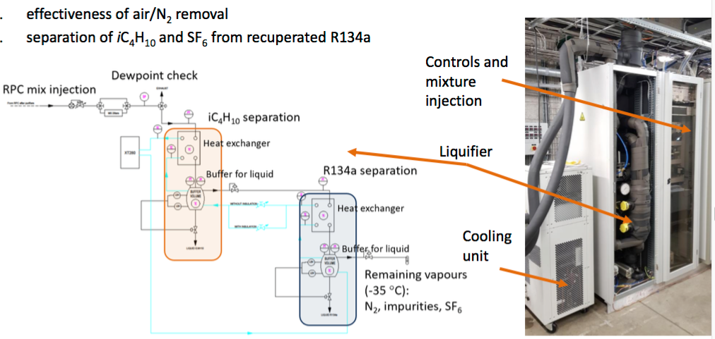
C₂H₂F₄ recuperation system: Status & Plan
CERN EP-DT Gas team is currently carrying out an R&D to develop the first C2H2F4 recuperation system.
Prototype0 was successfully tested in ATLAS-RPC in 2018:
  recuperation efficiency about 100 %
  air/N2 removed to same level of new R134a
  recuperated R134a does not contain iC4H10 or SF6
Working on:
Build and test compressor module for storage/reuse
Prototype0 will be installed in CMS by Oct 2019 and tested from middle Nov
Final system: EP-DT group plans to build it in 2021 for all LHC experiments. Budget and plan for CMS to be discussed (CMS-TC and EP-DT).
RPC group strongly recommends to agree (NOW) on the installation of first available recuperation system in CMS
R. Guida – B. Mandelli CERN EP-DT

Slide 19
Abatement system

Slide 20
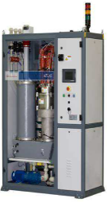
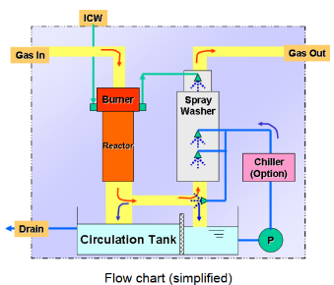
Abatement system..
Specifications for an abatements system for ~ 30l/h (CF₄) & ~900l/h (R134a+SF₆) finalized
Two companies EDWARDS (UK) and EBARA (Japan) proposed solutions based on the same technology: thermal (800-1800 ºC) PFC decomposition followed by wet scrubbing
      Required infrastructures defined: O₂, N₂ dewars, propane tank or natural gas supply, pump for exhaust (contains CO₂+water vapor + traces of HF)
Costs defined:
  Unit cost including installation and commissioning ~ 130 kChf
  Maintenance ~2 – 10 kCHF/year and running cost: 8.5 – 15.5 kCHF/month, almost entirely for gases. Lower after implementing RPC recuperation system
Expected performance: ~930 l/h GHG in input are reduced to 93 l/h GHG emission in CMS, or 97kg/day are reduced to ~9kg/day
187cm
130cm
Edwards ATLAS Etch system
Implications: system produces ~15m³/day waste water, from the CF₄ and C₂H₂F₄ combustion process, containing 0.4% HF concentration by volume, that is ~55 l/day of HF. The pH of the solution is ~2. Being highly acidic & toxic, the waste water cannot be discharged directly into local watercourses or in the local sewage system and can only be:
  sent for treatment
  treated & released in situ.

Slide 21
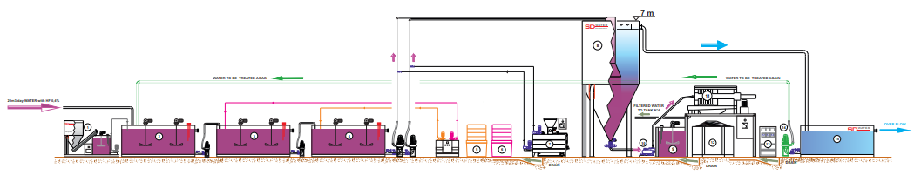

..and water treatment plant
A water treatment plant solution studied:
3 companies were contacted, but discussed in details with only one of them (Sd Water Management https://www.sdwm.it/). The Sd company has already an operational systems at P5 to purify muddy water.
The system is complex and It would require a rather sizeable footprint (~100 m²)
Preliminary cost for plant, installation and commissioning ranges between ~130 kChf (Sd) and ~500 kChf (EnviroChemie)
A technical Evaluation Report on
Reduction of Greenhouse Gas Emissions and Consumption at the CMS Experiment has been prepared and released in occasion of the CERN Workshop on ‘Management and optimization of the use of fluorinated gases by the LHC Experiments’ (26th February),
It is now up to CMS–TC to decide if continue with the next steps (engineering design and final specifications) towards the goal of total GHG emission reduction.
RPC group strongly recommends to continue with abatement solution

Slide 22
R&D on eco-gas mixture

Slide 23
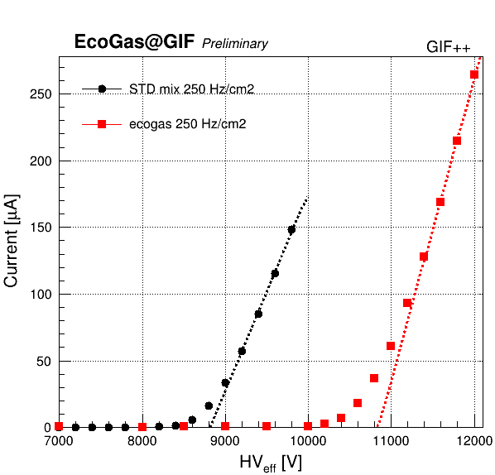
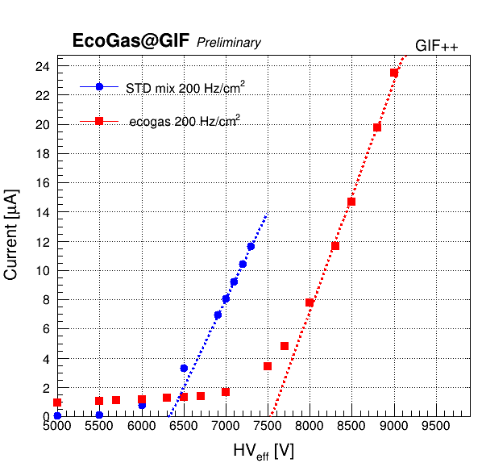
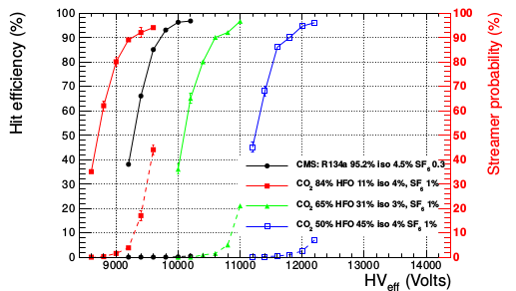
RPC Eco-gas mixture test @ GIF++
An R&D program on a new ecological RPC gas mixture started @ GIF++ in April 2019.
Five RPCs (2 CMS, 1 ATLAS, 1 ALICE, 1 EP-DT) are under test.
One eco-gas mixture based on HFO 1234ze (C₃H₂F₄) studied so far: 45%HFO, 50%CO₂, 1SF₆, 4%C₄H₁₀
Preliminary results on Working point:
2 kV of HV shifts @ 250 Hz/cm2 between the eco-gas and CMS mixture measured in agreement with TDR results done with cosmic muons.
1.2 kV of HV shifts @ 200 Hz/cm2 between the eco-gas and CMS mixture measured

Slide 24
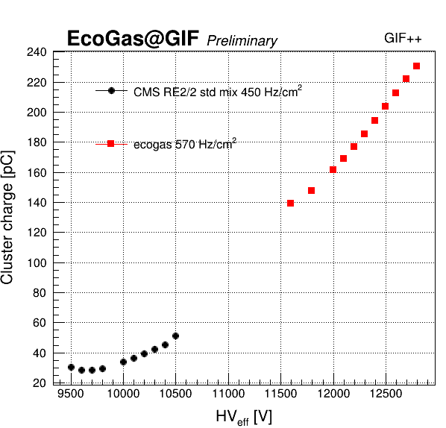
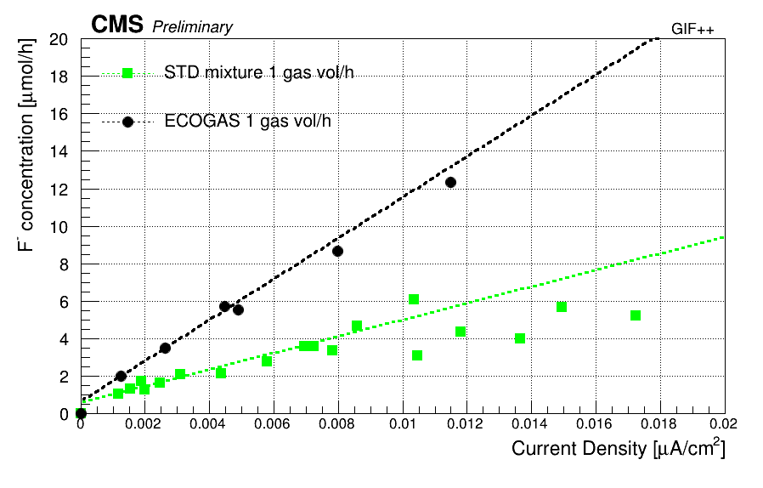
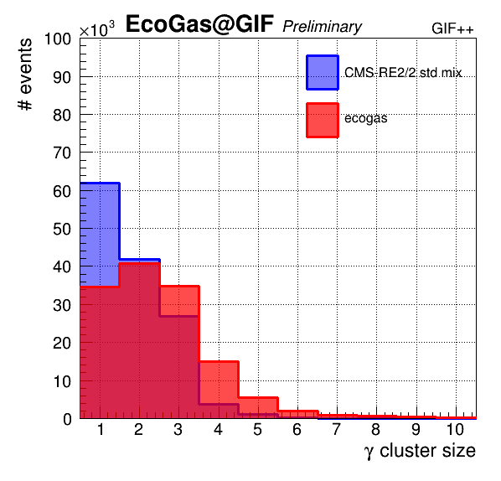
RPC Eco-gas mixture test @ GIF++ (2)
Preliminary results on performance:
Average Cluster size at WP: 2.6 strips for eco-gas and 1.9 strips for CMS
Average charge: ≈25-30 pC and ≈ 150 pC
F concentration: factor 2.5 higher with eco-gas
Plan:
Fine tune of gas composition (higher % C₄H₁₀ .. etc..)
Detector performance stability under irradiation
This is an R&D with a lot of uncertainties.
The probability to have a new eco-gas mixture before RUN5 is quite low.

Slide 25
GHG pre-purchase

Slide 26
Warning on GHG from Austin
From Austin’s report @ Sept 2019 CMSWEEK
CERN Environment Protection team has made us aware of the following:
Anticipated 5 fold increase in cost for some GHG is imminent (EU legislation) although at the moment it is left up to companies exactly when to comply.
French authorities refused a CEA request for exemption from GHG restrictions
Swiss authorities drew attention to CERN acting as a conduit for transfer of GHG from Switzerland to France
C₂H₂F₄ (R134a) is particularly vulnerable to cost increase and supply failure as industry already has an alternative in production (HFO based). CF₄ less so, as no alternative currently exists.
TC has proposed a target objective of maintaining the whole RPC system in a usefully operational state until LS4 (i.e. RUN3 and RUN4). After that, an upgrade of gas mix or detector or both is inevitable.
RRB Scrutiny group agreed to recommend additional expenditure of 0.6M CHF in 2020

Slide 27
C2H2F4 pre-purchase for cost containment
The RPC group considers:
Reasonable to pre-purchase C2H2F4 for next 7 years (results from eco-gas R&D on are not expected before)
Mandatory to have the recuperation system to reduce gas cost and the quantity of stocked gas. Already in RUN3, without recuperation system will be critical to run the RPC system without effecting the detector stability (i.e the increase of current due to not enough gas flow). No way for RUN4
Unavailable to disconnect all/part of leaky chambers for cost/emission reduction.
Quantity and cost for next 7 years have been estimated:
due to an imminent increase of gas cost we consider urgent to pre-purchase a quantity of gas for ≈1MCHF (option 3 with some margin). Next year could be already too late.
Options | RUN3 |  | RUN4 |  | TOTAL (7 years)
 | cost (MCHF) | Ton | cost (MCHF) | Ton | cost (MCHF) | Ton
1 (all leaky on) → 23% remission reduction | 0.6 | 88 | 0.8 kCHF | 112 | 1.7 M | 230
2 (50% of leaks off) → 45% remission reduction | 0.5 | 63 | 0.6 kCHF | 88 | 1.3 M | 170
3 (all leaks off) → 73% remission reduction | 0.2 | 30 | 0.3 kCHF | 41 | 0.6 M | 85
No rec. | 0.7 | 102
  Note:
  RUN3 increase of 10% the total flow and recuperation with 80% of efficiency
  RUN4: increase of total flow of 30% and recuperation with 80% of efficiency

Slide 28
Conclusions
Status of the CMS strategy for reducing GHGs cost and emissions:
  Repairs: repaired 49% of leaky chambers. We should be able to re-establish the flow rate to the exhaust in RUN3. However, RPC community is proposing a new prevention campaign on not-leaky chambers (to slow down the increase of leak rate) and an improvement of the gas distribution (to reduce the impact of the disconnection of leaky chambers on the detector/physics performance). Up to Muon Community and CMS to approve or not it.
  Gas recuperation system R&D is progressing, but still in R&D phase. If not recuperation available, emission and cost will increase of 10% in RUN3 putting in serious risks the RPC operation. If recuperation will be installed, depending by number of disconnected chambers a reduction in emission and cost between 20 and 70% is expected.
  Abatements and water treatment systems technical document produced. Muon group should push CMS to continue to support it.
  R&D on eco-gas is ongoing in order to validate detector operation, qualify performance and establish longevity.
  Cost of C2H2F4 pre-purchase & stockpile for next 7 years is evaluated. Muon strategy to be be approved urgently and propagated to CMS.

Slide 29
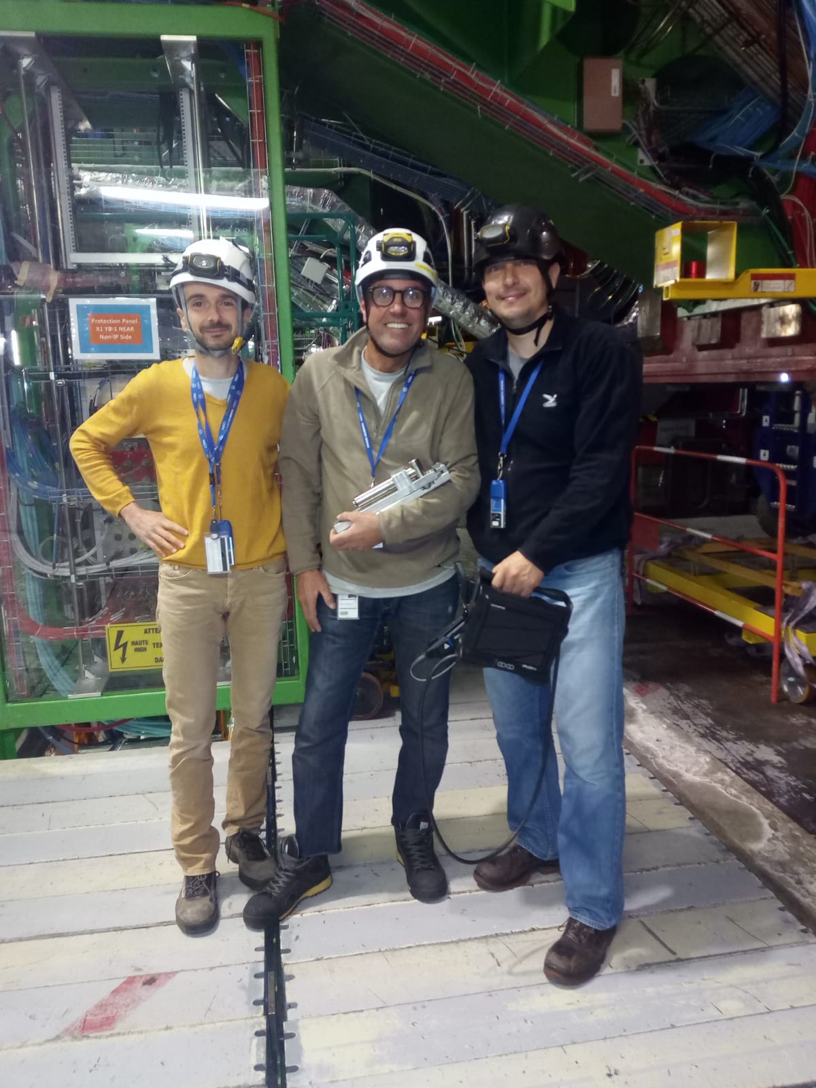
Great muon team!
Thanks to the teams involved in the RPC leak repairs from DT and RPC community!
A particular thanks to:
Daniele Fasanella, Mimmo Dattola, Massimo Benettoni, Vittorio Cafaro, Vincenzo Giordano, Aleksandar Aleksandrov, Jan Eysermans. Filippo Vercellati, Samuel Gigli, Jorge Flores
Muon system is investing a lot of manpower, time and money in the project of GHG emission reduction but we must continue to do our part to complete us.

Slide 30
SPARE

Slide 31
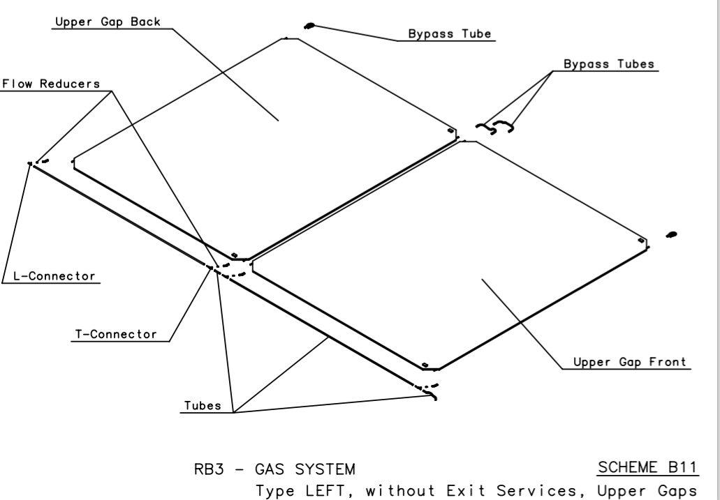
RB3 and RB4 gas distribution
Aluminum bar
C profile
RB3 and RB4 stations consist of two twin chambers.
The gas distribution between the two chambers is connected in series:
From one chamber (the one with the service, fig.left), the polyetilene pipe crosses the chamber inside an aluminum bar (in green in figure). Then the gas pipe goes in the C profile (in blue) and finally it is connected to the other chamber (the one without service, fig. right)

Slide 32
CERN long term objectives
CERN HSE is concerned with negative environmental impact of GreenHouse Gases (GHG) used in several LHC Muon gaseous systems. In Run 2, CMS is responsible for ~40% GHG emissions of all LHC experiments
CERN should become a model for an environment-aware scientific research laboratory.
  Annual limits established for the use of fluorinated gases in the LHC detectors: reduce emissions to 70% of the 2016 levels in Run 3 and 30% in Run 5 (DG report 16 January 2018)
EU regulation in environmental safety policy may lead to further restrictions or banning on the use of GHGs. As a consequence, procurement may become problematic and costs could increase substantially

Slide 33
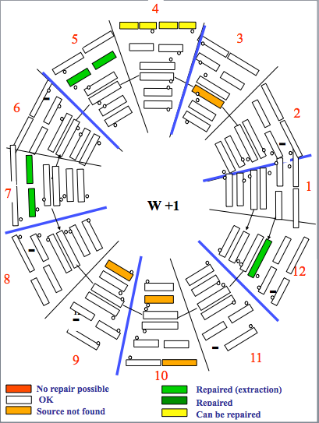
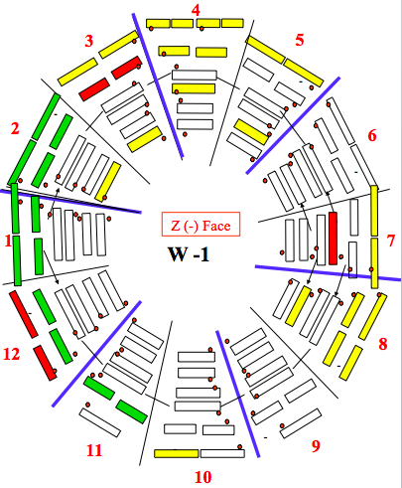
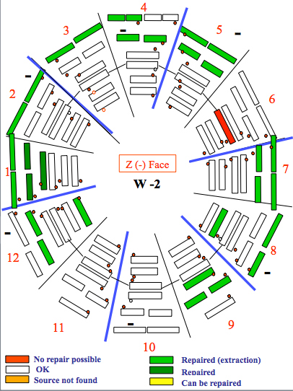
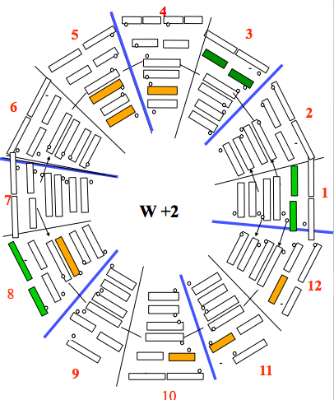
Prevention intervention

Slide 34
Concern : Greenhouse gases
CMS committed to CERN target of 30% reduction in GHG emissions by end LS3.
Long term effectiveness of RPC repair programme to be seen (leak reduction by up to ~ 50% likely)
Recuperation systems recover >90% of C₂H₂F_{4.} from exhaust gas, providing there is some.
(First tests at CMS in Nov 19)
Need gas supply for ~ 7 years:
Propose making provision to secure this now (2020 M & O A budget)
The budget and the use made of it depend on the strategy chosen & the leak-repair-success.
repair programme only 1-2 M CHF. (including 6 storage dewars)
(amortise over 22-30 M&O A budget?)
+ isolating leaky chambers (preparations in LS2 to separate parallel chambers externally)
Aim: 80% return + express deployment of recuperation: 0.6 M CHF (incl 1 storage dewar)
obviously intermediate solutions exist
Proposing any large M & O over-cost may well kill the prospects for funding the new control room.
Nevertheless, RRB Scrutiny group agreed to recommend additional expenditure of 0.6M CHF in 2020.

Slide 35
GHG cost increase
From CMSWEEK Austin’s report
CERN Environment Protection team has made us aware of the following:
Anticipated 5 fold increase in cost for some GHG is imminent (EU legislation) although at the moment it is left up to companies exactly when to comply.
French authorities refused a CEA request for exemption from GHG restrictions
Swiss authorities drew attention to CERN acting as a conduit for transfer of GHG from Switzerland to France
C₂H₂F₄ (R134a) is particularly vulnerable to cost increase and supply failure as industry already has an alternative in production (HFO based). CF₄ less so, as no alternative currently exists.
TC has proposed a target objective of maintaining the whole RPC system in a usefully operational state until LS4 (i.e. RUN3 and RUN4). After that, an upgrade of gas mix or detector or both is inevitable.

