Slide 1
Gas leak repairs in the endcaps (update)
Aleksandar Aleksandrov
RPC TCM meeting,
20/03/2017, CERN, Meyrin

Slide 2
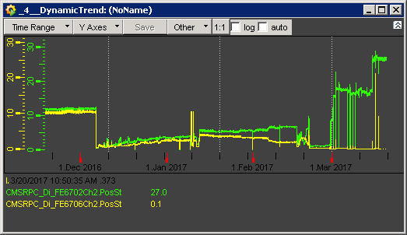
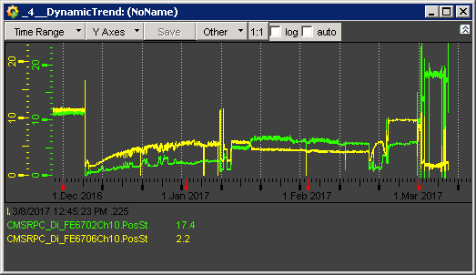
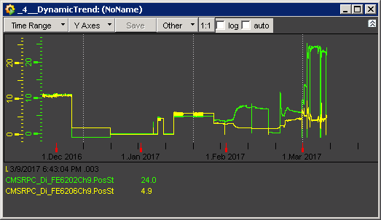
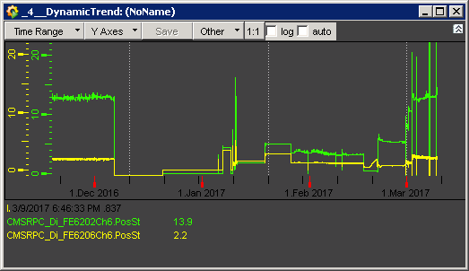
List of leaks in RE minus
RE-3/S04-S06/Top
RE-3/S16-S18/Bottom
RE-2/S33-S35/Bottom
RE-2/S27-S29/Top (old)
Gap between YEN2 and YEN3
NEAR and FAR side
Gap between YEN1 and YEN2
NEAR and BOTTOM
RE-3/S04 – S06/Top,
Started developing on 26/01/17, 20:20,
and major breaking on 06/02/, 4:07
RE-3/S16 – S18/Bottom,
leaking since 17/01/17, 4:43
RE-2/S33 – S35/Bottom,
leaking since 03/02/17, 14:55
RE-2/S27 – S29/Top,
leaking before 2014

Slide 3
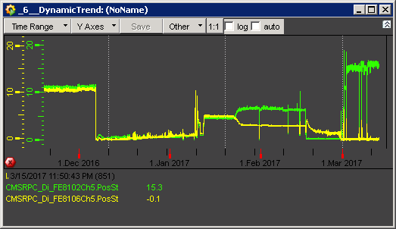
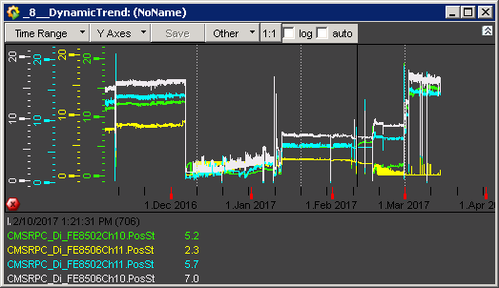
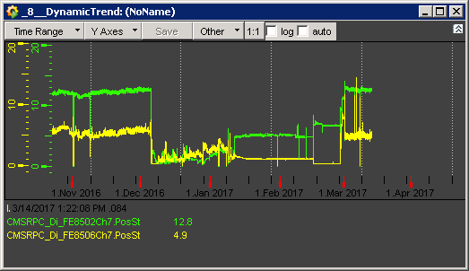
List of leaks in RE plus
RE+3/S10 – S12/Top
RE+3/S01 – S03/Top (old)
RE+3/S31 – S33/Top (old)
Gap between YEN2 and YEN3
TOP/FAR and NEAR side
RE+3/S10 – S12/Top,
leaking since 23/01/17, 6:40
RE+3/S01 – S03/Top,
leaking before 2014 and an increase of leak rate on 11/02/17, 4:28
RE+3/S31 – S33/Top,
leaking before 2014

Slide 4
Leak repair proposal
Gas leak measurement with the Ar leak box of the copper pipe line (from the rack to the chamber PP, chambers disconnected) . Polyethylene pipe extension connected between PP supply and PP return – 10 mins.
Connect back the PP supply to the S1/R3 chamber.
Connect polyethylene extension (4 – 5 m long) at the PP return and S1/R2 chamber return.
Gas leak measurement of the connected sector to identify the leak – 20 mins.
If no leak continue probing by adding a new sector. Restore connection of S1/R2 and connect the extension to S2/R3.
Gas leak measurement of the connected sectors to identify the leak – 20 mins.
If leak is found open the PP of S2. Connect the extension to S2/R2. If no leak then the leak is in S2/R3. In case of leak then the leak is in S2/R2.
Visual inspection of the polyethylene bypass pipe. In case the pipe is OK check with endoscope inside the chamber/below the cover close to the inlets if possible. Unscrewing few screws (4 – 5, tested at 904) on top of the honeycomb will allow to see inside by eye/endoscope the inlets (only if chamber is OFF yoke).
Repair if possible – 30 mins.
In case the bypass pipe is not OK, replace the pipe – 10 mins.
Restore the connections and put the small cover back – 20 mins.
Work estimated time for 1 gas channel – 3 hours.
The leaky channel positions allow simultaneous work of two teams of two people each and one staying close to the gas rack to do the measurements.
Manpower: 5 people in case of two teams and 3 people in case of one team.

Slide 5
Endcap RE2, 3 gas channel schematic
Chamber PP
Supply (S)
Copper pipe
S
R
Gas Rack
Return (R)
R3 chamber
Legris brass unions
Polyethylene pipe
R2 chamber

Slide 6
RE+3/S10 – S12/Top

Slide 7
RE+3/S01 – S03/Top

Slide 8
RE+3/S31 – S33/Top

