Slide 1
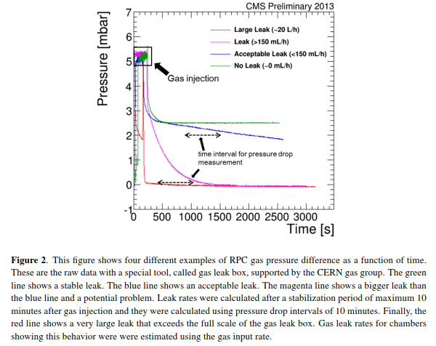
https://biblio.ugent.be/publication/6832173/file/6833574.pdf

Slide 2
