Slide 1
Gas leak repairs in the endcaps
Aleksandar Aleksandrov
RPC TCM meeting,
13/03/2017, CERN, Meyrin

Slide 2
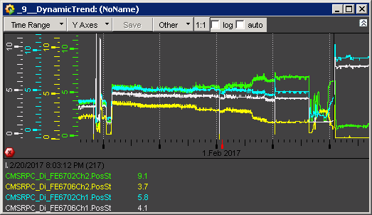
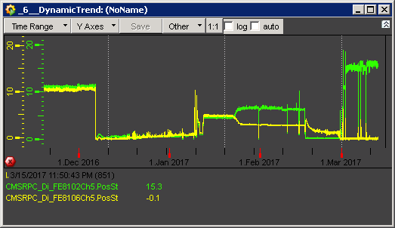
List of all leaks in the endcap
Leaking chambers in RE minus:
RE-3/S04-S06/Top
RE-3/S16-S18/Bottom
RE-2/S33-S35/Bottom
RE-2/S27-S29/Top (old)
Gap between YEN2 and YEN3
NEAR and FAR side
Gap between YEN1 and YEN2
NEAR and BOTTOM
Leaking chambers in RE plus:
RE+3/S10 – S12/Top
RE+3/S01 – S03/Top (old)
RE+3/S31 – S33/Top (old)
Gap between YEN2 and YEN3
TOP/FAR and NEAR side

Slide 3
Leak repair proposal
Leak search and repair:
Remove the small covers of the three sectors – 20 mins
Gas leak measurement of the copper pipe (chambers disconnected) – 10 mins
Gas leak measurement of each gap to identify the leak – 15 mins per gap or 1 hour 30 mins.
Check with endoscope the leaking gap (the two inlets) and try to repair – 30 mins.
Put the small covers back – 20 mins.
Work estimated time for 1 gas channel – 3 hours.
If the big chamber covers need to be removed in order to access the inlets additional time will be needed – 3 hours.
  Removing the bid cover requires uncabling and cabling after the cover is in place – 2 hours.
  Fix the leak if the leak is near the inlet (worst possible scenario) – 1 hour.
  We need to test the procedure on an old RE3 chamber at 904 to see whether fixing the leak is possible.
Work estimated time for 1 gas channel: 3 + 3 hours.
Manpower: two people needed.

