Slide 1
Gas bottle reaction hazard
Ian
09 04 2019

Slide 2
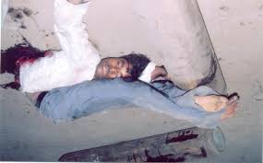

Slide 3
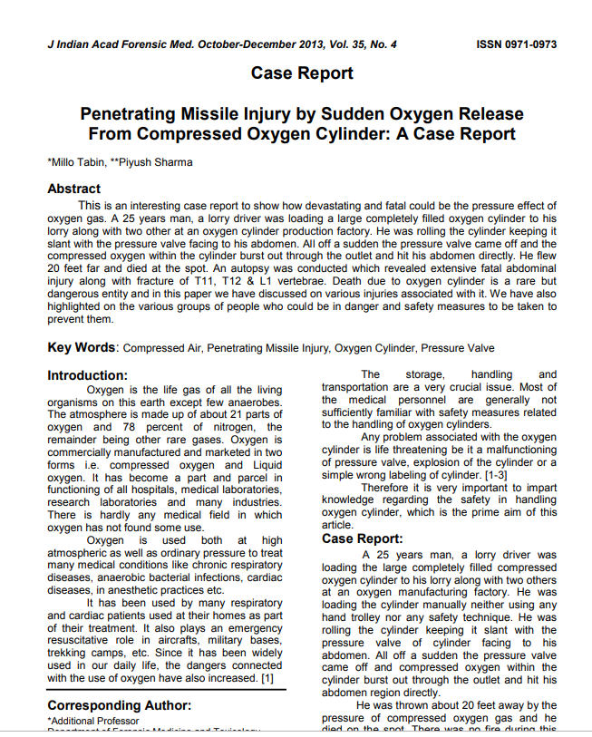
http://medind.nic.in/jal/t13/i4/jalt13i4p392.pdf

Slide 4
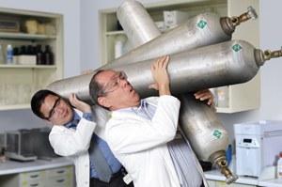
Good advice
https://www.youtube.com/watch?v=2oXoP2_R8Us
No they are NOT toys

