Slide 1
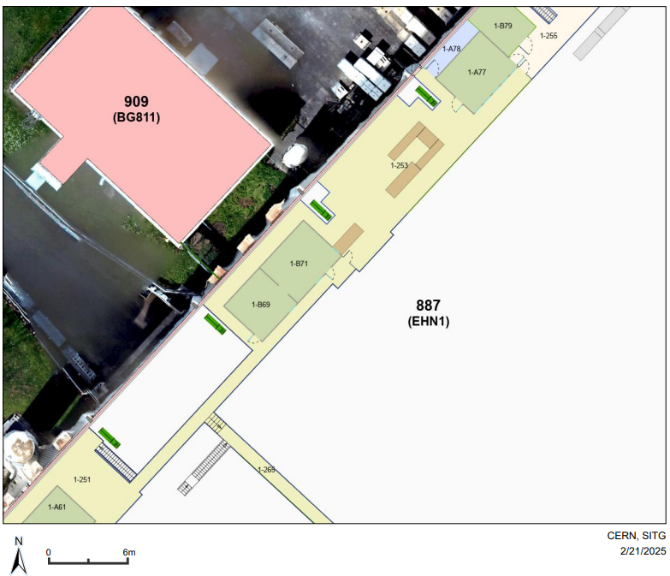
Emplacemt des 2 racks
887-1-253
Between 887-1-B71 and 887-1A77
\

Slide 2
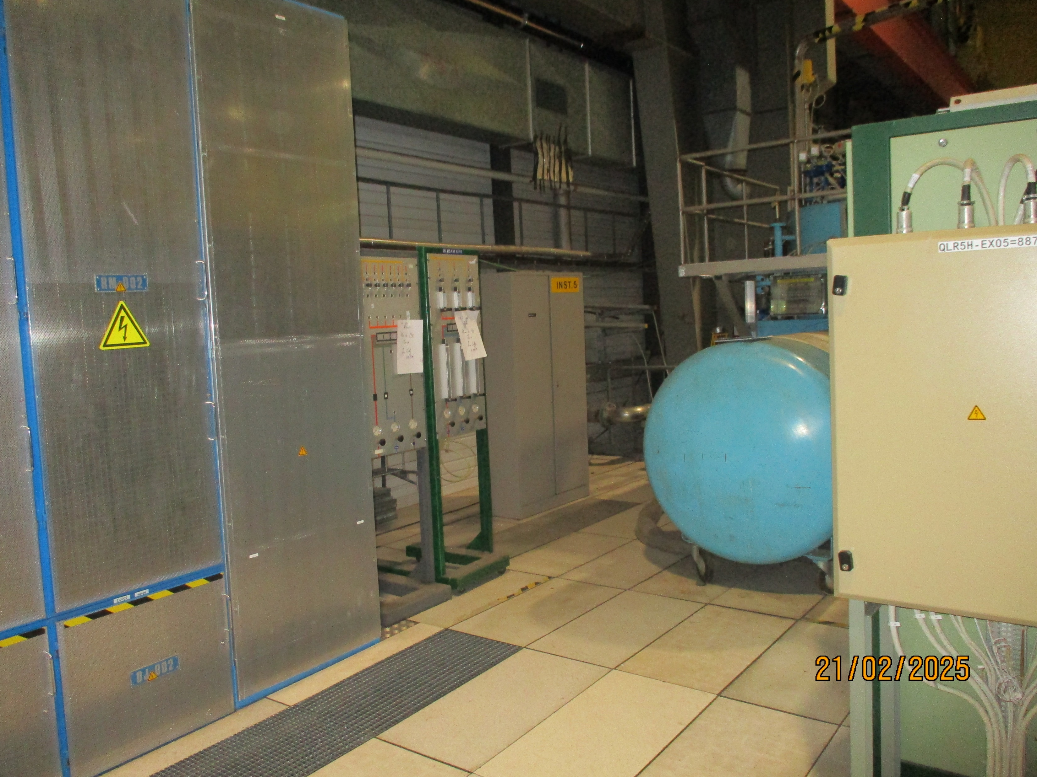

Slide 3
