Slide 1
Gas abatement RPCs
Ian
25 May 2018

Slide 2
Gases to recover
R134a, isoButane and SF6, proportions 94.7, 5.0 ,0.3 [%]
1.5 – 3.0 tonnes /month

Slide 3
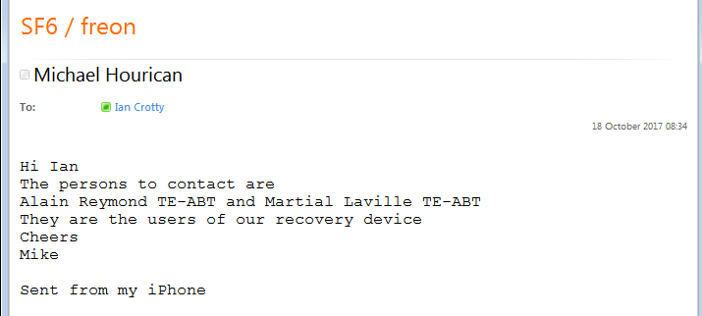
Contact from Michael Hourican
TE-ABT-KSC 865/2-A04 Alain.Remond@cern.ch 162993
Martial Laville TE-ABT TE-ABT-KSC 865/2-A04 Martial.Laville@cern.ch 163698
Met with Martial on 1 June 2018. showed me the machine. See photos. Dilos Oiless SF6 Model MPC-02. Machine USA ?.
Gas taken to Inventec at Lyon. The gas appears to be compressed at < 16Bar but is liquid as the max weight of the bottled gas is 32kg. Specific bottles with ss valves. Recovers gas from cables (~100m) with 9-12kg ! Is that pressure or weight ?
Gave name of his boss/deals with the gas recovery.
TE-ABT-EDS 865/2-B05 72543 164910 Remy.Noulibos@cern.ch Z06600

Slide 4
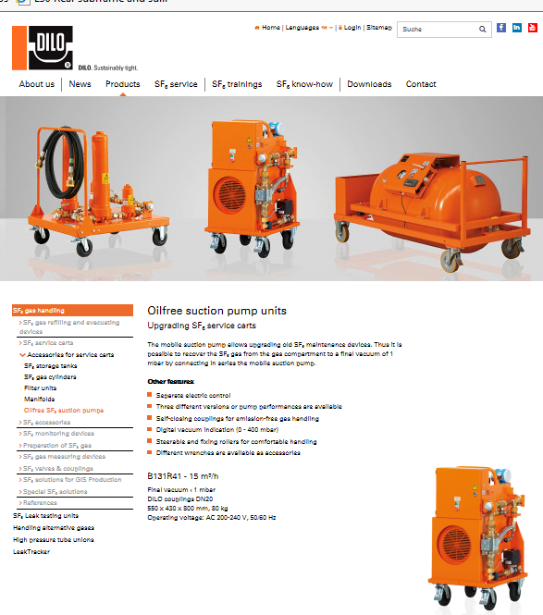
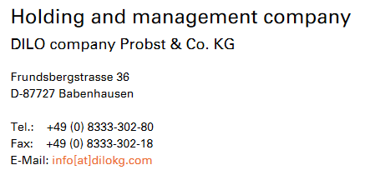
https://www.dilo-gmbh.com/en/products/sf6-gas-handling/accessories-for-service-carts/oilfree-sf6-suction-pumps.html
https://www.dilo.com/recovery-systems/sf6-mobile-substation/
DILO Company, Inc
11642 Pyramid Dr. Odessa, FL 33556
Ph: 727-376-5593
Fax: 866-281-1119

Slide 5
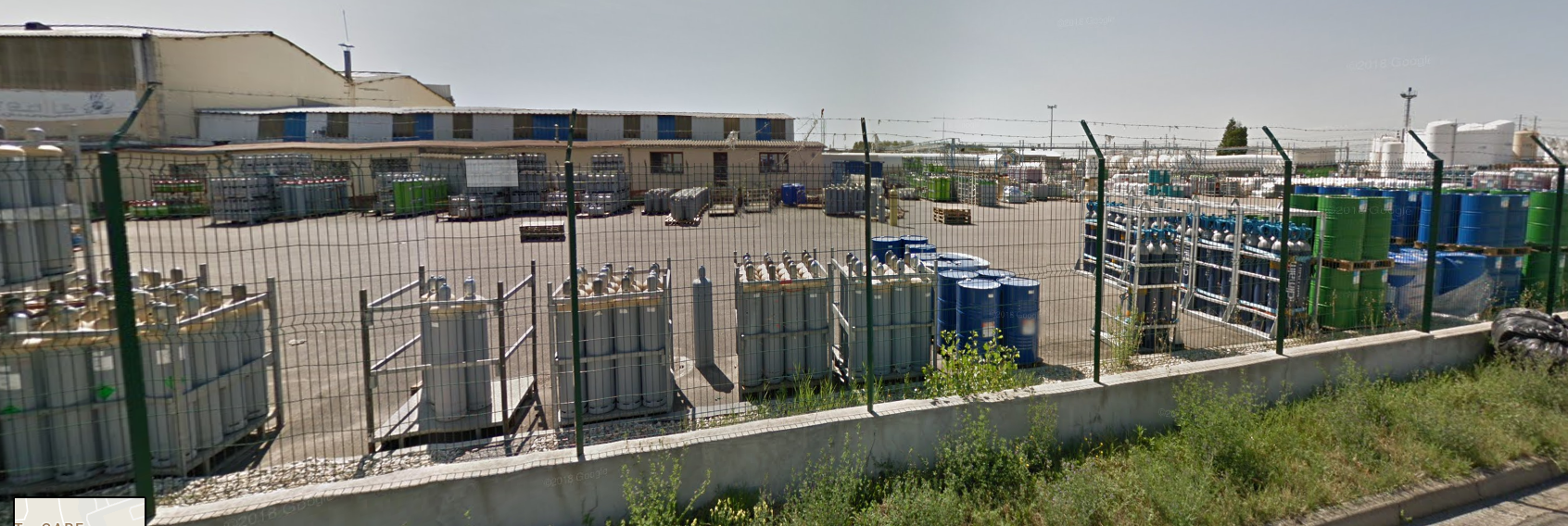
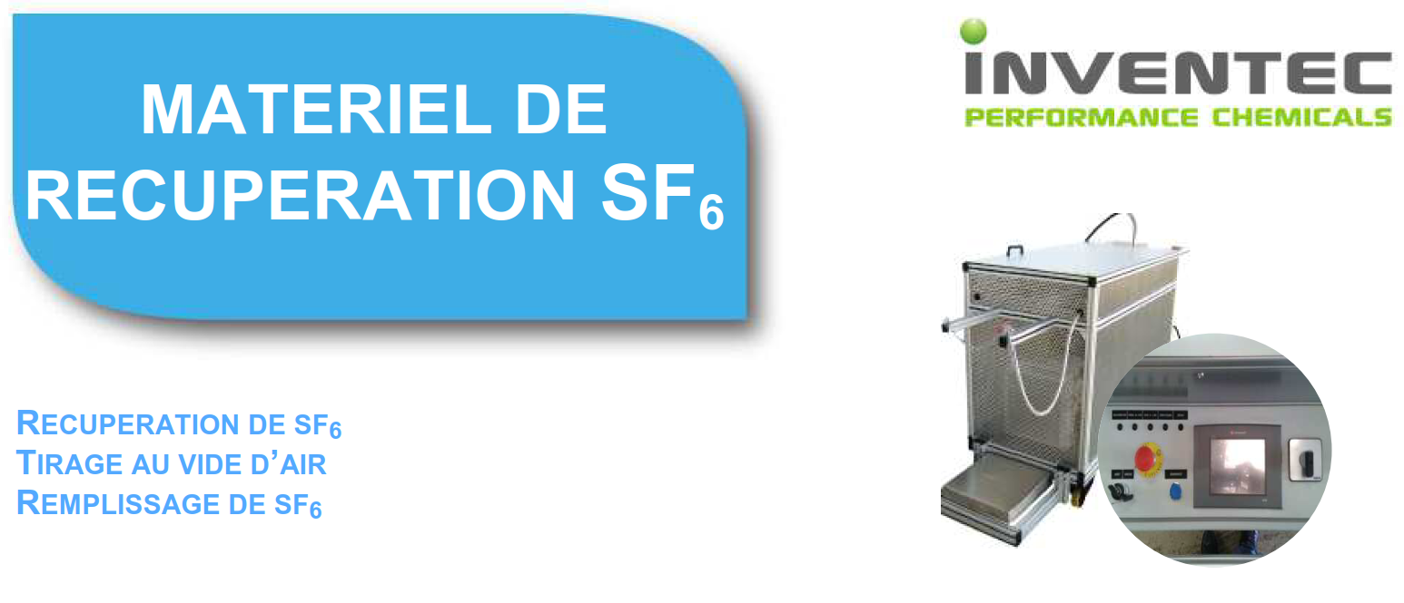
INVENTEC PERFORMANCE CHEMICALS
20 RUE DE BOURGOGNE
69800 SAINT PRIEST
France
Tél : 0472281300
contact-web@inventec.dehon.com
Names of directors
http://fr.viadeo.com/fr/search/rcl/fr/INVENTEC+Performance+Chemicals/fr/
Recuperation de SF6
http://www.inventec.dehon.com/documents/pdf/35748264ee31608cd8ea5ca05f8d5c189724fefa.pdf

Slide 6
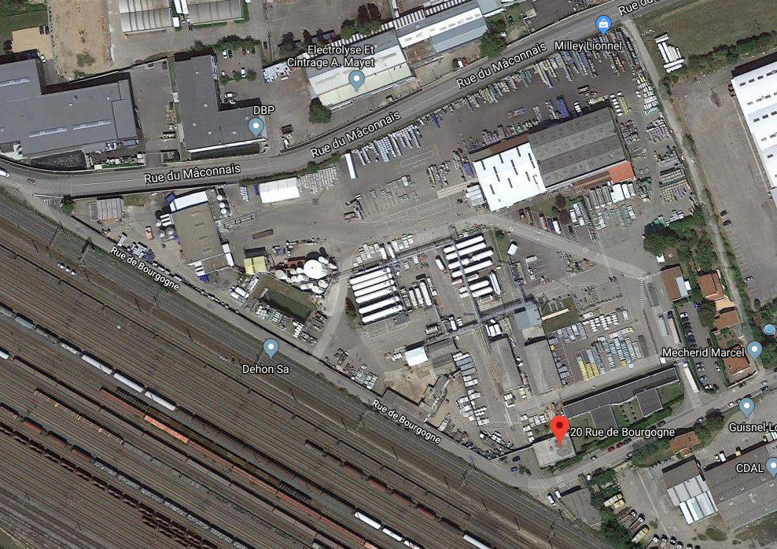
Inventec site in Lyon. Seems to be big !

Slide 7
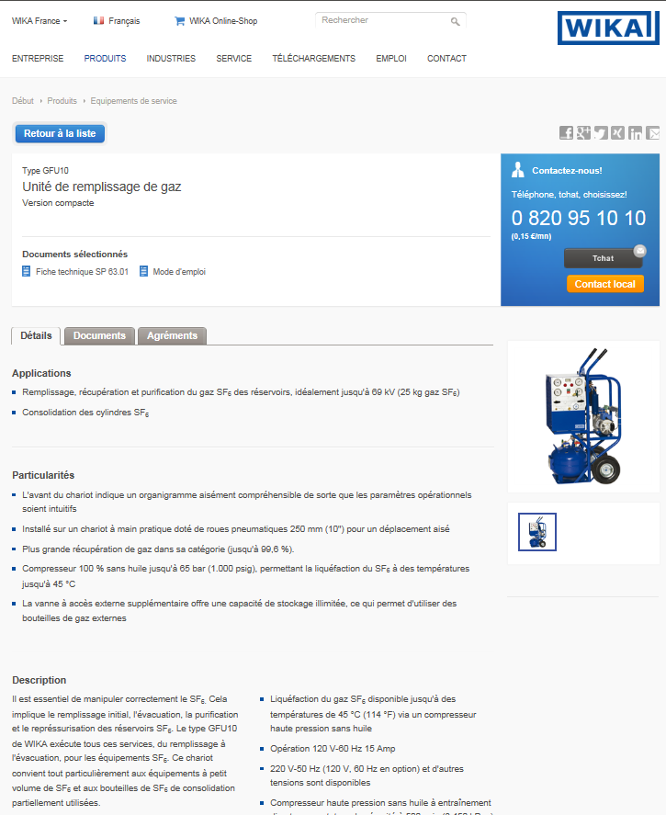
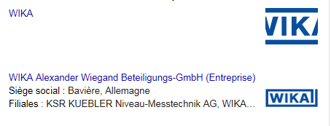
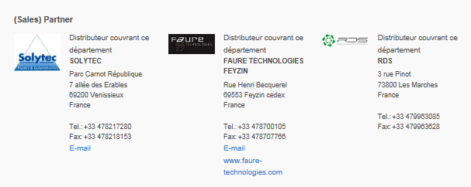
Meeting between Remy and German company 14 June 2018 at 10am bat 367
https://www.power-technology.com/contractors/tandd/wika-sf6-division/
SF6 Visit WIKA DE - Mr Andre DAHLHEIMMER, Mr HEIMANN
https://www.wika.fr/gfu10_fr_fr.WIKA?ProductGroup=70956

Slide 8
Meeting with Remy (and organised by him) and Wika at CERN Bat 367 next to PS power dated 14 June 2018
Daniel Heimann: daniel.heimann@wika.com
Andre Dahlheimer: andre.dahlheimer@wika.com
They deal with SF6 almost exclusively in the electrical power industry.

Slide 9
Other recovery solutions, notably for R134a

Slide 10
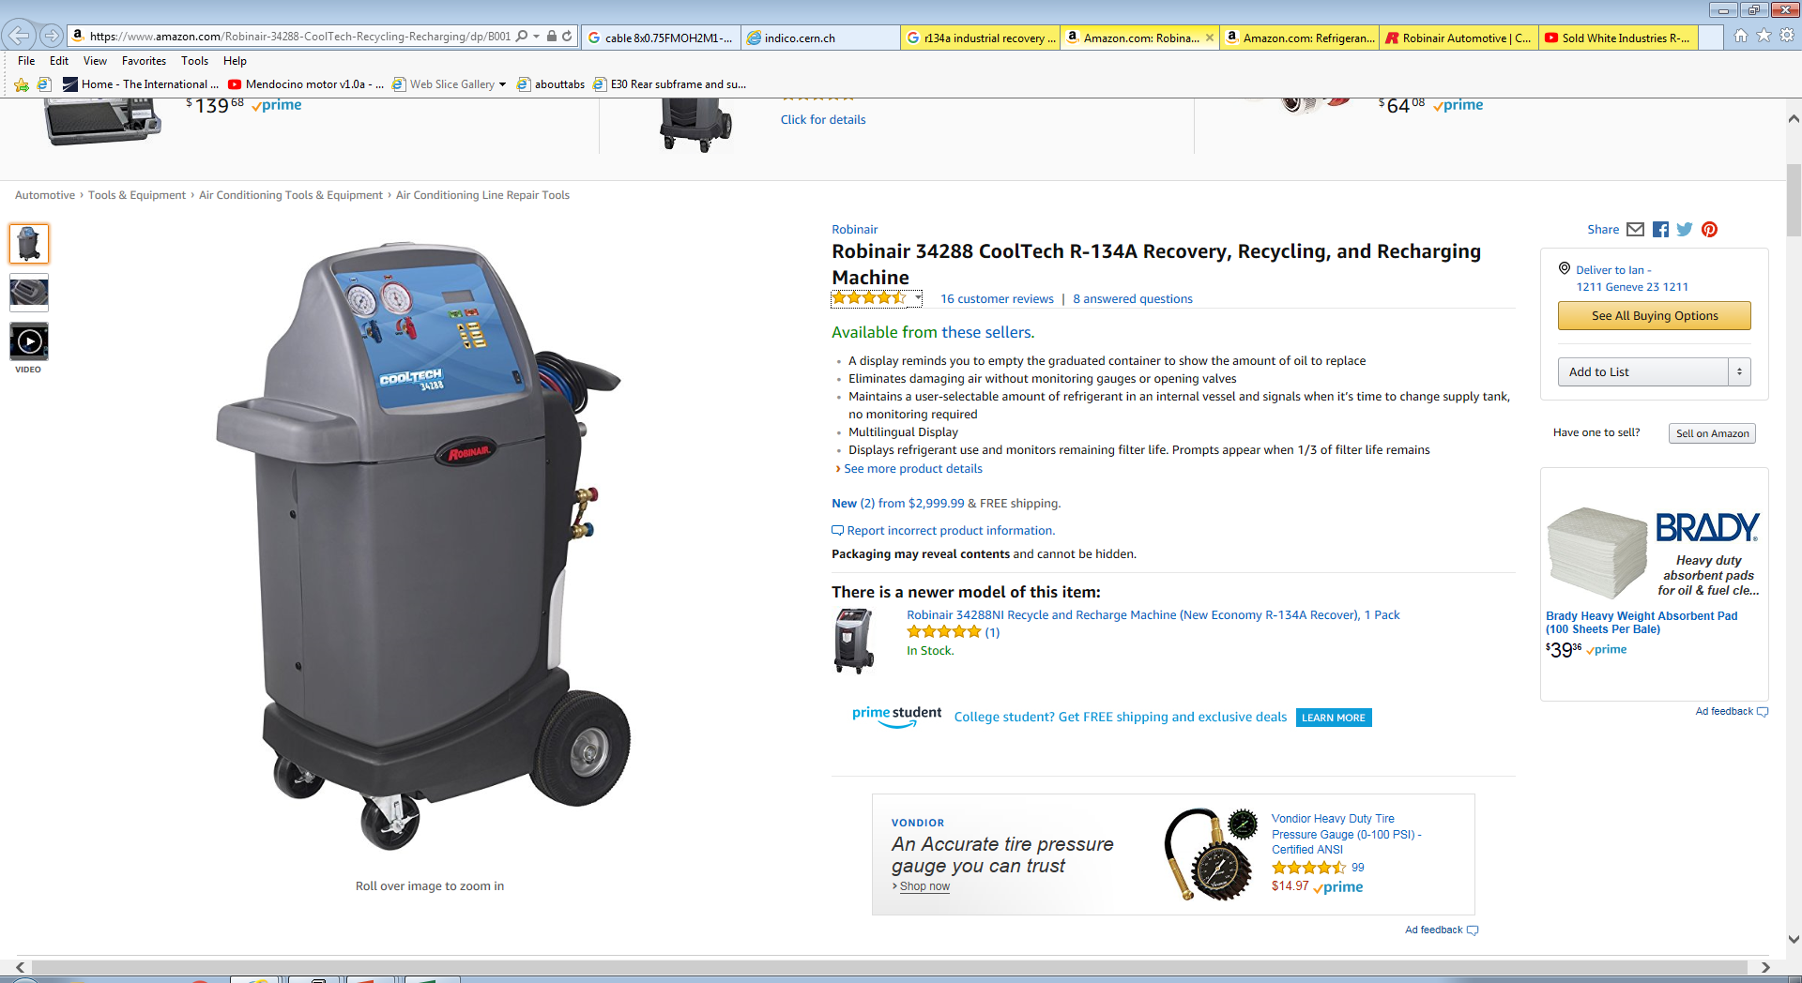
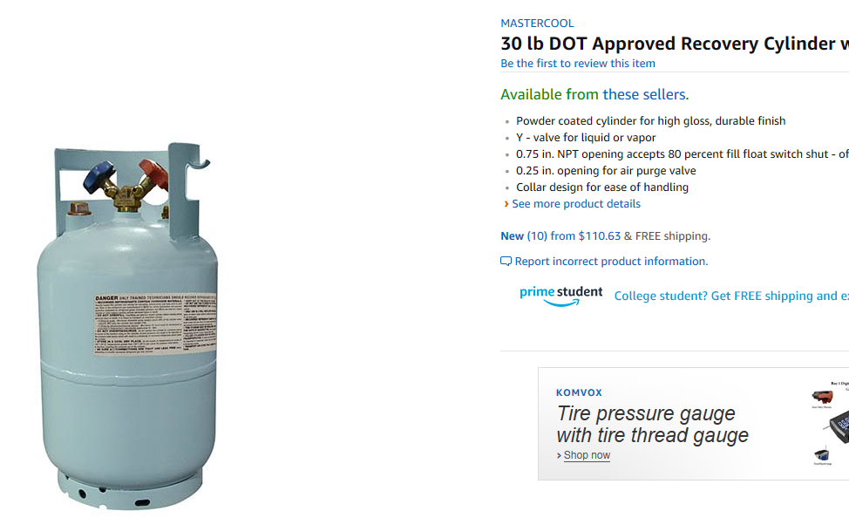

Slide 11
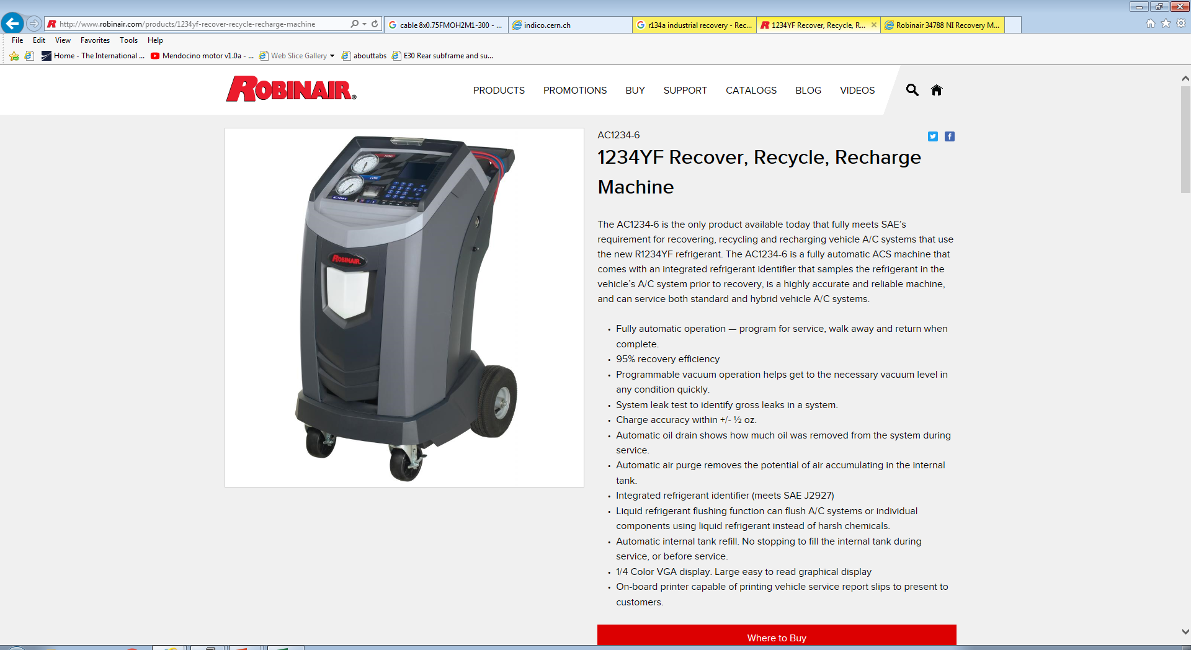

Slide 12
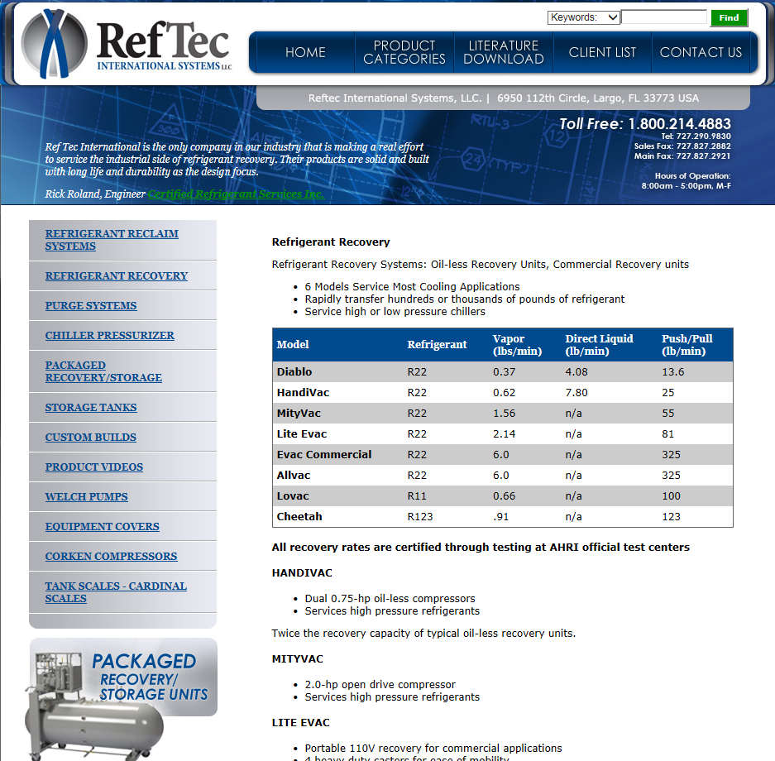
http://www.reftec.com/shop/category.aspx?catid=1

Slide 13
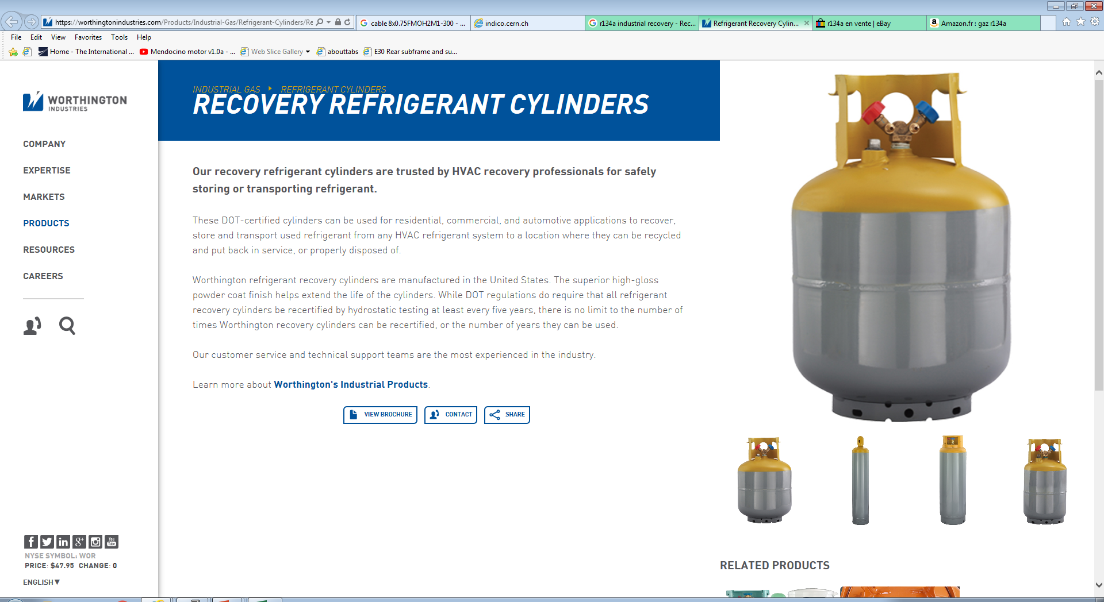

Slide 14
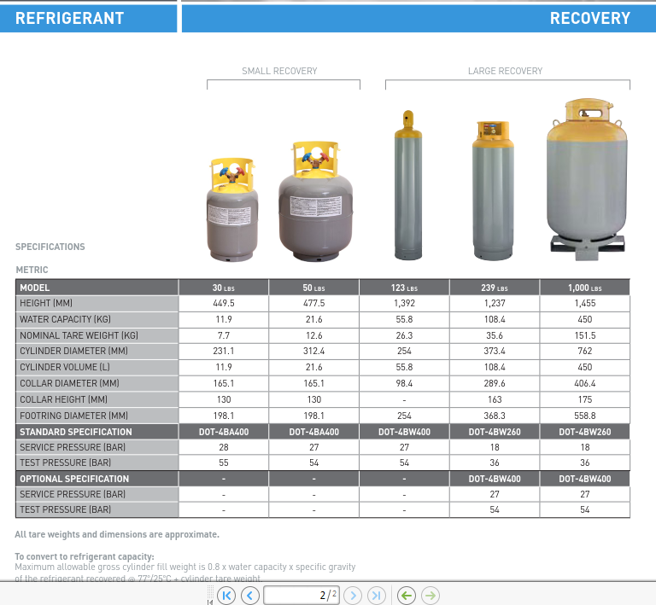
https://worthingtonindustries.com/getmedia/19967b83-011e-4289-9cef-dacac8bc99ac/Recovery.pdf?ext=.pdf

Slide 15
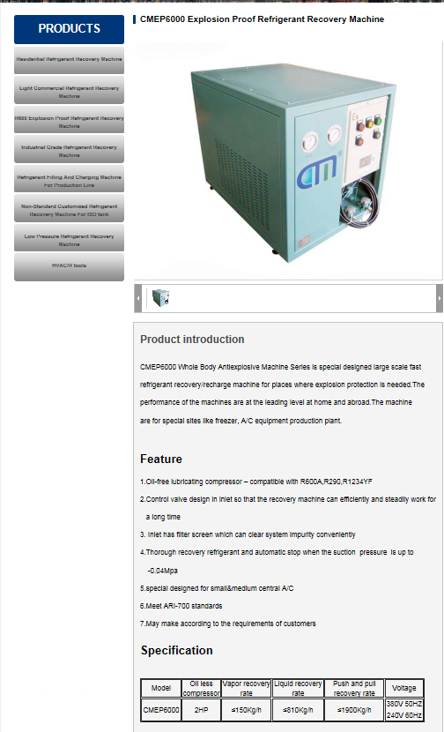
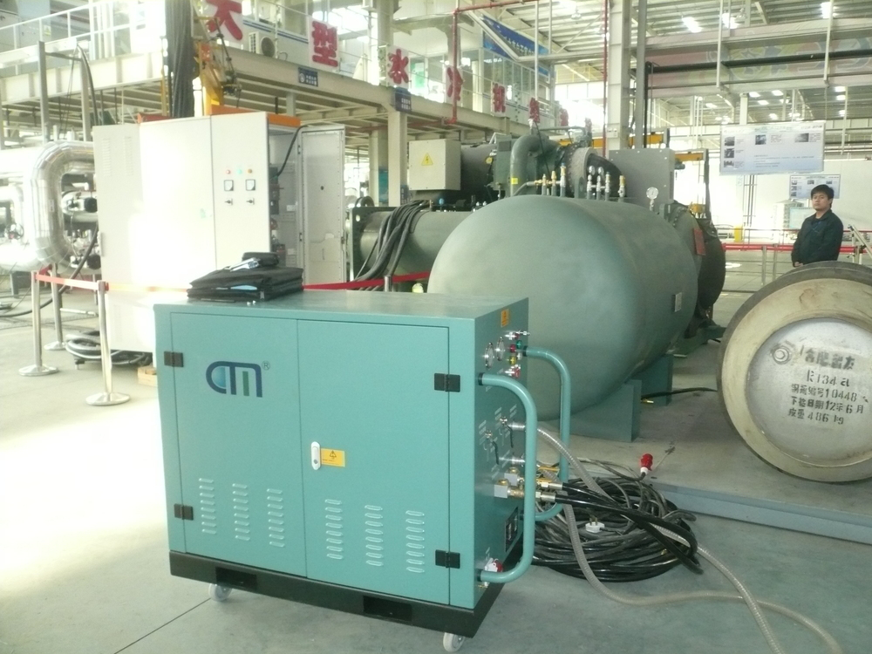
http://www.cm-green.com/prodicts_xiangxi/productId=56.html

Slide 16
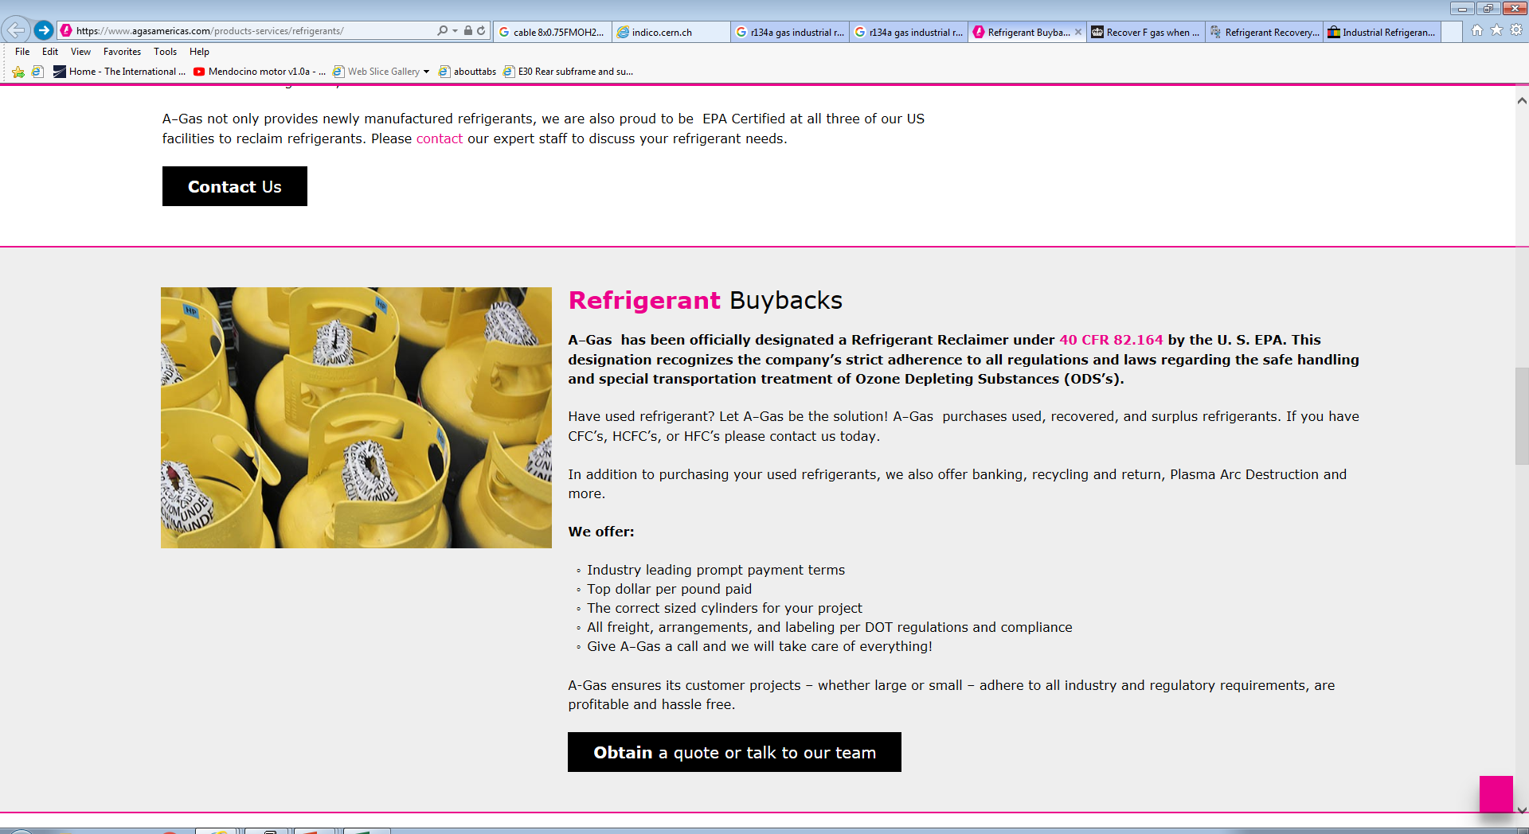
https://www.agasamericas.com/products-services/refrigerants/

Slide 17
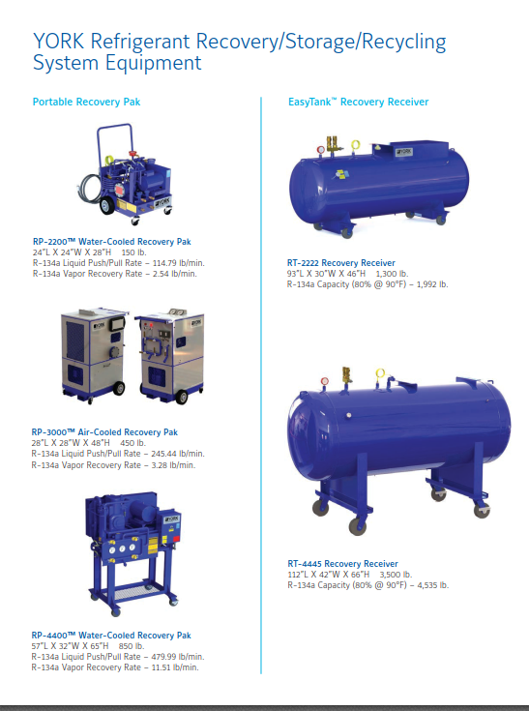
https://resolute-industrial.com/wp-content/rsr.pdf

Slide 18
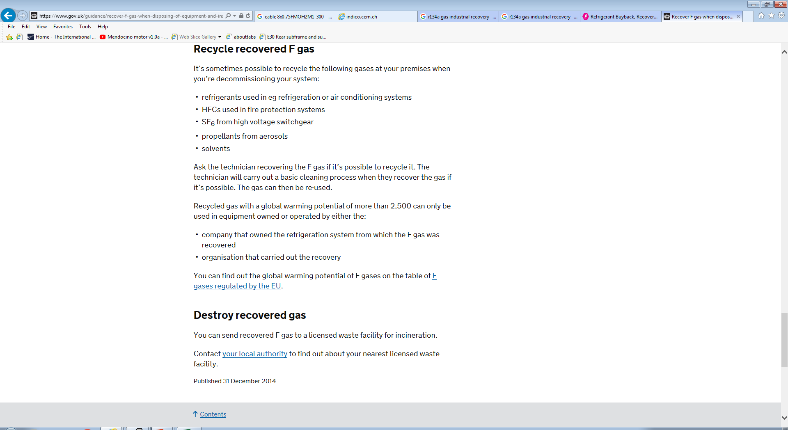
The British Way !
https://www.gov.uk/guidance/recover-f-gas-when-disposing-of-equipment-and-insulating-foam#recycle-recovered-f-gas

Slide 19
Conclusion
The recuperation of these florine based cases is industrialised in numerous countries, in Europe and beyond, Mexico etc

