Slide 1
Temperature variations over 2016
A steady drop to varying degrees is observed in the UXC, RE and RB
The RPC community is investigating any impact.
Is there a simple explanation ?
Can this change be avoided ?
Ian Crotty 07 Nov 2016

Slide 2
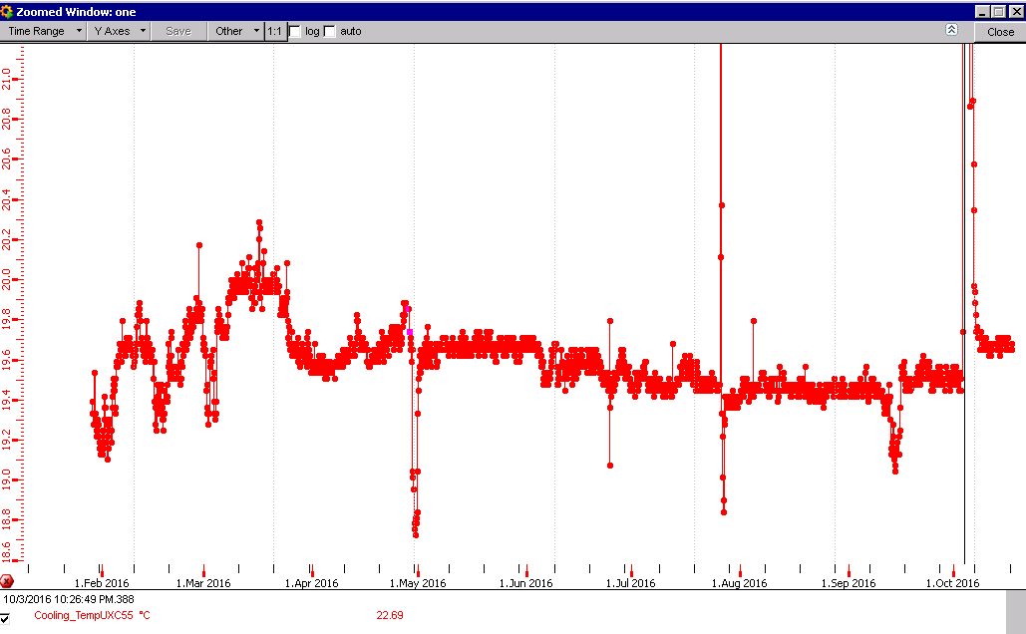
UXC Temp this year
After 3 day jump April temp restablished
Temp decrease over year

Slide 3
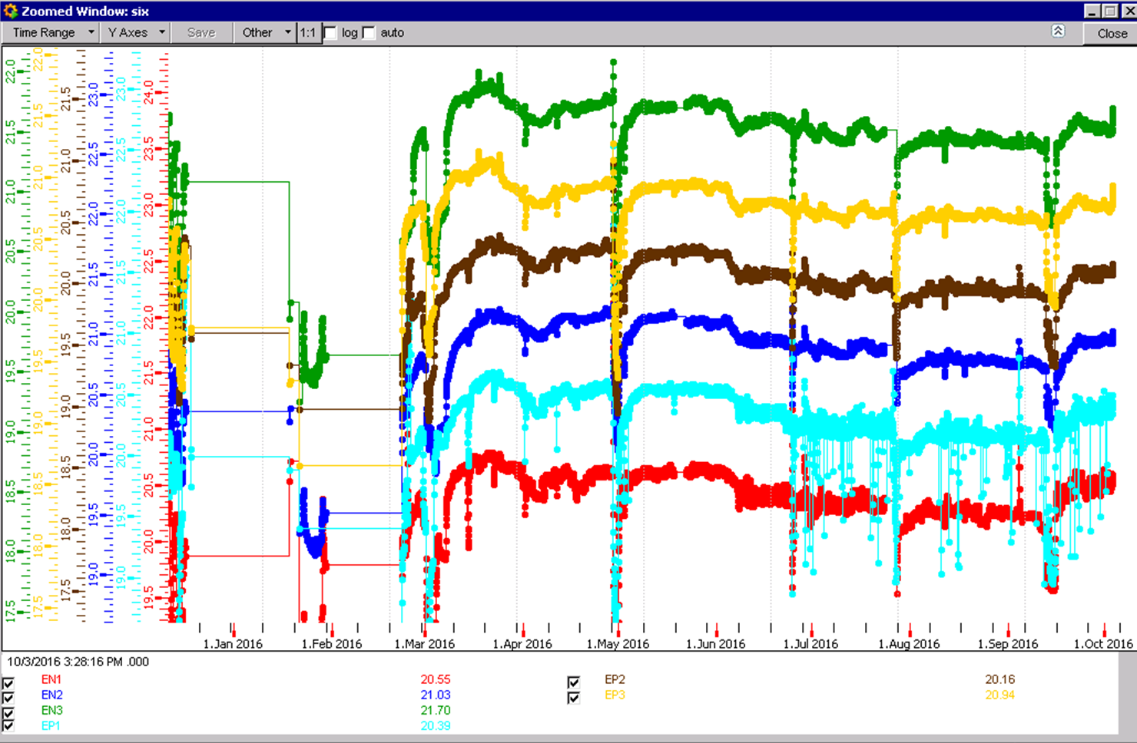
RE Decrease in temp since March
0.5 deg decrease

Slide 4
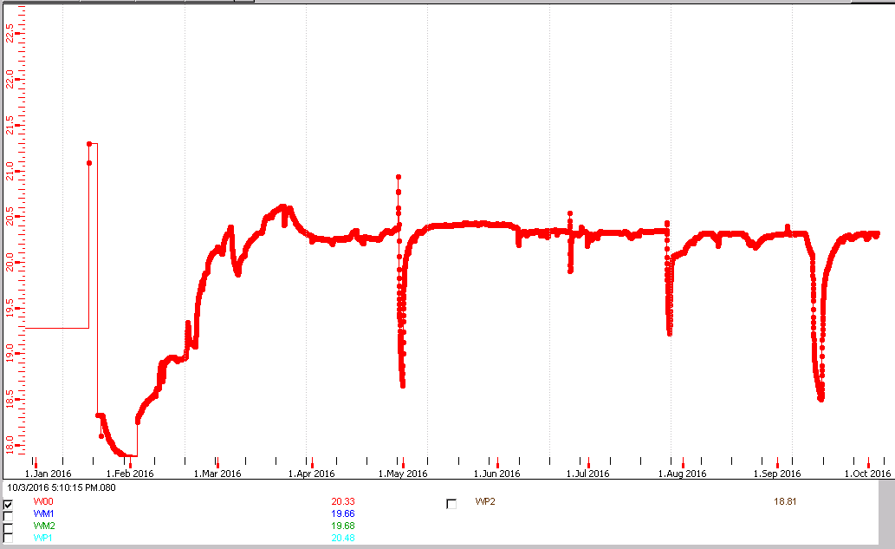
RB Wheel 0
0.1degC temp change since April 2016

