Slide 1
Environmental parameters
CMS
20/04/15
Ian

Slide 2
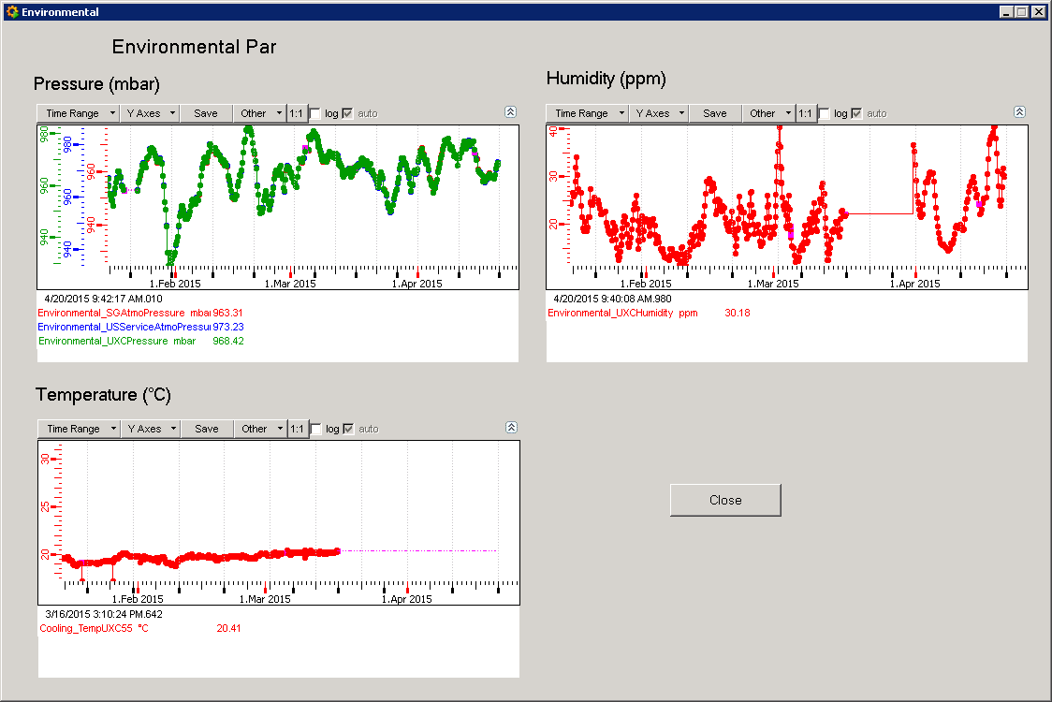
Temp, Pressure & Humidity in SG,USC and UXC

Slide 3
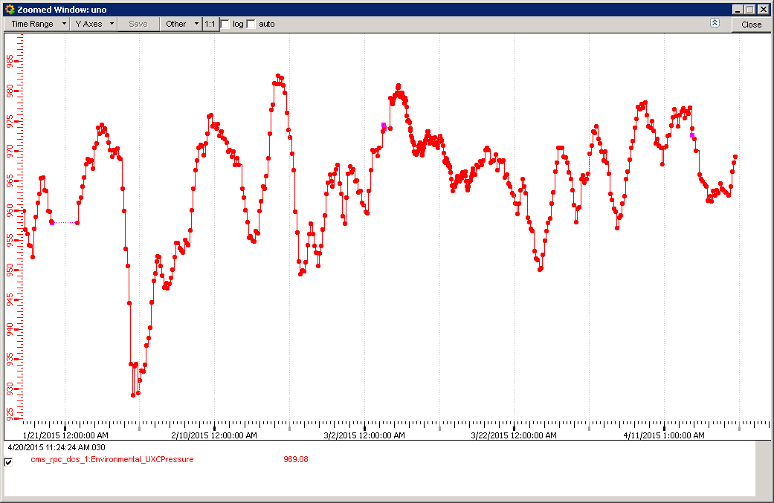
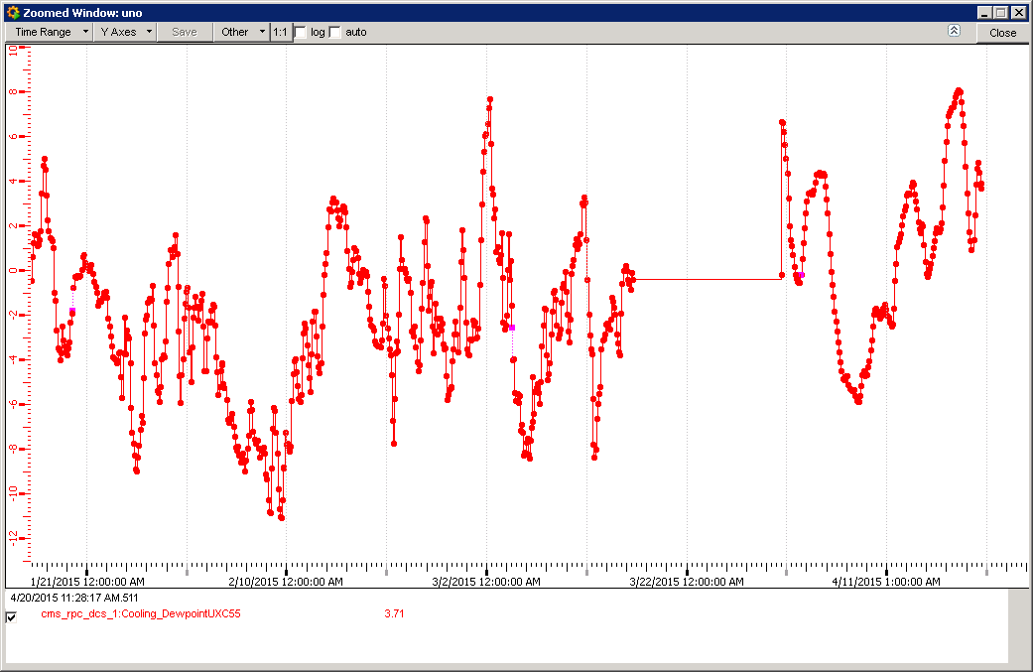
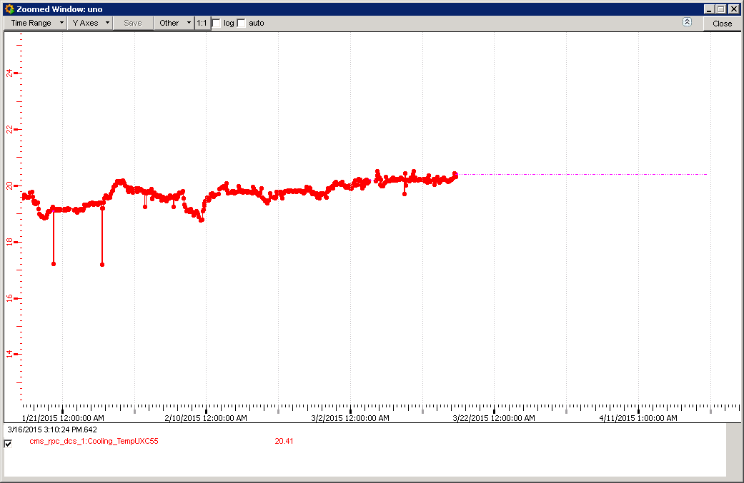
UXC sensor from “Hardware View” window
Sensor positions, not so important for Pressure but more for temperature.
Pressure
Dew Point
Temp

Slide 4
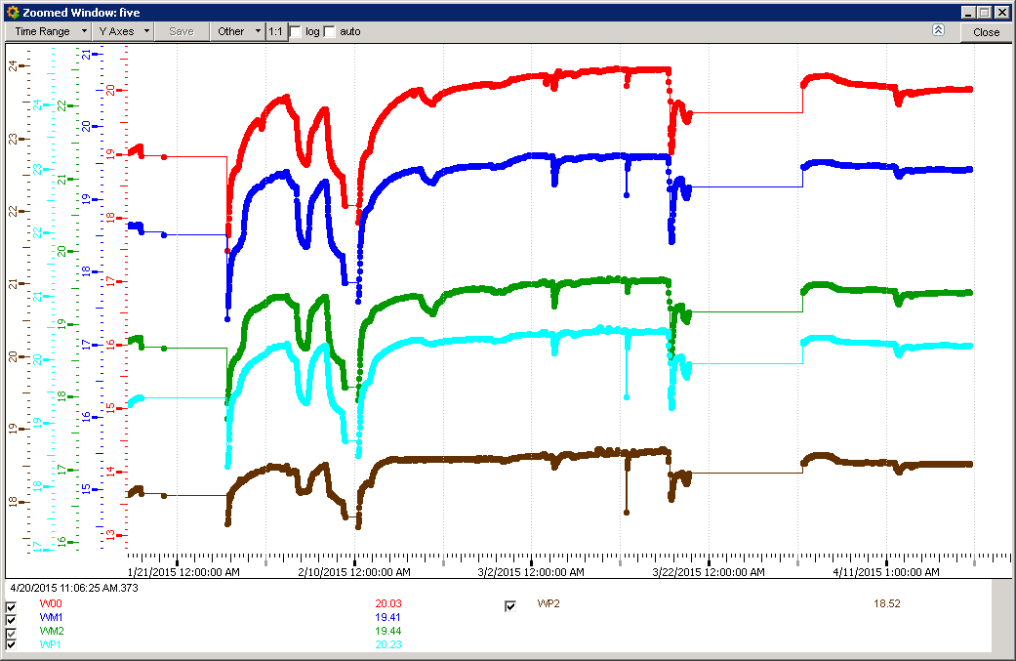
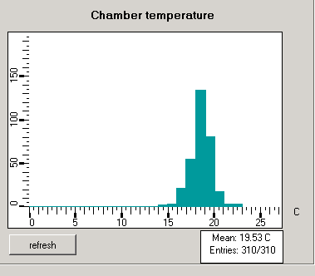
RB Temps

Slide 5
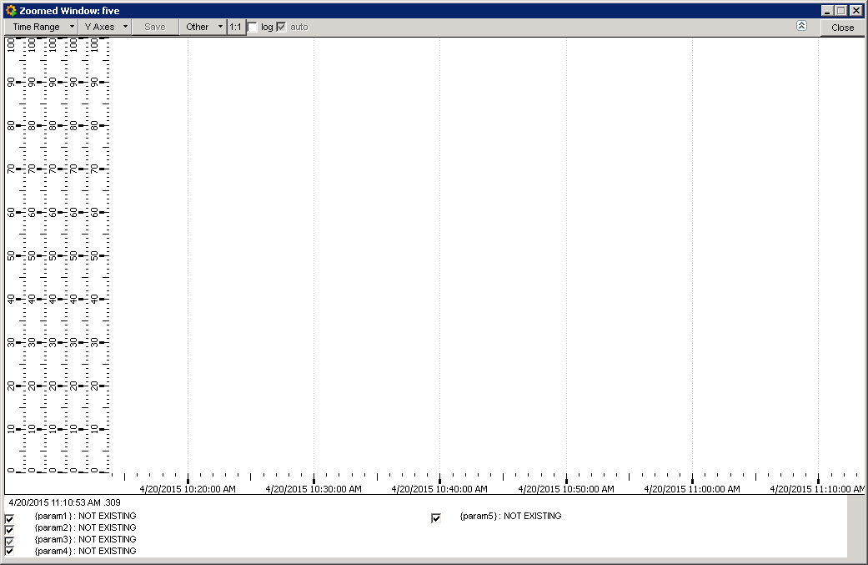
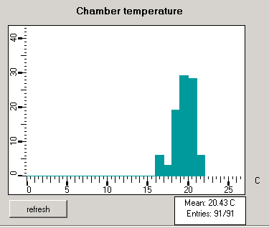
RE Temps ?

Slide 6
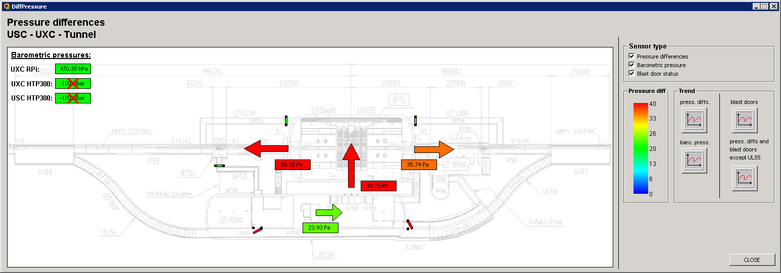
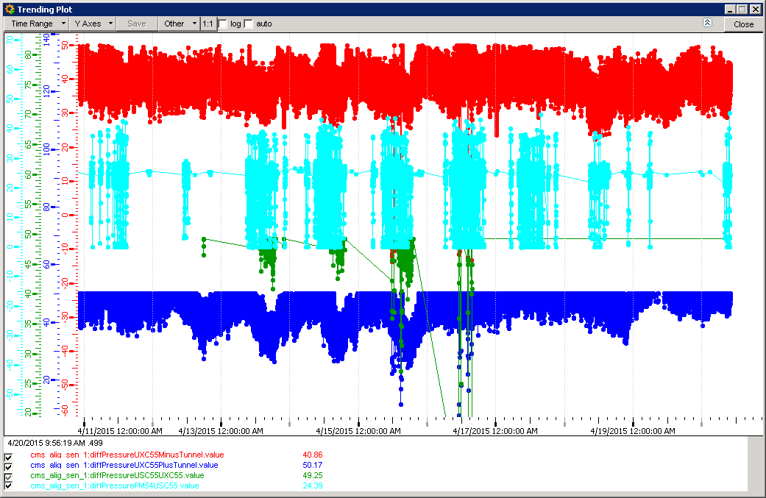
Cavern Differential Pressures

Slide 7
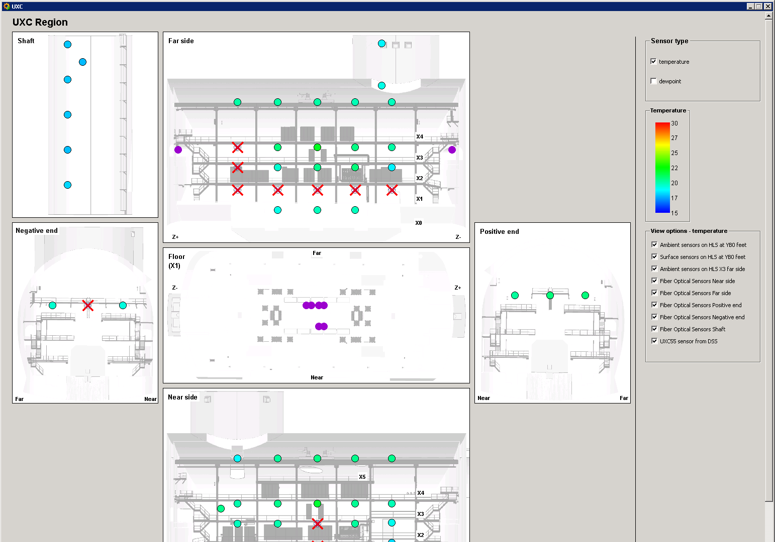
Cavern temperature distributions

Slide 8
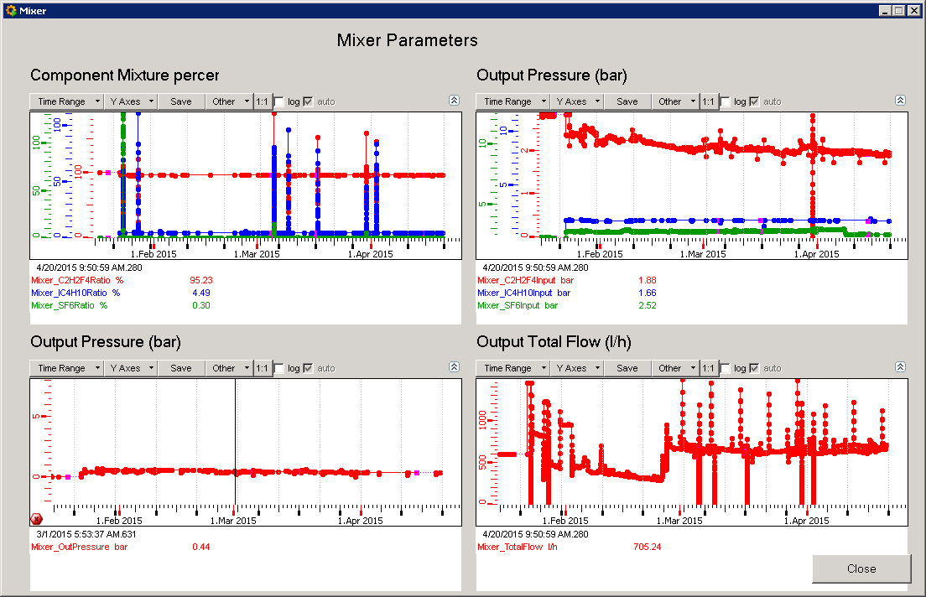
Gas mixing parameters

Slide 9
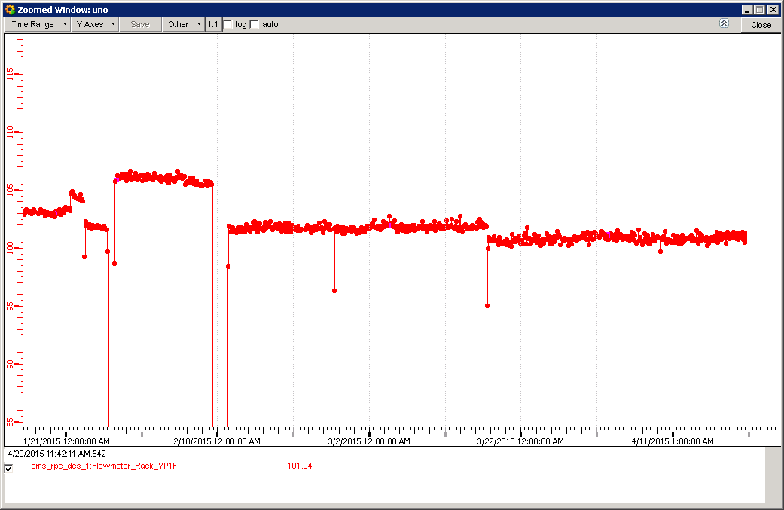
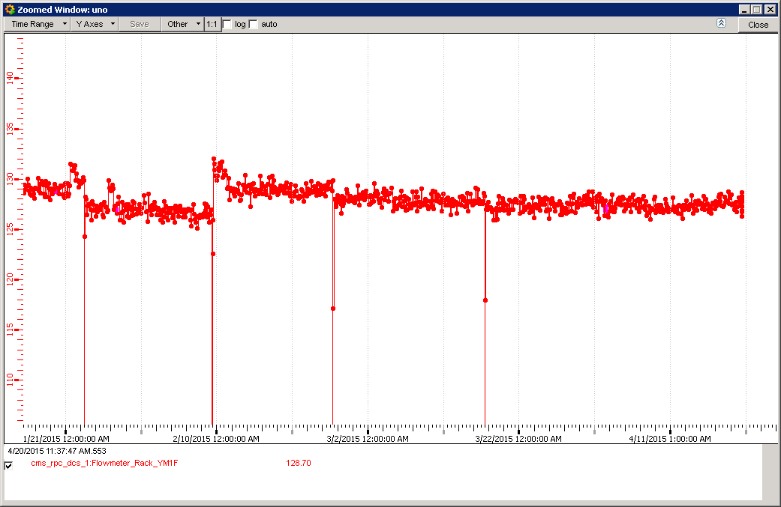
Coolant temperatures
A Rack coolant flow rate, examples.

Slide 10
Conclusions
The fibre temp sensors RE ?
Other parameters
The above parameters correlated to data taking ?
No FEB temps ?
Water Coolant temps Rack, Yoke & Chambers?
Elog for shaft open/close state

