Slide 1
Environment P5
Ian Crotty

Slide 2
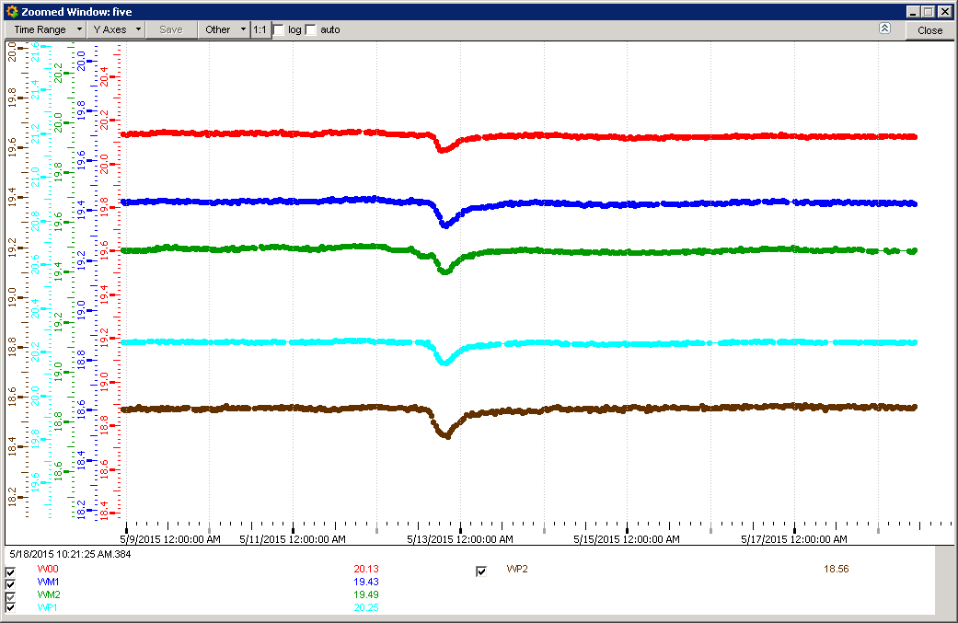
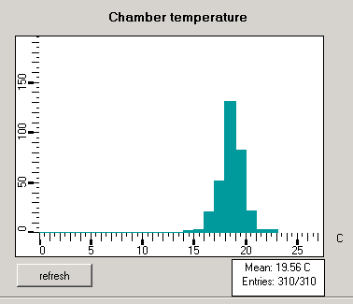
RB temps

Slide 3
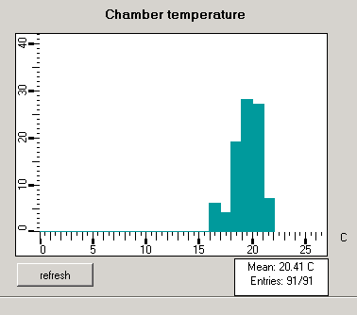
RE Temps.
FOS details coming this week

Slide 4
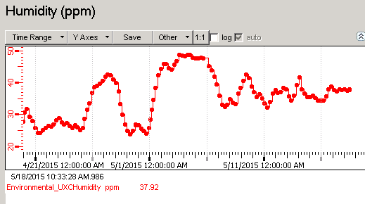
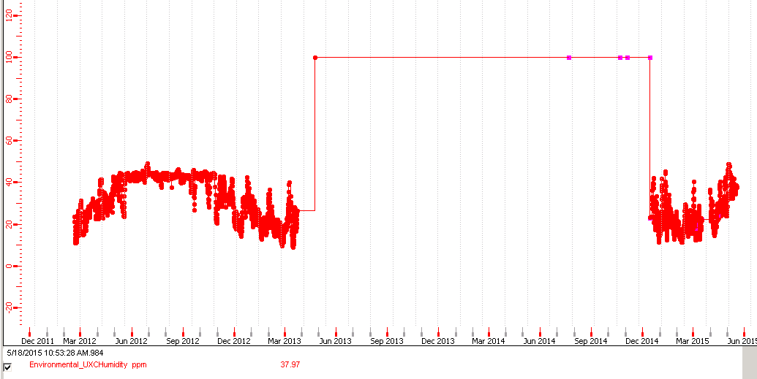
Humidity UXC
Higher maximum value than normal values from Run 1

Slide 5
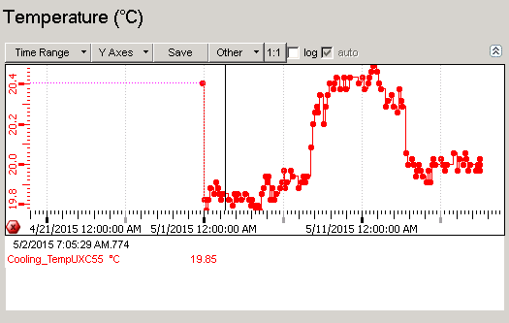
Temp UXC

Slide 6
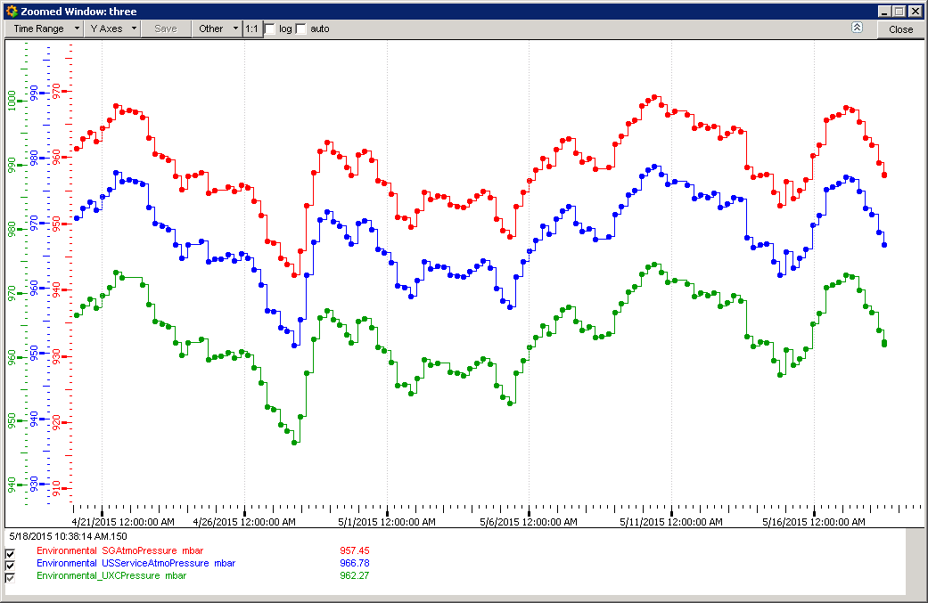
Pressure Surface,USC & UXC

Slide 7
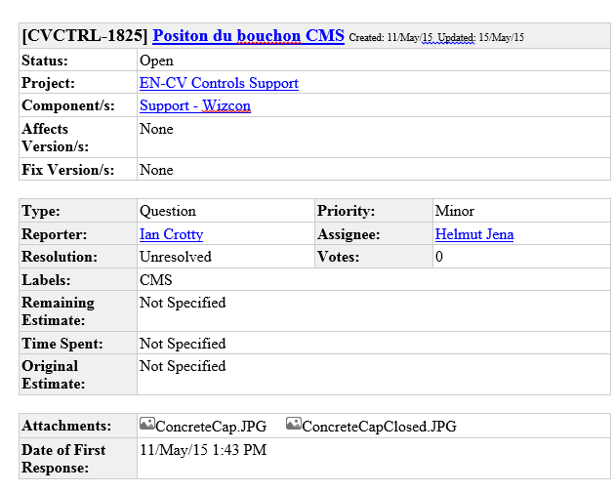
Response for the Shaft seal position
To be published on DIP rather than an OPC server

