Slide 1
Ambient condition P5 specifically Humidity
Ian
06 July 2015

Slide 2
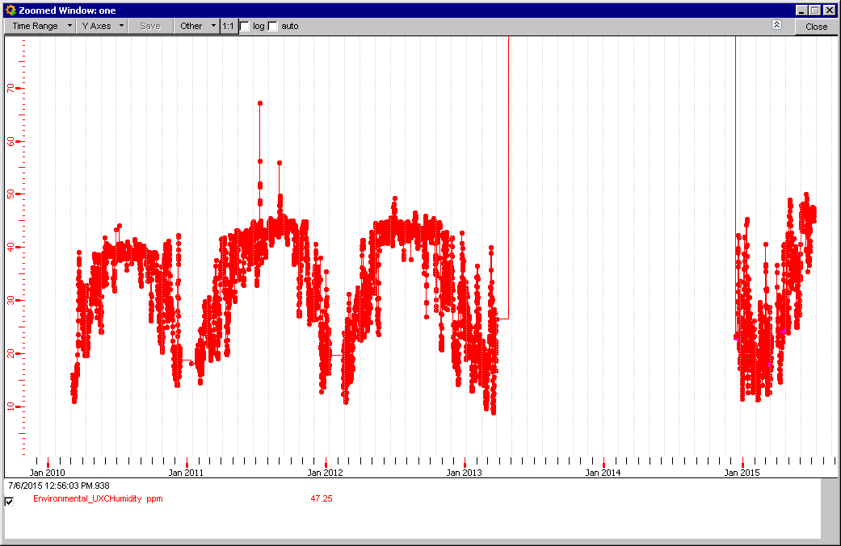
RH in UXC55 since 2010
3 periods 2010, 2011 and 2012 stable upper RH limits
43% RH

Slide 3
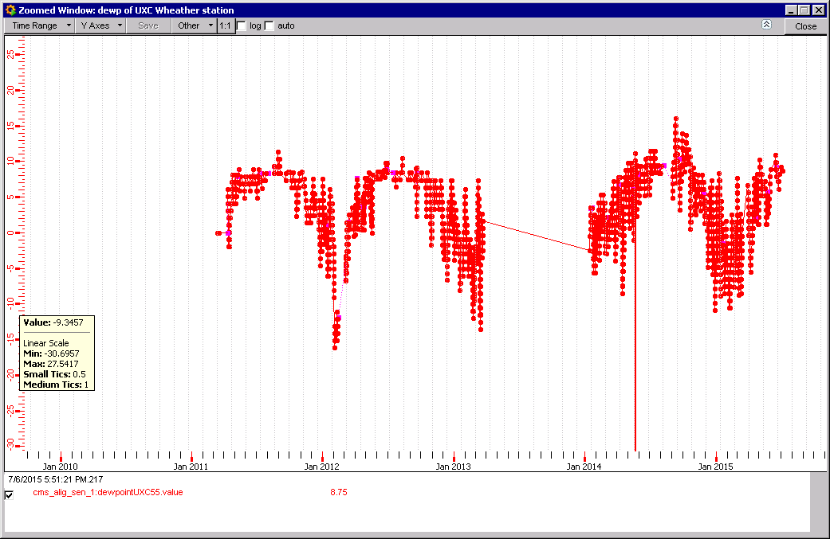
RH UXC55 alignment sensor X3 minus
DP 8.5degC = 49% RH
From the dew point and Temp the RH can be calculated.

Slide 4
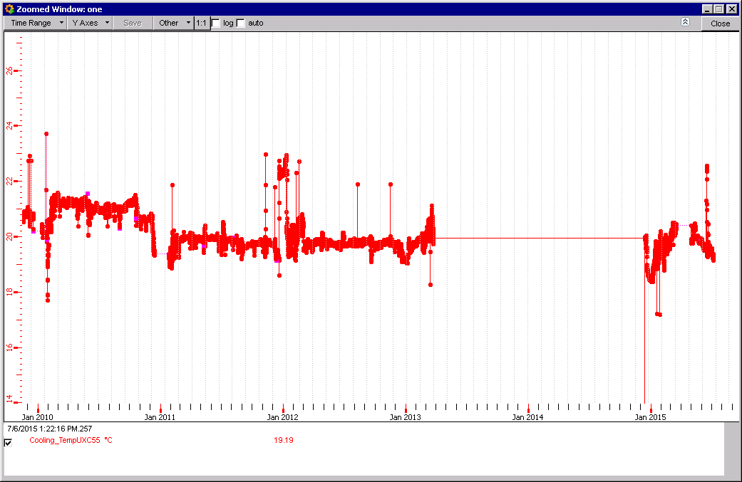
Temperature UXC55
19.8degC

Slide 5
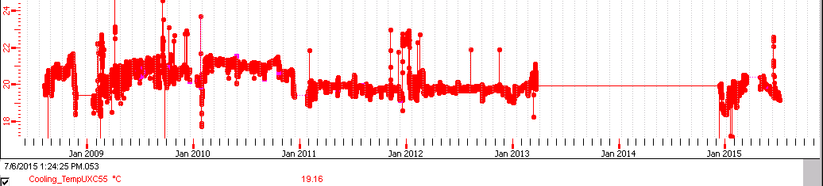
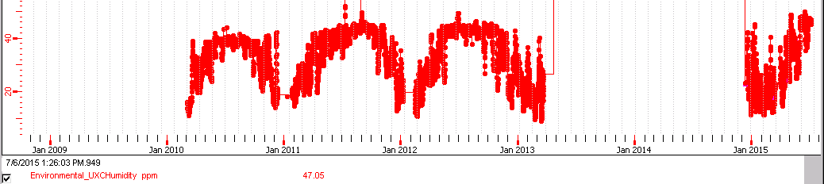
Previous to 2011 temp UXC was not stable, there was some training period
Since Jan 2015 for both Temp and RH there may be a similar training period ?
Unfortunately for RH there are no records available before 2010

Slide 6
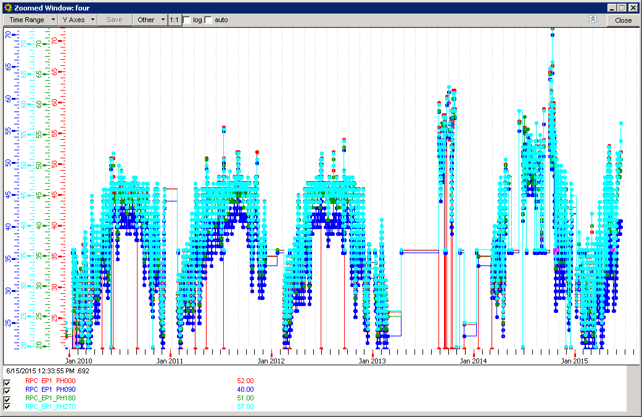
RH RE+1 4 positions 2010 to date
High RH reading 46%
Low RH reading 41%

Slide 7
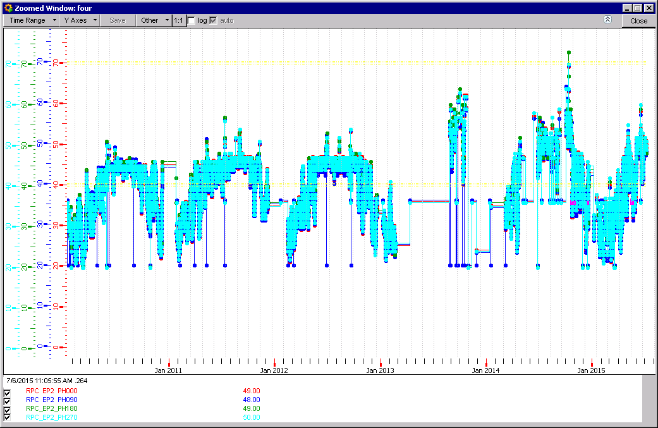
RH RE+2 4 positions 2010 to date
RH 45%

Slide 8
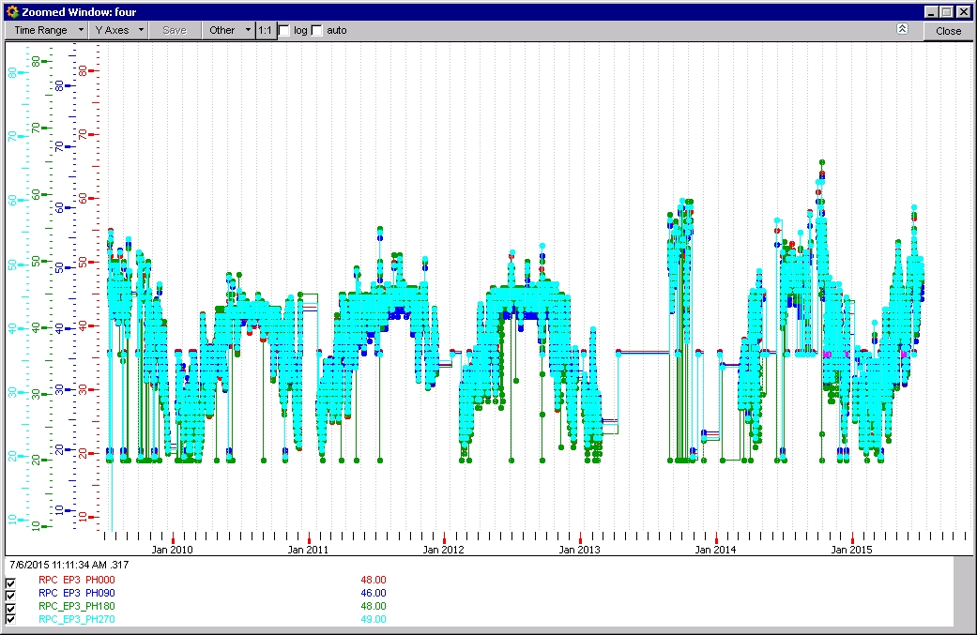
RH RE+3 4 positions 2010 to date
RH 45%

Slide 9
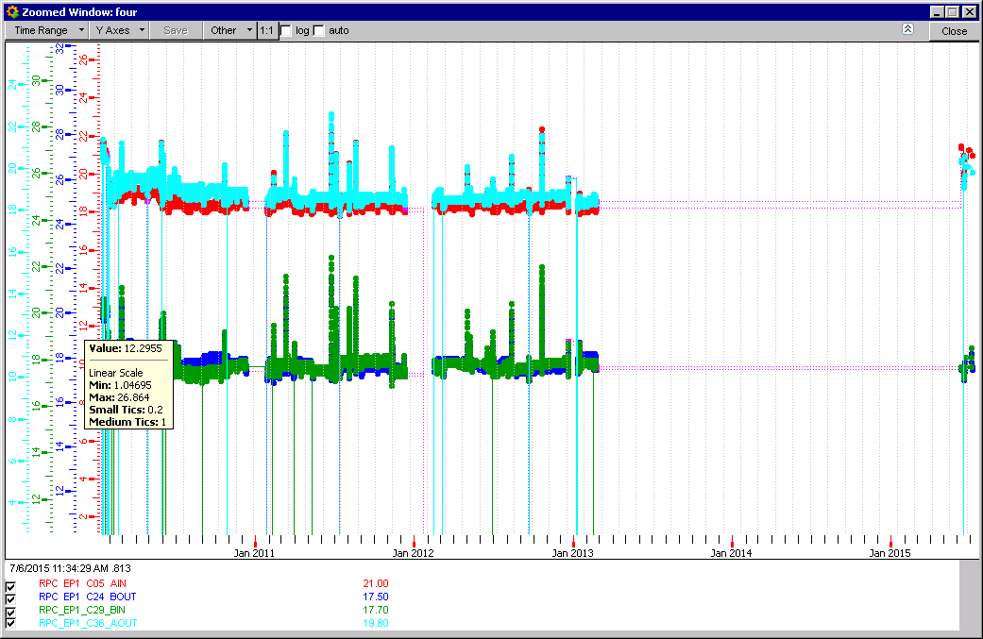
Temperature of cooling system RE+1

Slide 10
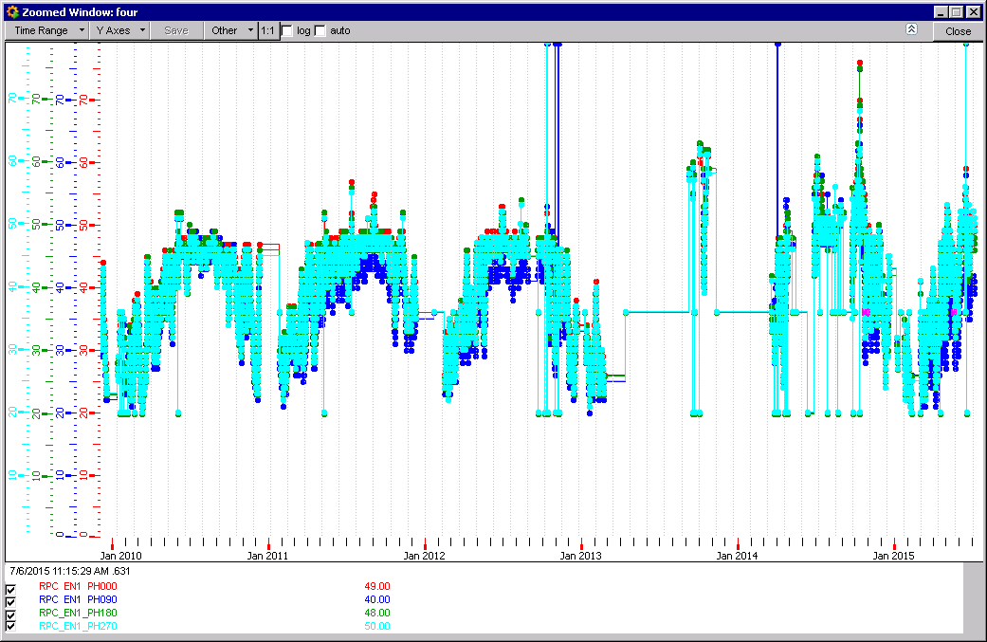
RH RE-1 4 positions 2010 to date
RH average upper limit 47%

Slide 11
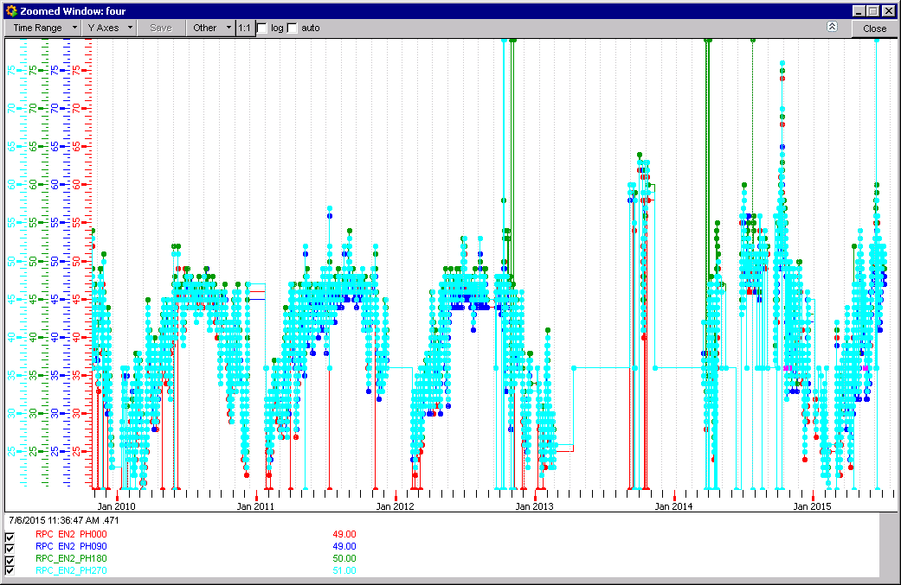
RH RE-2 4 positions 2010 to date
RH average upper limit 47%

Slide 12
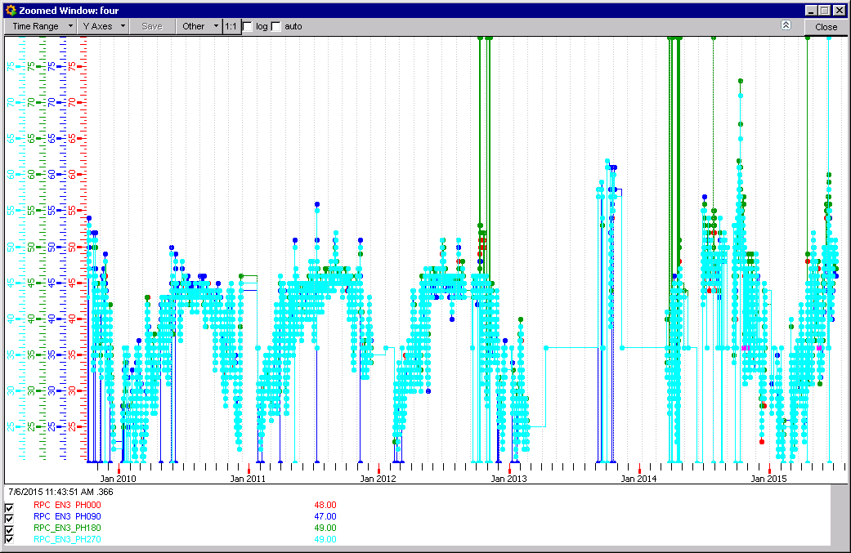
RH RE-3 4 positions 2010 to date
RH average upper limit 45%

Slide 13





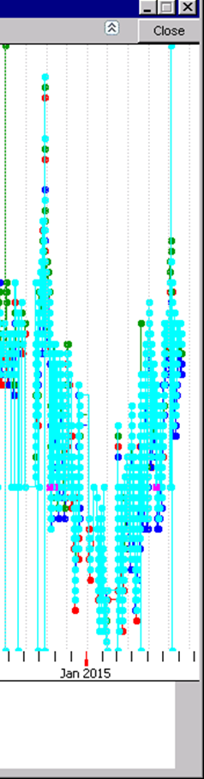
The Disk Sensors show similar increase since Jan 2015 to the UXC55 sensor. Nota the ordinate is scale variant, abscissa almost not.
UXC55
RE+1
RE+2
RE+3
RE-1
RE-2
RE-3

Slide 14
RH since 2010
All values available from UXC and REs agree to within ± 4% RH.
Response to changing values is also similar.

Slide 15
Values of RH taken at time XXXX for UXC and Disks (REs)
Intend to show that sensors agree, or not, at instantaneous times rather than spanned out over years.

Slide 16
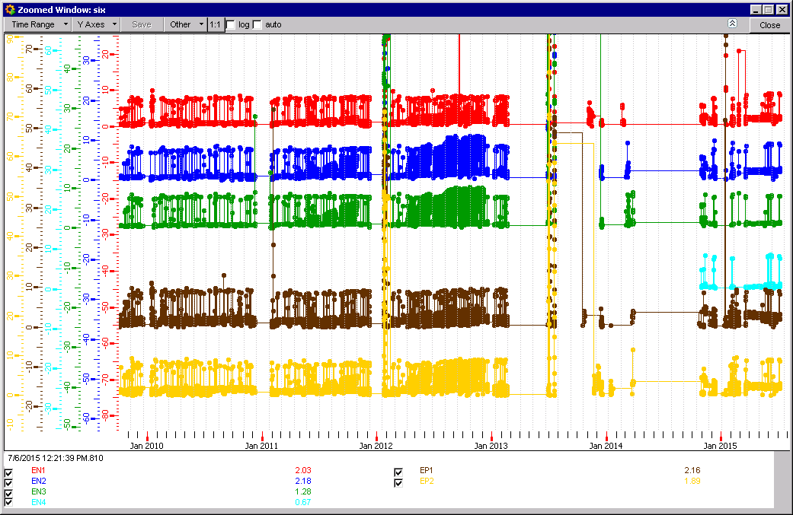
Average Current in RE back to 2010

Slide 17
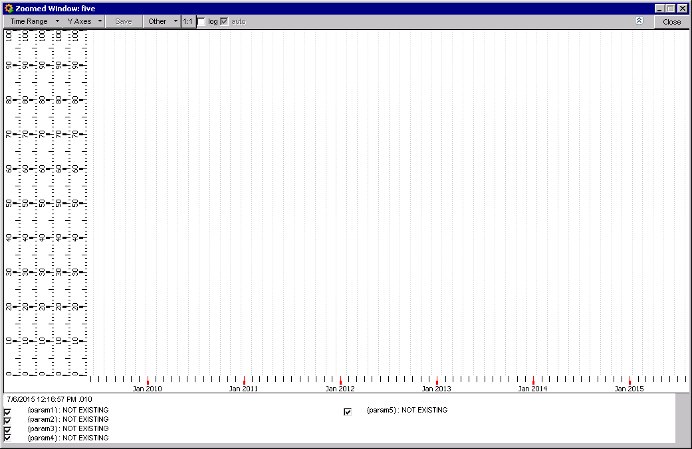
Temp in RE log of data is not available here.

Slide 18
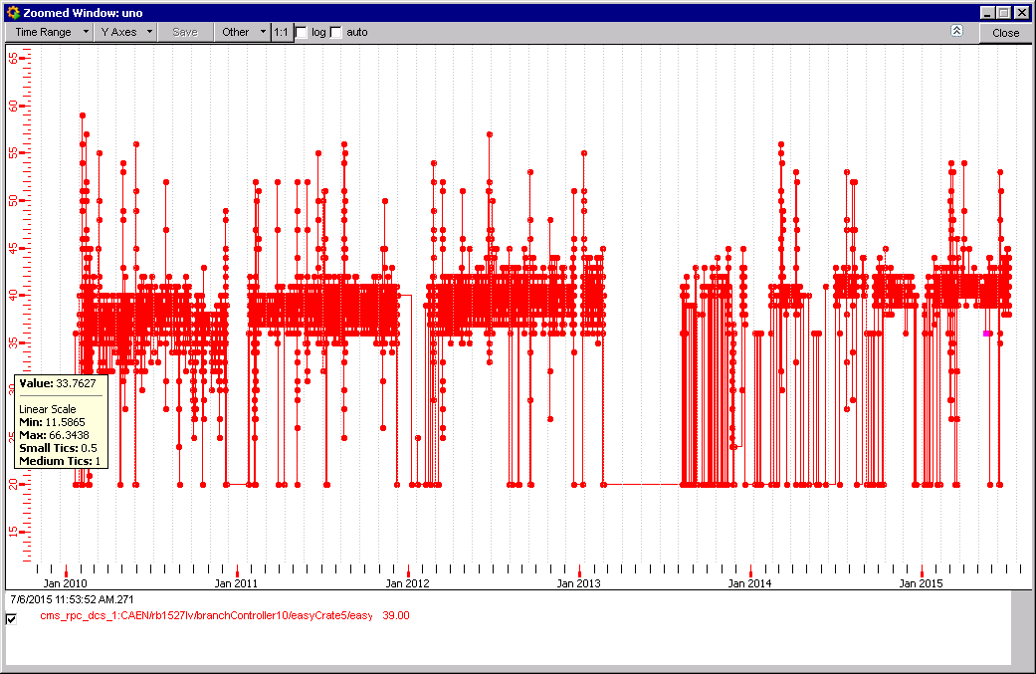
RH in Barrel region WM2 BIN
(others are Bout, Tin and Tout, not shown
As these are marked in and out then is this RH gas or RH ambient ?

Slide 19
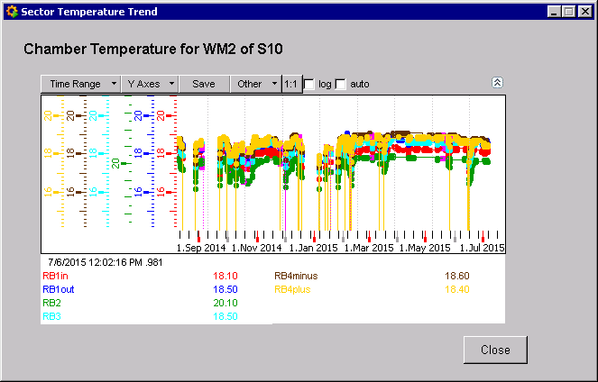
Temp taken from WM2 of S10 RB4minus BUT it shows RB1,2,3 and 4…….

Slide 20
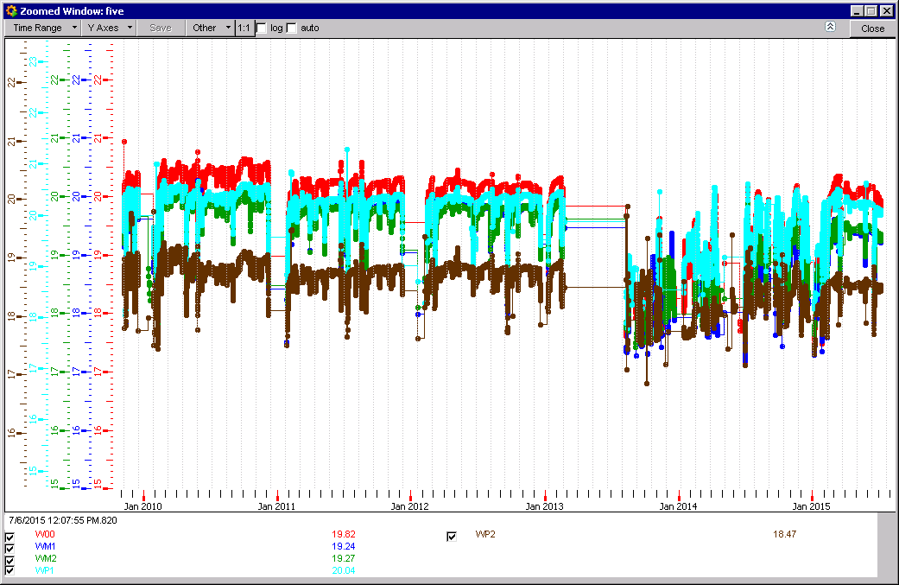
Temperatures in RB global

Slide 21
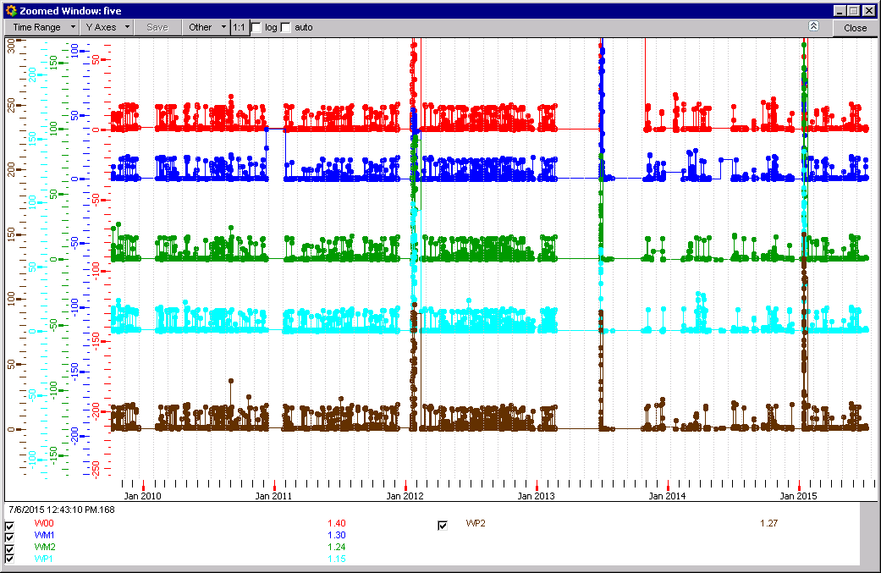
Currents, average in RB since 2010

Slide 23
There may be 8% dispersion in the RH readings in RE and UXC.
No data from the RE4s
Years 2010, 2011 and 2012 were more stable than 2015 as shown by the sensors on the disk faces.
RH in RB is not clear if gas or Ambient. ?
It is clear that RH values for 2015 are not yet stable, with excursions higher than the stable upper limit from 2010, 2011 & 2012.

