Slide 1
Ambient P5 UXC
5 Oct 2015

Slide 2
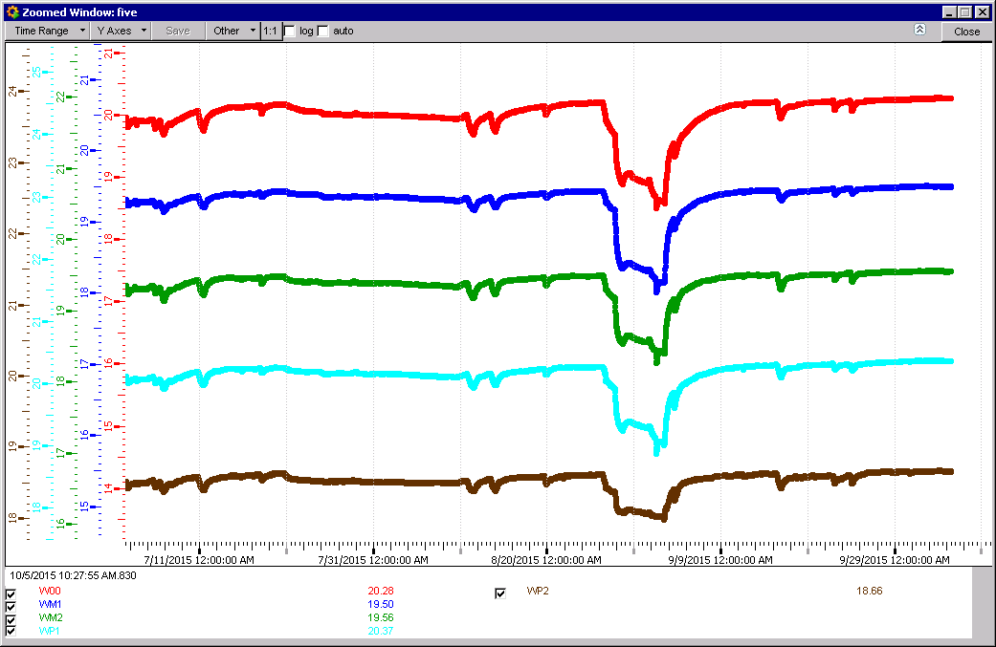
RB

Slide 3
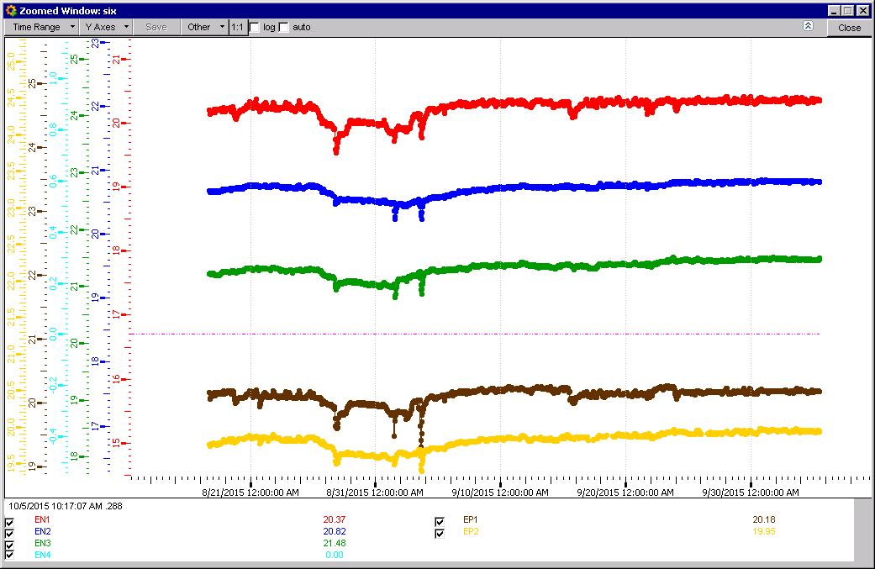
RE
We have lost RE+3, instead it is marked RE-4

Slide 4
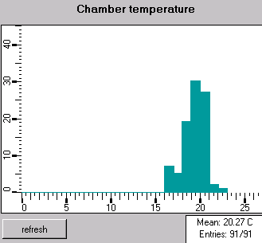
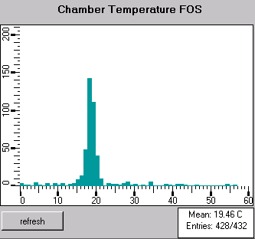
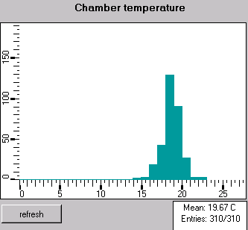
Mean Temp. plots
RE
RB

Slide 5
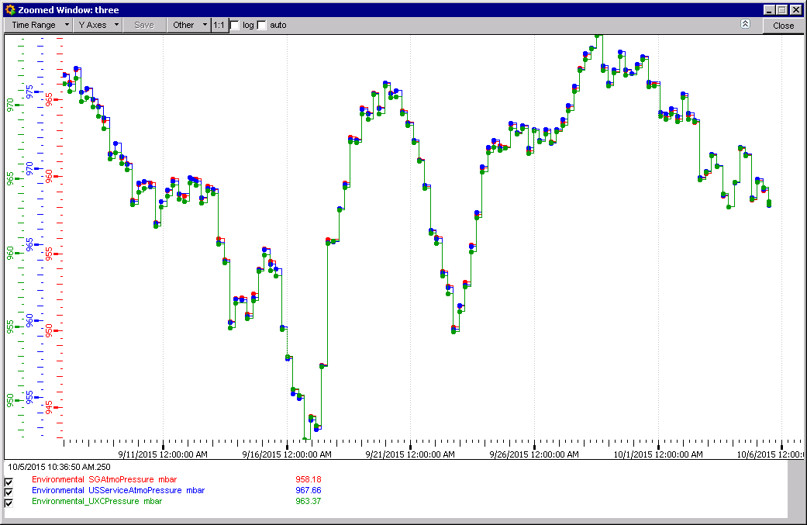
Pressure UXC55

Slide 6
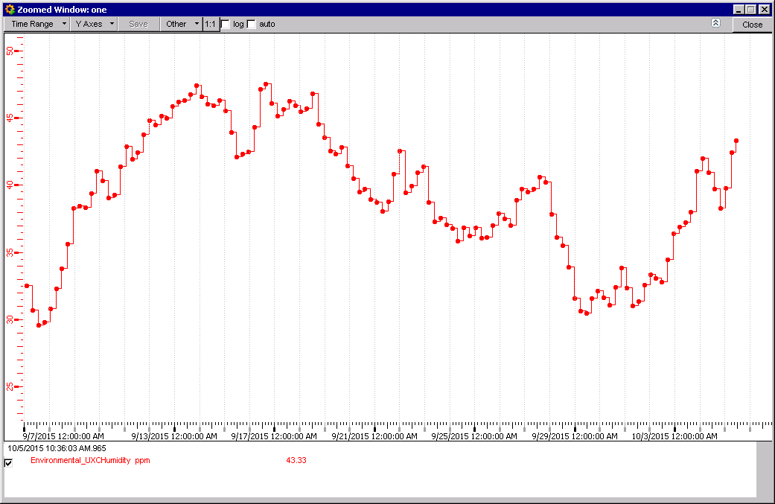
RH UXC 55

Slide 7
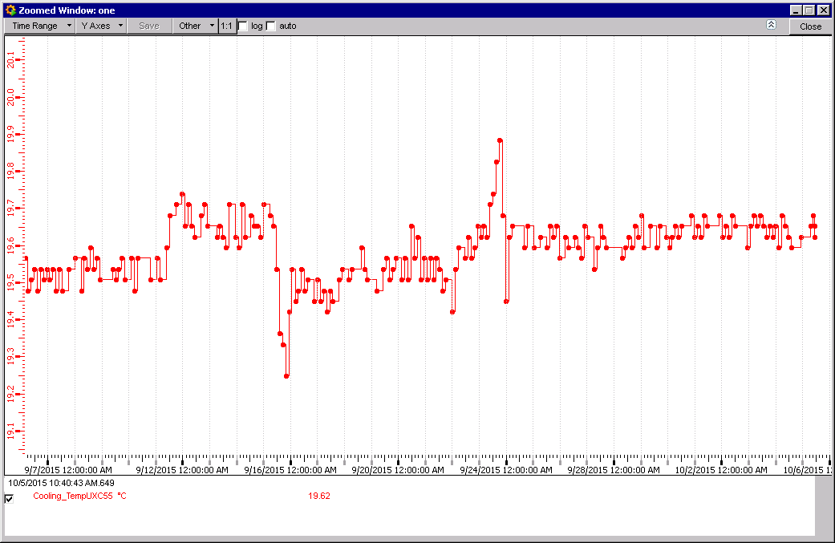
Temperature UXC55

Slide 8
Conclusion
Very stable temperatures
Some cleaning up of Fos spread
Recover RE+3 temp data.
Two contact made with Atlas for temp and RH values.

