Slide 1
Ambient P5 UXC
2 May 2016
All plots are taken since beginning of the year unless otherwise stated

Slide 2
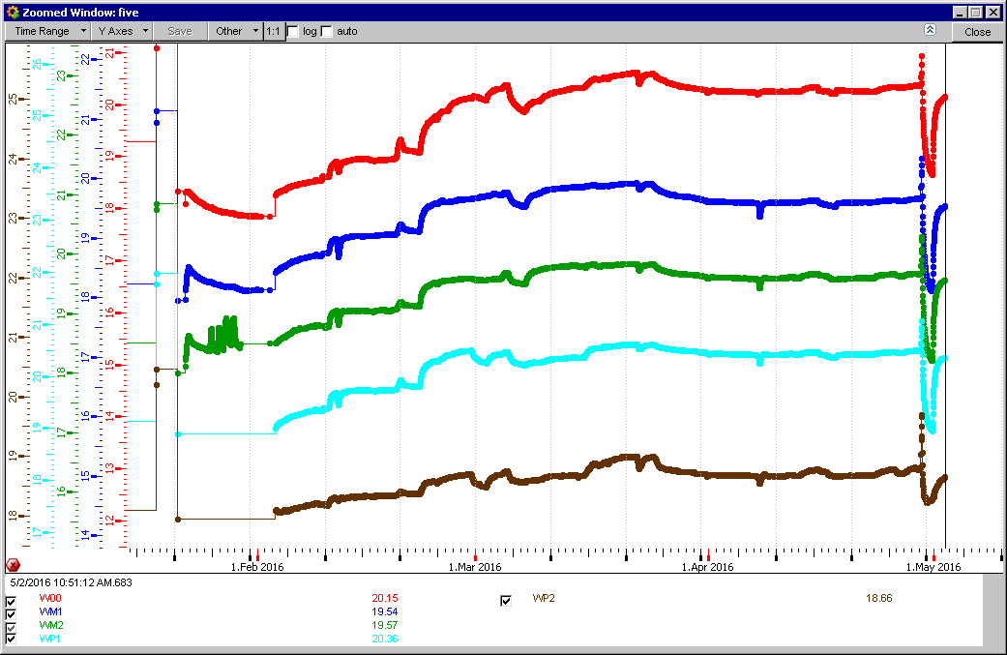
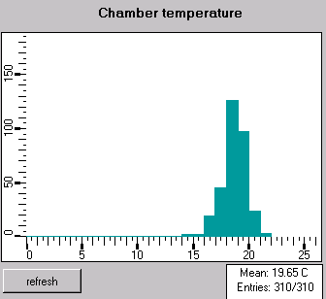
RB Temperatures

Slide 3
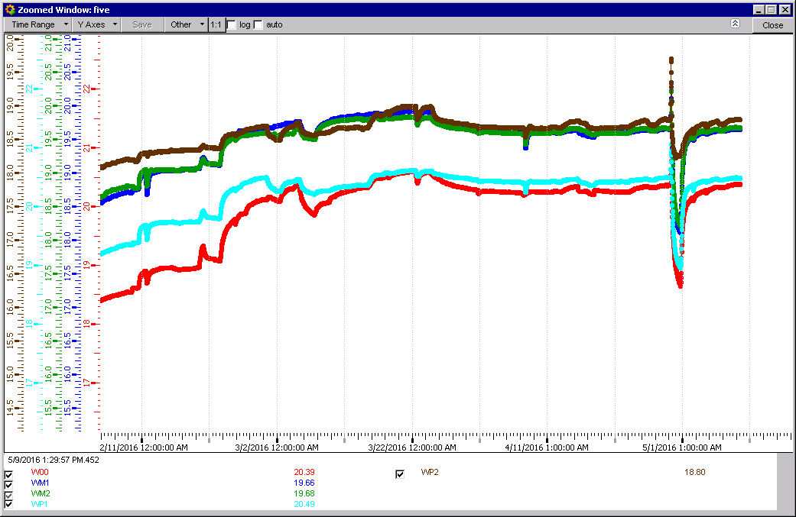
Update since last week.
RB temperatures almost recovered despite glitch due to the mass of the yokes remaining warm

Slide 4
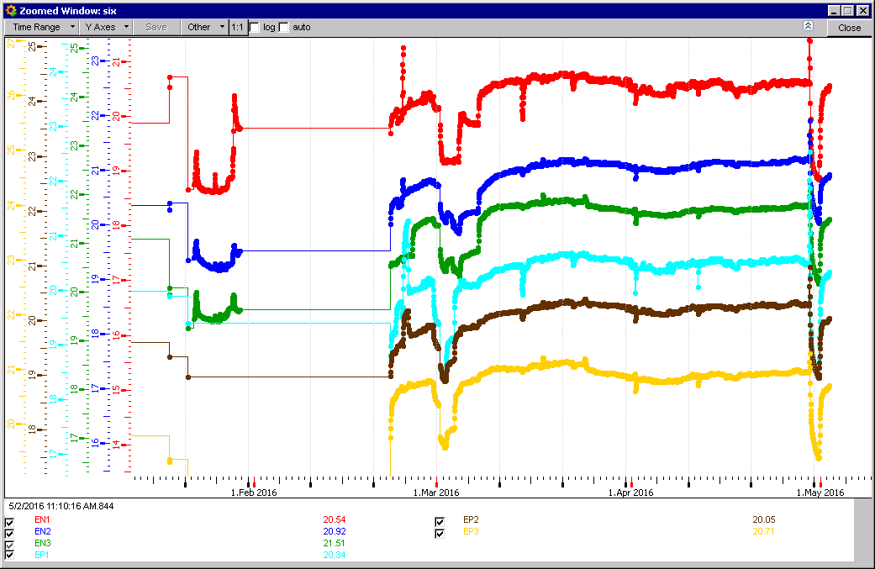
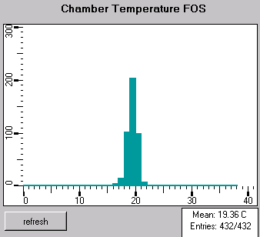
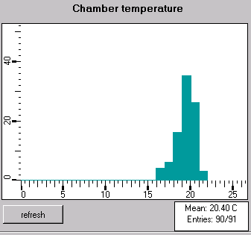
RE Temperatures

Slide 5
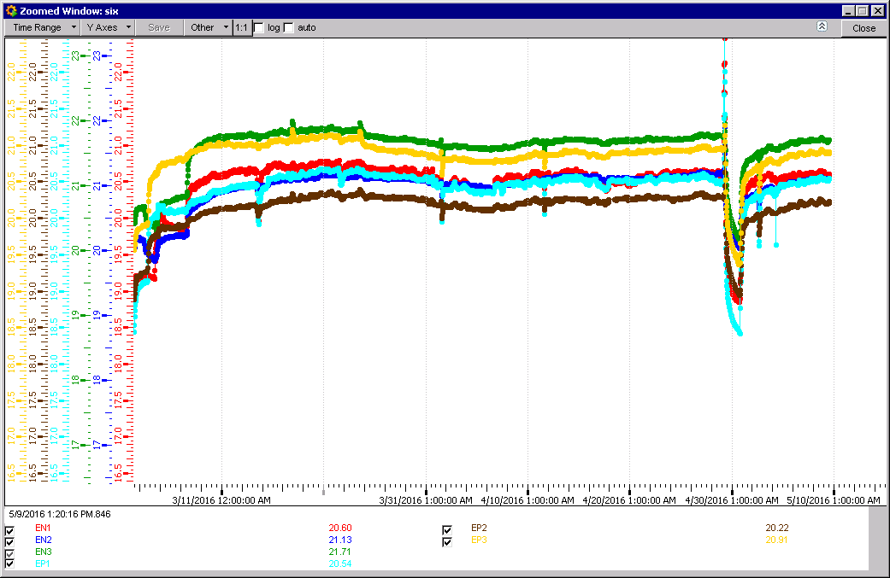
Update since last week.
Almost stable after glitch, only 10 days as temperatures are lower !

Slide 6
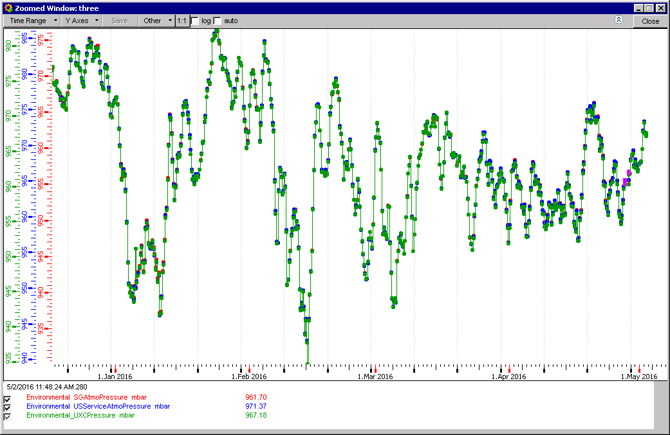
Abs Pressure differences surface & caverns
Pressure is more stable after the winter

Slide 7
Hydrostatic pressure difference surface to USC
UXC
USC
Surface
9.5mBar ~ 80m @ 18degC. This delta h is within a few metres of reality
The 4 mbar delta USC UXC is ~ constant to keep contamination in the Tunnel and not allow entry to the UXC/USC. But not consistent with P dif sensors in “CMS Sensors”

Slide 8
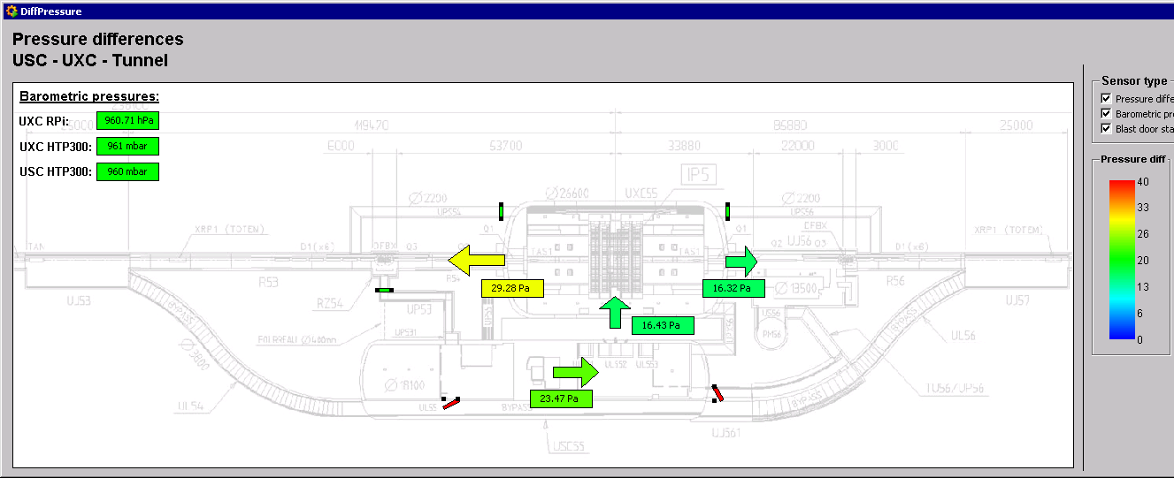
CMS sensors wrt tunnel……….
20 – 30 Pascal is 0.2 - 0.3mBar

Slide 9
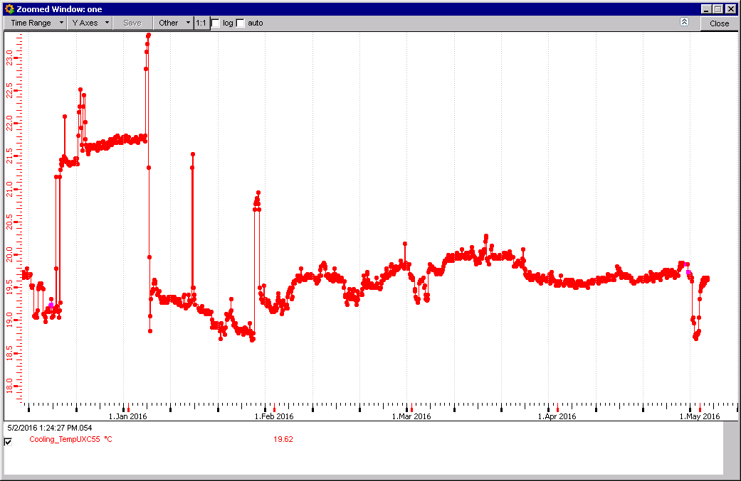
Ambient temp UXC55 cavern
20 degC
19degC

Slide 10
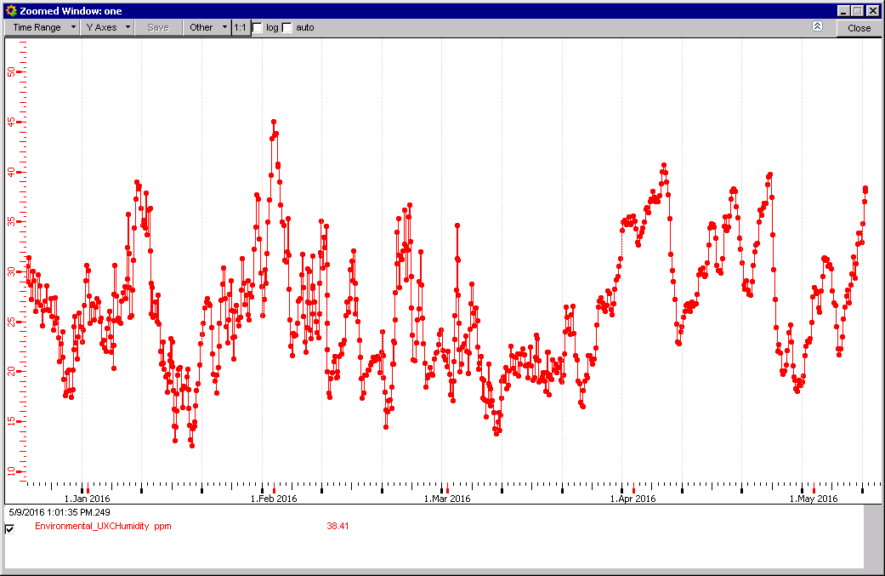
Ambient RH UXC55 cavern
RH around 1 May was low as the temperatures on the surface were low.

Slide 11
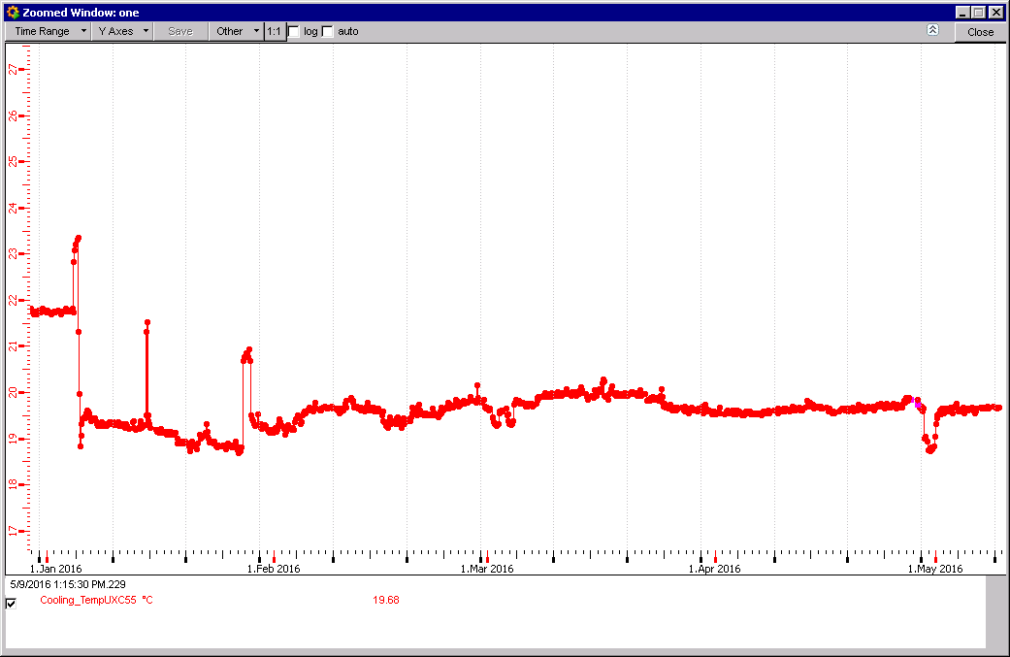
UXC55 Ambient Temperature
Temp drop on Sunday ?

Slide 12
Conclusion
Temperatures are still not stable after YETS.
Glitch end April due to ……..
RB takes almost 2 months to stabilse in temperature.
RE is quicker at < 1 month.
Temp recovery from end april glitch is quick due to Yoke mass.
FOS and ADC temp sensors means in RE are out by 1degC, the dispersion is the similar namely 16 – 22degC.

