Slide 1
Ambient conditions in P5
28 Nov 2016

Slide 2
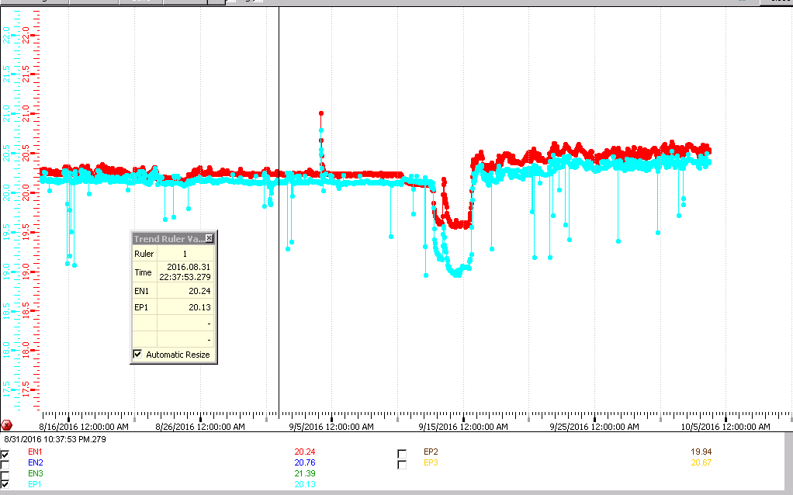
RE-1 and RE+1
0.1 DEG DIFFERENCE

Slide 3
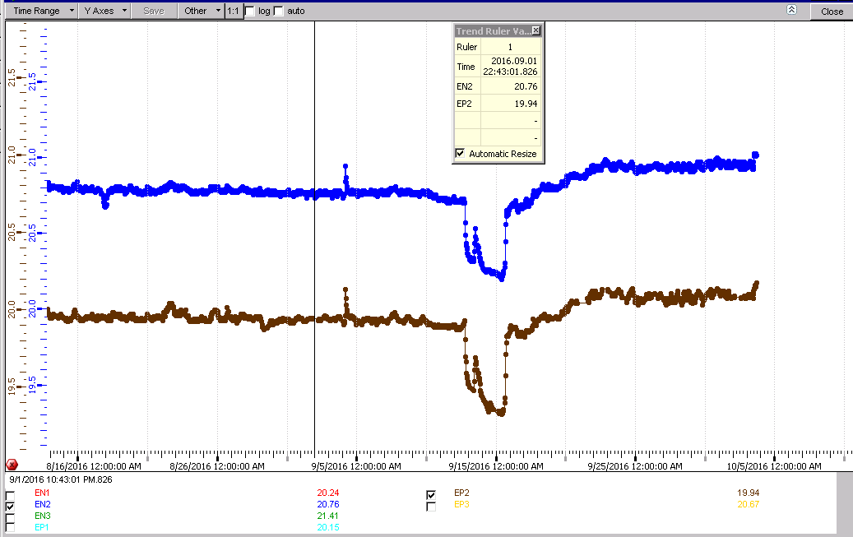
RE+2 & RE-2
0.8deg difference

Slide 4
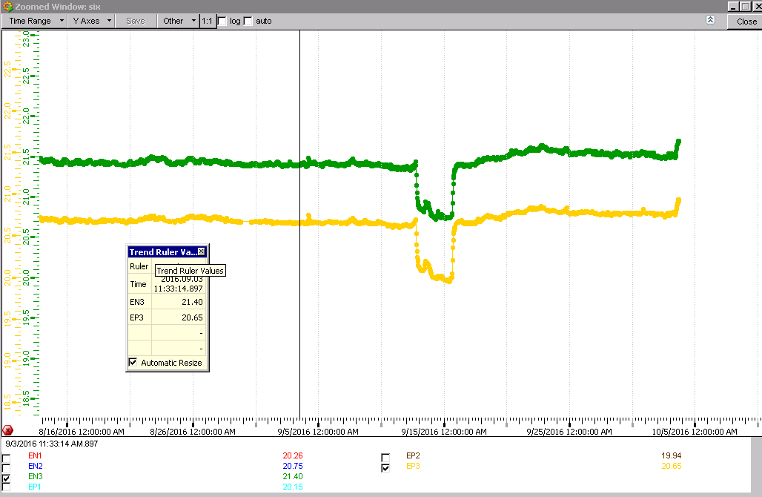
RE+3 & RE-3
0.75degC difference

Slide 5
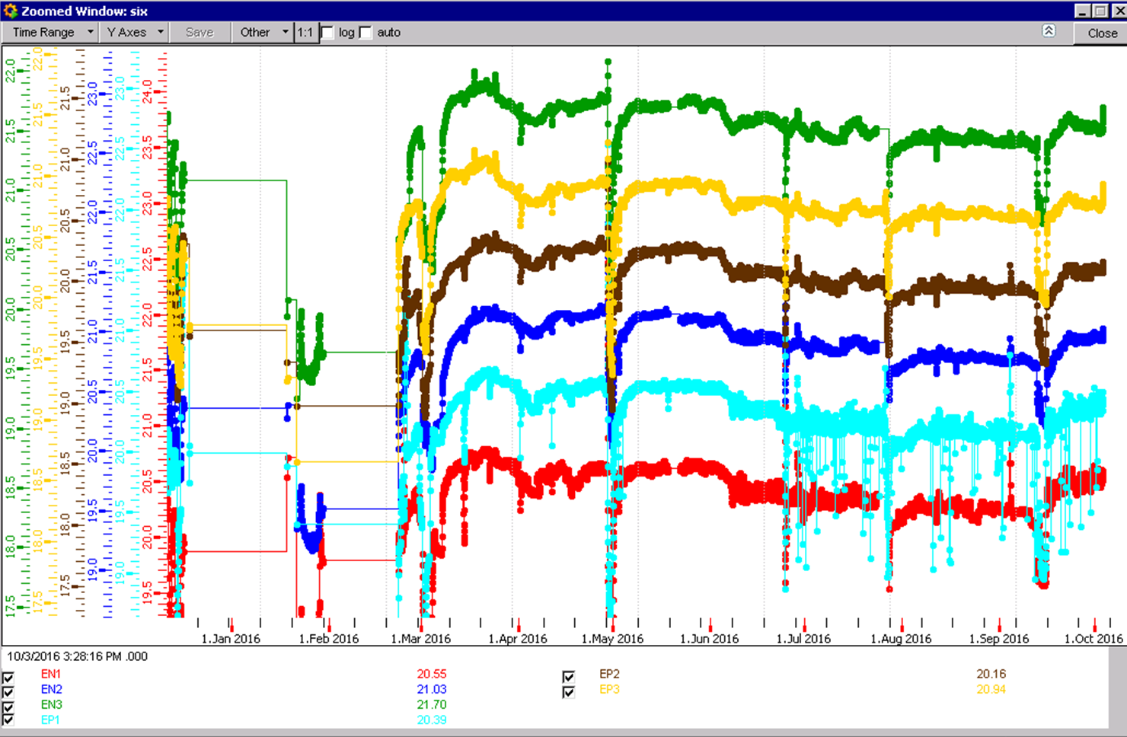
RE Decrease in temp since March
0.5 deg decrease

Slide 6
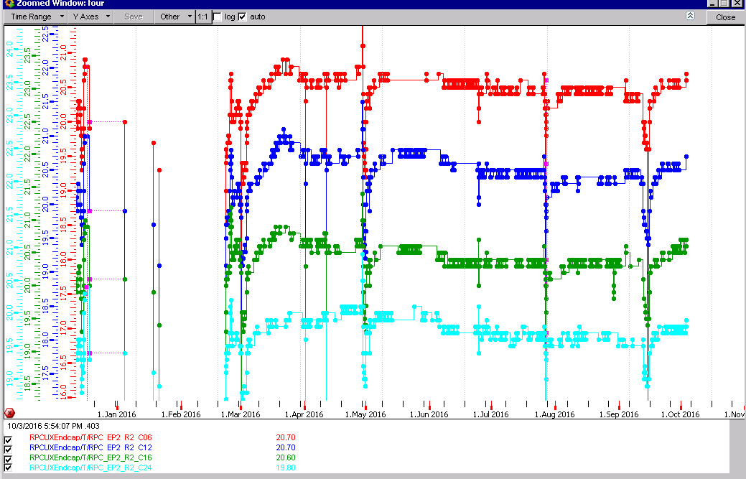
RE+2 temp sensors

Slide 7
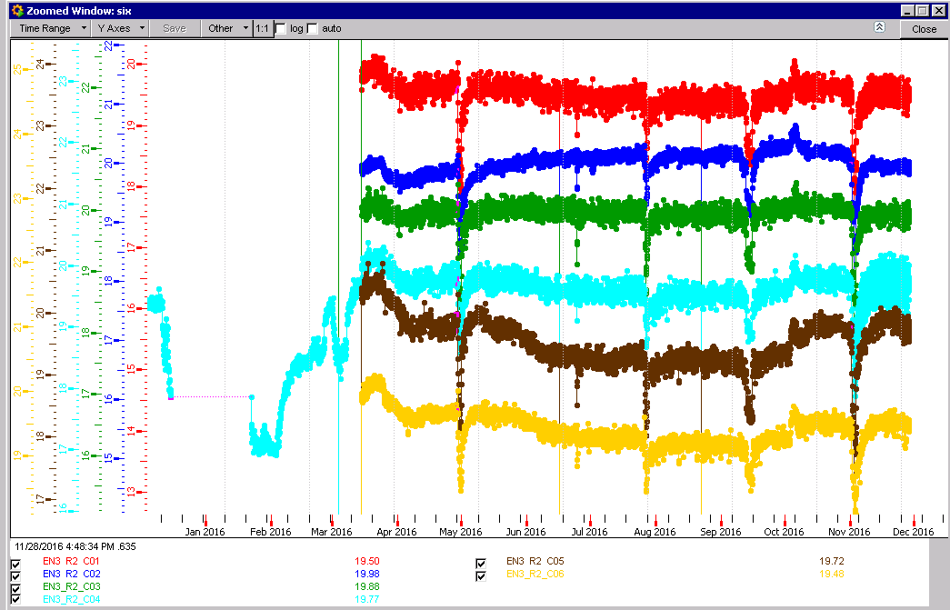
Full 2016 FOS RE-3/3/1-6

Slide 8
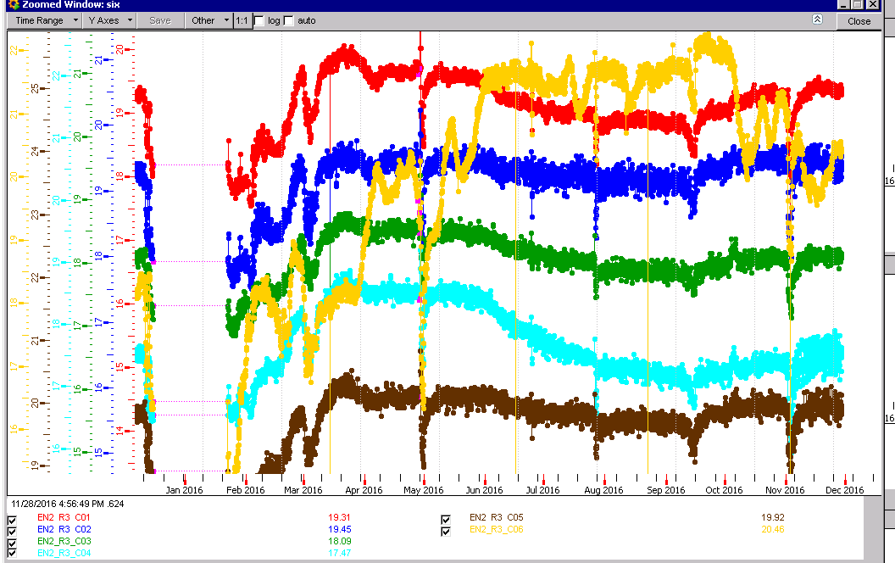
Full2016 RE-2/3/1-6 FOS

Slide 9

Full 2016 RE-2/3/1-6 FOS

Slide 10
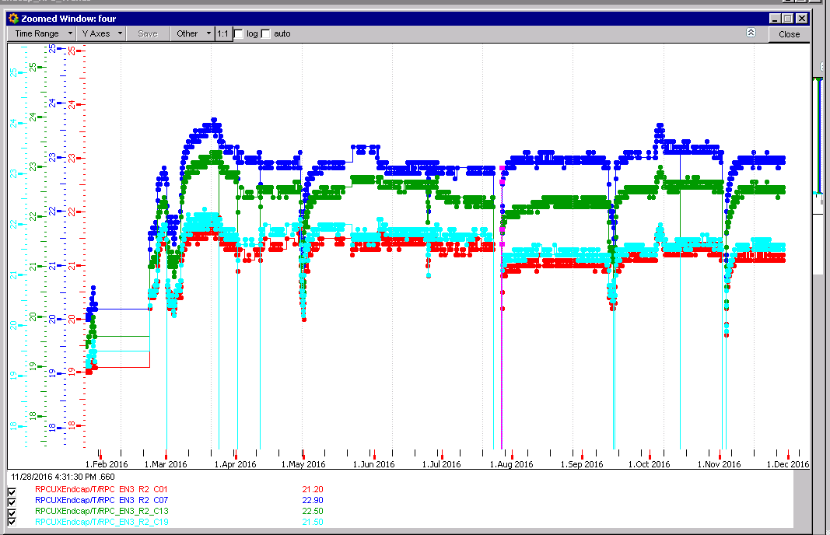
RE-3/2/1,7,13 & 19

Slide 11
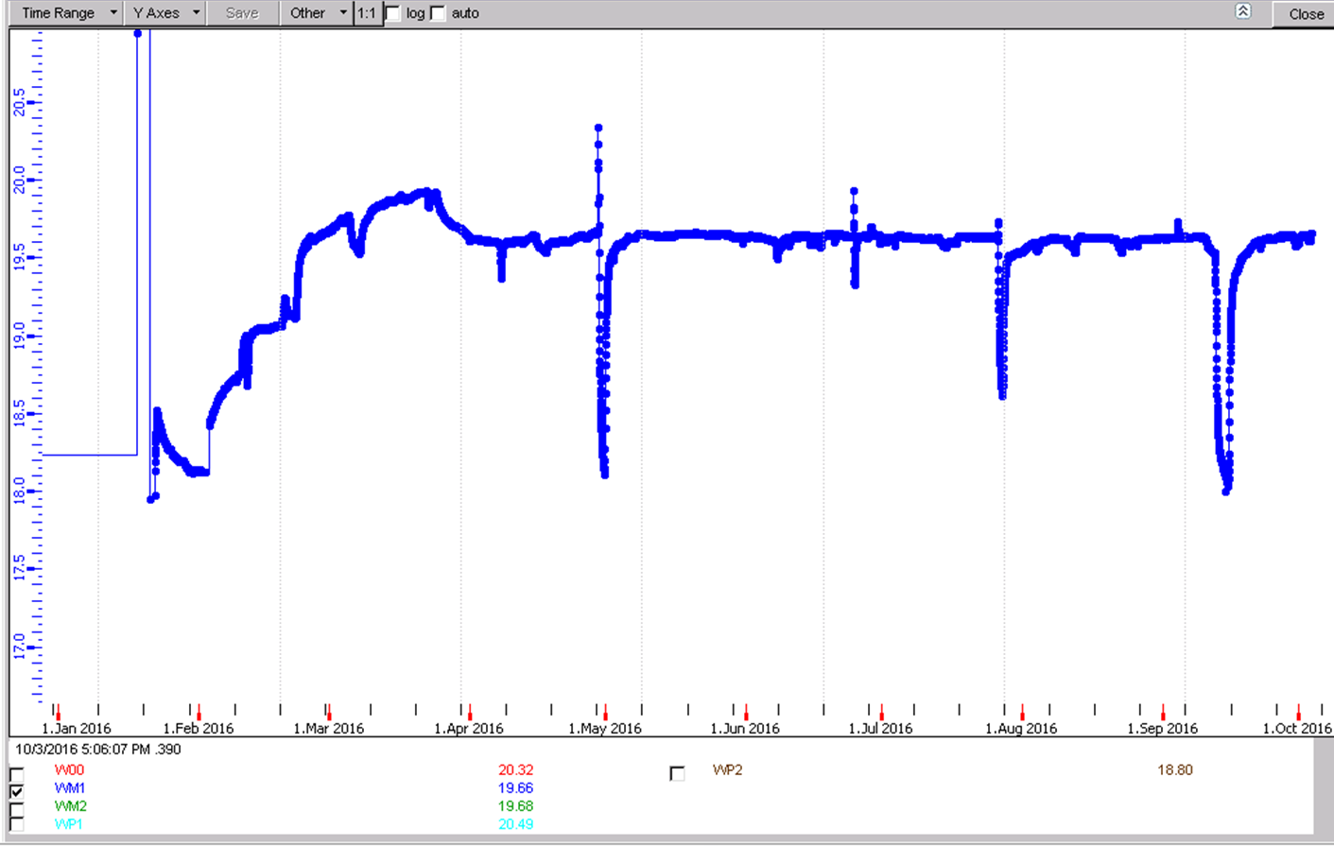
RB Wheel-1
Imperceptible temp change since April 2016

Slide 12
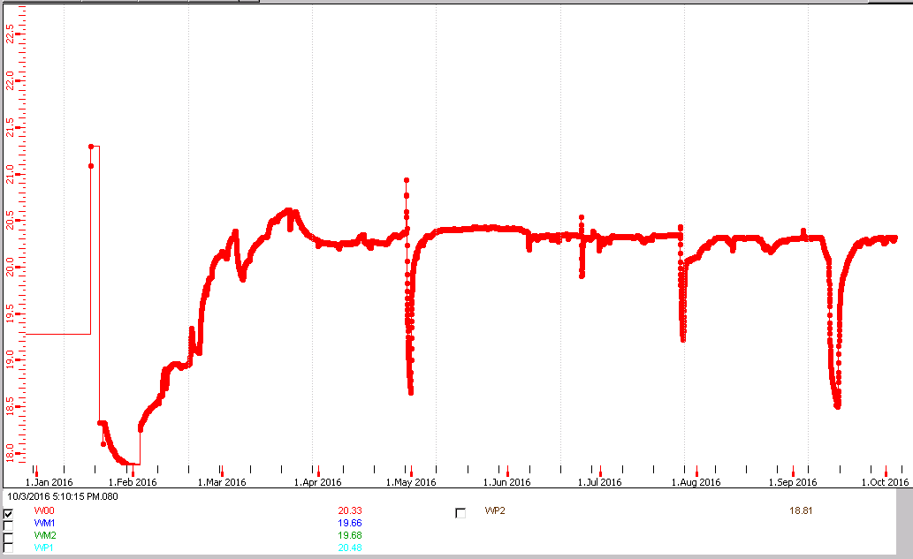
RB Wheel 0
0.1degC temp change since April 2016

Slide 13
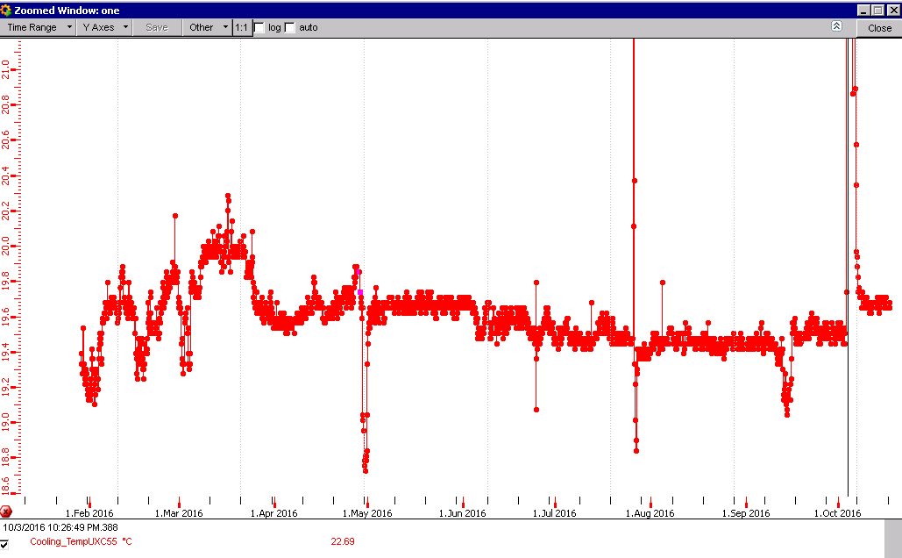
UXC Temp this year
After 3 day jump April temp restablished
Temp decrease over year

Slide 14
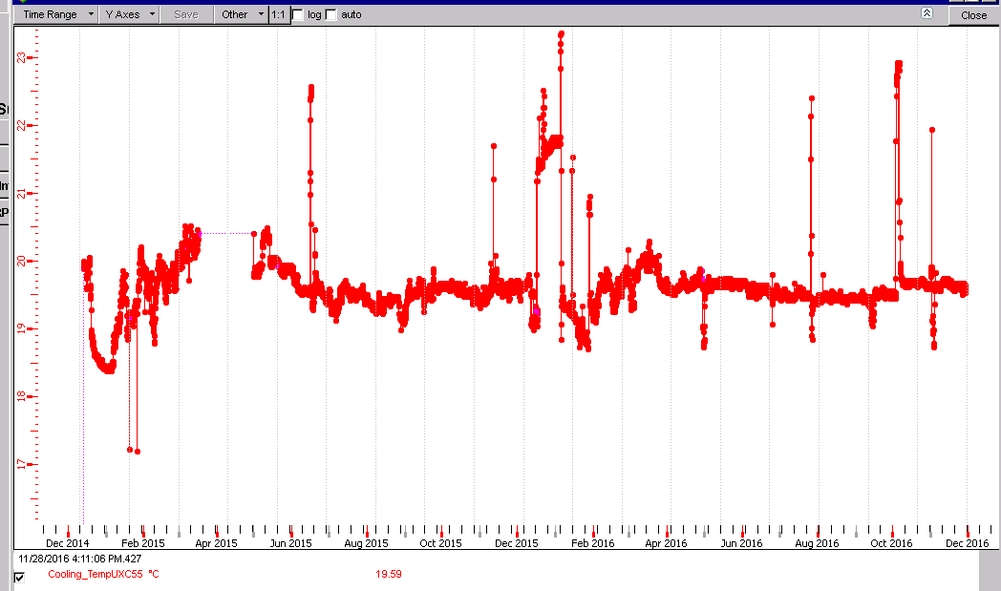
Full 2015 & 2016

Slide 15
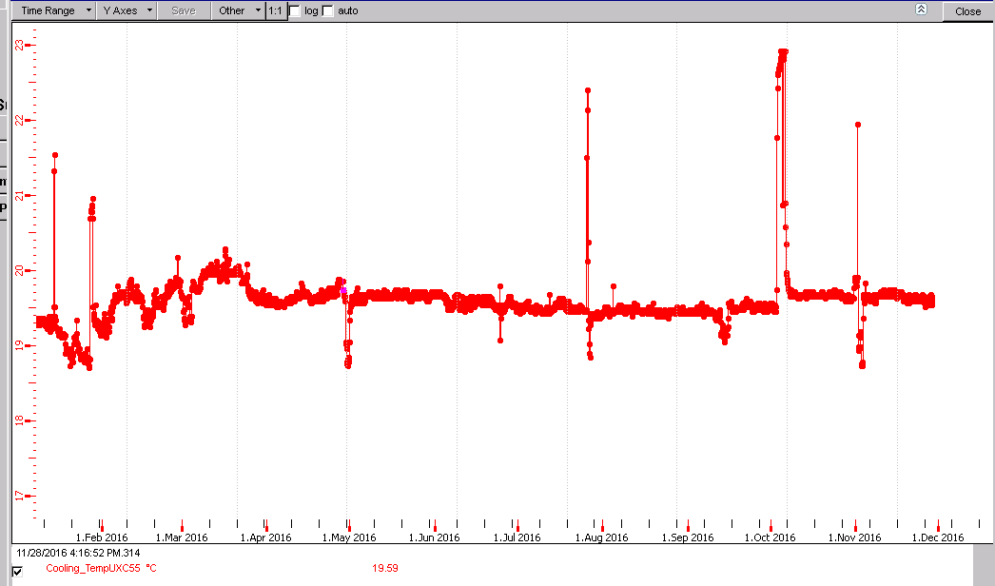
Full 2016

Slide 16
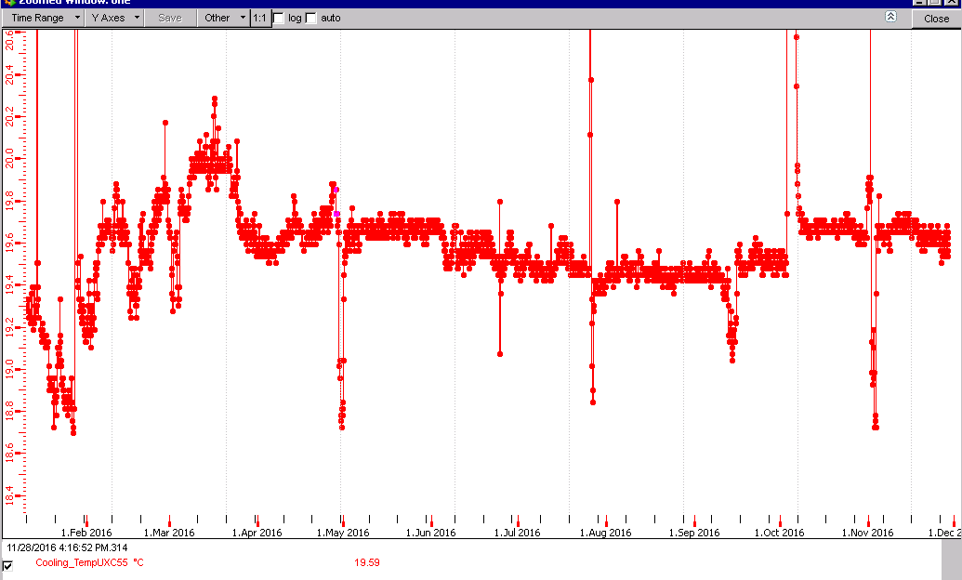
Full 2016

Slide 18
Conclusions
Temperature instabilities in RE+1 & RE-1 after TS in September.
RE-2/3/6 increased in temp until XXX
Temperature increase after TS.
RE temperatures decrease since April by 0.5degC
Short term changes and long term trends.

