Slide 1
Ambient P5 UXC
5 Oct 2015
All plots are over 10 days duration

Slide 2
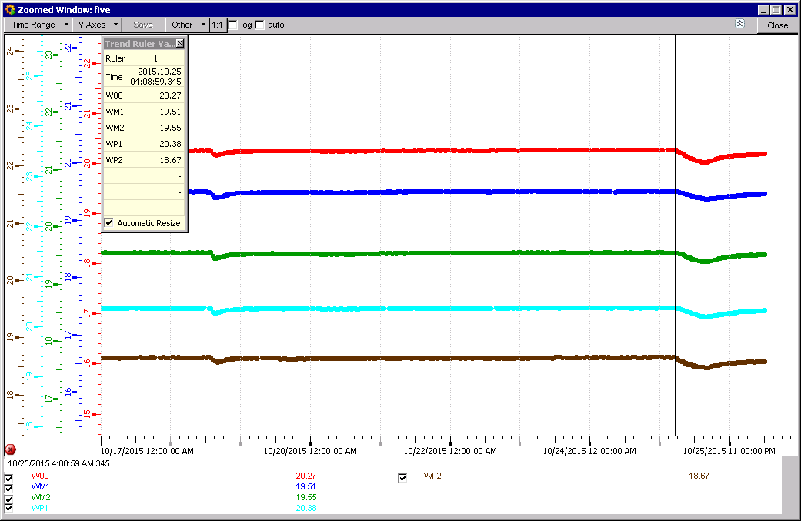
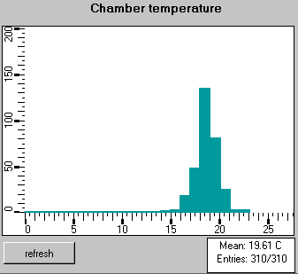
RB drops on each Sunday shown this time at 4am !

Slide 3
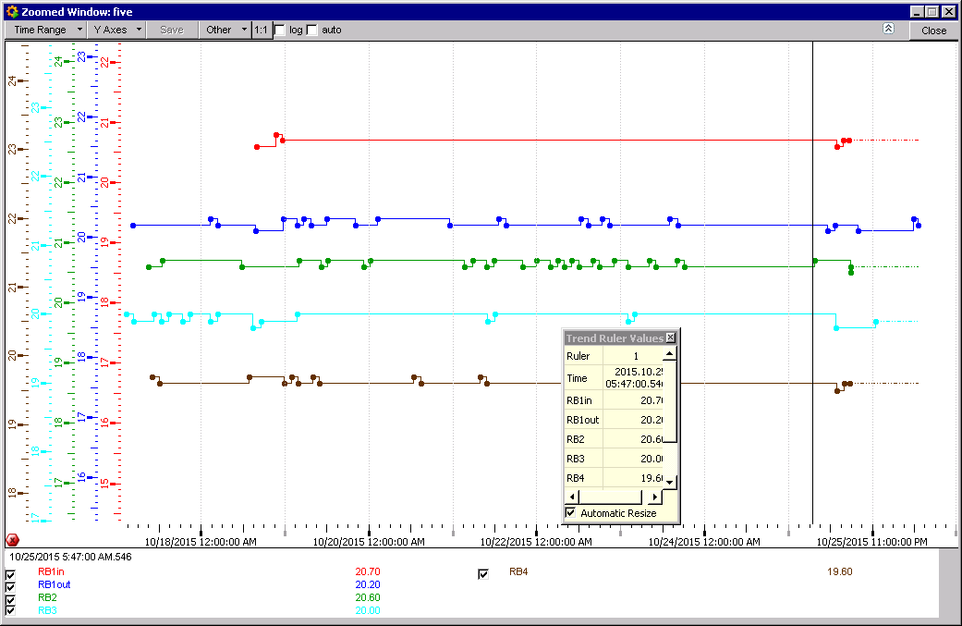
Temperatures. Wheel Zero Sector 12

Slide 4
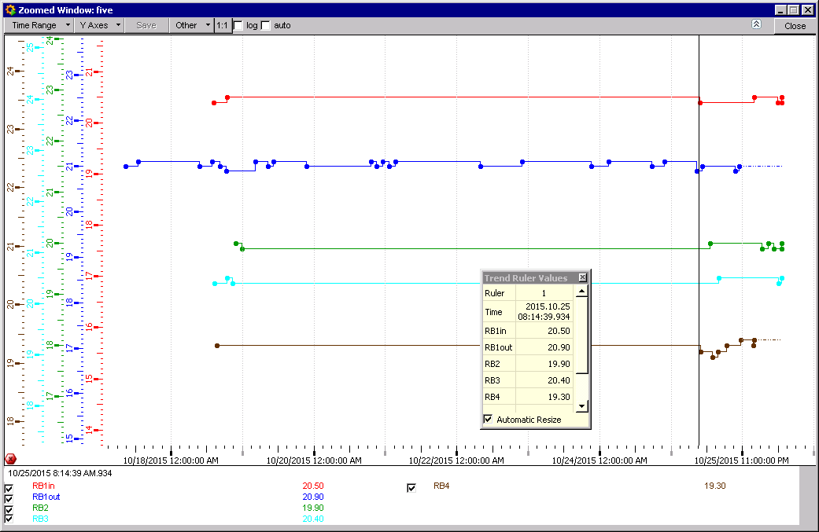
Wheel 0 Sector 8

Slide 5

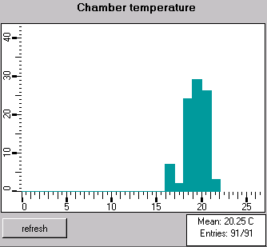
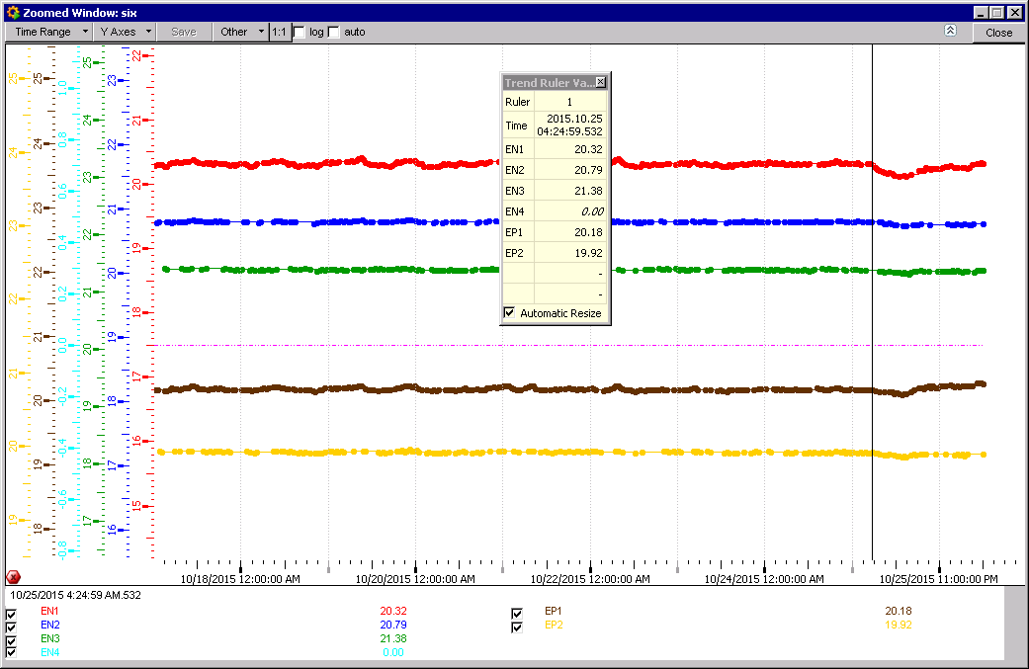
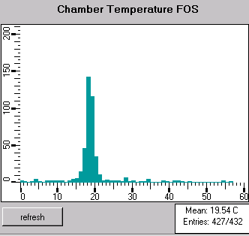
We have lost RE+3, instead it is marked RE-4

Slide 6
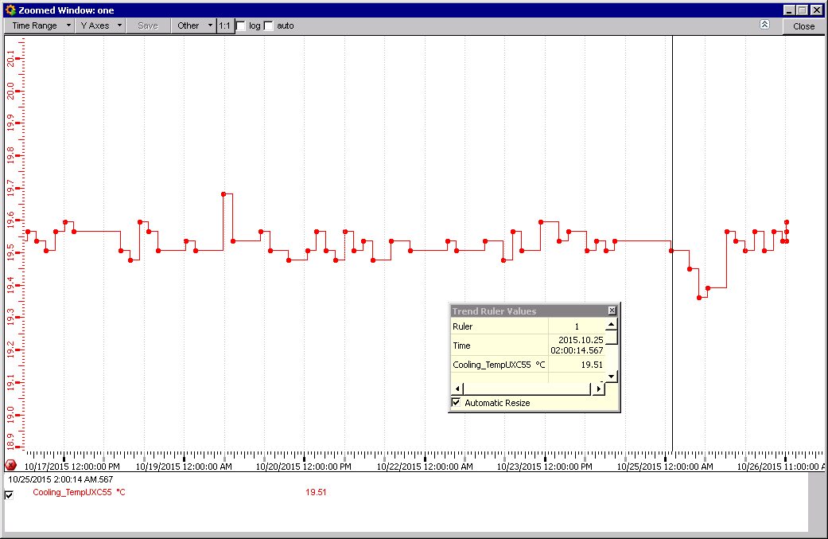
UXC55 Ambient Temperature
Temp drop on Sunday ?

Slide 7
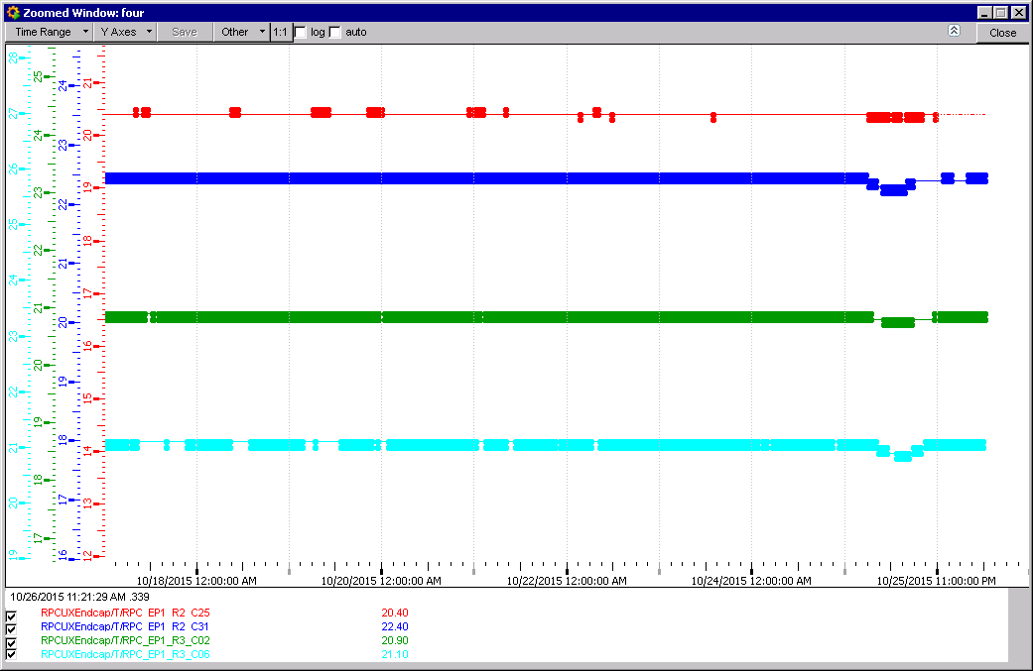
YE+1 also see the Sunday drop in Temperature between the yokes.

Slide 8
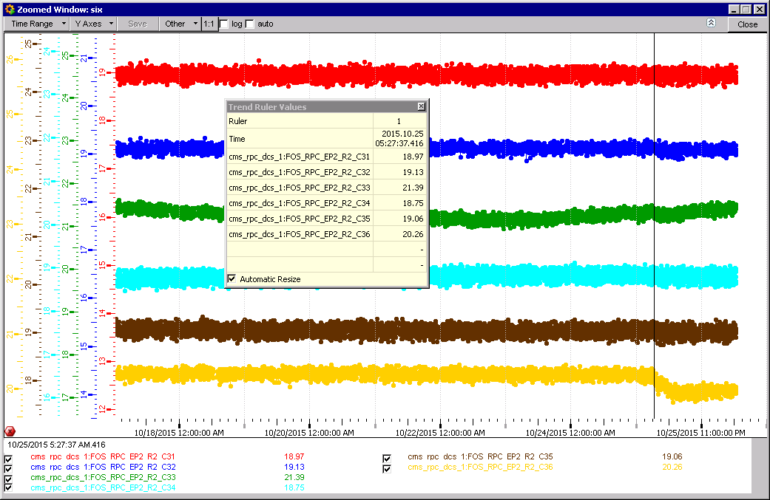
RE+2 FOS sensors
Individual FOS temperatures. Only one shows the temp. drop.

Slide 9
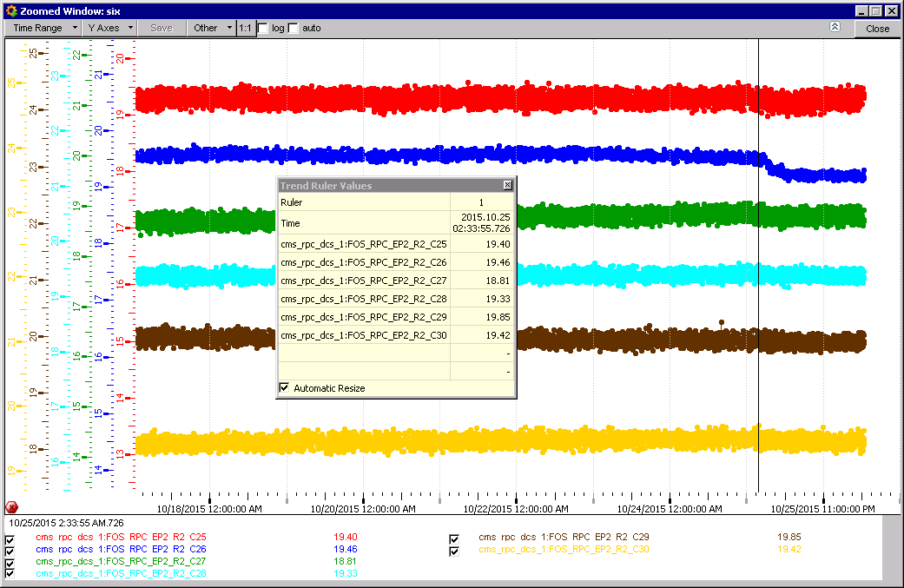

Slide 10
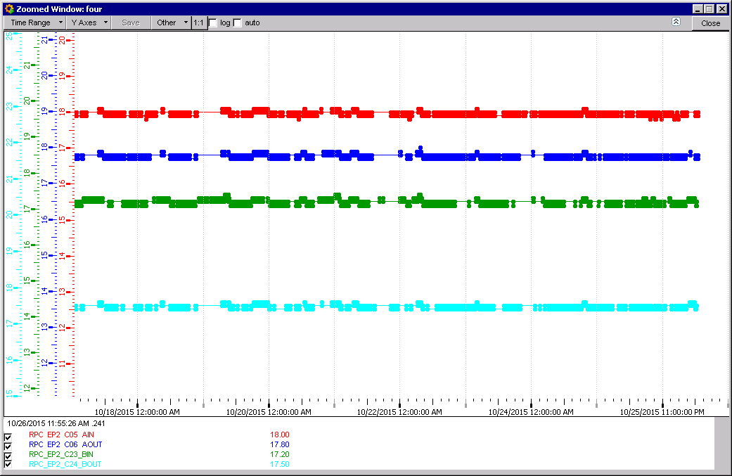
Coolant temperature RE+2

Slide 11
Conclusion
Stable temperatures.
Strange drop on 2 previous Sundays, especially yesterday.
Andres reports that the magnet ramped at 4am Sunday consequences for consumed power.

