Slide 1
Ambient conditions in P5
17 Oct 2016
Ian Crotty

Slide 2
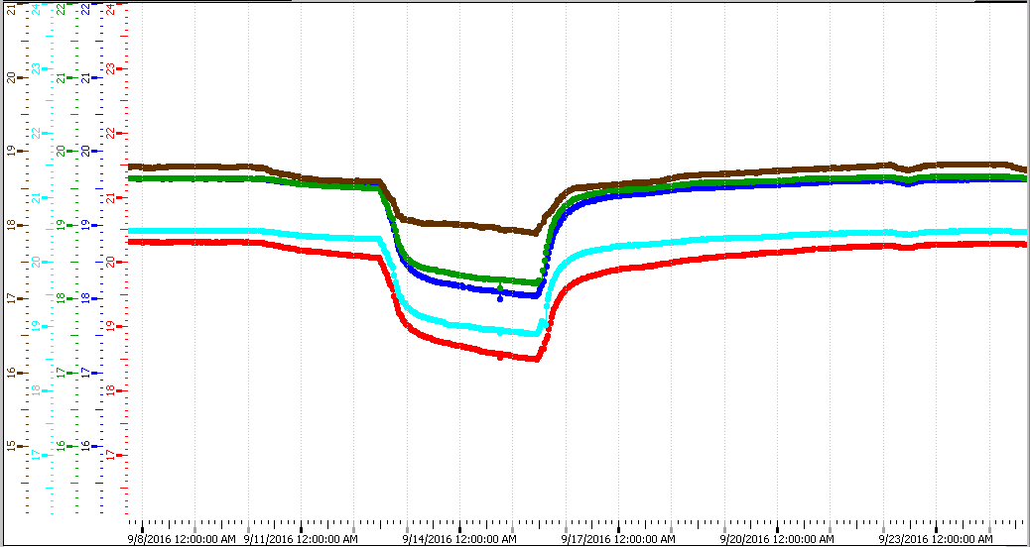
RB temperatures
Technical stop 12- 16 Sept 2016

Slide 3
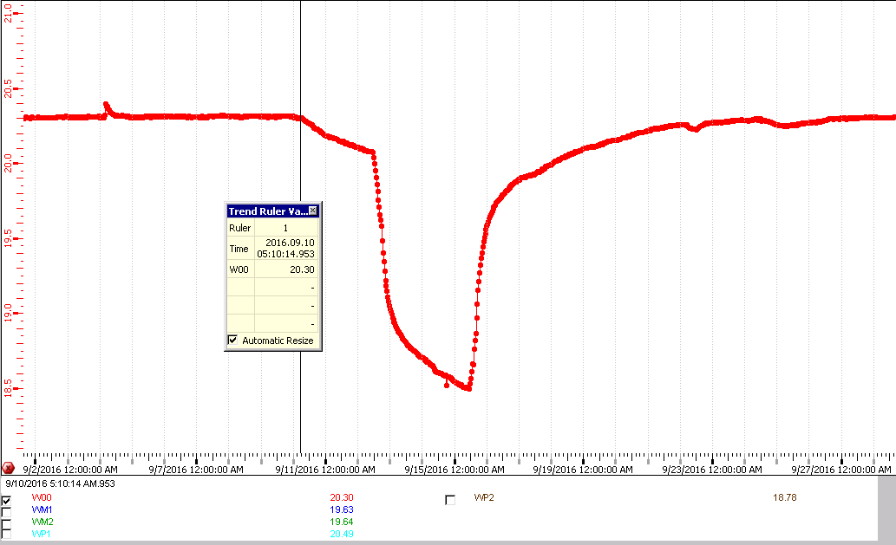
WB0 temp response during TS

Slide 4
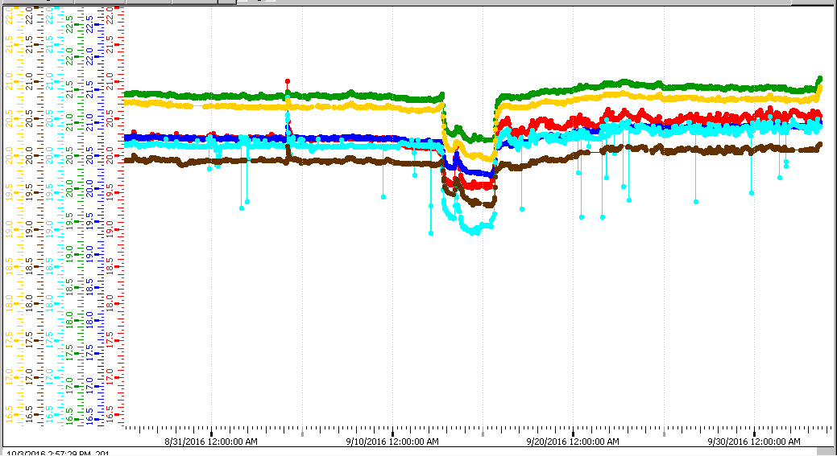
RE Temperatures
Some level of instabilities after TS

Slide 5
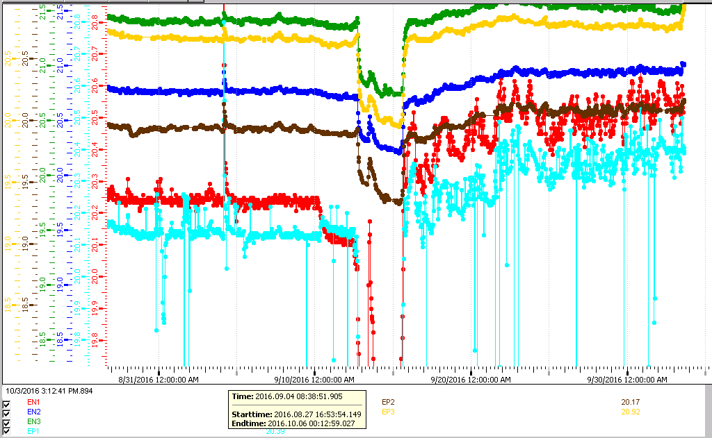
RE +1 has the only noisy channels
Temp. increase after TS
Greater oscillation in RE1s after TS
Noise is present only on RE+1

Slide 6
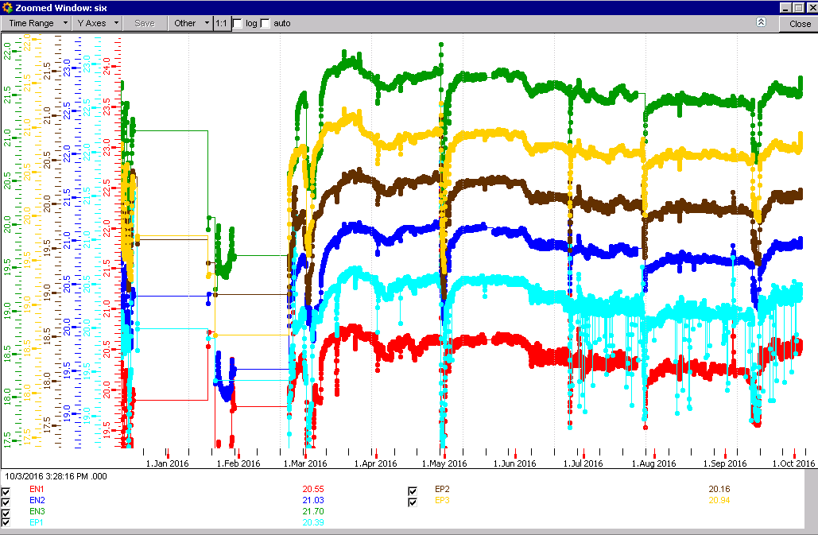
RE temperatures 2016
Noise increase REP1
On 24 June 2016

Slide 7
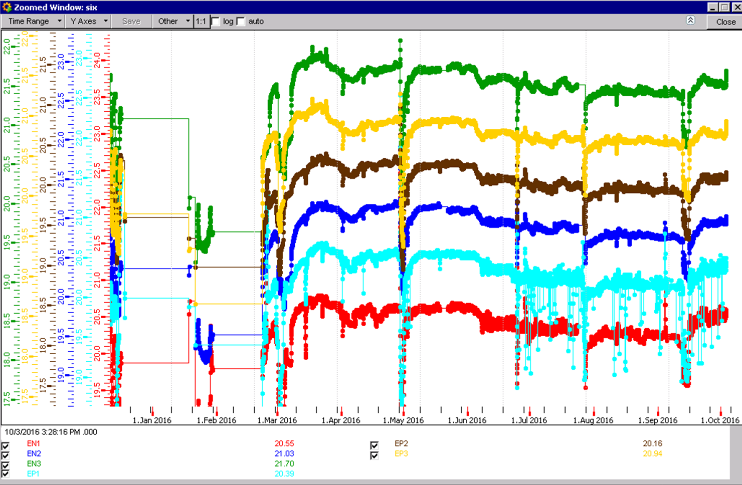
RE Decrease in temp since March
0.5 deg decrease

Slide 8
Humidity

Slide 9
Temp REs 2015

Slide 10
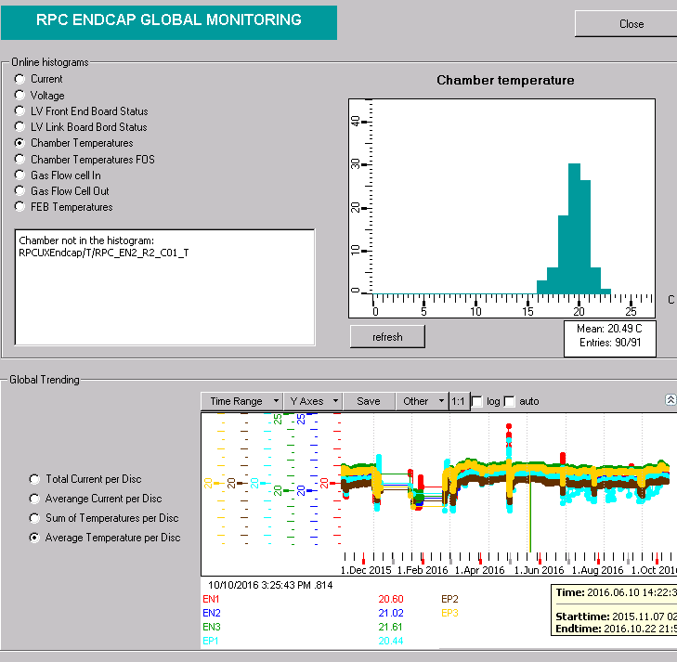
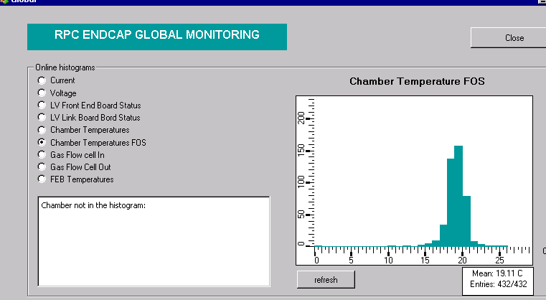
FOS what do they tell us
CAEN ADC temp sensors on RE1, 2 & 3
FOS temp sensors on RE2, 3 & 4

Slide 11
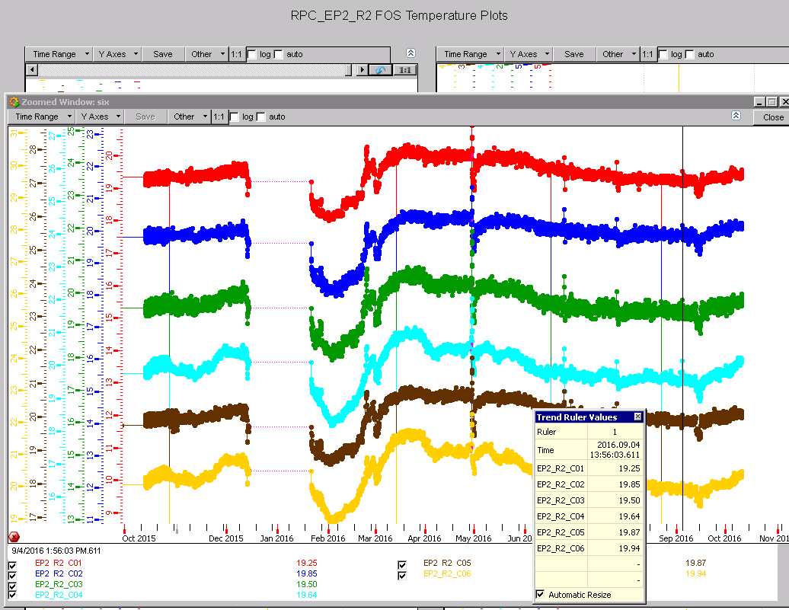
RE+2/2/1-6 FOS since Oct 2015

Slide 12
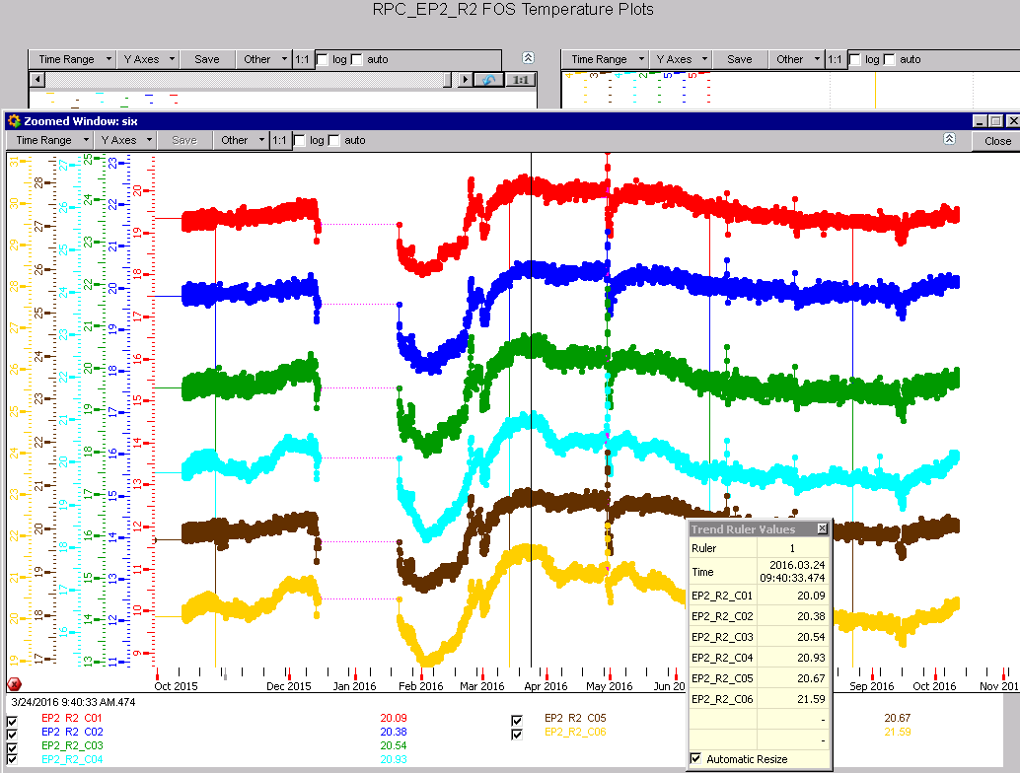
RE+2/2/1-6 FOS since Oct 2015

Slide 13
Temp differences year 2016

Slide 14
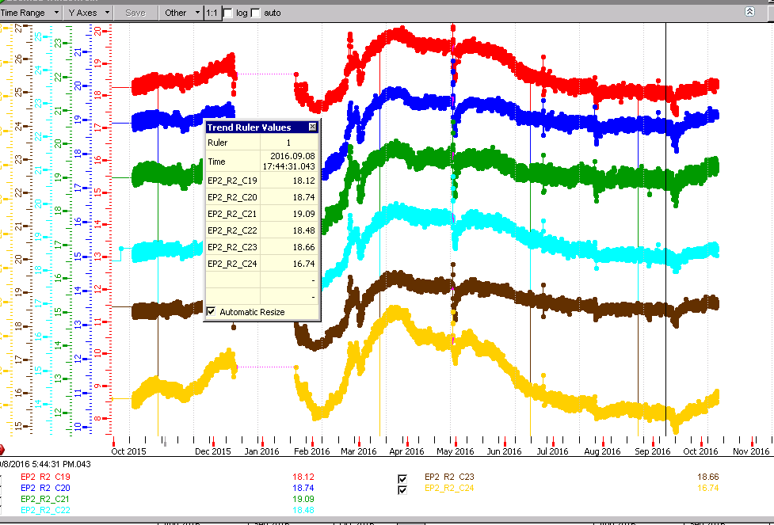
RE+2/2/19-24 FOS since Oct 2015

Slide 15
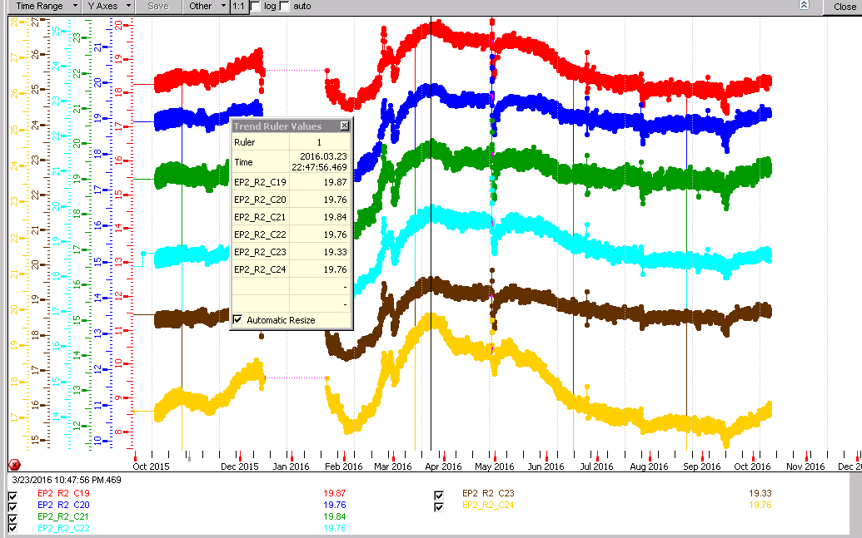
RE+2/2/19-24 FOS since Oct 2015

Slide 16
Temp differences

Slide 17
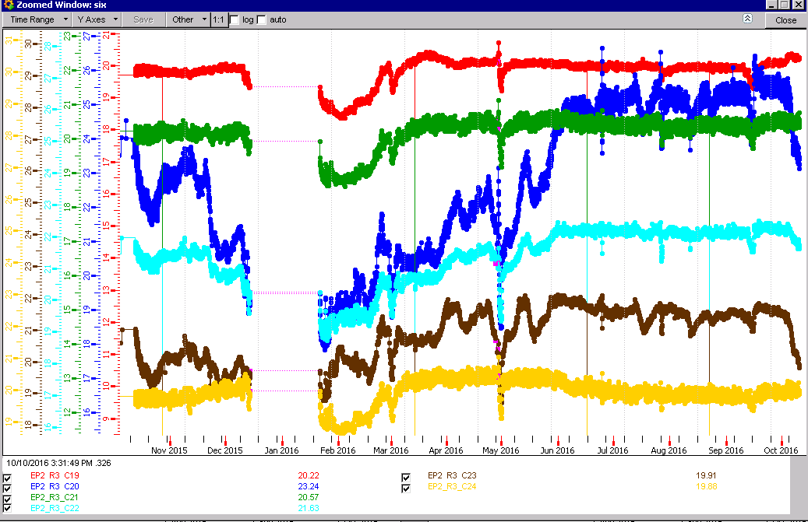
RE+2/3/19-24 FOS since Oct 2015

Slide 18
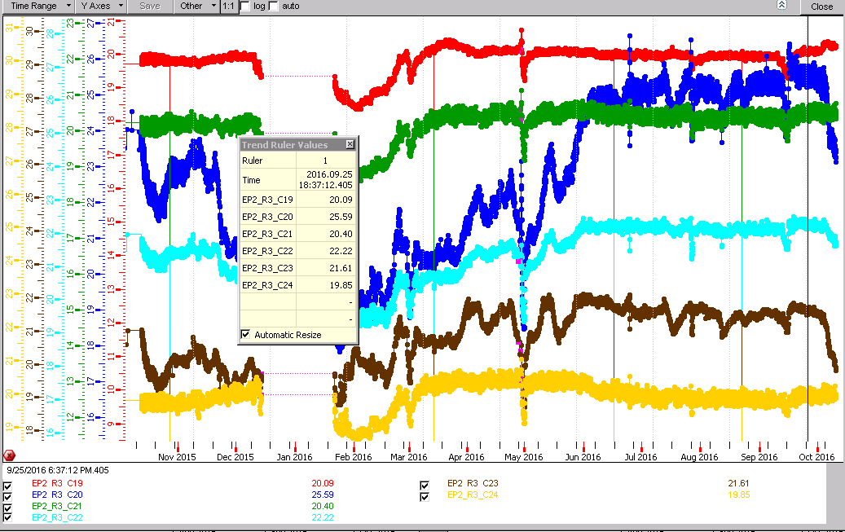
RE+2/3/19-24 FOS since Oct 2015

Slide 19

RE+2/3/19-24 FOS since Oct 2015

Slide 20
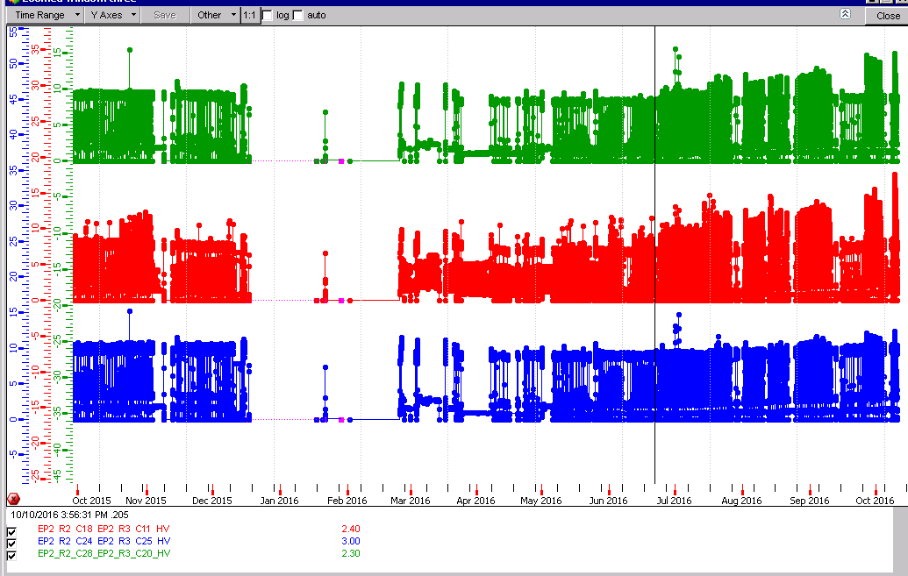
Currents of RE+2/3/20 (and 28)

Slide 21
RE+2/3/20

Slide 22
Temp difference top to bottom

Slide 23
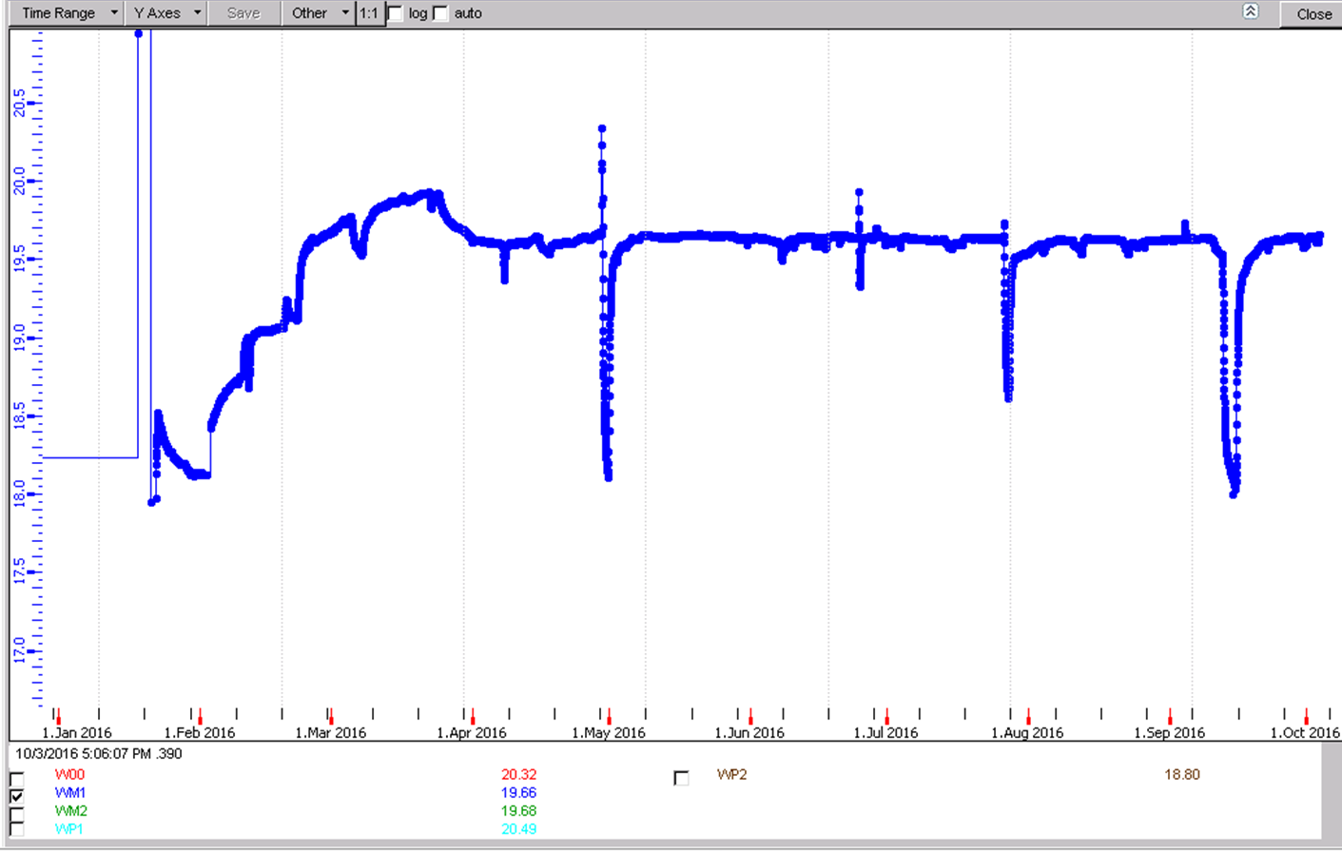
RB Wheel-1
Imperceptible temp change since April 2016

Slide 24
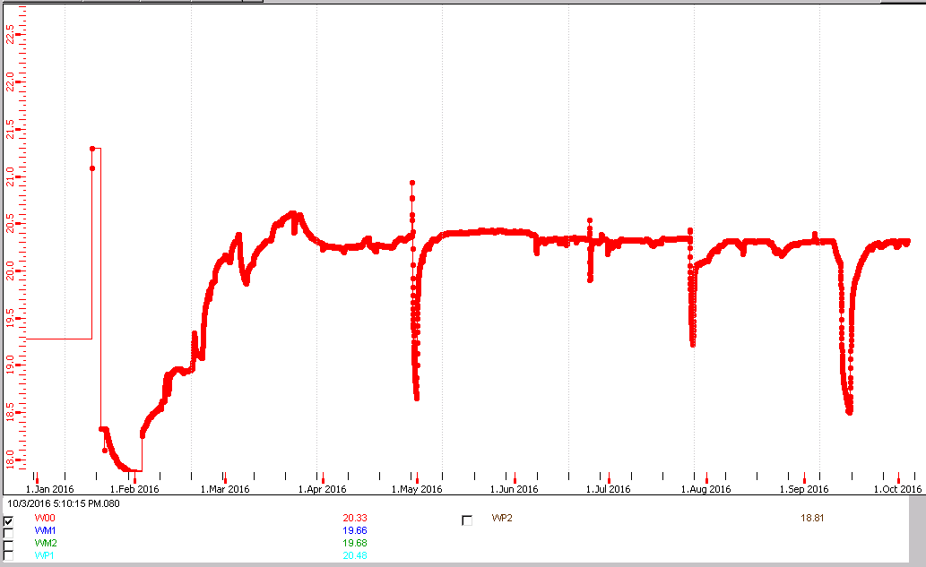
RB Wheel 0
0.1degC temp change since April 2016

Slide 25
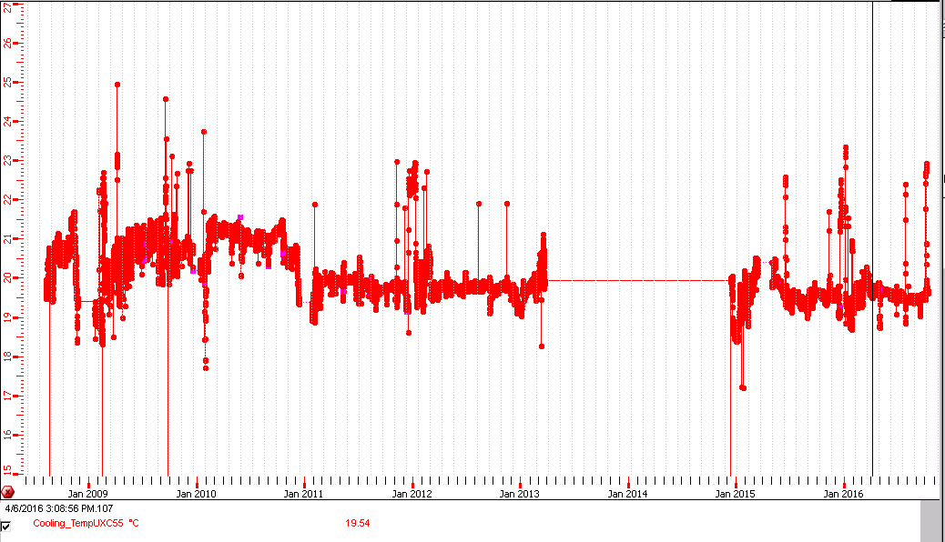
Alarm in UXC55 >22degC
Large prolonged excursions are rare over the last 7 years

Slide 27
Conclusions
Temperature instabilities in RE+1 & RE-1 after TS.
Temperature increase after TS.
Noisy channel RE+1/1/C01 after 24June2016
RE temperatures decrease since April by 0.5degC
Fos ?
RE+2/3/20 has increasing temp but no(?) current increase.

