Slide 1
Ambient P5 UXC
Compared with Atlas
5 Oct 2015

Slide 2
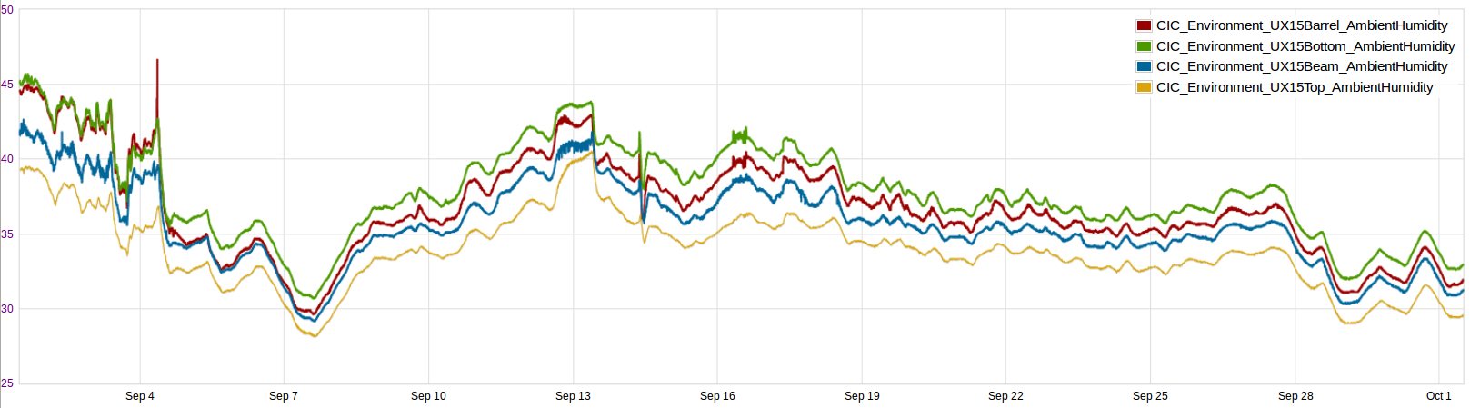
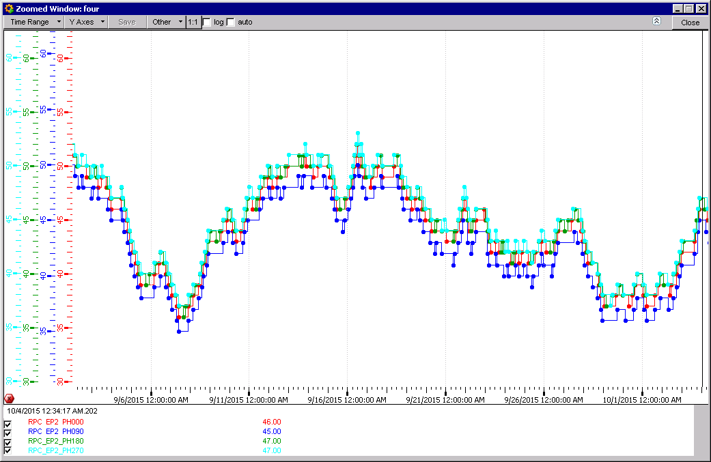
Humidity in Both Caverns
ATLAS
CMS

Slide 3
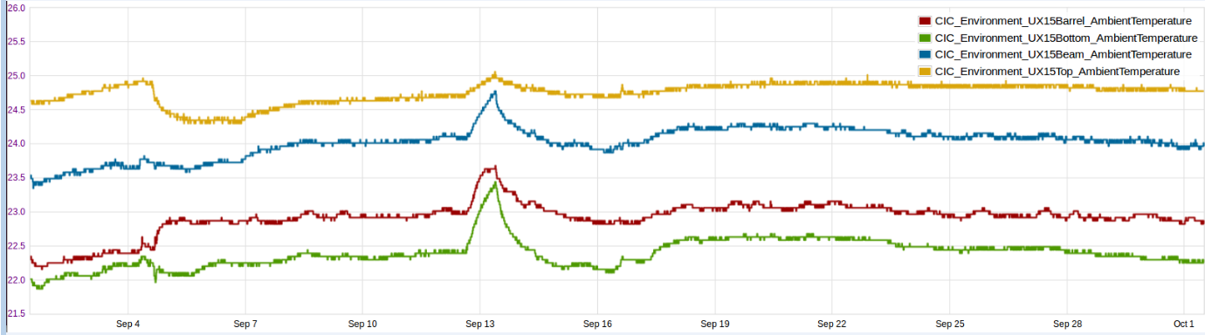
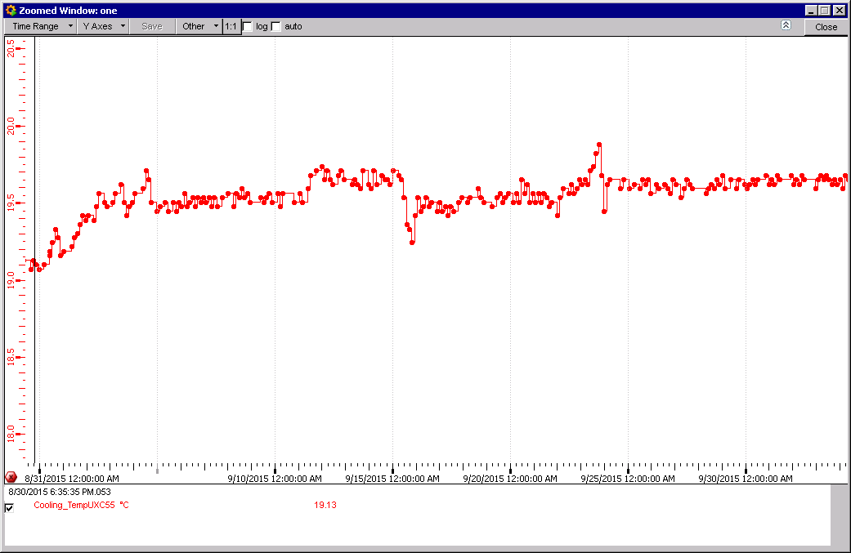
ATLAS Temperature.
CMS Temperature.

Slide 4
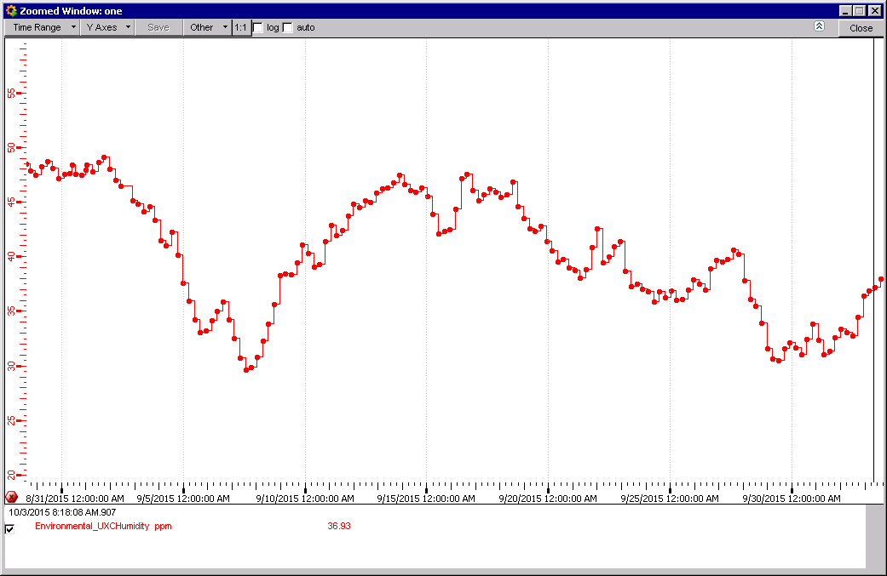
CMS Temperature UXC
CMS UXC RH

Slide 5
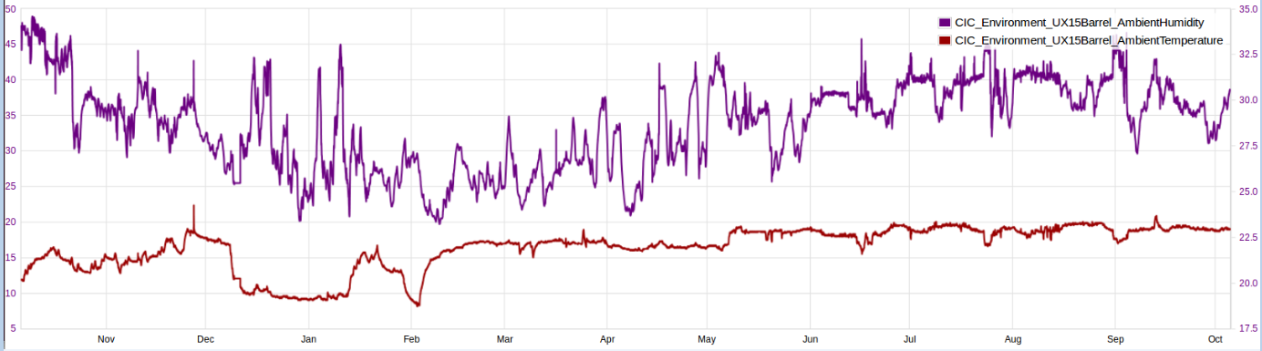
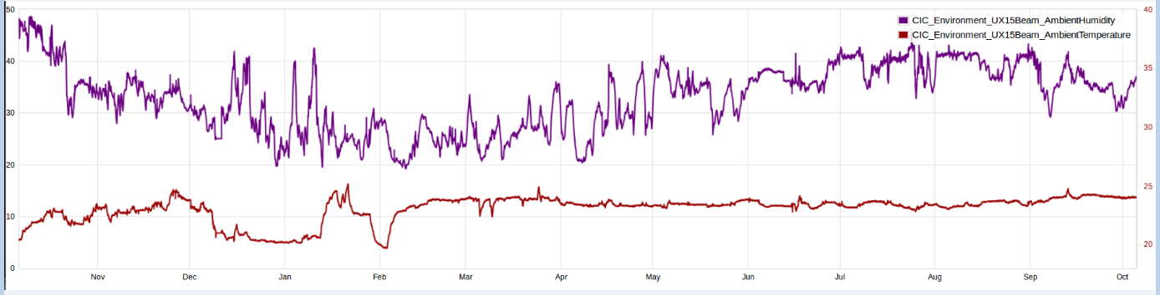
ATLAS RH and Temperature Barrel and Beam

Slide 6
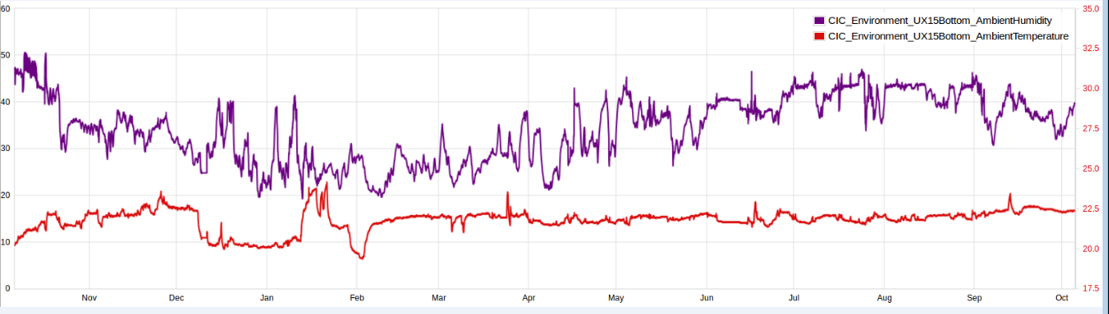
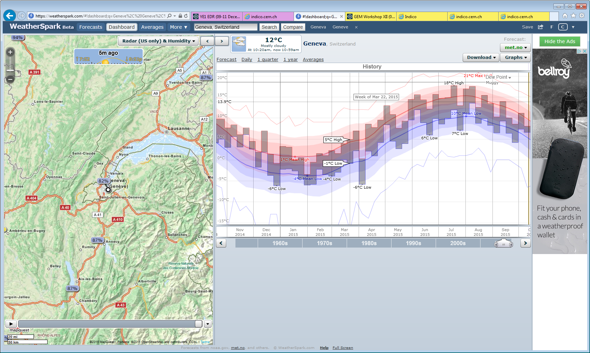
ATLAS RH and Temperature Bottom
DP at Geneve Airport

Slide 7
Conclusion
The Temperature in ATLAS is very stable but warmer (~3degC) than CMS.
The RH in ATLAS and CMS follow similar trends
The RH in ATLAS is 5-10% lower than CMS.But as the indicted temperatures are 3degC higher in ATLAS then the corrected RH gives the same value in both experiments. That is to say is the same.
RH ambient on surface defines the RH in the caverns, except if there is a control as in CMS on the upper limit.

Slide 8
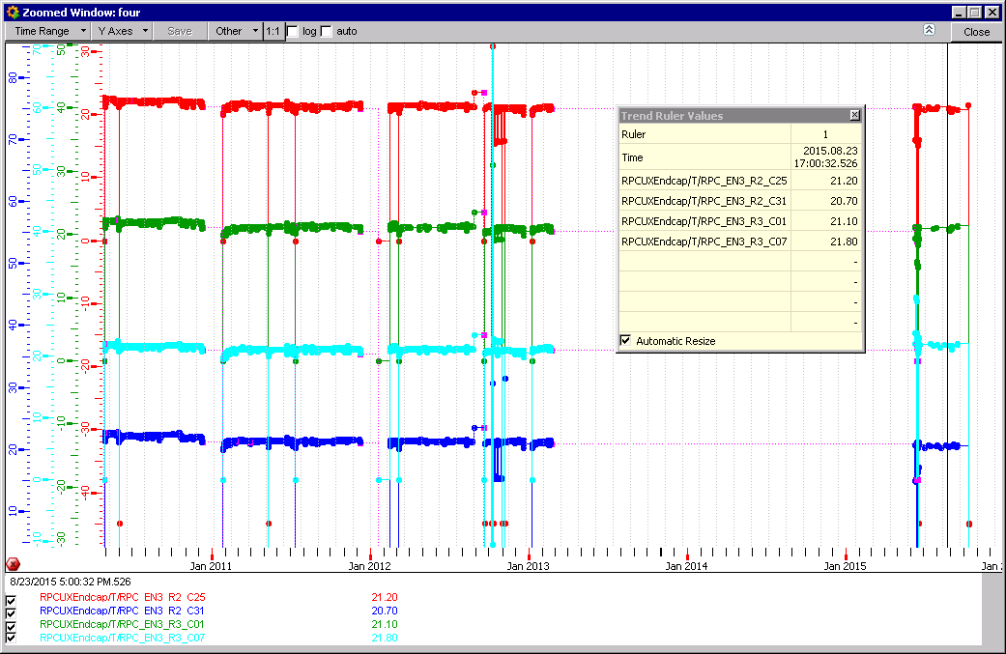
Temperatures in YE-3 since 2010

Slide 9
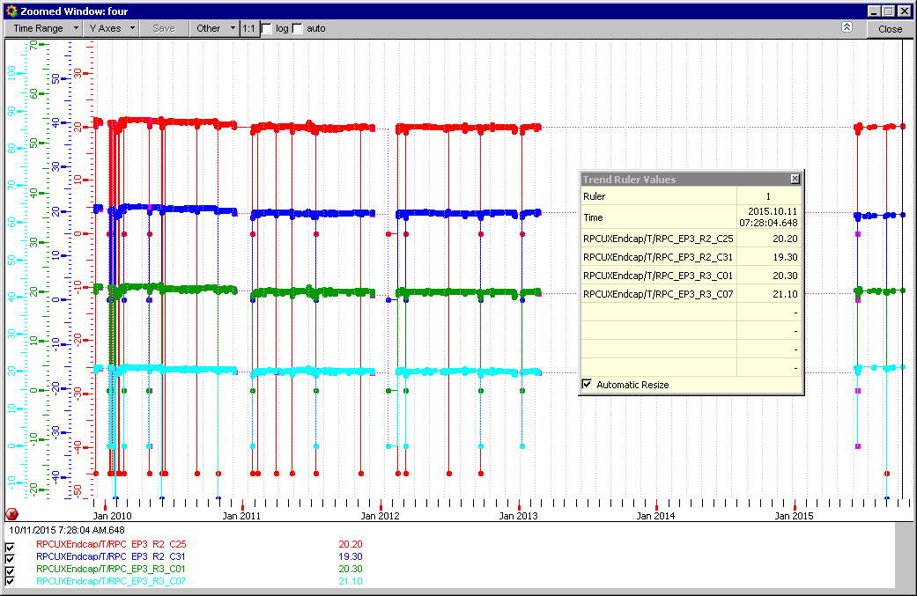
Temperatures in YE+3 since 2010

