Slide 1
Ambient conditions in P5
3 Oct 2016

Slide 2
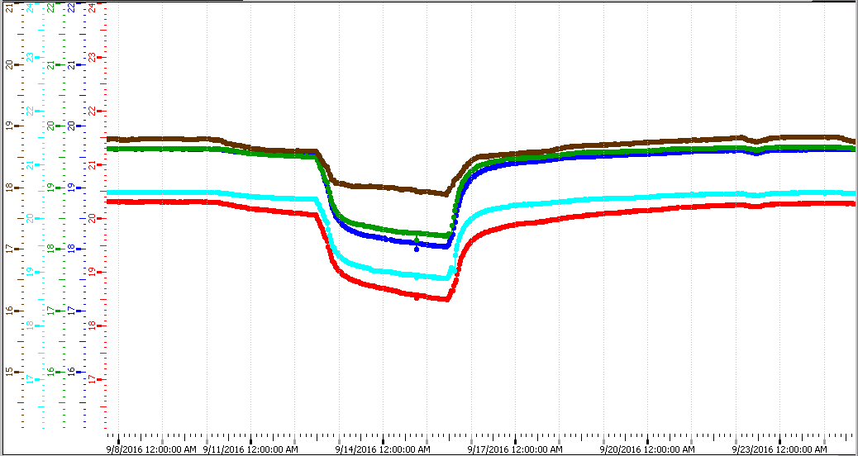
RB temperatures
Technical stop 12- 16 Sept 2016

Slide 3
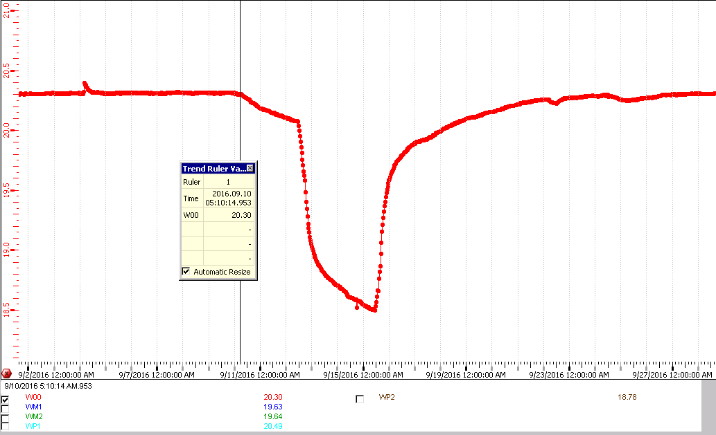
WB0 temp response during TS

Slide 4
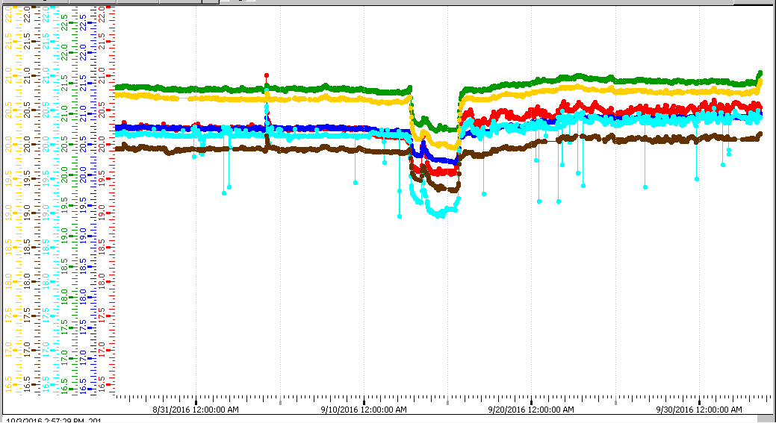
RE Temperatures
Some level of instabilities after TS

Slide 5
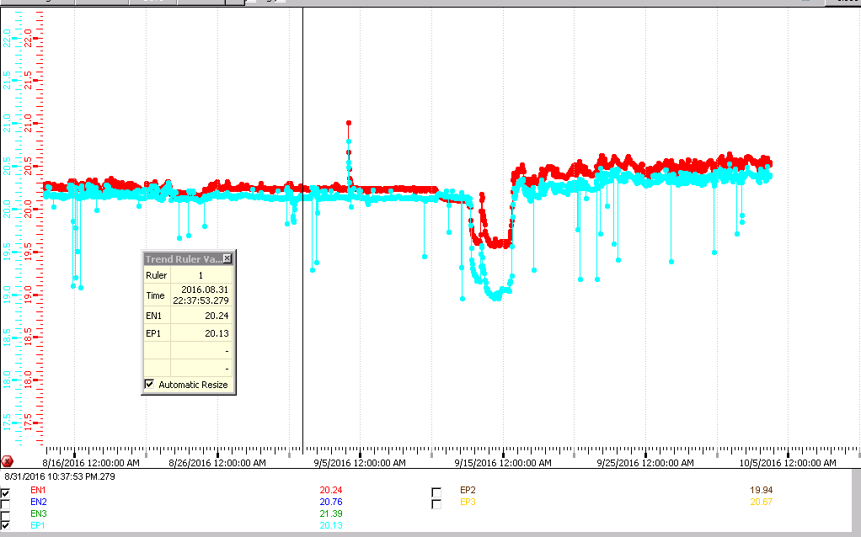
RE-1 and RE+1
0.1 DEG DIFFERENCE

Slide 6
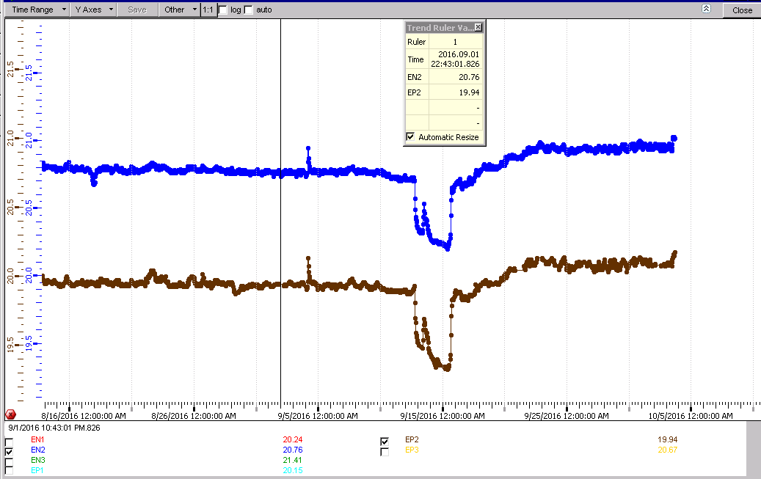
RE+2 & RE-2
0.8deg difference

Slide 7
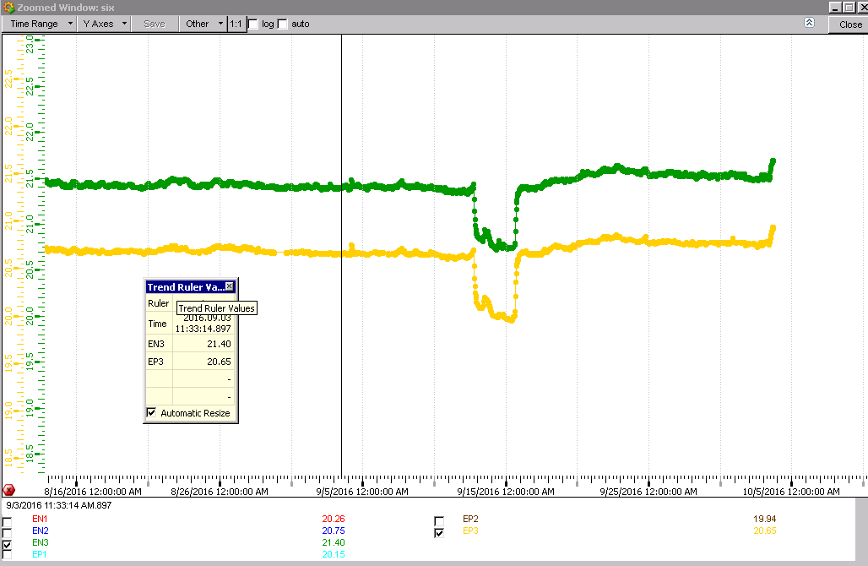
RE+3 & RE-3
0.75degC difference

Slide 8
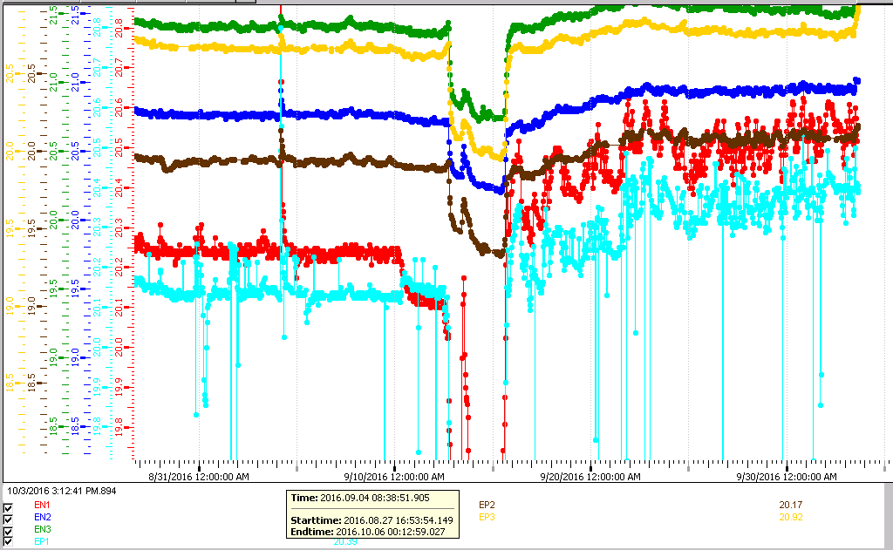
RE +1 has the only noisy channels
Temp. increase after TS
Greater oscillation in RE1s after TS
Noise is present only on RE+1

Slide 9
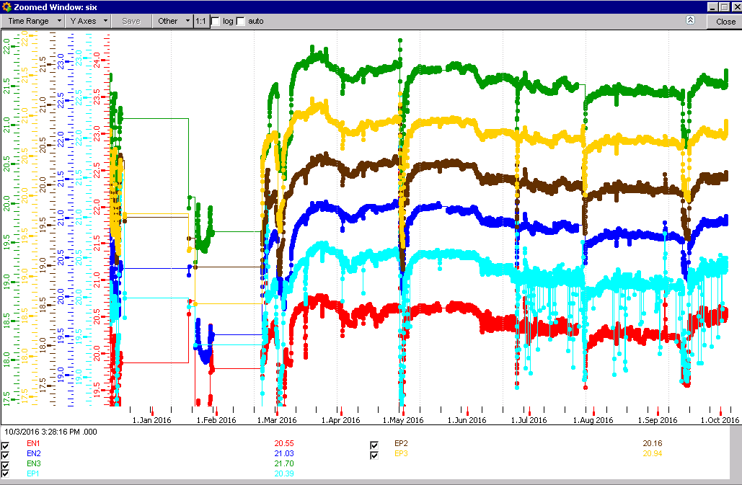
RE temperatures 2016
Noise increase REP1
On 24 June 2016

Slide 10
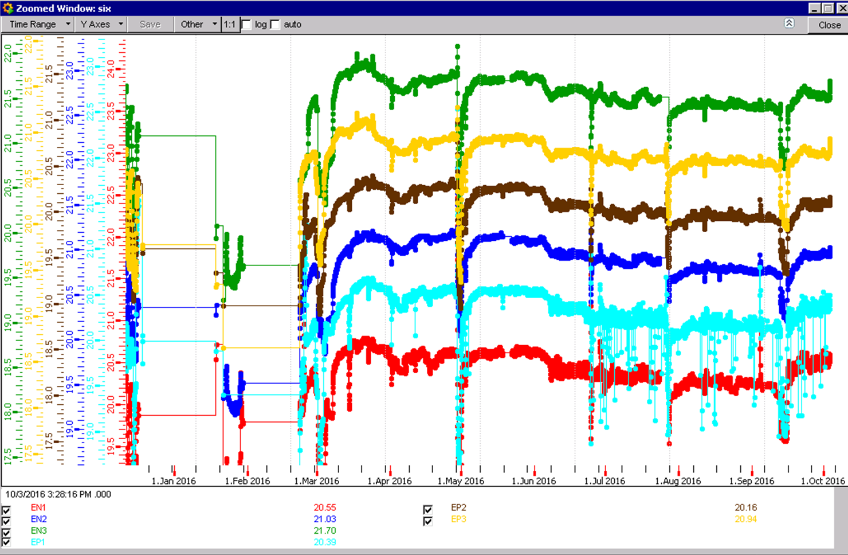
RE Decrease in temp since March
0.5 deg decrease

Slide 11
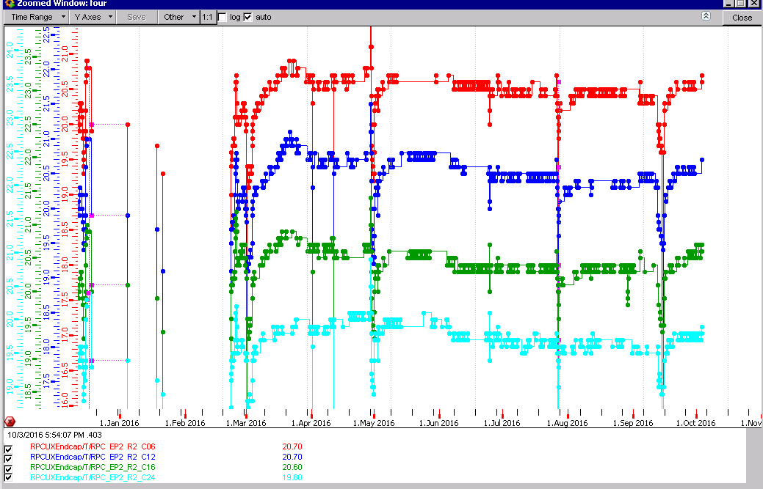
RE+2 temp sensors

Slide 12
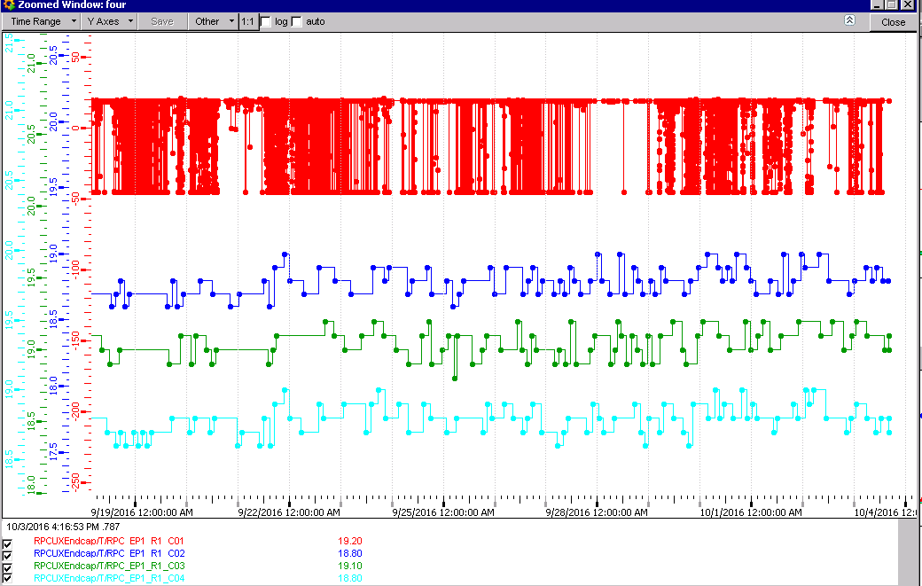
Noisy channel RE+1
Nota Scale

Slide 13
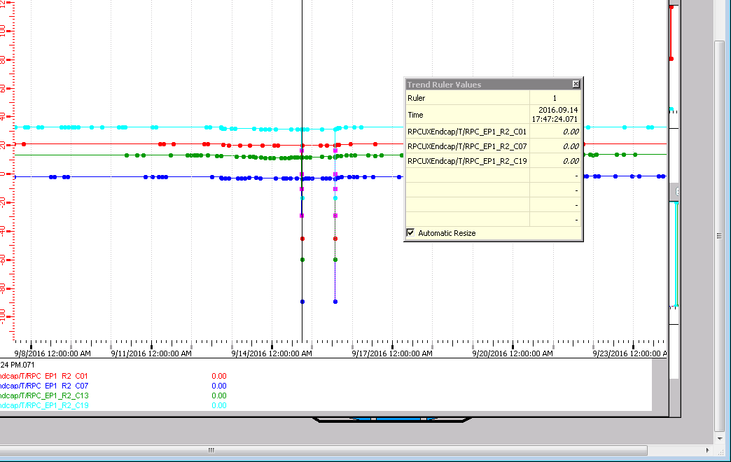
Noise at two distinct times

Slide 14
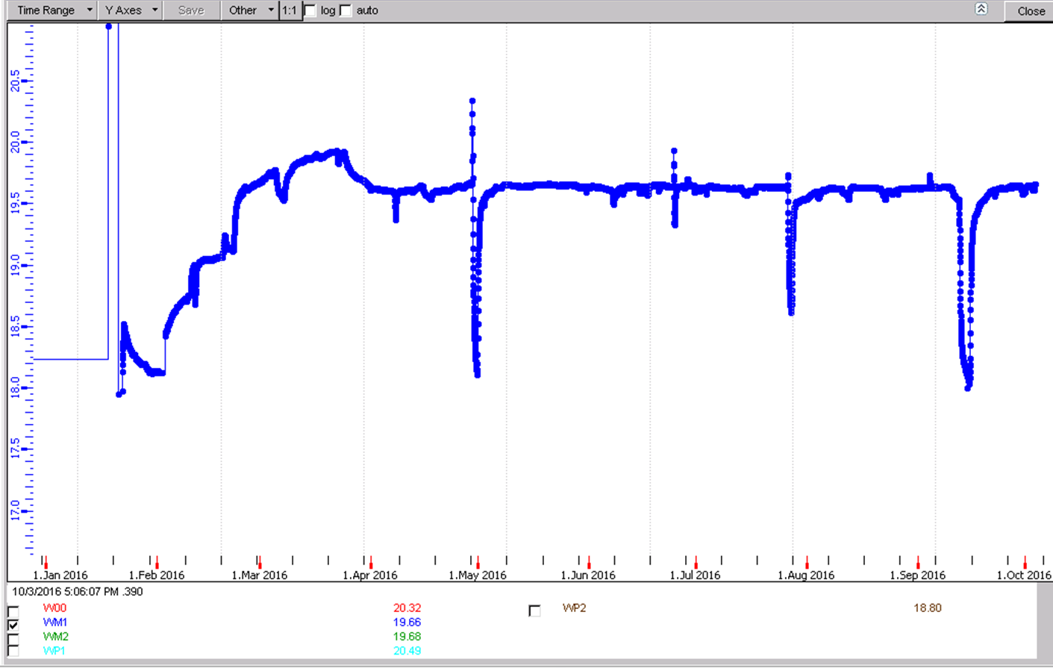
RB Wheel-1
Imperceptible temp change since April 2016

Slide 15
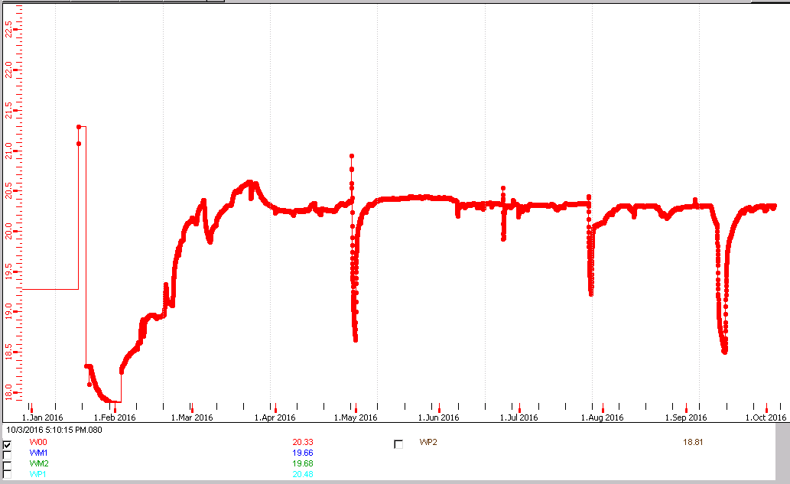
RB Wheel 0
0.1degC temp change since April 2016

Slide 16
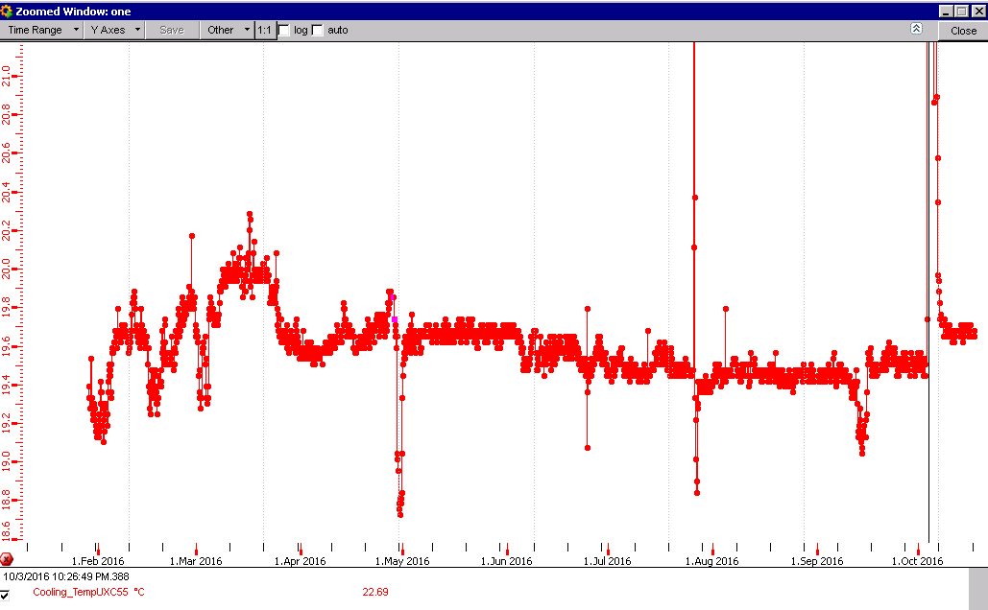
UXC Temp this year
After 3 day jump April temp restablished
Temp decrease over year

Slide 17
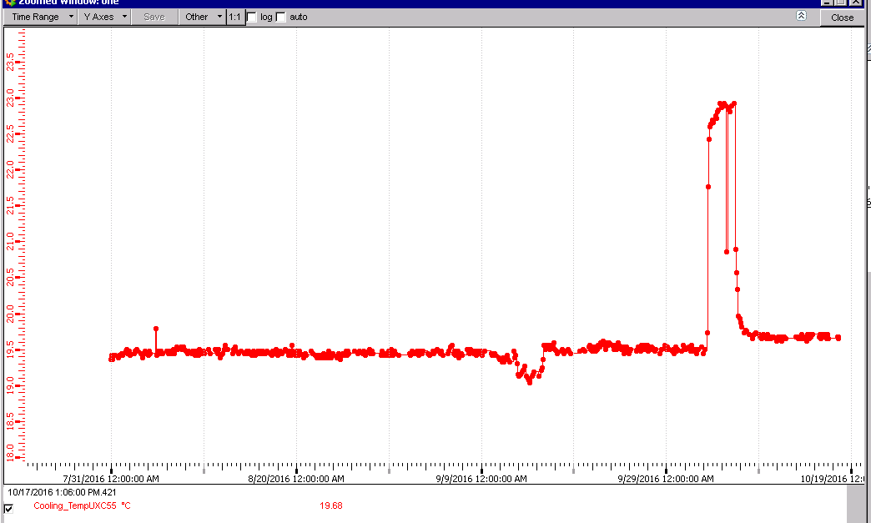
Temp excursion in UXC
3 days (3-6 Oct) temp increase from 19.5 to 23degC

Slide 18
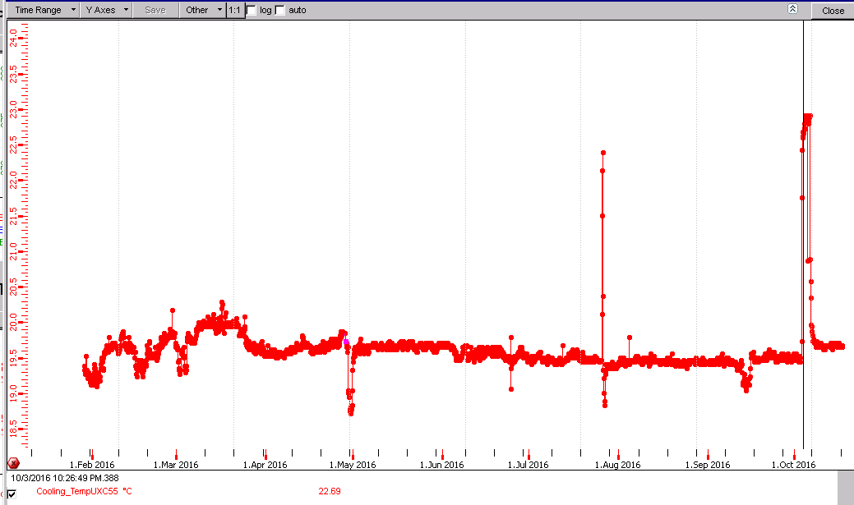
The only one this year >1day

Slide 19
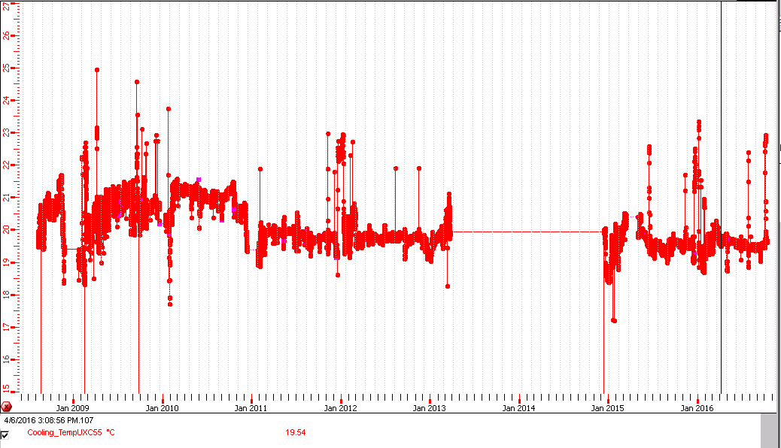
Alarm in UXC55 >22degC
Large prolonged excursions are rare over the last 7 years

Slide 20
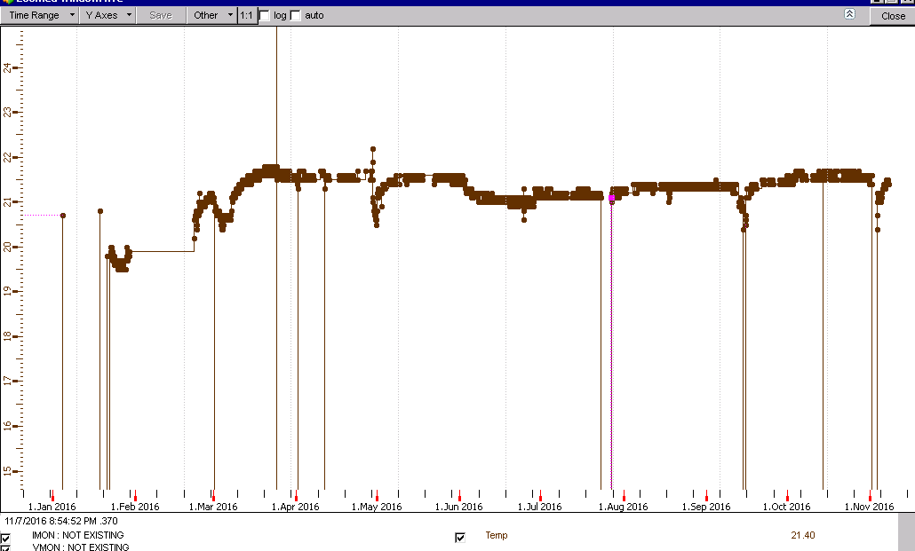
FOS
Sensors on all chambers in stations RE2, RE3 & RE4.
An example, RE-2/2/19

Slide 21
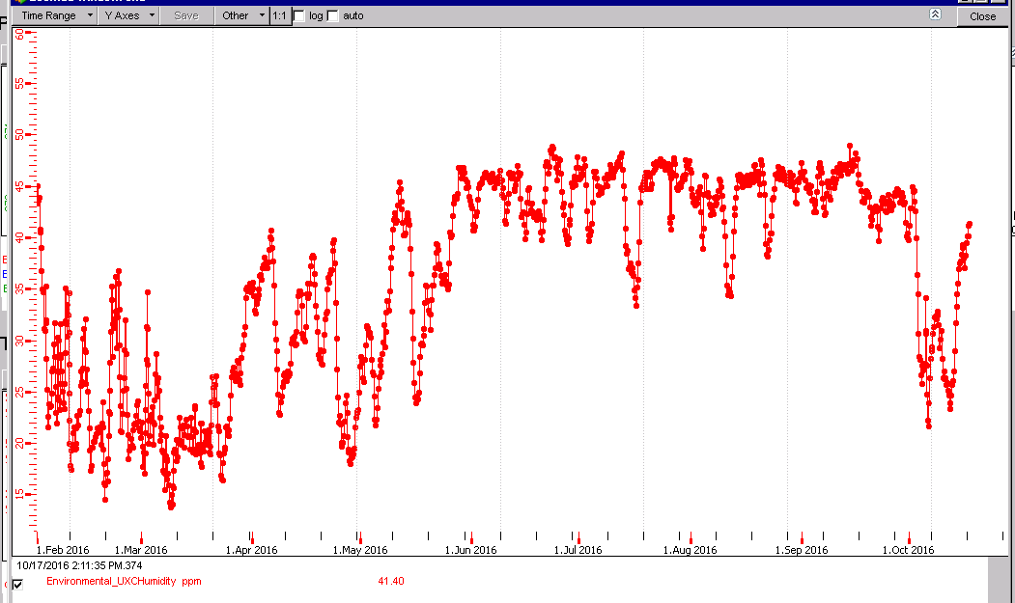
Humidity 2016
Capped at ~46% RH

Slide 22
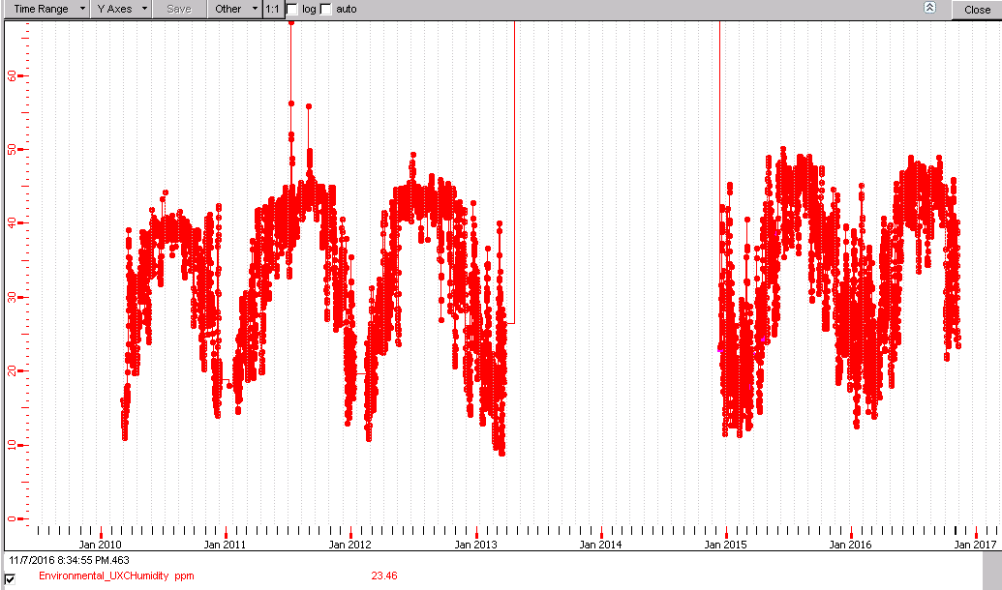
Humidity UXC since 2010
47% RH
44% RH
Average is increasing ?
11% RH

Slide 23
Conclusions
Temperature instabilities in RE+1 & RE-1 after TS in September.
Temperature increase after TS.
Noisy channel RE+1/1/C01 after 24June2016
RE temperatures decrease since April by 0.5degC
Temp Alarm
Short term chamges and long term trends.

