Slide 1
Ambient conditions CMS
Ian
15 June 2015

Slide 2
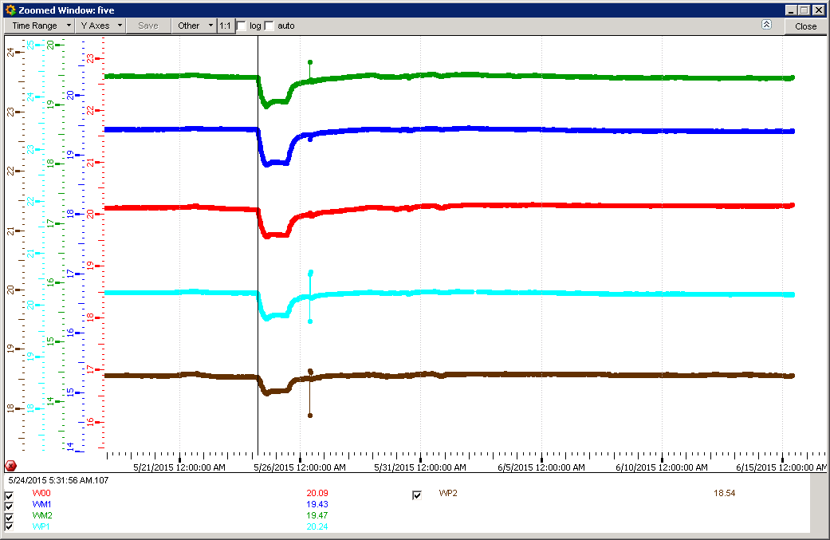
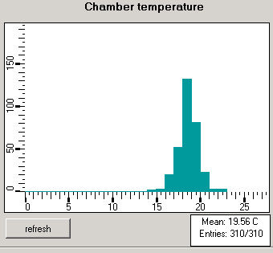
RB 1 month

Slide 3
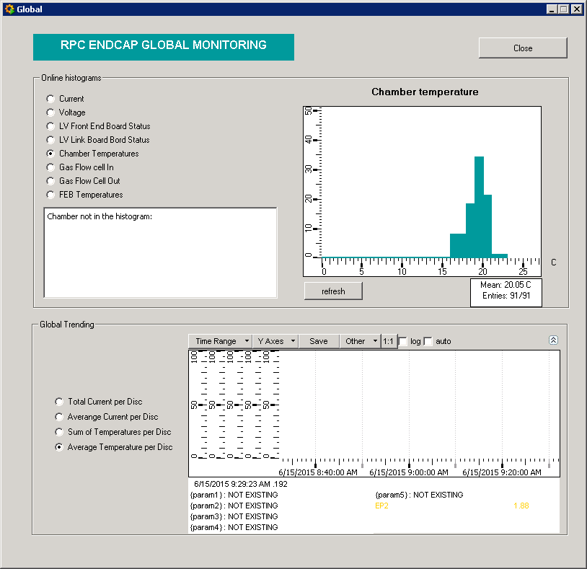
RE temps

Slide 4
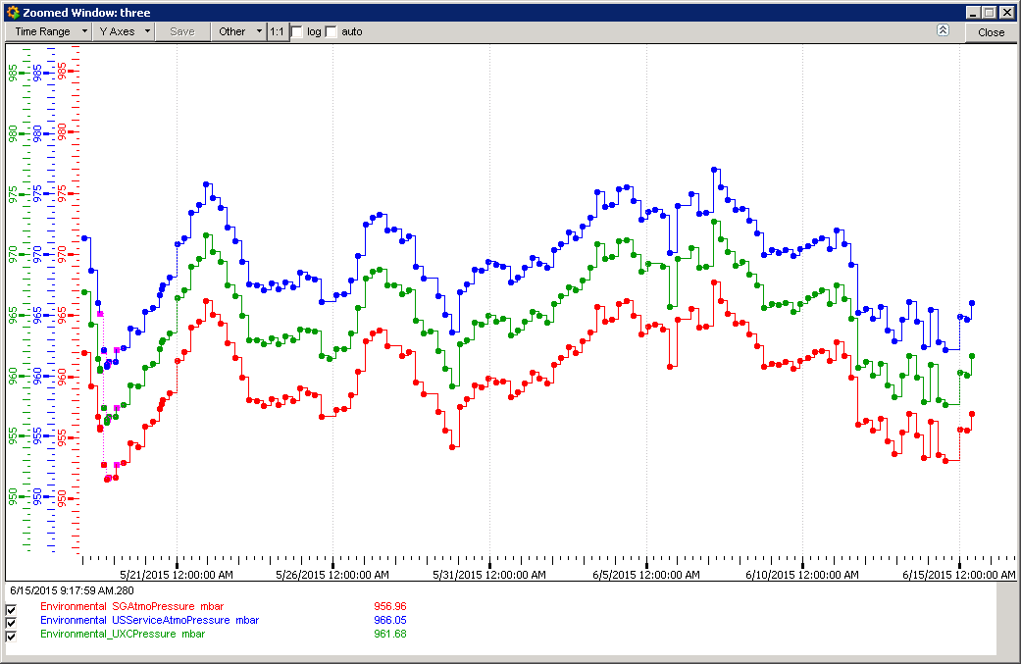
Pressure Surface, UXC & USC
30 days

Slide 5
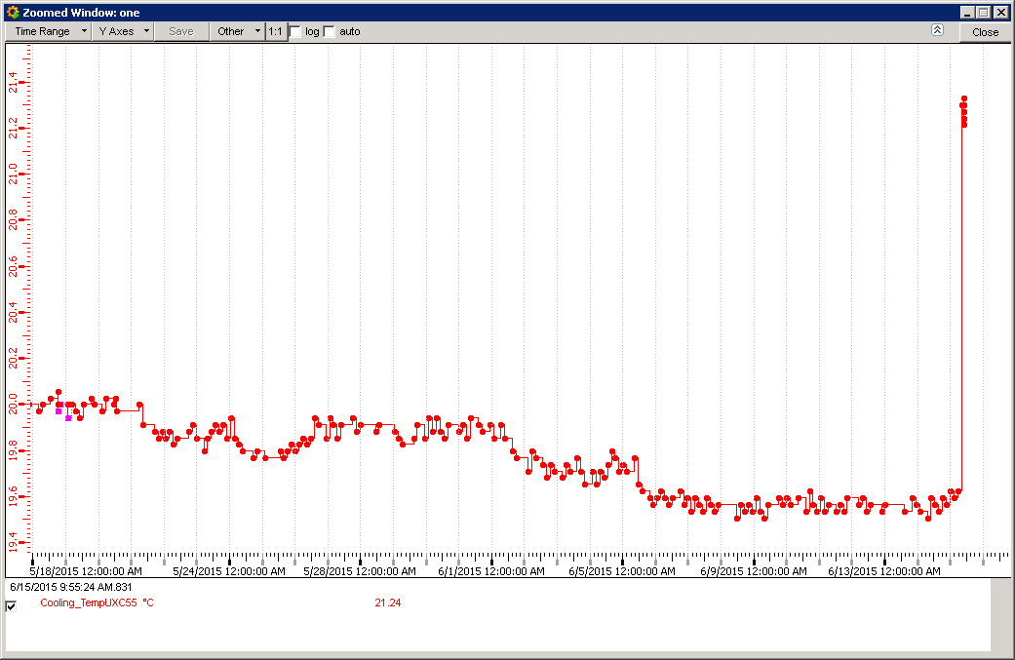
Temperature UXC 30 days
0750am today

Slide 6
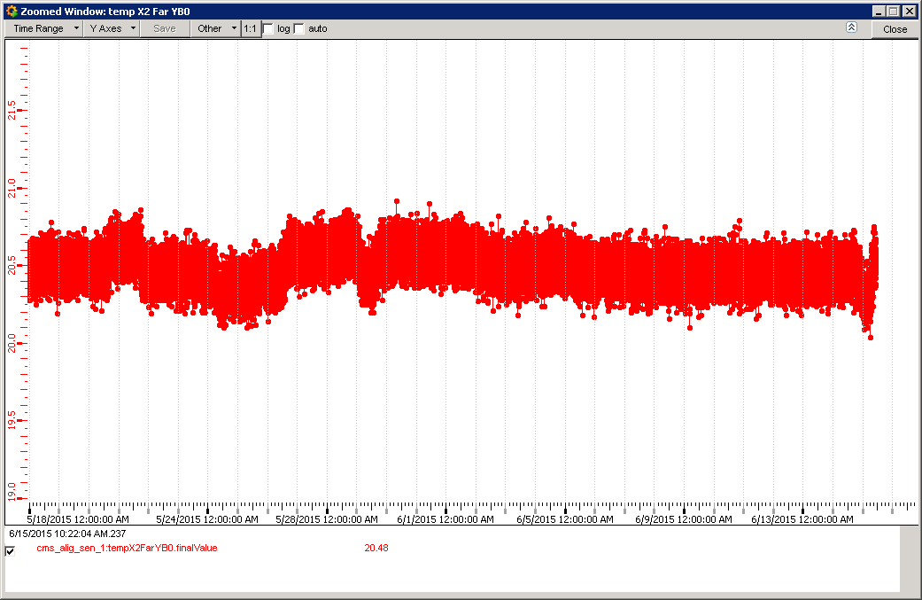
Temperature YB0 X2 Far

Slide 7
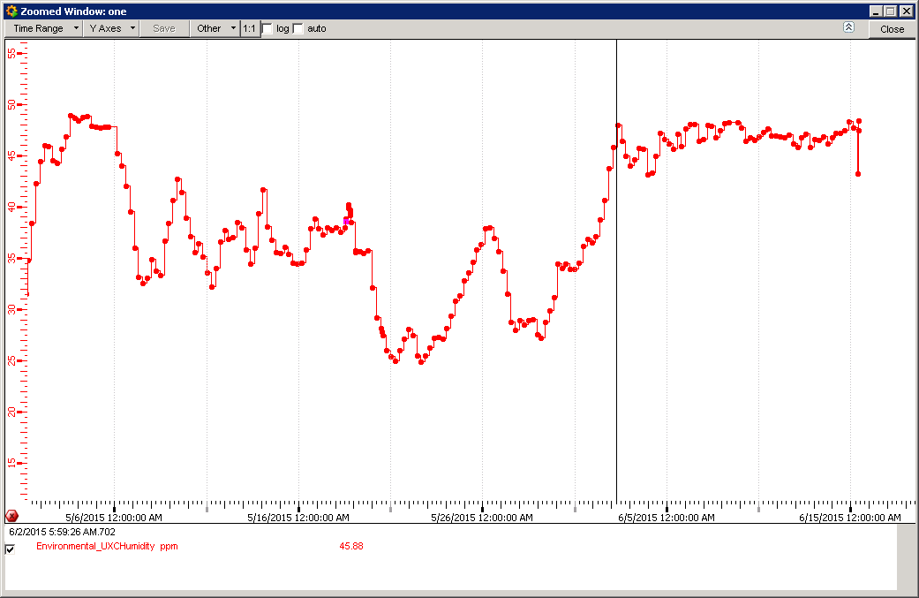
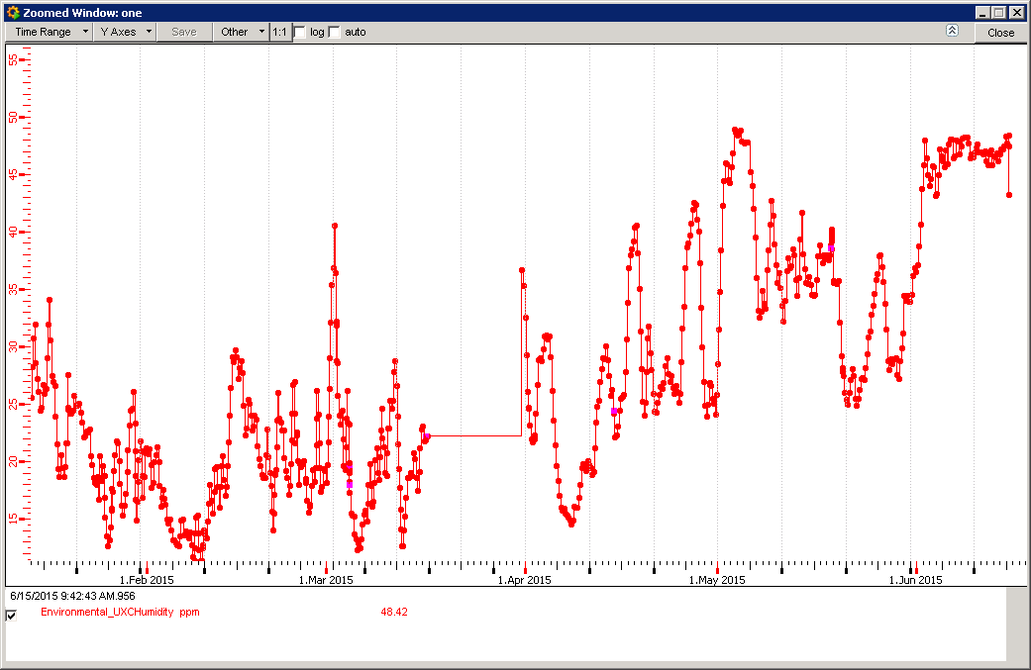
Humidity UXC
More stable since 2 June @ 48% RH
Wolfram will investigate
Calculate RH from Dew point at 19.6degC = 52.5 %RH
20.5deC = 49.7 %RH

Slide 8
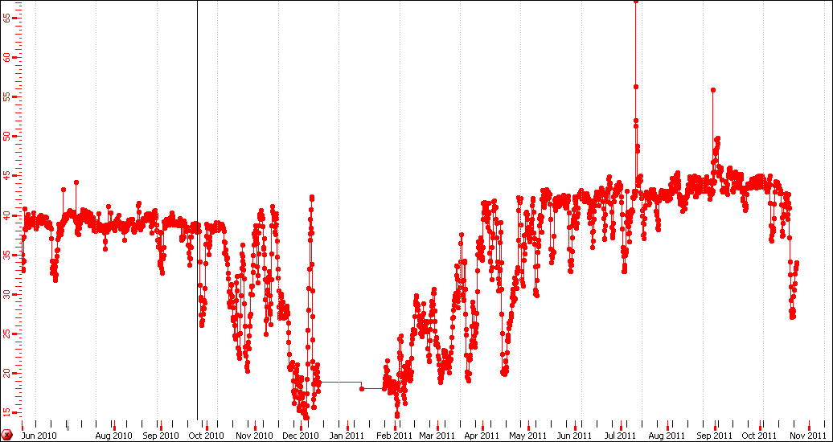
Humidity UXC 2010 to 2011

Slide 9
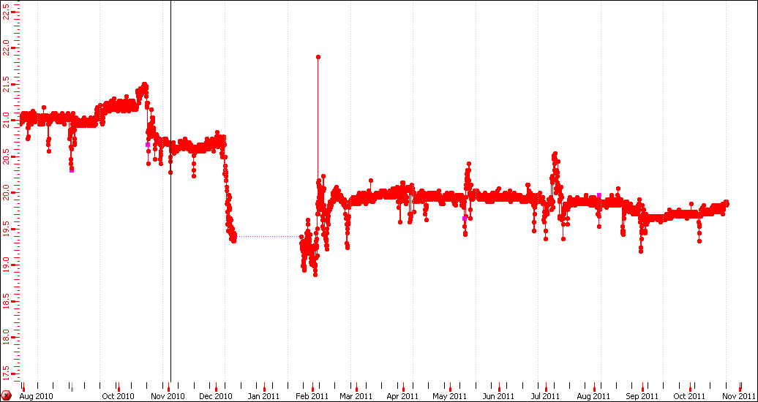
Temperatures UXC 2010 to 2011

Slide 10
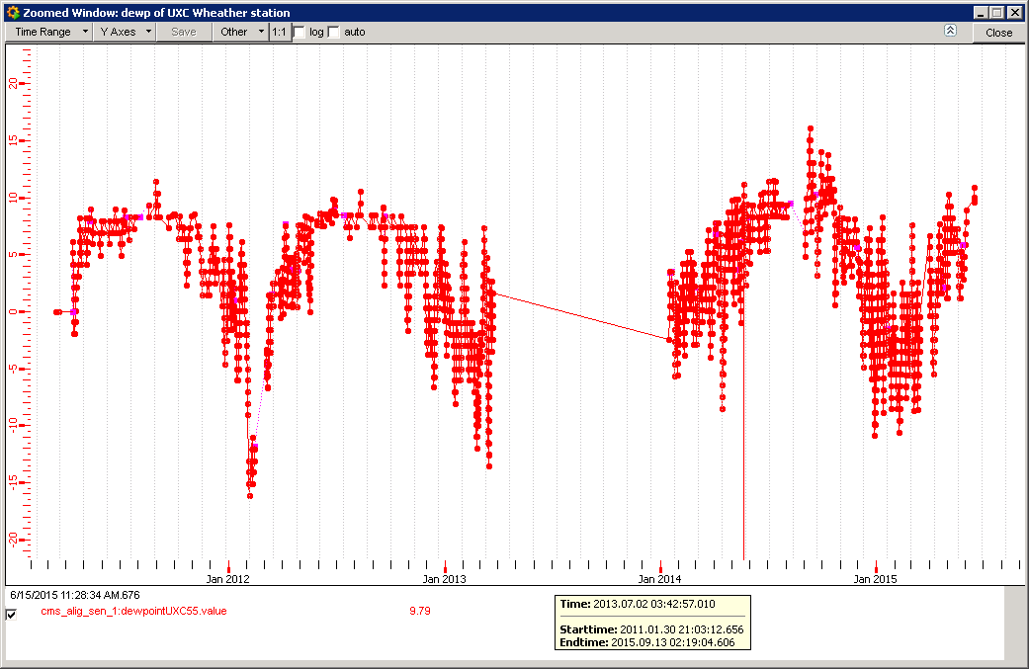
Dew Point (Alignment) UXC back to 2011
Stable at 8degC
Not yet stable

Slide 11
Conclusion
Was the temperature increase due to change in ventilation or shaft change.
Given the information shown above, rather limited, the temperatures in the UXC were similar in 2011(19.8degC) and today. The RH registered at one point was < 45%RH in 2011 and ~ 40%RH in 2010. At the same point today we have 19.6degC and RH of 48-50 %RH. The values today are higher than 2010 and 2011. These values are being checked back to be sure.
These values agree with values calculated given by the dew point calculation, is it the same sensor !
The dew point at alignment sensor on -Z today is not yet stable but seems similar to 2011.

