Slide 1
Ambient conditions
28 Sept 2015
Ian

Slide 2
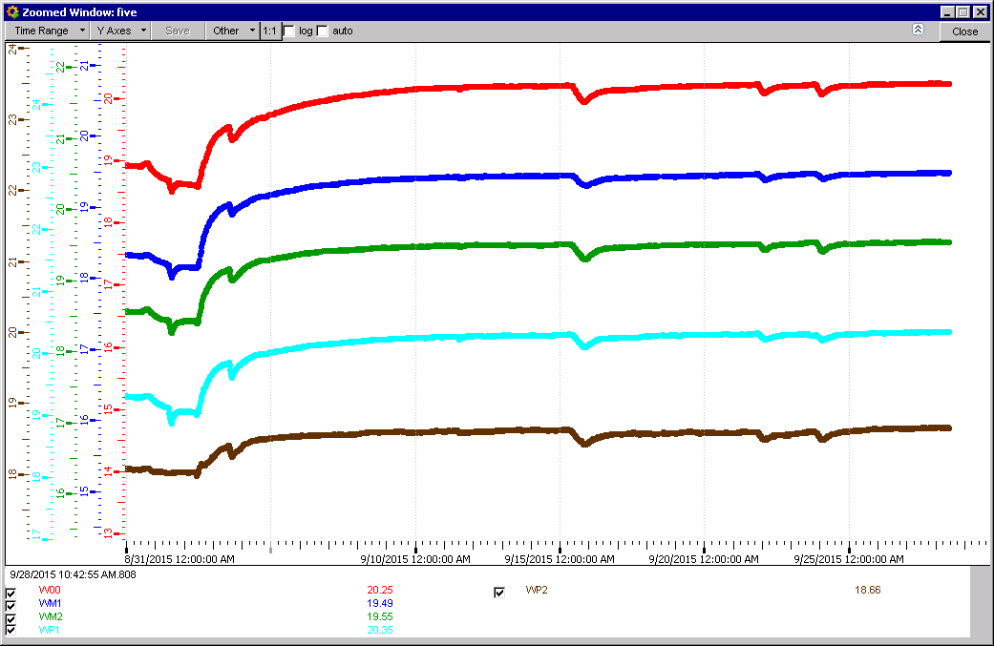
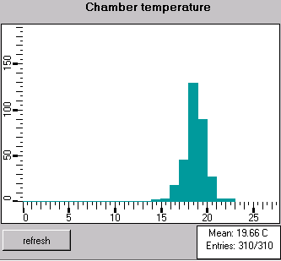
RB Temps

Slide 3
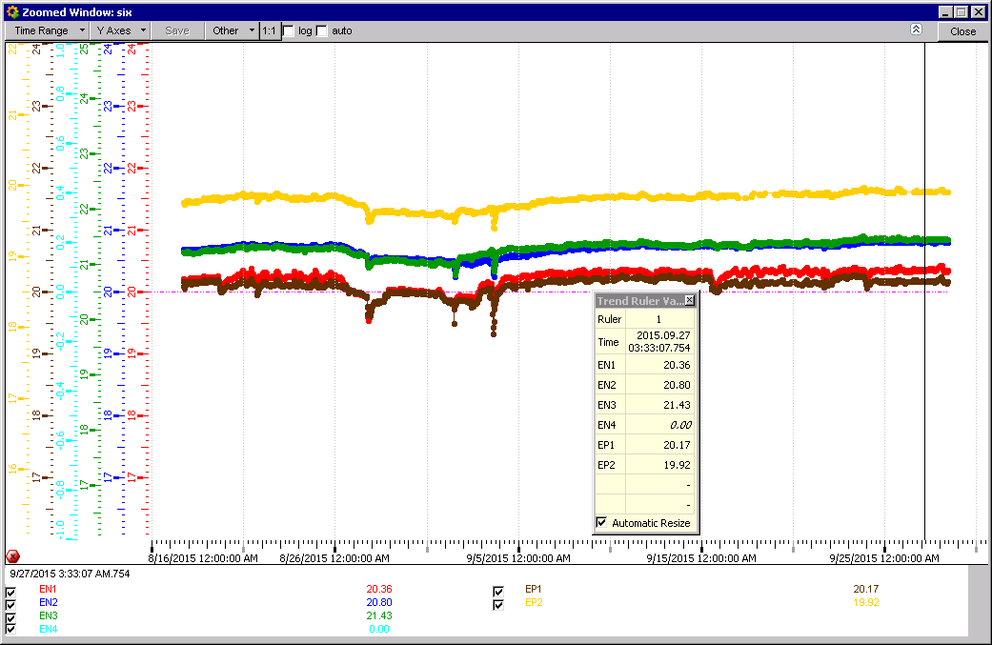
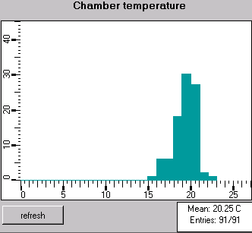
RE Temp ADC
8 Deg spread ?
20.25 Deg Mean

Slide 4
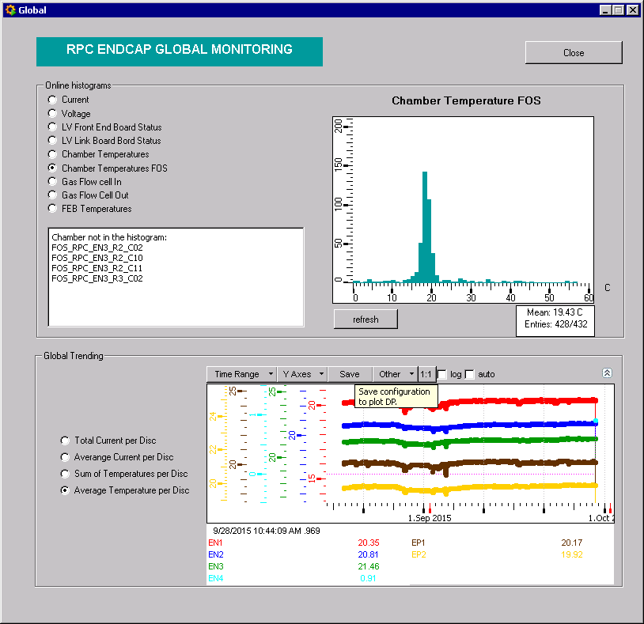
RE Temp FOS
57 Deg spread
19.43 Deg Mean

Slide 5
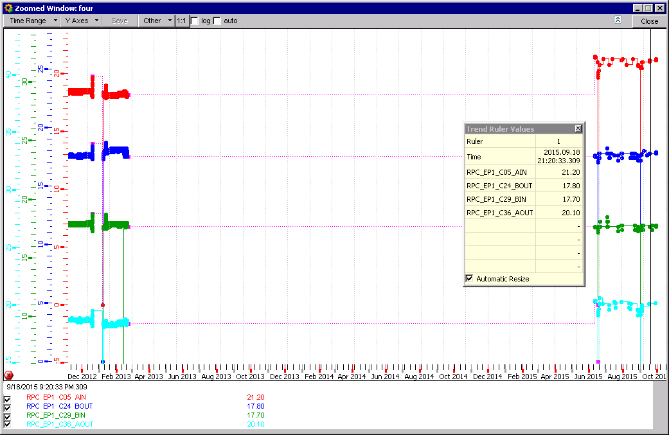
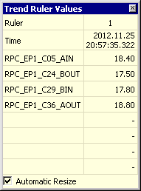
Two coolant temp circuits on Yoke YE+1 RE1 side
C05 supply is warmer than return, there is a problem
Increase of one circuit by few degrees since Jan 2013

Slide 6
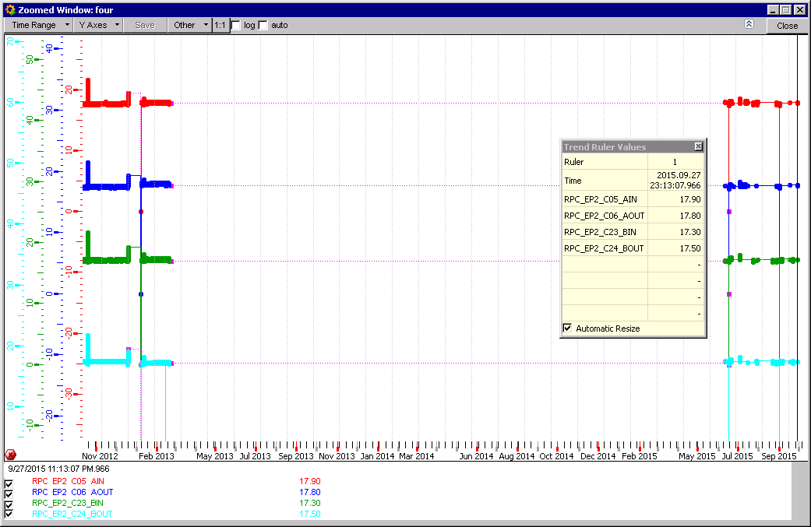

Two coolant temp circuits on Yoke YE+1 RE1 side
No increase of the two circuits since Jan 2013

Slide 7
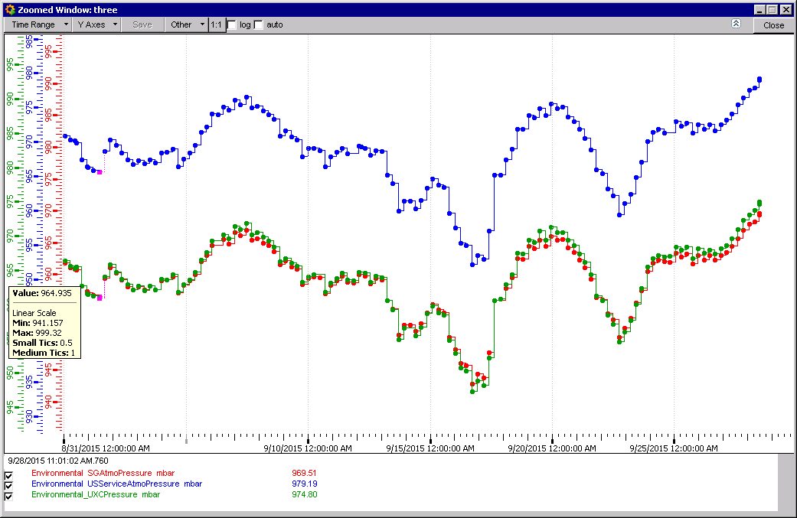
Pressure UXC55

Slide 8
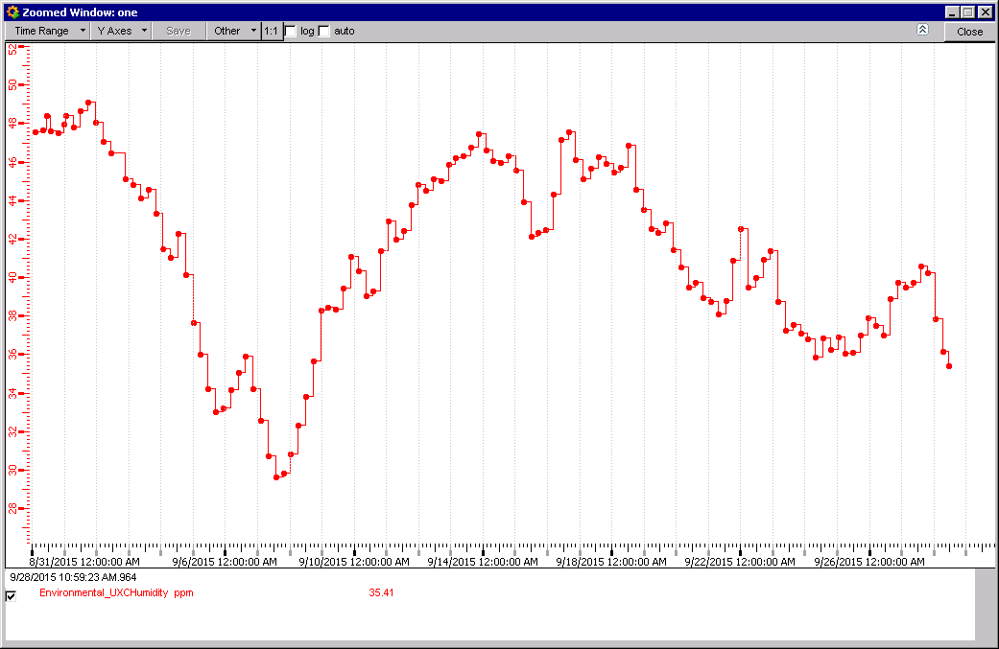
Humidity UXC

Slide 9
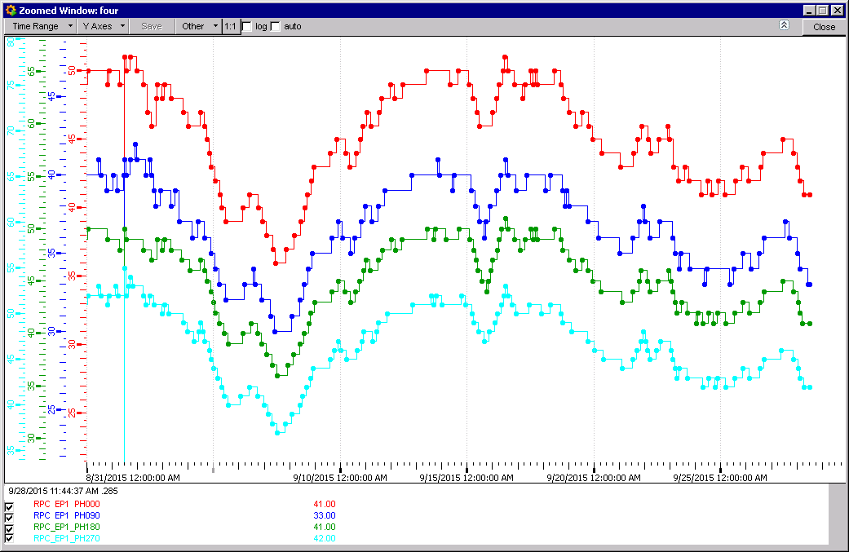
RH in RE+1 x4 sensors

Slide 10
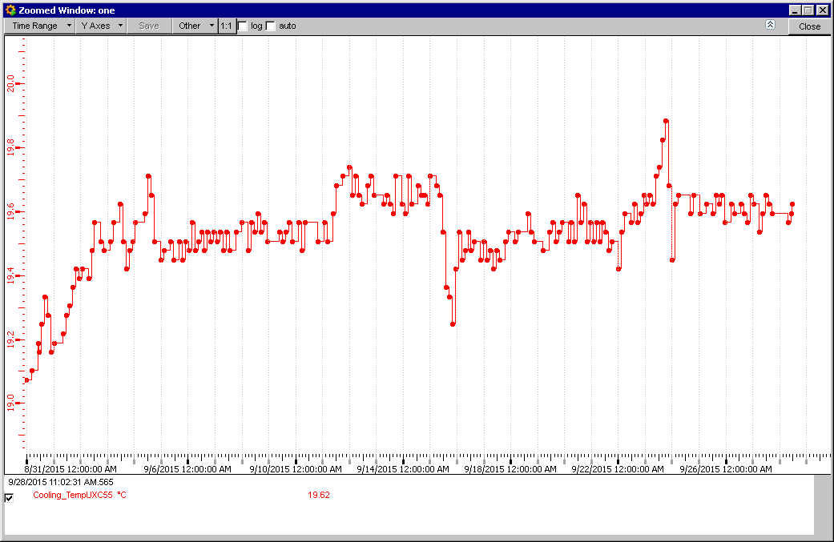
Temp UXC 55

Slide 11
Conclusion
Stable conditions except for Humidity and Pressure
Fos require some attention for spread and mean…
Curious temperature increase in one of the coolant circuits.

