Slide 1
Ambient Conditions in P5.
Look back over 70 days
Ian Crotty
7 Sept 2015

Slide 2
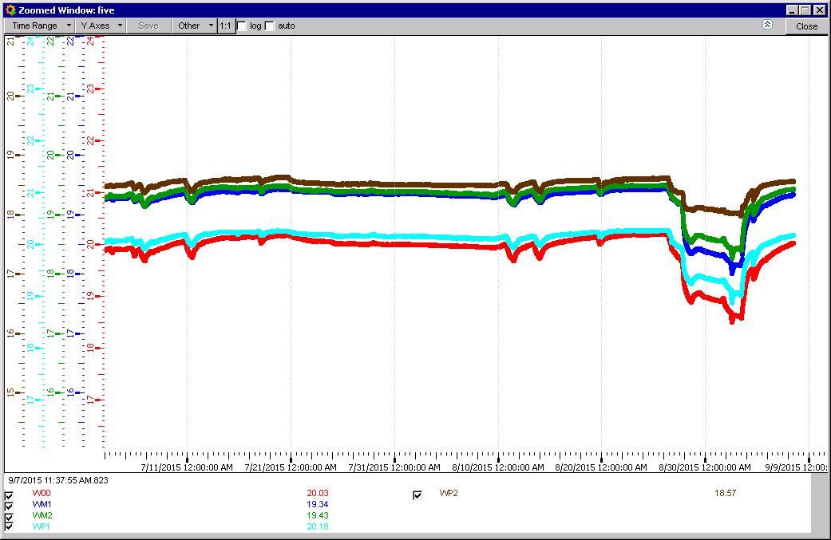
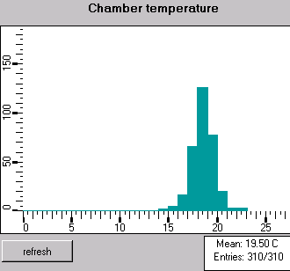
RB Chamber Temps
Tech stop

Slide 3
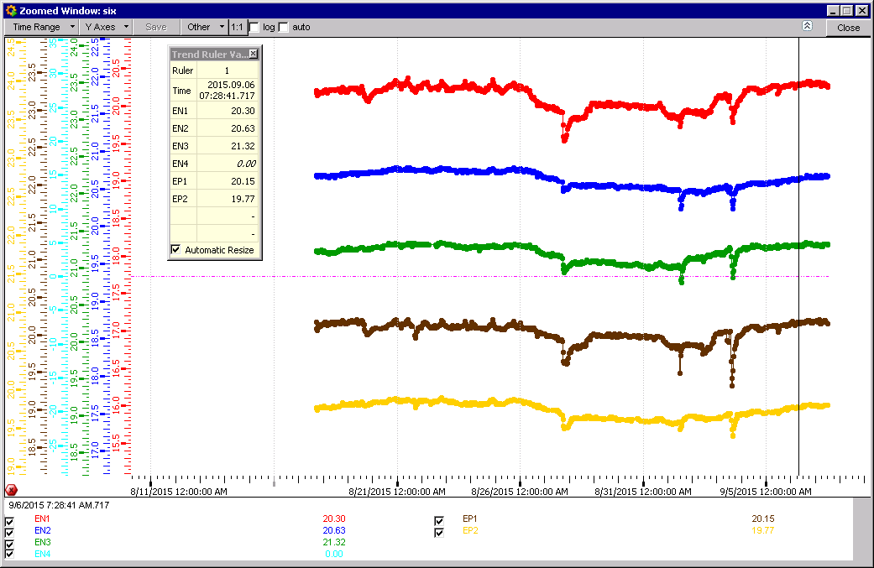
FOS temps REs
Start reading

Slide 4
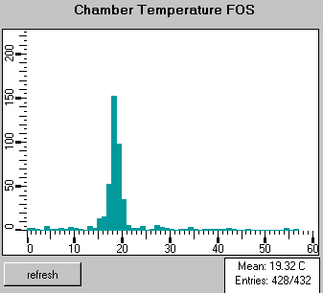
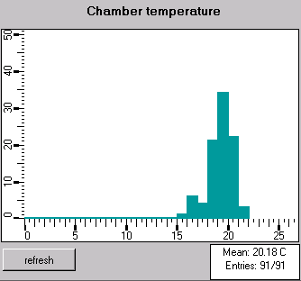
REs FOS & CAEN ADC system today

Slide 5
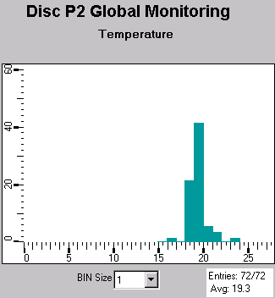
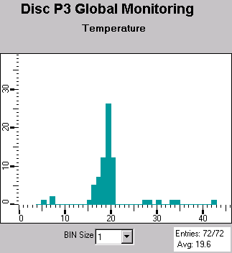
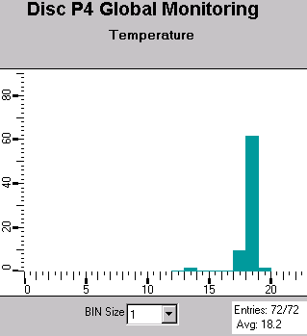
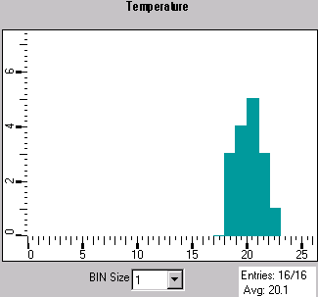
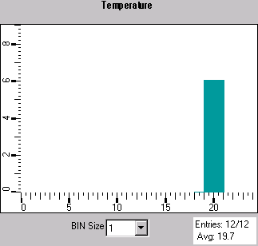
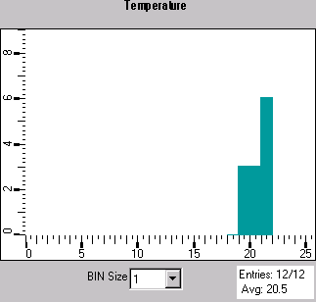
Individual Disc Temp FOS & CAEN
Disc P1 CAEN

Slide 6
FOS and CAEN
FOS sensors 72/ station
CAEN 12 sensors/station
Map will come.

Slide 7
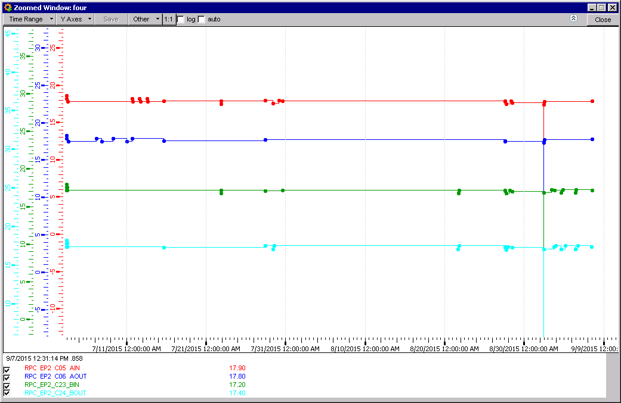
Cooling Probes RE+2

Slide 8
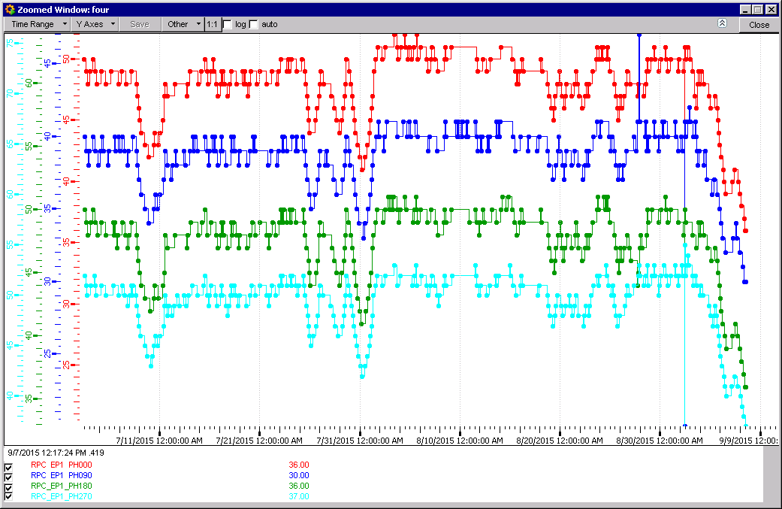
RH in RE+1
RH rapid decrease

Slide 9
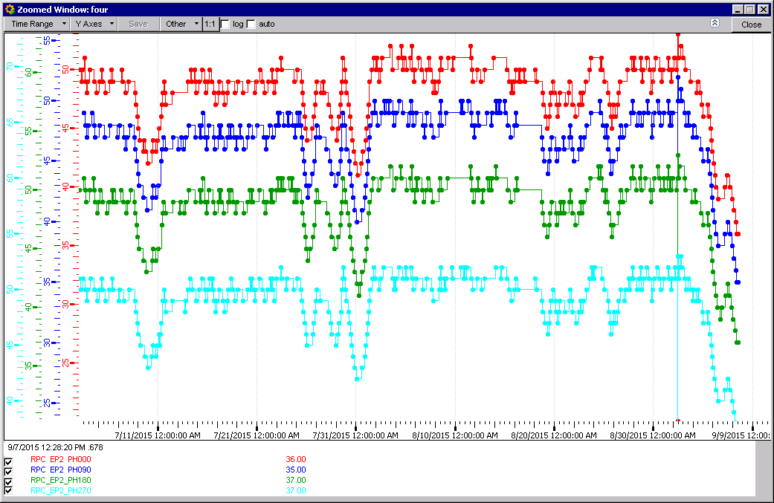
RH in RE+2
RH rapid decrease

Slide 10
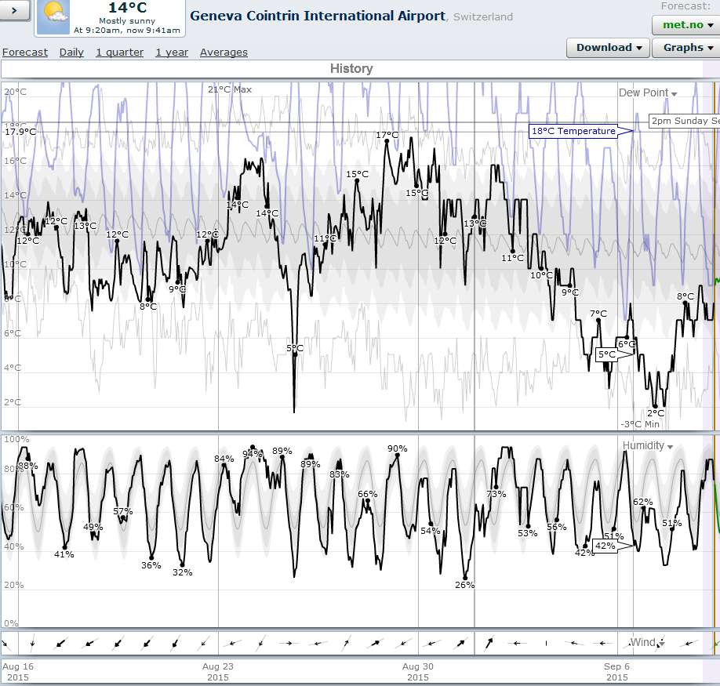
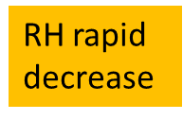

Slide 11
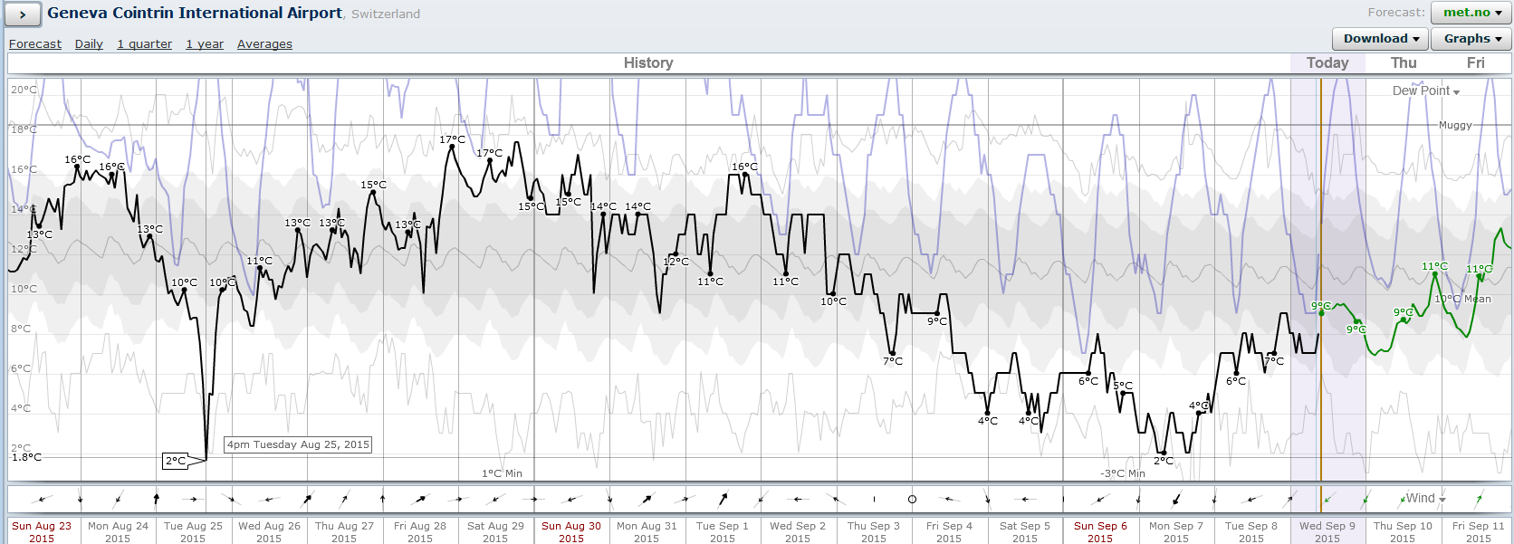
Surface RH at Airport Geneve

Slide 12
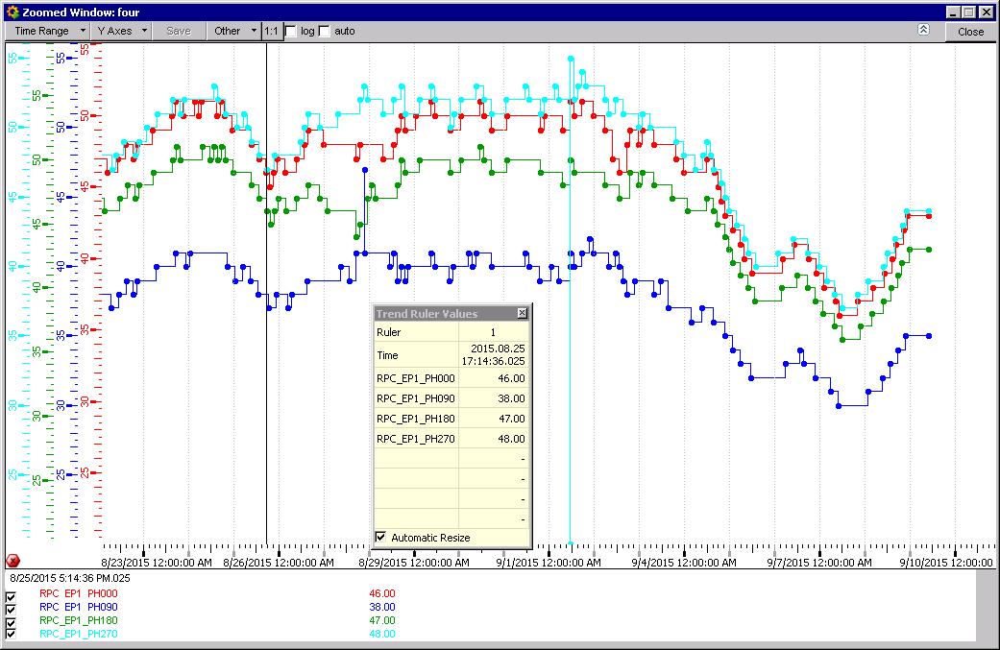
Same period RH RE+1, similar form

Slide 13
Conclusions
FOS and CAEN appear agree rather well.
Ambient RH on the surface has direct impact on UXC RH.

