Slide 1
Formulas for cooling Calculations
Ian

Slide 2
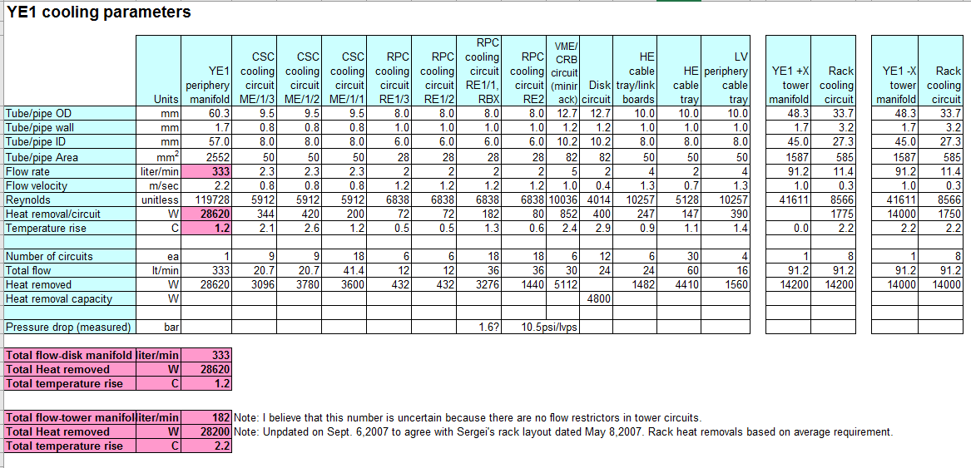
CSC calculations by Dick loveless 2007

