Slide 1
Pressure drop in iRPC cooling in 904 lab
Ian
11 April 2024

Slide 2
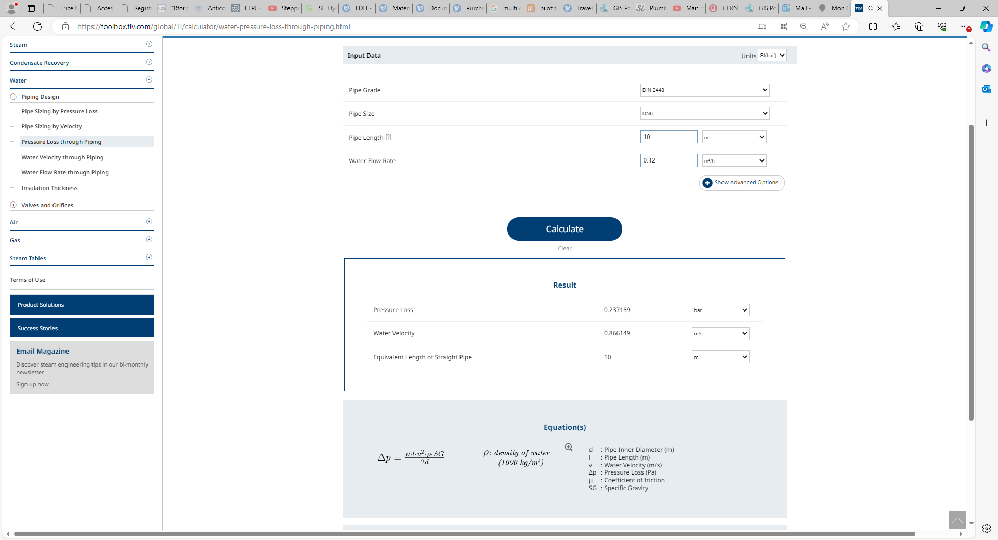
https://toolbox.tlv.com/global/TI/calculator/water-pressure-loss-through-piping.html

Slide 3
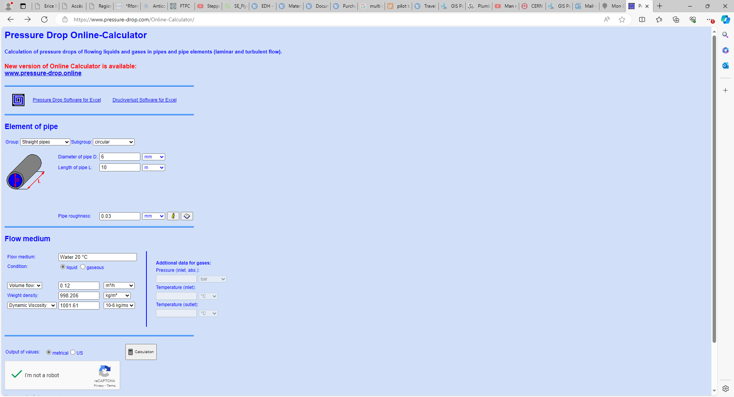
https://www.pressure-drop.com/Online-Calculator/

Slide 4
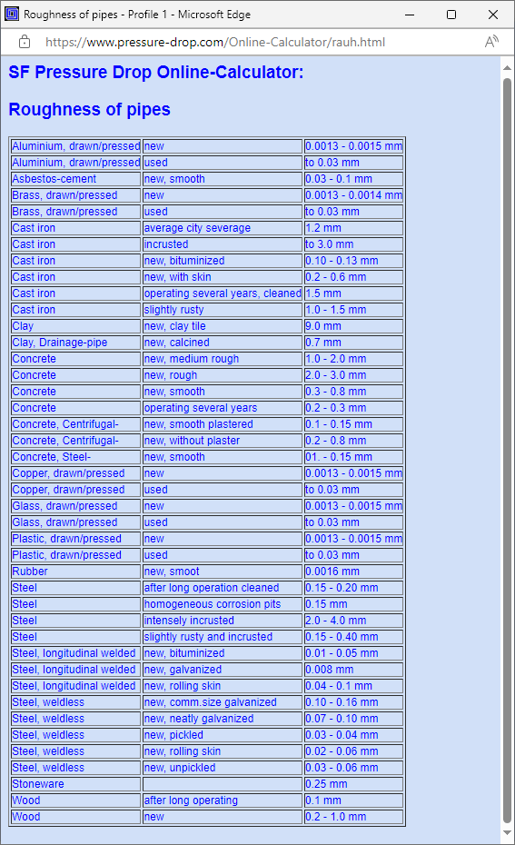
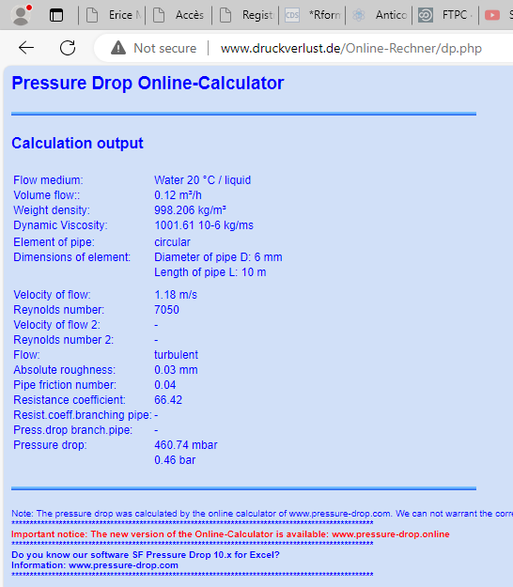

Slide 5
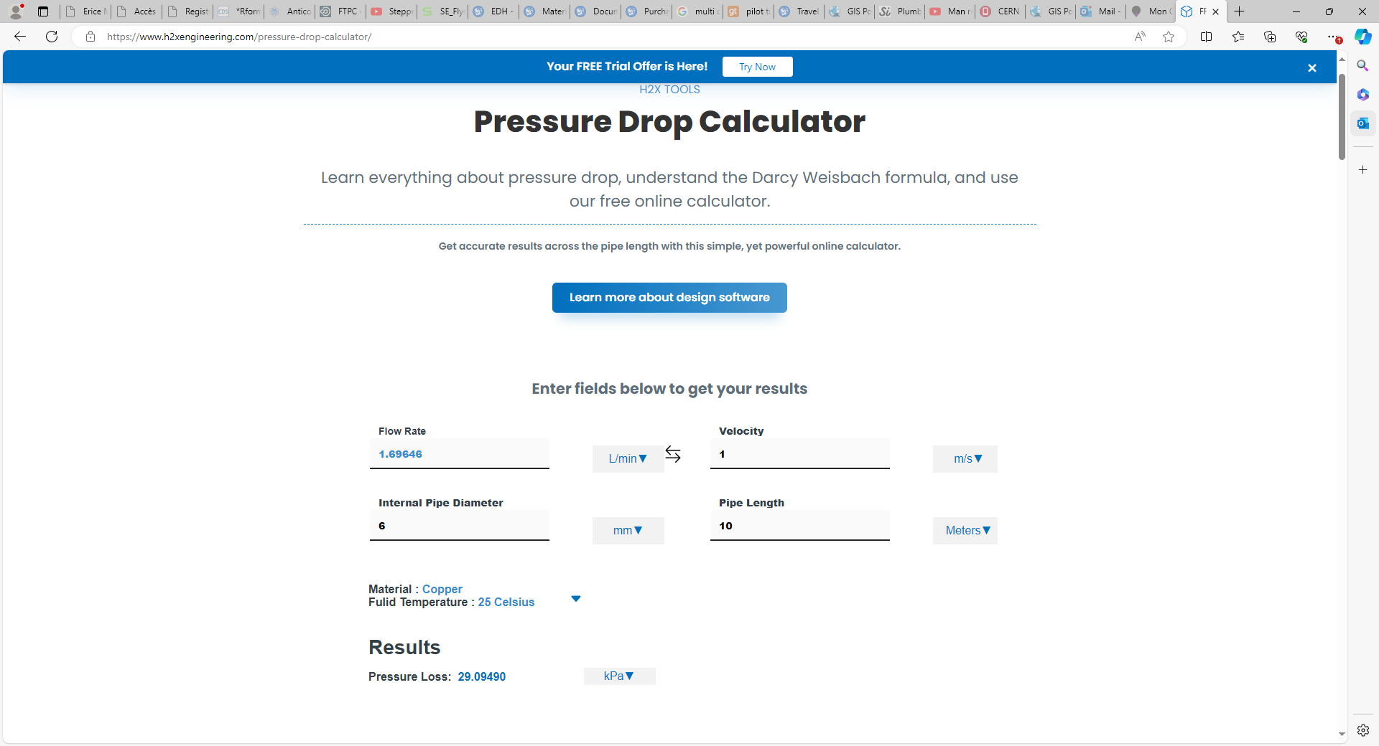
https://www.h2xengineering.com/pressure-drop-calculator/

