Slide 1
Rack cooling conditions
All info is through DIP
Nov 2014
Ian Crotty
17 Nov 2014

Slide 2
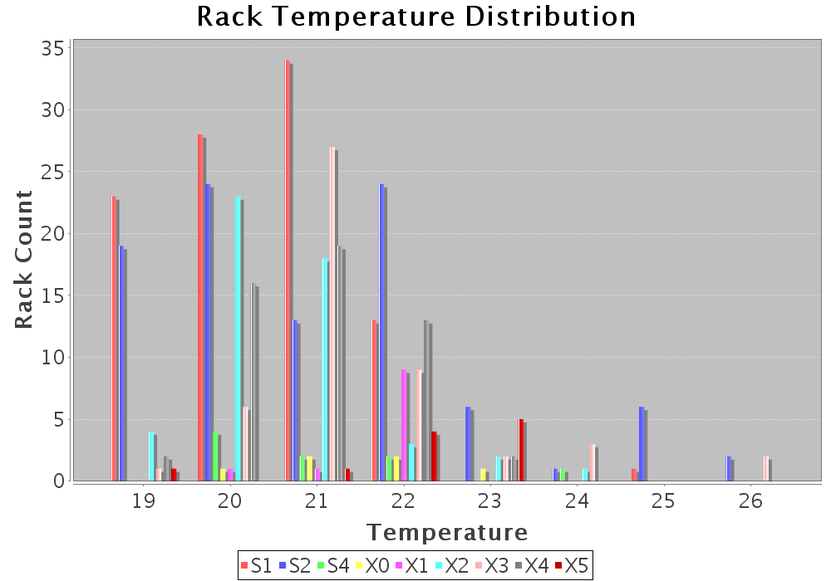

Slide 3
X3A51
ME_X3A51_TMP1_RET_HE float 20.17
ME_X3A51_TMP2_SUP_HE float 17.84
ME_X3A51_TMP3_RET_HE float 20.44
ME_X3A51_TMP4_SUP_HE float 18.72
ME_X3A51_TMP5_RET_CRB float 18.65
ME_X3A51_TMP6_SUP_CRB float 17.48
RPC_temp_inside1 float 20.17
Temperature1 float 22.67
Temperature2 float 22.57

