Slide 1
Pinched Cooling hose against YE-4
Ian
3 feb 2021

Slide 2
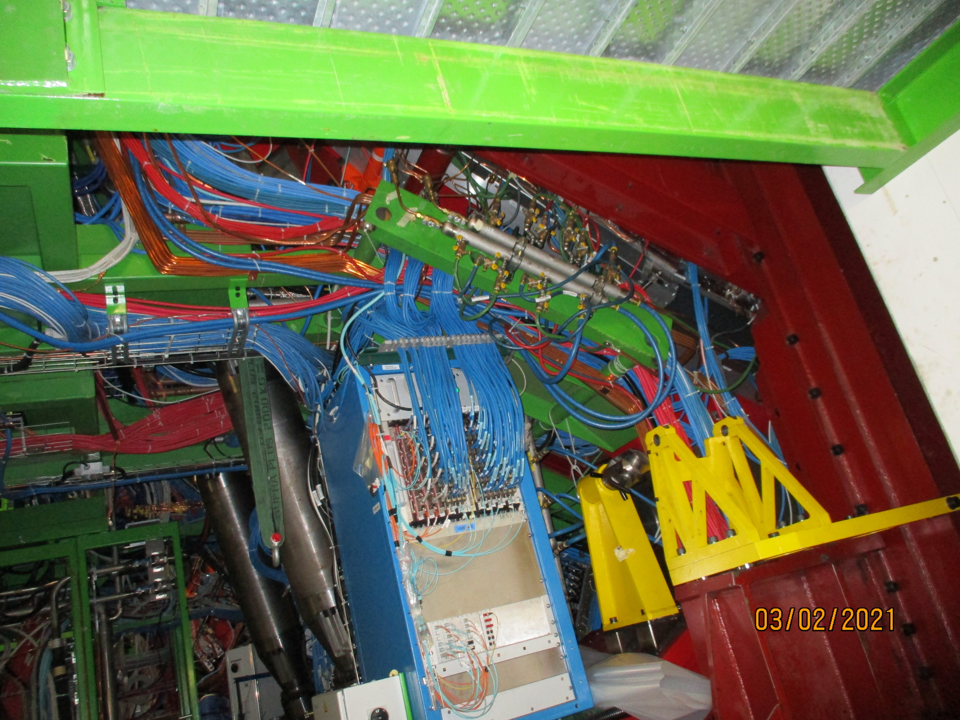
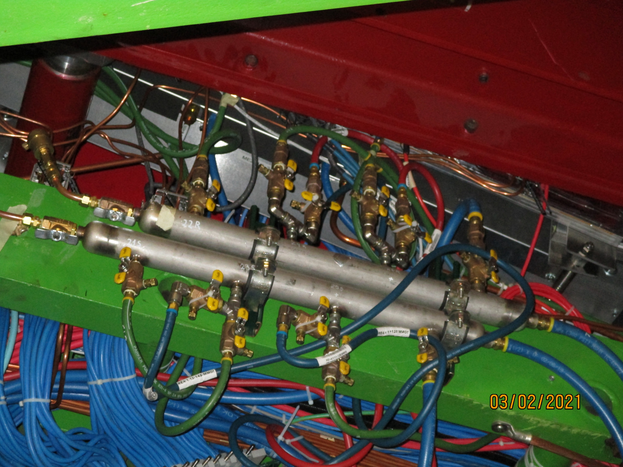
Plus Z Far

Slide 3


Plus Z Far
Here the Mini Manifold is mounted near the bottom of the green channel section

Slide 4
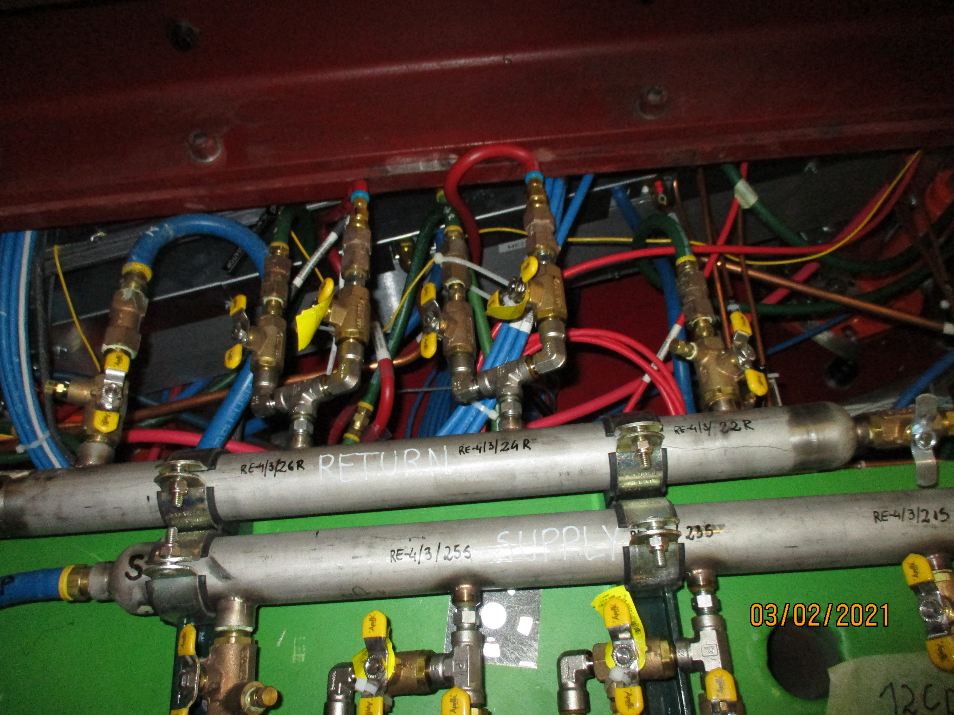
The Minus Z end far

Slide 5

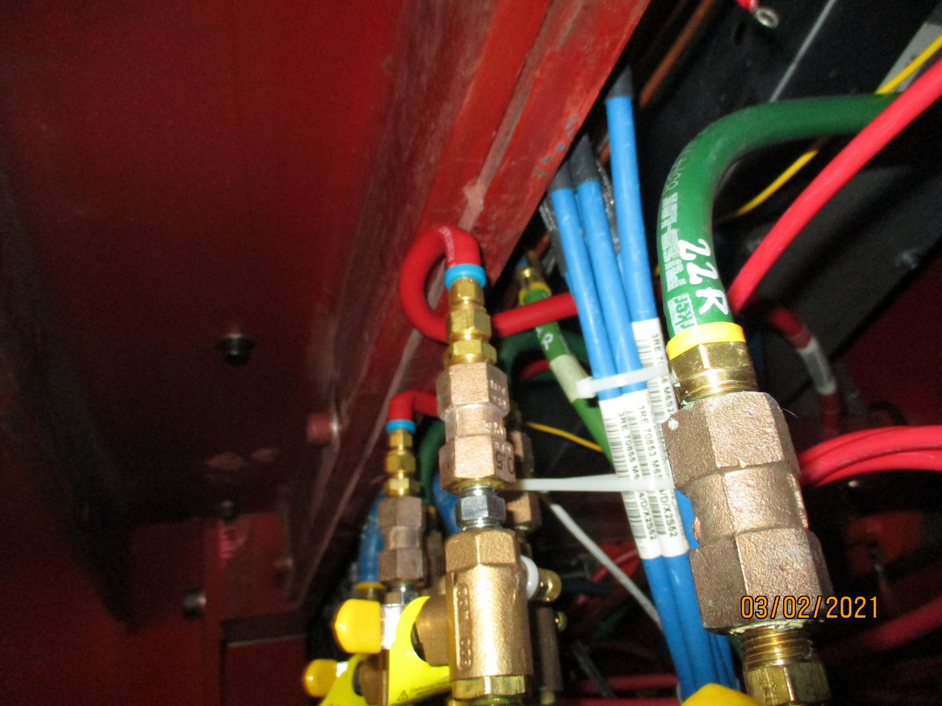
The Minus Z end far
Here the Mini Manifold is mounted higher 5-10cm than the plus Z on the green channel section.
Here it is clear there is no return flow possible

