Slide 1
Pitting corrosion of copper pipe with demineralsied water
Ian
1 Feb 2021

Slide 2
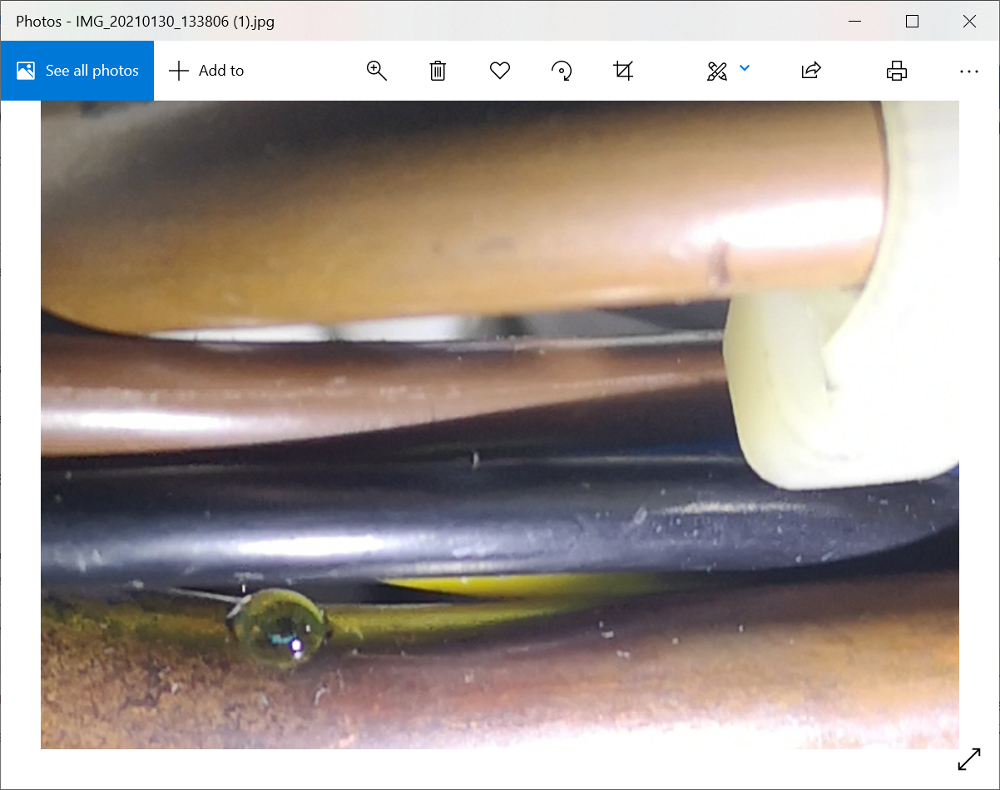
The distinct colour of XX copper

Slide 3
Sulphor , chlorine or biological attack (MIC)
Stress corrsion at bend with inclusion from bending tool
Internal corrsion dur to granular defect from bemding
Pitting corrosion due to demin water.pH
Erosion excess velocity
Inert gas cushioning in buffr tanks to stop O2
Differential potential !! Metals or ….
DO NOT STOP the system
cavitation

Slide 4
https://www.ncbi.nlm.nih.gov/pmc/articles/PMC5615691/
D = diffusedO2
Copper has a strong tendency to react with DO. Based on thermodynamic calculations and kinetic studies, Ives and Rawson [50,51,52,53] propose that cuprite (Cu2O) is the first solid corrosion by-product formed on the pipe inner-surface. They proposed that the metallic surface is covered with a two-layer cuprite film. This conceptual model was called “duplex film model”. The first layer on the metal surface is compact and ~2 µm thick. The second layer of cuprite has high porosity. Due to these structural differences, the electrical resistance increases strongly at the interface between the compact and the porous cuprite films. This effect decreases the availability of electrons in the porous film, leading to further oxidation of the porous cuprite film and the subsequent formation of divalent copper scales [2].

Slide 5
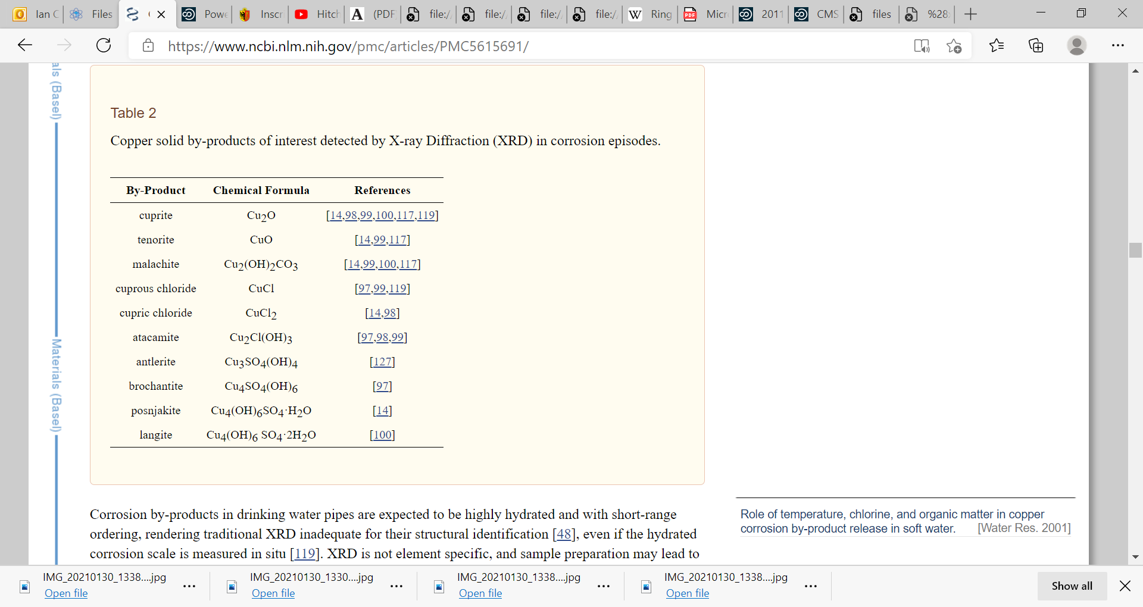

Slide 6
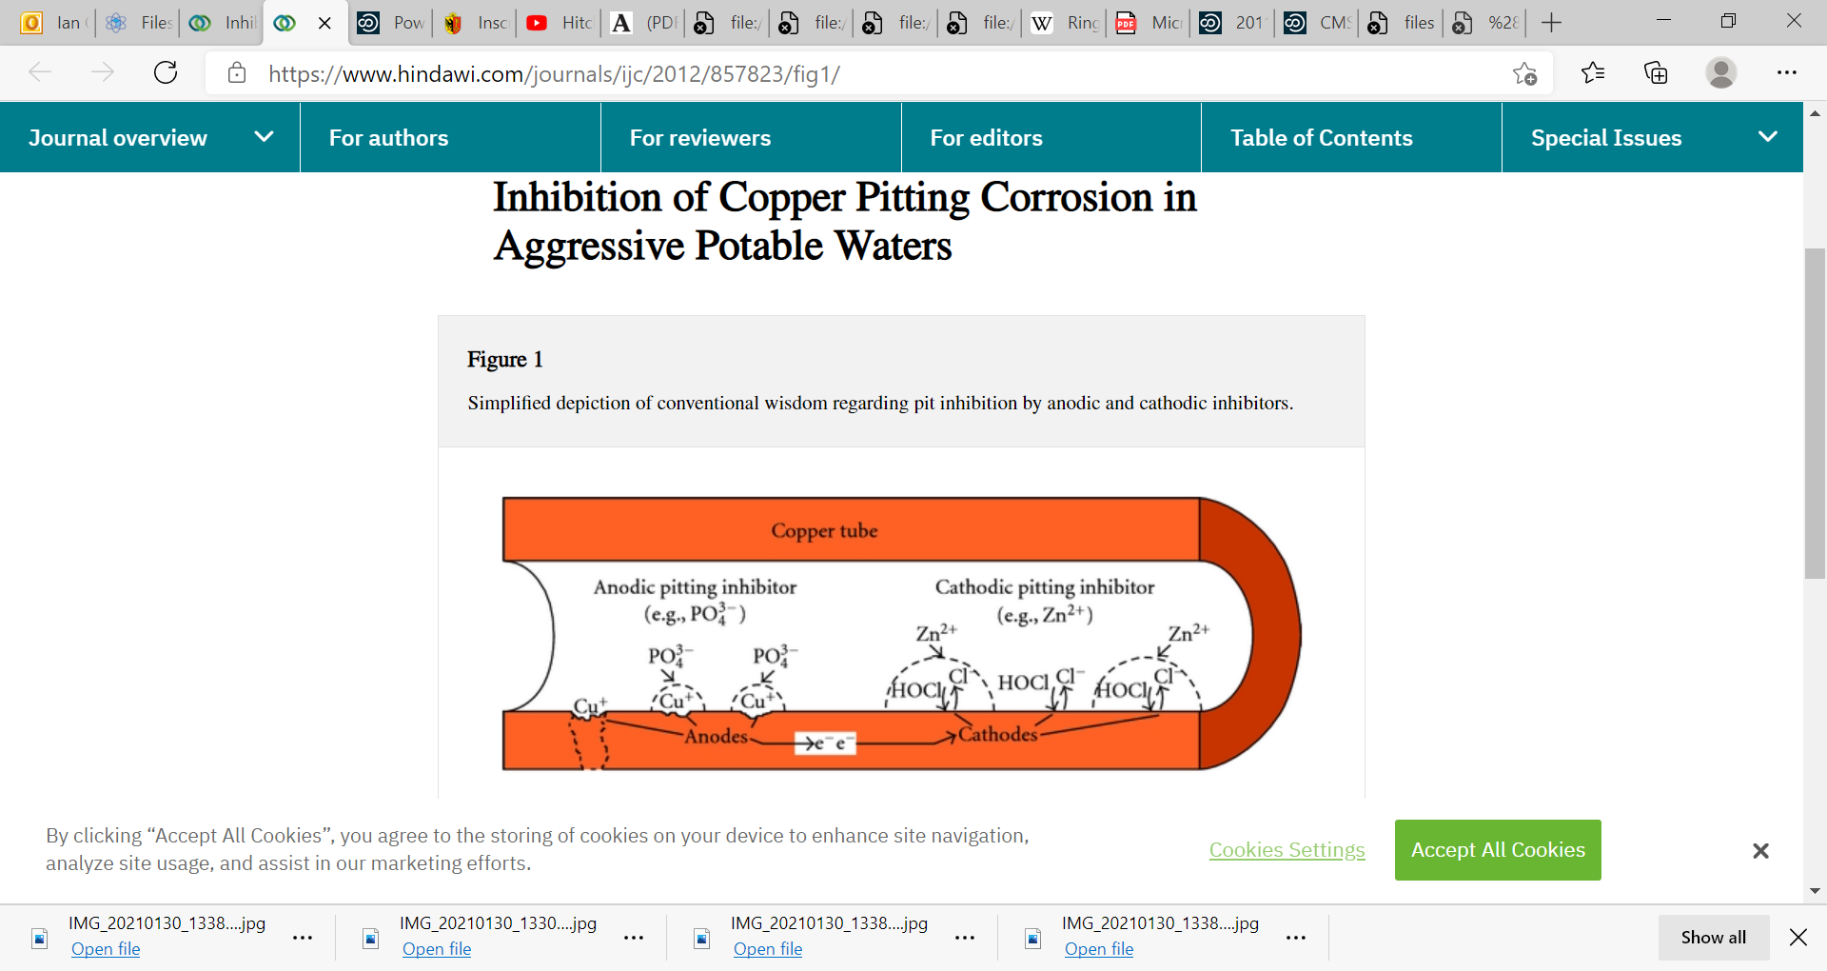
https://www.hindawi.com/journals/ijc/2012/857823/fig1/
However, at low enough dosages of anodic inhibitors, inactivating some of the pit sites could increase the cathodic driving force for corrosion at a few surviving sites, thereby accelerating the rate of pit growth relative to a condition without any inhibitor at all [26]. For this reason, very low doses of anodic inhibitors might actually decrease the time-to-failure; so only at dosages high enough to inactivate all anodic sites are anodic inhibitors considered “safe.”

Slide 7
