Slide 1
Leaks in RE+4
Ian Crotty

Slide 2
Chronology
End of 2015 Run water was noticed on the floor and CSC rack under YE+4 far side.
YE4 was put back on the wall 2 Feb 2016 and the leak identified as “upper most union” of RE+4/3/22. Fixed by ZEC the same week by intervening with no SM change necessary. An “easy fix” with flexibility in piping system.
During testing of sectors one Mini-manifold was found to leak, ZEC fix.
4 Feb 2016 another leak on RE+4/2/06 spotted by the crew measuring dimensions of the unions for tightness control. Fixed on Friday 5 Feb. More difficult fix with shorter union and no flexible length on chamber.
Monday adjacent union leaks! Fixed in the same way.

Slide 3
Fixing of leaks is possible, but why the leaks ?
Initially Sagana brass unions were purchased. Later it was understood that the pipe was hard and a harder ferrule was necessary. Sagana suggest replacing the ferrules by stainless steel. The production of the cooling circuits was started. The copper pipe however was annealed during the production and it was found difficult to obtain a good leak QA. After 36 circuits had been produced the decision was taken to go back to brass ferrules. Given that there are 3 leaks with ss ferrules there is a high suspicion that these are the origine despite > 3 QA levels being passed. This will be investigated further to conclude.

Slide 4
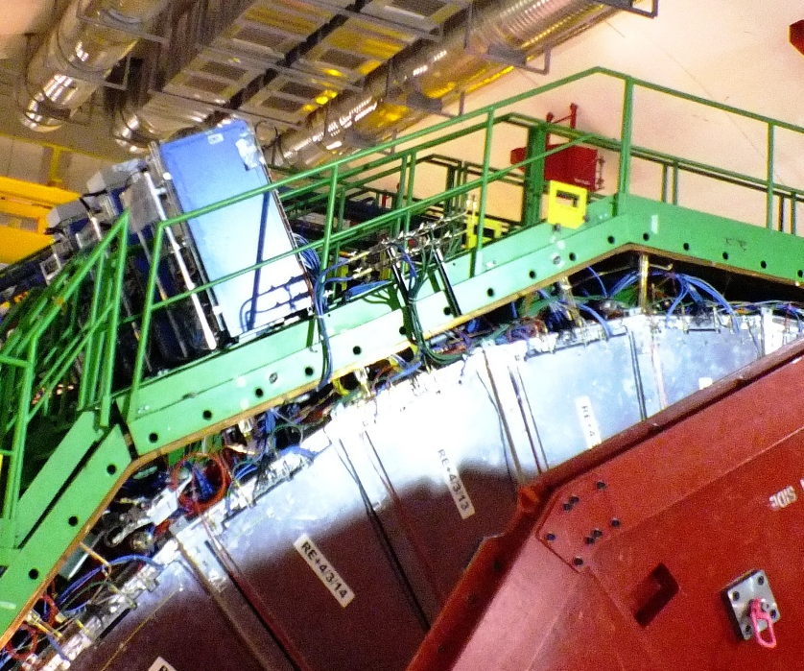
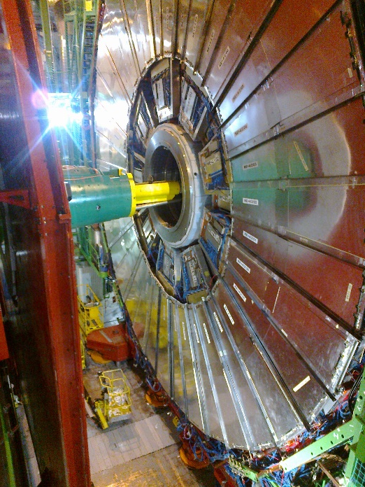
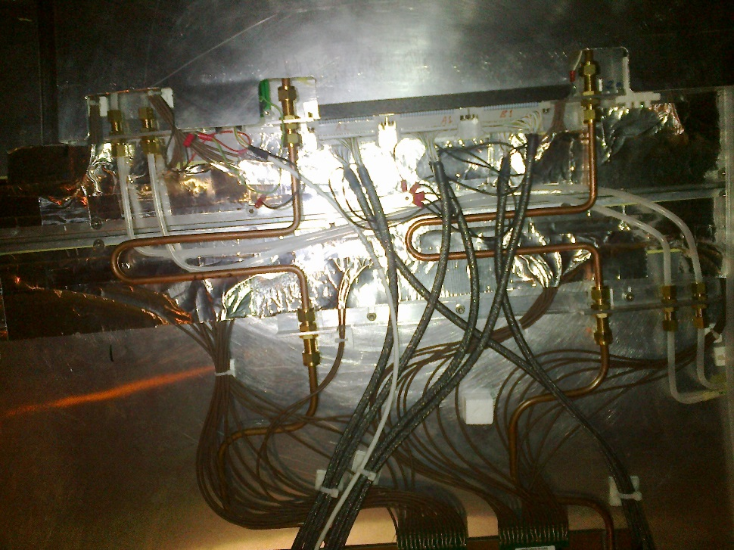
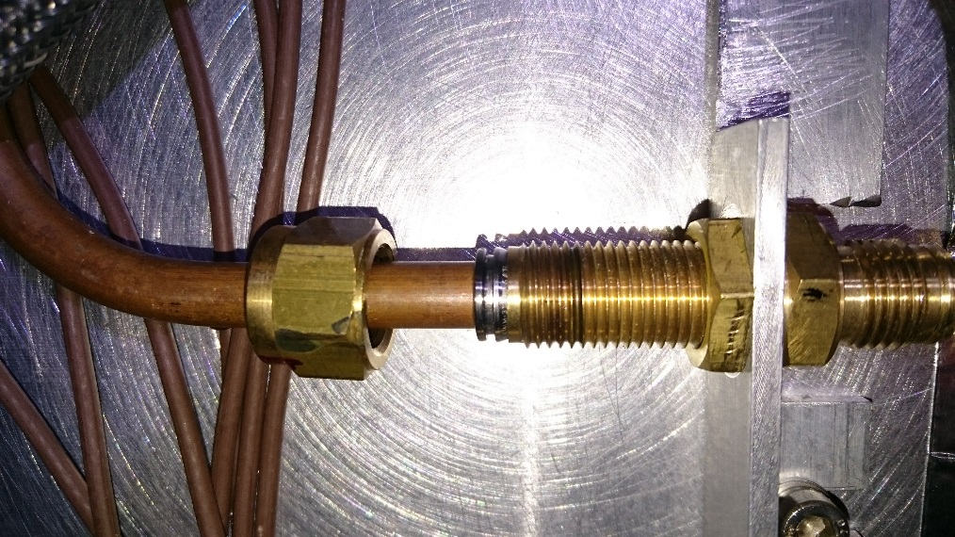
.
Excellent access when open or “Push backed”

Slide 5
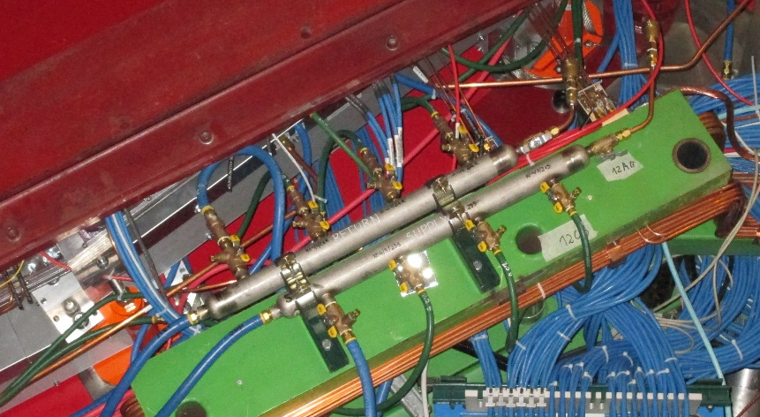
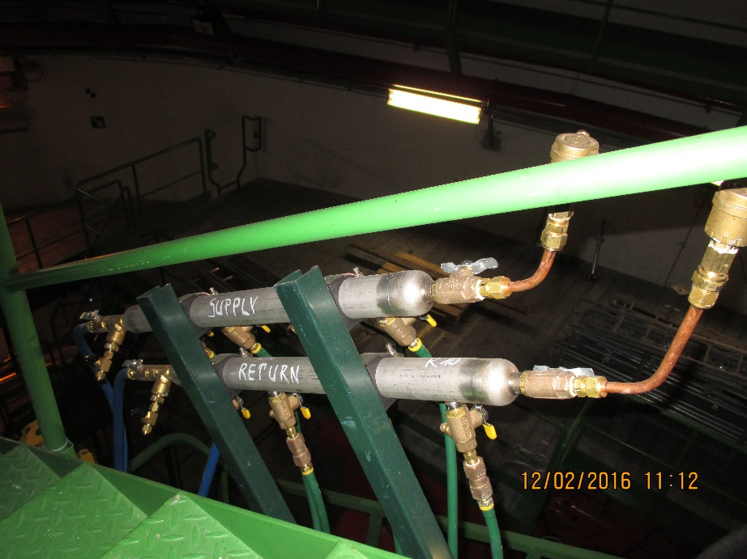
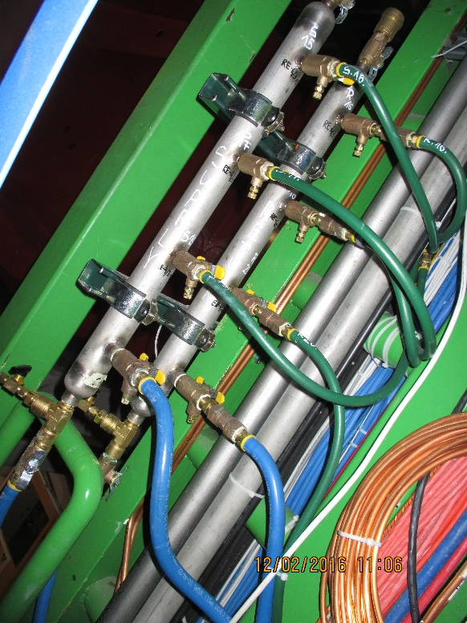
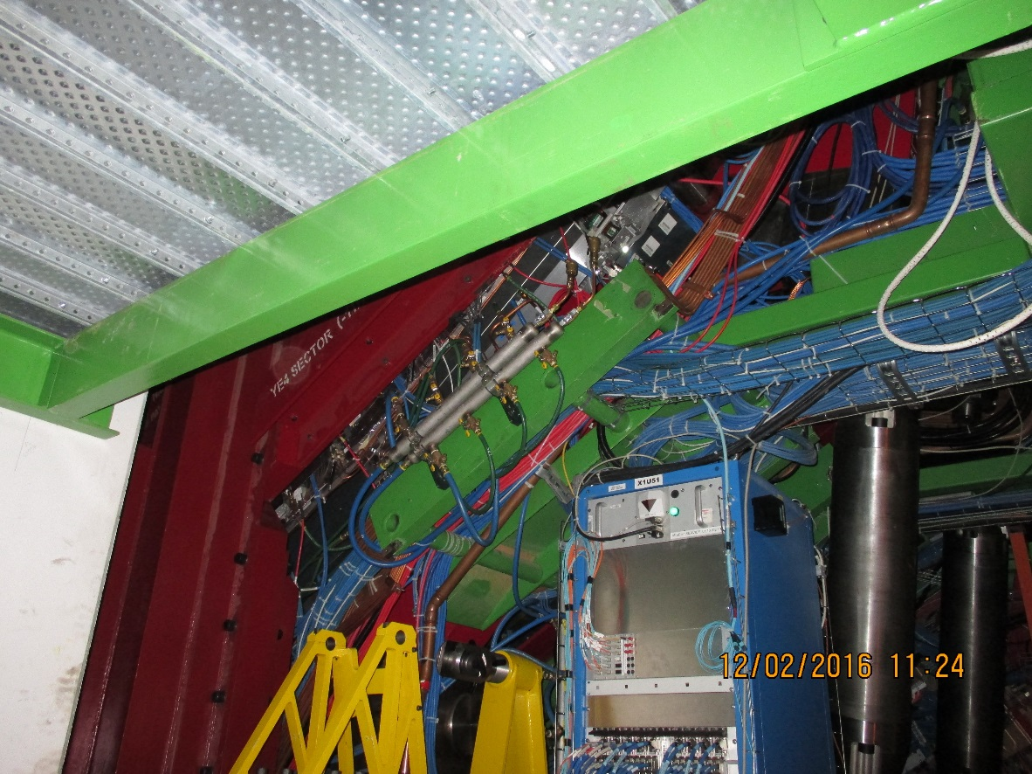
Acces to all valves on RE4 when closed
Intermediate in Racks
Bottom at floor level
Top sectors

Slide 6
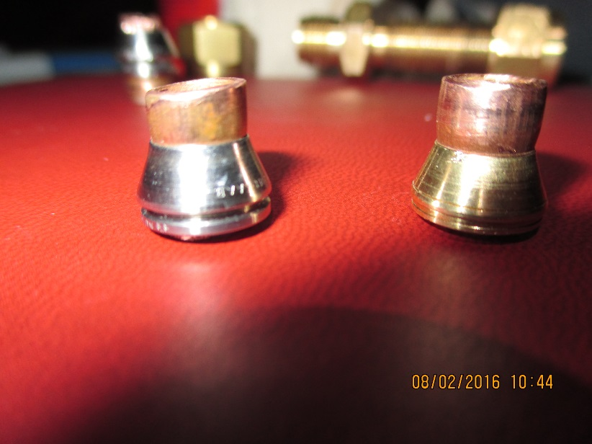
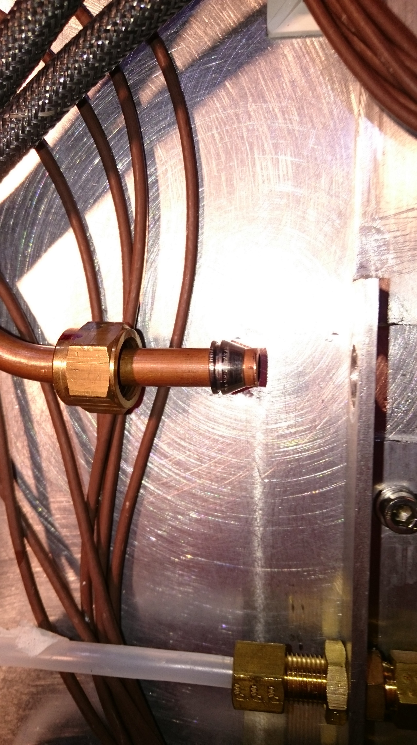


Swaging of stainless steel ferrules
The pipe diameter is reduced showing swaging of front ferrule
Distance between front and rear ferrules is less with ss than brass indicating that swaging is insufficient of rear ferrule.

Slide 7
Conclusion
The leaks on RE+4 are repaired, as is the mini-manifold.
It is unlikely that we will have access to the RE-4. However we should do a leak test @ 12Bar.
Complete the tightness study, 1700 measurements to be transcribed, Unions to be made up by ZEC to check for technique.
Study the cooling circuit to find proof of suspected weakness and find solution for both RE+ & -4.
Plan intervention for the RE+4.
Correlate pressure drop to drops of water, assuming one leak/20deg.
Implement yearly inspection and leak tests.
Can the operating pressure be reduced ?
YE+4 “Push back” not operated nor commissioned.

