Slide 1
Leaks on RE4s Feb 2016
Ian Crotty
21 March 2016

Slide 2
Information already available or to be produced
1 Leak on RE+4/3/22
2 Leaks on RE+4/2/06
1 leak on RE-4/X/27
Tersts in 904 QC4
The “Tightness” of all unions on RE+4 (“tightness” = swag level)
Unions produce by ZEC
Unions produced by Sagana tooling
Tigtness versus leak rate

Slide 3
Leak Rates RE+4 after repairs on 22 and 6
Sector 15-20 passes @ 18Bar
Sector 9-14 has factor 3-4 higher than “ALR”.
However the ALR does not give the Volume
The leak rate appears higher at 12 than at 18 Bar
“Acceptable leak Rate” (ALR) = 5E-2 [mBar.l/s]
There appears no correlation with SS ferrules
SS Ferruled chambers

Slide 4
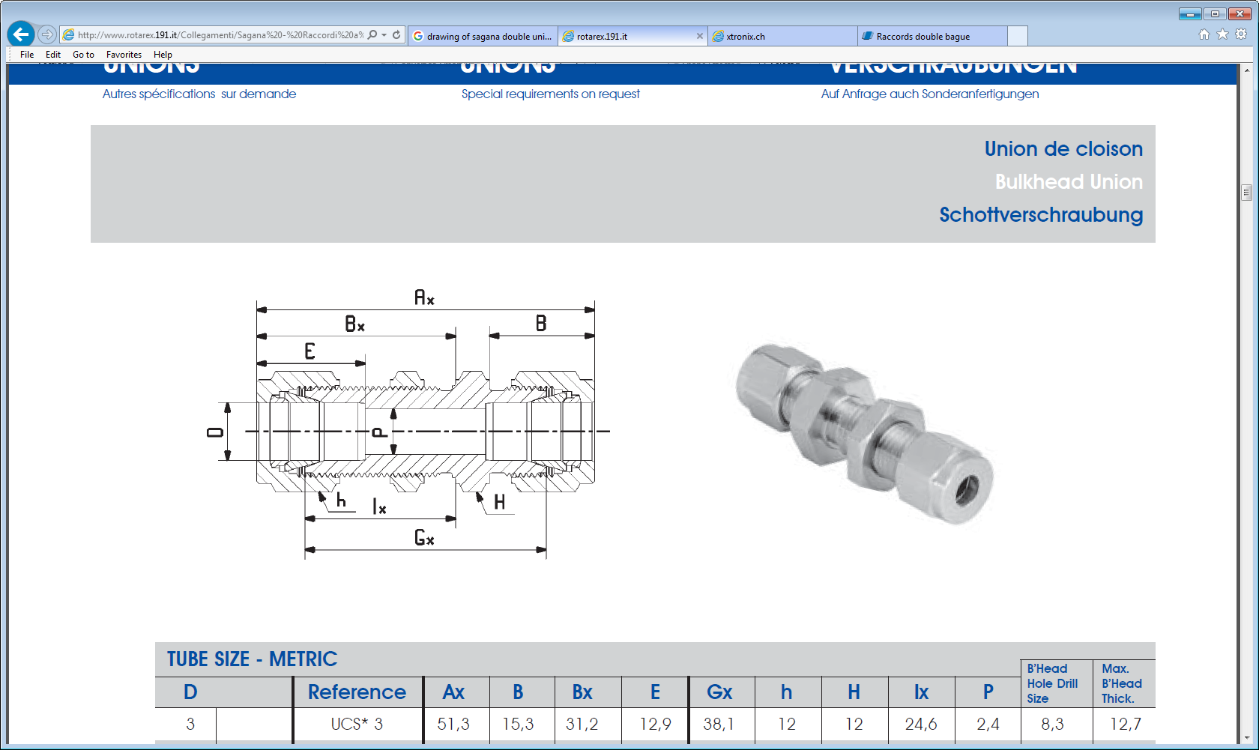
“Tightness”, the level at which the union has been tightened.
Bulkhead
Thread pitch is 20 tpi = 1.254mm
Union
Locknut is always inside the chamber

Slide 5
Schematic of SM cooling System
There are 2 ends to each union, one inside and the other outside
Inside
Outside
Type 2 Out Low R
Type 2 In Low R
Type 2 In High R
Type 3 In Low R
Type 3 In High R
Type 3 Out High R
Histograms will be made for all 8 positions to look for differences between SS and Brass ferruled unions.
Type 2 Out High R
Type 3 Out Low R
“R”

Slide 6
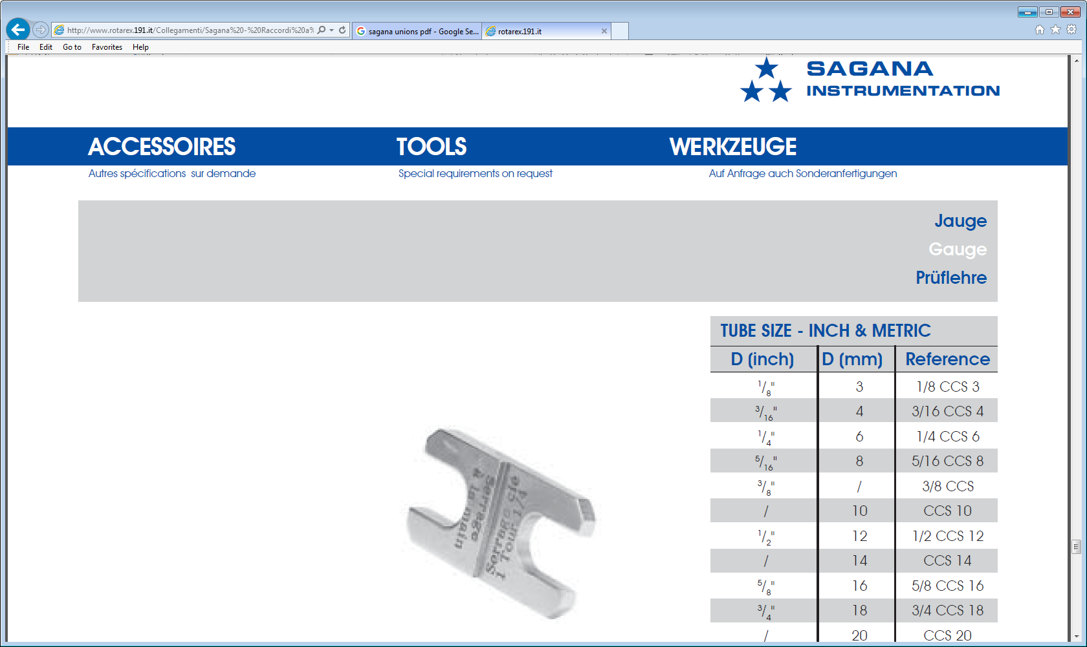
Specified “tightness” or swag
Before Tightening 4.83mm
After Tightening 3.62mm
Instructions in French
Pitch is 20tpi (1.254mm). 1 ¼ turns = 1.568mm. But the Difference in Shim is 4.83-3.62 = 1.21mm which is 0.96 turns.
The question is the point at which the 1 ¼ turns is started. The shim tool necessitates tools to achieve the “Serrage a la main” !

Slide 8
Looking at the level of swaging for each of the 8 positions across the radius.
1 ¼ turns = 3.4 ± 0.1[mm]
Brass Ferrules
SS Ferrules
Mean
StDev
3.23 | 3.29
0.31 | 0.35
Tighter

Slide 9
4 Unions over tight, perhaps to reduce leak rate in QC4
1 ¼ turns = 3.4 ± 0.1[mm]
Brass Ferrules
SS Ferrules
Mean
StDev
3.19 3.02
0.36 0.32
Tighter

Slide 10
An example of the inner (lock nut end) of the union “tightness”
Brass Ferrules
SS Ferrules
Mean
StDev
13.66 13.57
0.48 0.28
13.57 | 13.66
0.28 | 0.48

Slide 11
Conclusions
From the leak tests done there appears no correlation between SS ferrules and leaks.
This may be due to the closeness of the mean SS and mean Brass values.
The spread seen in the histograms is large
Tightening of the unions not yet understood but ongoing.
Request ZEC to make up 10 unions and measure
Sagana shim tool are not correct (!!) for the unions supplied.
We HAVE to improve our assembly technique
Further Work
Complete histograms for all positions in radius.
Make measurements of leak rate vs “tightness”
Understand leak rate vs Test pressure.
Should we improve the leak test procedure
Introduce yearly leak tests and inspections.

Slide 12
Additional Material
Sagana Catalogue
http://www.rotarex.191.it/Collegamenti/Sagana%20-%20Raccordi%20a%20compressione%20doppia%20ogiva%20.pdf
From the Oxford dictionary
The term "swage" comes from the Old French term souage, meaning "decorative groove" or "ornamental moulding".
Notice the name of the company “Swagelok”

Slide 13
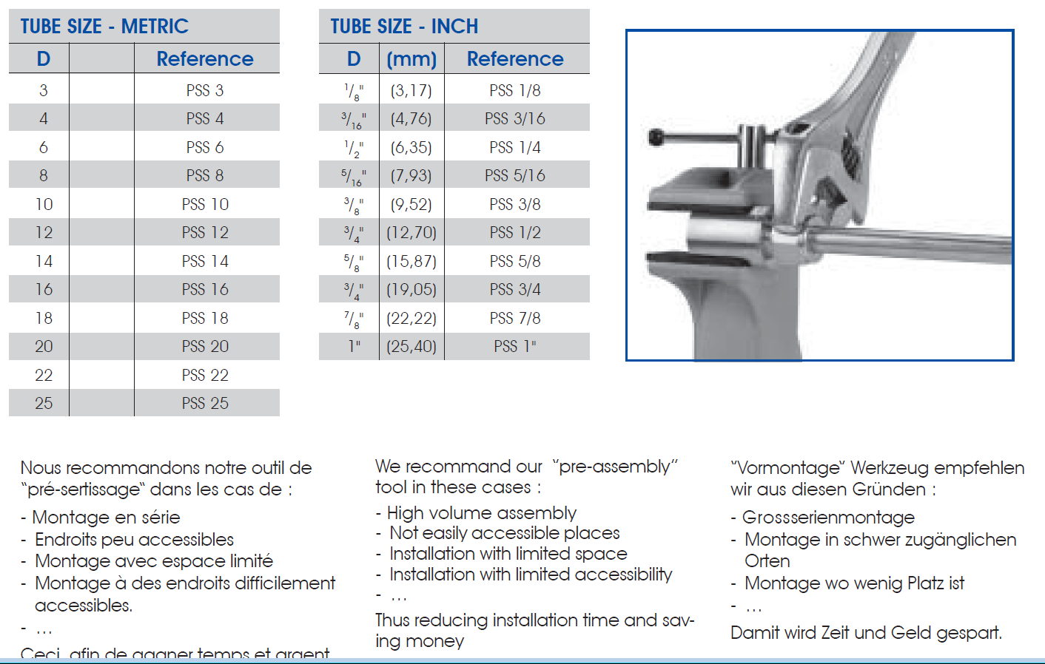

Slide 14
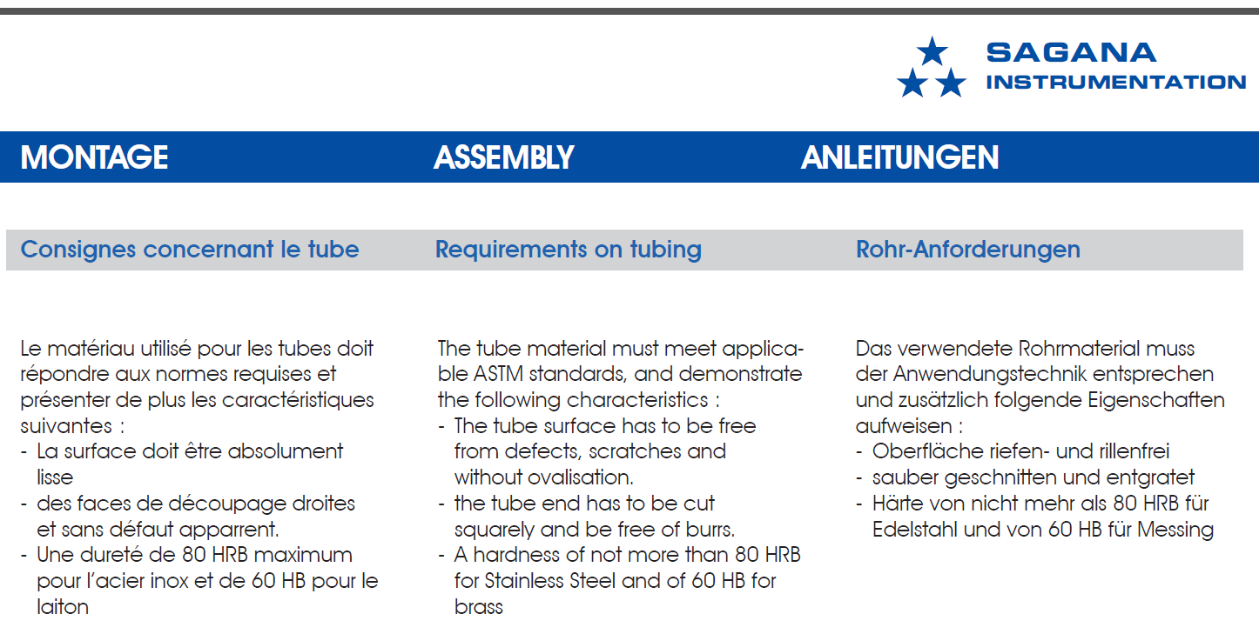

Slide 16
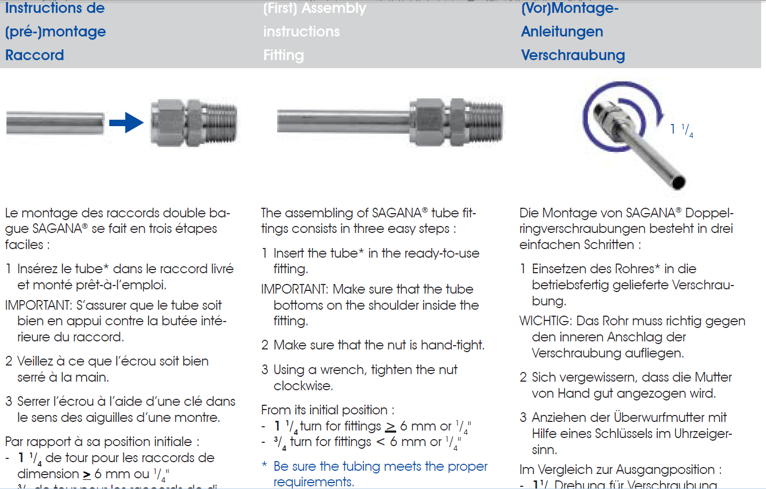

Slide 17
