Slide 1
Info for new cooling circuit using ECAL manifolds
Ian
1 June 2021

Slide 2
RE1 and RE2 cooling configurations.
RE1/2 and RE1/3 are in series in 60deg sectors
RE2/3 and RE2/2 are connected in sectors of 20degrees

Slide 3
http://project-cms-rpc-endcap.web.cern.ch/rpc/Services/Cooling/Components/CoolingUnionsRPCJan2016.xlsx

Slide 4
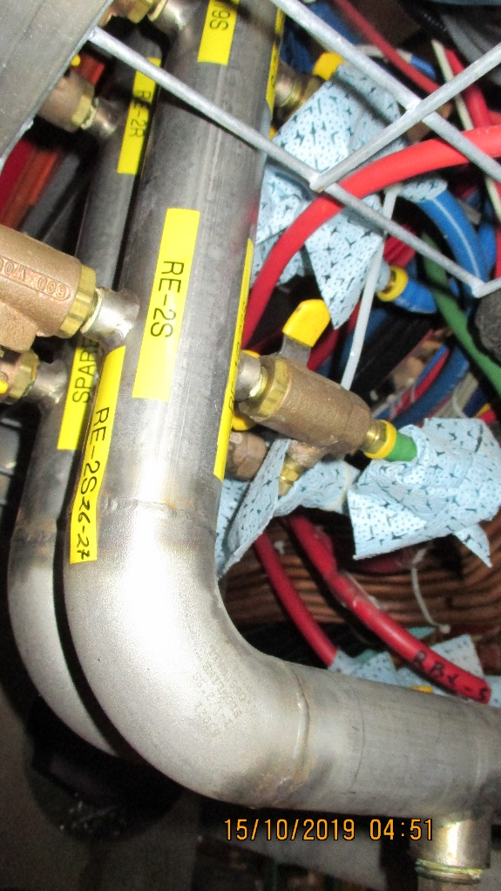
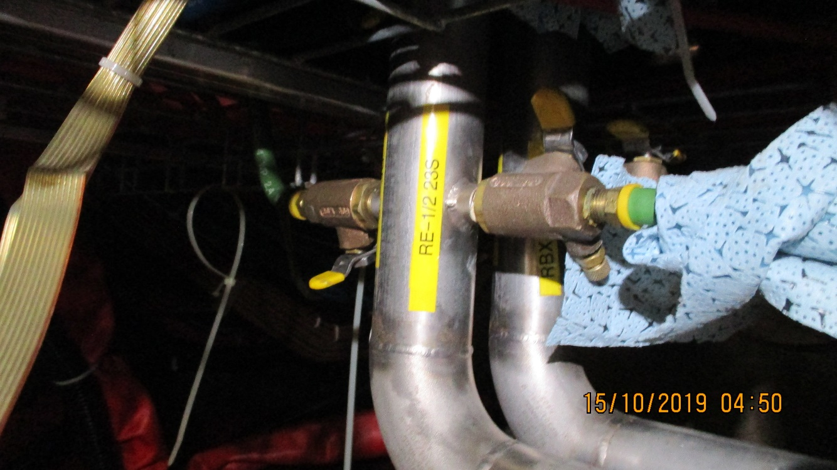
Labelling on manifolds
http://project-cms-rpc-endcap.web.cern.ch/rpc/Services/Cooling/YokeManiFolds/Photos/YEMinus1Oct2019/

Slide 5
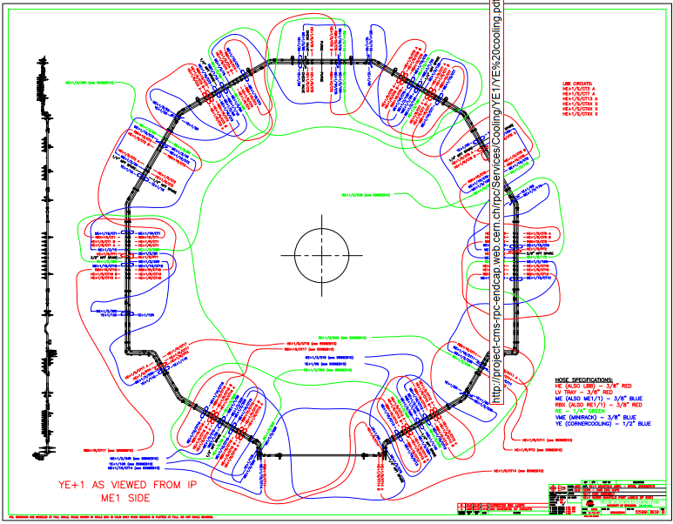
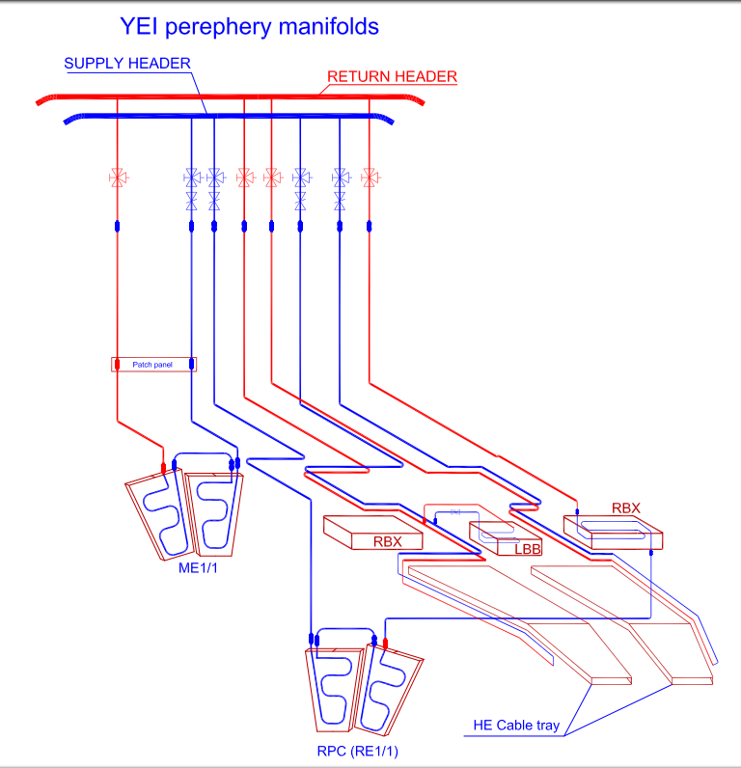
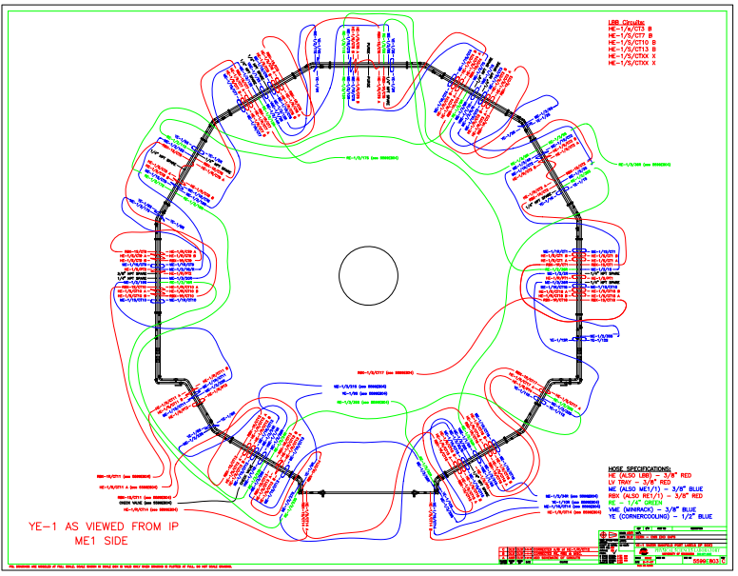
http://project-cms-rpc-endcap.web.cern.ch/rpc/Services/Cooling/YE1/YE%20cooling.pdf
http://project-cms-rpc-endcap.web.cern.ch/rpc/Services/Cooling/YE1/YEM1FromIPview.pdf
http://project-cms-rpc-endcap.web.cern.ch/rpc/Services/Services2000/Cool/5599804e[1]IanModRE-2%20Model%20(1).pdf

Slide 6
 | RE+1 Cooling Connexions
 |  |  | Checked for labelling 13 Jan 2010
Chamber & Valve allocation
Return | Supply
RE+1/2 -36R | RE+1/2 -05S
RE+1/2 -30R | RE+1/2 -35S
RE+1/2 -24R | RE+1/2 -29S
RE+1/2 -18R | RE+1/2 -23S
RE+1/2 -12R | RE+1/2 -17S
RE+1/2 -06R | RE+1/2 -11S
RE+1/3 -36R | RE+1/3 -05S
RE+1/3 -30R | RE+1/3 -35S
RE+1/3 -24R | RE+1/3 -29S
RE+1/3 -118R | RE+1/3 -23S
RE+1/3 -12R | RE+1/3 -17S
RE+1/3 -06R | RE+1/3 -11S
 | An example of Valve labeling that should be.
Return Valve |  | RE-1/2 36R-05S
Supply Valve |  | RE-1/2 05S-36R
 |  | Ian Crotty13 Jan 2010
In workspace dfs

Slide 7
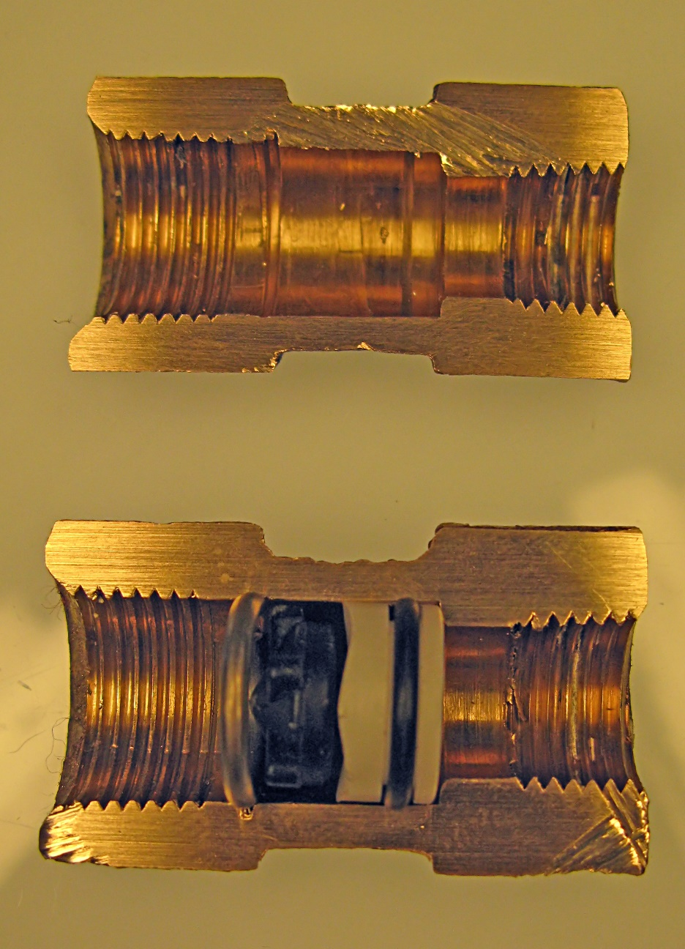

Slide 8
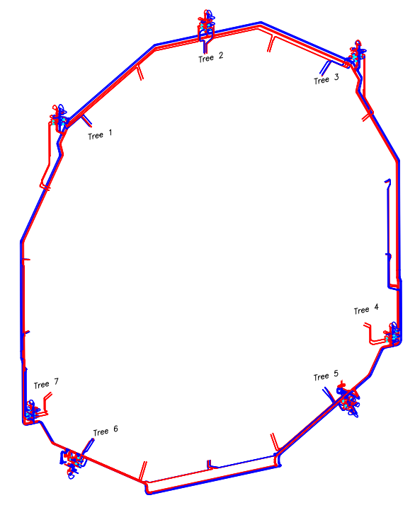
Dfs
Work space
Cms integration
3D Models
YE+1
YE1 cooling
Drawings
EE_Cooling_laterals……..
OR
Manifold ME RPC HE

Slide 9
NOT FOR YE1
But this is similar to the material I had for YE1
http://project-cms-rpc-endcap.web.cern.ch/rpc/Services/Cooling/Components/CoolingUnionsRPCJan2016.xlsx

Slide 10
http://project-cms-rpc-endcap.web.cern.ch/rpc/Services/Cooling/Components/CoolingUnionsRPCJan2016.xlsx

Slide 11
Conclusions
The flow rates should be similar as it is to today
The flow restrictors can be easily blown out and give almost zero impedance.
The chambers are mounted with metric piping. The flexibles are all sourced in the USA and so are in inches AND with NPT rather than BSP. Problematic spares supply. Change all to what is readily here in Europe. Example is Swagelok. To be seen with the CSC colleagues.
The valves should be accessible.
Who pays ?

