Slide 1
Info for new cooling circuit using ECAL manifolds
Ian
1 June 2021

Slide 2
http://project-cms-rpc-endcap.web.cern.ch/rpc/Services/Cooling/Components/CoolingUnionsRPCJan2016.xlsx

Slide 3
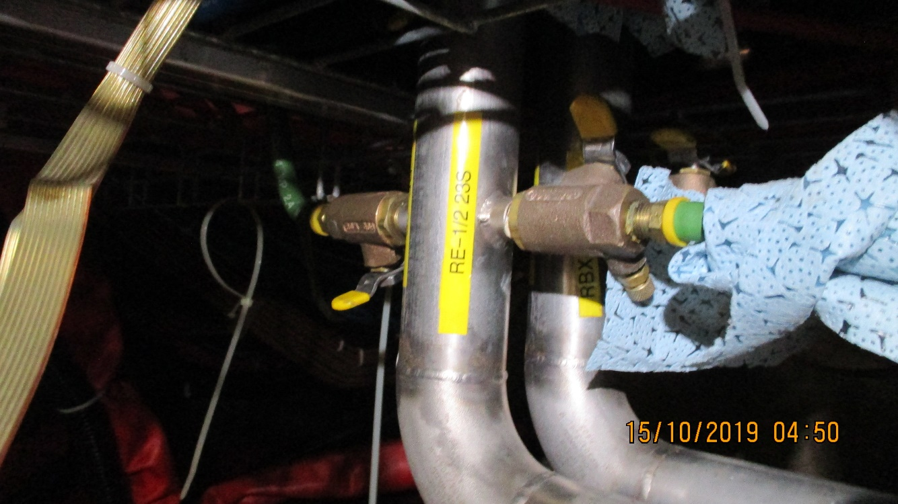
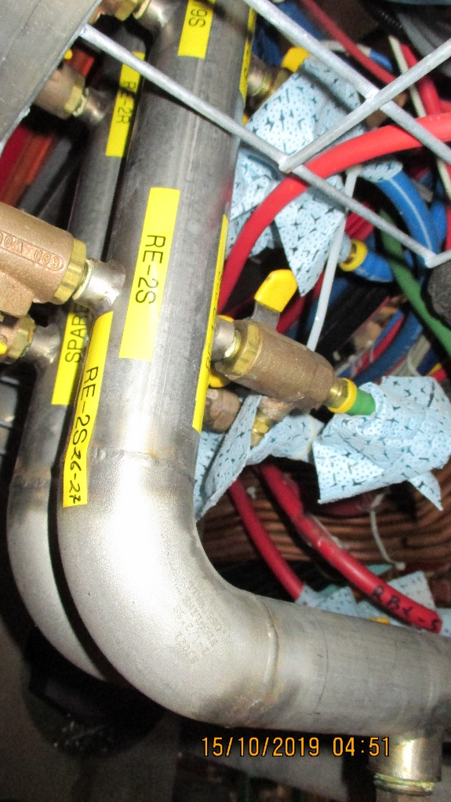
http://project-cms-rpc-endcap.web.cern.ch/rpc/Services/Cooling/YokeManiFolds/Photos/YEMinus1Oct2019/

Slide 4
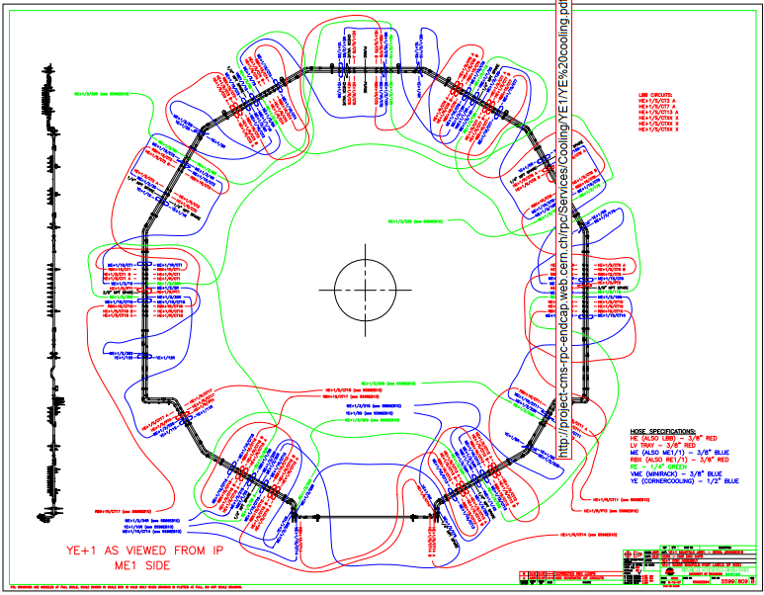
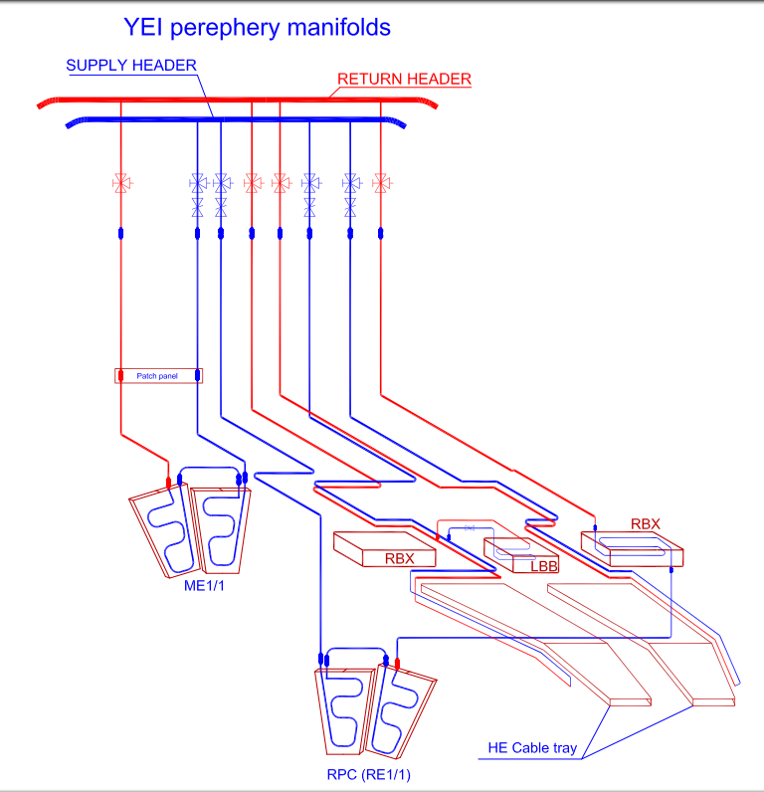
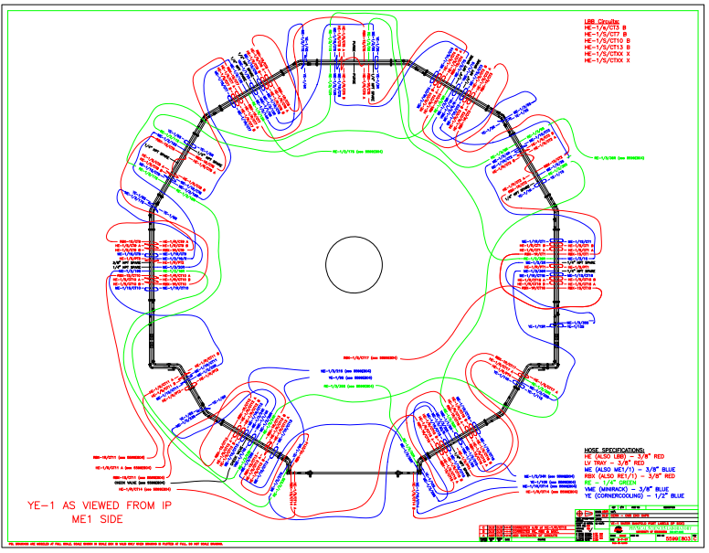
http://project-cms-rpc-endcap.web.cern.ch/rpc/Services/Cooling/YE1/YE%20cooling.pdf
http://project-cms-rpc-endcap.web.cern.ch/rpc/Services/Cooling/YE1/YEM1FromIPview.pdf
http://project-cms-rpc-endcap.web.cern.ch/rpc/Services/Services2000/Cool/5599804e[1]IanModRE-2%20Model%20(1).pdf

Slide 5
 | RE+1 Cooling Connexions
 |  |  | Checked for labelling 13 Jan 2010
Chamber & Valve allocation
Return | Supply
RE+1/2 -36R | RE+1/2 -05S
RE+1/2 -30R | RE+1/2 -35S
RE+1/2 -24R | RE+1/2 -29S
RE+1/2 -18R | RE+1/2 -23S
RE+1/2 -12R | RE+1/2 -17S
RE+1/2 -06R | RE+1/2 -11S
RE+1/3 -36R | RE+1/3 -05S
RE+1/3 -30R | RE+1/3 -35S
RE+1/3 -24R | RE+1/3 -29S
RE+1/3 -118R | RE+1/3 -23S
RE+1/3 -12R | RE+1/3 -17S
RE+1/3 -06R | RE+1/3 -11S
 | An example of Valve labeling that should be.
Return Valve |  | RE-1/2 36R-05S
Supply Valve |  | RE-1/2 05S-36R
 |  | Ian Crotty13 Jan 2010
In workspace dfs

Slide 6
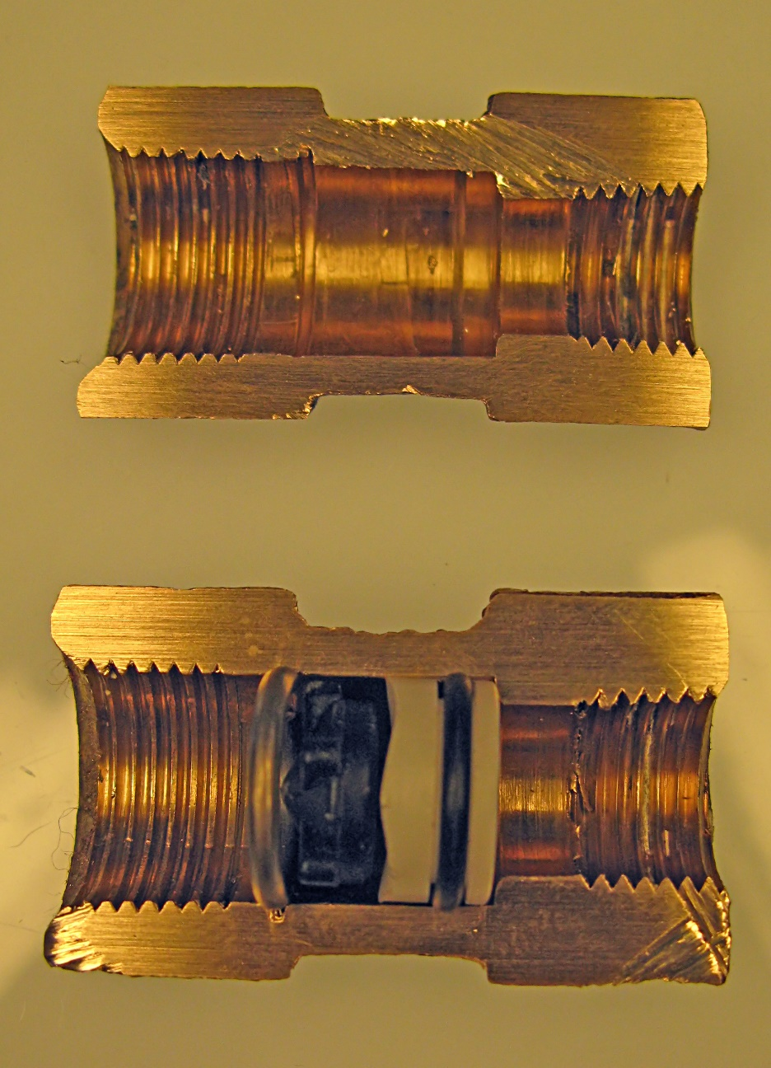

Slide 7
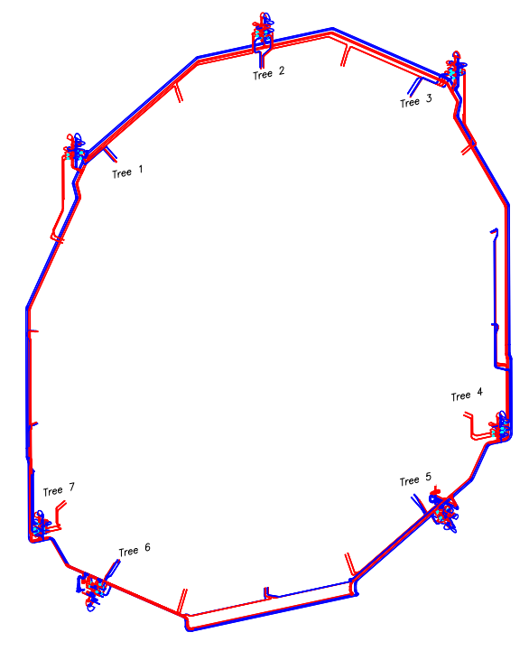
Dfs
Work space
Cms integration
3D Models
YE+1
YE1 cooling
Drawings
EE_Cooling_laterals……..
OR
Manifold ME RPC HE

Slide 8
NOT FOR YE1
But this is similar to the material I had for YE1
http://project-cms-rpc-endcap.web.cern.ch/rpc/Services/Cooling/Components/CoolingUnionsRPCJan2016.xlsx

Slide 9
http://project-cms-rpc-endcap.web.cern.ch/rpc/Services/Cooling/Components/CoolingUnionsRPCJan2016.xlsx

