Slide 1
iRPC cooling 904
Ian
14 oct 2023

Slide 2
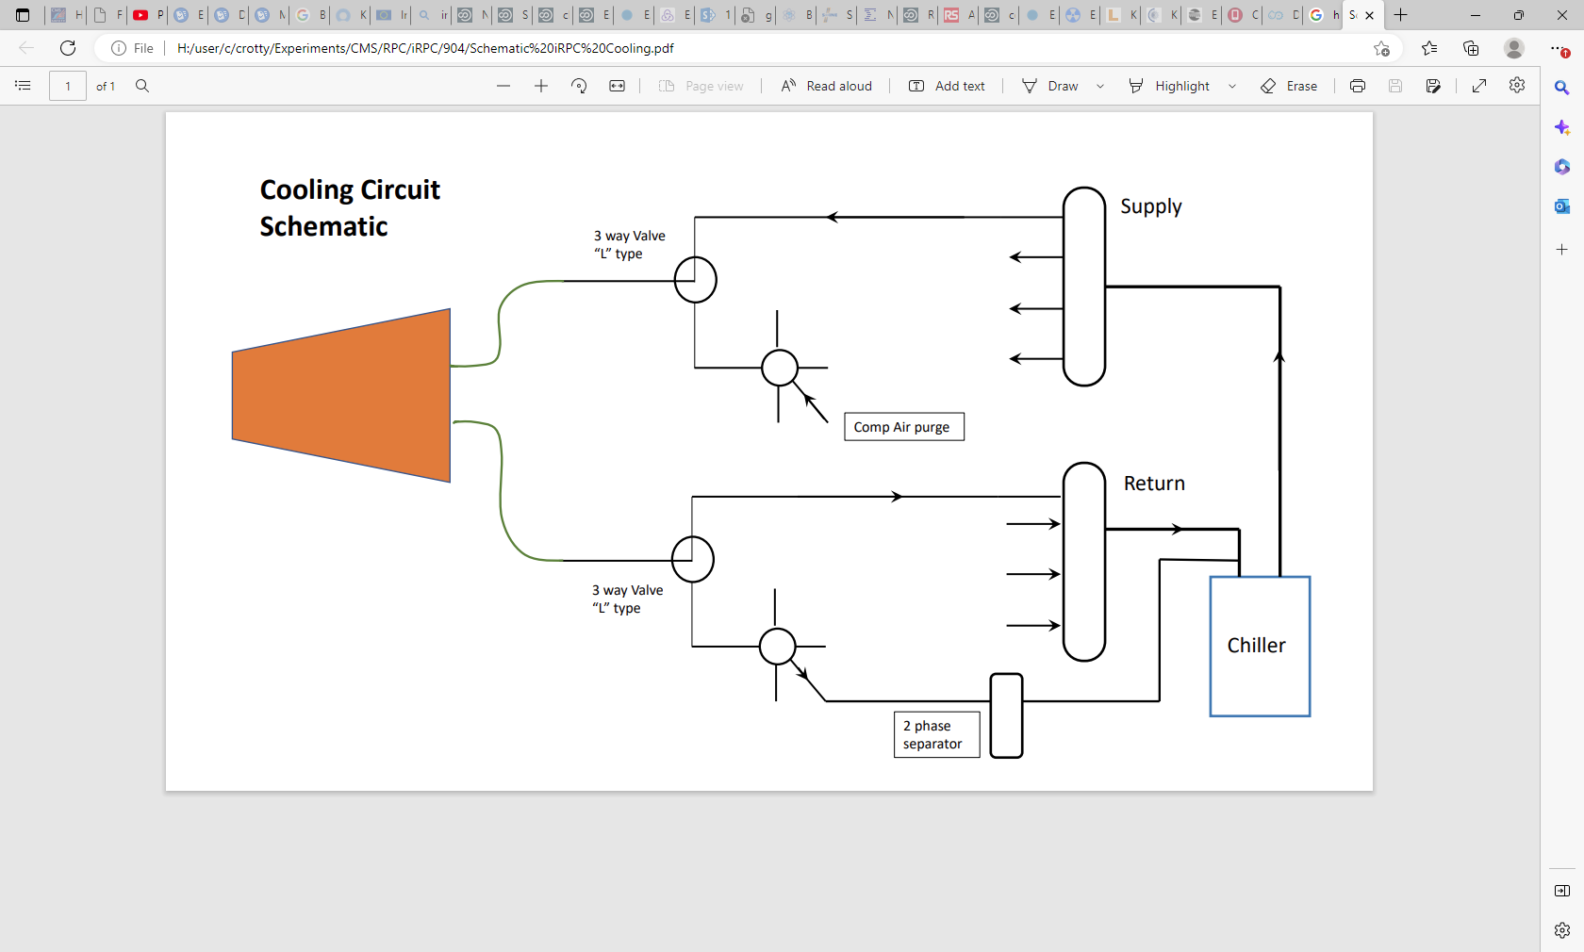

Slide 3

 | iRPC Cooling 904
 |  | 30-Sep-23
 |  | Ian Crotty
 | CERN stores have been given priority in the choices made, if cheap wrt exterior sources
Designation | Description | Total cost | Comments
Chiller to distributor Manifold
 | 1/2 inhch union supplied with Unichill | 0
 | Brass 3/8inch to int 13mm hose | 15.6
 | Reinforced PVC hose 13x19mm | 9.6
 | 3/8 to 14mm Cu pipe | 0
 | Cu 14mm pipe 50mm
 | Hose clamp 19mm | 8 | RS
 | 14mm to 1/2 inch Sagana | 38
 | reduction 1/2M to 3/8inch F | 2.6
 | Female to F 1/2 inch | 9.2
 |  |  | In the cataloge CERN there are alternatives to the barb to 1/2 fittindgs
Short across the chiller to ensure flow
 |  |  | Possible up grades
Air bleed valve | on the Manifolds. Weld modification |  | Possible up grades

Slide 4
Distributor
to 3 way Valve
 | Nuts | 80.4
 | Ferrules dia 14mm Sagana front | 33.6
 | Ferrules dia 14mm Sagana rear | 19.2
 | Cu.Pipe dia 14mm | 29
Union 14mm pipe to 3WV | Sagana 1/2 inch to 14mm | 190
 | Cu seal | 7.8
OR | Legris 1/2 inch to 16m | 76
 | Reduction 16 to 14mm | 105
 | Cu seal | 7.8
3WV | Distribution from Manifold | 120 | Aliexpress
 | to chambers
 |  | 720 | Sagana

Slide 5
From 3WV to chambers
2 solutions
PU hose dia 8mm | 1/2 inch to 1/4inch bush | 11.4
 | Legris 1/4 inch to 8mm | 28.8
 | Internal ferrules 6x8mm | 17.4
 | PU 8x6mm hose | 190
 | O Ring seal to chamber 8mm | 20 | replaces rear ferrule
Sagana pushlok Hose 1/4 inch | 1/4 inch hose | 300
 | Swagelok 8mm to 1/4 inch barb | 200
 | Swagelok 1/4inch to 1/4 inch barb | 200
 | 1/4 inch to 1/2 inch bush | 22.8

Slide 7
Compressed air to chambers
 | Distributor 1/4inch from P5
 | 6mm to 1/4 inch
Pressure Regulator | from previous installation | 0

Slide 8
Conclusions
The majority (90%) of the components has been established.
Alternatives have been proposed in many cases to try to reduce costs.
A major element is the 3 way valves. We need cheap alternatives to test at 30-60 bar.
5 to 10 price ratio for 10 pieces.
No total cost is given as there are alternatives but very approx. 0.5-1kchf, requires another iteration. To be confirmed
Phase separator for the drain has been sourced at CERN, may need modification in P5 to reduce unions cost. Giving auto redrain to chiller.
Interlock has not been established but we checked for the flow elements in 904.
Rack and front panel will be needed.

