Slide 1
iRPC cooling trials in cosmic stand
Ian
15 July 2024

Slide 2
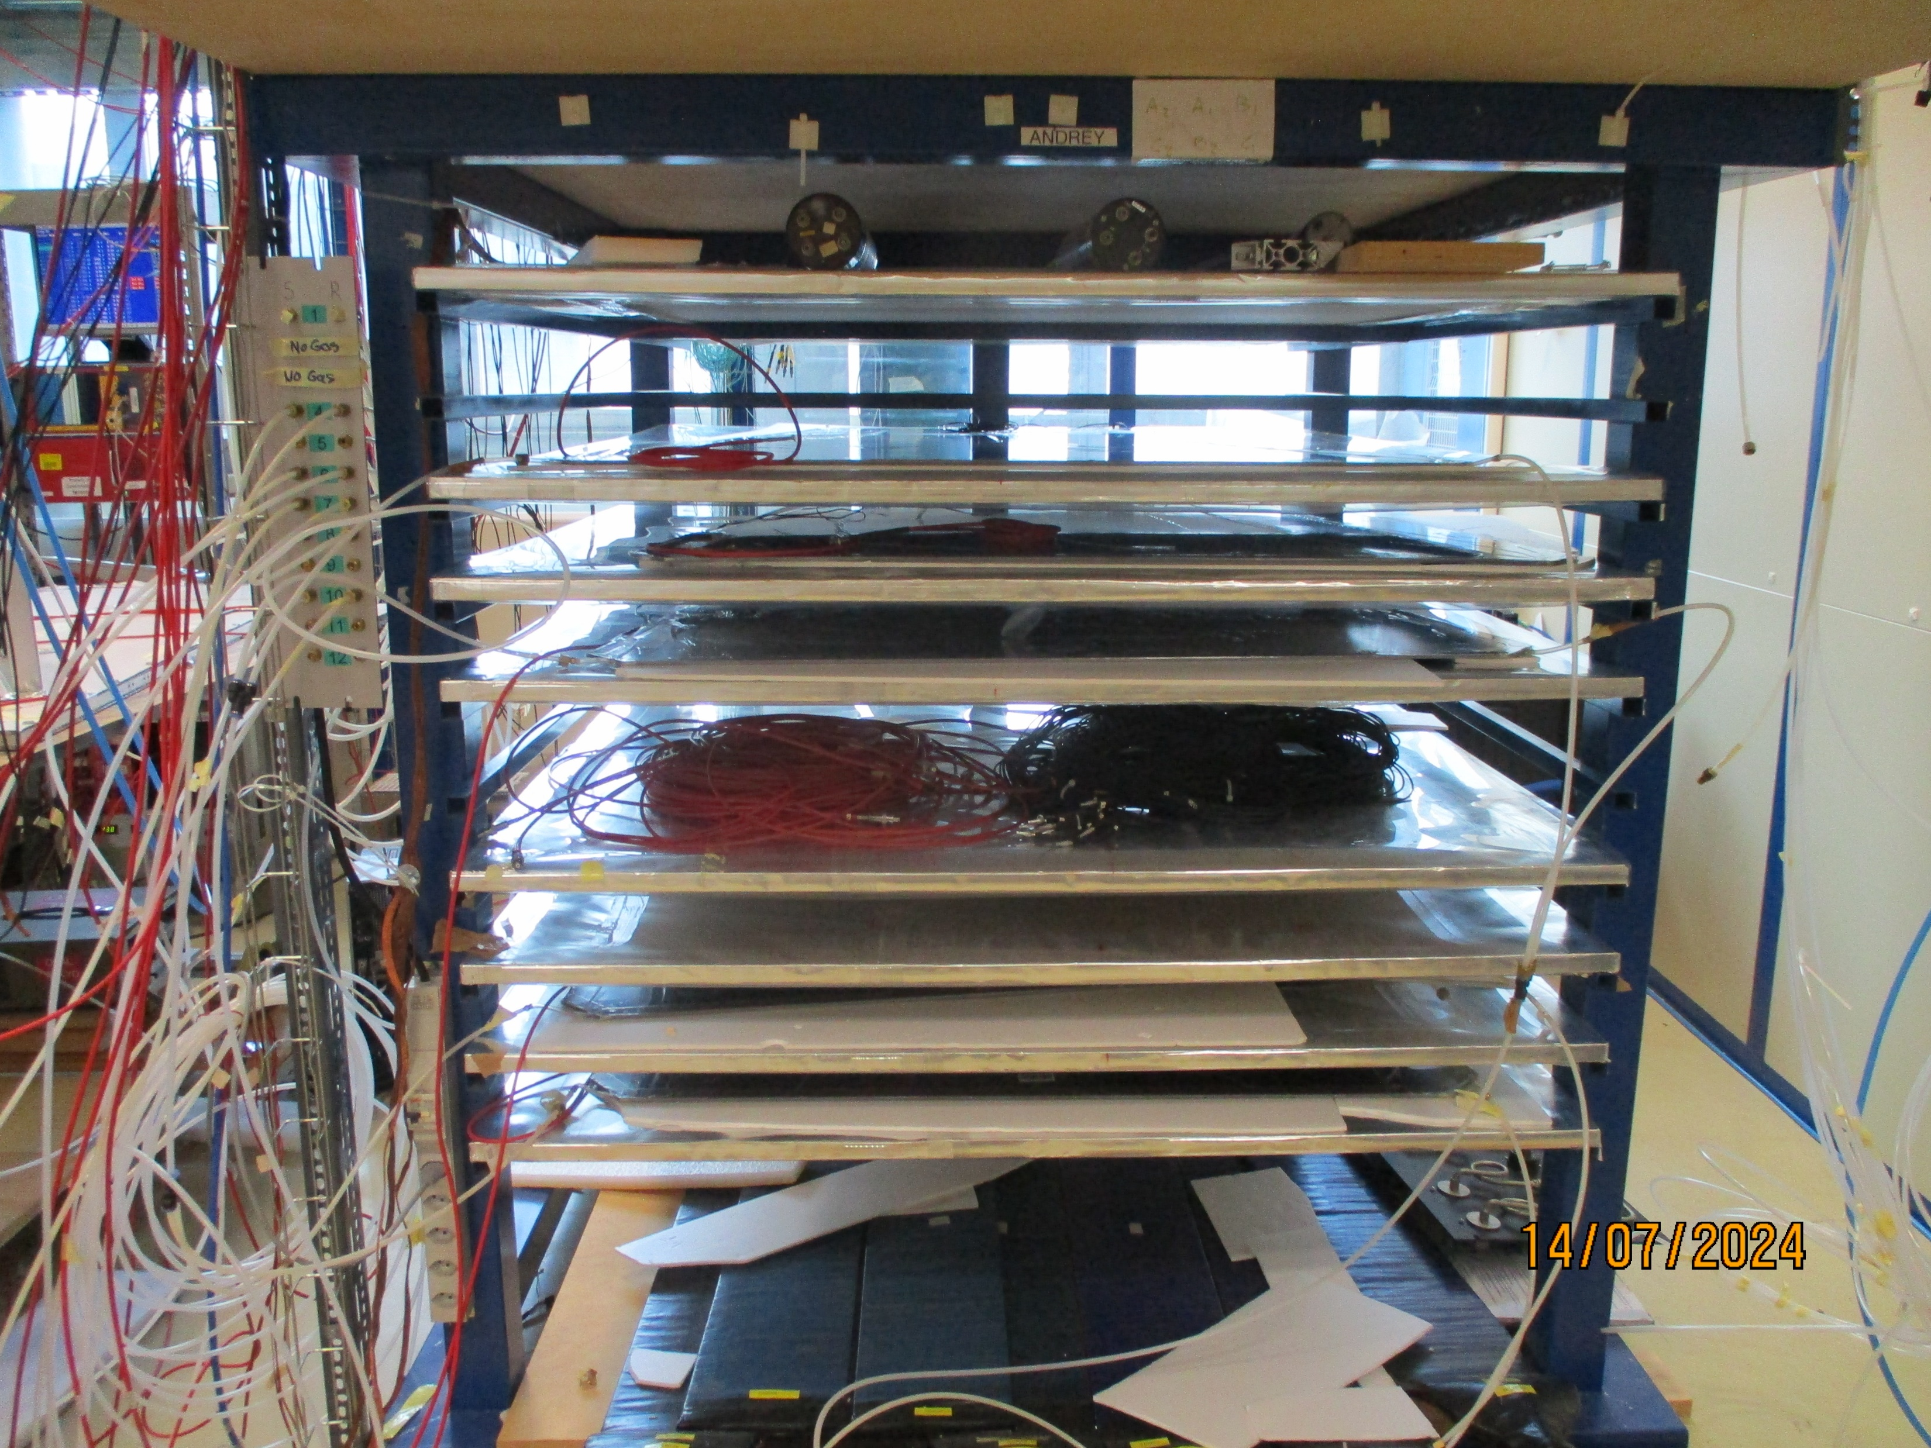
Space available. Which slot to choose?
Low down will be more difficult to purge requiring higher pressure/flow rate
and longer times as the pipe will be on top of the stand.
Gap tests should not be interrupted ? So they should be kept on the higher levels

Slide 3
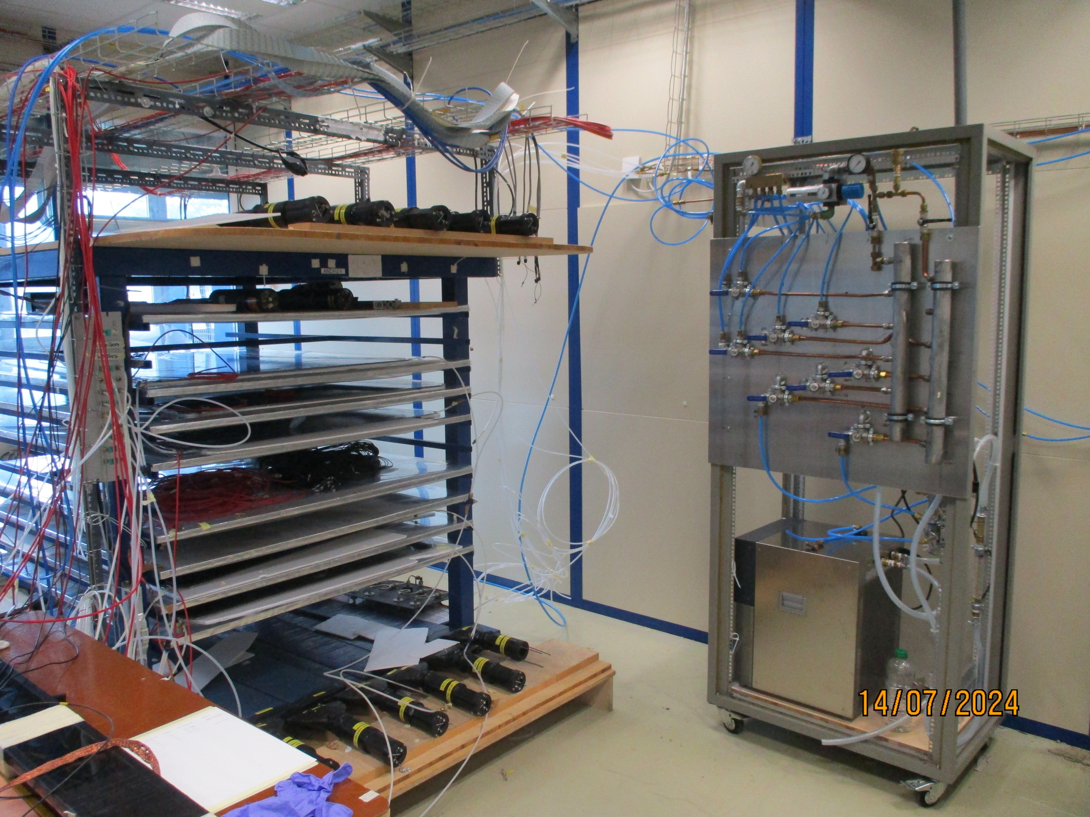
Pipes in position
For one channel.
Tests should include all channels but using only one chamber as we have only on test chamber.

Slide 4
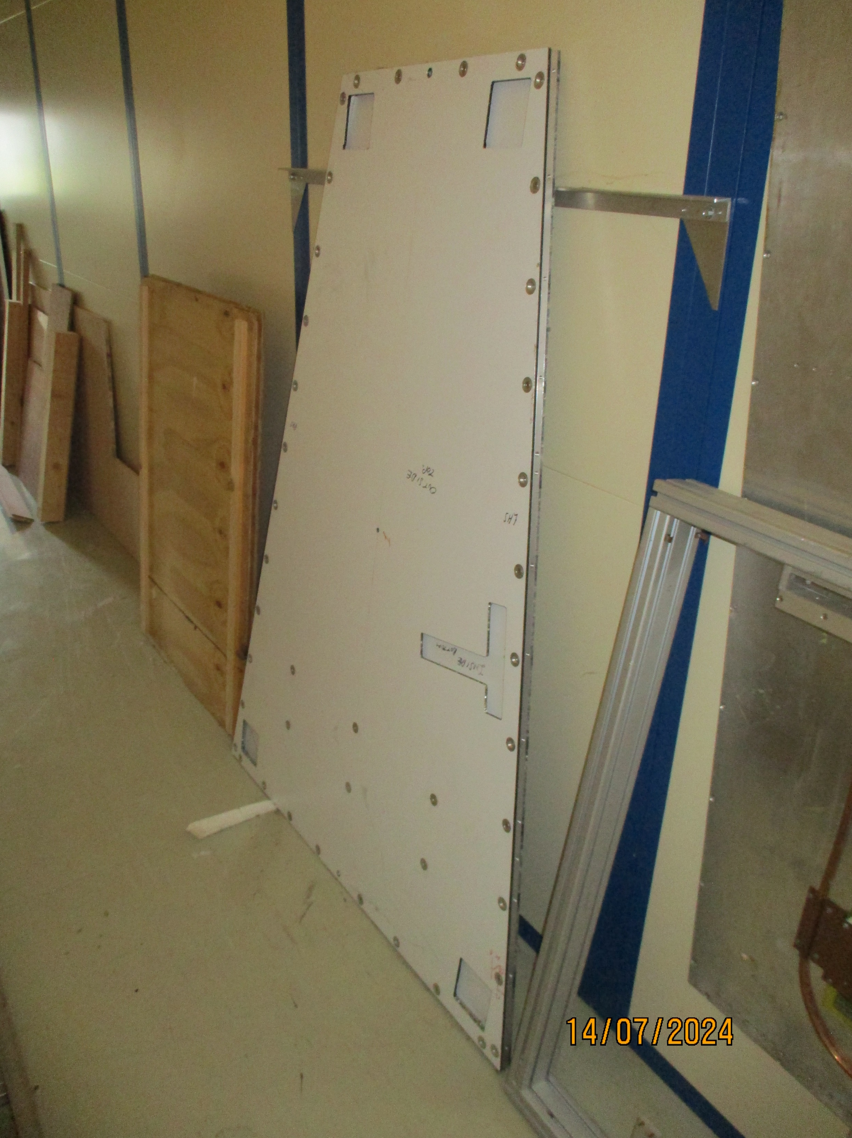
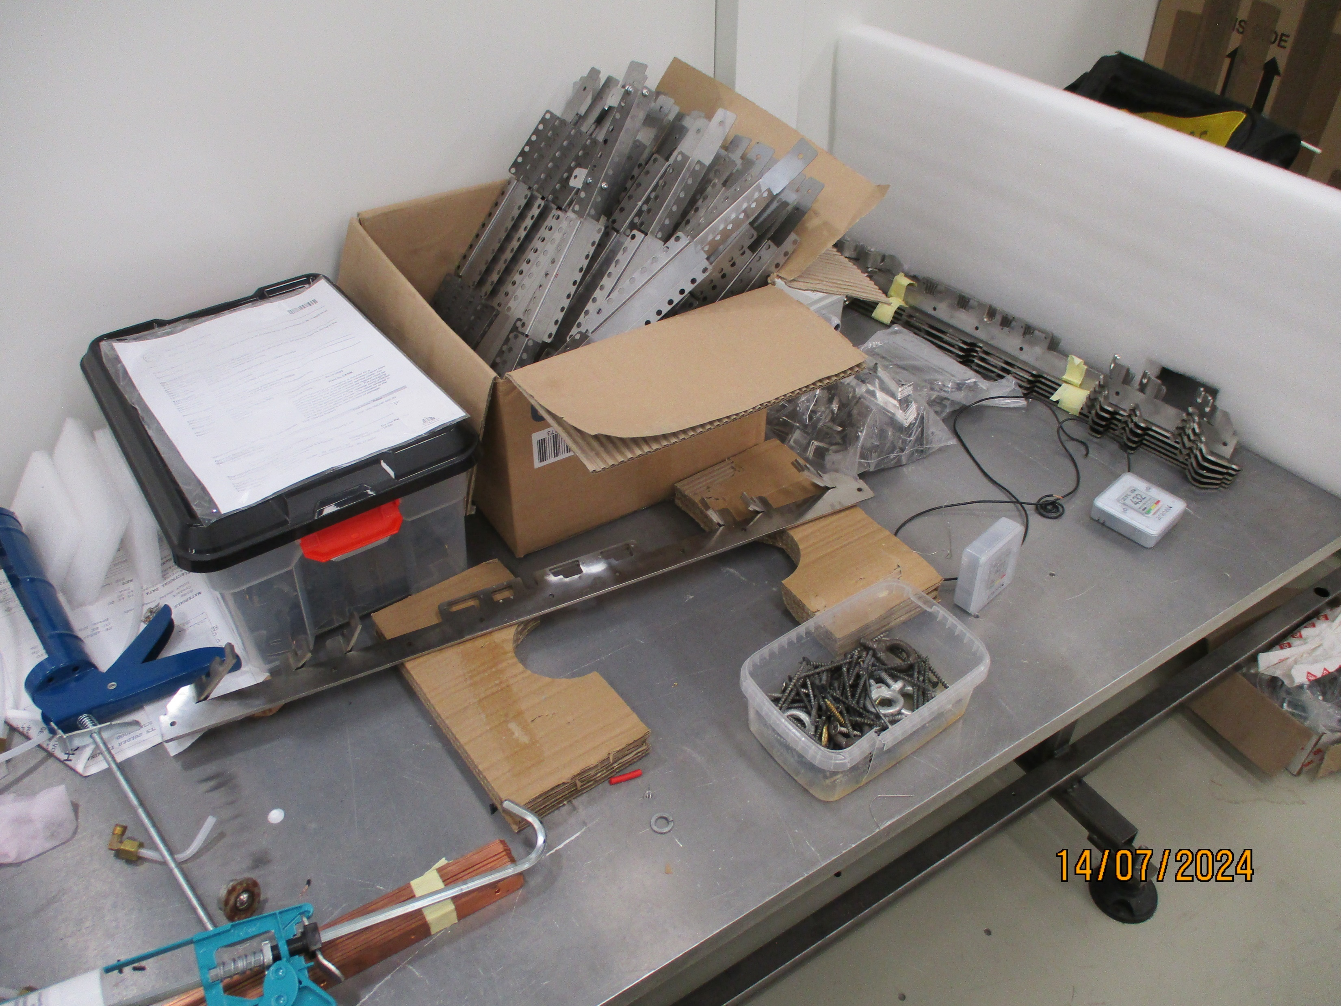
Elements used

Slide 5
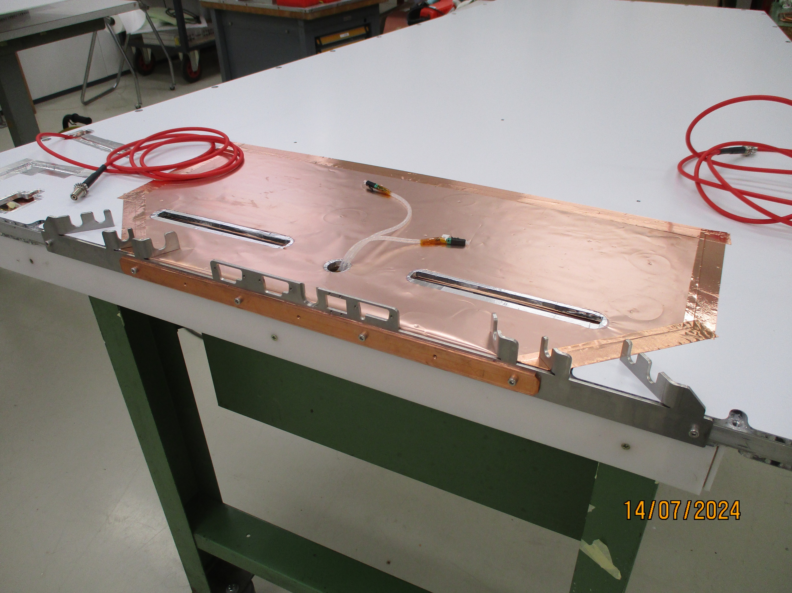
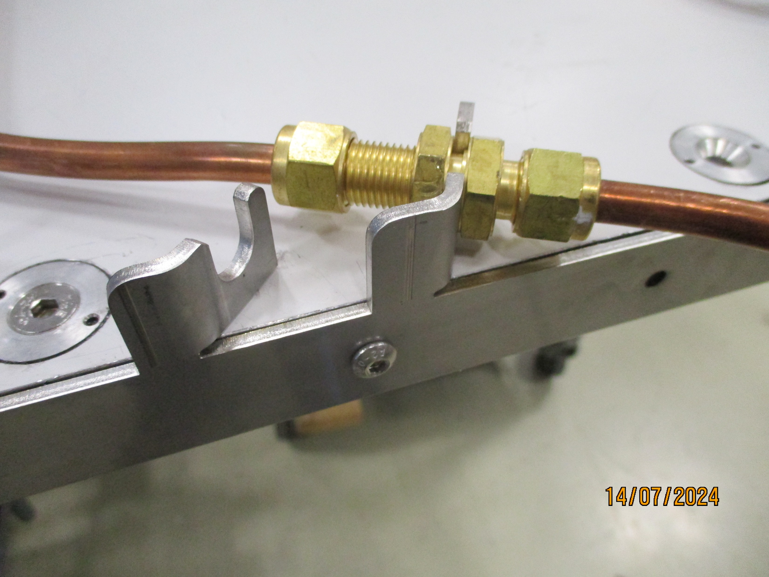
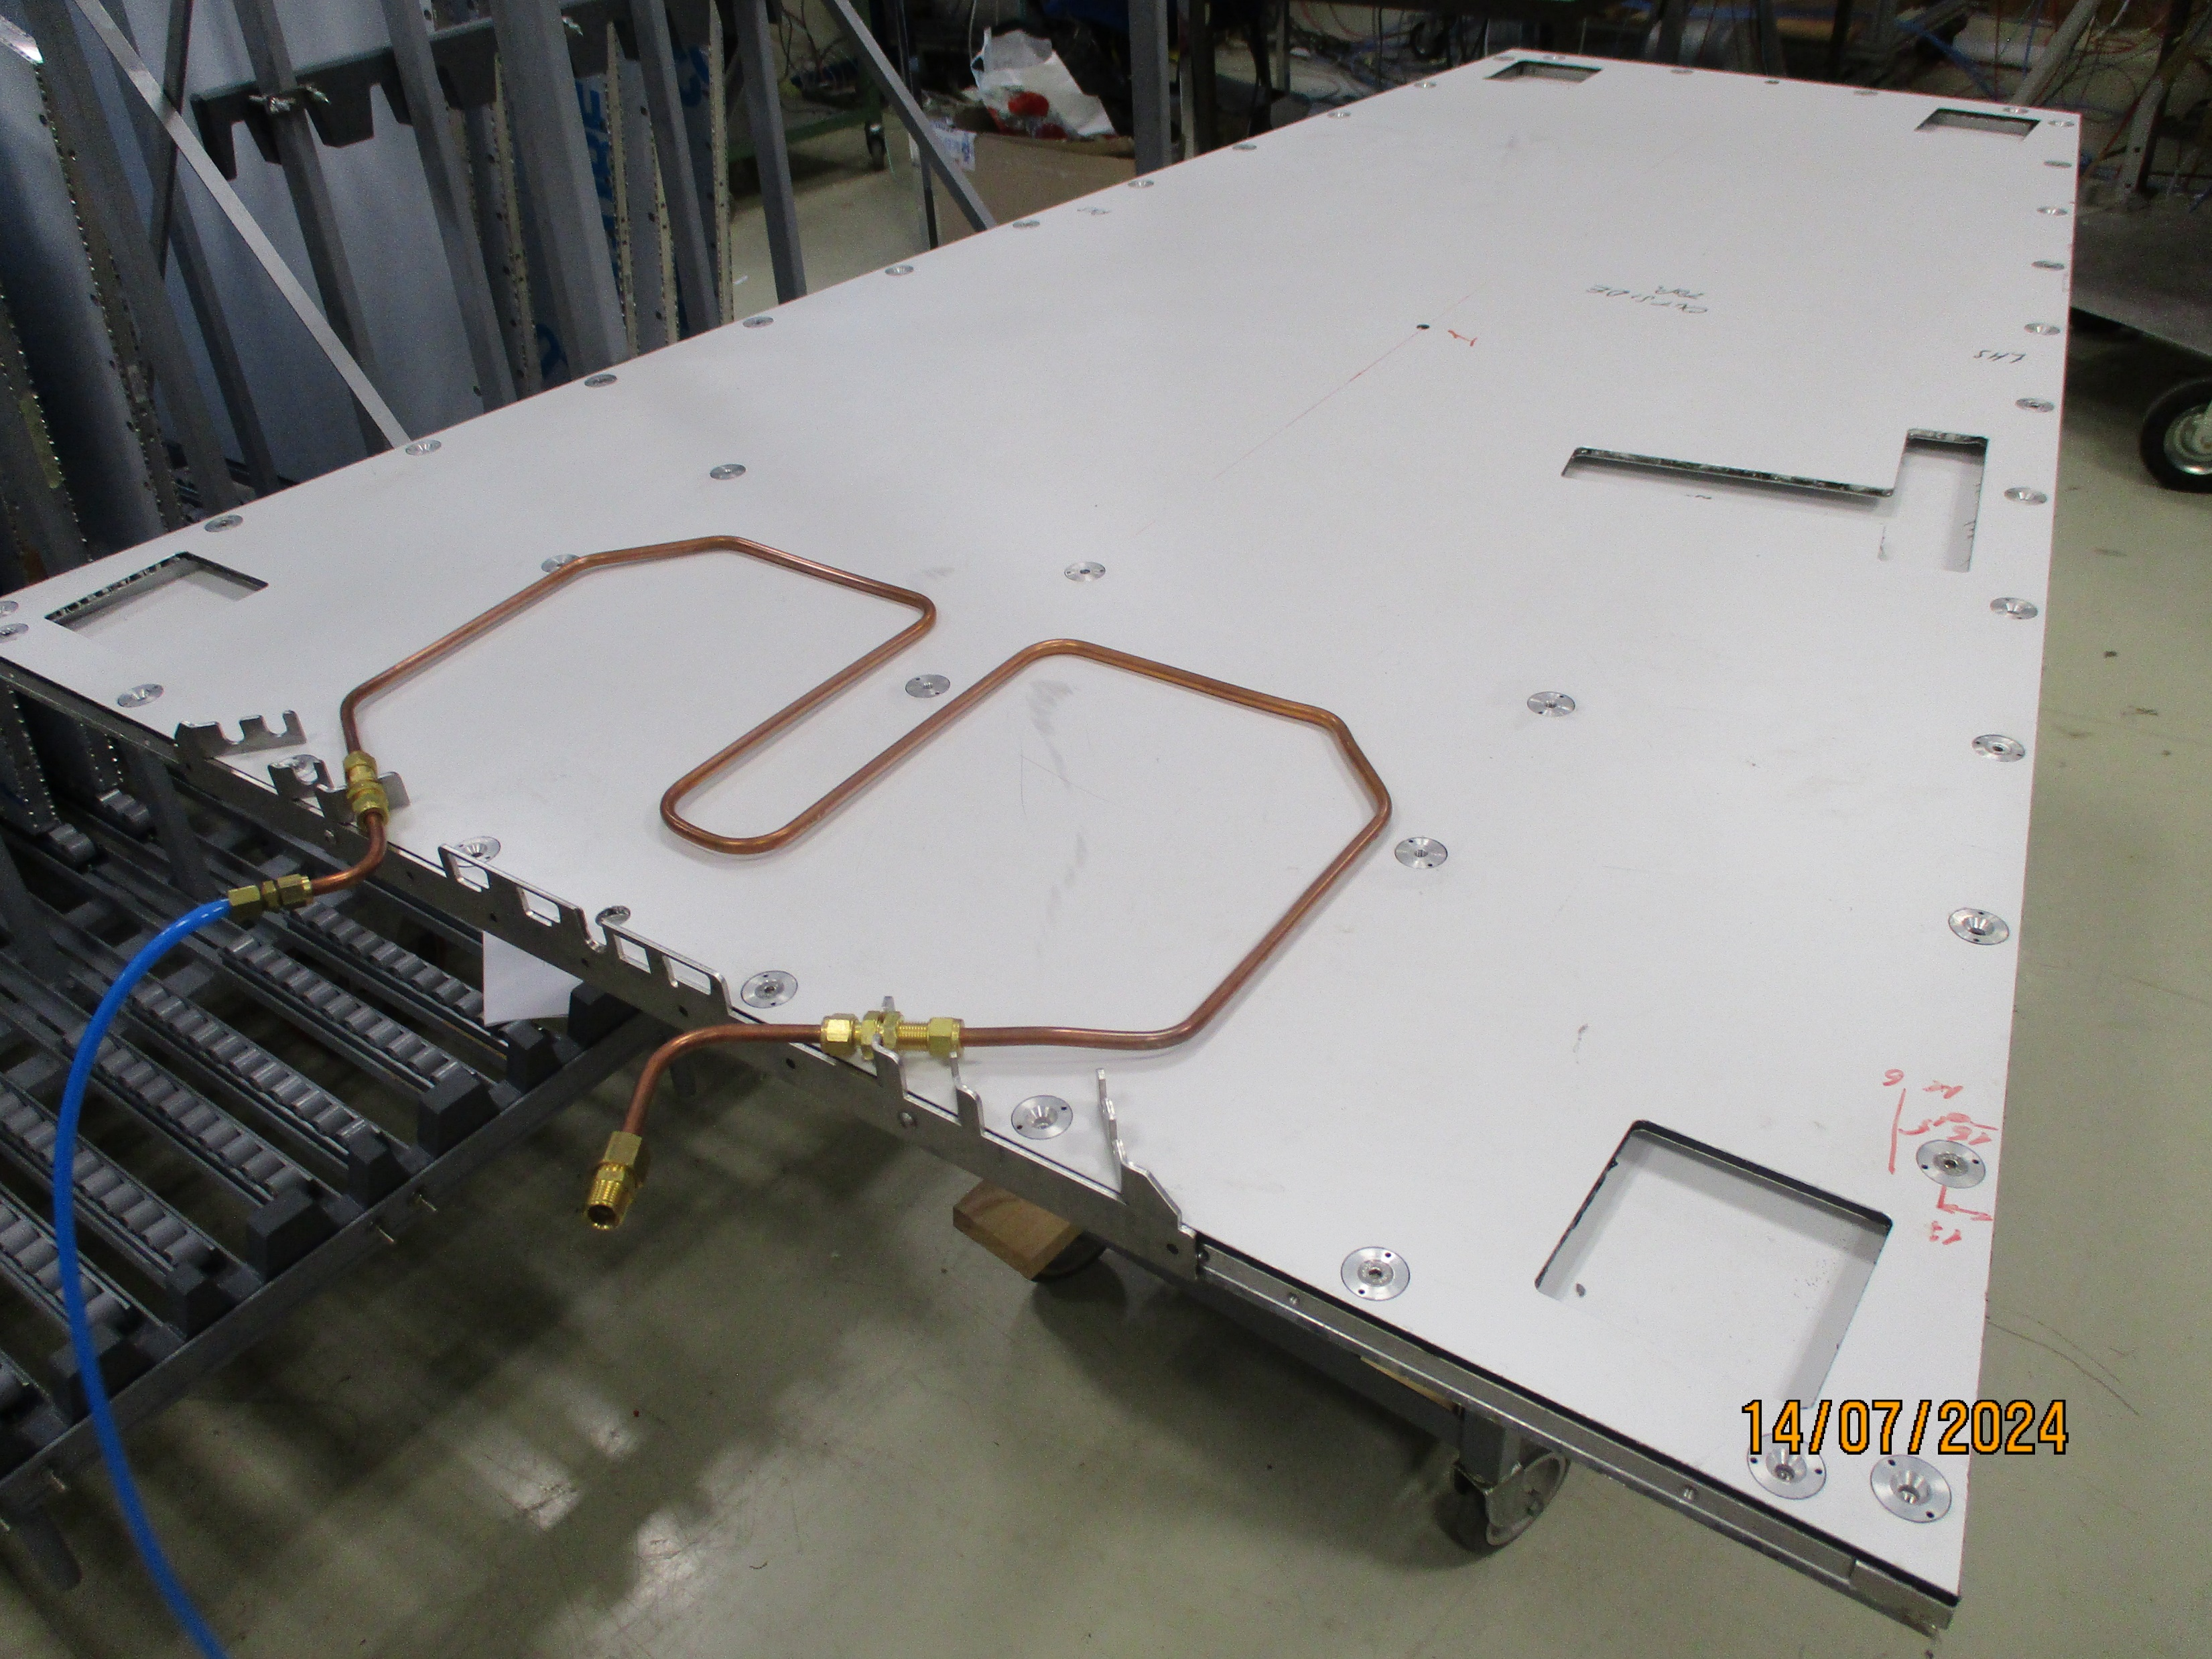
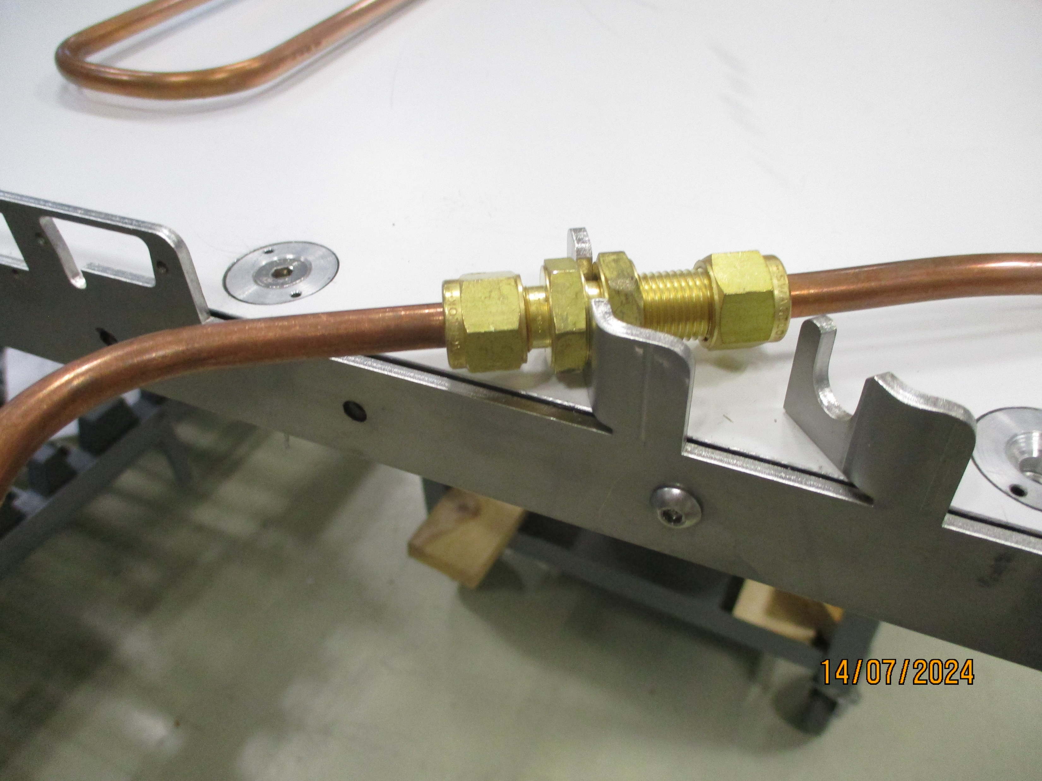
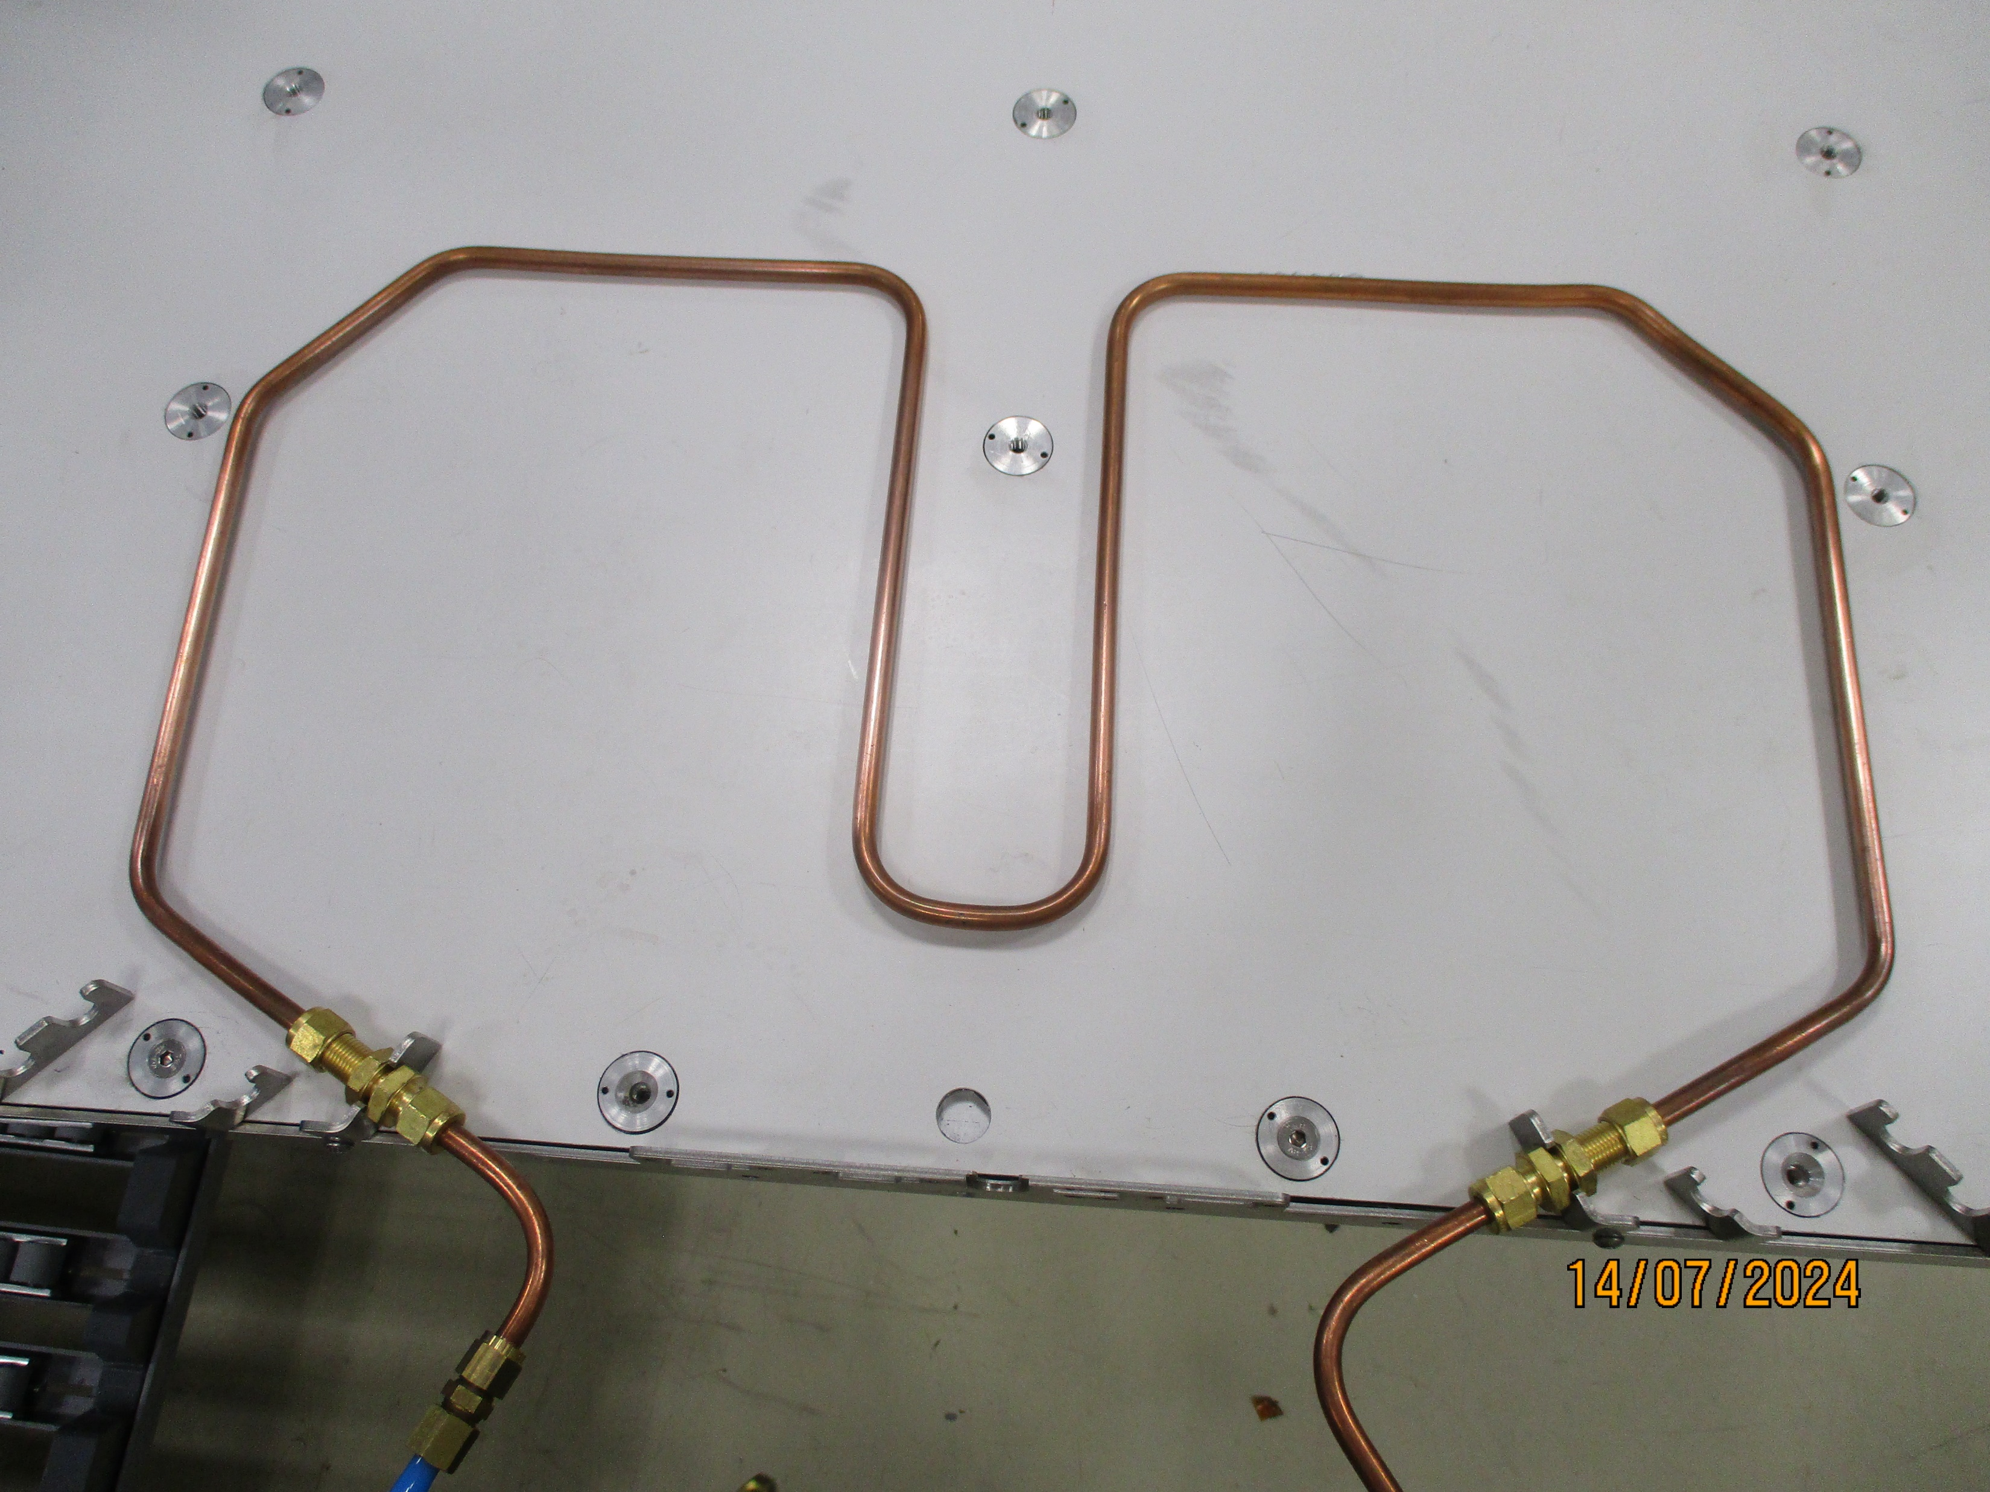
Prototype with cooling Manifold attached

Slide 6
RESULTS

