Slide 1
3 way valves
Ian
12 Jan 2024
Up dated 23 Jan 2024

Slide 2
Specification
Stainless body 316 or 304 (brass can readily split it unions are over tightened
½ inch BSP pipe female thread on all 3 orifices
DN15
There are two possible configurations “L” or “T”. It must be “L”.
Pressure classification “1000WOG”

Slide 3
Companies/suppliers looked at
Aliexpress
Alibaba
RS (Uk and Fr)
CERN (Sagana and Trimatic)
Amazon.fr
Metaltek
Valvesonline.co.uk
Schwer.com
Syveco.com
Valtec.com

Slide 4
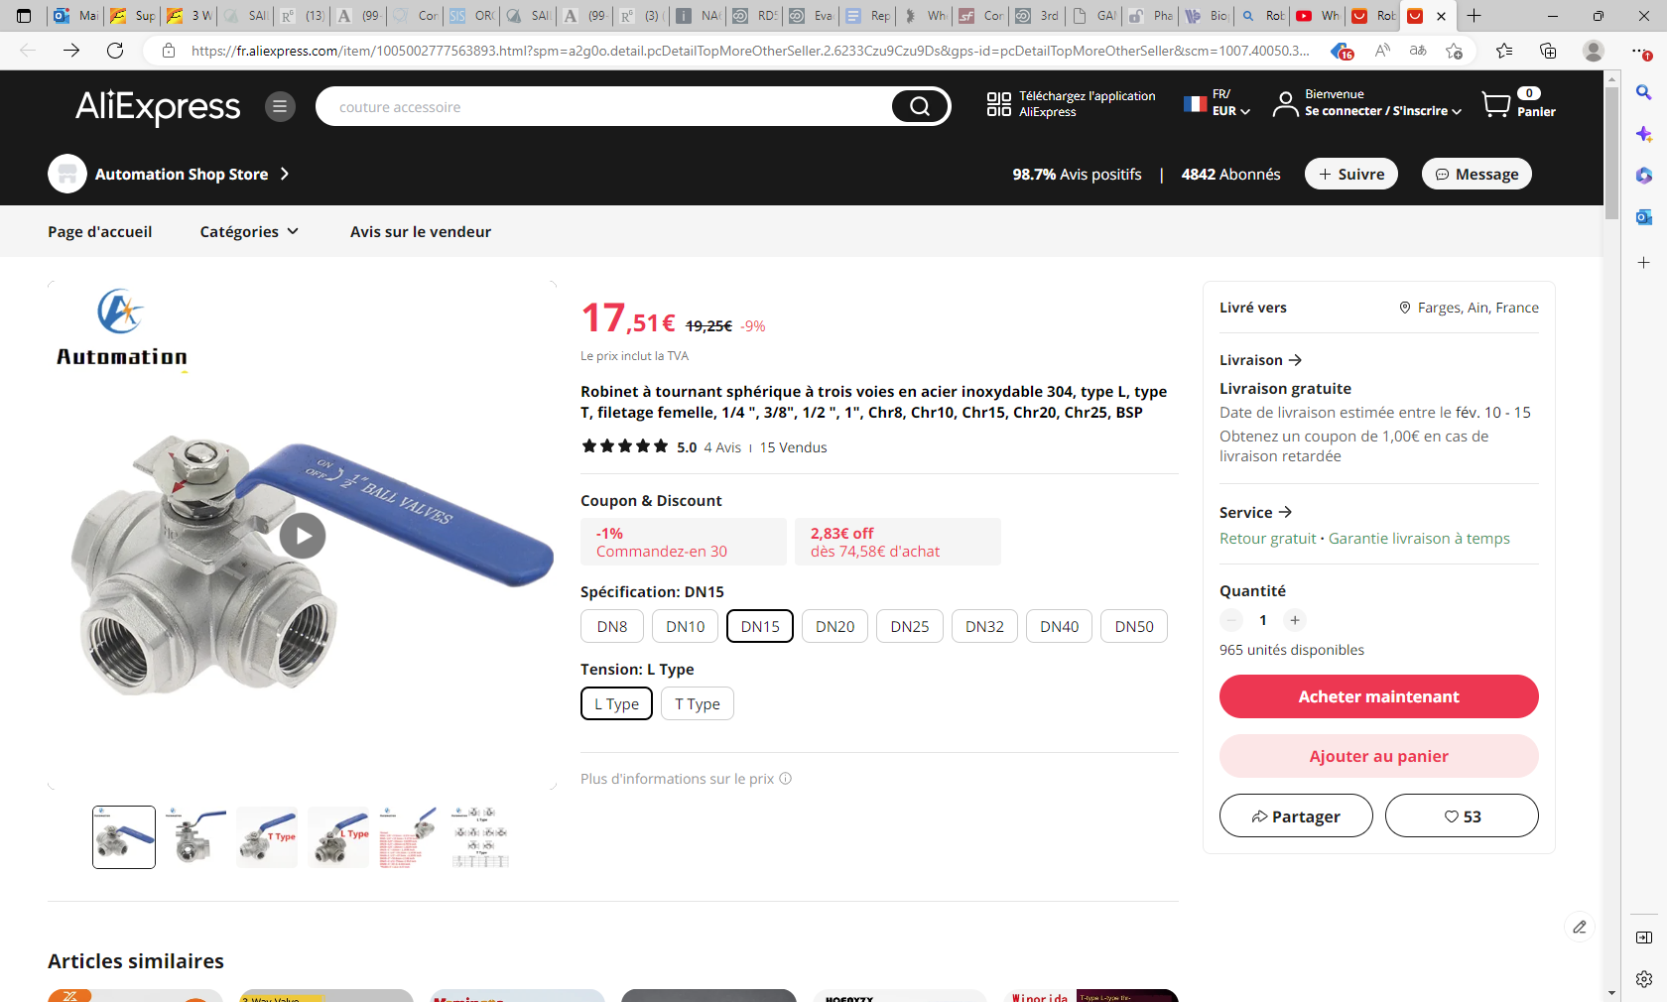

Slide 5
Robinet à tournant sphérique à trois voies en acier inoxydable 304, type L, type T, filetage femelle, 1/4 ", 3/8", 1/2 ", 1", Chr8, Chr10, Chr15, Chr20, Chr25, BSP (aliexpress.com)
https://fr.aliexpress.com/item/1005002777563893.html?spm=a2g0o.detail.pcDetailTopMoreOtherSeller.2.6233Czu9Czu9Ds&gps-id=pcDetailTopMoreOtherSeller&scm=1007.40050.354490.0&scm_id=1007.40050.354490.0&scm-url=1007.40050.354490.0&pvid=c50372ae-7dbc-489c-9c08-85fb3dc1e4e6&_t=gps-id:pcDetailTopMoreOtherSeller,scm-url:1007.40050.354490.0,pvid:c50372ae-7dbc-489c-9c08-85fb3dc1e4e6,tpp_buckets:668%232846%238114%231999&pdp_npi=4%40dis%21EUR%2119.25%2117.51%21%21%2120.39%2118.55%21%402103011417065290615916636e8a00%2112000022139675004%21rec%21FR%21100737469%21&utparam-url=scene%3ApcDetailTopMoreOtherSeller%7Cquery_from%3A

Slide 6
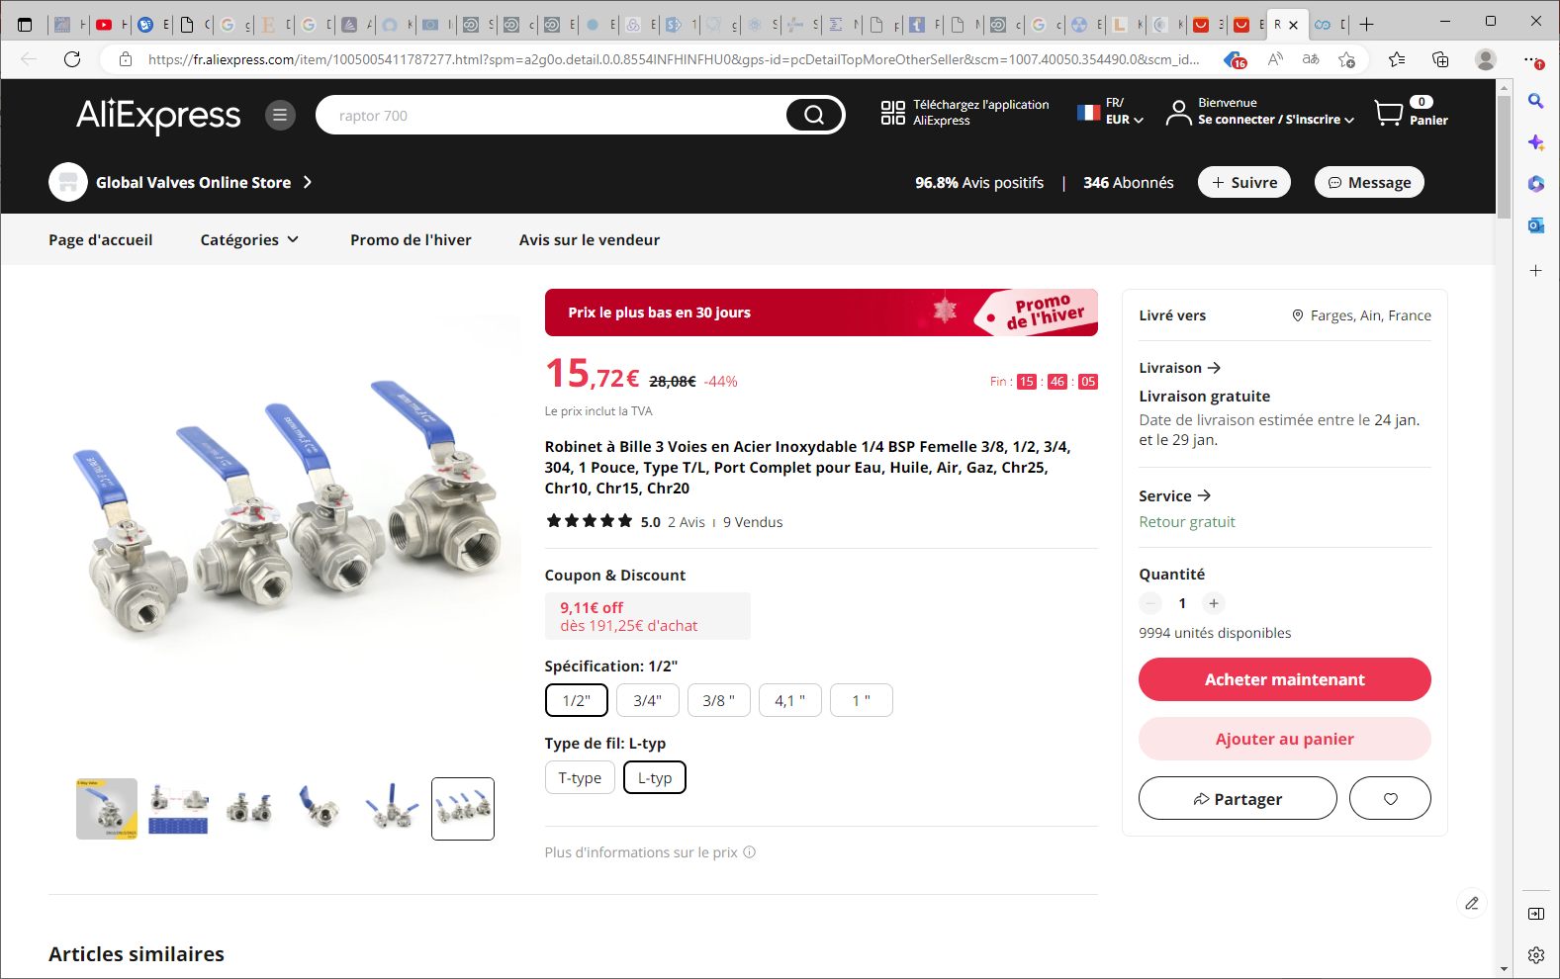
Robinet à Bille 3 Voies en Acier Inoxydable 1/4 BSP Femelle 3/8, 1/2, 3/4, 304, 1 Pouce, Type T/L, Port Complet pour Eau, Huile, Air, Gaz, Chr25, Chr10, Chr15, Chr20 - AliExpress

Slide 7
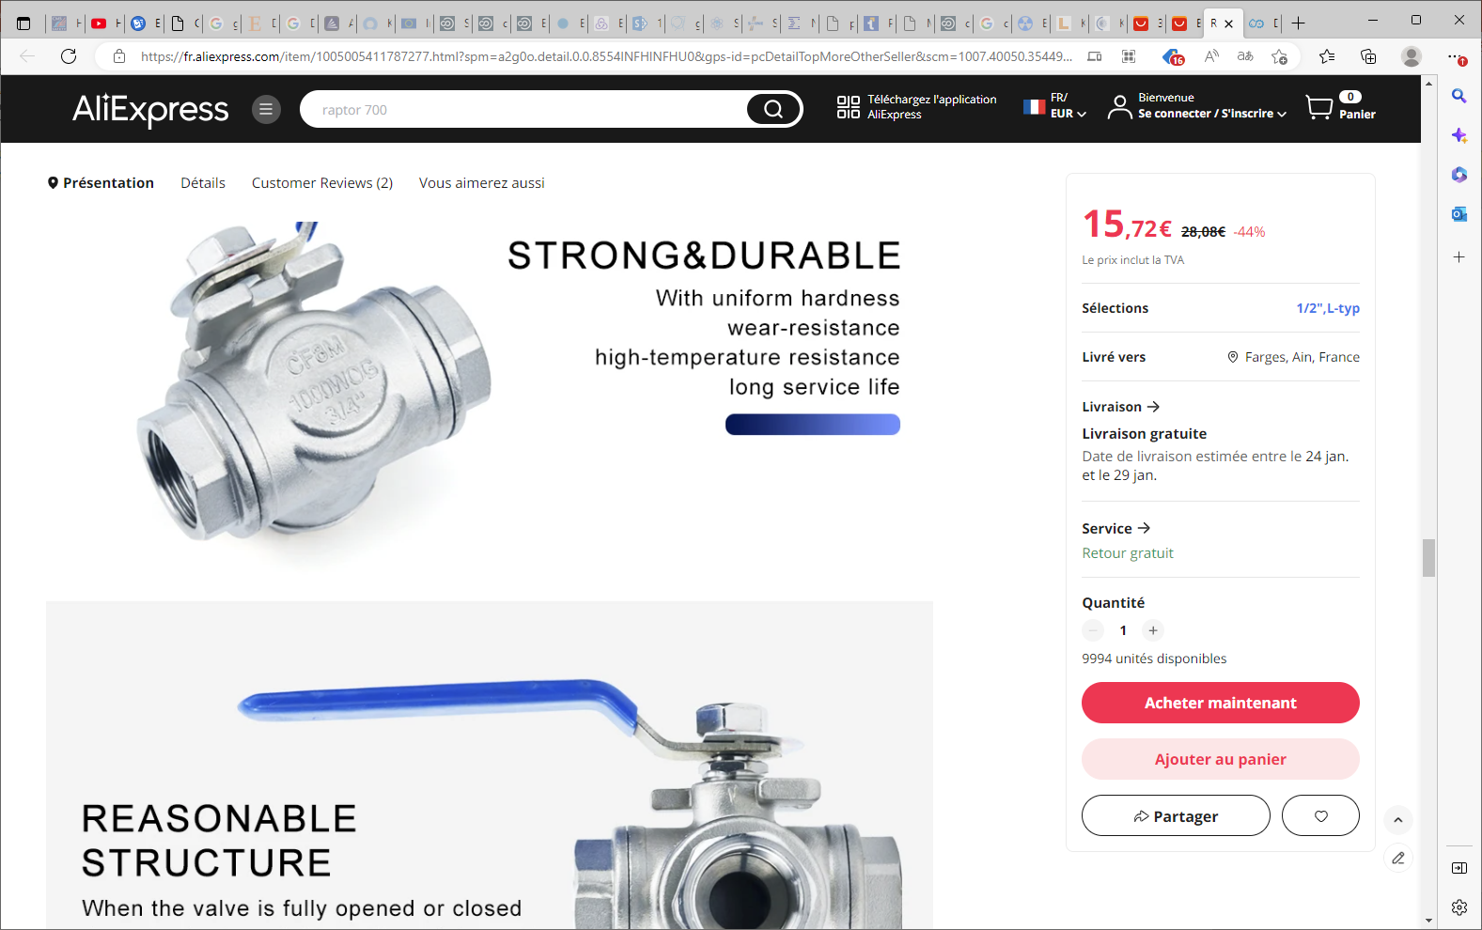
Robinet à Bille 3 Voies en Acier Inoxydable 1/4 BSP Femelle 3/8, 1/2, 3/4, 304, 1 Pouce, Type T/L, Port Complet pour Eau, Huile, Air, Gaz, Chr25, Chr10, Chr15, Chr20 - AliExpress

Slide 8
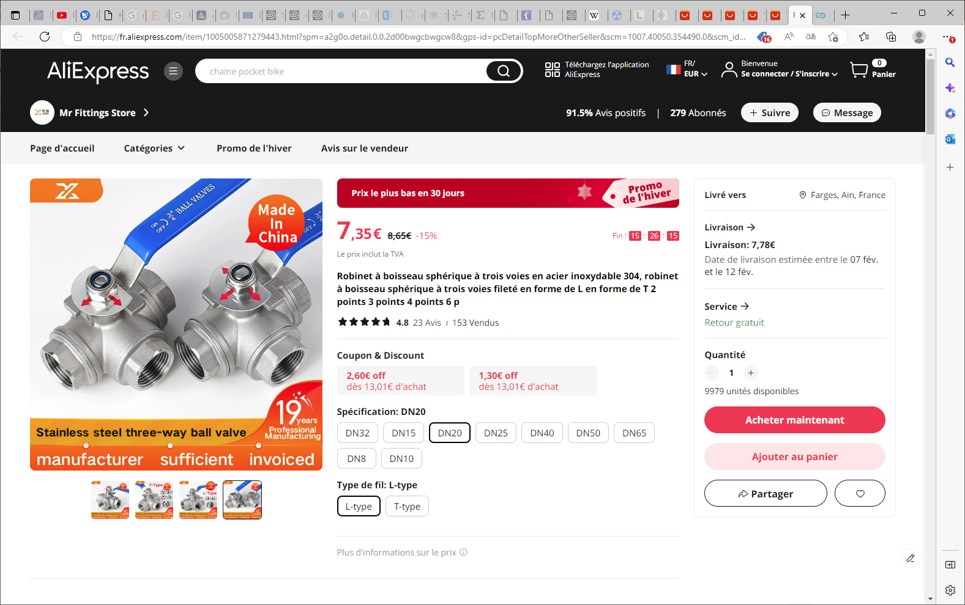
Robinet à boisseau sphérique à trois voies en acier inoxydable 304, robinet à boisseau sphérique à trois voies fileté en forme de L en forme de T 2 points 3 points 4 points 6 p - AliExpress

Slide 9
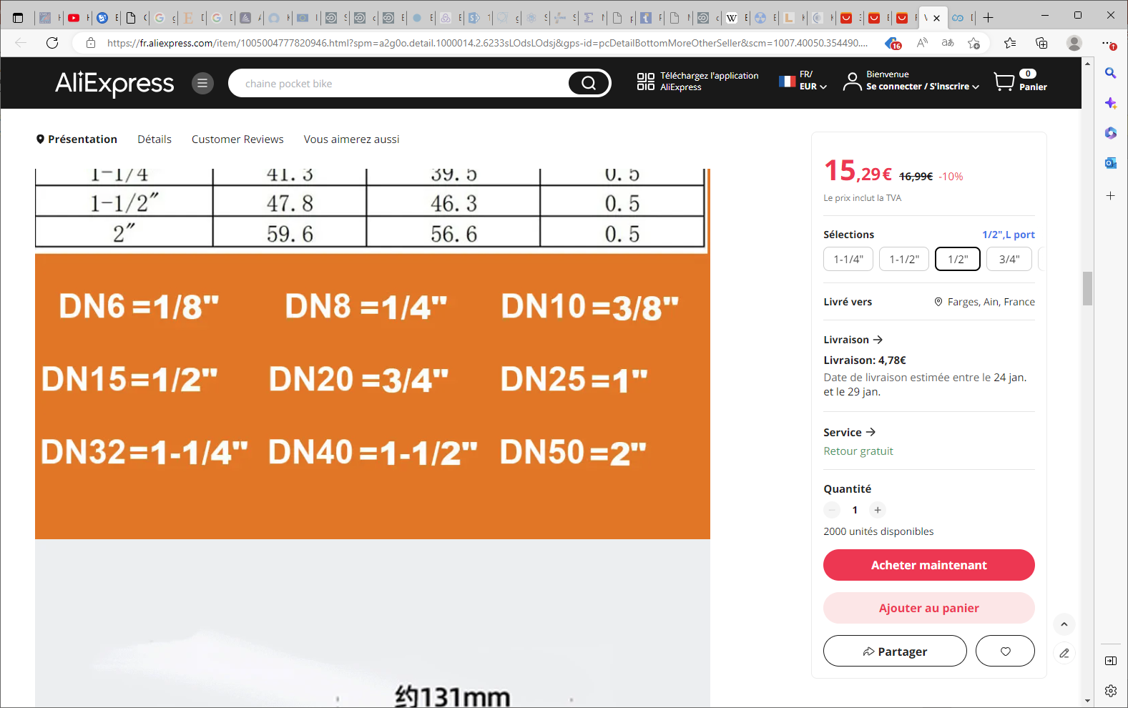
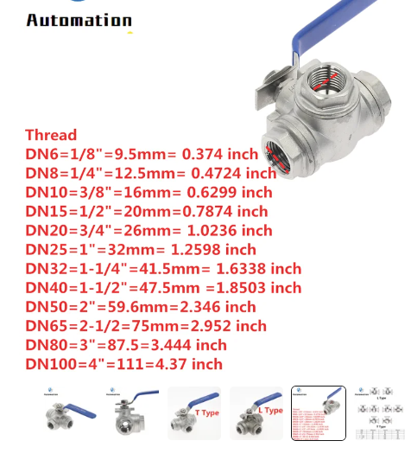

Slide 10
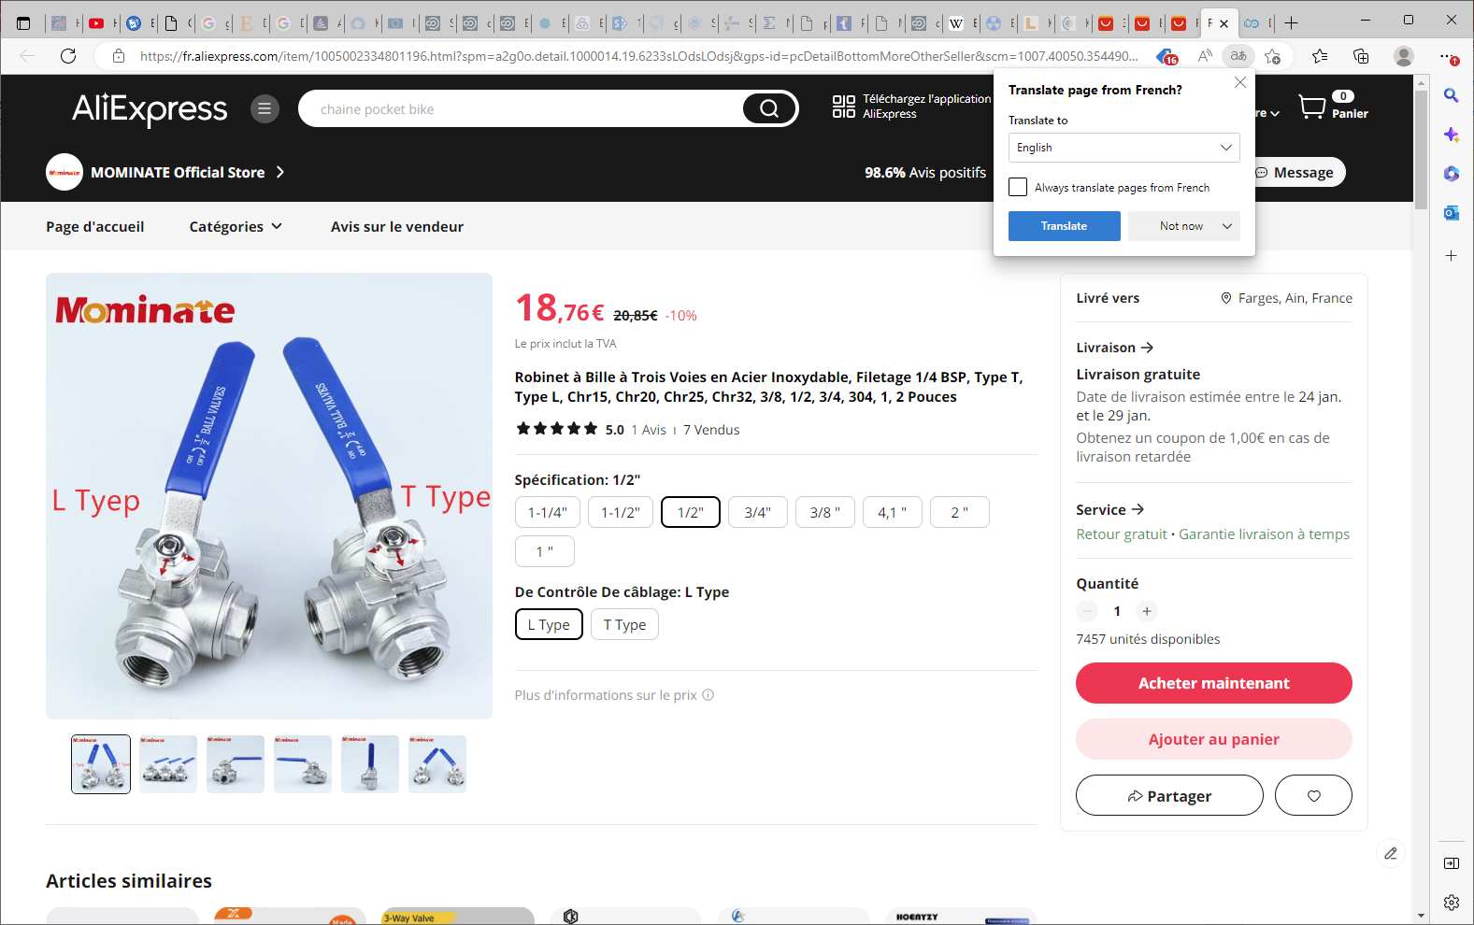

Slide 11
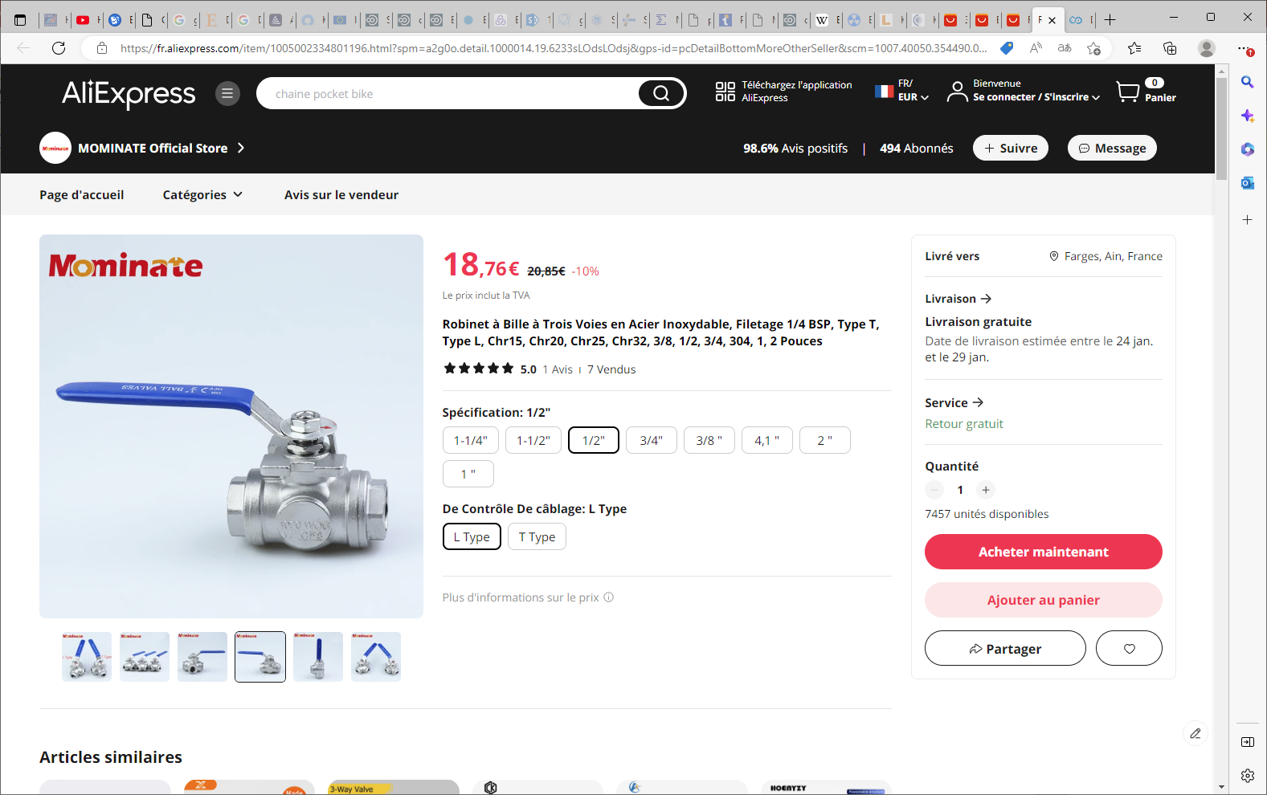
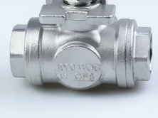
Robinet à Bille à Trois Voies en Acier Inoxydable, Filetage 1/4 BSP, Type T, Type L, Chr15, Chr20, Chr25, Chr32, 3/8, 1/2, 3/4, 304, 1, 2 Pouces (aliexpress.com)

Slide 12
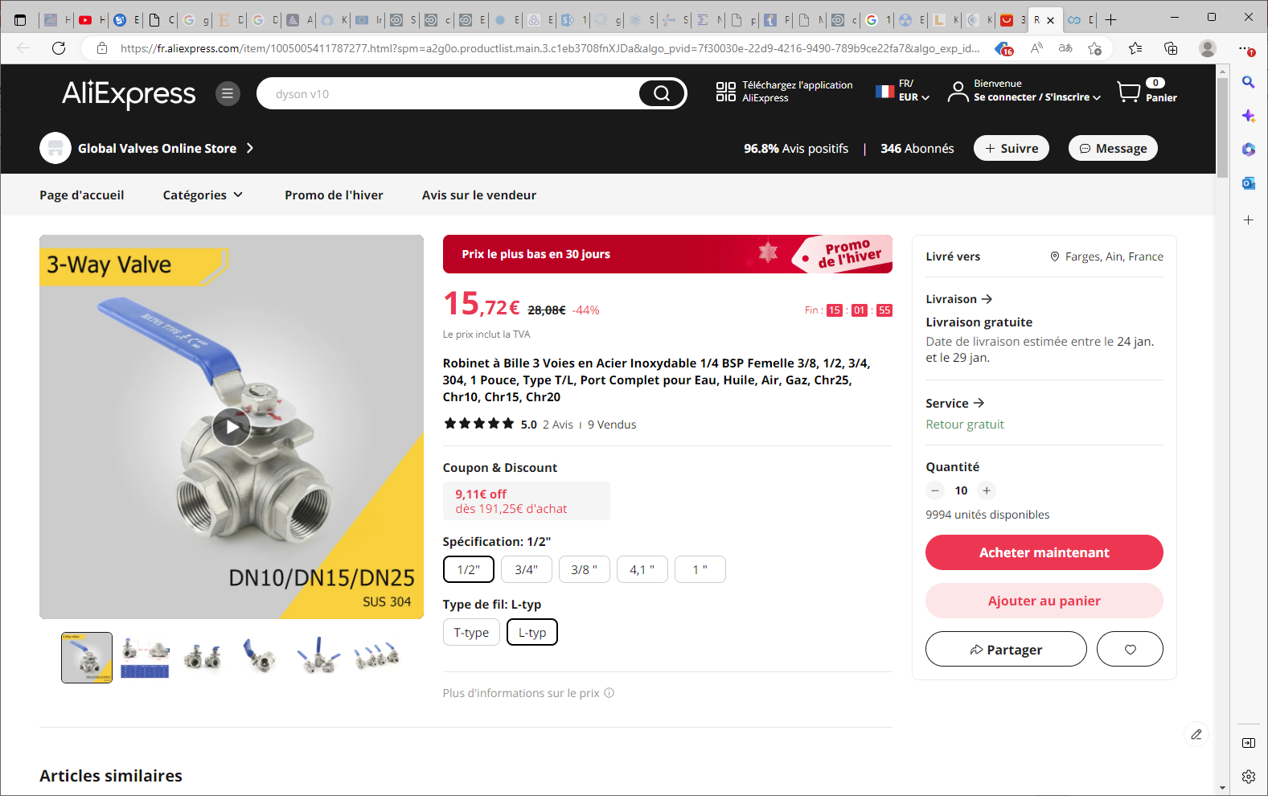
Robinet à Bille 3 Voies en Acier Inoxydable 1/4 BSP Femelle 3/8, 1/2, 3/4, 304, 1 Pouce, Type T/L, Port Complet pour Eau, Huile, Air, Gaz, Chr25, Chr10, Chr15, Chr20 - AliExpress

Slide 13
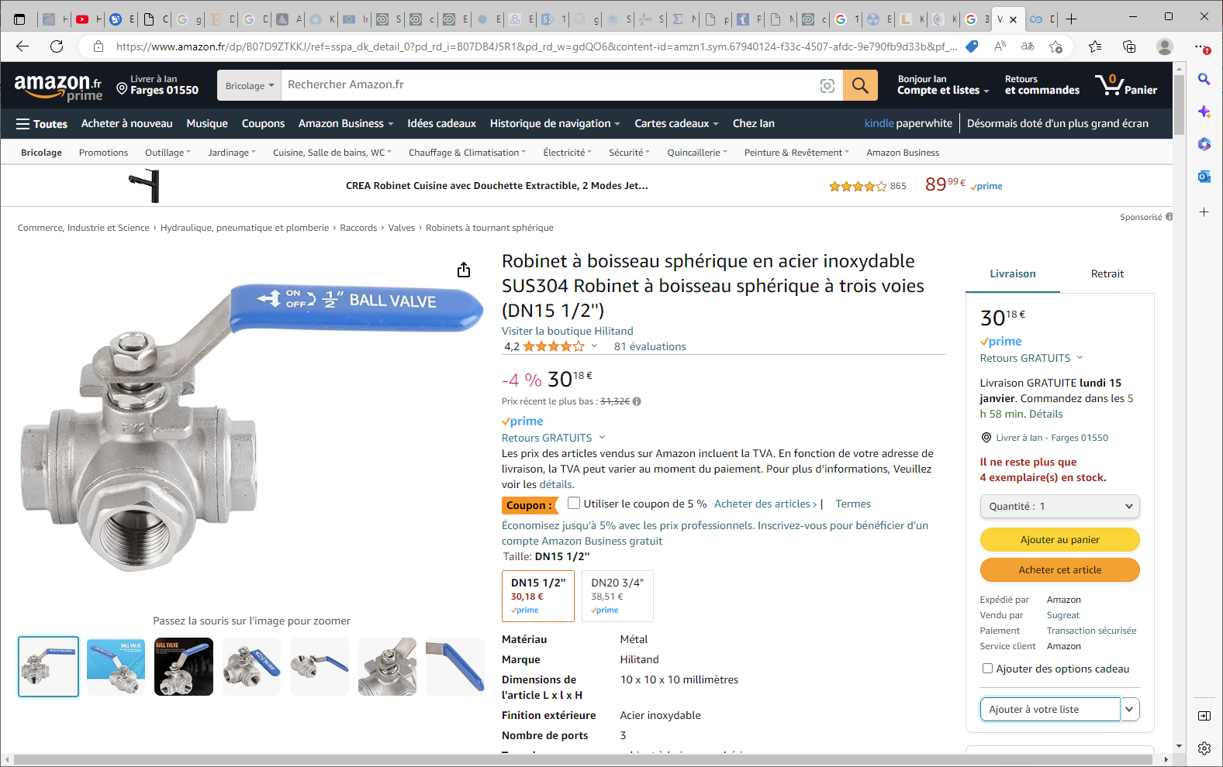

Slide 14
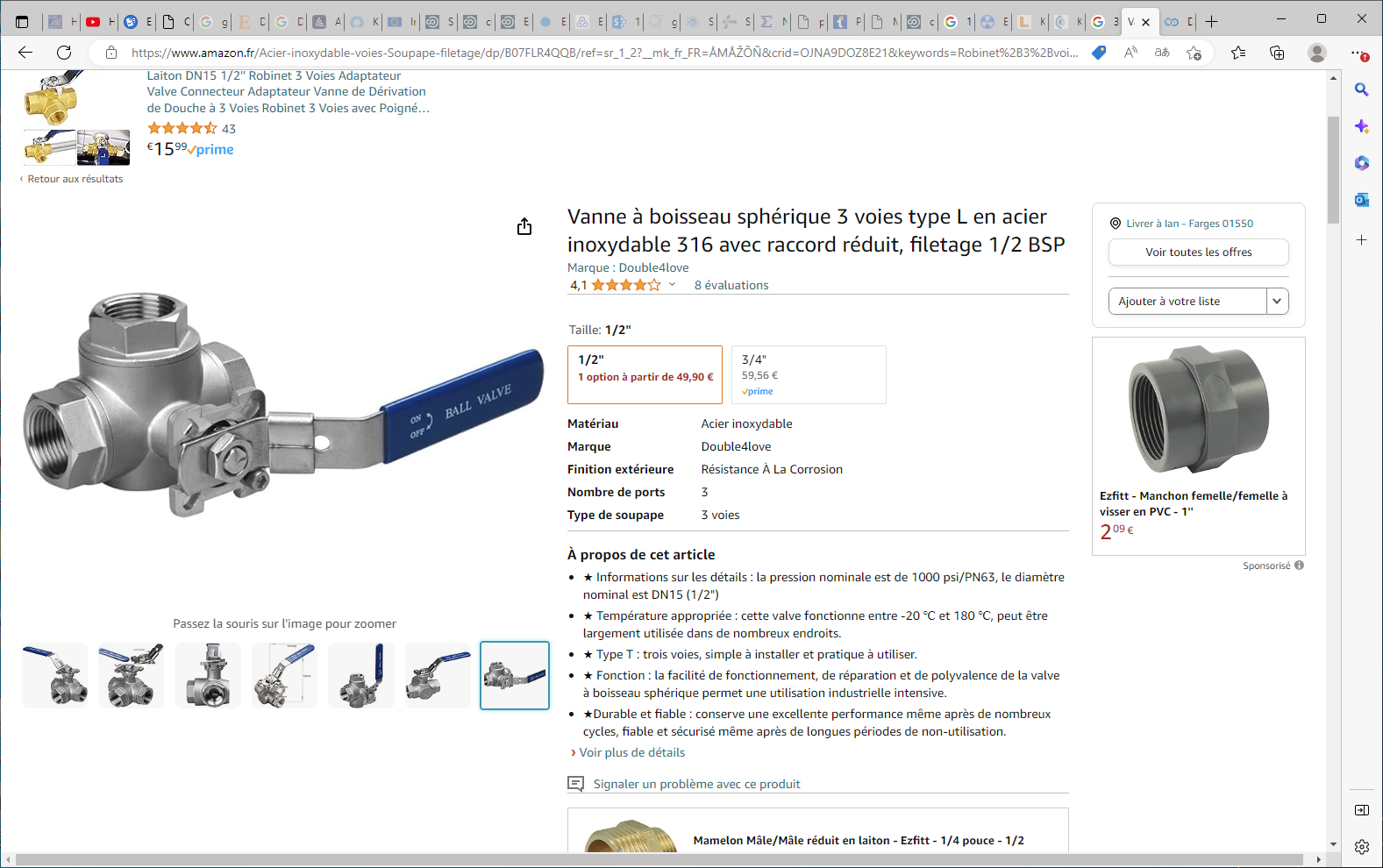

Slide 15
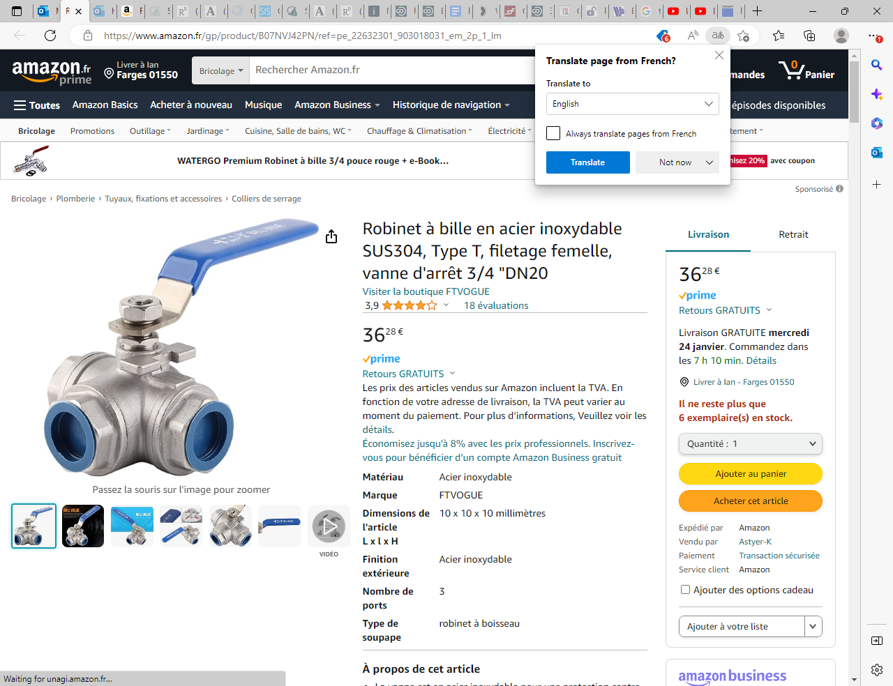
https://www.amazon.fr/gp/product/B07NVJ42PN/ref=pe_22632301_903018031_em_2p_1_lm

Slide 16
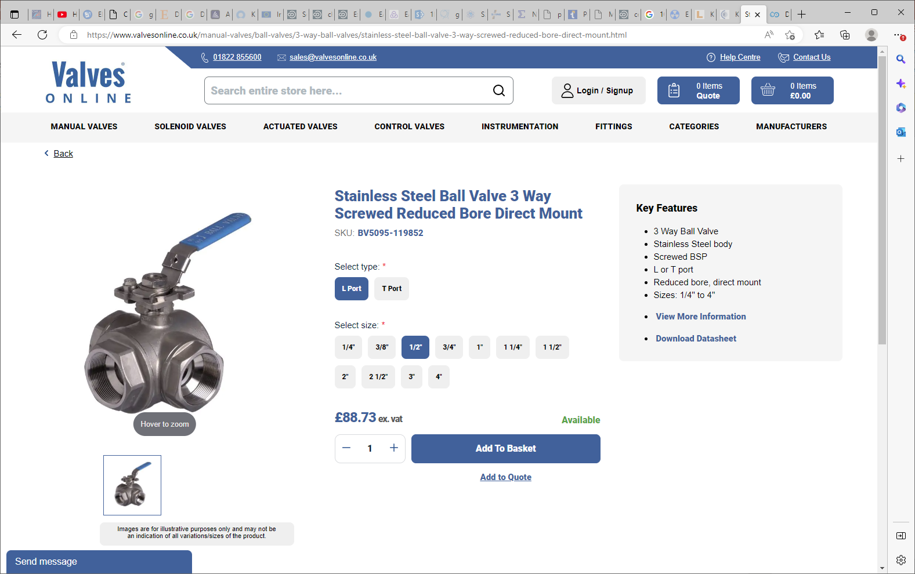
Stainless Steel Ball Valve 3 Way Screwed Reduced Bore Direct Mount - Valves Online

Slide 17
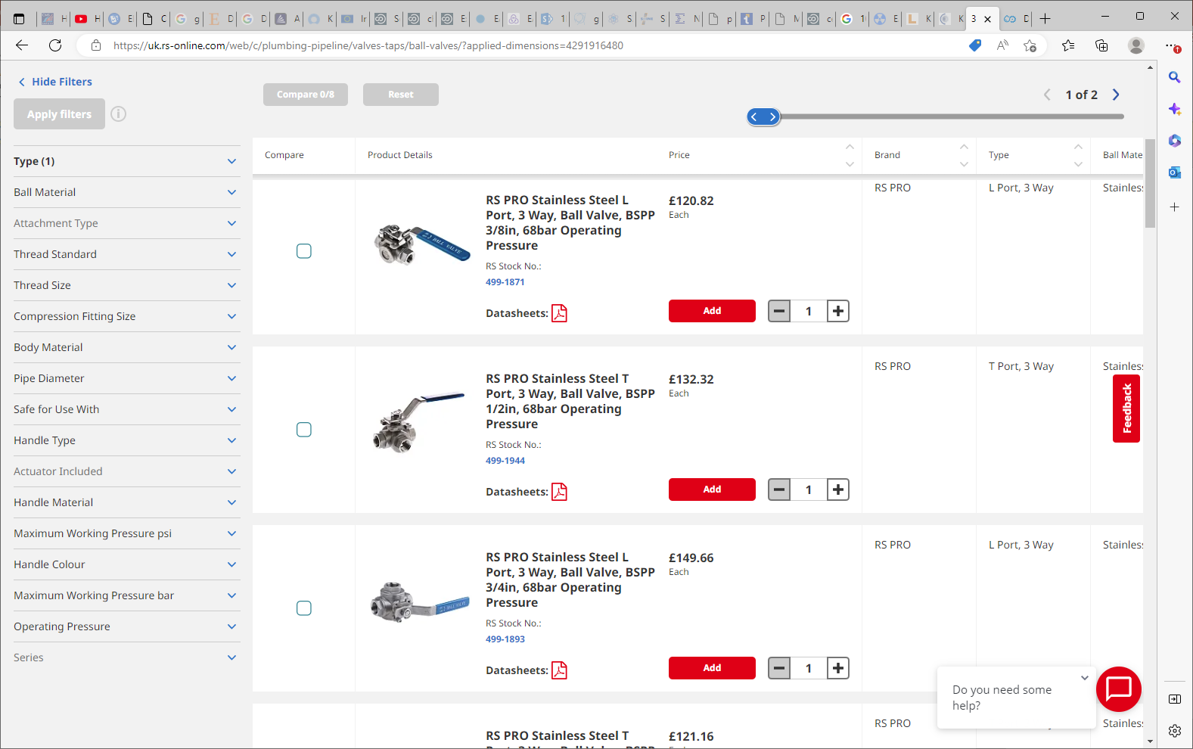
3 Way Ball Valve | RS (rs-online.com)

Slide 18
Pipe supports

Slide 19
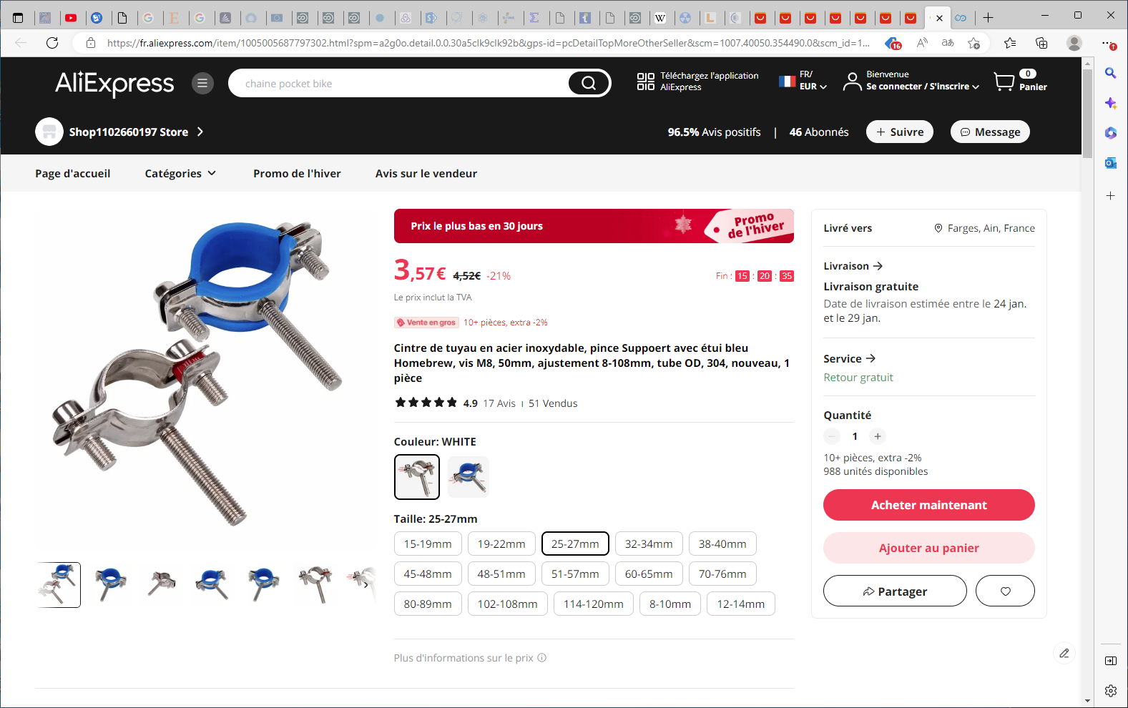
Cintre de tuyau en acier inoxydable, pince Suppoert avec étui bleu Homebrew, vis M8, 50mm, ajustement 8-108mm, tube OD, 304, nouveau, 1 pièce - AliExpress

Slide 20
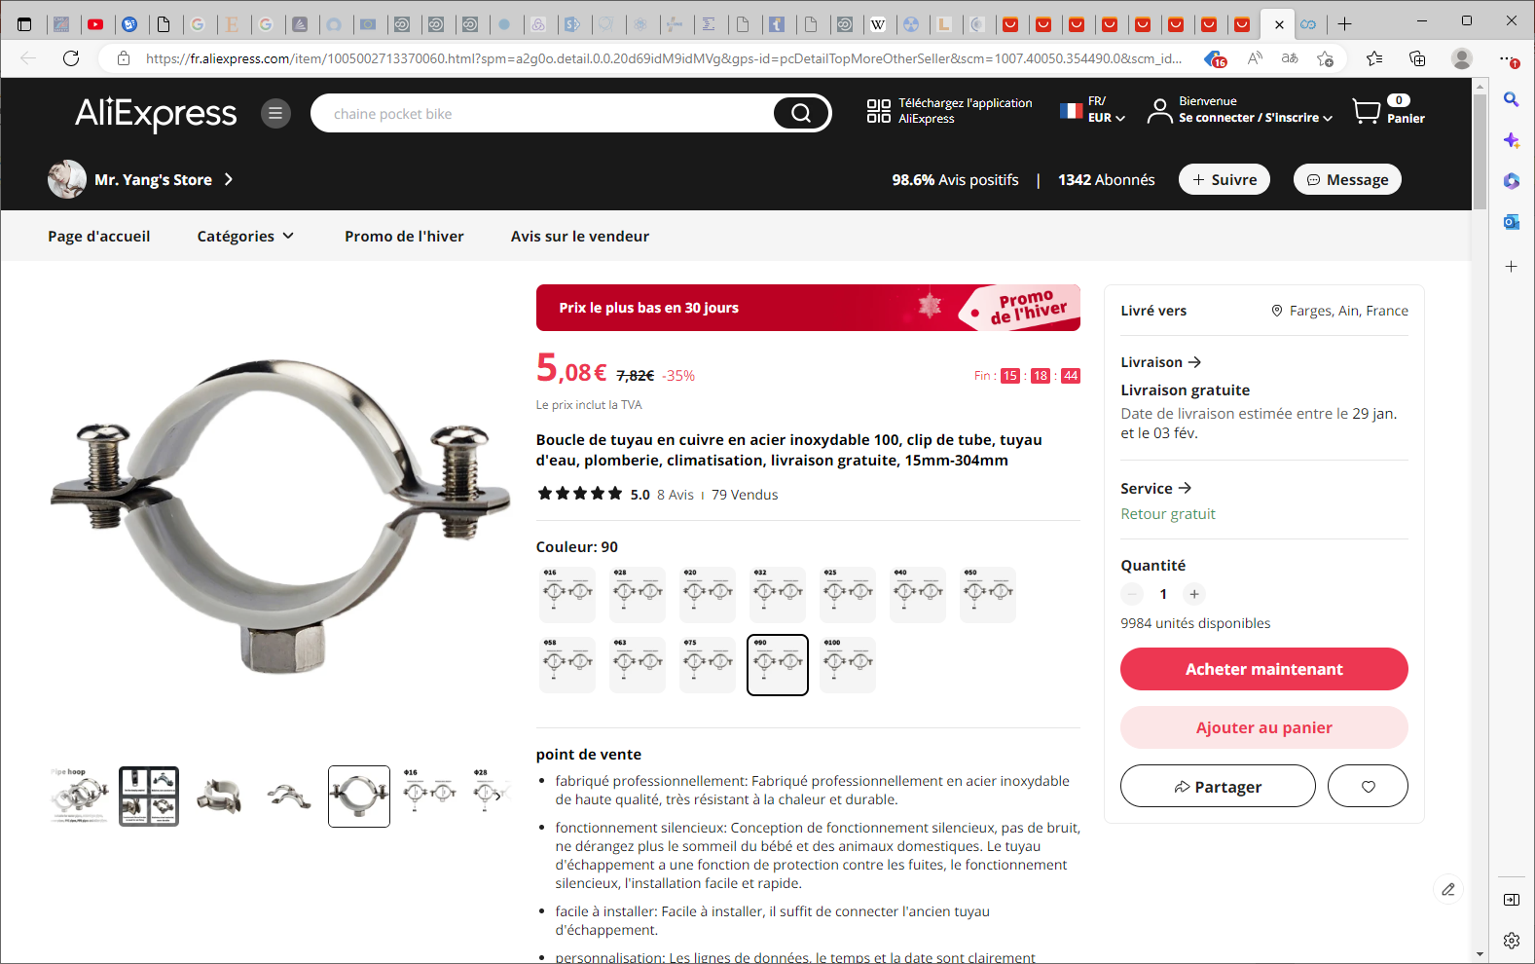
Tube En Acier Inoxydable 100, 15mm-304mm, Boucle De Tuyau En Cuivre Pour Plomberie Et Climatisation, Livraison Gratuite - Brides - AliExpress

Slide 21
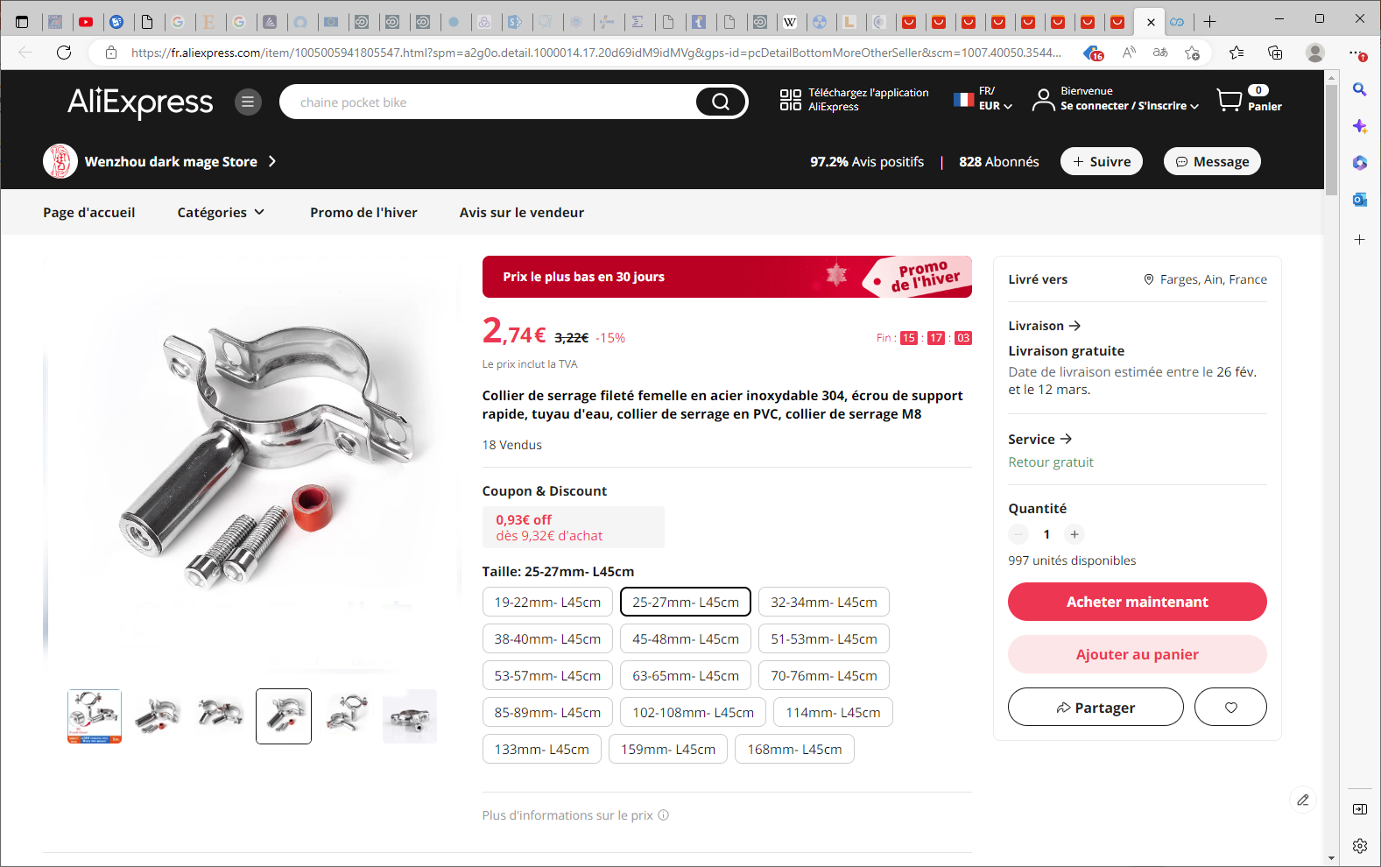
Collier de serrage fileté femelle en acier inoxydable 304, écrou de support rapide, tuyau d'eau, collier de serrage en PVC, collier de serrage M8 - AliExpress

Slide 22
Brass body

Slide 23
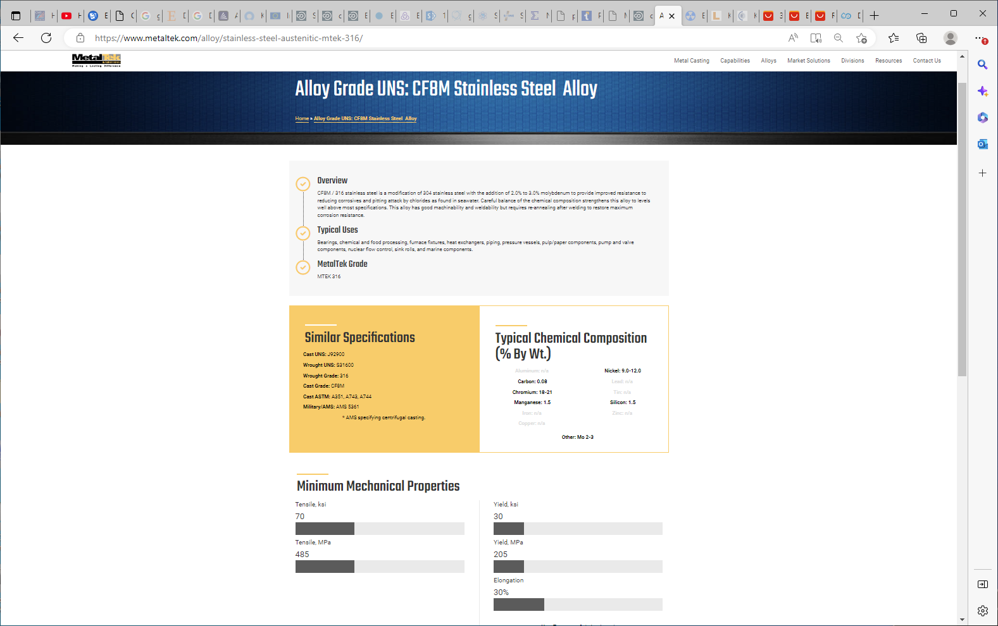
https://www.metaltek.com/alloy/stainless-steel-austenitic-mtek-316/

Slide 24
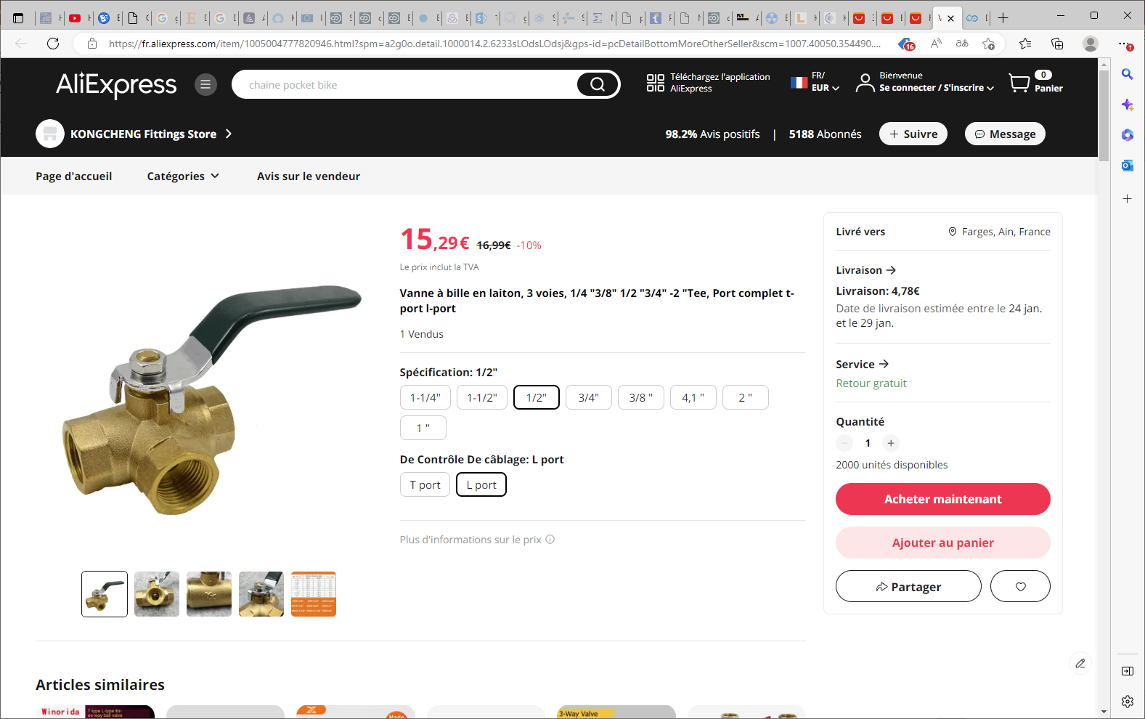
Vanne à bille en laiton, 3 voies, 1/4 "3/8" 1/2 "3/4" -2 "Tee, Port complet t-port l-port - AliExpress

Slide 25
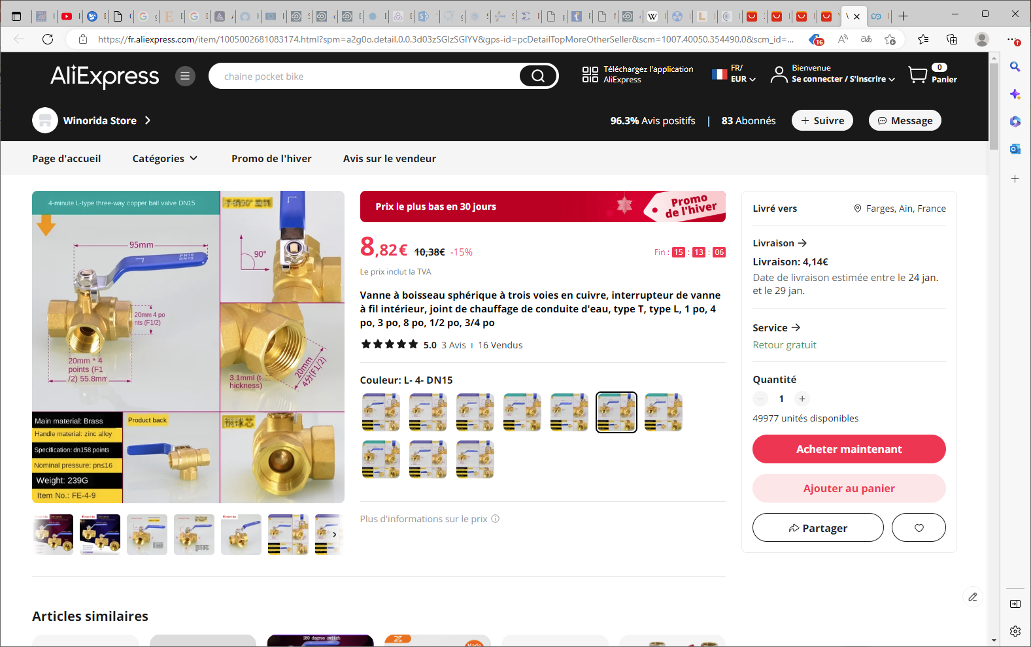
Vanne à boisseau sphérique à trois voies en cuivre, interrupteur de vanne à fil intérieur, joint de chauffage de conduite d'eau, type T, type L, 1 po, 4 po, 3 po, 8 po, 1/2 po, 3/4 po (aliexpress.com)

Slide 26
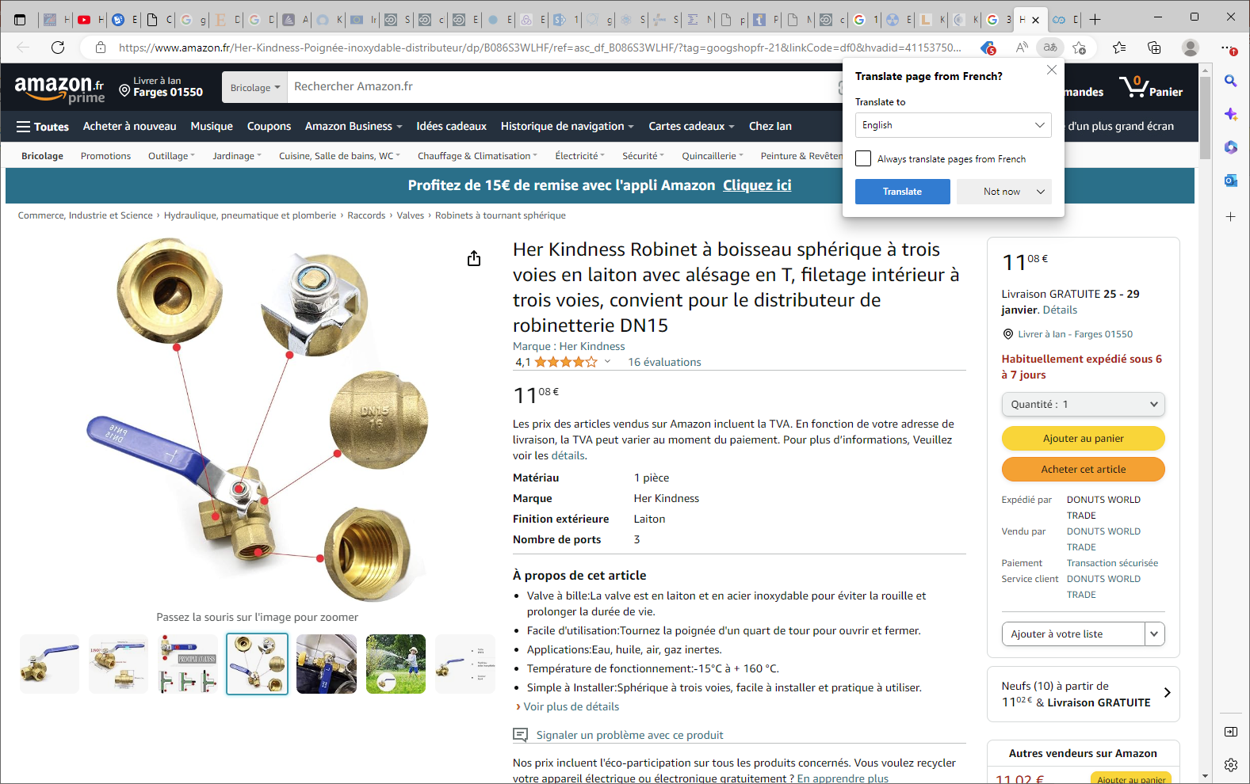

Slide 27
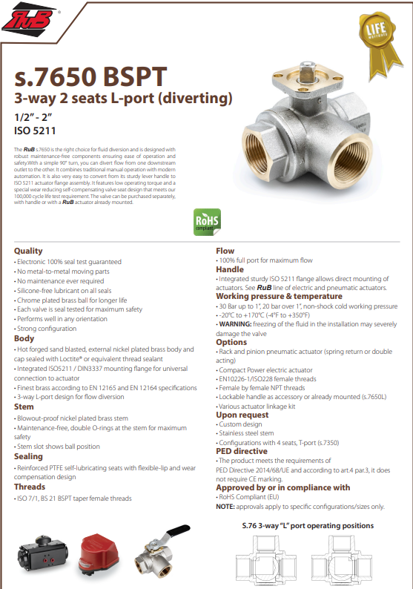
https://www.bonomiindustries.com/ball-valves/ball-valve-s7650-bspt-3-way-2-seats-l-port-diverting
The RuB s.7650 is the right choice for fluid diversion and is designed with robust maintenance-free components ensuring ease of operation and safety.With a simple 90° turn, you can divert flow from one downstream outlet to the other. It combines traditional manual operation with modern automation. It is also very easy to convert from its sturdy lever handle to ISO 5211 actuator flange assembly. It features low operating torque and a special wear reducing self-compensating valve seat design that meets our 100,000 cycle life test requirement. The valve can be purchased separately, with handle or with a RuB actuator already mounted

Slide 28
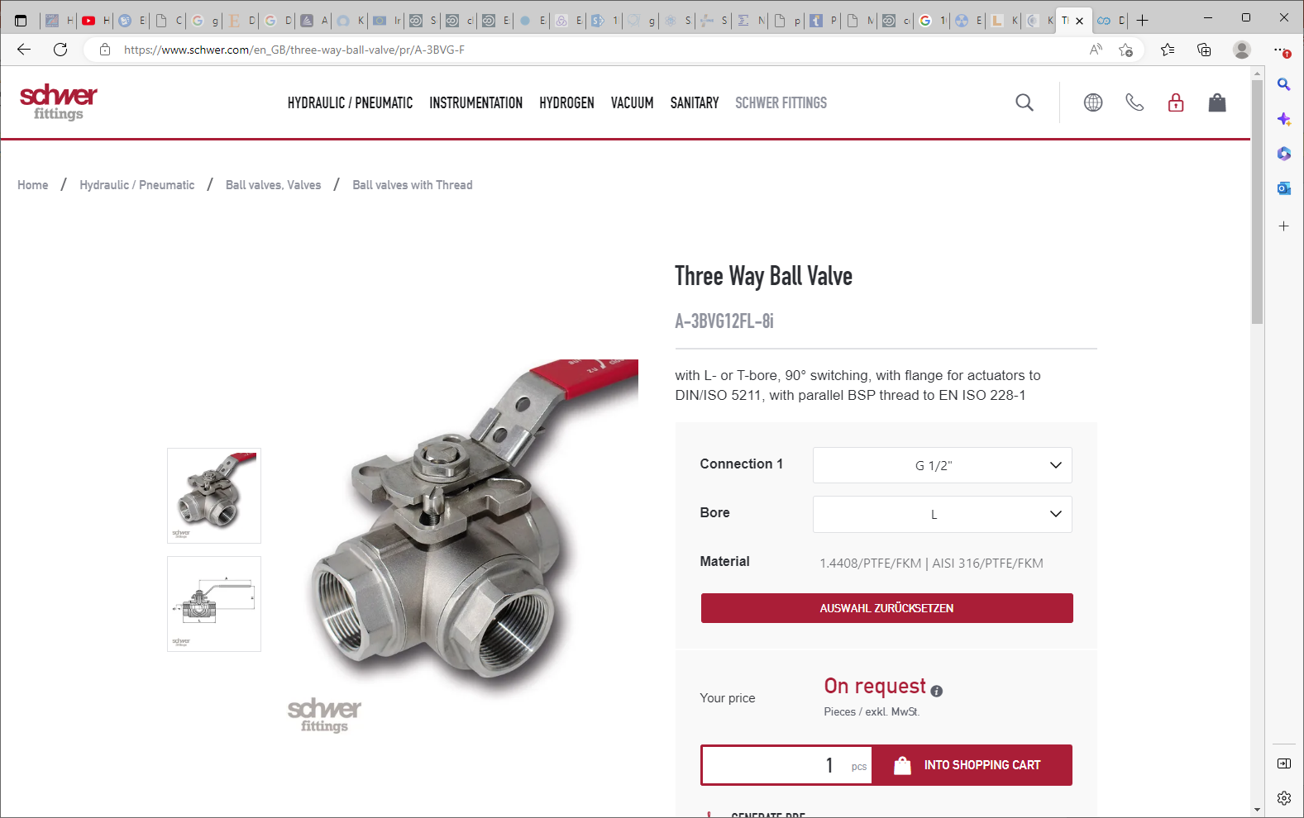
https://www.schwer.com/en_GB/three-way-ball-valve/pr/A-3BVG-F

Slide 29
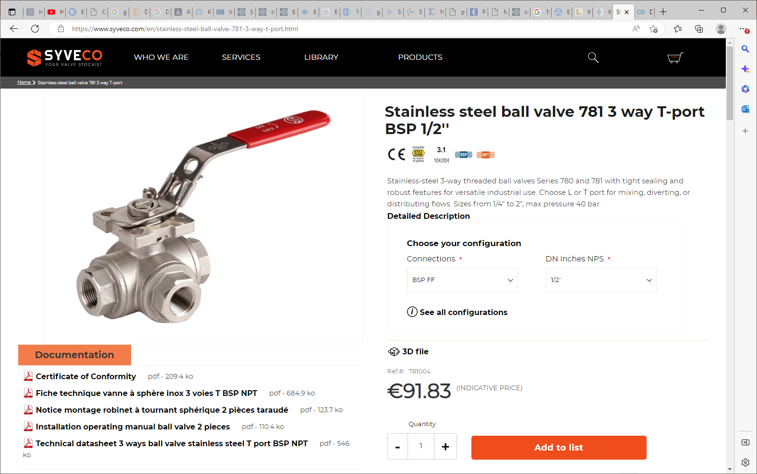
https://www.syveco.com/en/stainless-steel-ball-valve-781-3-way-t-port.html

Slide 30
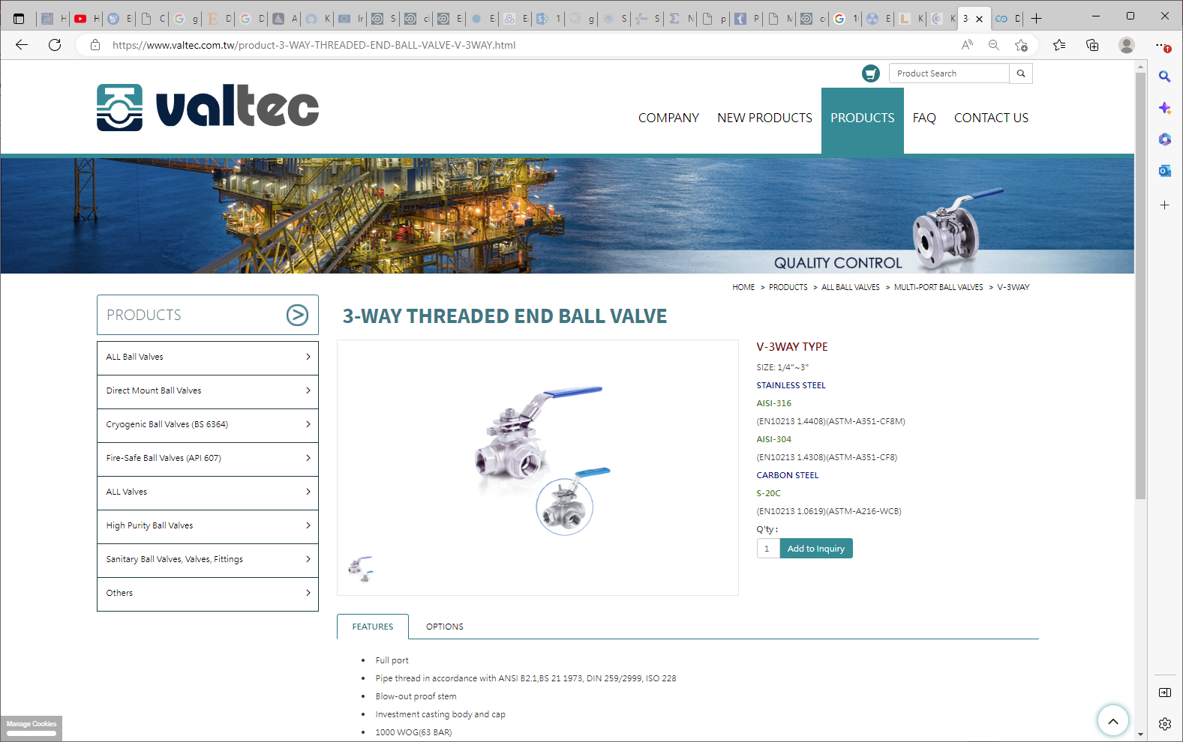
https://www.valtec.com.tw/product-3-WAY-THREADED-END-BALL-VALVE-V-3WAY.html

Slide 31
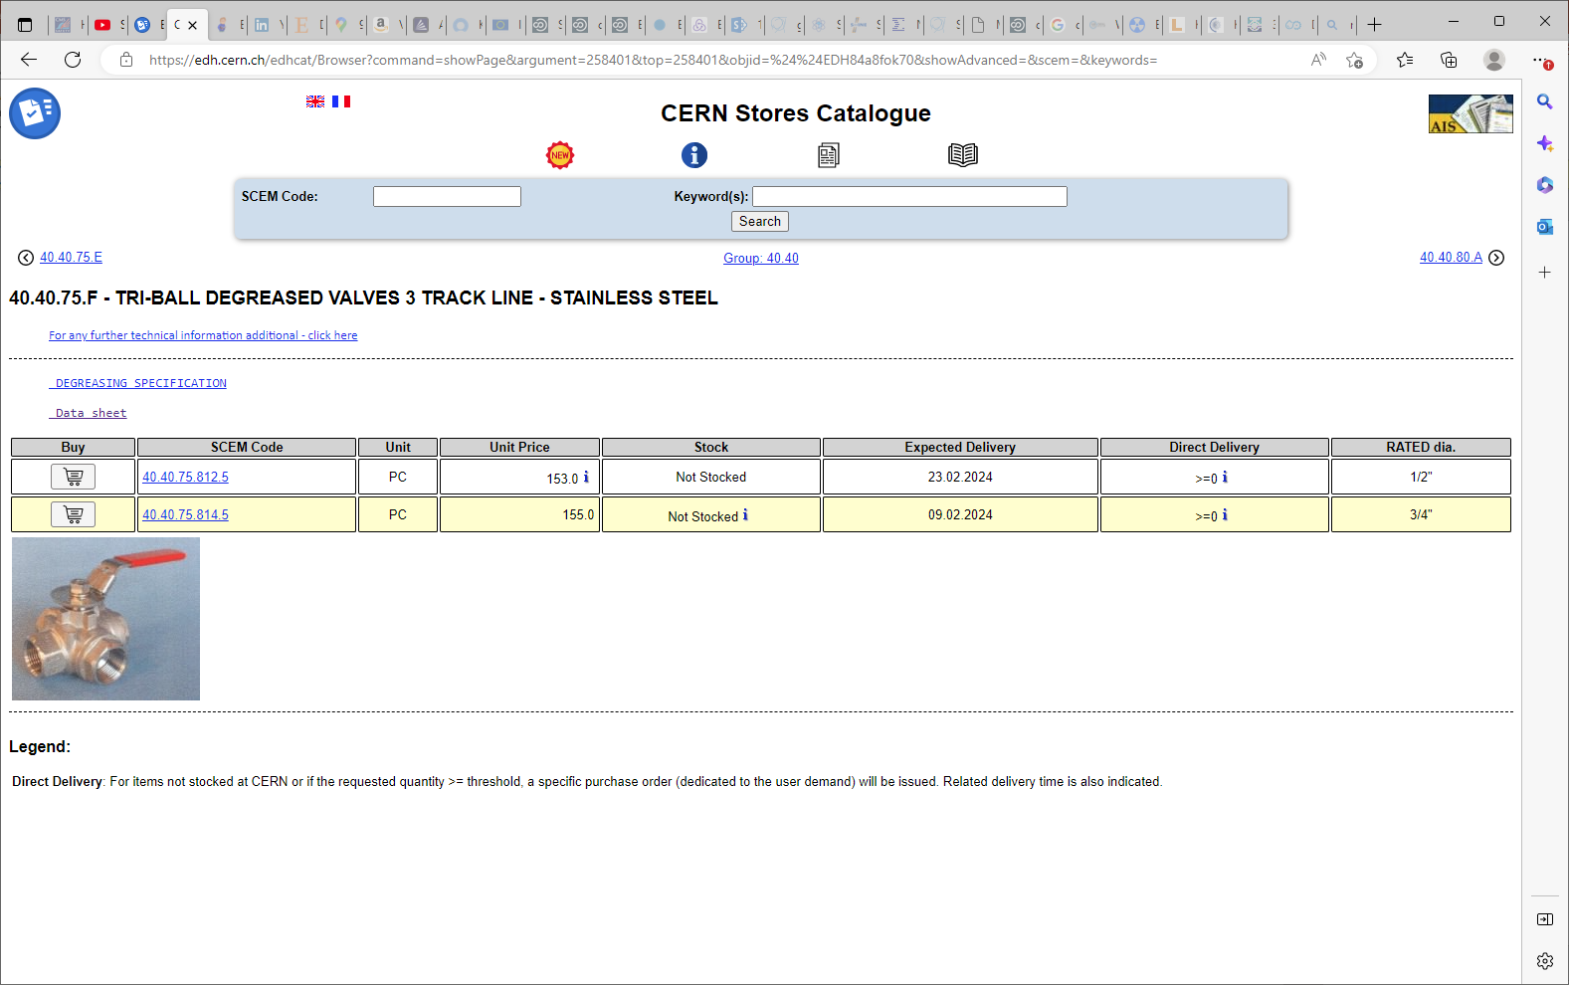

Slide 32
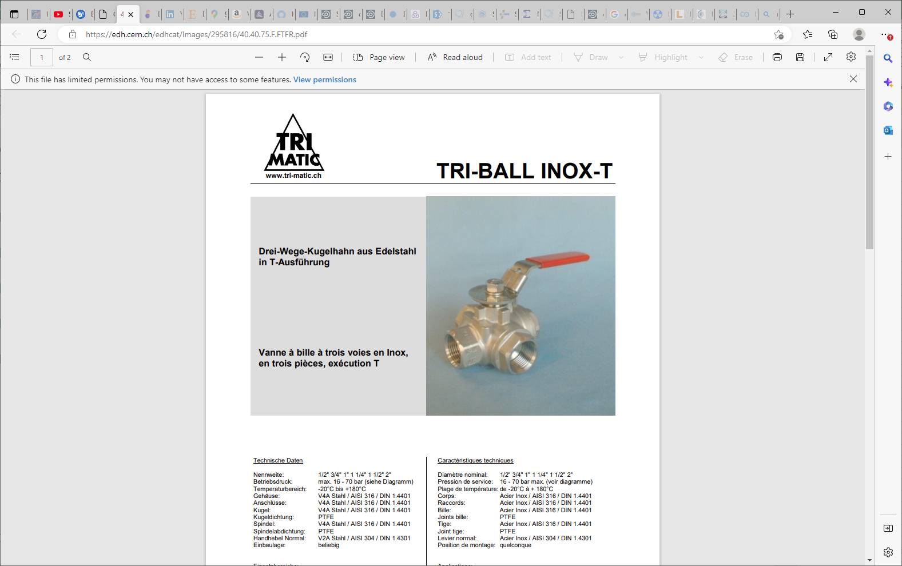
https://edh.cern.ch/edhcat/Images/295816/40.40.75.F.FTFR.pdf

Slide 33
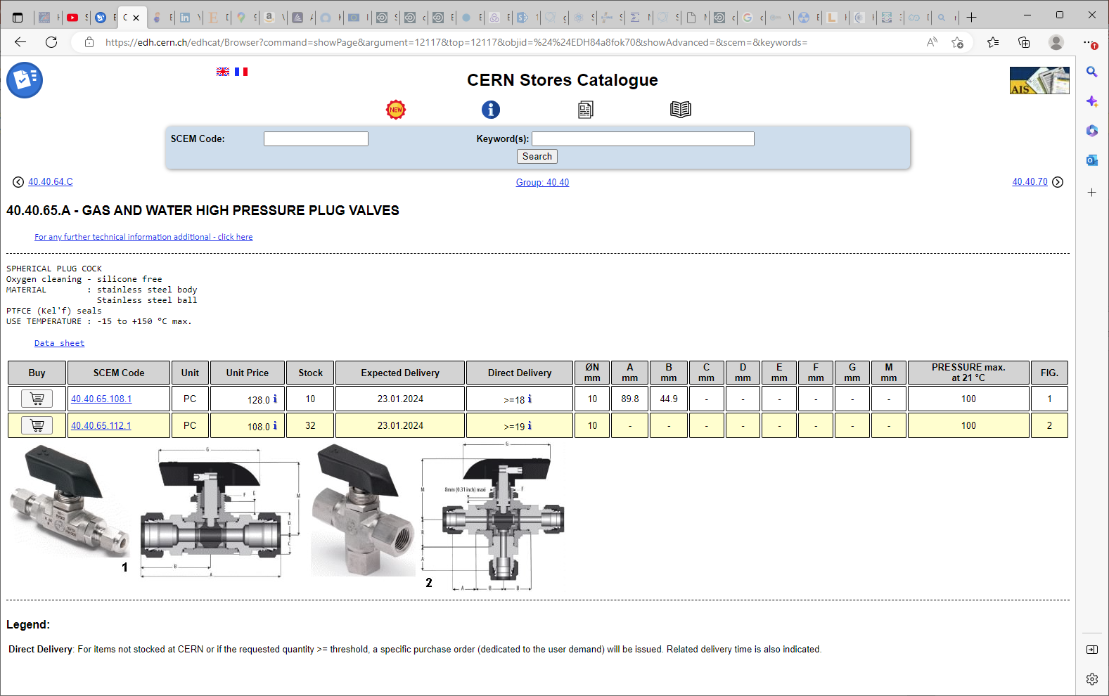
Sagana But is it “L” or “T” ?

Slide 34
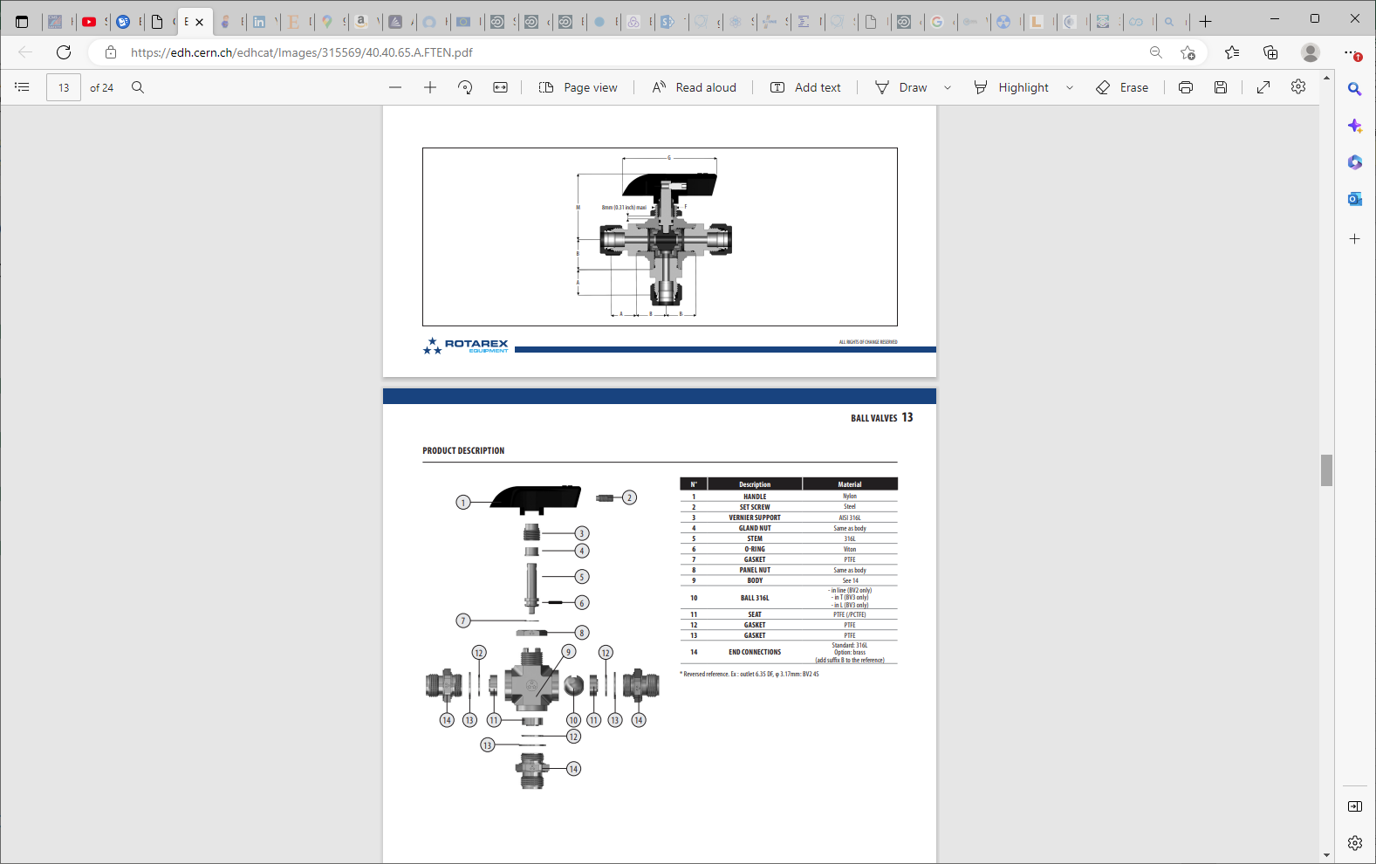

Slide 35
Conclusion
Aliexpress seems more expensive (7-18Euro) than last year , twice ?
Amazon (30-38Euro) is approx. twice the Aliexpress price.
European prices are from 100-300chf for similar item.
Delivery times from some European suppliers are similar to Aliexpress. Does this mean they have the same origine ?
Lets try Aliexpress for minimum 2-3 pieces.

Slide 36
Amazon version with 1/2inch BSP
L type
inox

Slide 37
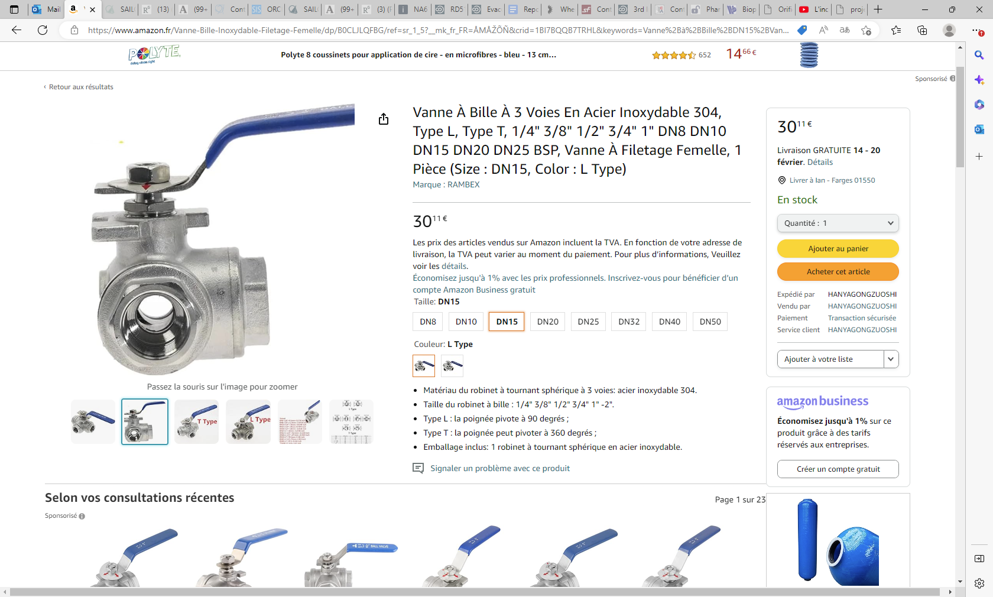
Vanne À Bille À 3 Voies En Acier Inoxydable 304, Type L, Type T, 1/4" 3/8" 1/2" 3/4" 1" DN8 DN10 DN15 DN20 DN25 BSP, Vanne À Filetage Femelle, 1 Pièce (Size : DN15, Color : L Type) : Amazon.fr: Bricolage

Slide 38
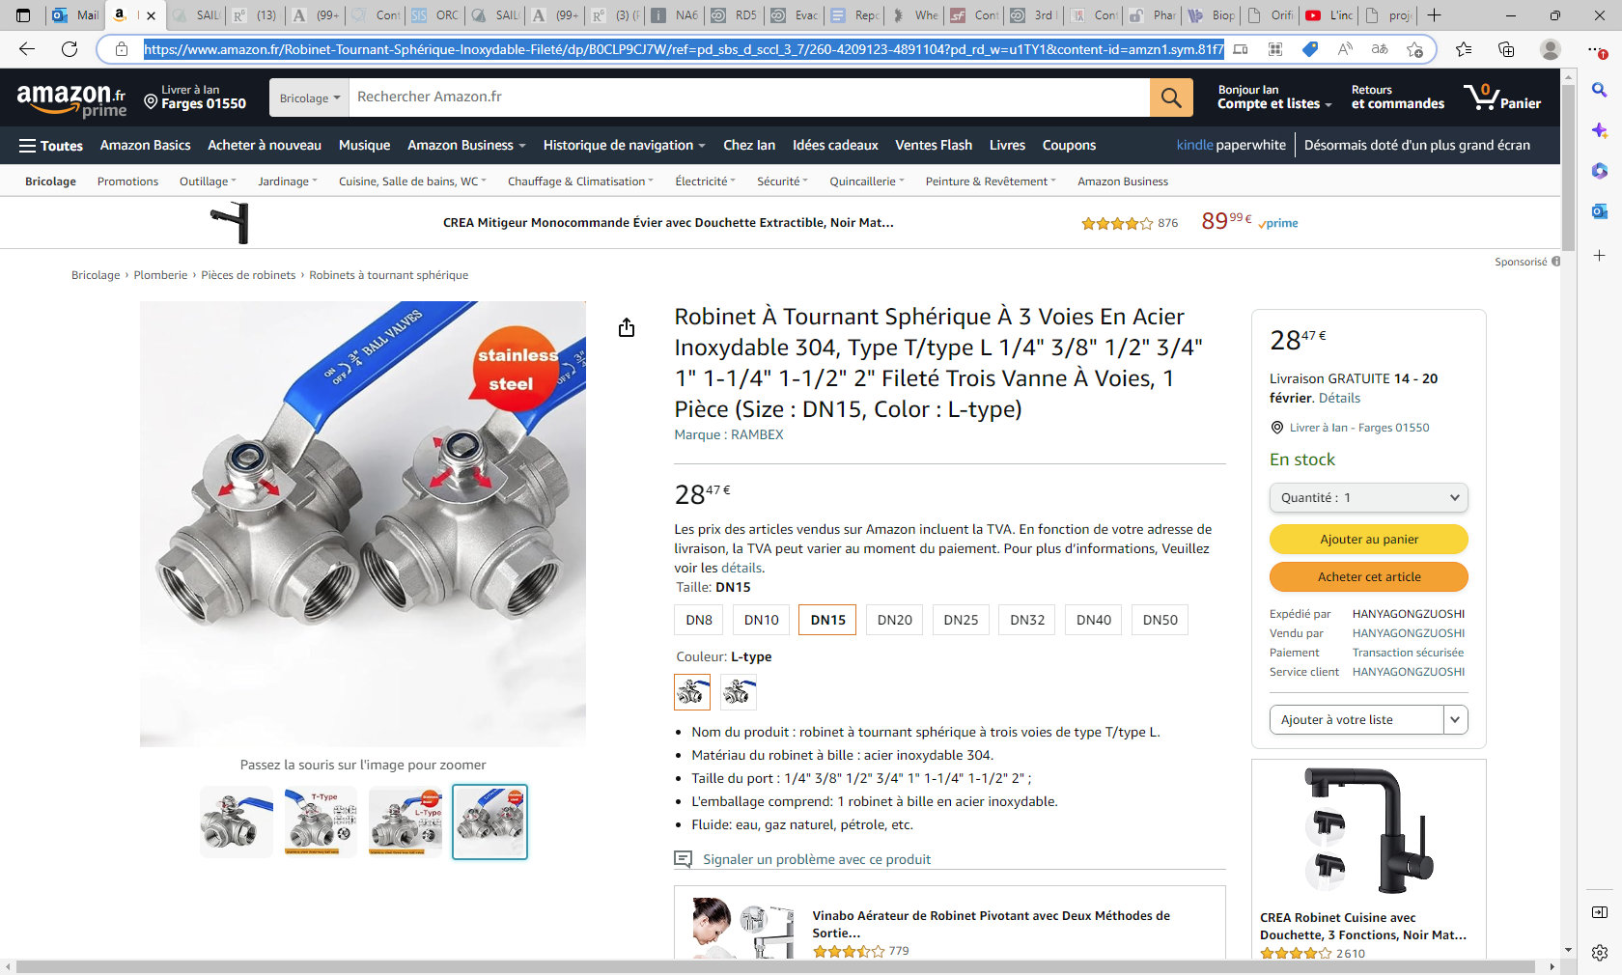
Robinet À Tournant Sphérique À 3 Voies En Acier Inoxydable 304, Type T/type L 1/4" 3/8" 1/2" 3/4" 1" 1-1/4" 1-1/2" 2" Fileté Trois Vanne À Voies, 1 Pièce (Size : DN8, Color : T-type) : Amazon.fr: Bricolage

Slide 39
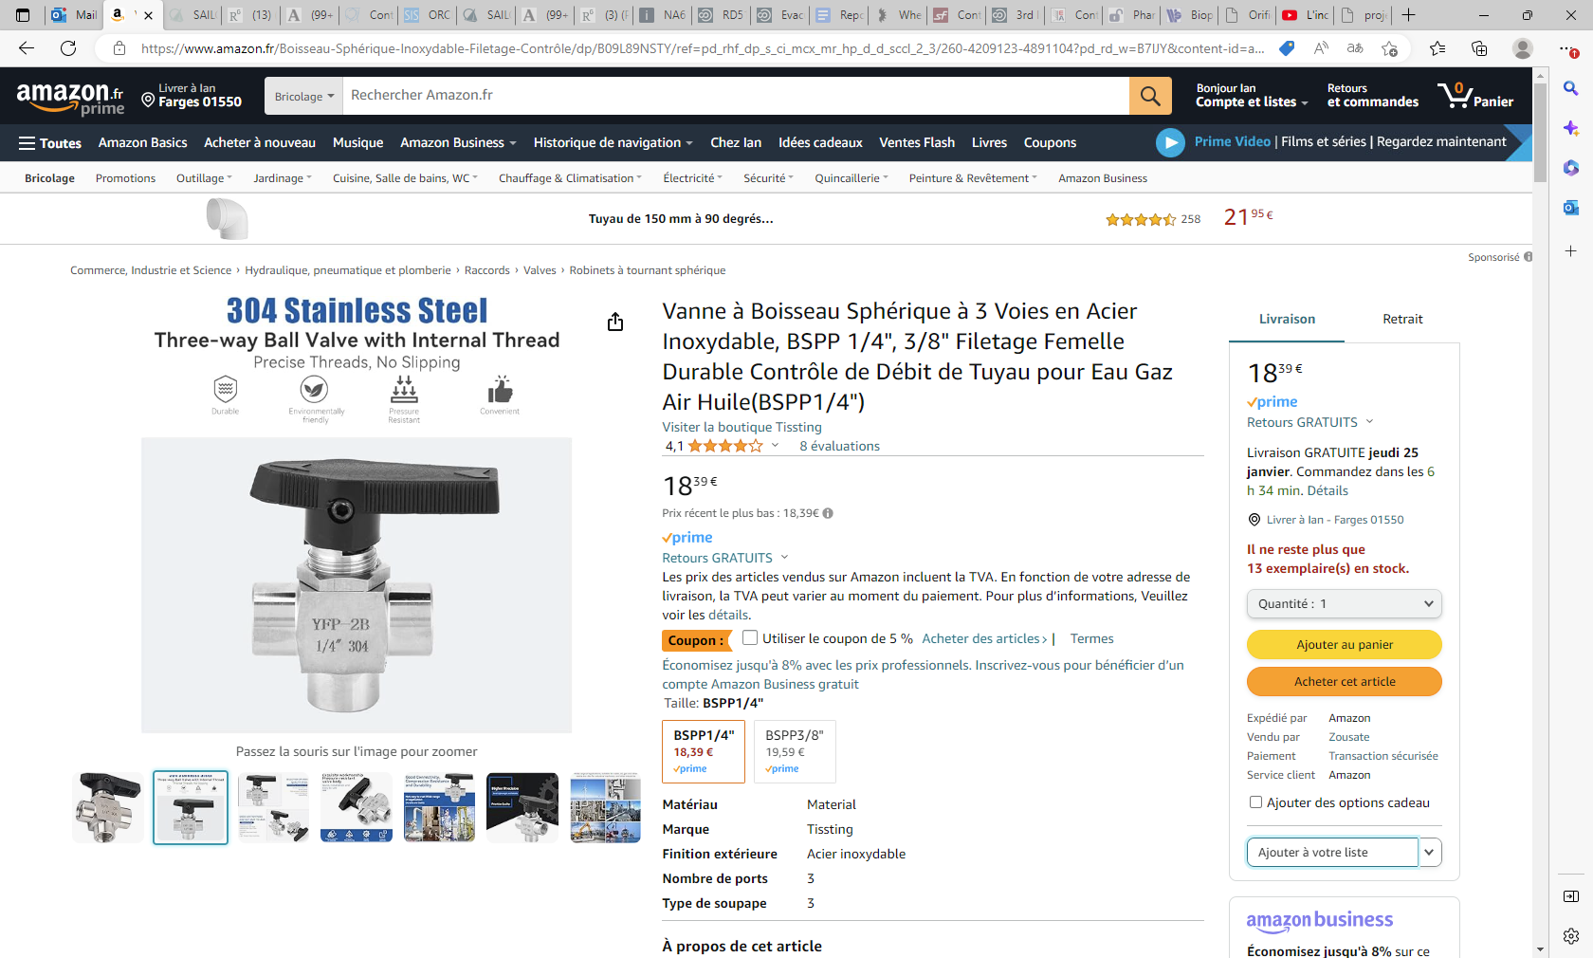
Vanne à Boisseau Sphérique à 3 Voies en Acier Inoxydable, BSPP 1/4", 3/8" Filetage Femelle Durable Contrôle de Débit de Tuyau pour Eau Gaz Air Huile(BSPP1/4") : Amazon.fr: Commerce, Industrie et Science

Slide 40
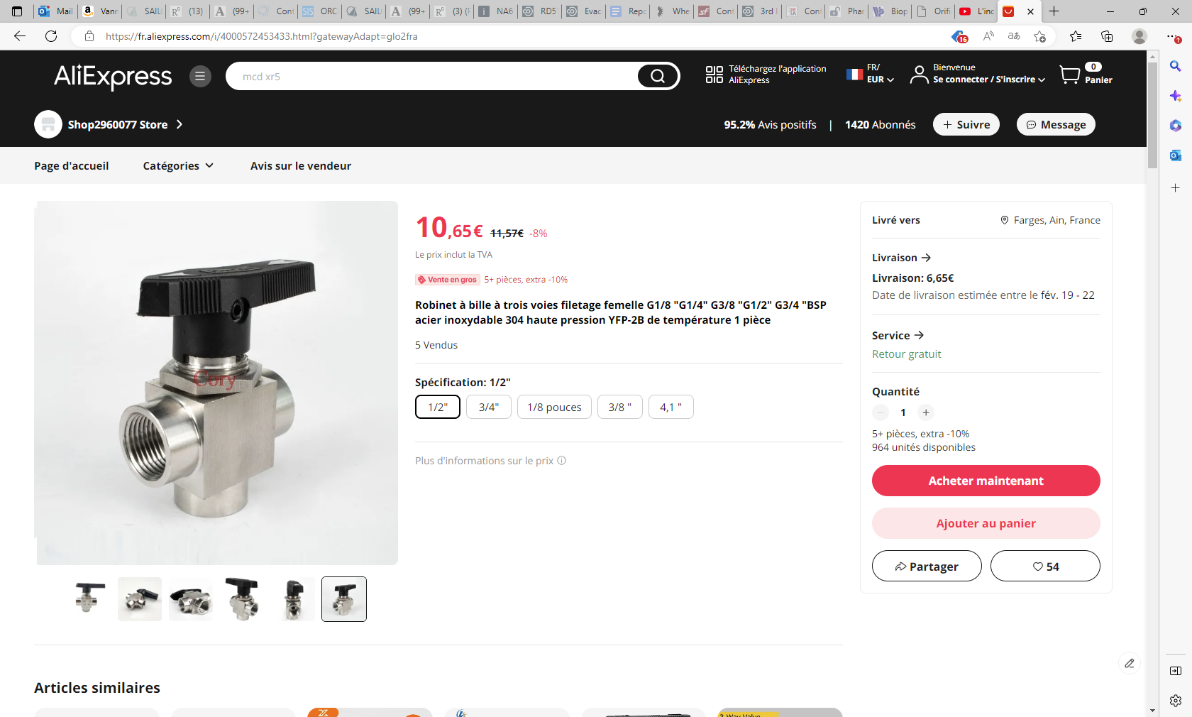
https://fr.aliexpress.com/i/4000572453433.html?gatewayAdapt=glo2fra

Slide 41
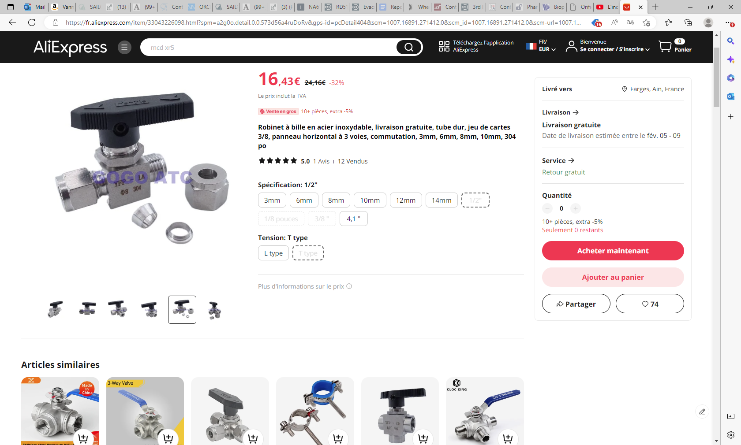

Slide 42
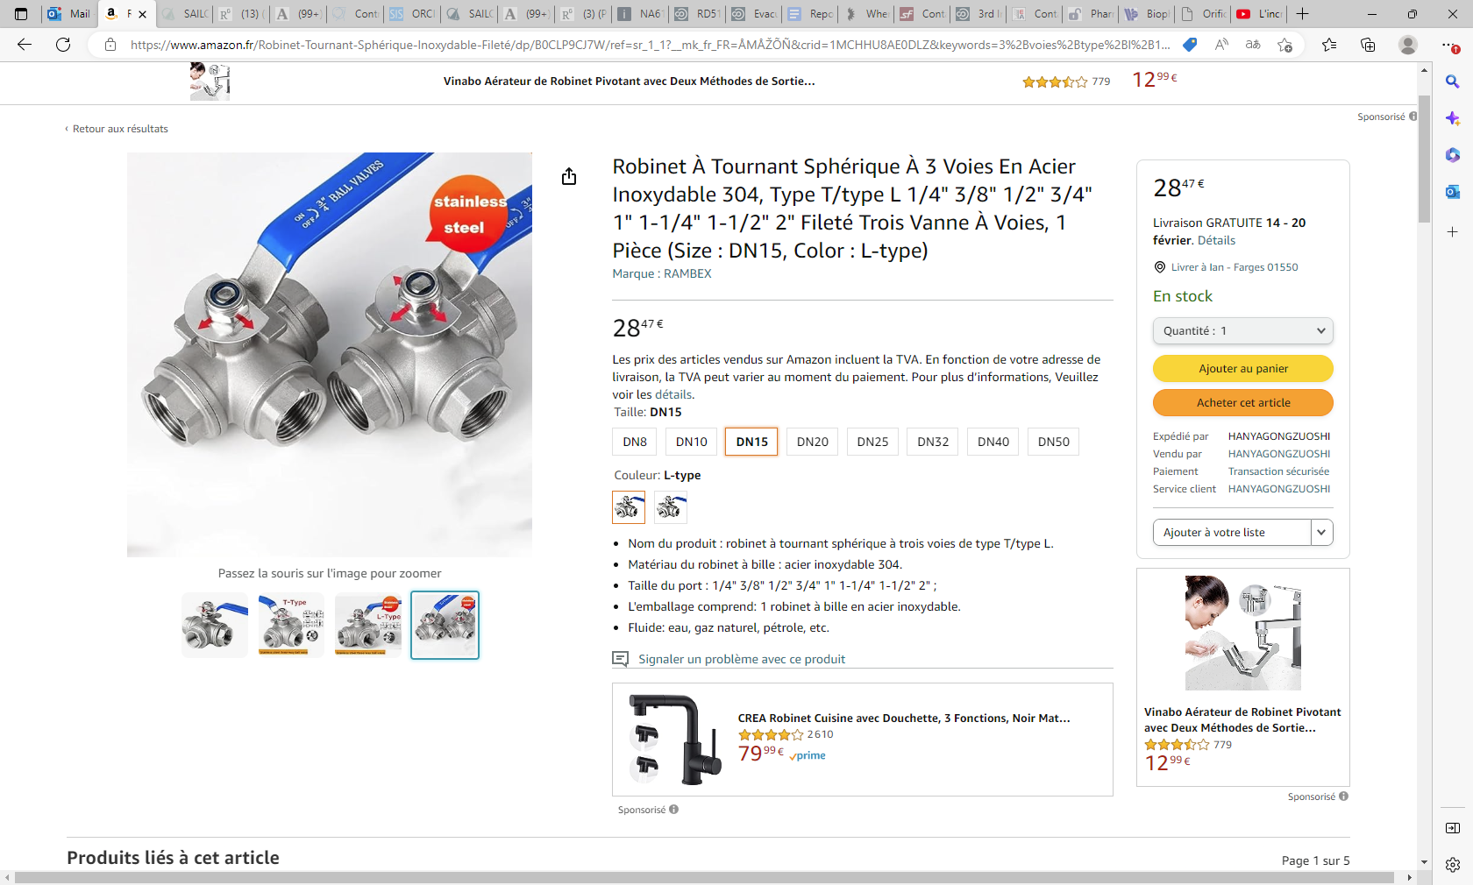

Slide 43
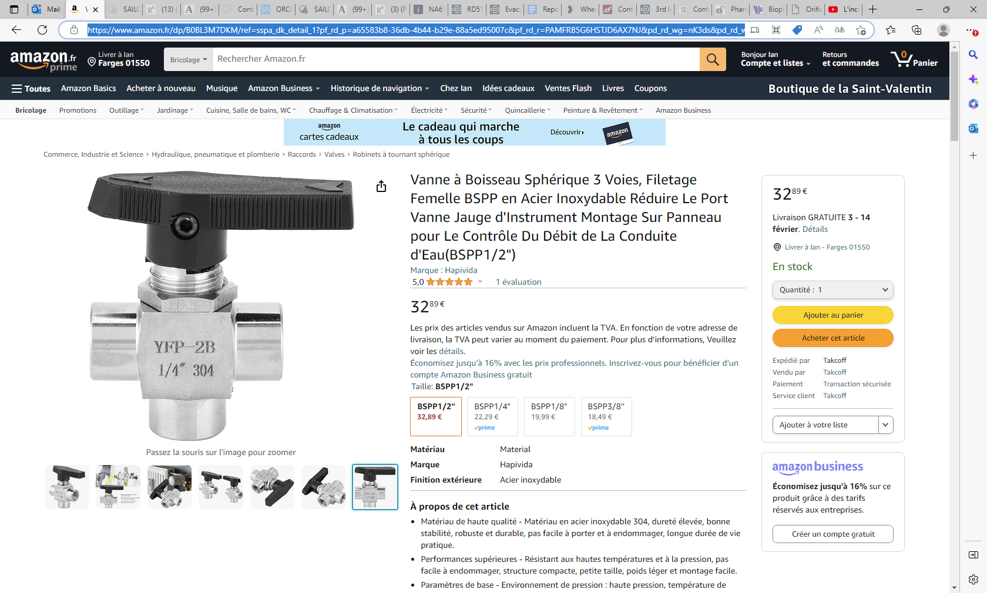
Vanne à Boisseau Sphérique 3 Voies, Filetage Femelle BSPP en Acier Inoxydable Réduire Le Port Vanne Jauge d'Instrument Montage Sur Panneau pour Le Contrôle Du Débit de La Conduite d'Eau(BSPP1/4") : Amazon.fr: Commerce, Industrie et Science

Slide 45
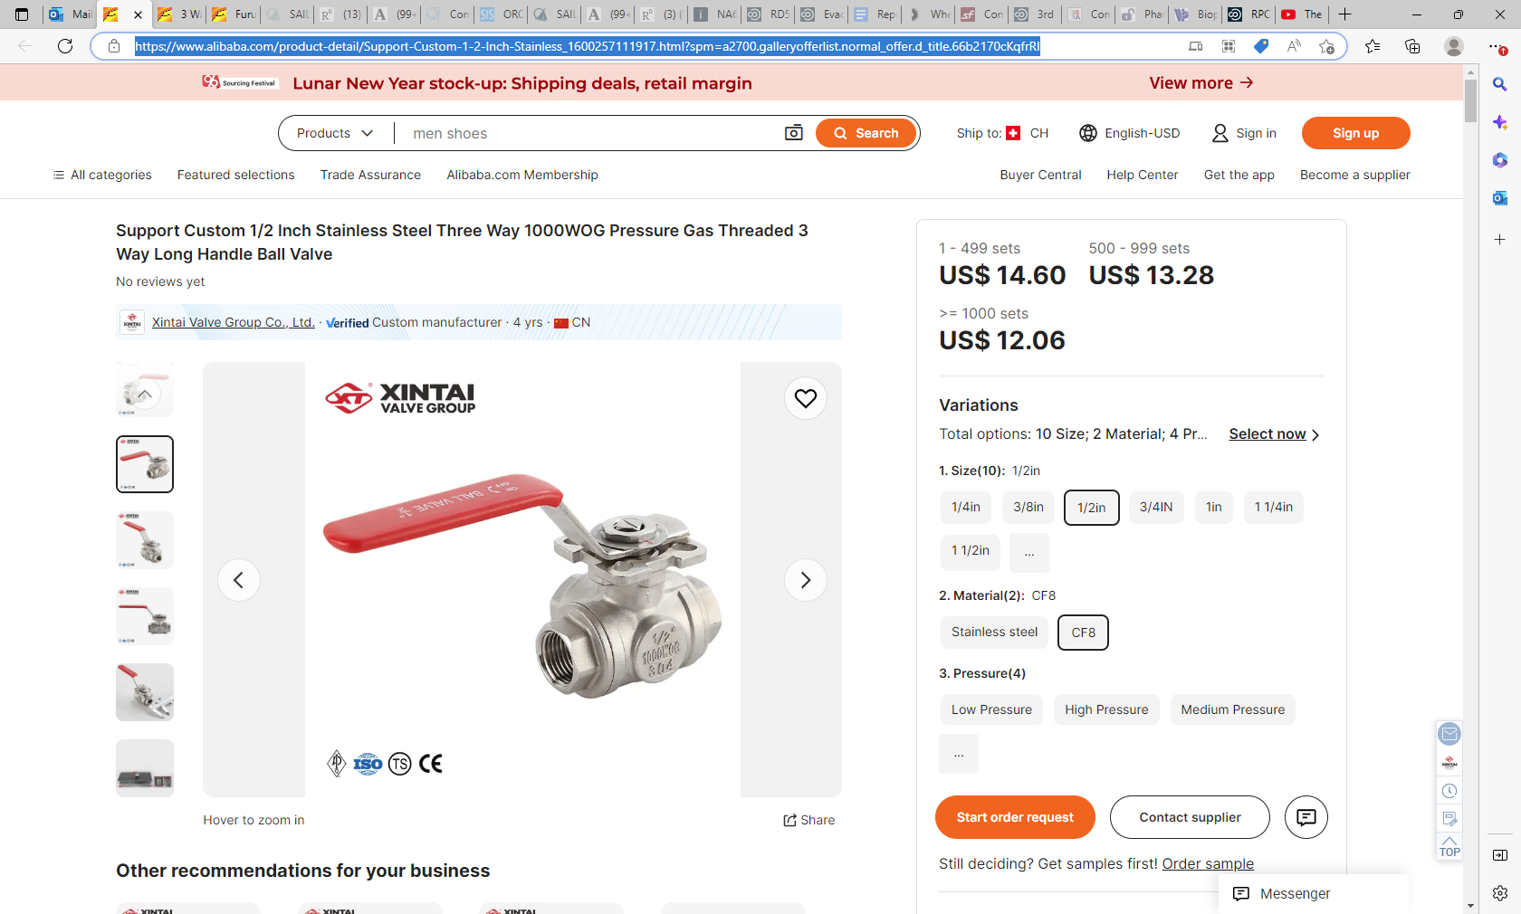
https://www.alibaba.com/product-detail/Support-Custom-1-2-Inch-Stainless_1600257111917.html?spm=a2700.galleryofferlist.normal_offer.d_title.66b2170cKqfrRl

Slide 46
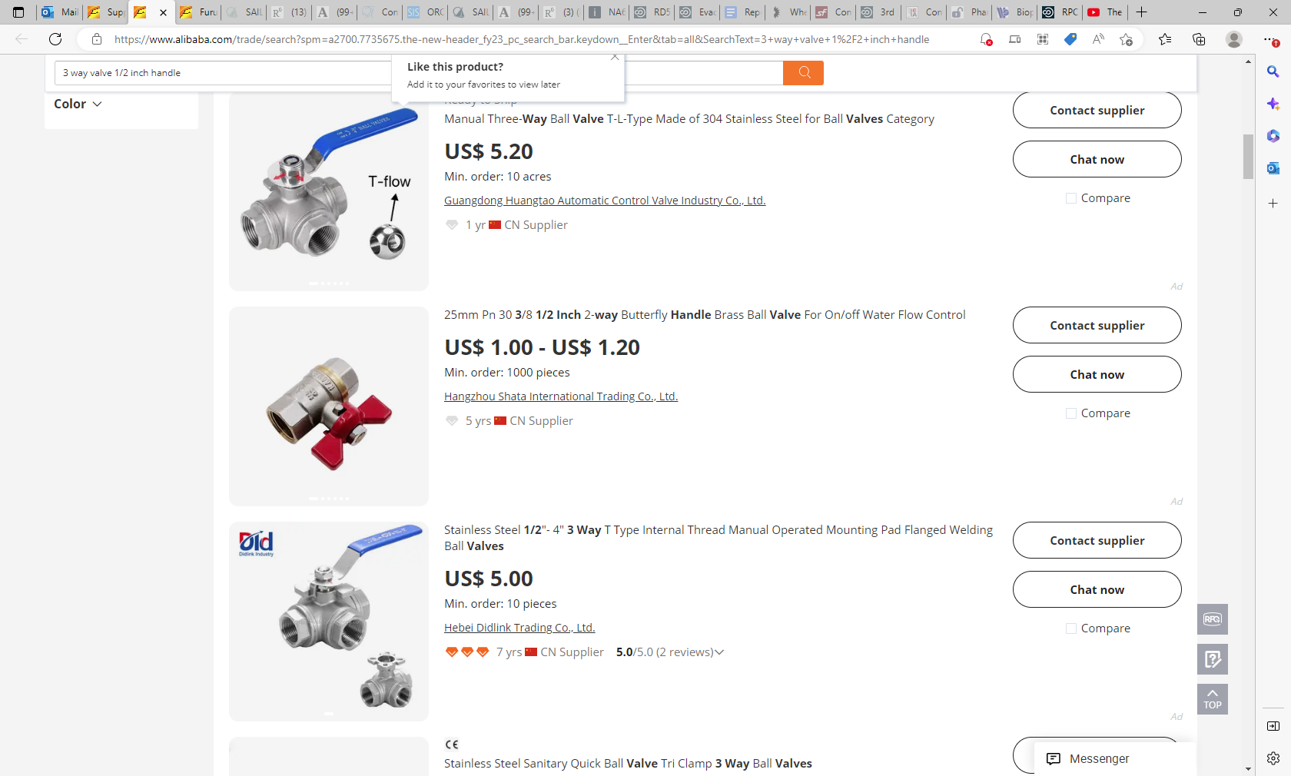
https://www.alibaba.com/trade/search?spm=a2700.7735675.the-new-header_fy23_pc_search_bar.keydown__Enter&tab=all&SearchText=3+way+valve+1%2F2+inch+handle

Slide 47
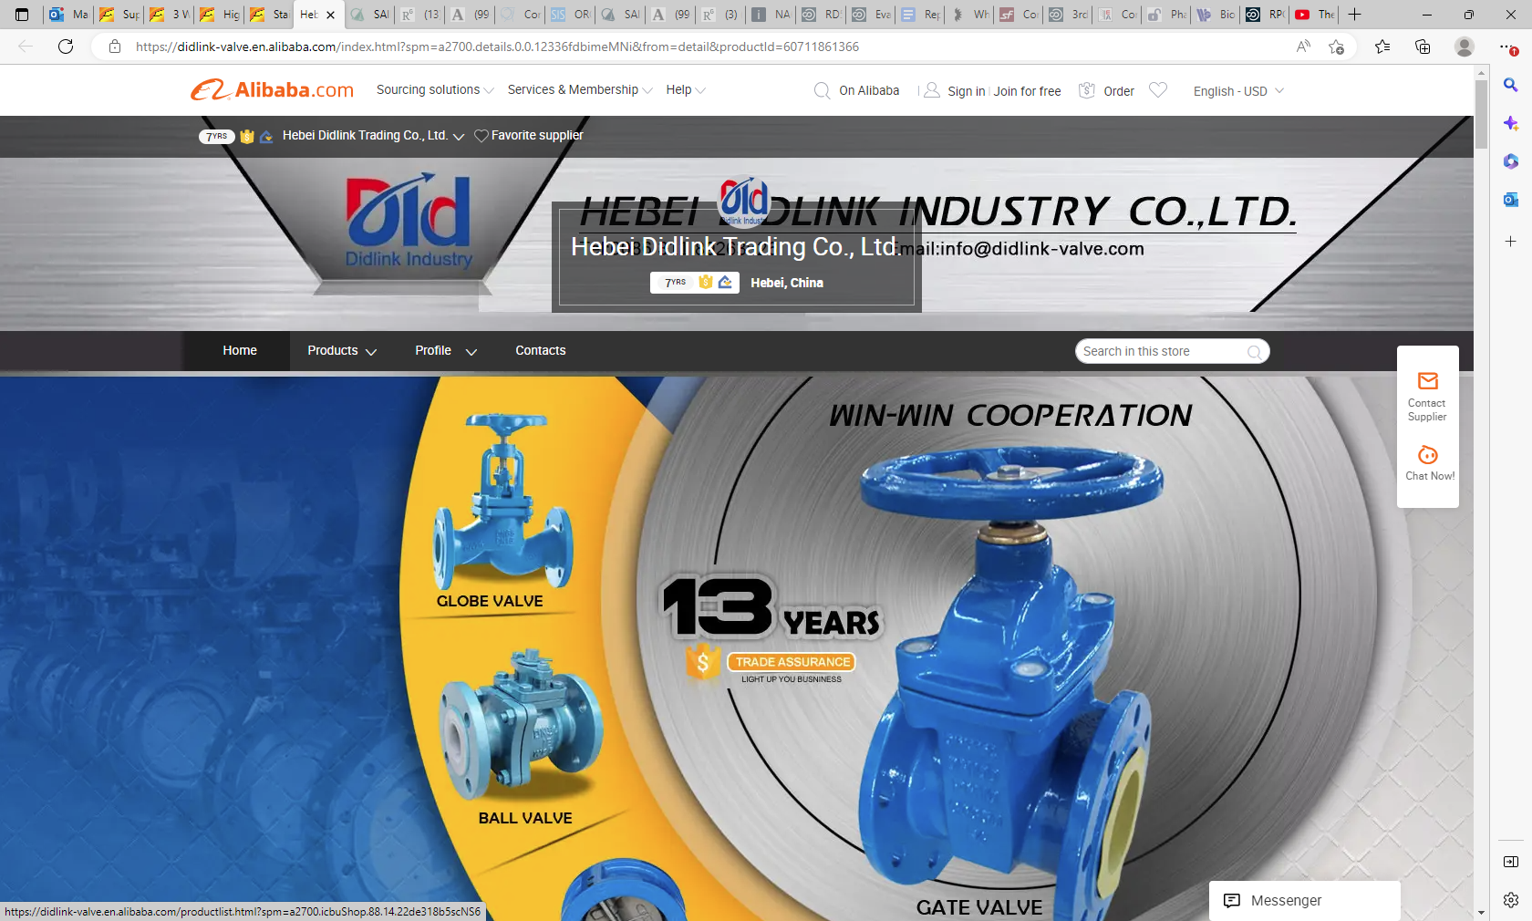
Hebei Didlink Trading Co., Ltd. - valve, flange (alibaba.com)

Slide 48
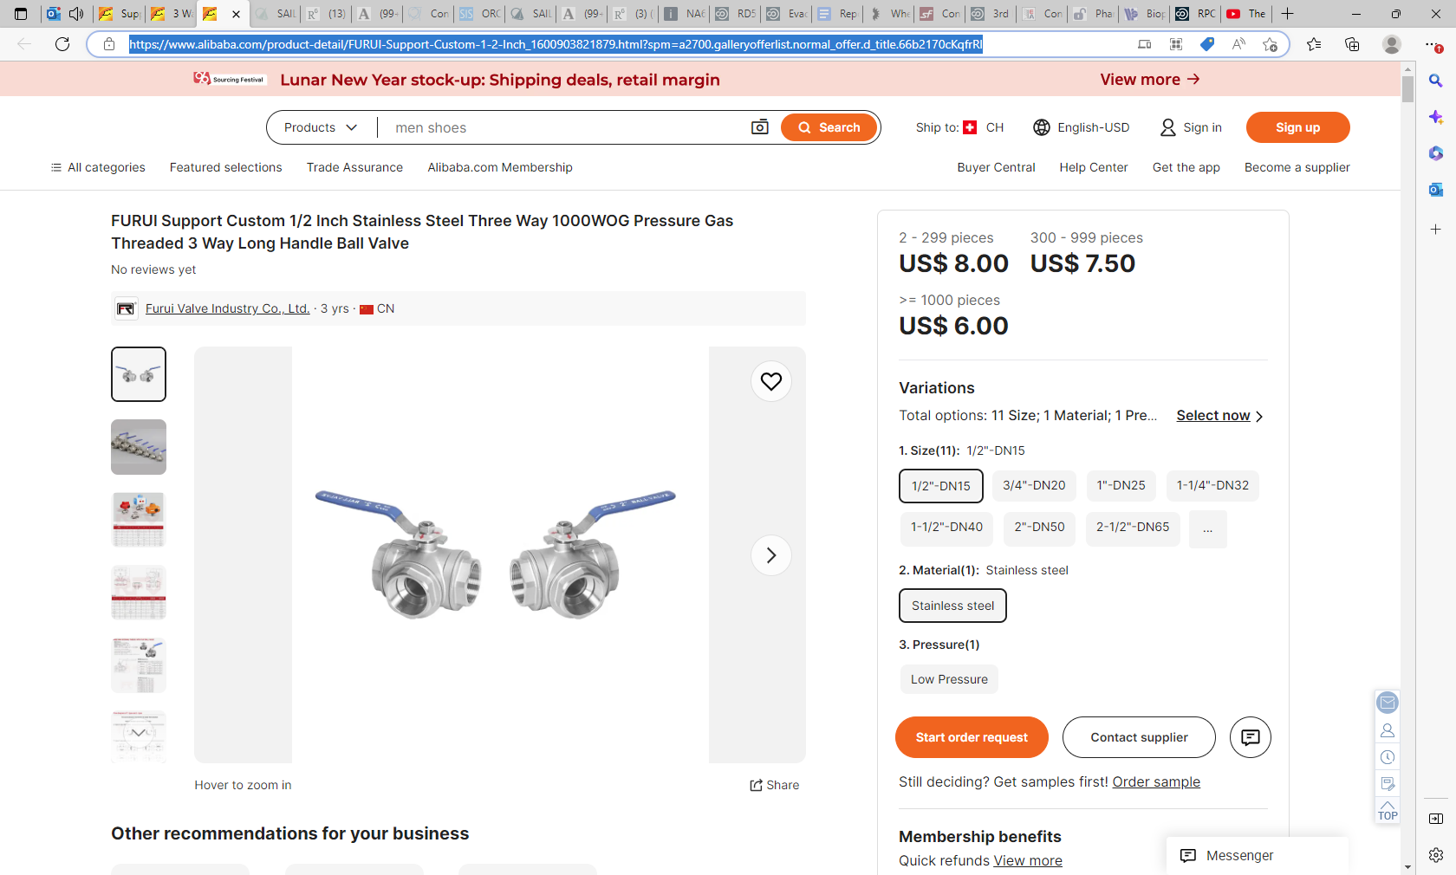
https://www.alibaba.com/product-detail/FURUI-Support-Custom-1-2-Inch_1600903821879.html?spm=a2700.galleryofferlist.normal_offer.d_title.66b2170cKqfrRl

Slide 49
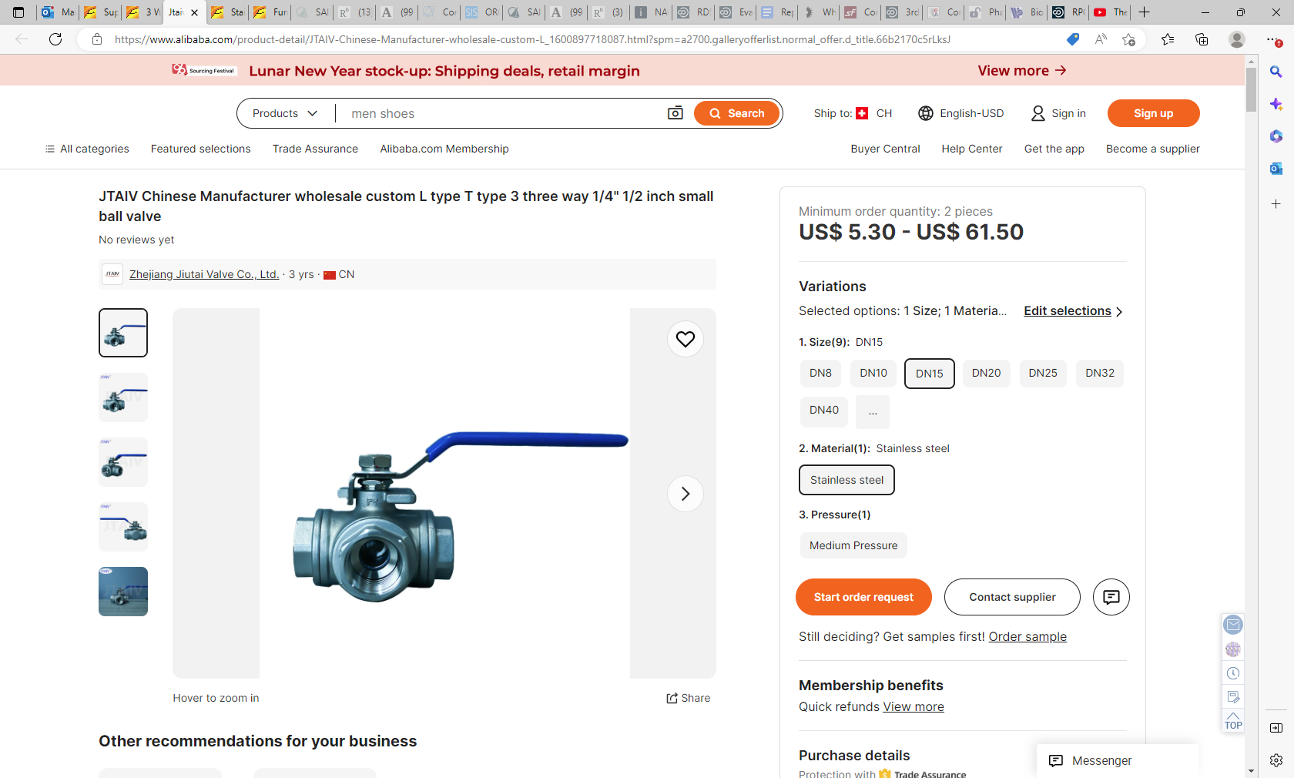
Jtaiv Chinese Manufacturer Wholesale Custom L Type T Type 3 Three Way 1/4" 1/2 Inch Small Ball Valve - Buy Ss304/316 L T Type Female Thread 3 Way Manual Operated Ball Valves,Screwed 3 Way Ball Valve,Manual Operated Ss304/316 L T Type Npt/bsp Female Thread Three Way Ball Valve Product on Alibaba.com

Slide 50
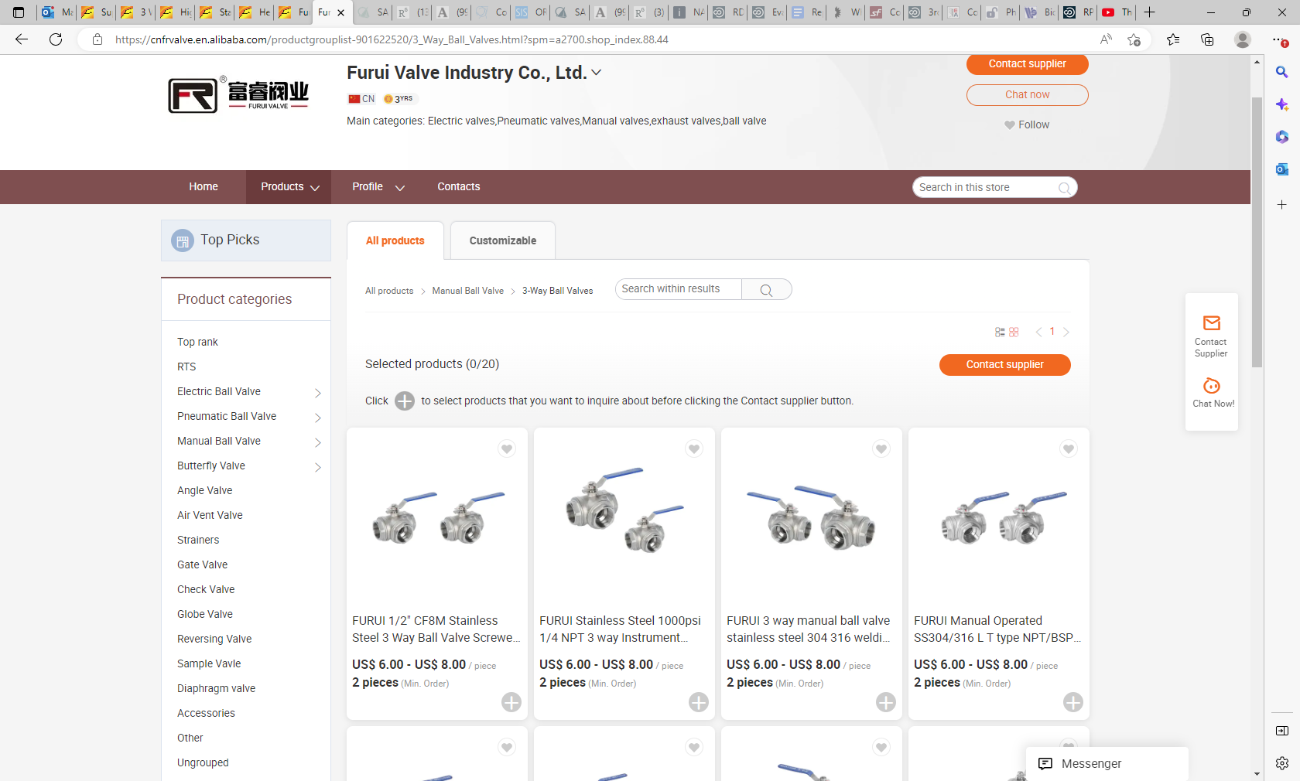
Furui Valve Industry Co., Ltd. - Electric valves, Pneumatic valves (alibaba.com)

Slide 51
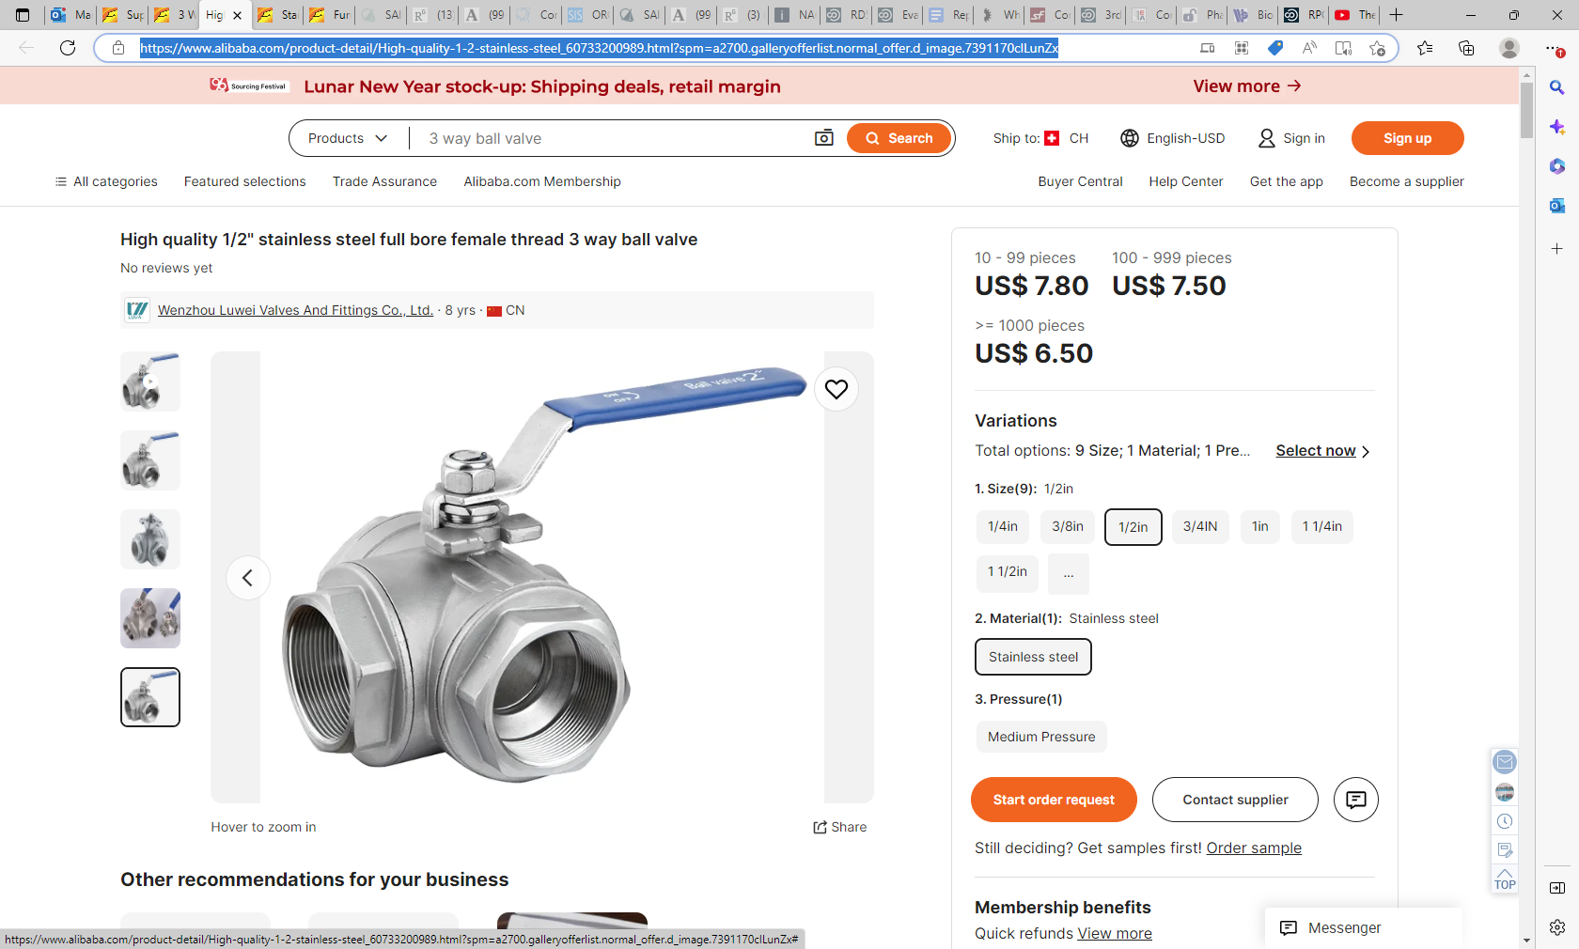
High Quality 1/2" Stainless Steel Full Bore Female Thread 3 Way Ball Valve - Buy Female Thread 3 Way Ball Valve,Full Bore Ball Valve,Stainless Steel Ball Valve Product on Alibaba.com

Slide 52
