Slide 1
3 way valves
Ian
12 Jan 2024
Up dated 23 Jan 2024

Slide 2
Specification
Stainless body 316 or 304 (brass can readily split it unions are over tightened
½ inch BSP pipe thread on all 3 orifices
DN15
There are two possible configurations “L” or “T”. It must be “L”.
Pressure classification “1000WOG”

Slide 3
Companies/suppliers looked at
Aliexpress
RS (Uk and Fr)
CERN (Sagana and Trimatic)
Amazon.fr
Metaltek
Valvesonline.co.uk
Schwer.com
Syveco.com
Valtec.com

Slide 4
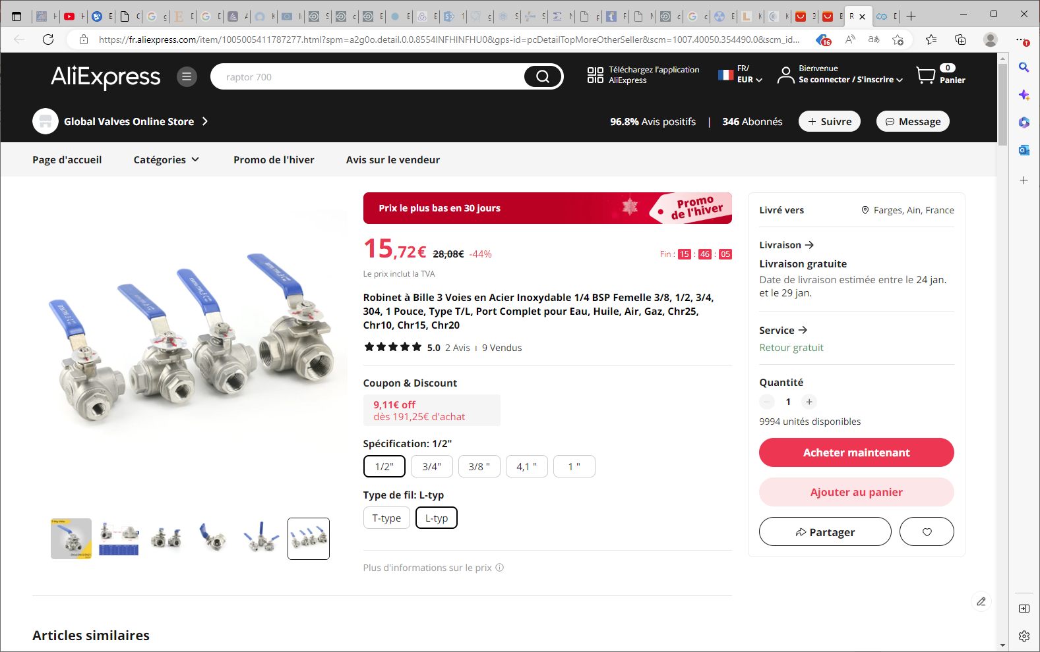
Robinet à Bille 3 Voies en Acier Inoxydable 1/4 BSP Femelle 3/8, 1/2, 3/4, 304, 1 Pouce, Type T/L, Port Complet pour Eau, Huile, Air, Gaz, Chr25, Chr10, Chr15, Chr20 - AliExpress

Slide 5
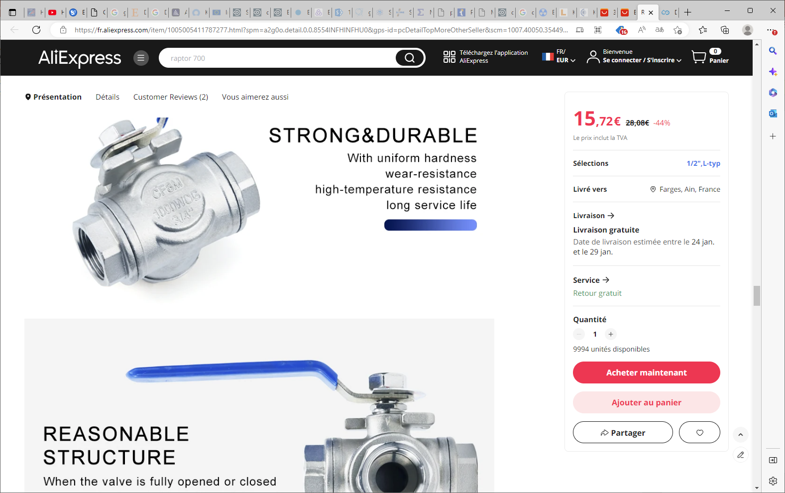
Robinet à Bille 3 Voies en Acier Inoxydable 1/4 BSP Femelle 3/8, 1/2, 3/4, 304, 1 Pouce, Type T/L, Port Complet pour Eau, Huile, Air, Gaz, Chr25, Chr10, Chr15, Chr20 - AliExpress

Slide 6
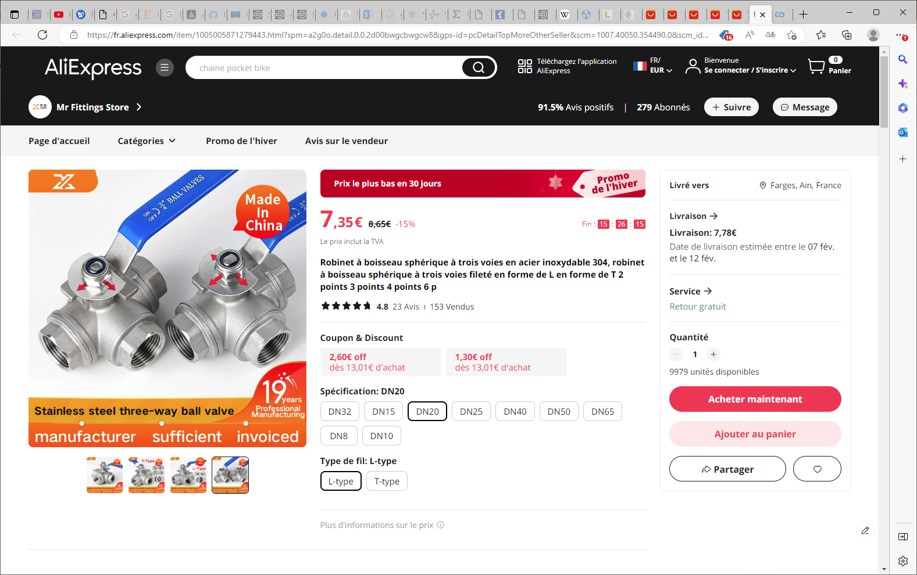
Robinet à boisseau sphérique à trois voies en acier inoxydable 304, robinet à boisseau sphérique à trois voies fileté en forme de L en forme de T 2 points 3 points 4 points 6 p - AliExpress

Slide 7
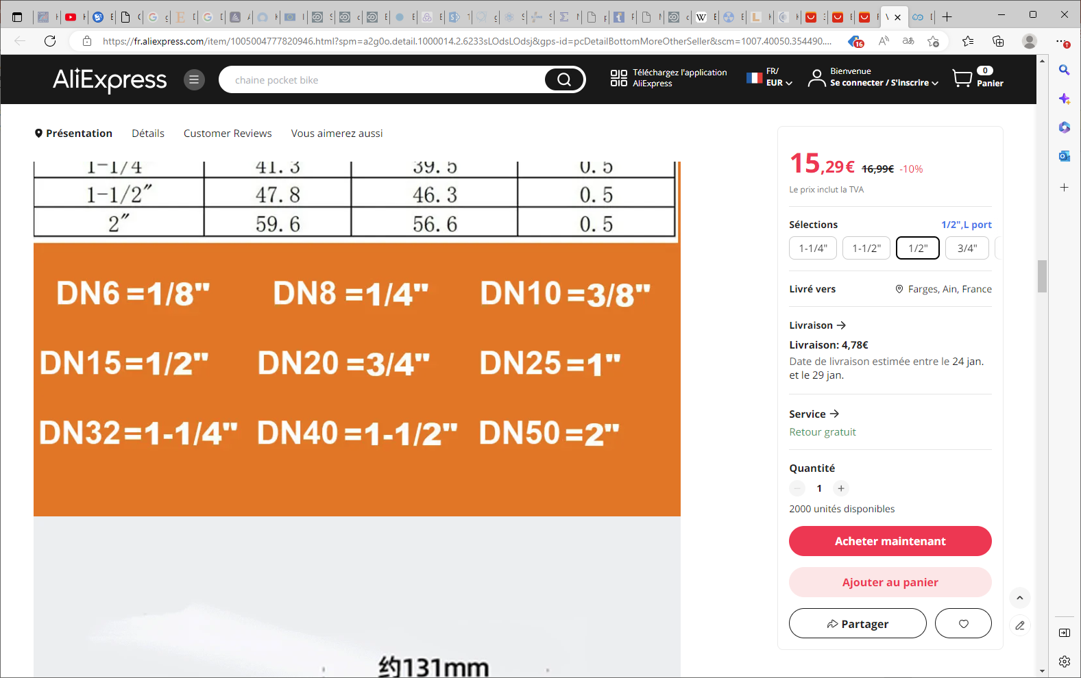
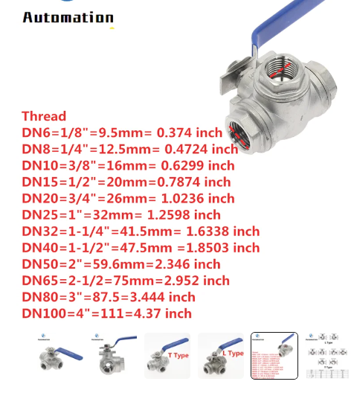

Slide 8
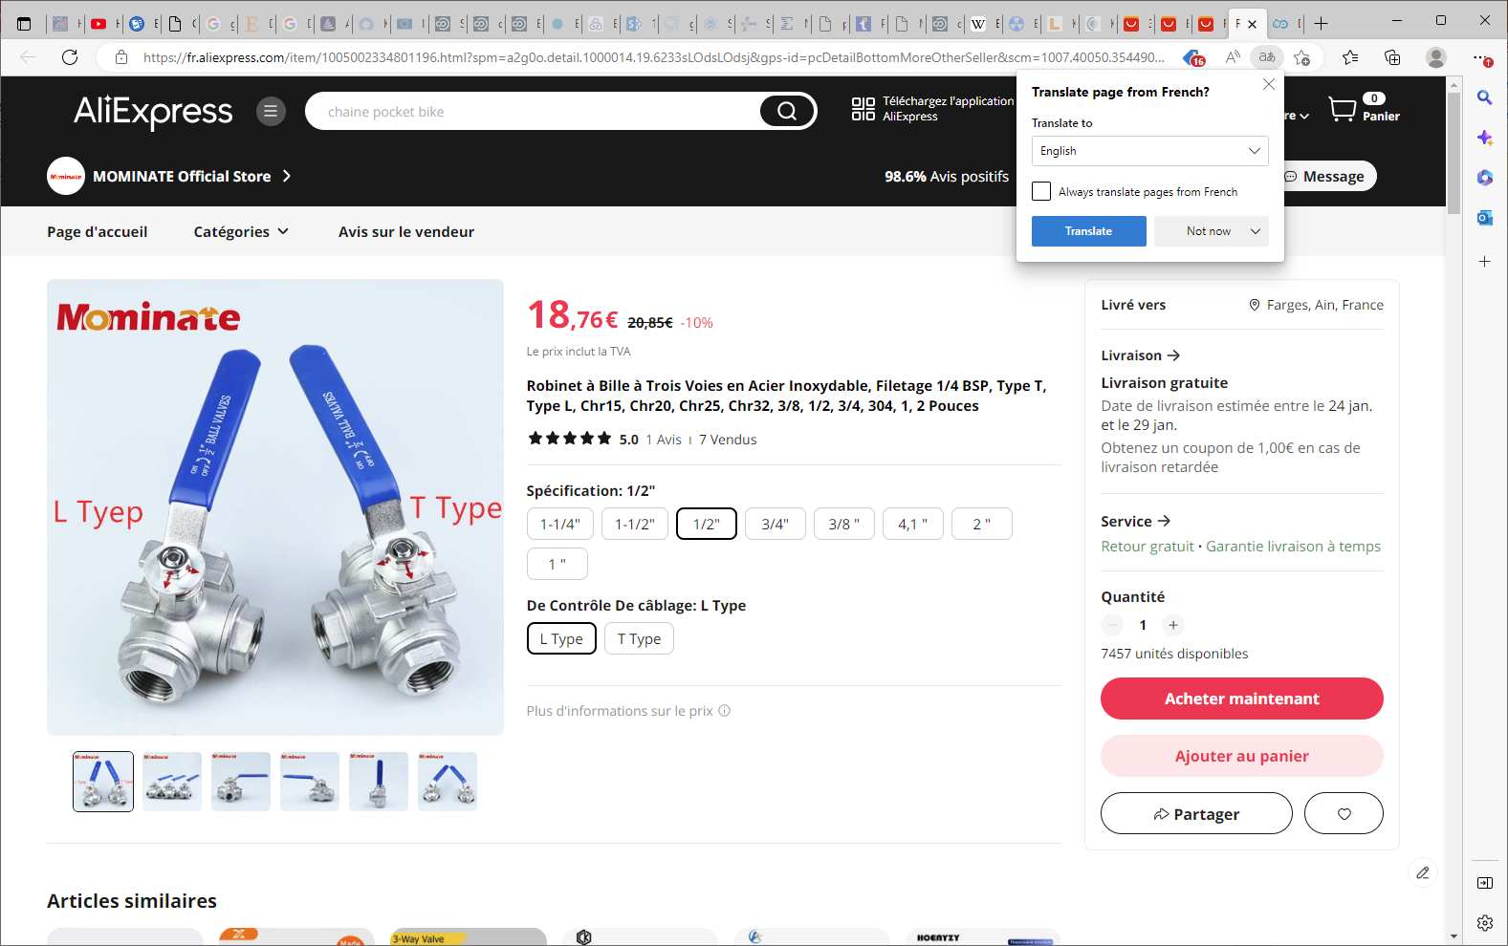

Slide 9
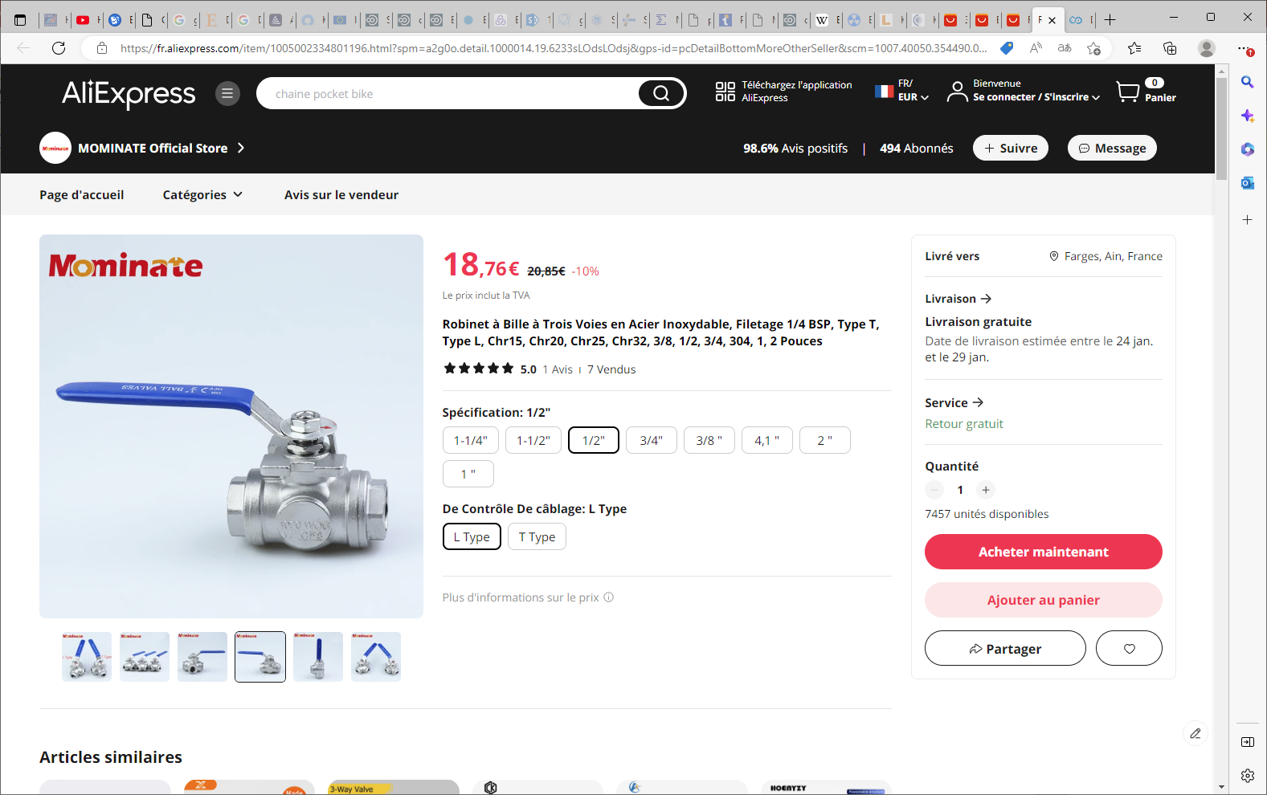
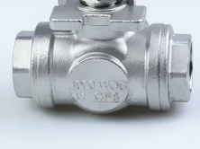
Robinet à Bille à Trois Voies en Acier Inoxydable, Filetage 1/4 BSP, Type T, Type L, Chr15, Chr20, Chr25, Chr32, 3/8, 1/2, 3/4, 304, 1, 2 Pouces (aliexpress.com)

Slide 10
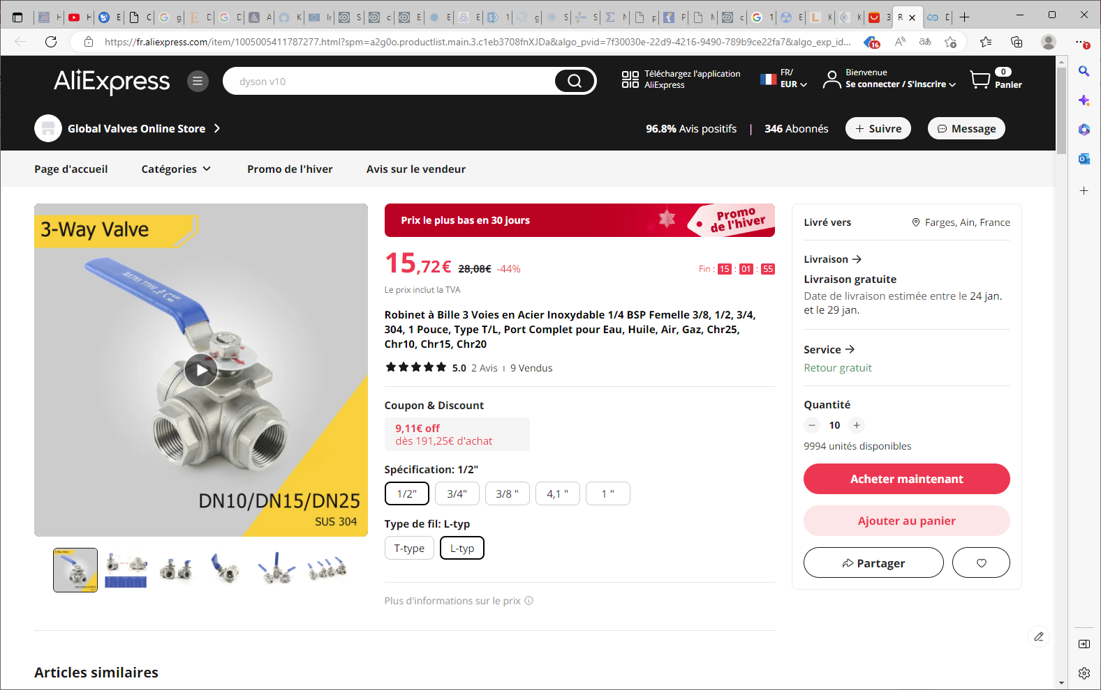
Robinet à Bille 3 Voies en Acier Inoxydable 1/4 BSP Femelle 3/8, 1/2, 3/4, 304, 1 Pouce, Type T/L, Port Complet pour Eau, Huile, Air, Gaz, Chr25, Chr10, Chr15, Chr20 - AliExpress

Slide 11
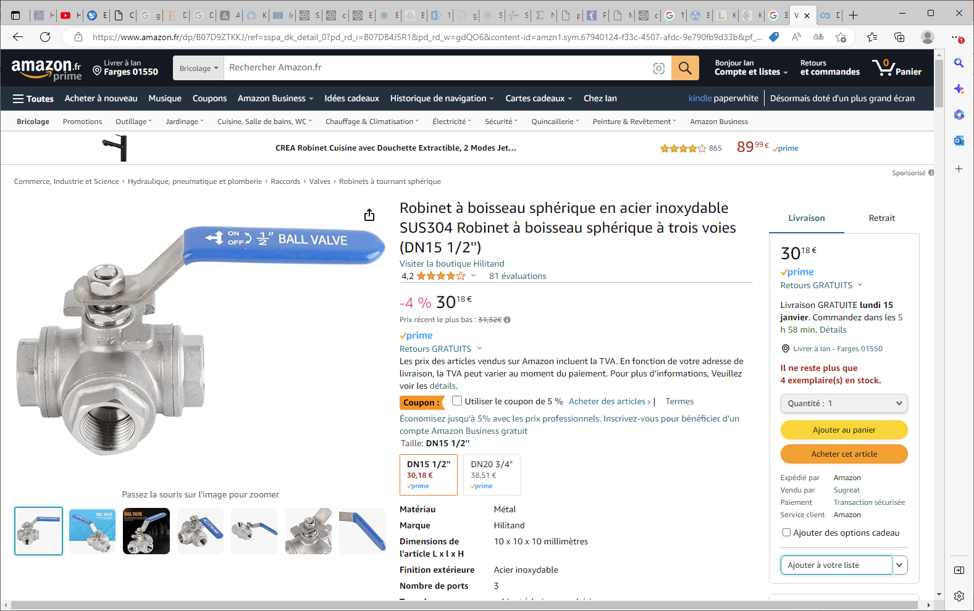

Slide 12
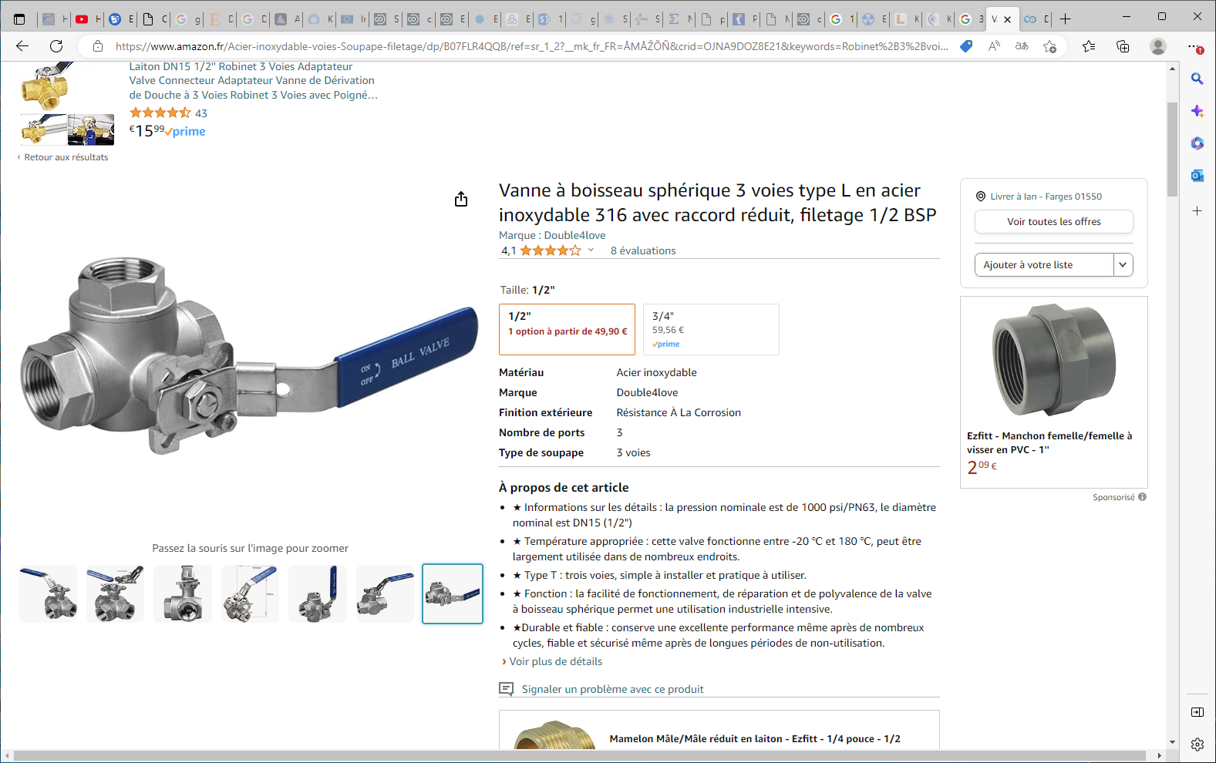

Slide 13
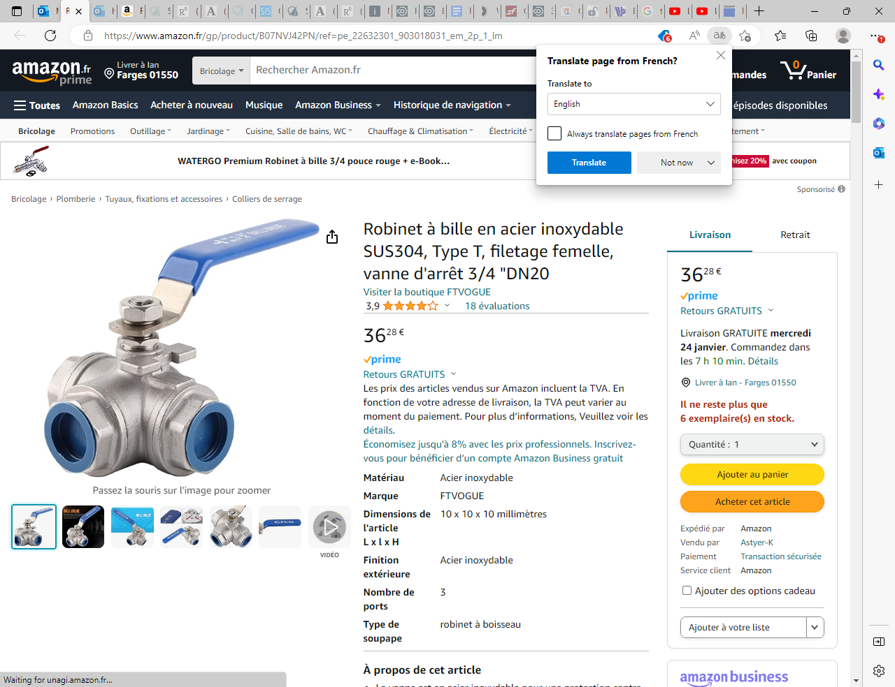
https://www.amazon.fr/gp/product/B07NVJ42PN/ref=pe_22632301_903018031_em_2p_1_lm

Slide 14
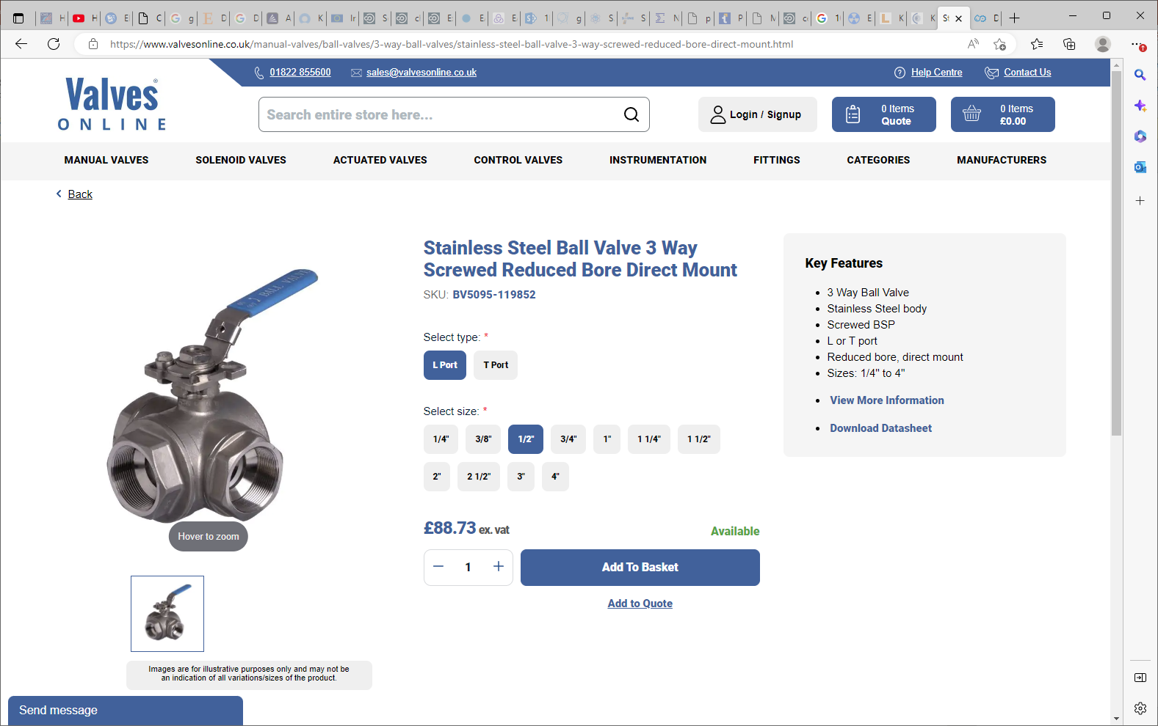
Stainless Steel Ball Valve 3 Way Screwed Reduced Bore Direct Mount - Valves Online

Slide 15
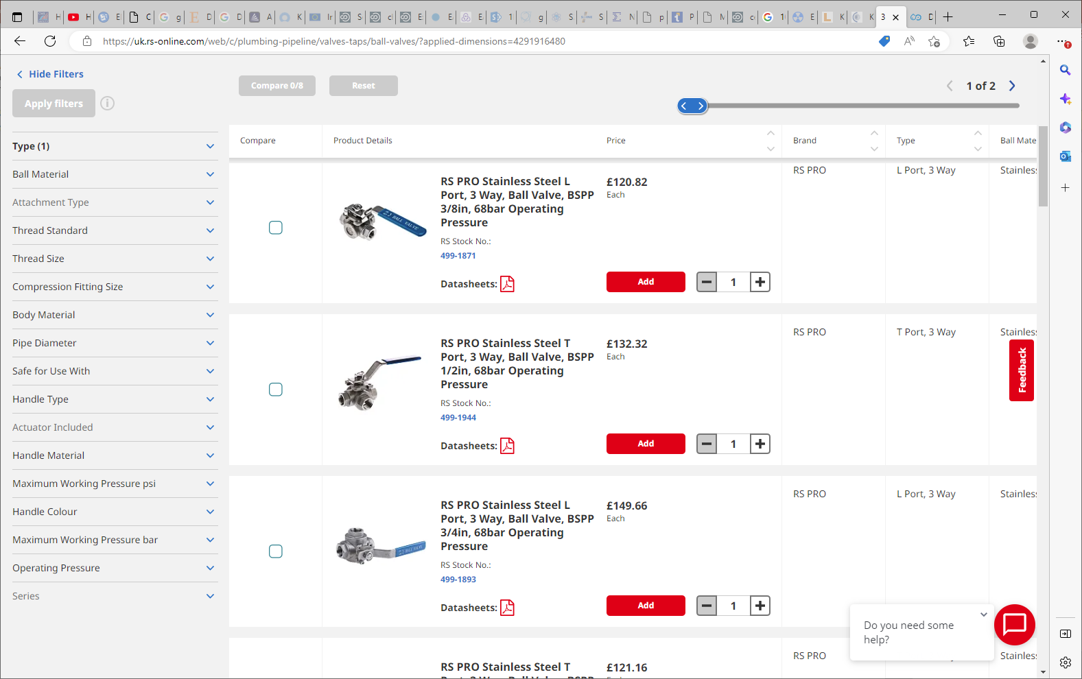
3 Way Ball Valve | RS (rs-online.com)

Slide 16
Pipe supports

Slide 17
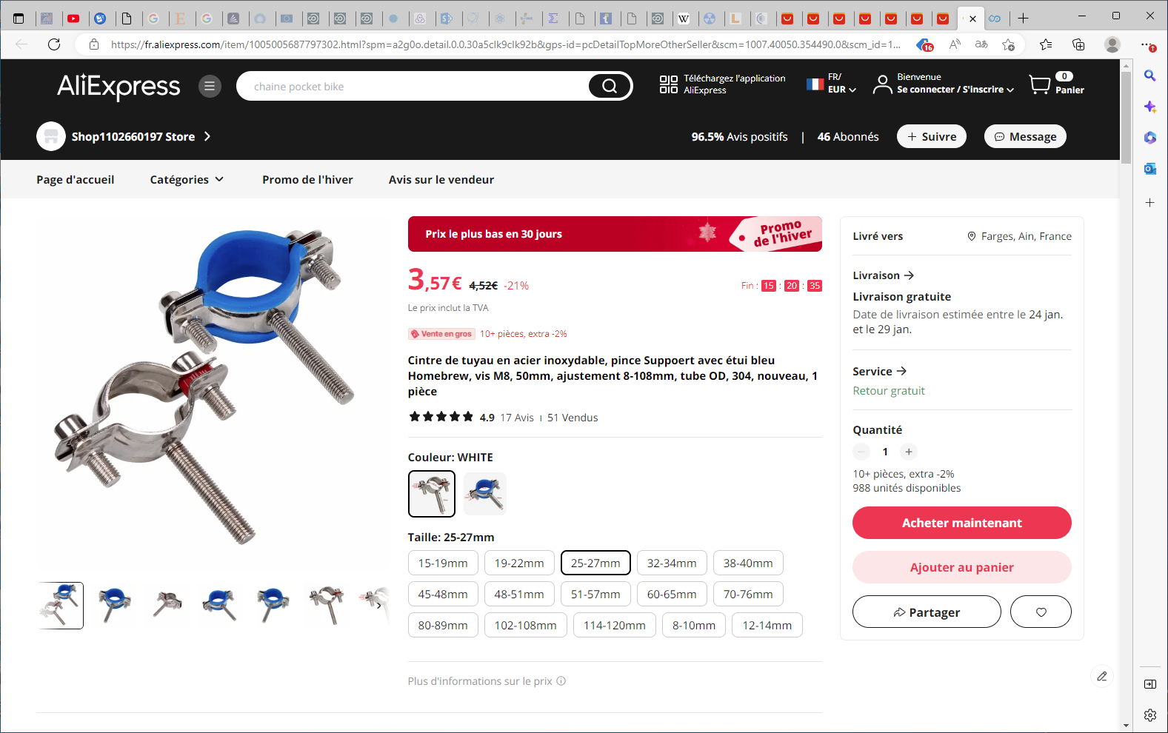
Cintre de tuyau en acier inoxydable, pince Suppoert avec étui bleu Homebrew, vis M8, 50mm, ajustement 8-108mm, tube OD, 304, nouveau, 1 pièce - AliExpress

Slide 18
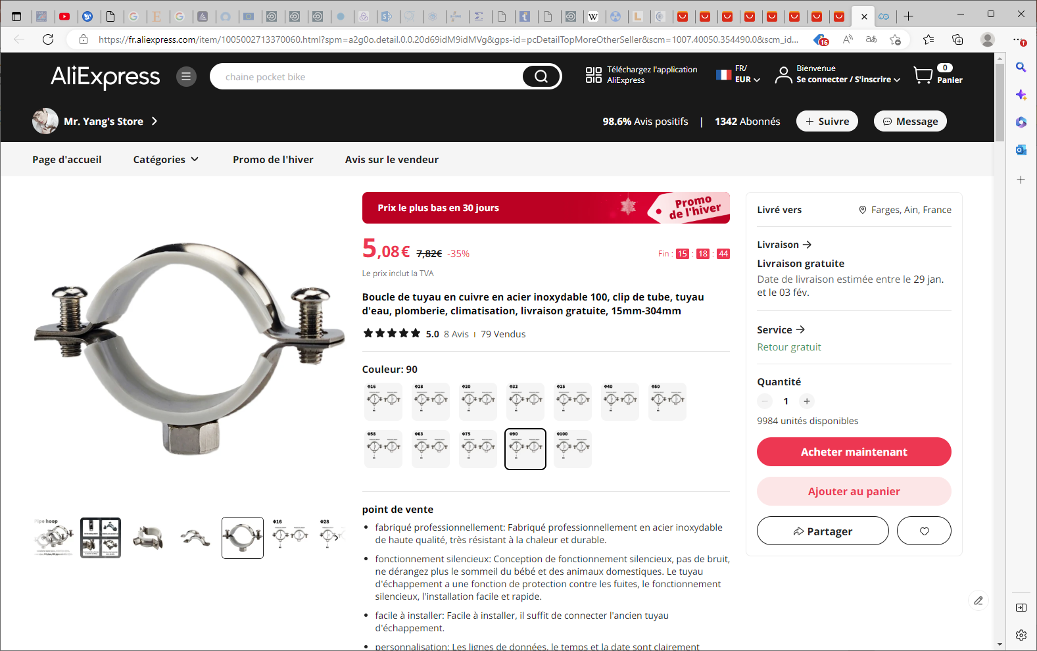
Tube En Acier Inoxydable 100, 15mm-304mm, Boucle De Tuyau En Cuivre Pour Plomberie Et Climatisation, Livraison Gratuite - Brides - AliExpress

Slide 19
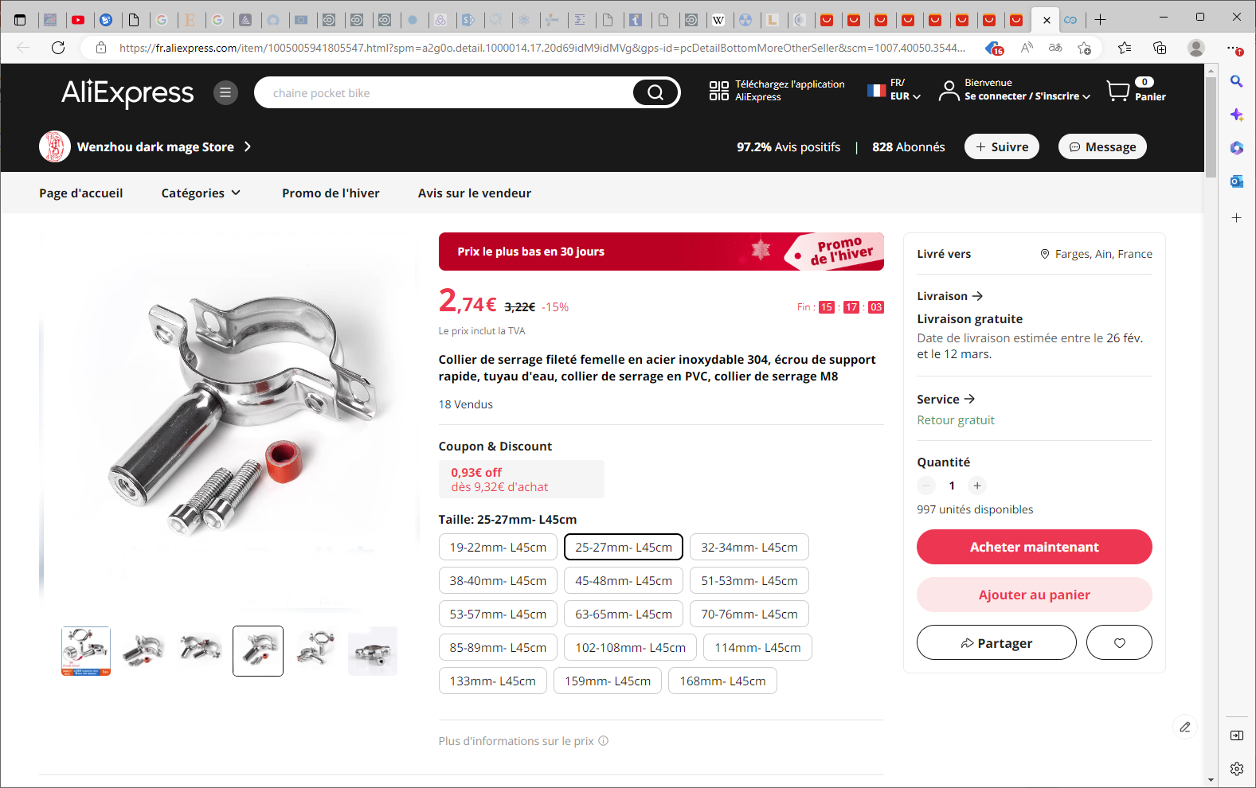
Collier de serrage fileté femelle en acier inoxydable 304, écrou de support rapide, tuyau d'eau, collier de serrage en PVC, collier de serrage M8 - AliExpress

Slide 20
Brass body

Slide 21
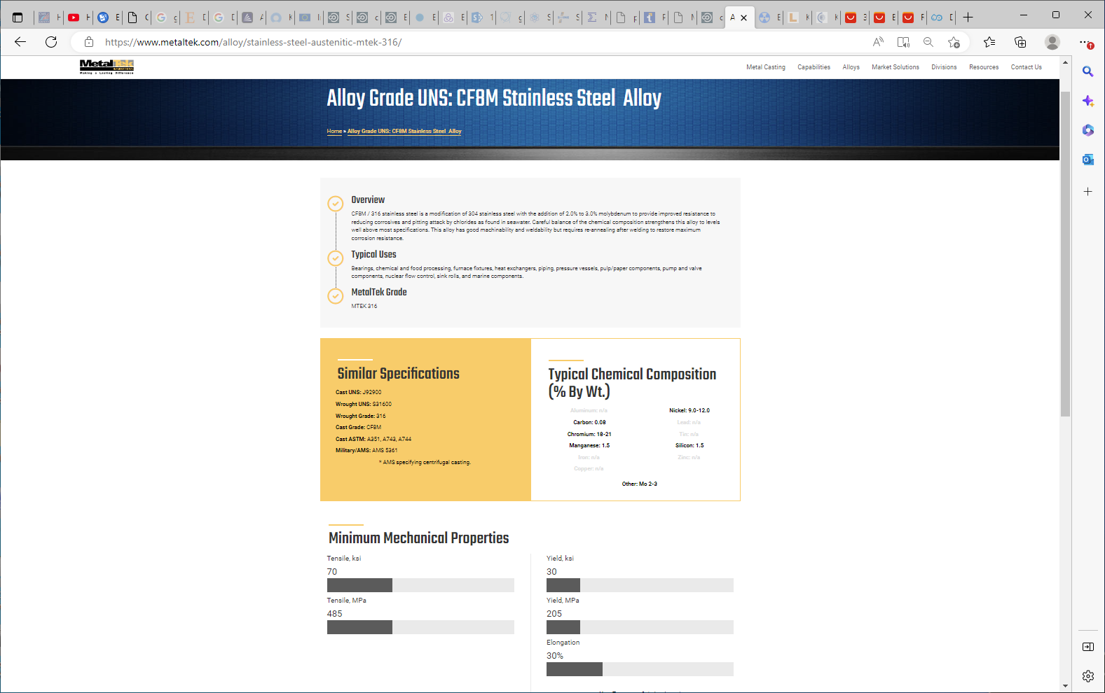
https://www.metaltek.com/alloy/stainless-steel-austenitic-mtek-316/

Slide 22
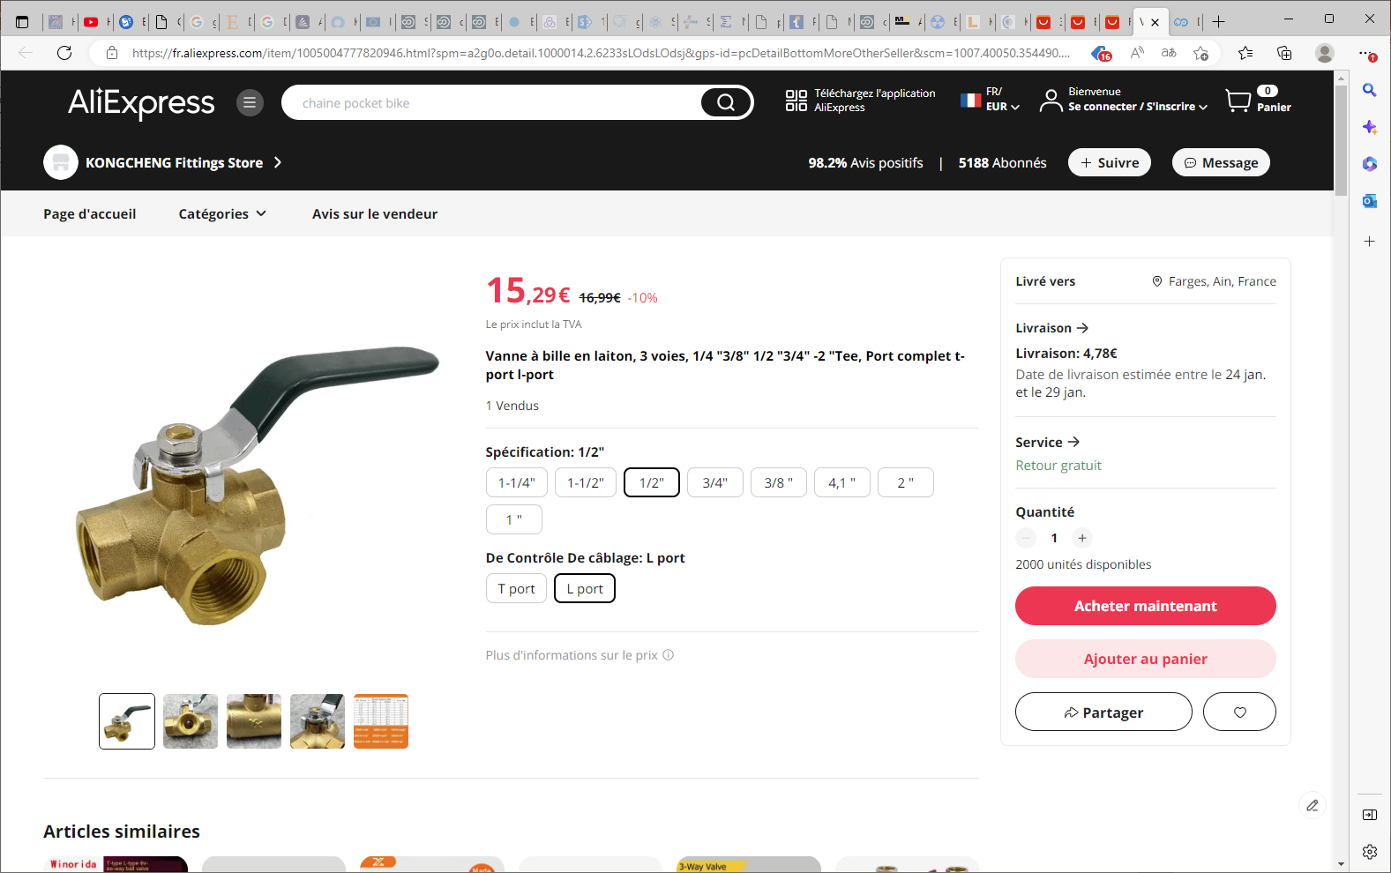
Vanne à bille en laiton, 3 voies, 1/4 "3/8" 1/2 "3/4" -2 "Tee, Port complet t-port l-port - AliExpress

Slide 23
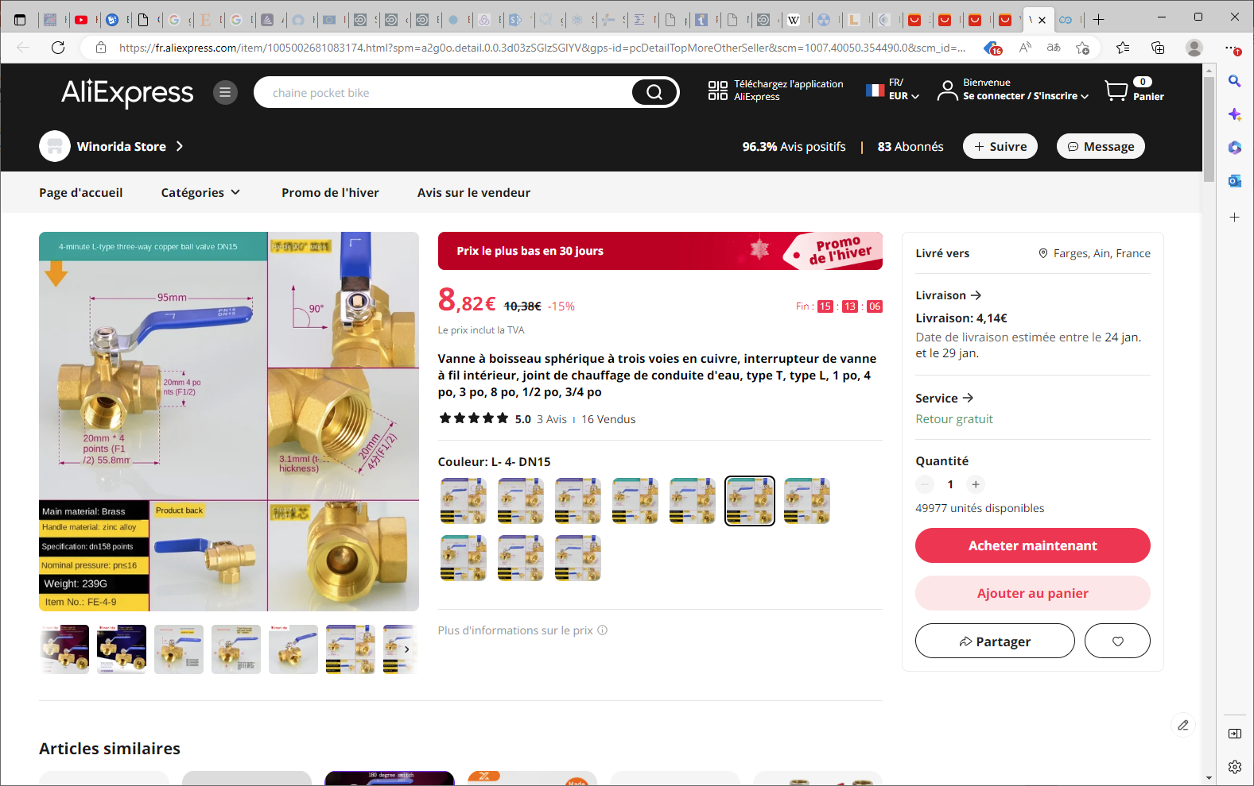
Vanne à boisseau sphérique à trois voies en cuivre, interrupteur de vanne à fil intérieur, joint de chauffage de conduite d'eau, type T, type L, 1 po, 4 po, 3 po, 8 po, 1/2 po, 3/4 po (aliexpress.com)

Slide 24
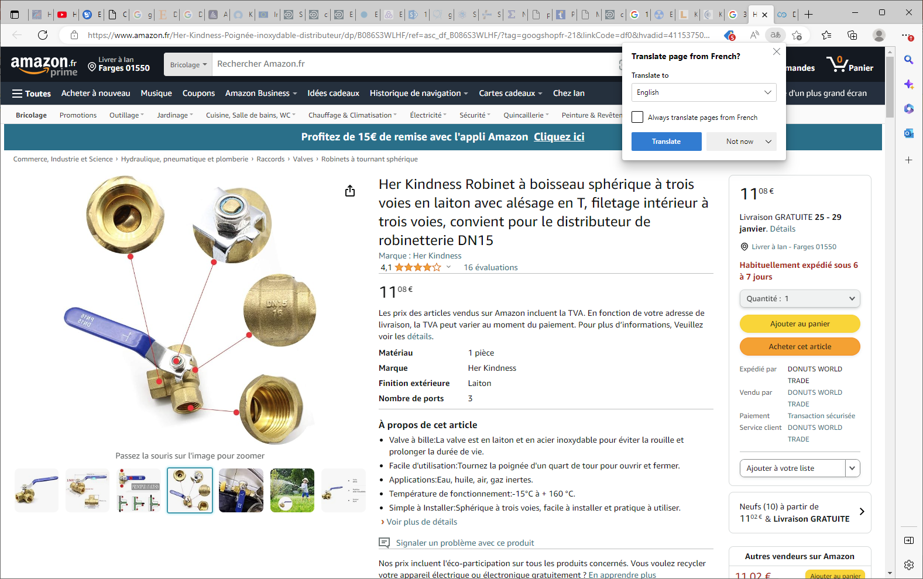

Slide 25
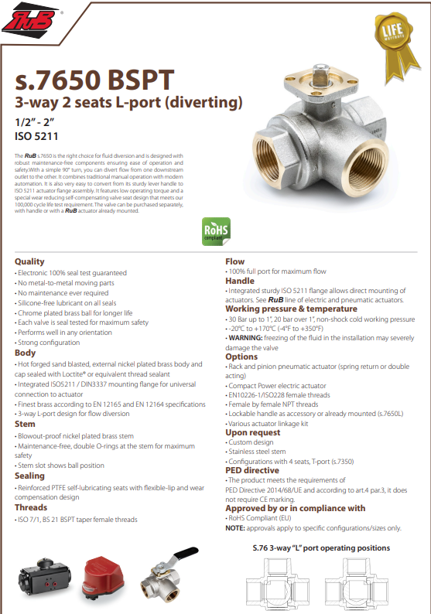
https://www.bonomiindustries.com/ball-valves/ball-valve-s7650-bspt-3-way-2-seats-l-port-diverting
The RuB s.7650 is the right choice for fluid diversion and is designed with robust maintenance-free components ensuring ease of operation and safety.With a simple 90° turn, you can divert flow from one downstream outlet to the other. It combines traditional manual operation with modern automation. It is also very easy to convert from its sturdy lever handle to ISO 5211 actuator flange assembly. It features low operating torque and a special wear reducing self-compensating valve seat design that meets our 100,000 cycle life test requirement. The valve can be purchased separately, with handle or with a RuB actuator already mounted

Slide 26
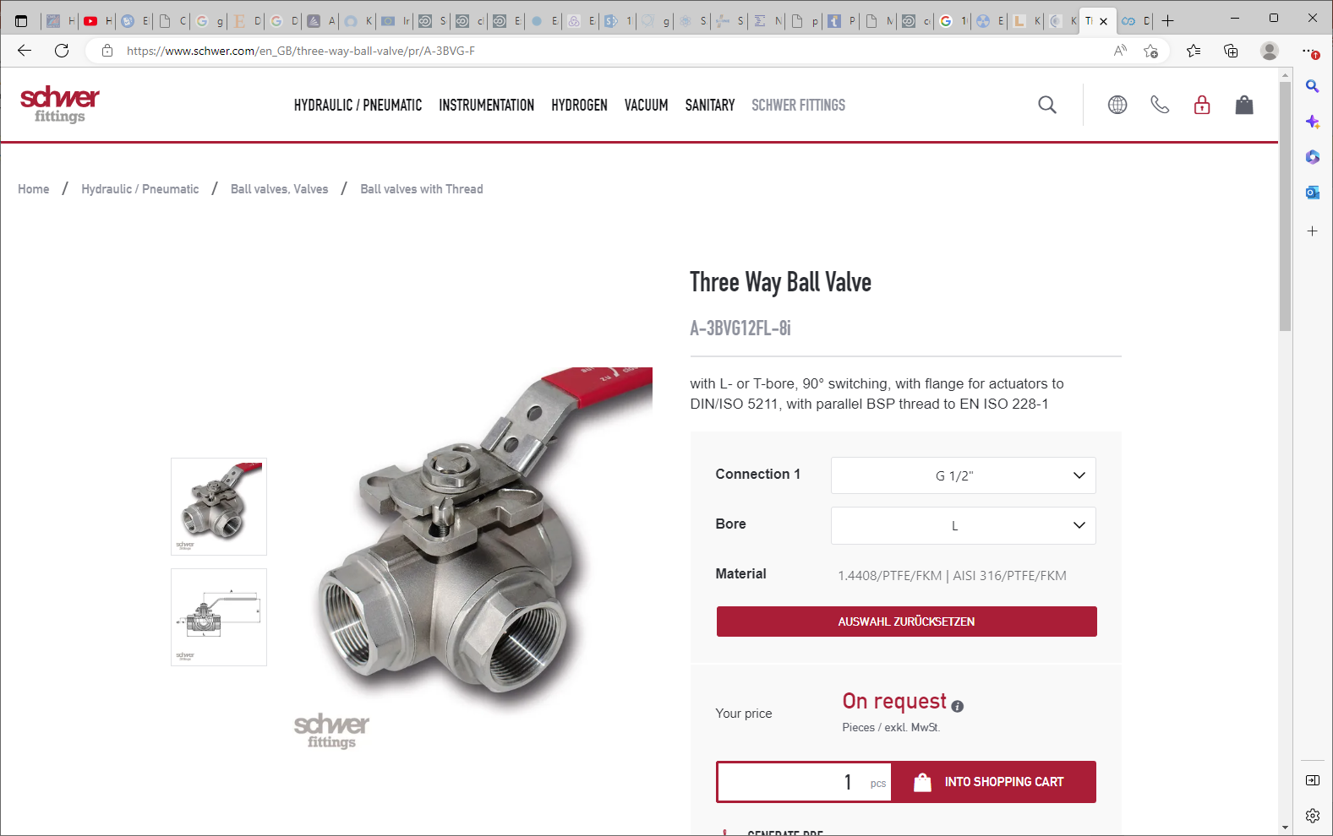
https://www.schwer.com/en_GB/three-way-ball-valve/pr/A-3BVG-F

Slide 27
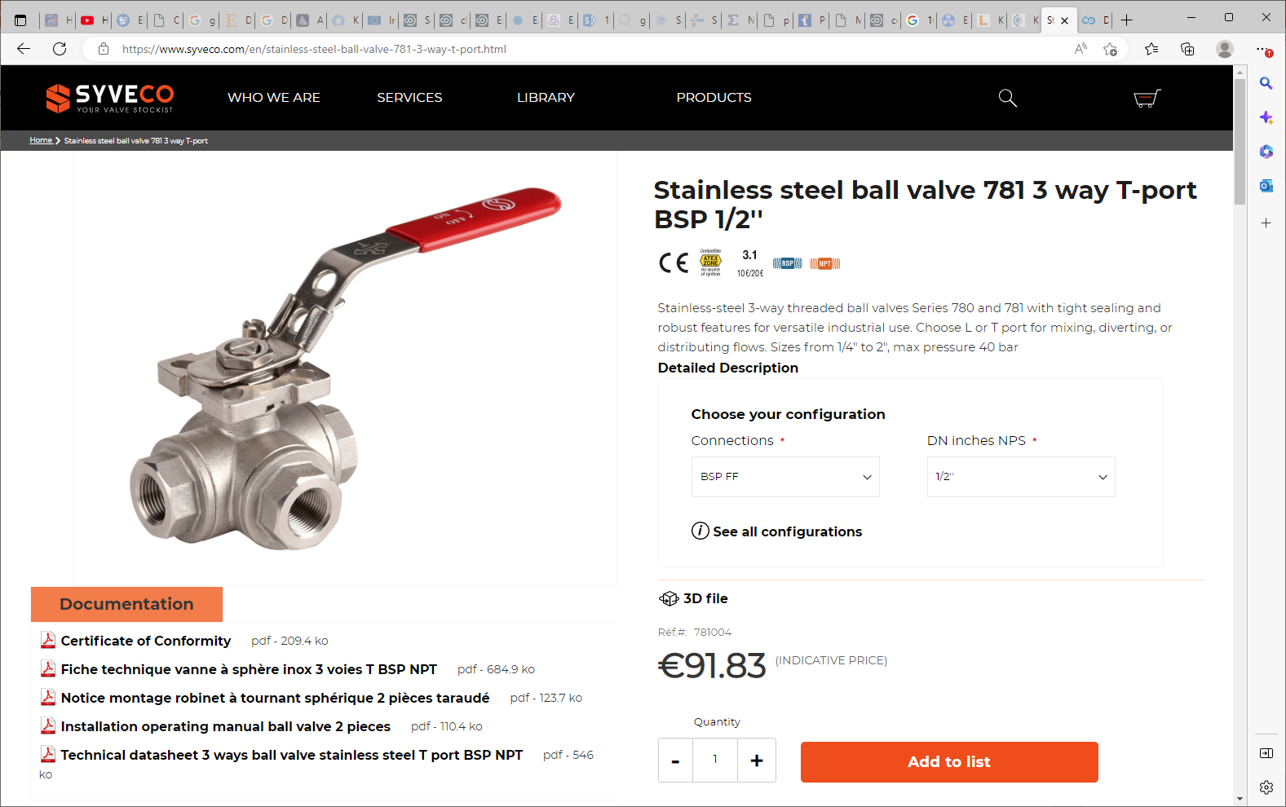
https://www.syveco.com/en/stainless-steel-ball-valve-781-3-way-t-port.html

Slide 28
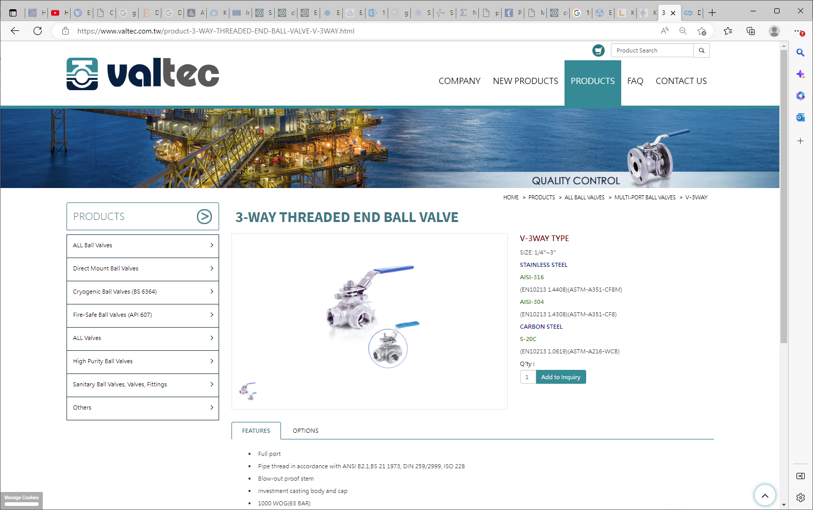
https://www.valtec.com.tw/product-3-WAY-THREADED-END-BALL-VALVE-V-3WAY.html

Slide 29
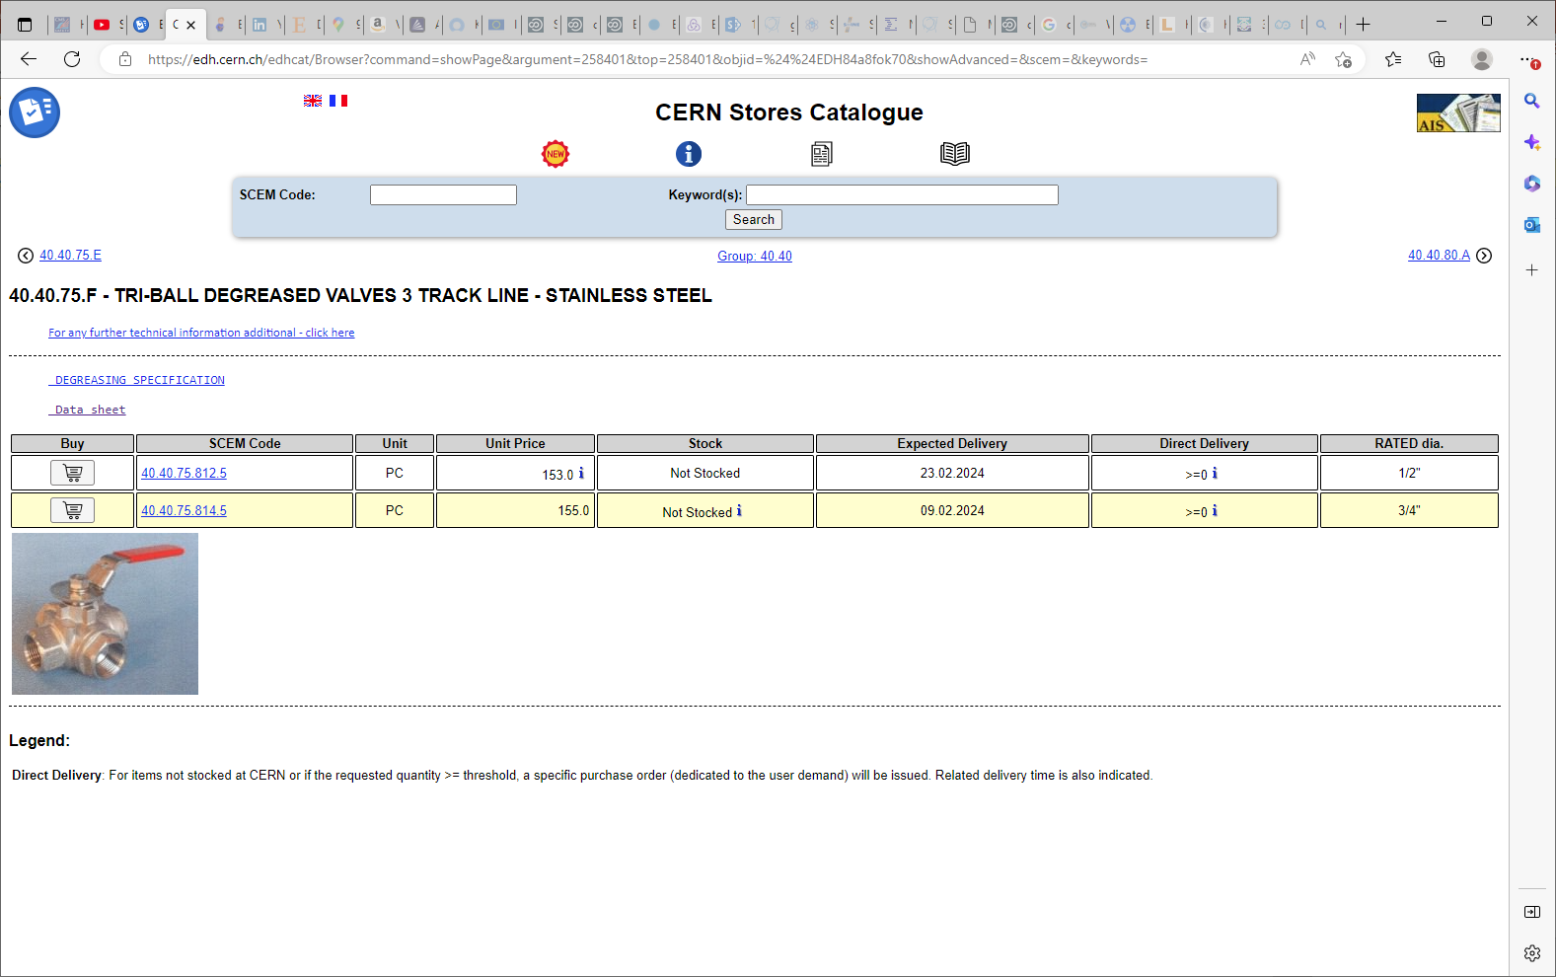

Slide 30
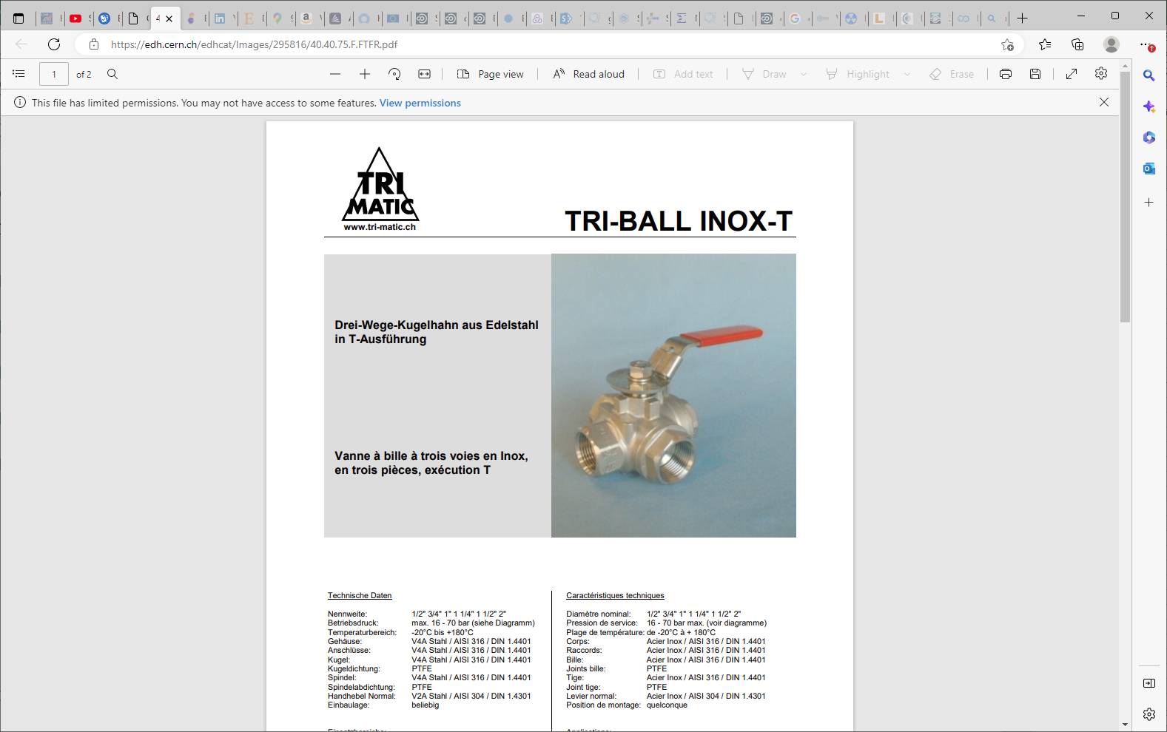
https://edh.cern.ch/edhcat/Images/295816/40.40.75.F.FTFR.pdf

Slide 31
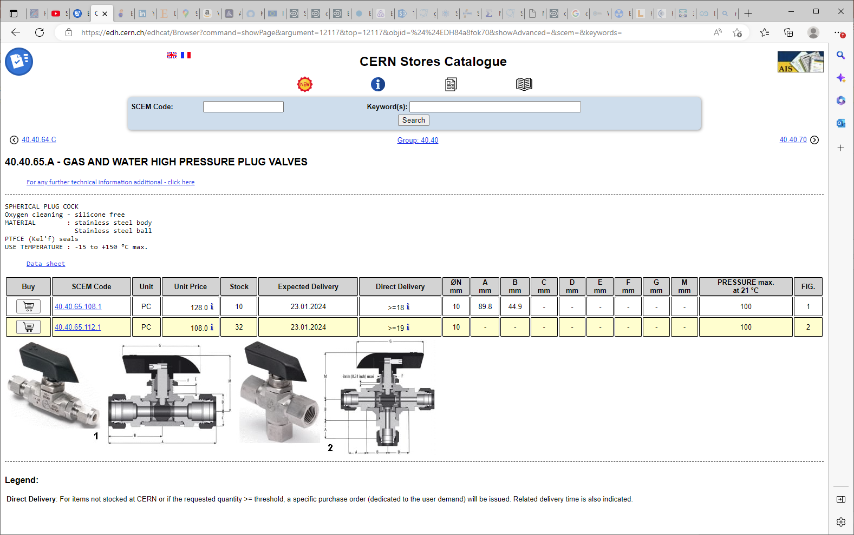
Sagana But is it “L” or “T” ?

Slide 32
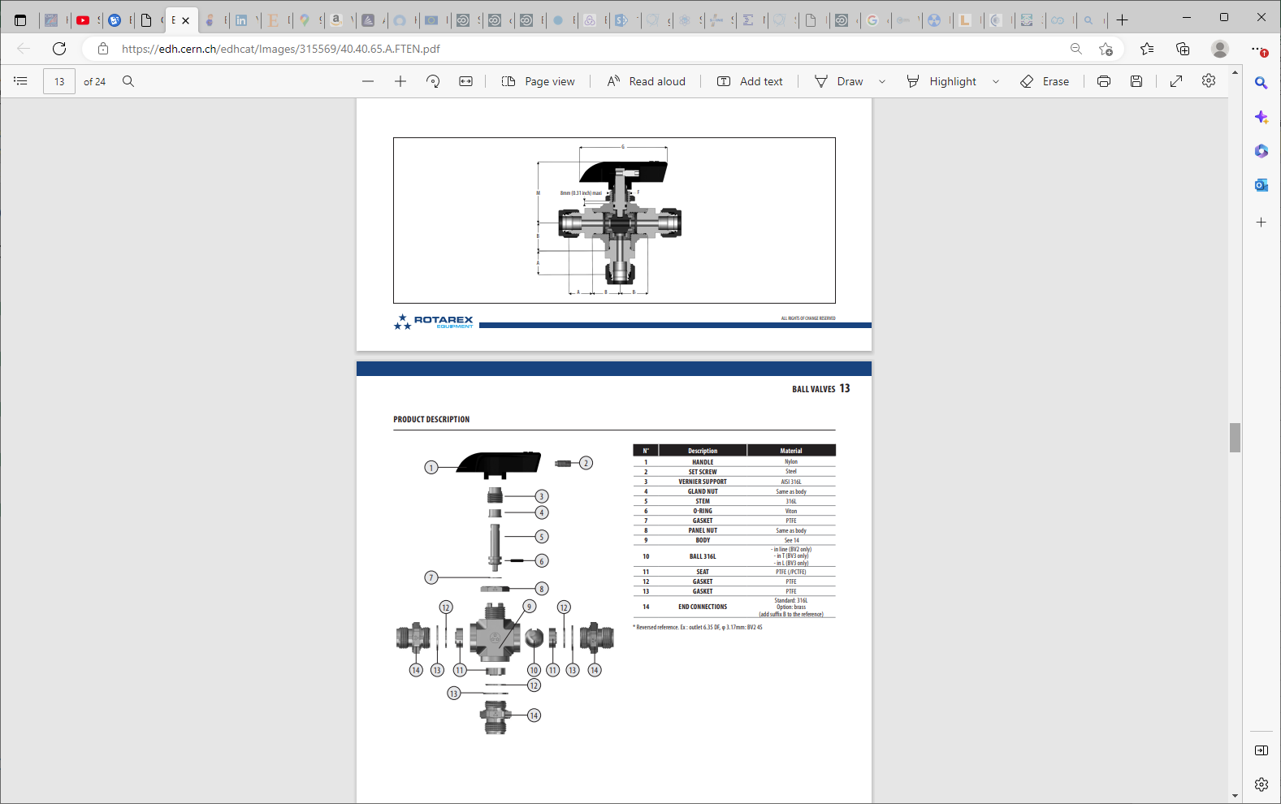

Slide 33
Conclusion
Aliexpress seems more expensive (7-18Euro) than last year , twice ?
Amazon (30-38Euro) is approx. twice the Aliexpress price.
European prices are from 100-300chf for similar item.
Delivery times from some European suppliers are similar to Aliexpress. Does this mean they have the same origine ?
Lets try Aliexpress for minimum 2-3 pieces.

