Slide 1
Cooling for iRPC Electronics
Ian
28 Aug 2023

Slide 4
Mehar will order these pieces
Email sent 29 Aug 2023 @ 1851hrs
Problem with the ss ones as you can only ask one at a time !! Can he solve this ?

Slide 5
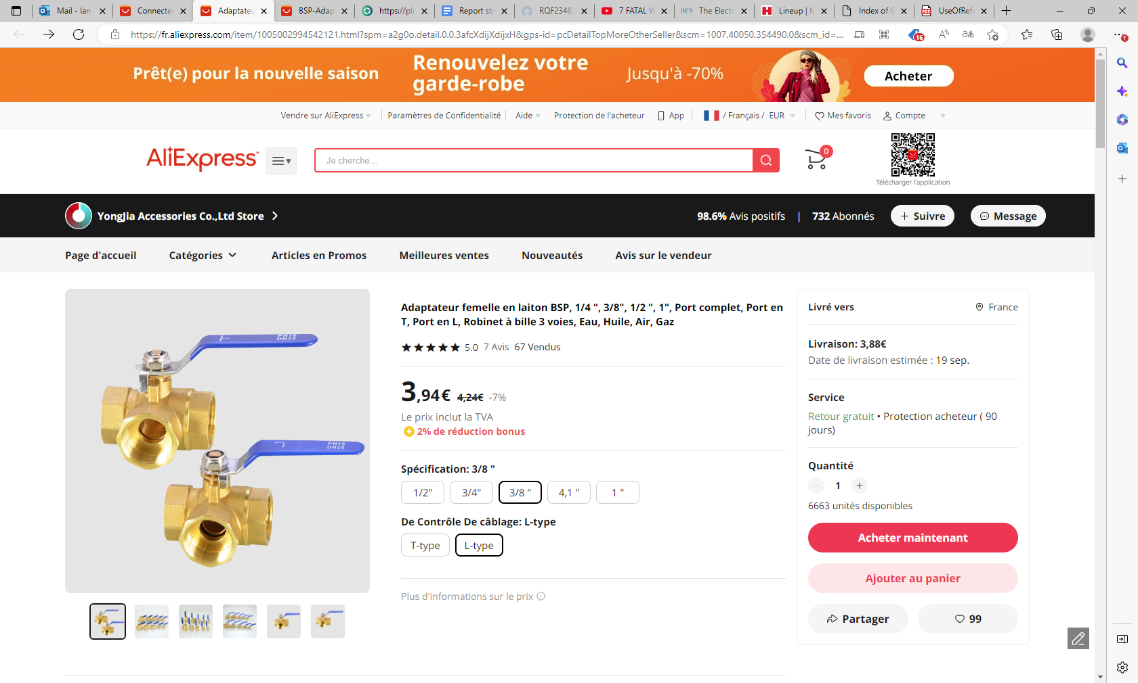
https://fr.aliexpress.com/item/1005004159976049.html?spm=a2g0o.cart.0.0.7007378dtwcZbG&gps-id=shoppingCartRecommend&scm=1007.13440.311564.0&scm_id=1007.13440.311564.0&scm-url=1007.13440.311564.0&pvid=daff6c3c-779e-4b04-9636-30ff911a1882&_t=gps-id:shoppingCartRecommend,scm-url:1007.13440.311564.0,pvid:daff6c3c-779e-4b04-9636-30ff911a1882,tpp_buckets:668%232846%238111%231996&pdp_npi=4%40dis%21EUR%213.42%213.25%21%21%213.62%21%21%40210318e816933264222027899e5629%2112000028233201753%21rec%21FR%21%21A

Slide 6
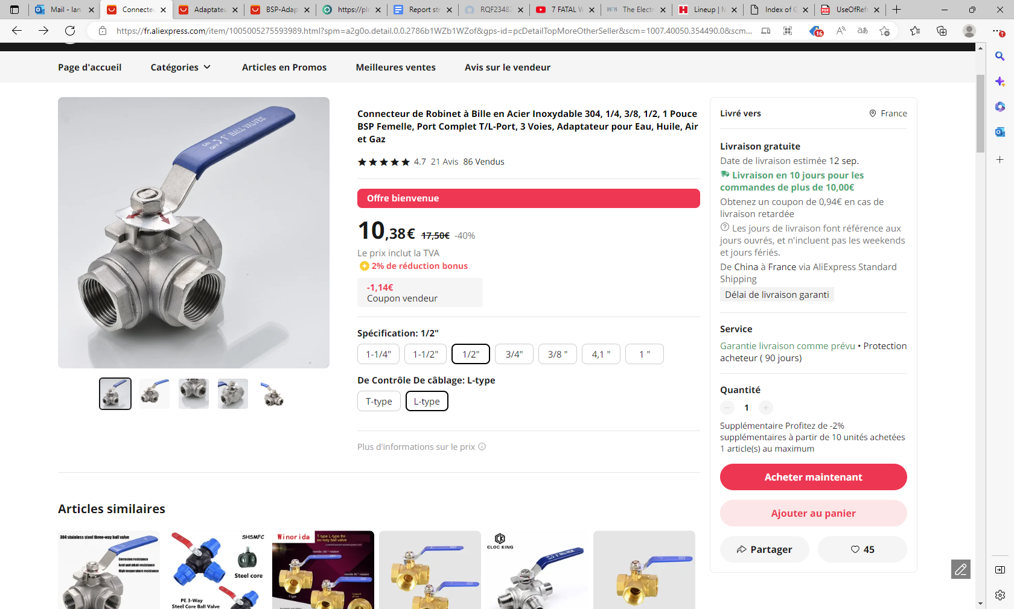
https://fr.aliexpress.com/item/1005005275593989.html?spm=a2g0o.detail.0.0.2786b1WZb1WZof&gps-id=pcDetailTopMoreOtherSeller&scm=1007.40050.354490.0&scm_id=1007.40050.354490.0&scm-url=1007.40050.354490.0&pvid=d2249927-0b40-40fa-8e93-1c07912419ce&_t=gps-id:pcDetailTopMoreOtherSeller,scm-url:1007.40050.354490.0,pvid:d2249927-0b40-40fa-8e93-1c07912419ce,tpp_buckets:668%232846%238111%231996&pdp_npi=4%40dis%21EUR%2115.59%218.75%21%21%21120.30%21%21%40210318e816933265459688913e5629%2112000032451146813%21rec%21FR%21%21A

