Slide 1
GIF Cooling manifold
Ian
25 March 2025

Slide 2
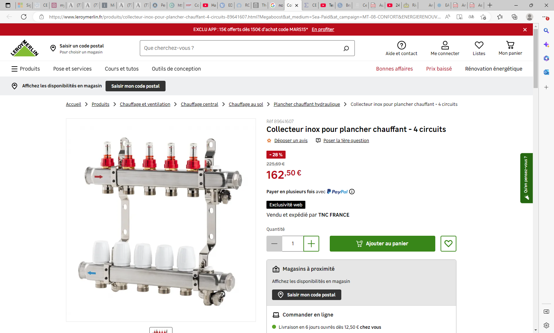

Slide 3
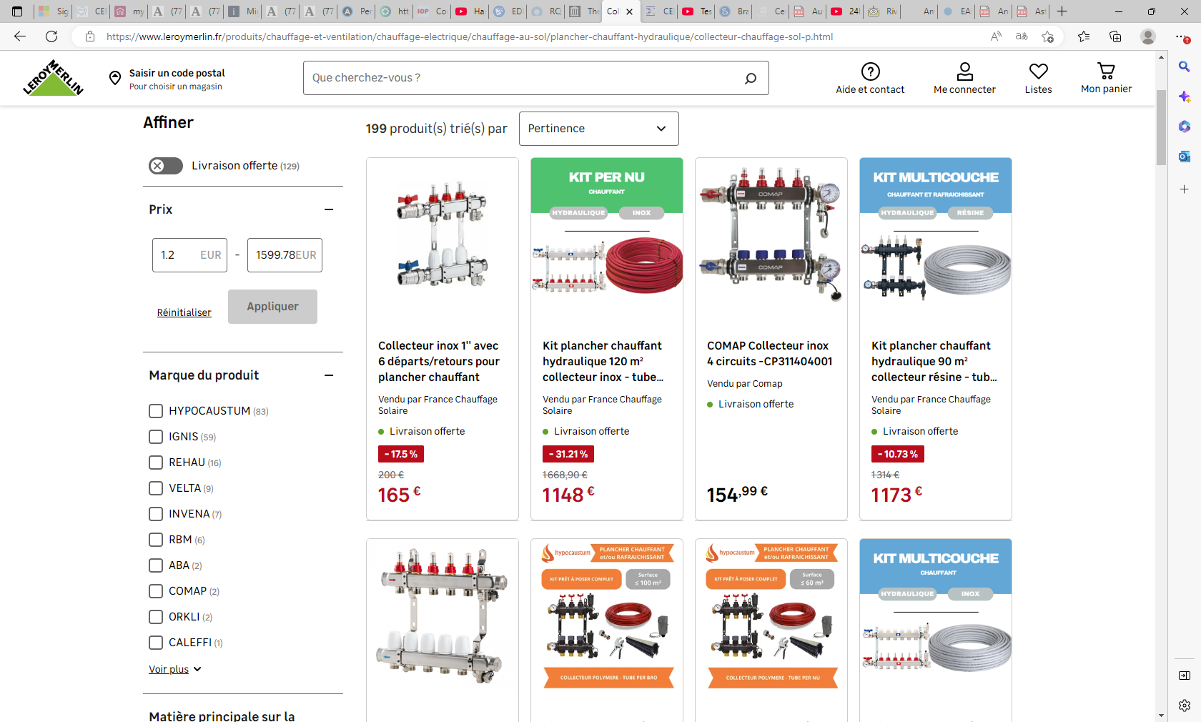

Slide 4
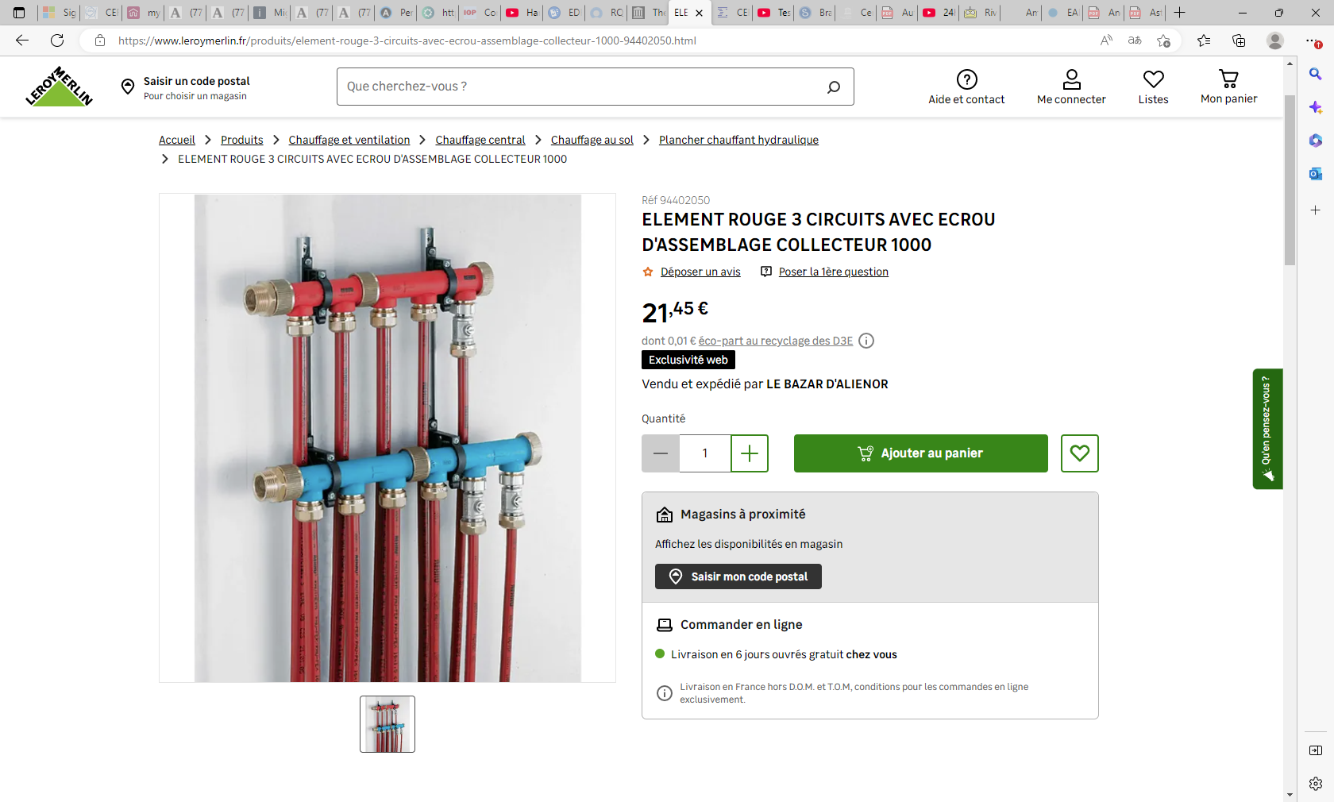

Slide 5
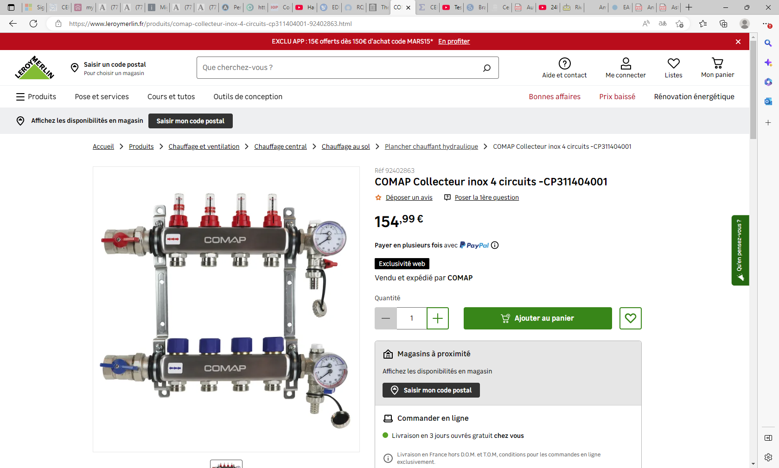

Slide 6
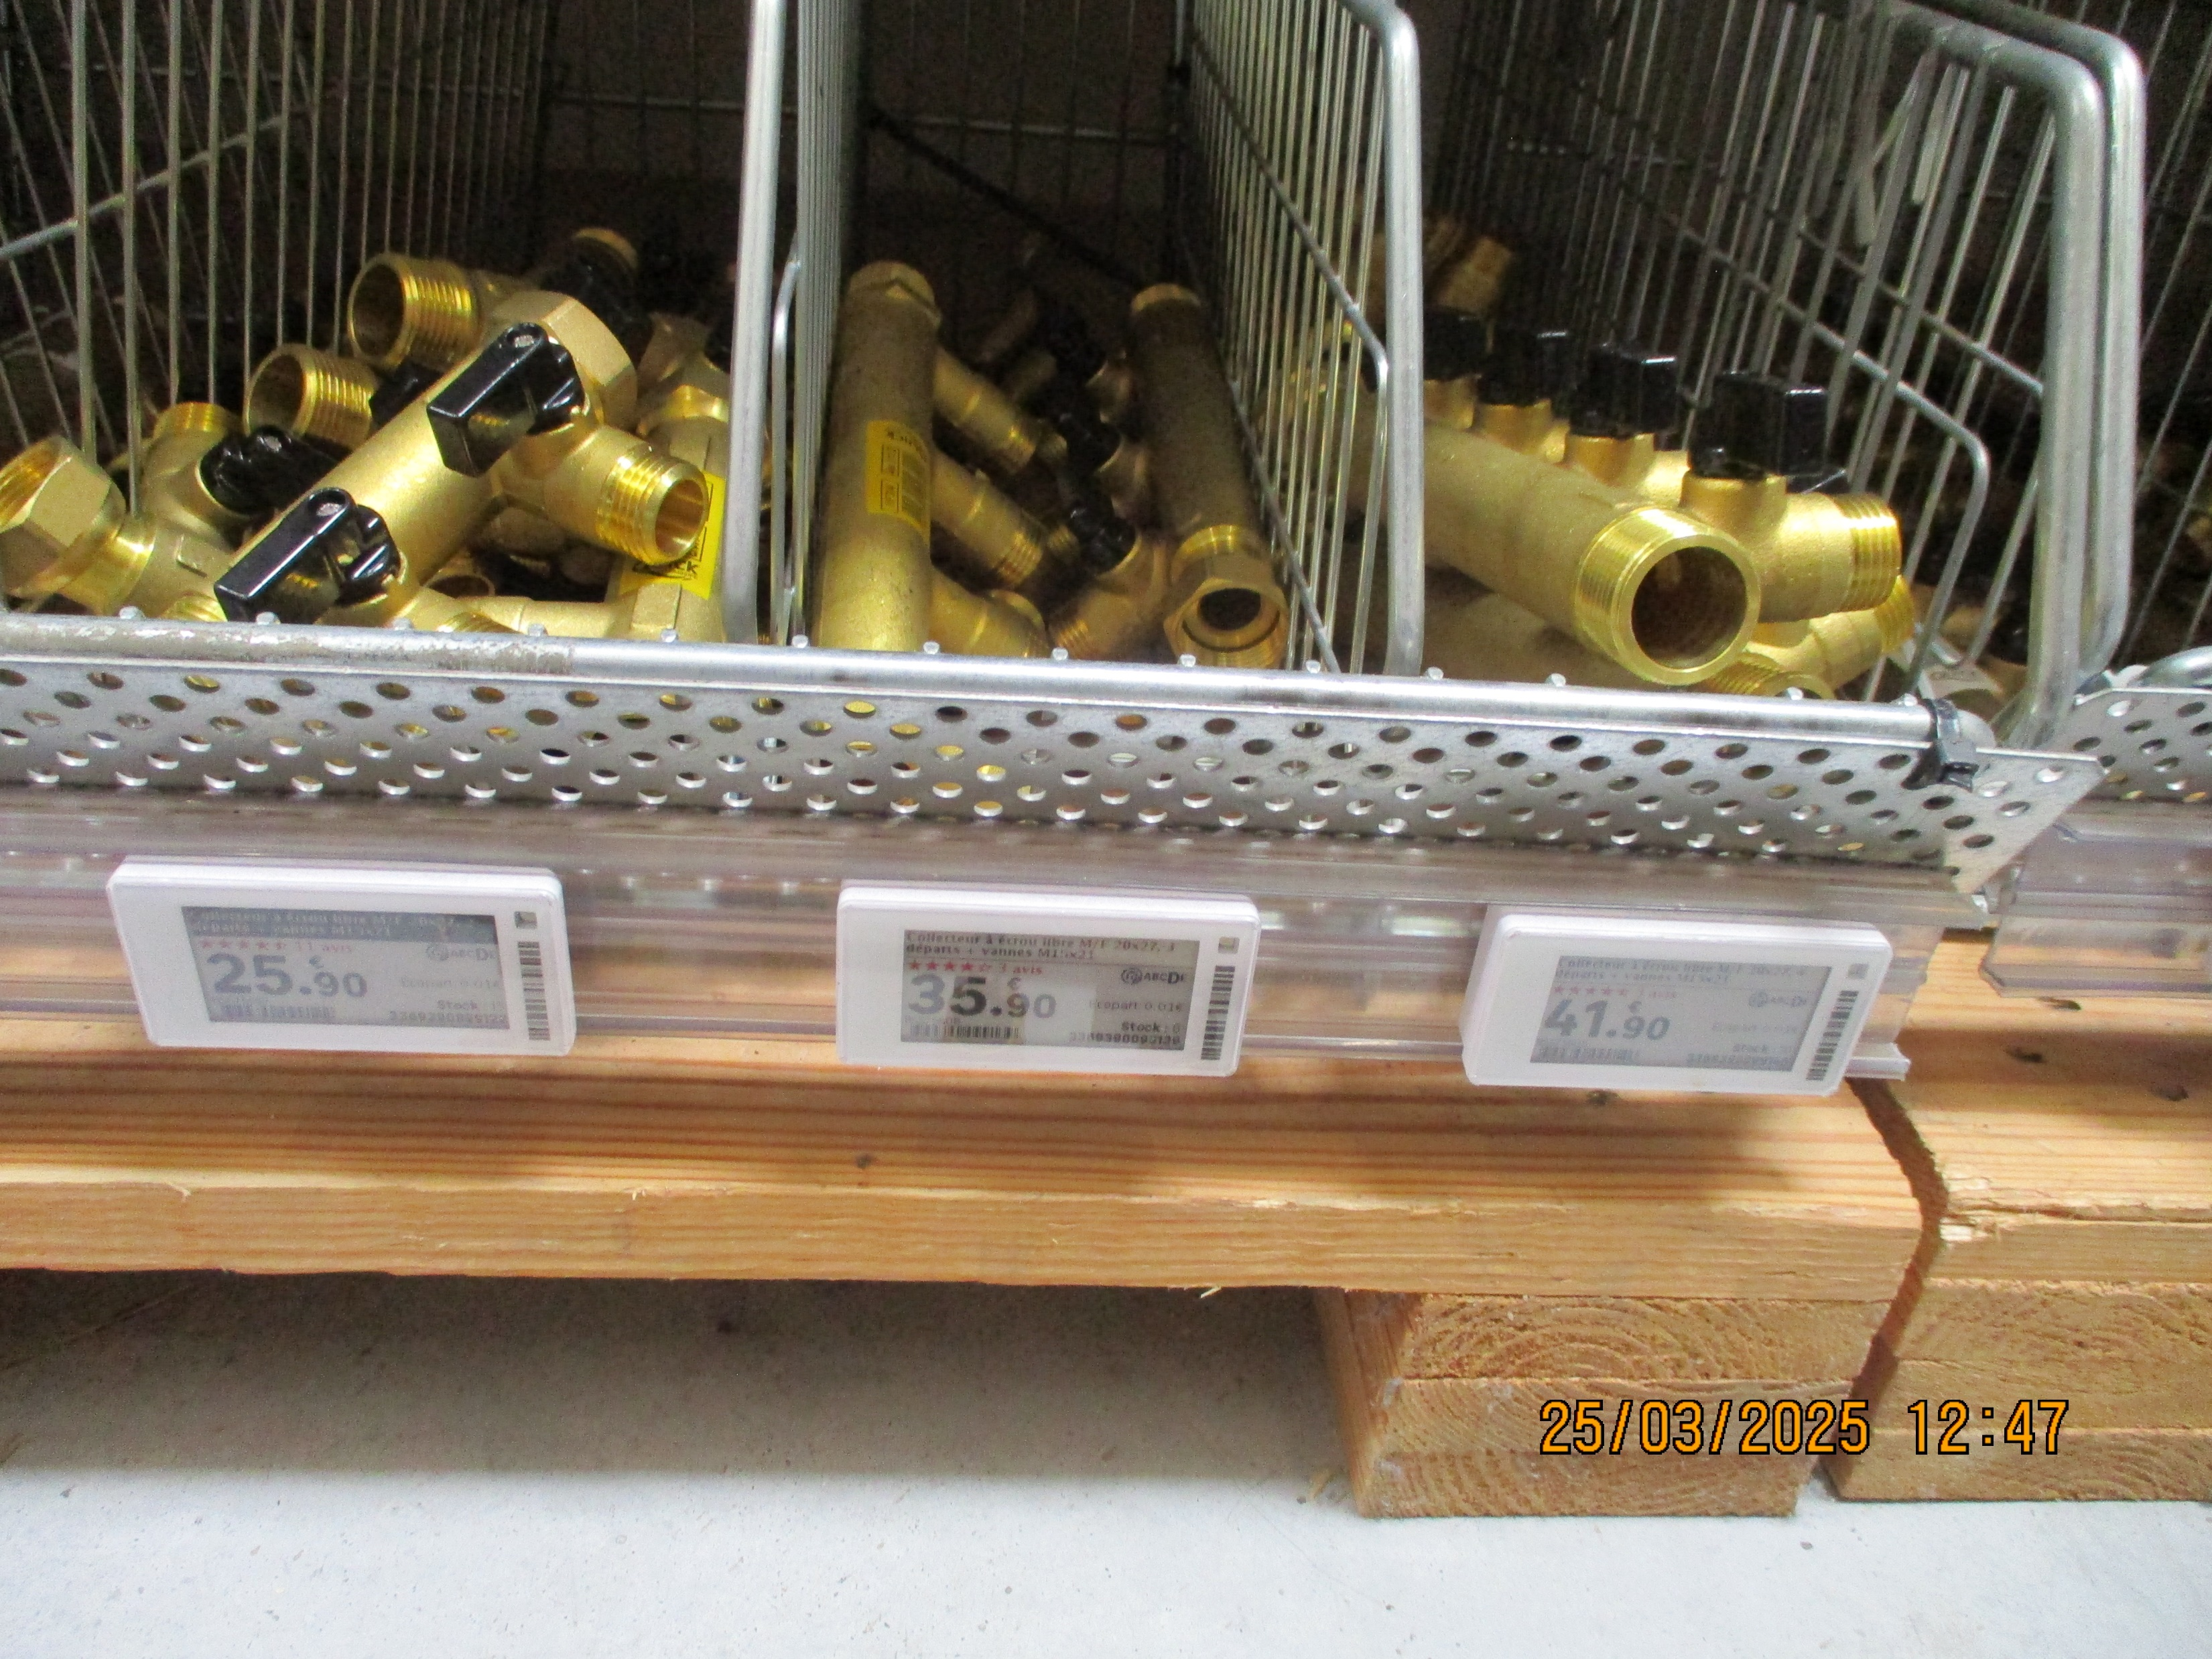
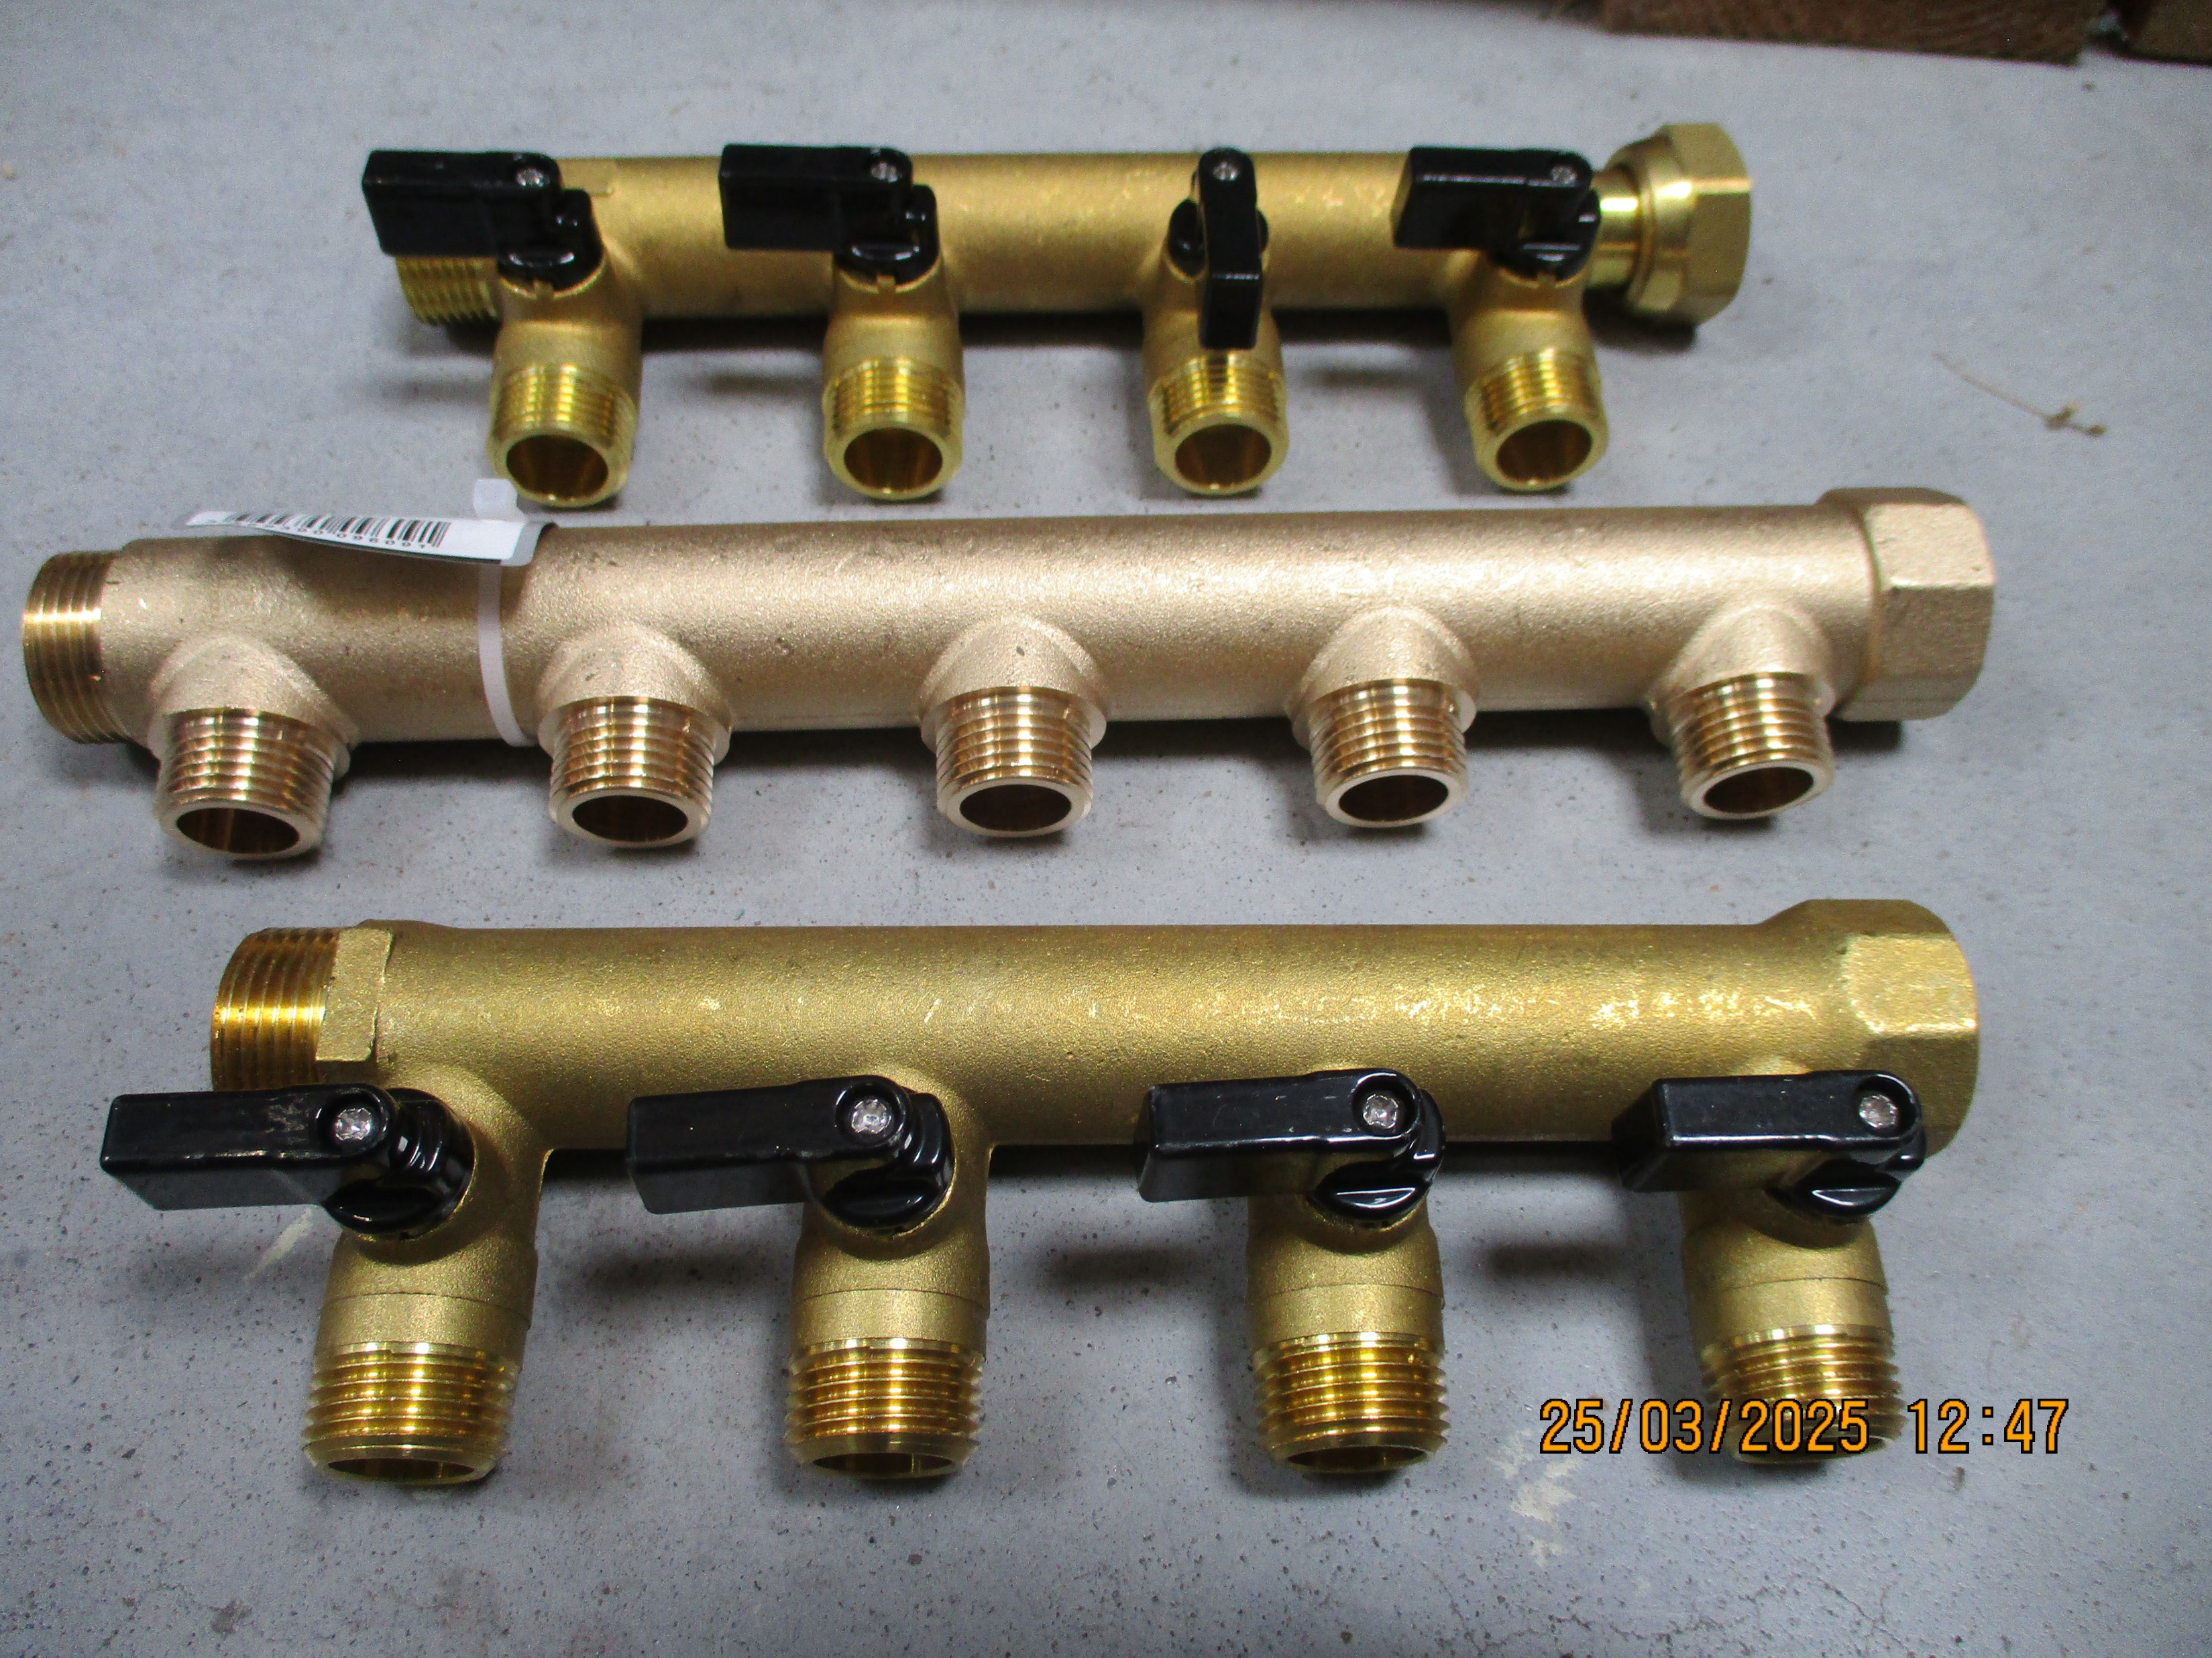
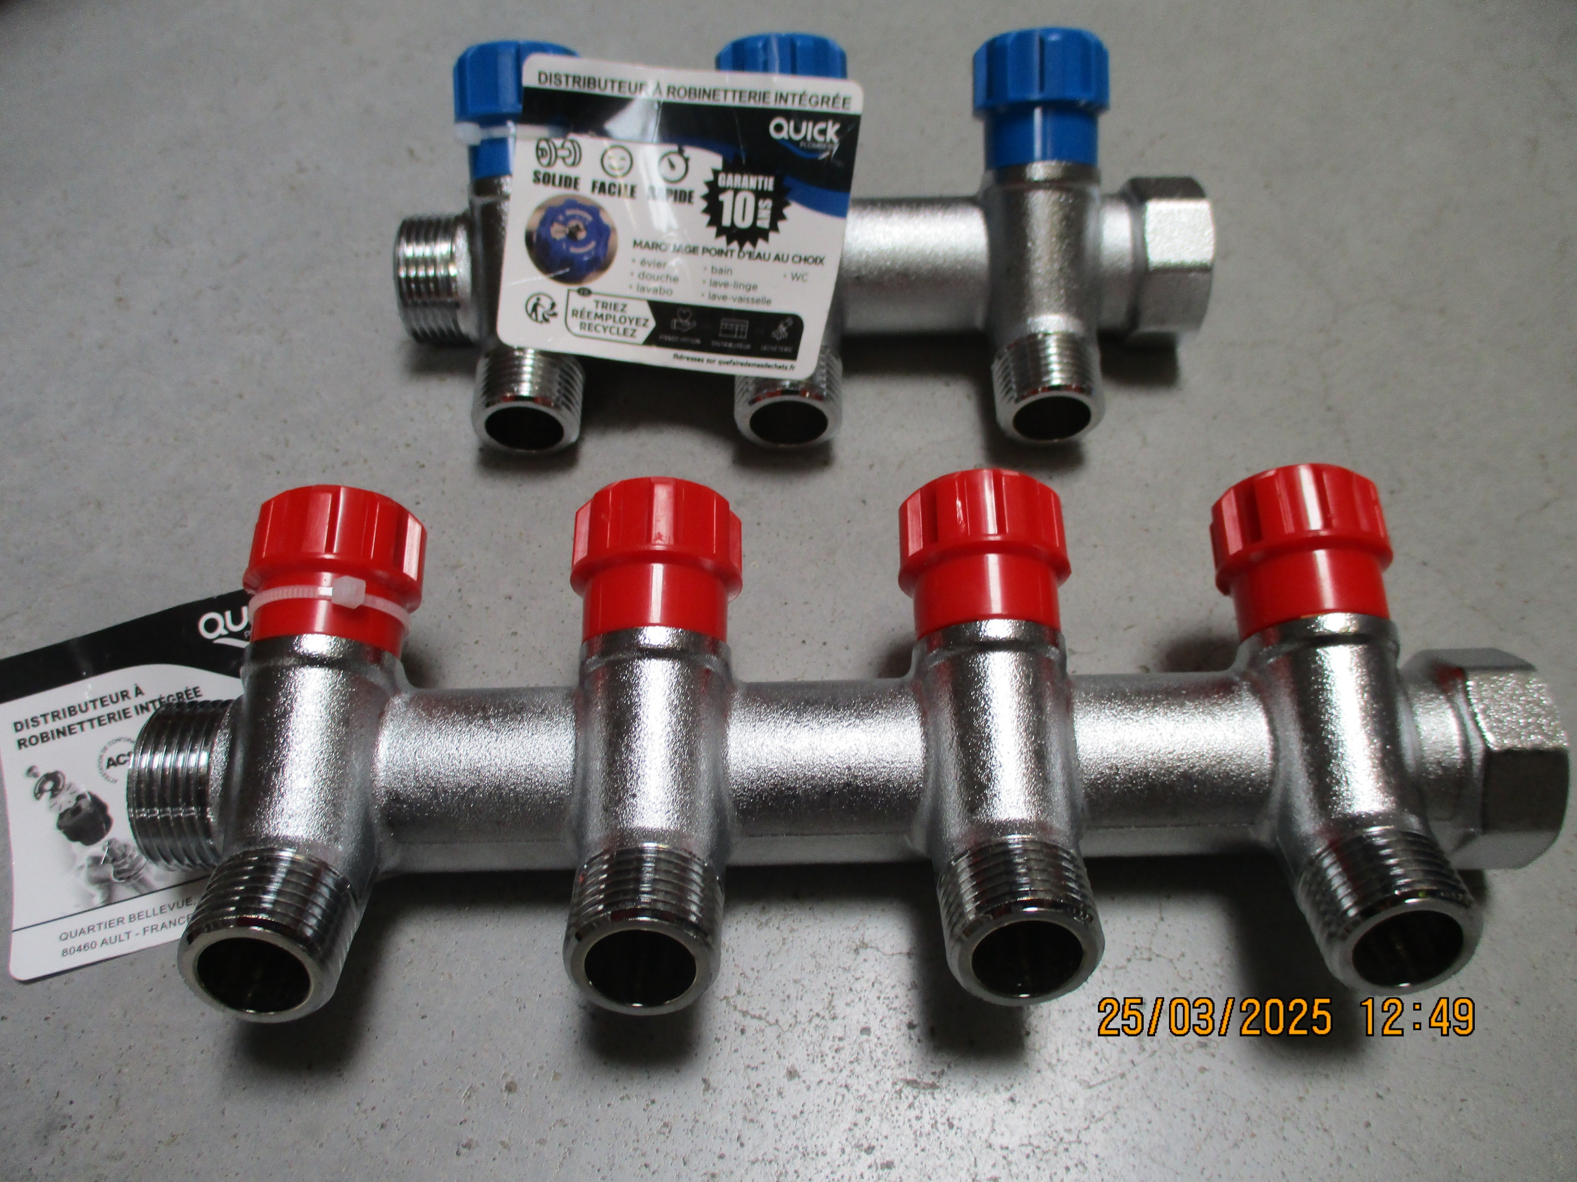
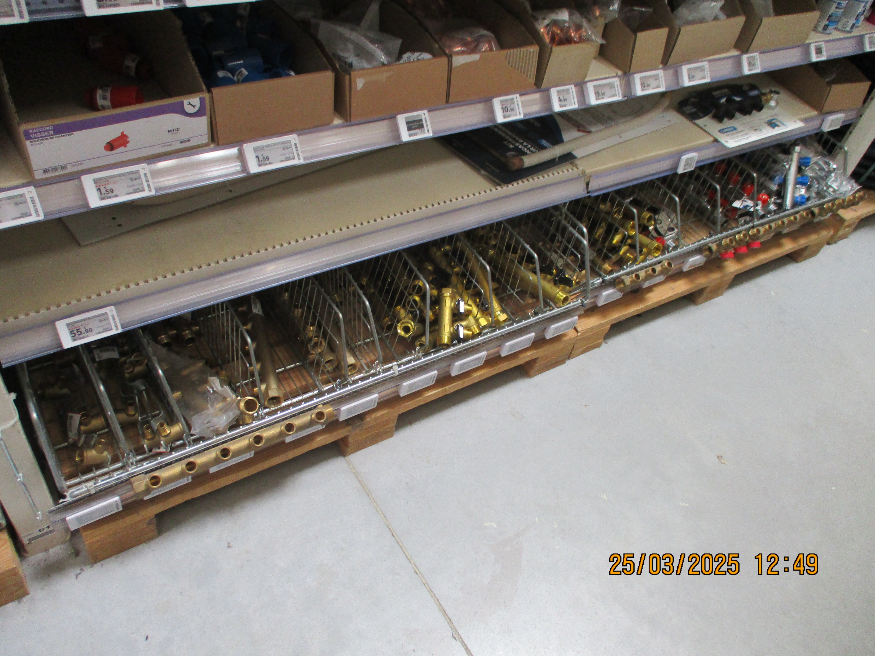

Slide 13
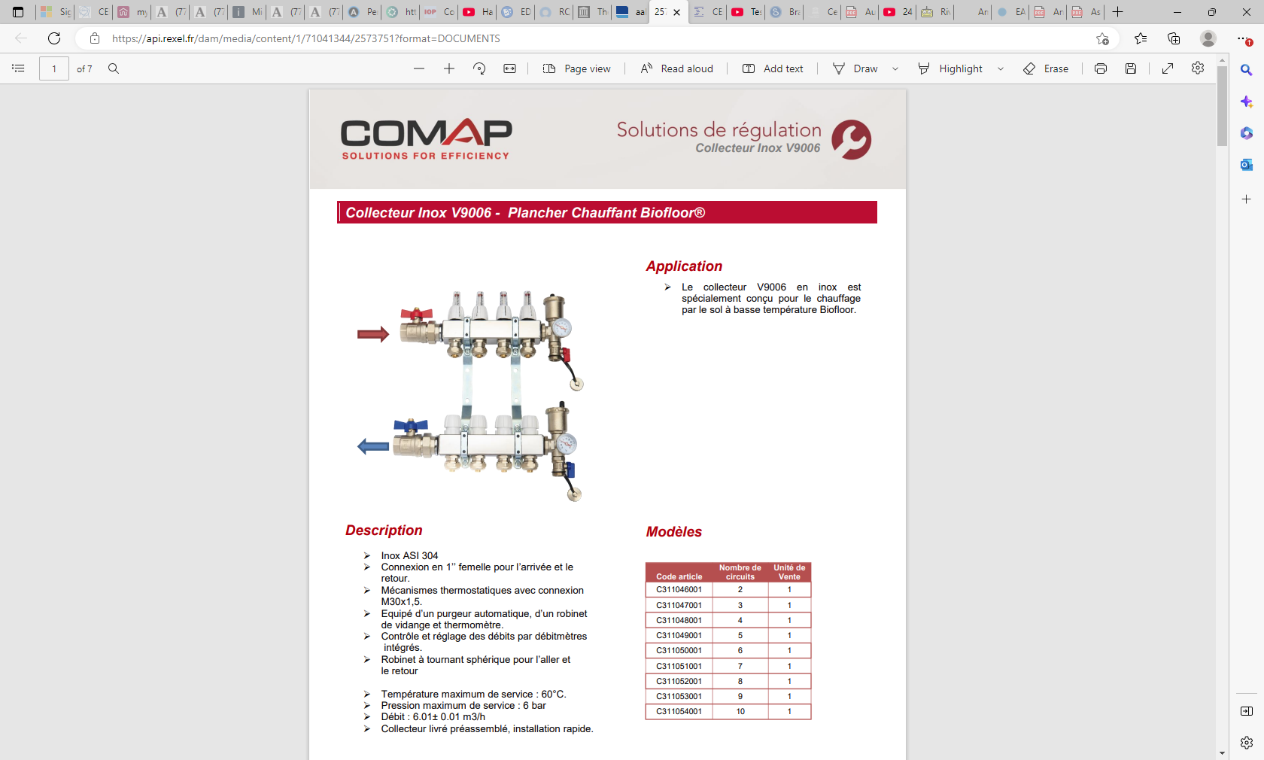
https://api.rexel.fr/dam/media/content/1/71041344/2573751?format=DOCUMENTS

Slide 14
References

Slide 15
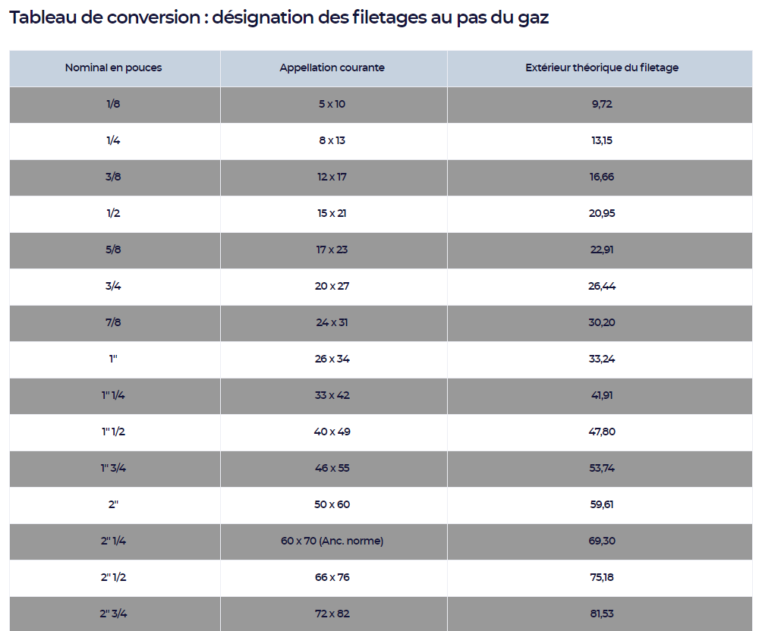
https://www.cedeo.fr/tableau-conversion-plomberie-chauffage

Slide 17
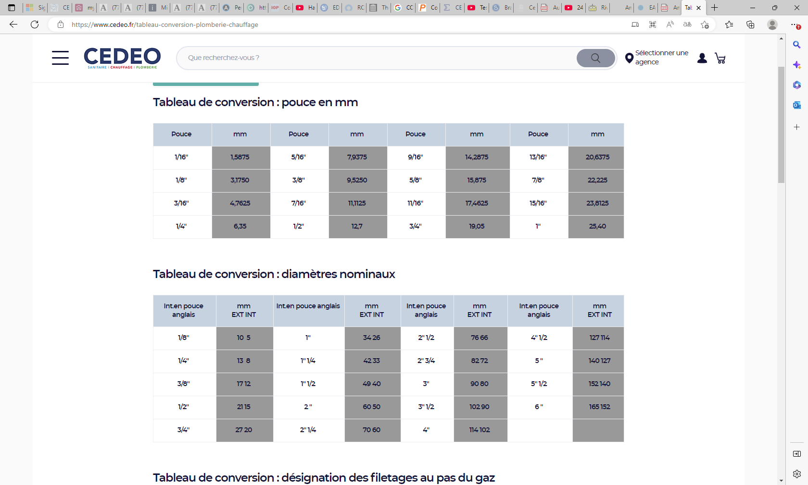

Slide 18
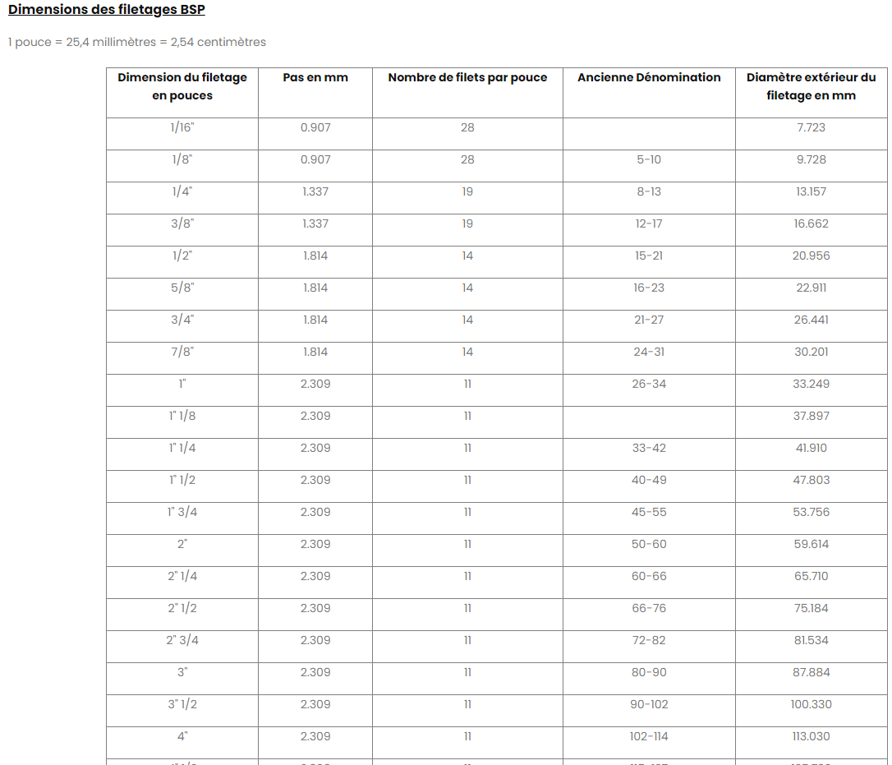
https://www.netraccord.fr/content/21-dimensions-des-filetages-d-un-raccord

Slide 19
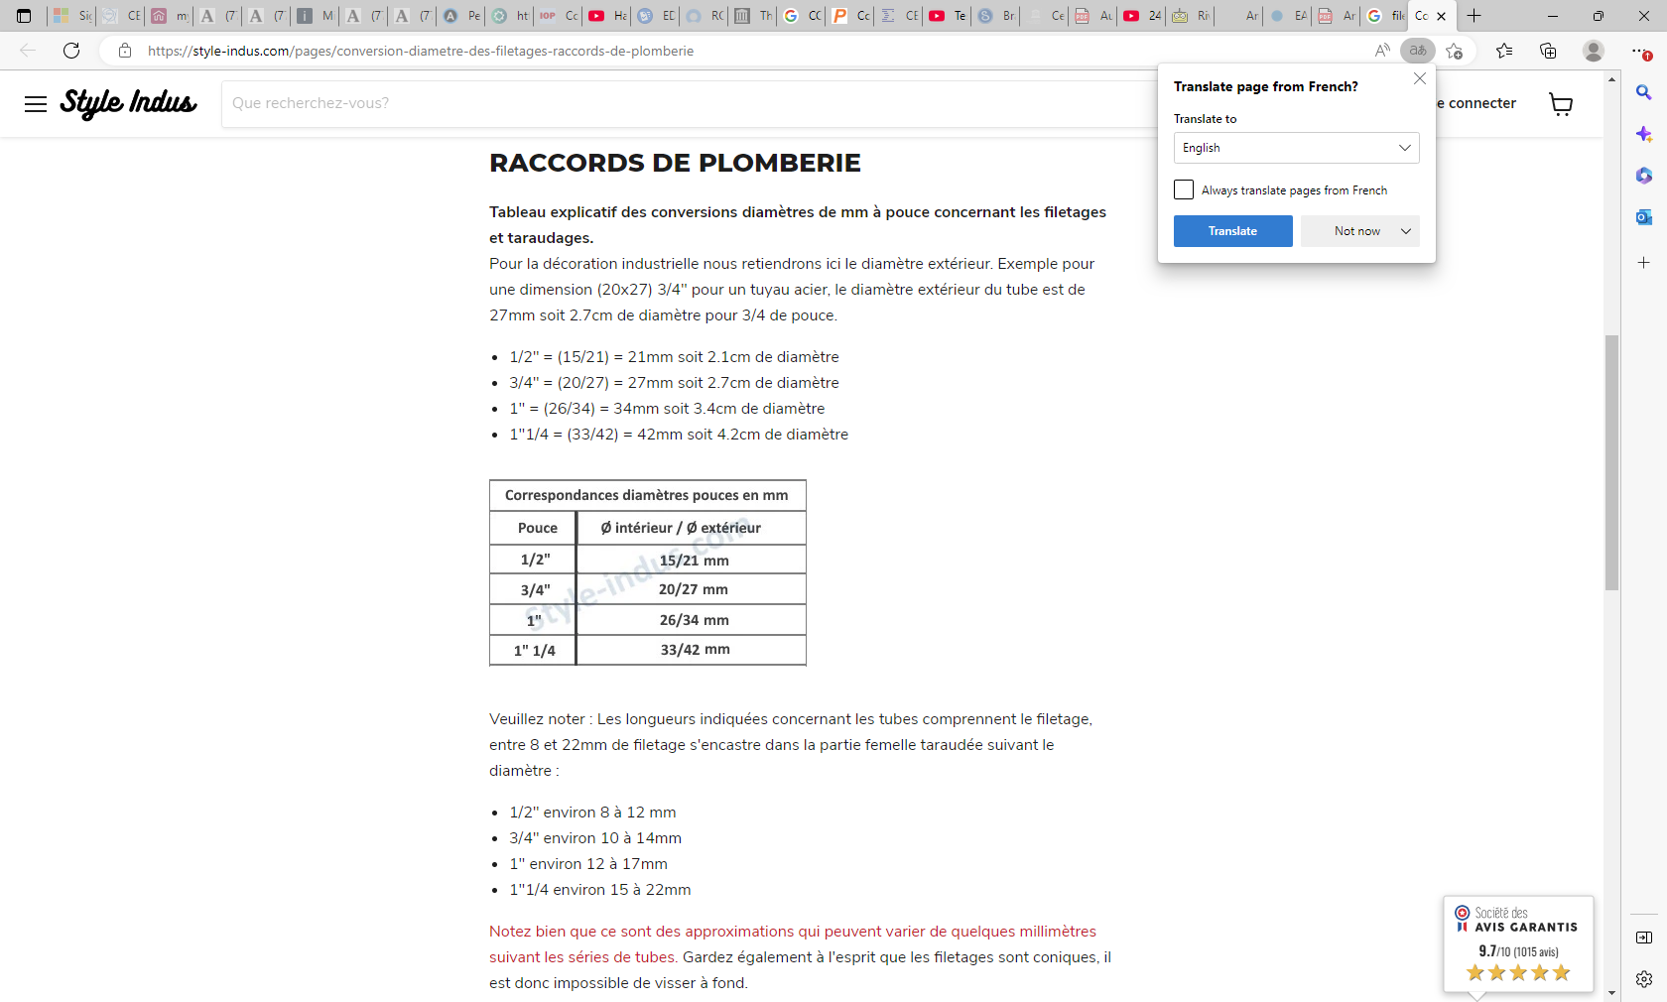
https://style-indus.com/pages/conversion-diametre-des-filetages-raccords-de-plomberie

Slide 20
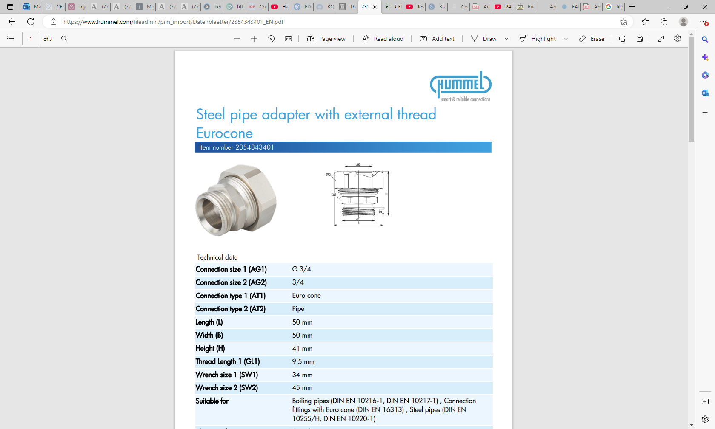
https://www.hummel.com/fileadmin/pim_import/Datenblaetter/2354343401_EN.pdf

Slide 21
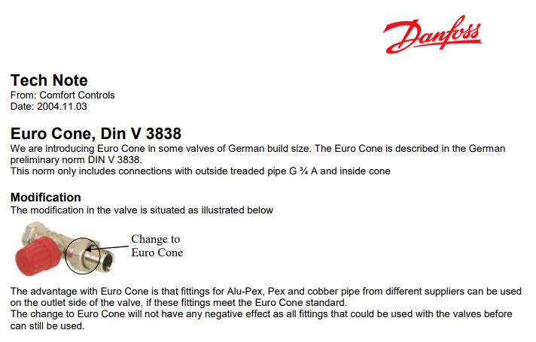
Euro Cone, Din V 3838
We are introducing Euro Cone in some valves of German build size. The Euro Cone is described in the German
preliminary norm DIN V 3838.
This norm only includes connections with outside treaded pipe G ¾ A and inside cone

