Slide 1
GIF Cooling manifold
Ian
25 March 2025

Slide 2
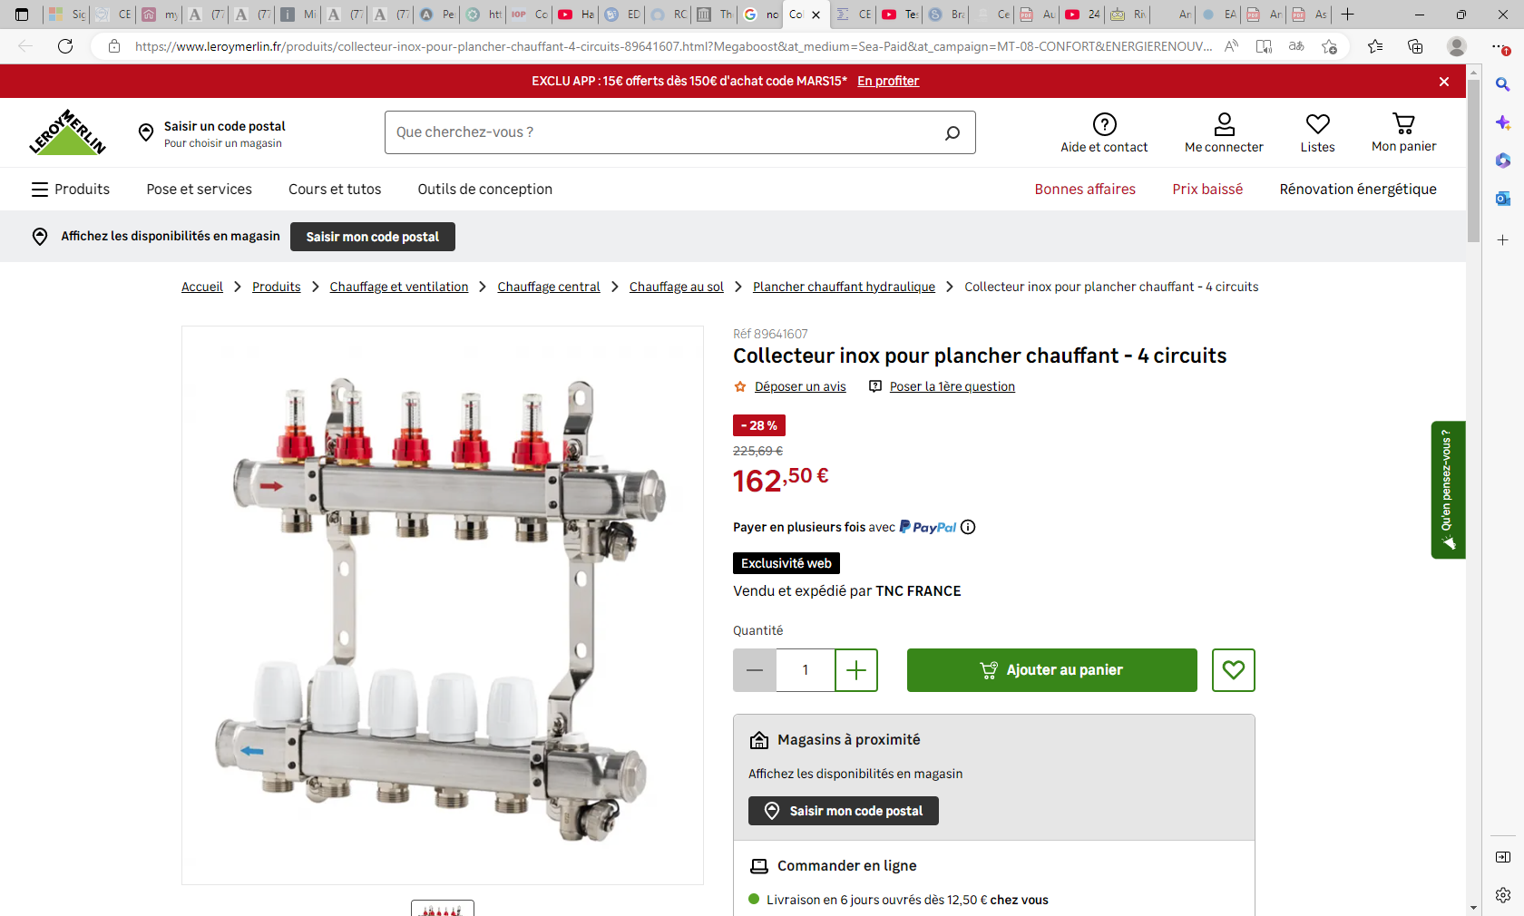

Slide 3
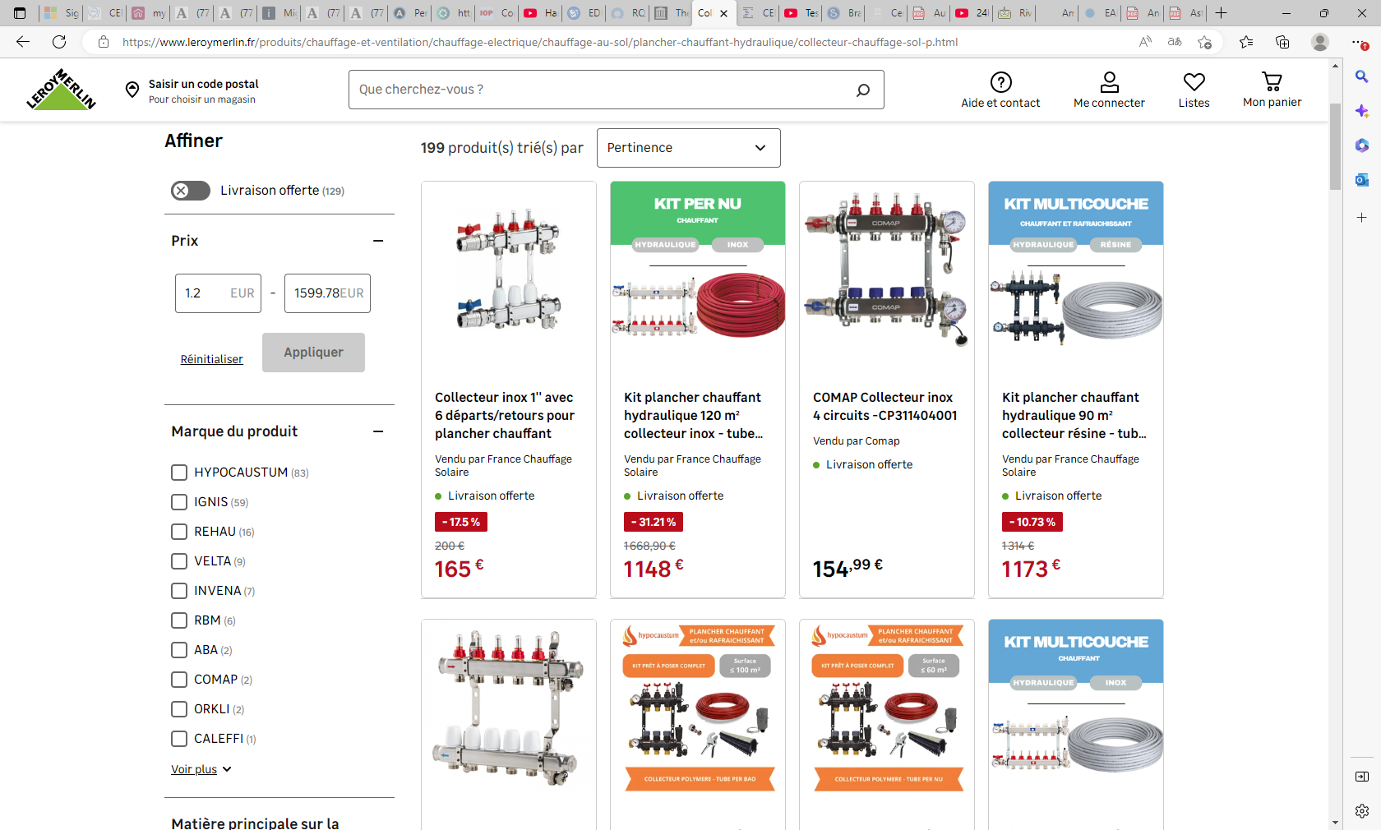

Slide 4
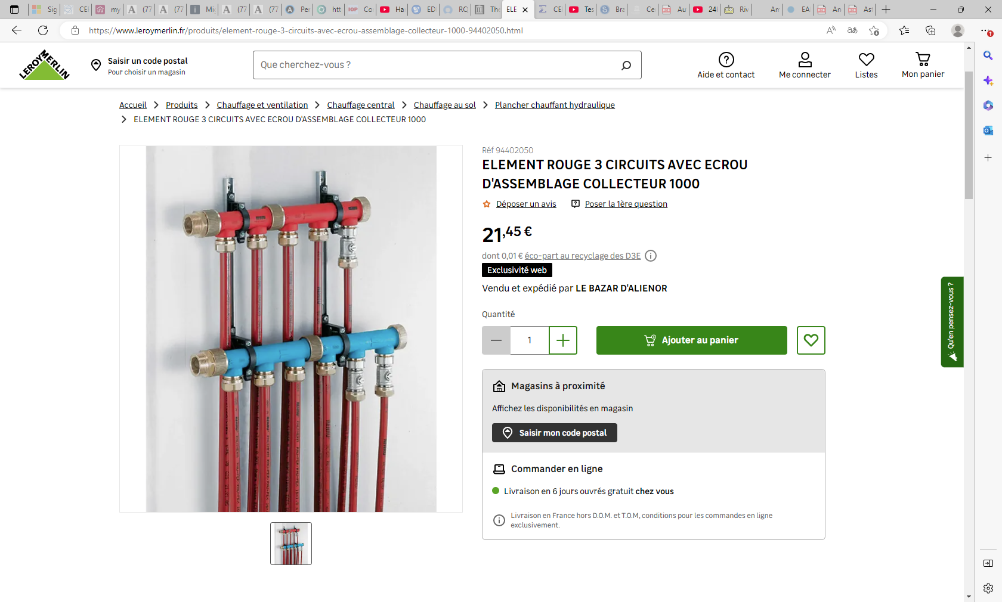

Slide 5
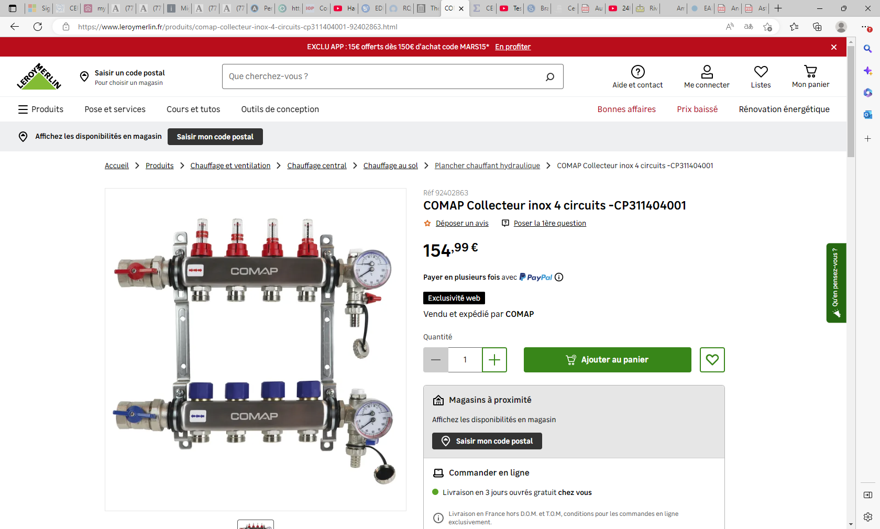
Flow meters 1-5l/min on each channel
with adjustment
& Temperature supply and Return !

Slide 6
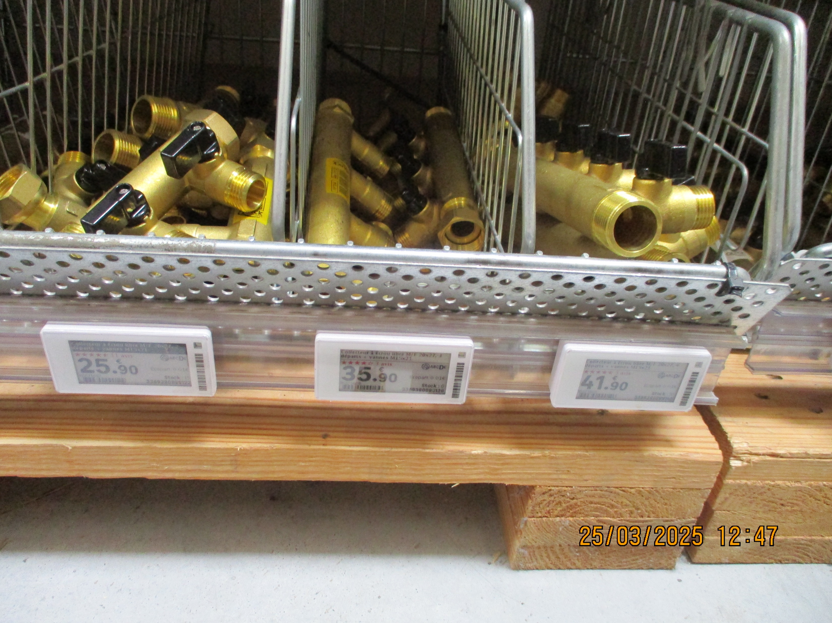
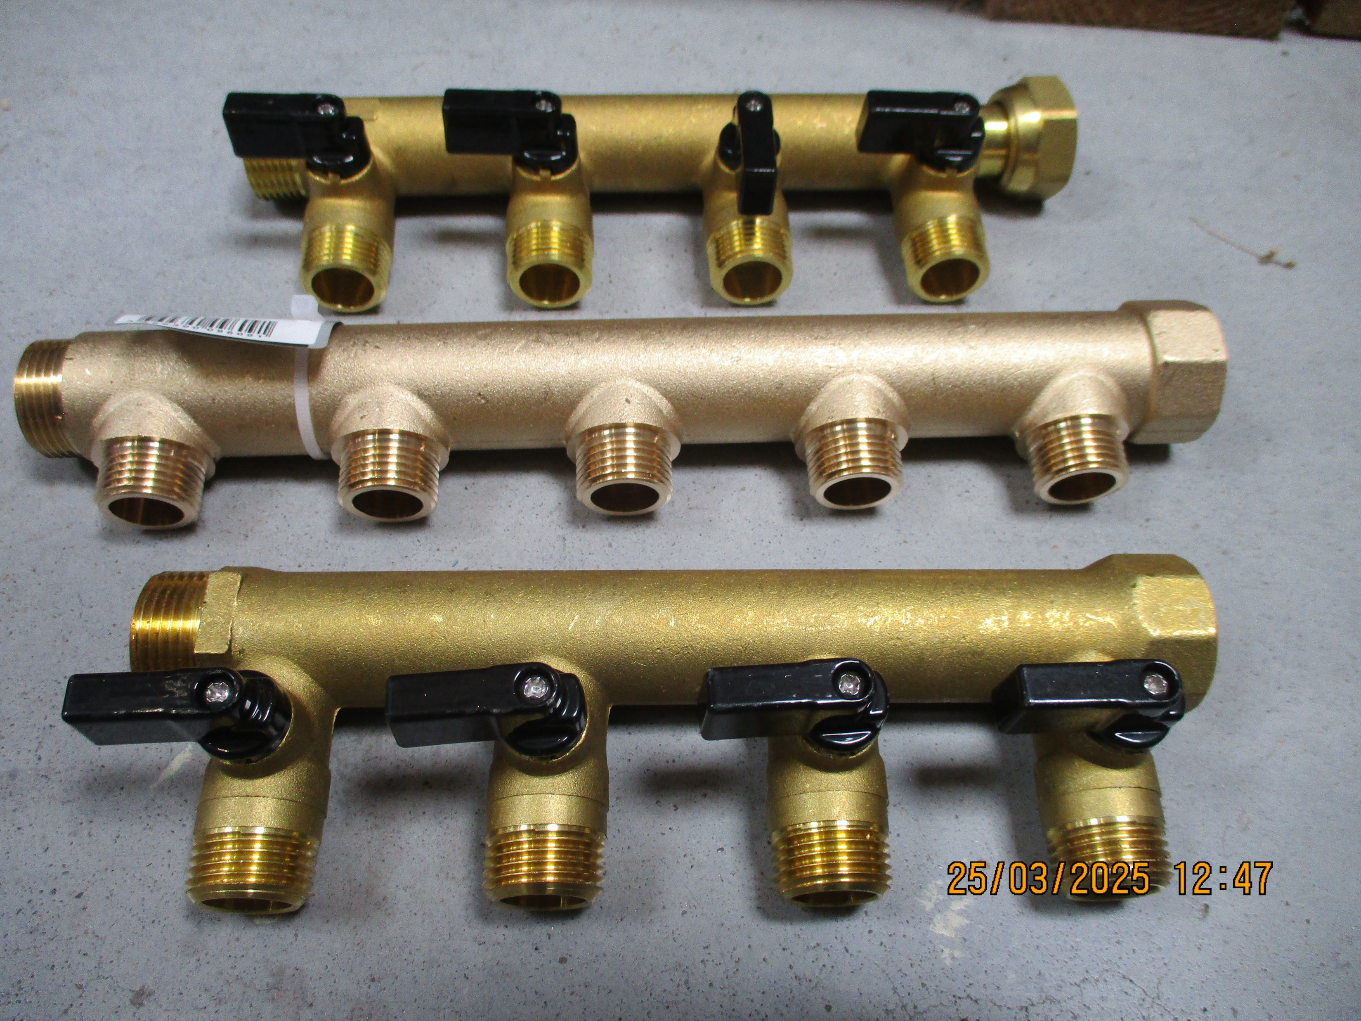
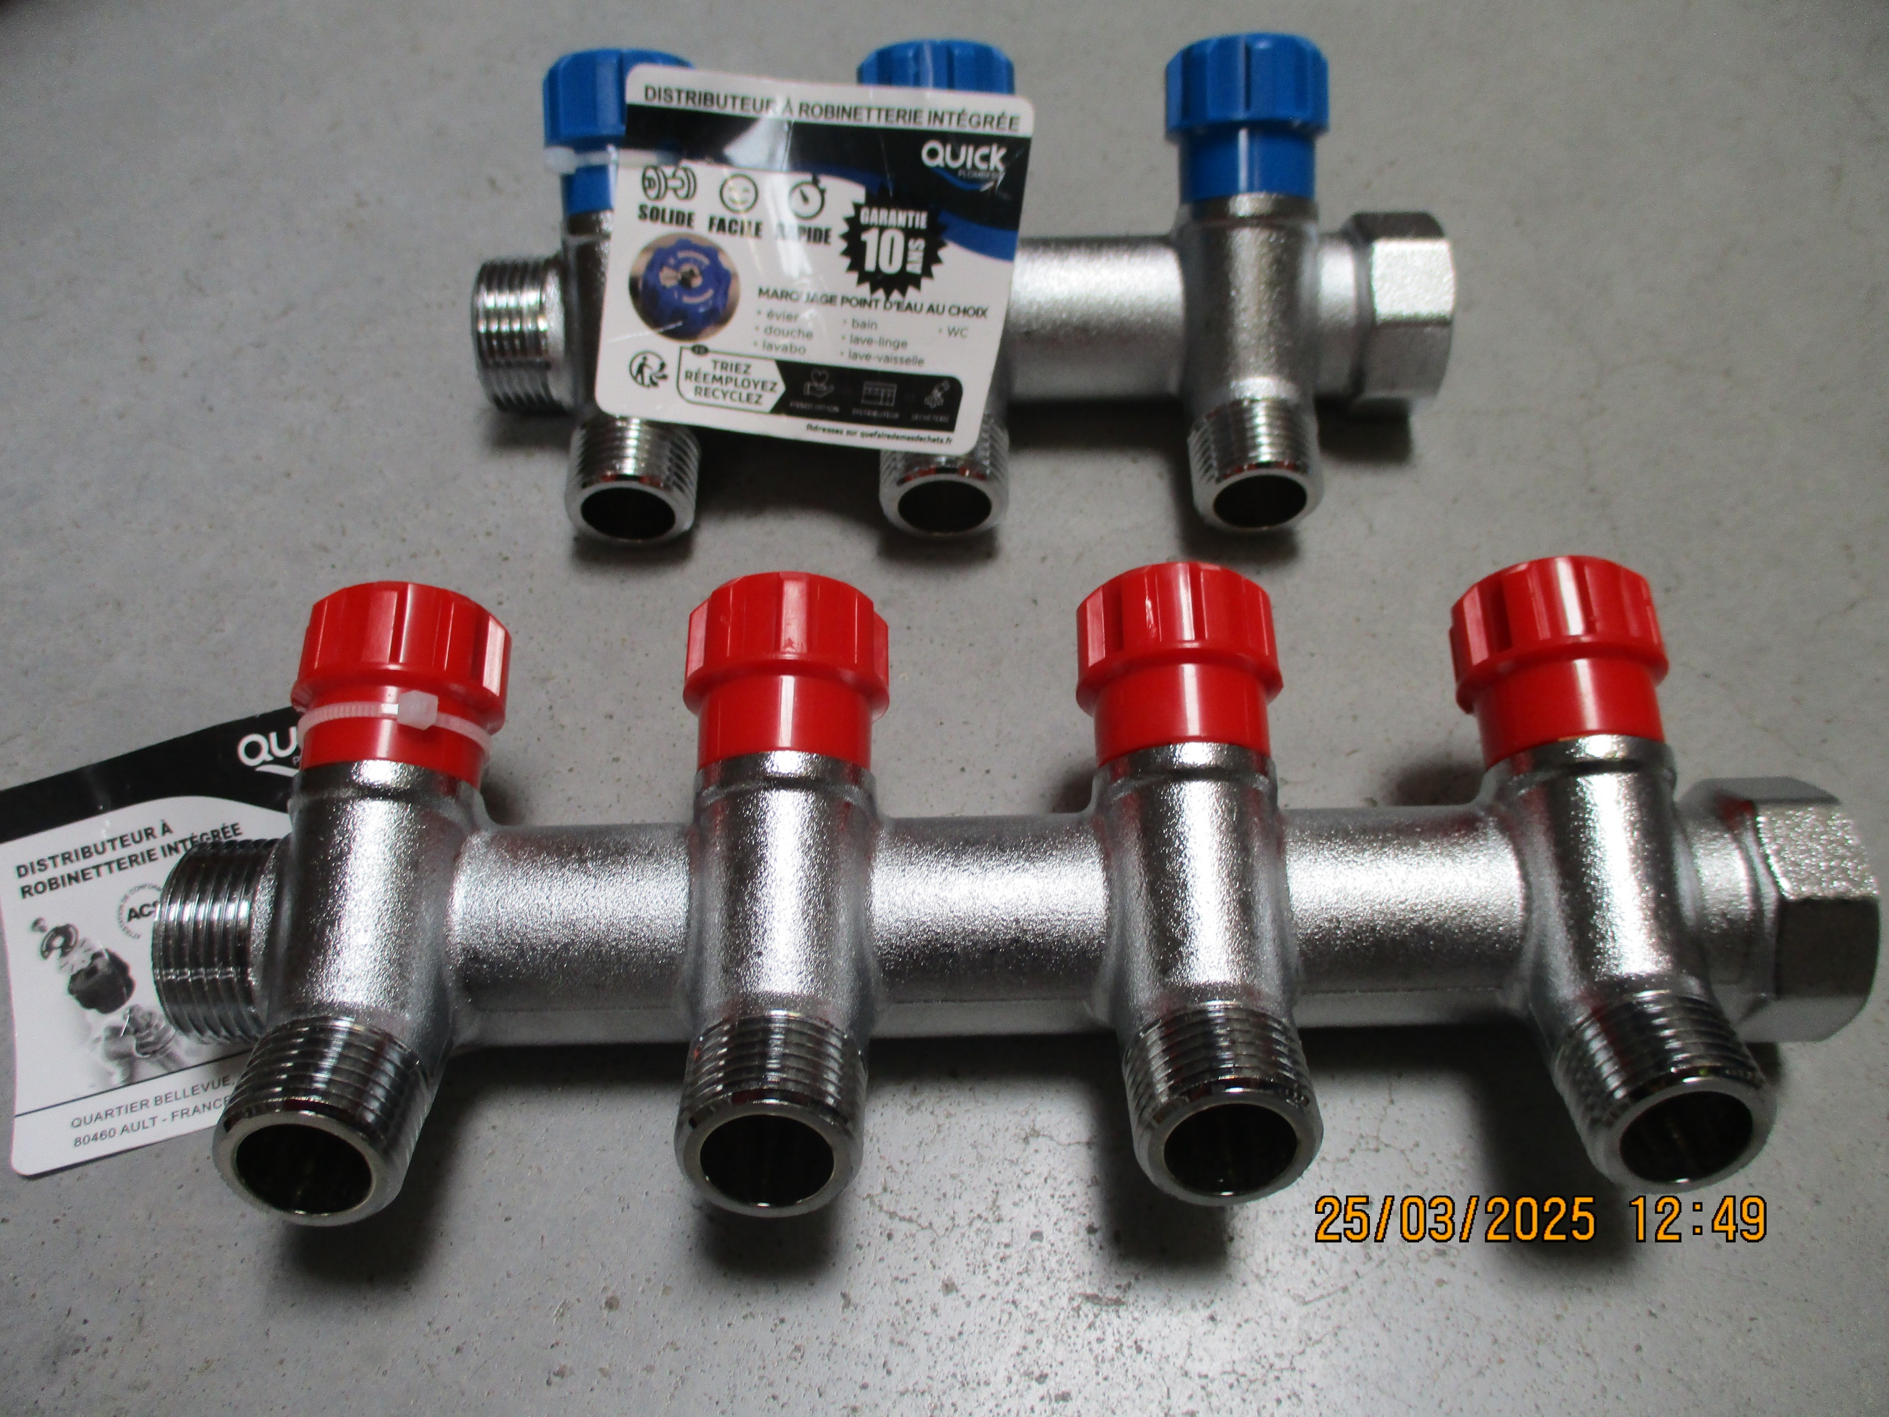
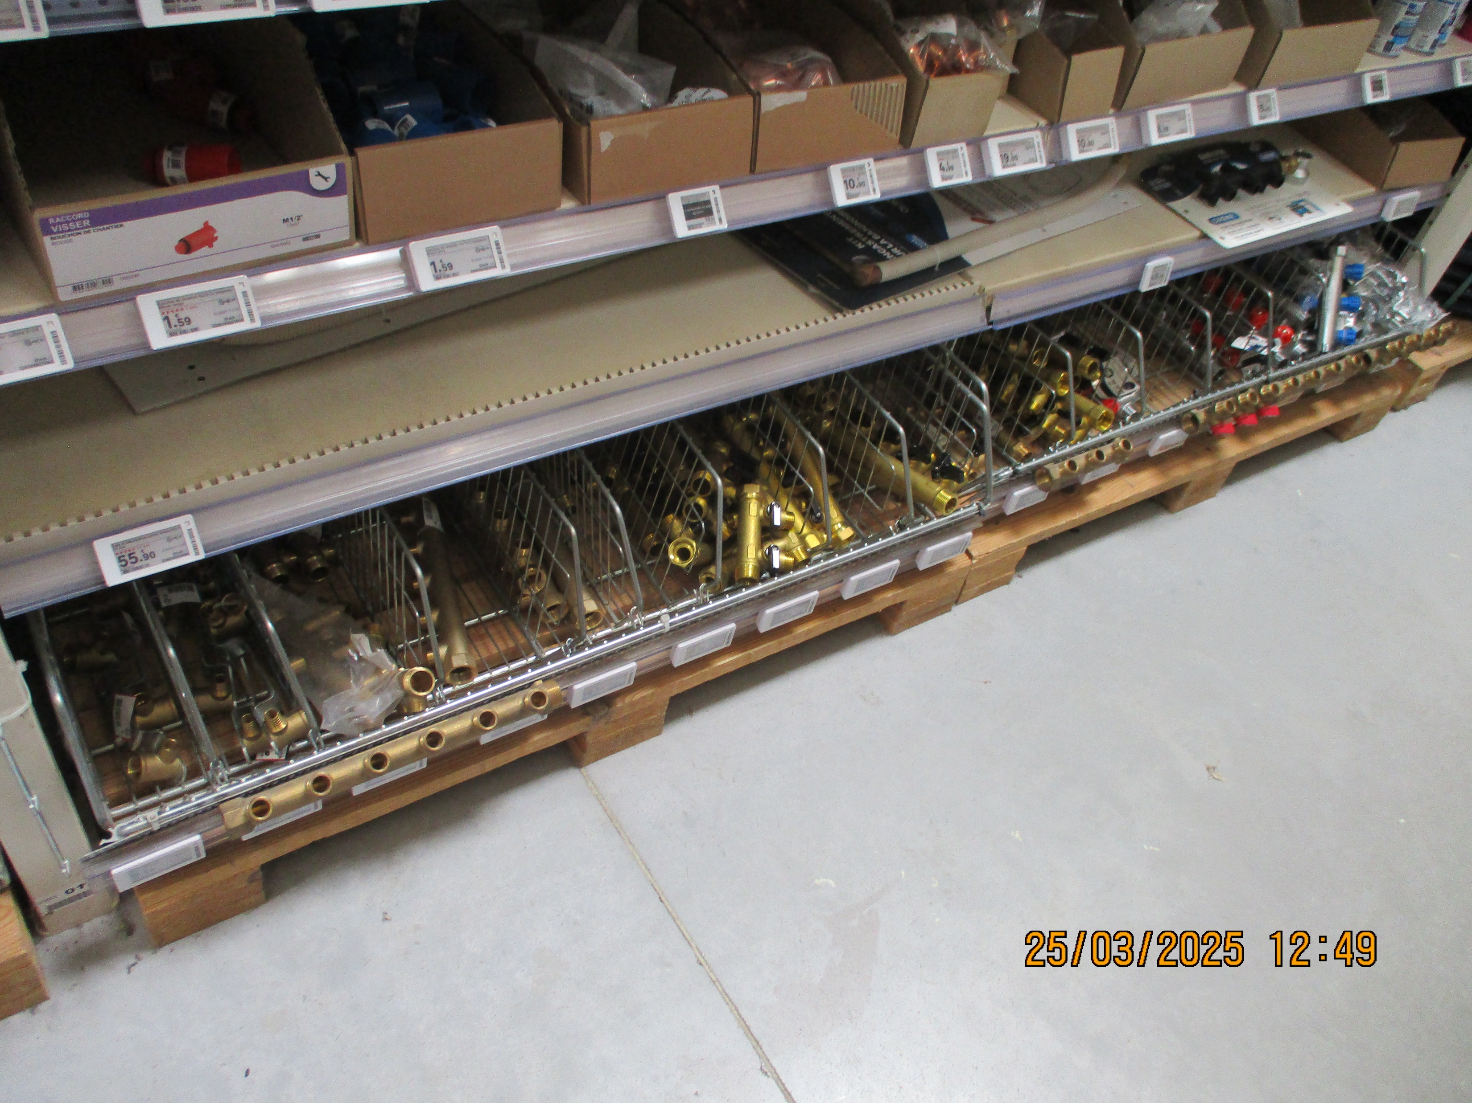

Slide 7
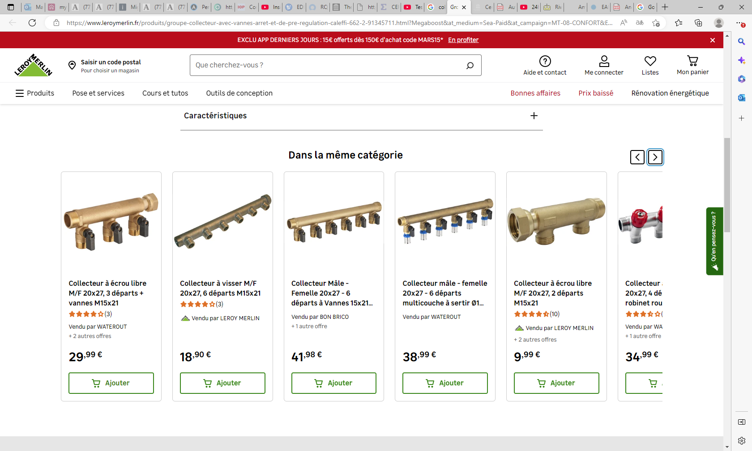
Groupe collecteur avec vannes d'arrêt et de pré-régulation Caleffi 662 - 2 | Leroy Merlin

Slide 8
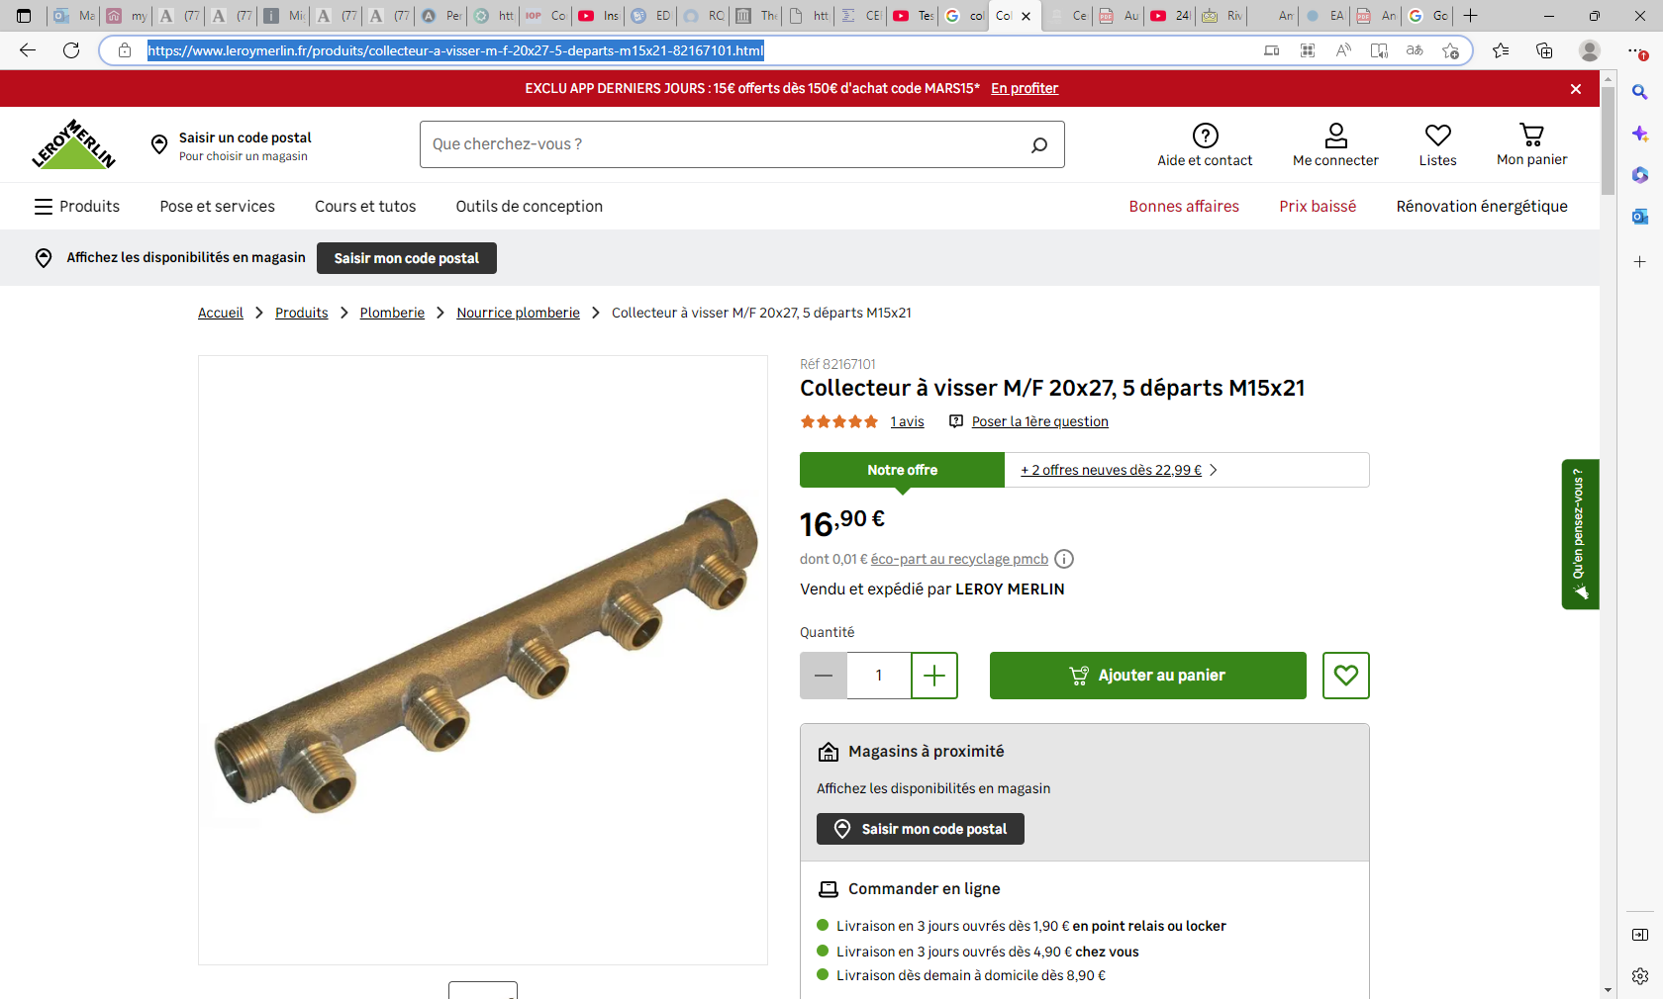
Collecteur à visser M/F 20x27, 5 départs M15x21 | Leroy Merlin

Slide 9
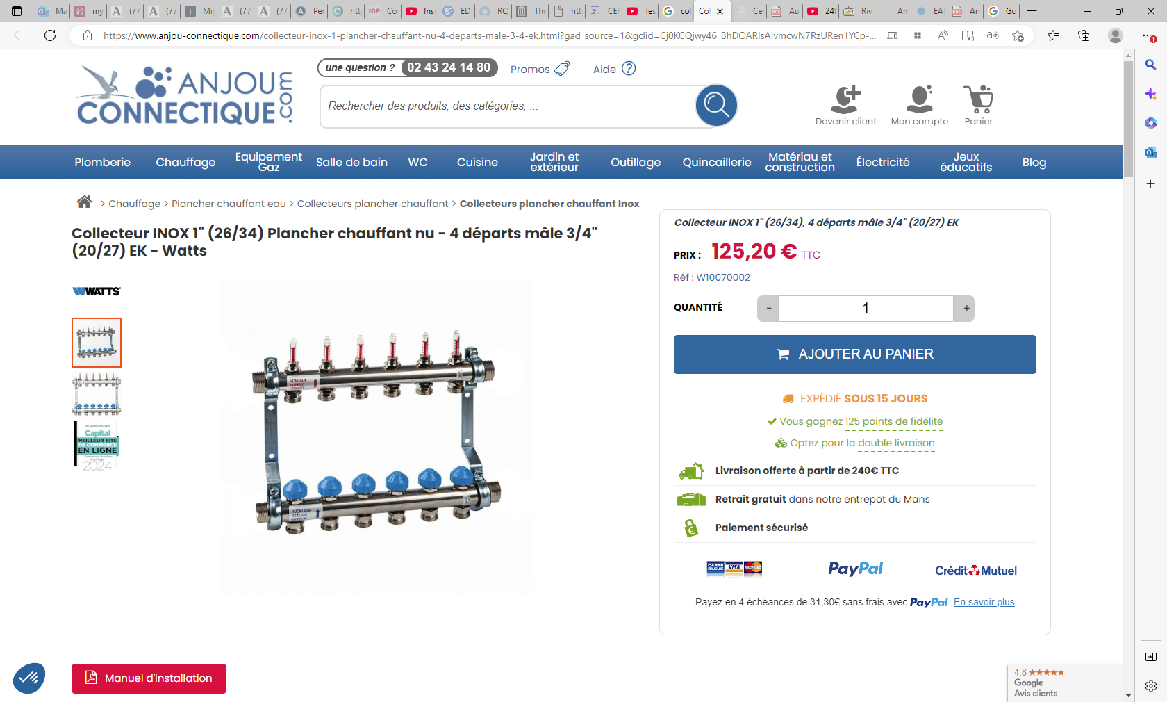
Collecteur INOX 1" (26/34) Plancher chauffant nu - 4 départs mâle 3/4" (20/27) EK - Watts (anjou-connectique.com)

Slide 10
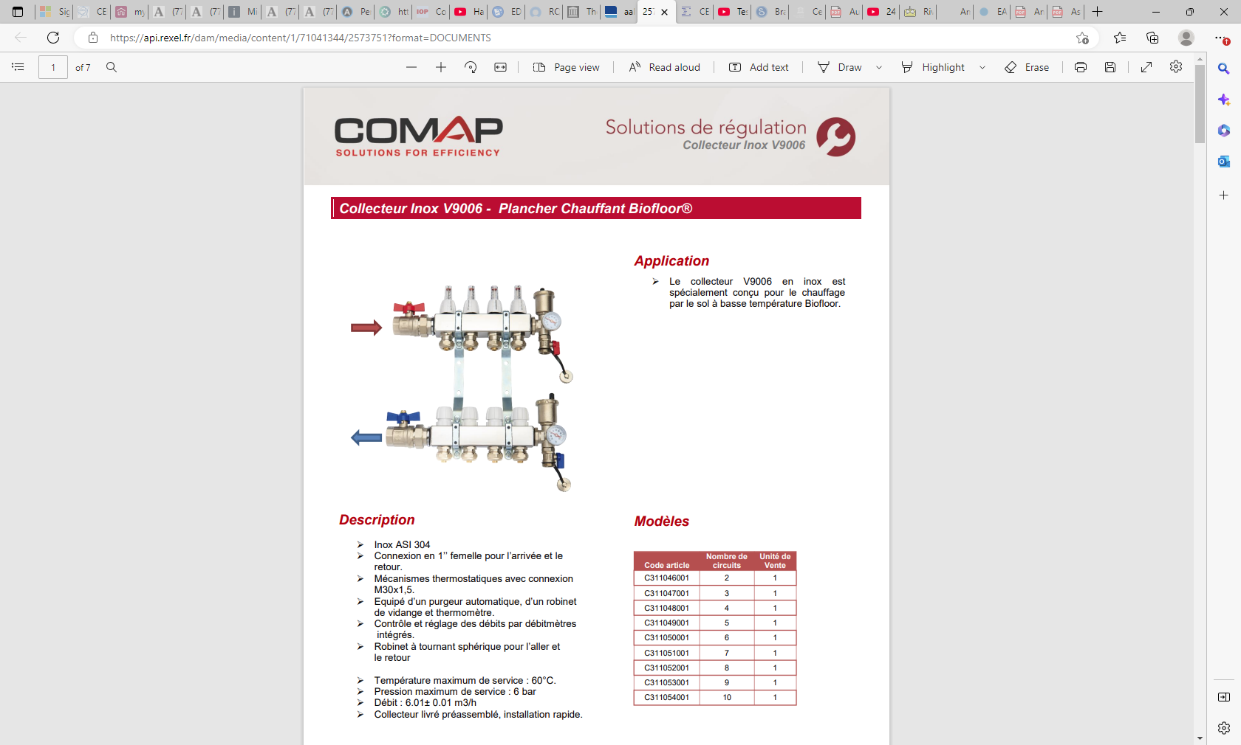
https://api.rexel.fr/dam/media/content/1/71041344/2573751?format=DOCUMENTS

Slide 11
References

Slide 12
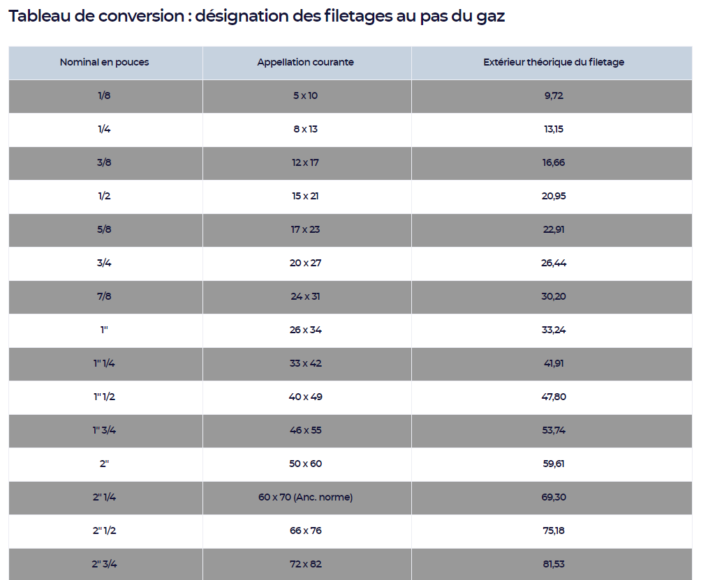
https://www.cedeo.fr/tableau-conversion-plomberie-chauffage

Slide 13
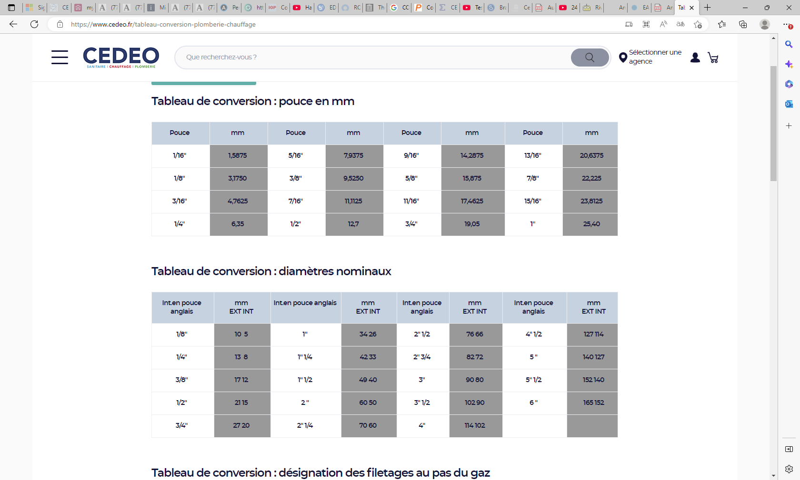

Slide 14
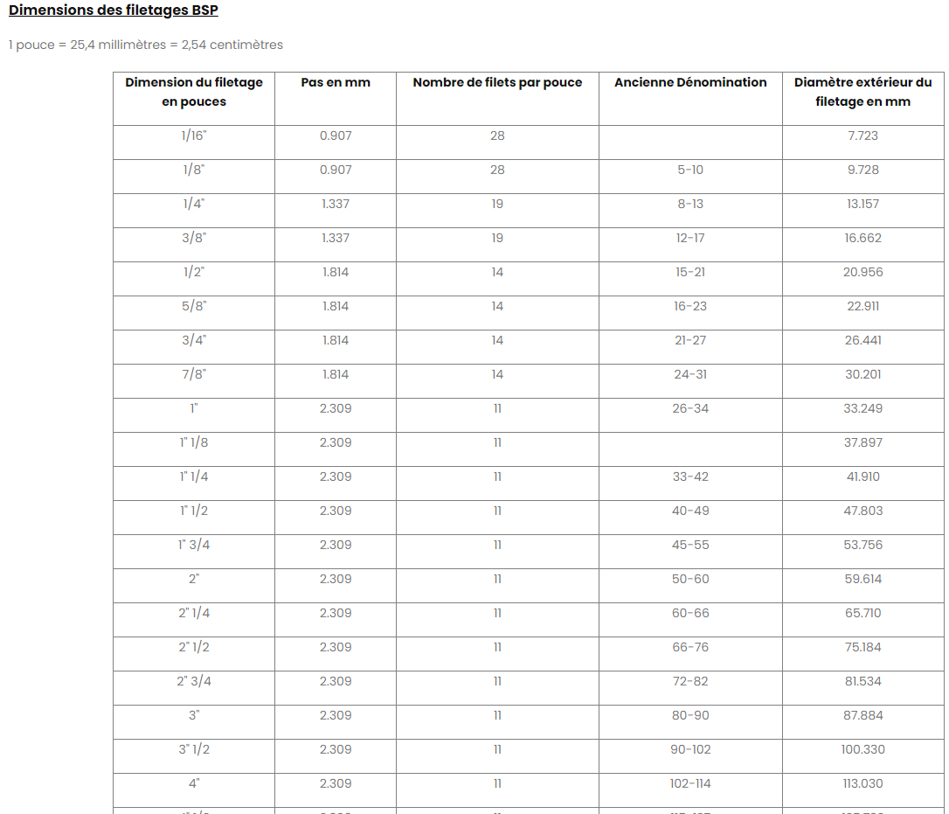
https://www.netraccord.fr/content/21-dimensions-des-filetages-d-un-raccord

Slide 15
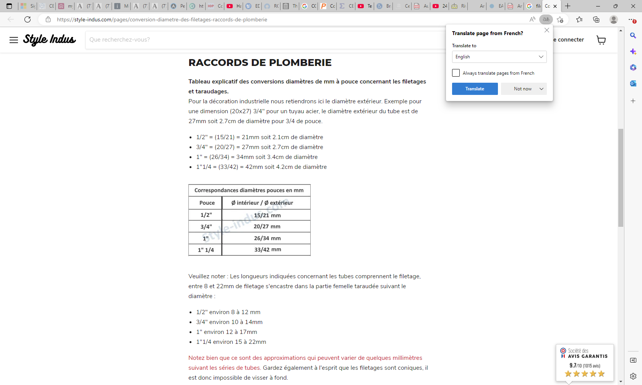
https://style-indus.com/pages/conversion-diametre-des-filetages-raccords-de-plomberie

Slide 16
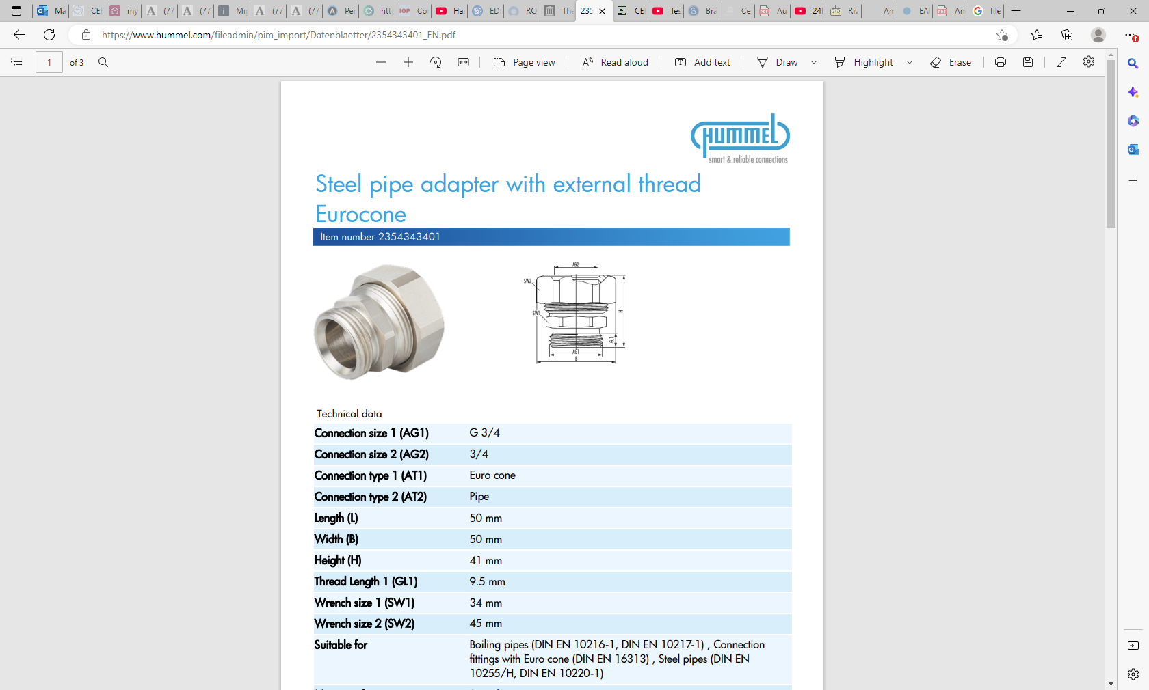
https://www.hummel.com/fileadmin/pim_import/Datenblaetter/2354343401_EN.pdf

Slide 17
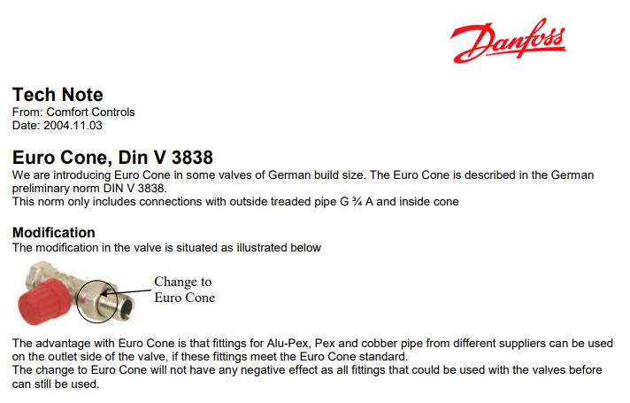
Euro Cone, Din V 3838
We are introducing Euro Cone in some valves of German build size. The Euro Cone is described in the German
preliminary norm DIN V 3838.
This norm only includes connections with outside treaded pipe G ¾ A and inside cone

Slide 18
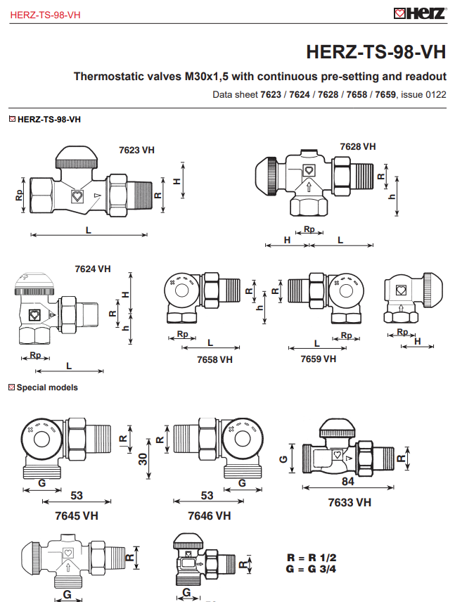
https://herzmediaserver.com/data/01_product_data/01_datasheets/7623_7624_7628_7658_7659_thermostatventil_unterteile_stufenlose_ablesbare_voreinstellung_TS-98-VH_EN_2022-01-13.pdf
This addresses Euro Cone (EK) for 3/4 inch thread only from the german DIN V3838
!!

